Slide 1
ClinicalRiskPredictor
Explainable Mortality Risk Prediction
from Clinical Event Sequences
ChronoFormer · Attention Rollout · Saliency · Fidelity
Farit Sharafutdinov Grigorii Belyaev Egor Sergeev
April 2026

Slide 2
Problem & Motivation
The Problem
Why XAI?
Patients accumulate hundreds of clinical events over time — diagnoses, procedures, lab results.
Identifying high-risk patients early enables timely intervention and better resource allocation.
Existing models treat EHR sequences as unordered bags of codes, ignoring the temporal structure between events.
High-stakes medical decisions require model transparency — a number alone is not enough.
Clinicians need to understand which past events and time gaps drove the prediction.
We implement Attention Rollout and Saliency maps, then validate them with a Fidelity metric.
Goal: Build a time-aware transformer for mortality prediction and make its decisions explainable.

Slide 3
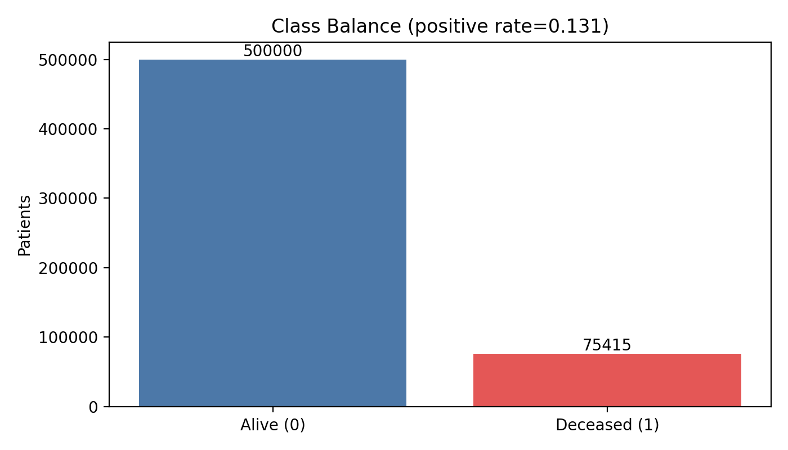
Dataset: Synthea 575k Patients
575,415
13.1%
Total Patients
Positive Rate (Deceased)
80
155 days
Median Sequence Length
Mean Time Between Events
Source: HuggingFace richardyoung/synthea-575k-patients (parquet) · Label: DEATHDATE present → 1

Slide 4
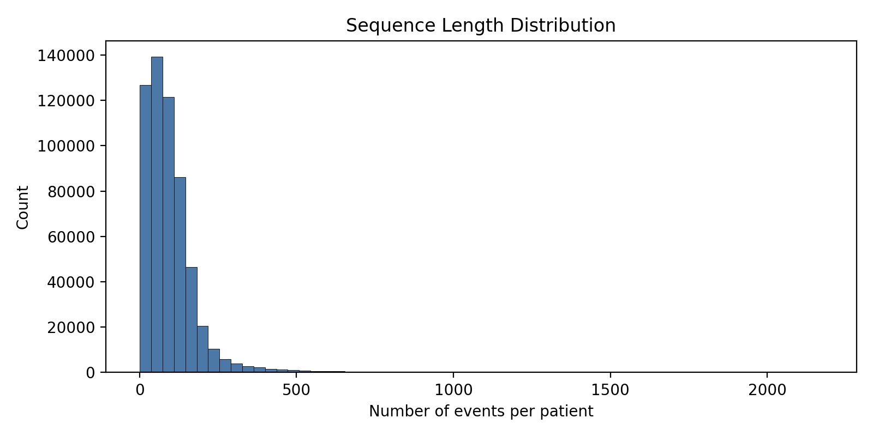
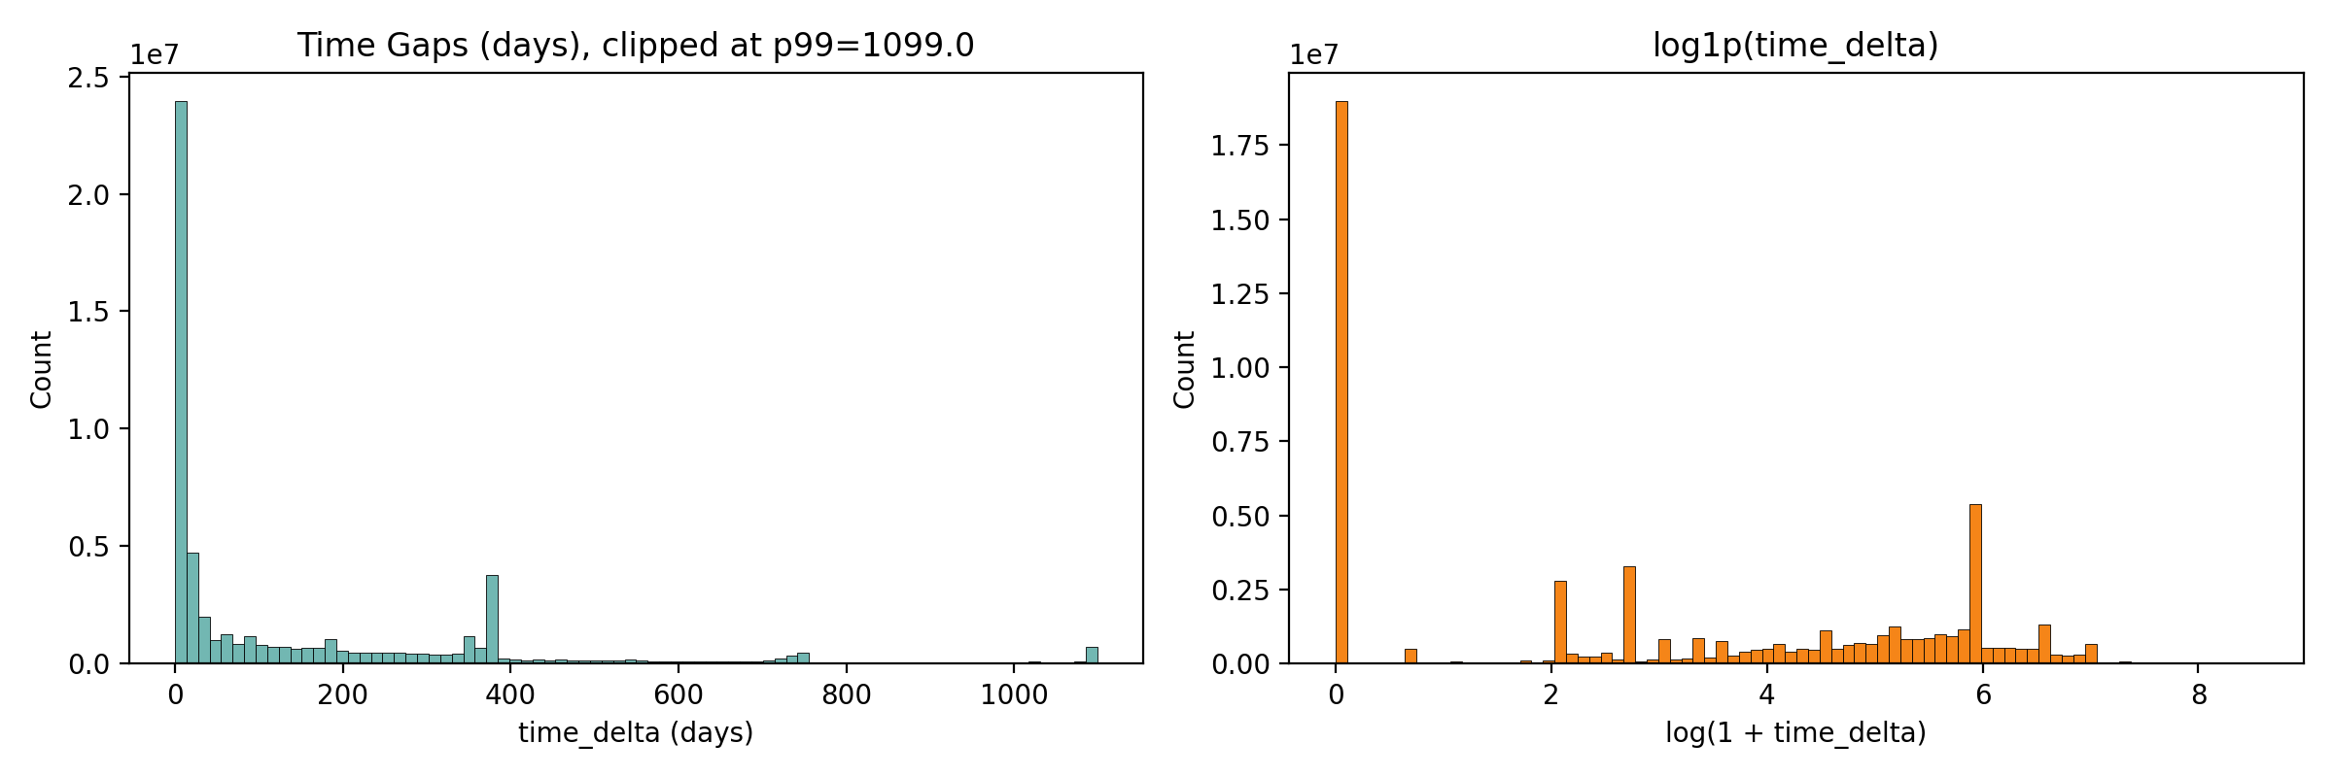
Data Distributions
Most patients have 20–150 condition events.
A long tail extends to 2000+ events.
Time gaps are heavily right-skewed (mean 155 days).
Log transform reveals rich temporal structure.

Slide 5
ChronoFormer Architecture
Event Codes + Time Deltas (days)
Key Equation — Time-Aware Attention
score(Q, K) = Q·Kᵀ / sqrt(d_k) + time_bias
Event Embedding ⊕ Time Embedding (binned)
time_bias shape: [B x H x 1 x S] — learned per head, indexed by binned time delta
TimeAwareAttention (4 heads)
Design Choices
d_model = 128, n_heads = 4, max_time_bins = 1000
Sequences padded / truncated to max_len = 128
Classifier reads the last-token representation h[:, -1, :]
Optimizer: AdamW · Loss: Binary Cross-Entropy
Early stopping (patience = 5) on validation AUROC
LayerNorm
MLP Classifier → p(mortality)
↑ classifies from last-token representation
Data split: 80% train / 10% val / 10% test (random_state = 42)

Slide 6
Training & Results
0.954+
CPU
8
64
Val AUROC
Device
Epochs
Batch Size
Best epoch ≈ 10–11
Runs on standard hardware
Early stopping (patience 5)
max_len = 128 tokens
Parameter
Value
Learning Rate (AdamW)
5 × 10⁻⁵
d_model / n_heads
128 / 4
max_time_bins
1000
Loss Function
Binary Cross-Entropy
Random Seed
42

Slide 7
Explainability: Two Complementary Methods
Attention Rollout
Saliency (Input Gradients)
How it works
Average attention weights across all heads, then add the residual identity (A + I) and re-normalize. The last-token row gives importance for each position.
Formula
Ā = mean_heads(A) → Â = (Ā + I) / row_sum
importance = Â[-1, :] (last-token row)
Properties
Captures information flow through layers. In a single-layer model, essentially the averaged attention distribution, which can be diffuse.
How it works
Compute gradients of the output probability with respect to the combined input representation (event_emb + time_emb). Aggregate over embedding dim with L1 norm.
Formula
h = event_emb(x) + time_emb(Δt)
s = ‖∂p / ∂h‖₁ per token, normalized to [0, 1]
Properties
Model-agnostic to architecture depth. More sensitive to local token influence; can highlight sharp, specific events in the sequence.

Slide 8
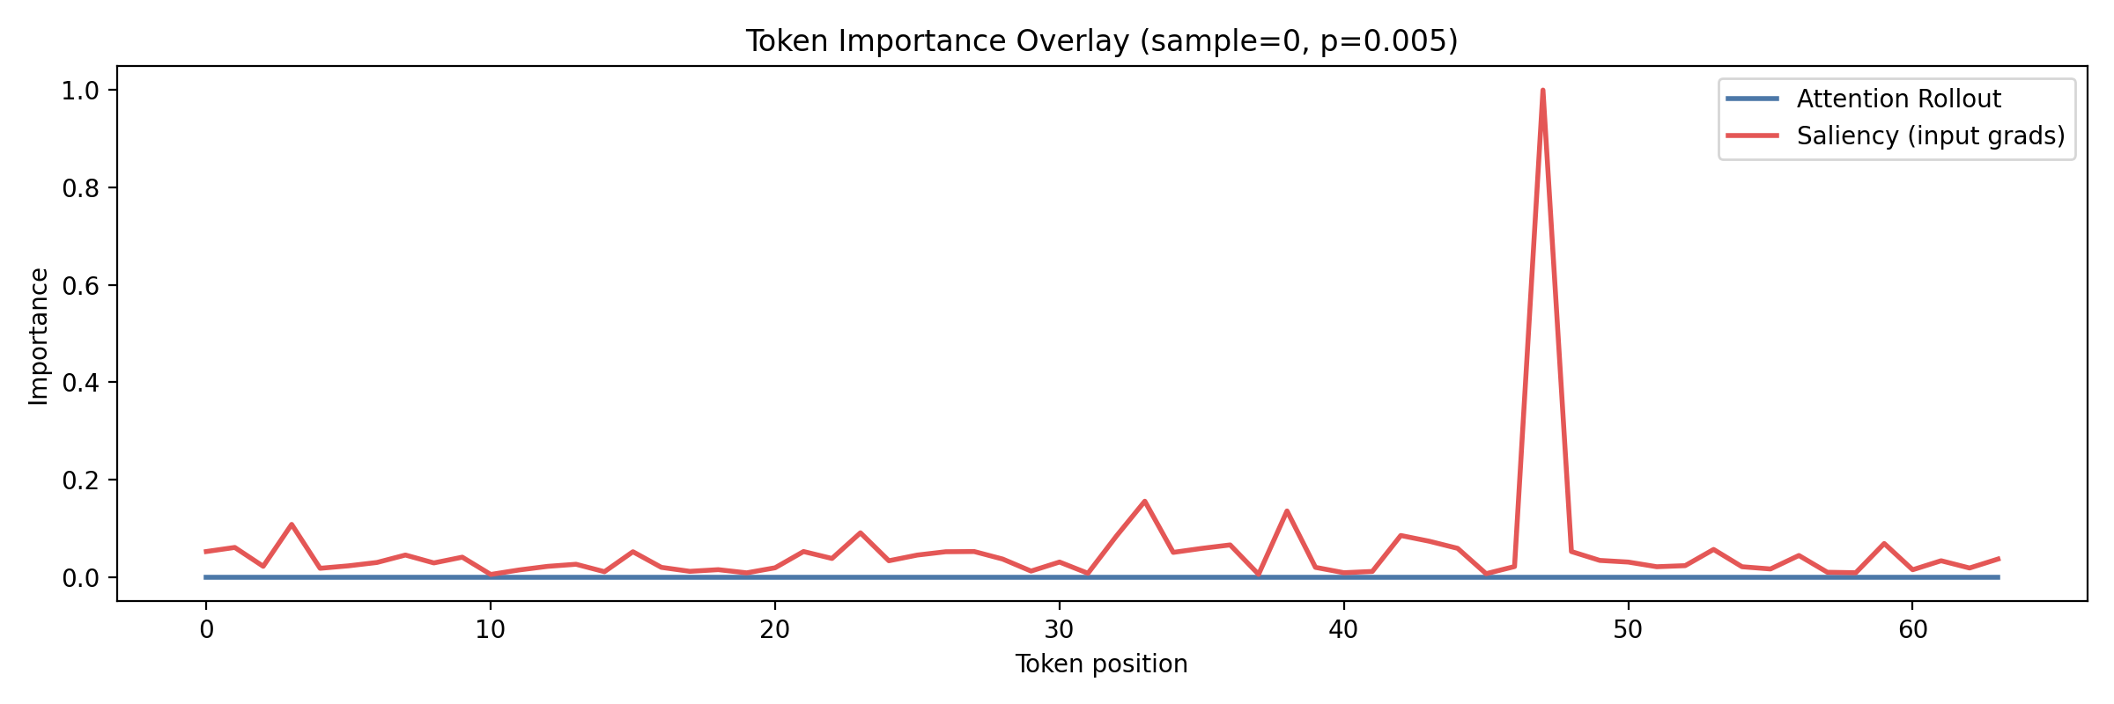
Token Importance: Rollout vs. Saliency
Saliency spike at pos. ~47
Rollout is nearly flat
Complementary signals
A single event dominates — its gradient is 10× higher than neighbors. This is the most influential event for this patient's low-risk prediction (p = 0.005).
In a single-attention-layer model, rollout averages over all heads and can become diffuse — a known limitation of the method.
Saliency captures sharp, local influences. Rollout gives a smoother global picture. Both are validated by the fidelity metric on the next slide.

Slide 9
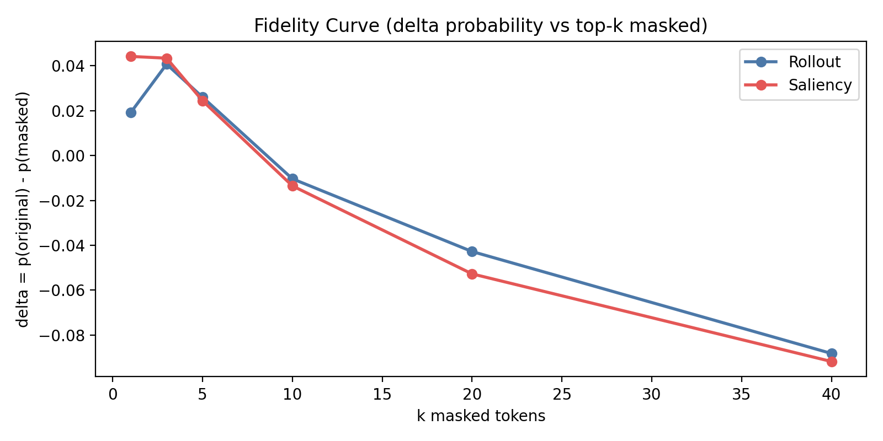
Fidelity Evaluation — Are Explanations Faithful?
delta = p(original) − p(masked)
k
Rollout Δ
Saliency Δ
1
+0.019
+0.044
3
+0.041
+0.043
5
+0.026
+0.024
10
−0.010
−0.014
20
−0.043
−0.053
40
−0.088
−0.092
k = 1–5: Masking top tokens reduces predicted probability (Δ > 0) → explanations correctly identify the most influential events.
k > 10: Masking many tokens makes the model confused — predicted probability rises (Δ < 0). Both methods show consistent behavior.

Slide 10
Lessons Learned & Future Work
What We Learned
Next Steps
Temporal structure matters — modeling time gaps between events, not just code order, improves clinical realism.
Saliency is more informative than Rollout for shallow (single-layer) transformers — Rollout tends to diffuse across all tokens.
Fidelity confirms explanations — both methods consistently identify influential tokens at small k.
Separating prediction quality (AUROC) from explanation quality (fidelity) is essential for rigorous XAI evaluation.
Validate on real EHR data (MIMIC-IV / eICU in MEDS format) for clinical relevance.
Multi-layer ChronoFormer — proper rollout across all attention layers.
Bias & fairness analysis before any clinical deployment.
Compare with SHAP / LIME for a broader XAI benchmark.

Slide 11
Thank You
Questions?
ClinicalRiskPredictor
Farit Sharafutdinov · Grigorii Belyaev · Egor Sergeev

