Slide 1
GTP Source Data
SharePoint:
Total xxx files
video: 1G to 3G file size, suggest dimension 100-500, chunk 10M to 100M
CSV, PDF, XLS, PPTX file size 1G to 3G file size, suggest dimension 100-300, chunk size 10M to 100M
PPT: if image heavy, file size 3M to 4M; suggest dimension 300 to 500, chunk 100KB to 1MB
Chunk sizes in the range of a few kilobytes to several hundred kilobytes could be appropriate for efficient processing and storage small file.
In Milvus, by default, Less than 1M, don’t automatically chunk.
Xxxxx
xxxxxx
Total, less than 1M vectors.
Potential for other use cases and scope extension

Slide 2
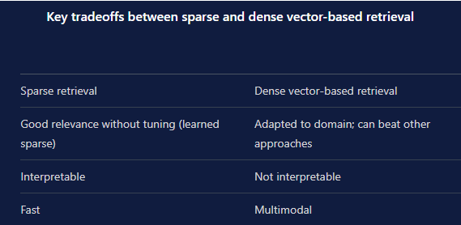
Search Algorithm and Vector Type
Dense vector vs. sparse vector
k-NN vs. ANN
k-NN is more accurate, ANN is more scalable
Benchmark of various implementations of ANN search
erikbern/ann-benchmarks: Benchmarks of approximate nearest neighbor libraries in Python (github.com)
Qsgngt, NGT-qg, scann is the best, it has highest recall and QPS. (see diagram in next page)
Which vector DB support NGT library? Milvus, Vald, NOT DIRECTLY
Which vector DB support ScaNN? Milvus (Beta version)

Slide 3
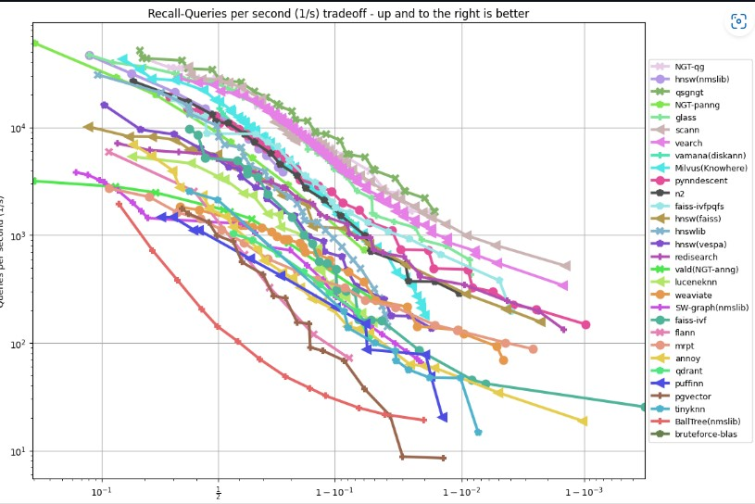
ANN benchmark

Slide 4
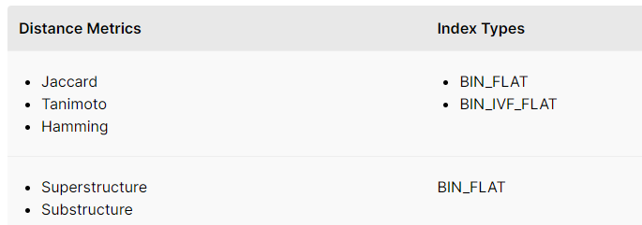
Metric and Index for Vector Search
Floating point embeddings
Similarity Metrics
L2 (Euclidean distance)
Cosine similarity
IP (Inner product)
Index Types
FLAT, IVF_FLAt, IVF_SQB, IVF_PQ, IVF_ADC, HNSW,IVF_HNSW, RHNSW_FLAT, RHNSW_SQ, RHNSW_PQ, ANNOY, SCANN(beta)
Binary embeddings

Slide 5
NGT
NGT (NGT stands for Neighborhood Graph and Tree) is an open-source library for high-speed approximate nearest neighbor search and similarity search. It is designed to efficiently handle large-scale high-dimensional data, making it suitable for applications that require fast and accurate nearest neighbor queries.
Some key features of NGT include:
Indexing methods: NGT supports various index structures for approximate nearest neighbor search, such as the Random Projection Tree (RP-tree) and the optimized index structure using edge pruning.
Efficient search algorithms: NGT implements efficient search algorithms, including both depth-first search and best-first search, to quickly find approximate nearest neighbors.
Vector normalization: NGT automatically normalizes vector data during the indexing process, which helps improve search performance and accuracy.
Online indexing: NGT allows incremental indexing, enabling the addition of new data points to an existing index without rebuilding the entire index.

Slide 6
Vector DB Selection (Milvus)
Pro:
Milvus support 3rd party search library like NGT, ScaNN, Fassis. It also support hybrid search ( Vector search and keyword search)
It supports re-ranking
Cache support is in roadmap
It supports both dense and sparse vector
It can handle Billion, Trillion Vectors with million second respond time and can handling dimension of the vectors up to xxx
It has much more other features like multitenancy, time travel
Security: support RBAC
It requires to define schema. But it support dynamic schema.
It provides flexible choices for hosting: managed service or hosting in different cloud provider
The cost is cheaper comparing to other scalable DB like Pinecone.
Managed service is $99 per month vs Pinecone &150 per month, self-host is about $55 per month
Con:
It require professional skillset higher than other product

Slide 7
Popular Embedding for Vector Search
Word2Vec, GloVe, FastText, BERT, Universal Sentence Encoder
Faiss: The Facebook AI Similarity Search (Faiss) library supports various embedding models for vector search, including PCA-compressed vectors, IVFADC (Inverted File + Adaptive Clustering), and HNSW (Hierarchical Navigable Small World). Faiss enables fast and accurate similarity search in large-scale vector datasets.
Annoy: Annoy (Approximate Nearest Neighbors Oh Yeah) is a lightweight library for approximate nearest neighbor search. Annoy supports embedding models such as Word2Vec, FastText, and GloVe. It constructs random projection trees or forest structures for efficient nearest neighbor retrieval.
NMSLIB: Non-Metric Space Library (NMSLIB) provides a range of indexing methods for approximate nearest neighbor search. It supports embeddings from various models like Word2Vec, GloVe, FastText, and BERT. NMSLIB offers customizable indexing parameters and allows you to perform efficient vector searches.
Milvus: Milvus is an open-source vector database designed for similarity search. It supports various embedding models, including Word2Vec, GloVe, FastText, BERT, and more. Milvus includes indexing methods like IVF (Inverted File), HNSW (Hierarchical Navigable Small World), and FLAT (Flat) to optimize vector search performance.
ScaNN: The Scalable Nearest Neighbors (ScaNN) library focuses on efficient vector similarity search in large-scale datasets. ScaNN supports embeddings from models like Word2Vec, GloVe, and BERT. It utilizes dynamic clustering techniques and approximate nearest neighbor search for fast retrieval.

Slide 8
Define collection and field schema
Milvus 2.0 only need to define vector field, don’t need to define scalar field.
Scalar field index is for hybrid search to do attribute filtering by sorting scalar field values
Support dynamic schema: Dynamic schema enables users to insert entities with new fields into a Milvus collection without modifying the existing schema. This means that users can insert data without knowing the full schema of a collection and can include fields that are not yet defined.

Slide 9
Define collection and field schema Example
import random
from milvus import Milvus, DataType, MetricType, IndexType
# Establish a connection to the Milvus server
milvus = Milvus(host='localhost', port='19530')
# Create a collection
collection_name = 'my_collection'
dimension = 128
metric_type = MetricType.L2 # Choose the desired metric type
field_schema = [
{"name": "embedding", "type": DataType.FLOAT_VECTOR, "params": {"dim": dimension}, "metric_type": metric_type},
{"name": "title", "type": DataType.STRING},
{"name": "date", "type": DataType.INT64}
]
param = {
"index_type": IndexType.IVF_FLAT,
"params": {
"nlist": 64
}
}
milvus.create_collection(collection_name=collection_name, fields=field_schema)
# Generate and insert vectors
vectors = [[random.random() for _ in range(dimension)] for _ in range(1000)]
titles = ["vector 1", "vector 2", ...]
dates = [1611061130000, 1611061140000, ...]
data = [
{"embedding": vector, "title": title, "date": date}
for vector, title, date in zip(vectors, titles, dates)
]
milvus.insert(collection_name=collection_name, records=data)
# Build an index
milvus.create_index(collection_name=collection_name, field_name="embedding", index_params=param)
# Disconnect from the Milvus server
milvus.close()

Slide 10
Inserting to multiple collections Example
first_collection = 'collection1'
second_collection = 'collection2'
milvus.create_collection({
"collection_name": first_collection,
"fields": [
{"name": "embedding", "type": DataType.FLOAT_VECTOR, "params": {"dim": dimension}}
]
})
milvus.create_collection({
"collection_name": second_collection,
"fields": [
{"name": "embedding", "type": DataType.FLOAT_VECTOR, "params": {"dim": dimension}}
]
})
vectors_for_collection1 = [[0.1, 0.2, 0.3], [0.4, 0.5, 0.6]]
vectors_for_collection2 = [[1.0, 1.1, 1.2], [1.3, 1.4, 1.5]]
# Insert vectors into collection1
milvus.insert(collection_name=first_collection, records=vectors_for_collection1)
# Insert vectors into collection2
milvus.insert(collection_name=second_collection, records=vectors_for_collection2)

Slide 11
Example for LangChain upload, chunk, embedded and insert

Slide 12
Data Ingestion Pipeline (Exploring only)
To ingest vectors into Milvus using Azure Data Factory, you would typically follow these steps:
Set up the Azure Data Factory: Create an instance of Azure Data Factory in your Azure account. This involves configuring the necessary connections and defining pipelines to manage your data workflows.
Prepare the data source: Ensure that your vector data is available in a supported format such as CSV, JSON, or Parquet. If the data is in a different format, you may need to perform a conversion step to transform it into a compatible format. ???
Create a pipeline: Define a pipeline in Azure Data Factory to orchestrate the ingestion process. This pipeline should include the necessary activities to extract the vector data from the source, transform it if required, and load it into Milvus.
Configure the Vector Ingestion activity: Within your pipeline, configure a specific activity to ingest the vectors into Milvus. This activity will typically involve executing the appropriate Milvus SDK code or API calls to insert the vectors into the desired collection.
Run and monitor the pipeline: Execute the pipeline in Azure Data Factory and monitor the progress and results of the vector ingestion process. You can leverage monitoring tools provided by Azure Data Factory to track the execution and identify any issues or errors.

