Slide 1
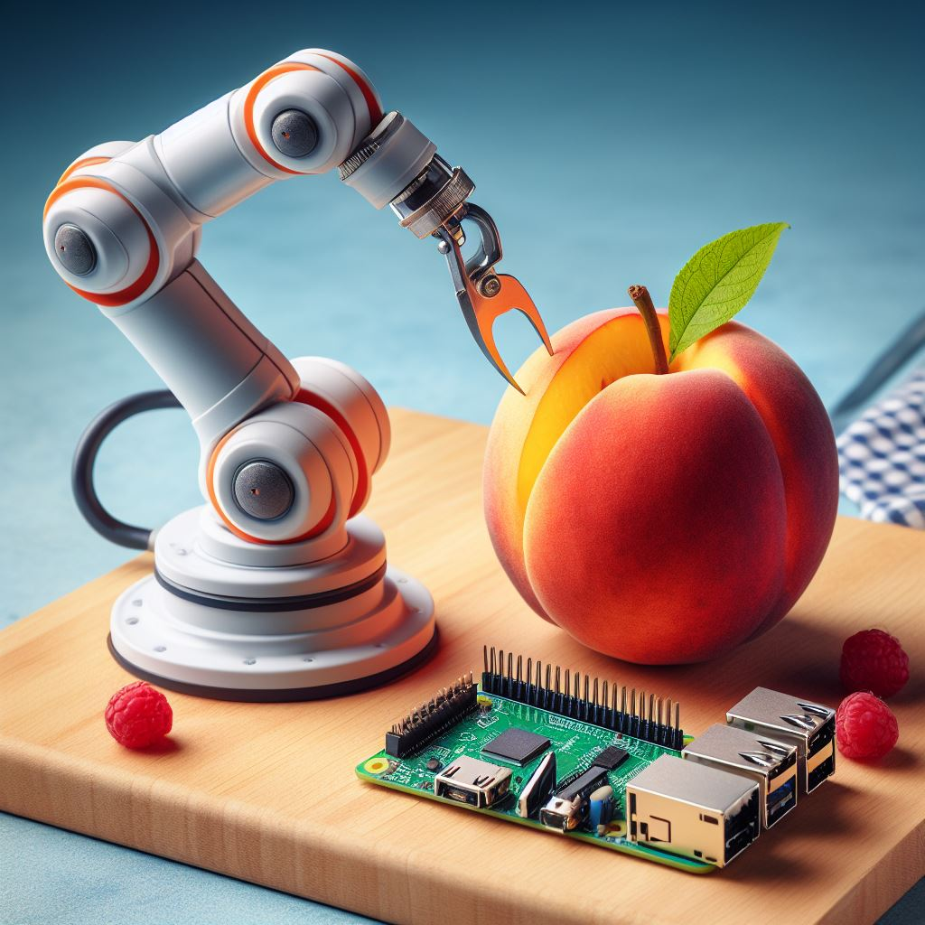


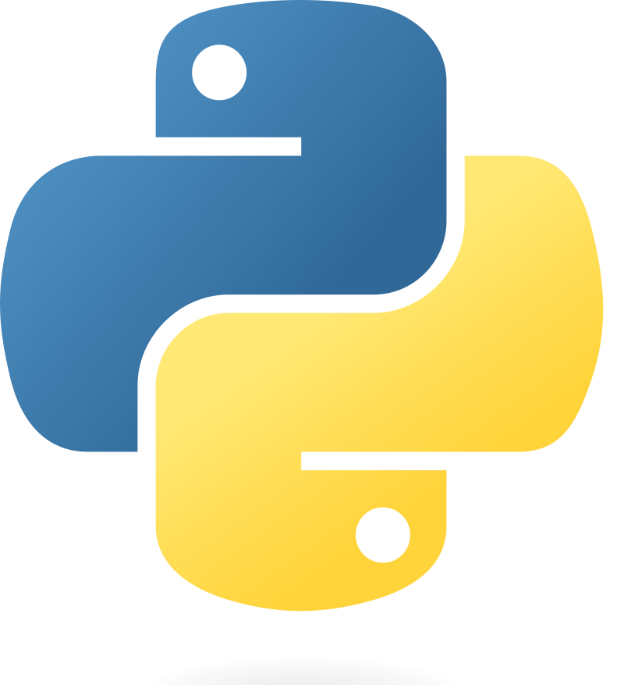
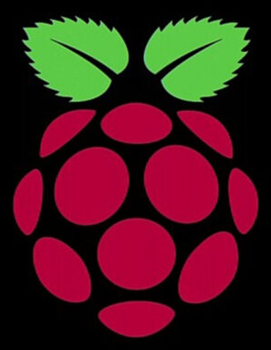


Pi-Peach Cutter
An End-to-End Pipeline with DevOps,Produce,Cloud,Robotic
Notes:
Thank you. Today, I would like to introduce an application of Raspberry Pi instances to move a robotic arm in order to slice a variety of produce using the fundamentals of DevOps.

Slide 2


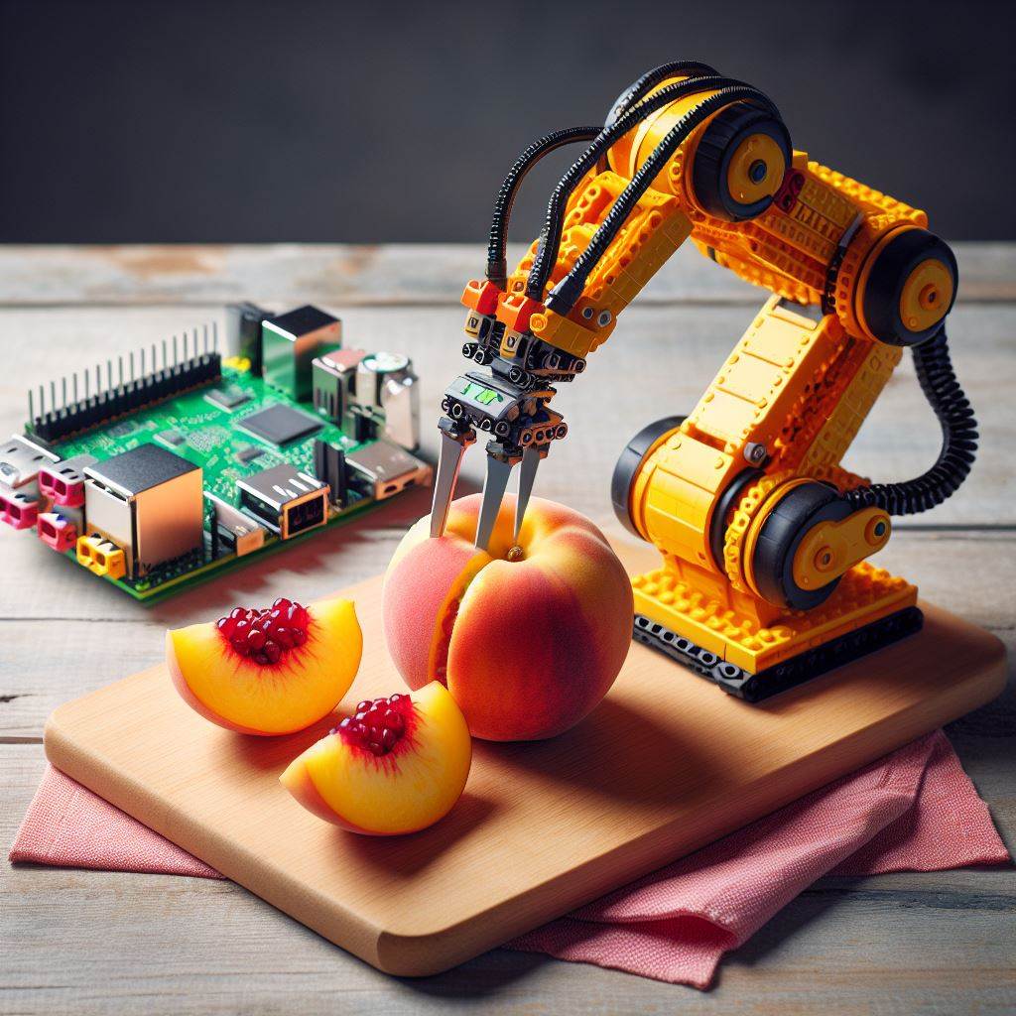
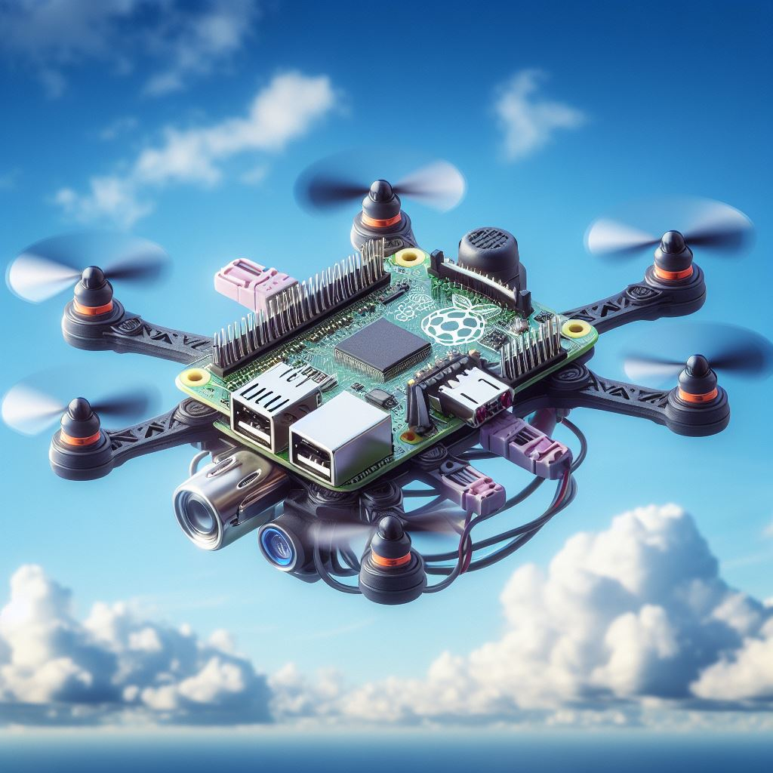

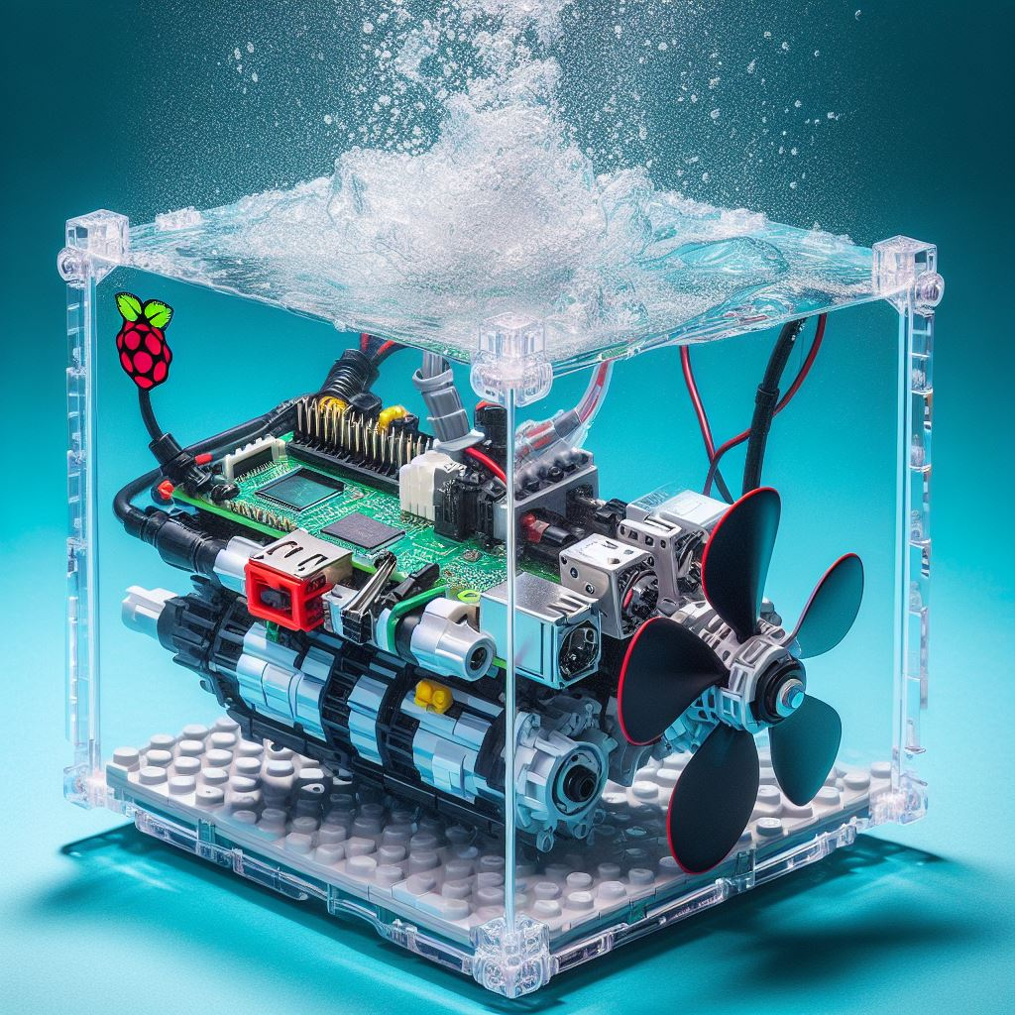
Presentation Overview
DevOps Fundamentals
Continuous Delivery
Infrastructure-as-a-Code
Observability
Container Technologies
Summary
Notes:
The majority of the presentation will cover Infrastructure as Code, Container Technologies, and Continuous Delivery.

Slide 3







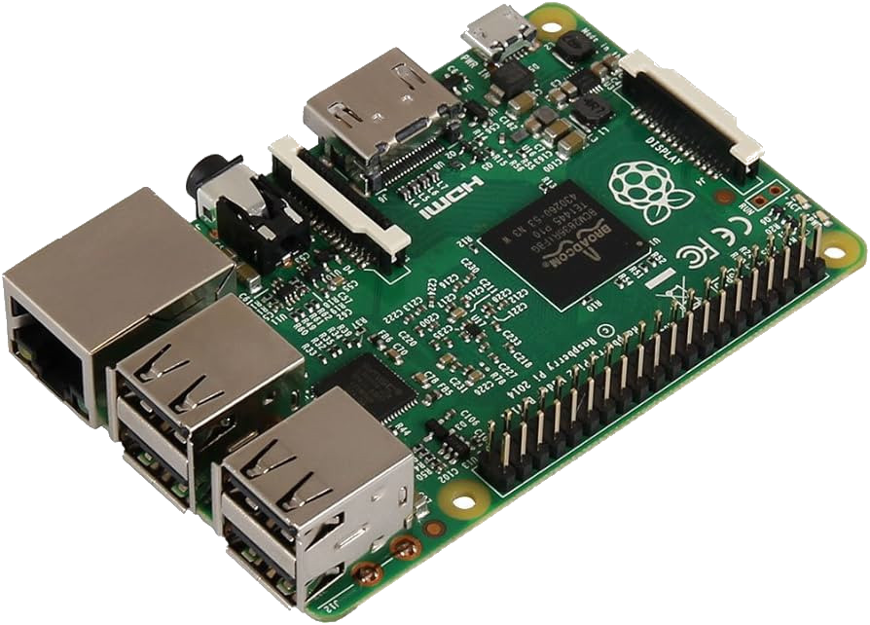
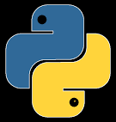
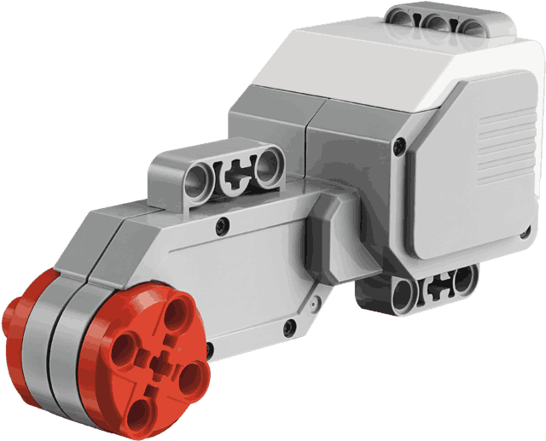
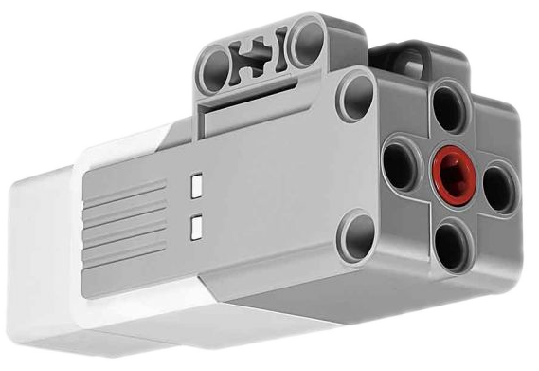
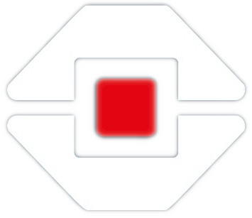



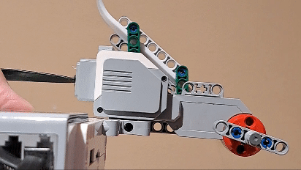
Master Node
LINUX OS
GIT & GITHUB
Worker Node 1
Worker Node 2
ARCHITECTURAL DIAGRAM
Notes:
In short, DevOps involves applying principles and practices such as using Linux OS, Git, and Architectural Diagrams. For this capstone project, we will be using a simple application involving Raspberry Pi and Lego EV3 robotics to automate the slicing of produce while implementing DevOps practices.

Slide 4


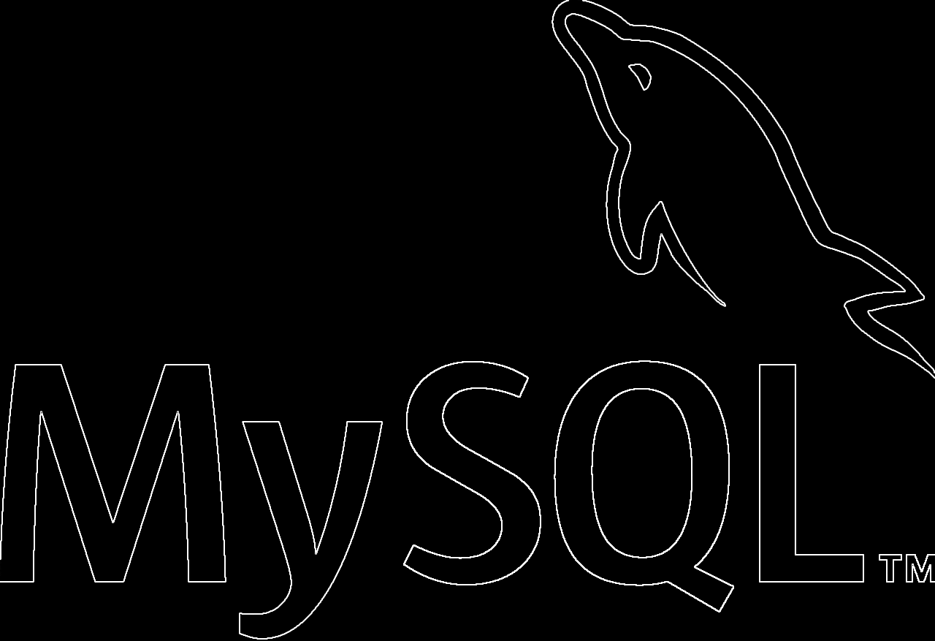
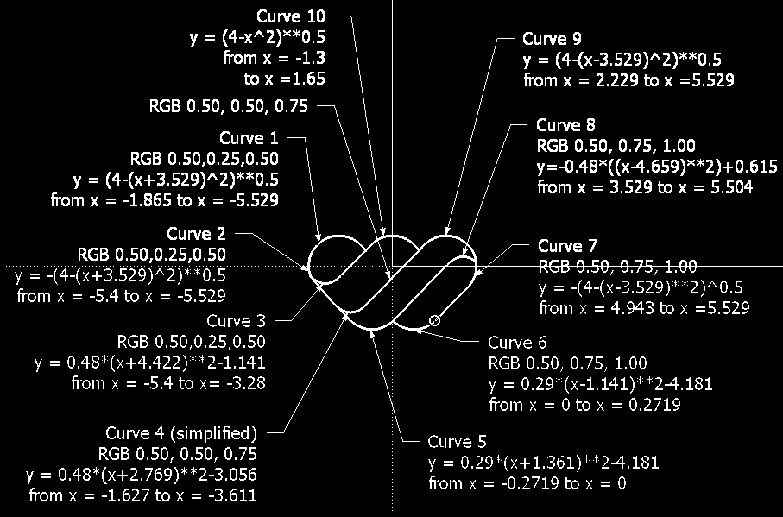


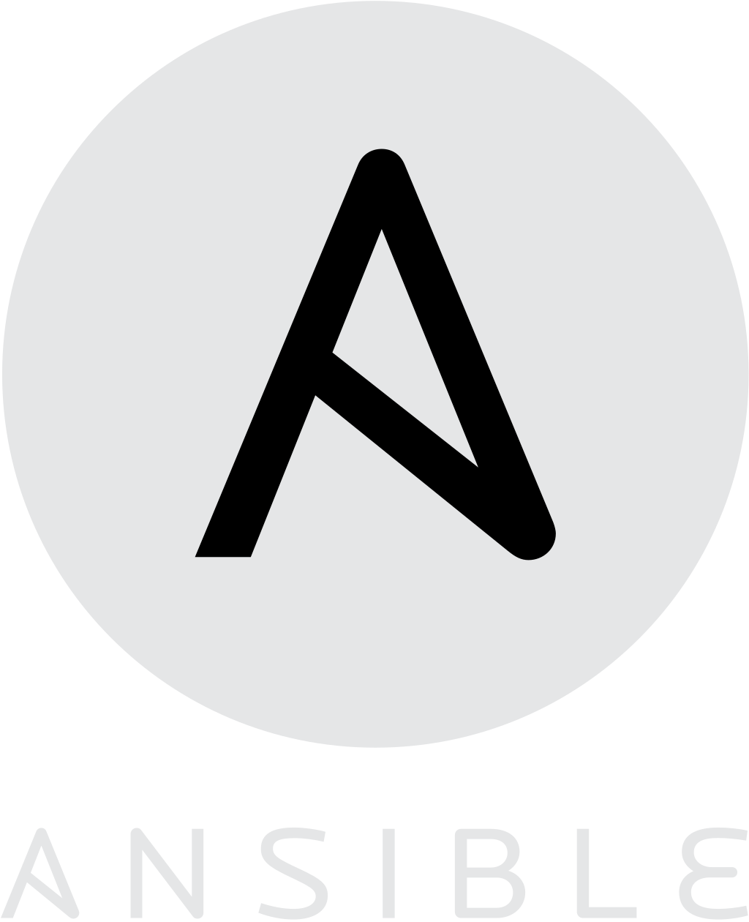
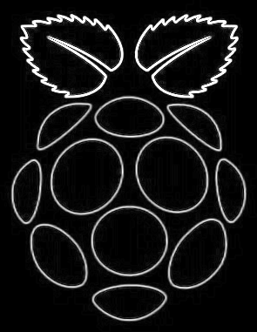
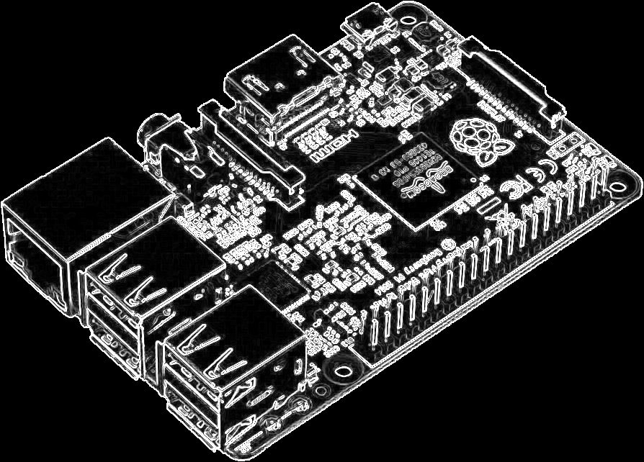

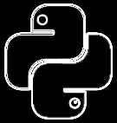
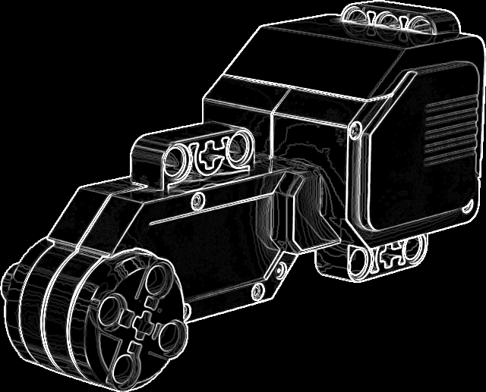
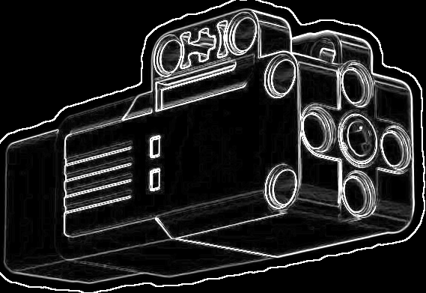

Infrastructure as Code for
Notes:
Unlike on-premises computers, cloud computing platforms like AWS EC2 and Azure Virtual Machine require more resources to set up beforehand. I have been exploring bash, Terraform, Ansible, and Chef to automate the deployment of EC2 and Azure Virtual Machine instances. In this project, we will create an instance that will store a master plan to move the robotic arm to slice peach fruit at the master node.

Slide 5
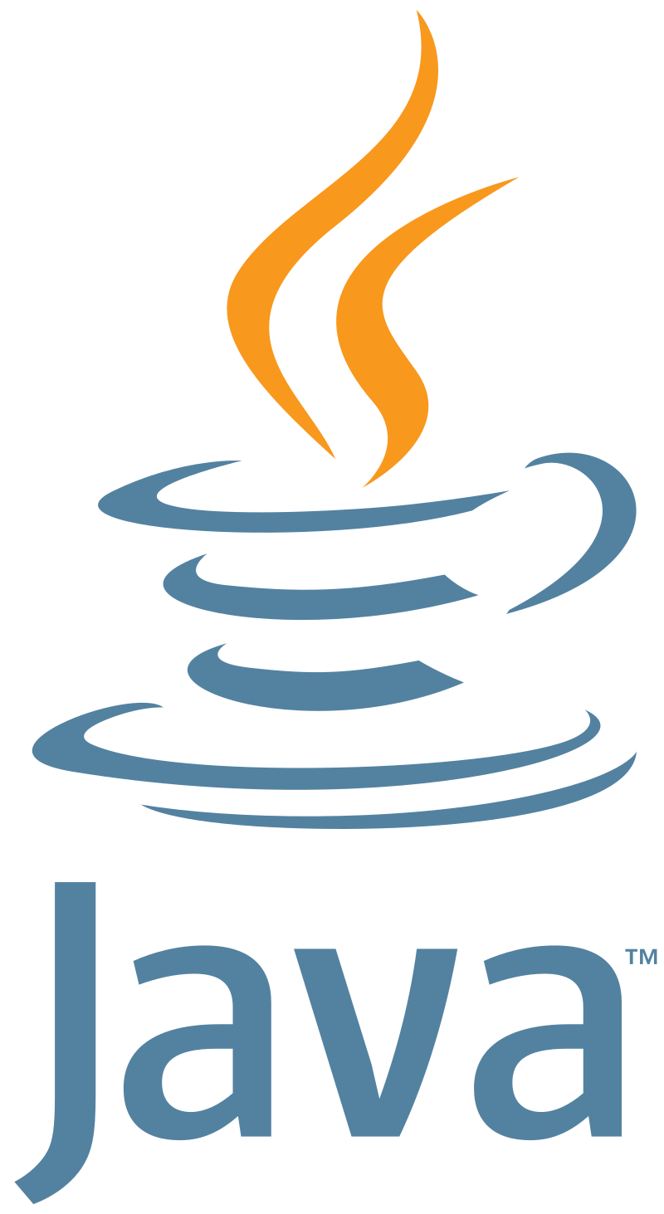
Infrastructure as Code for
jenkins-cli.jar
java -jar jenkins-cli.jar
-auth admin:$passjenkins
-s http://localhost:8080
create-job project6 < config.xml
Notes:
The next thing we can automate in terms of infrastructure is Jenkins Continuous Integration and Continuous Deployment, also known as Continuous Delivery. While it is easier to set up CI/CD with a web UI, there is a Java tool called jenkins-cli.jar that can automate this process. This Java program reads a config.xml file that mimics all the setup options available through the web browser for setting up the pipeline.

Slide 6
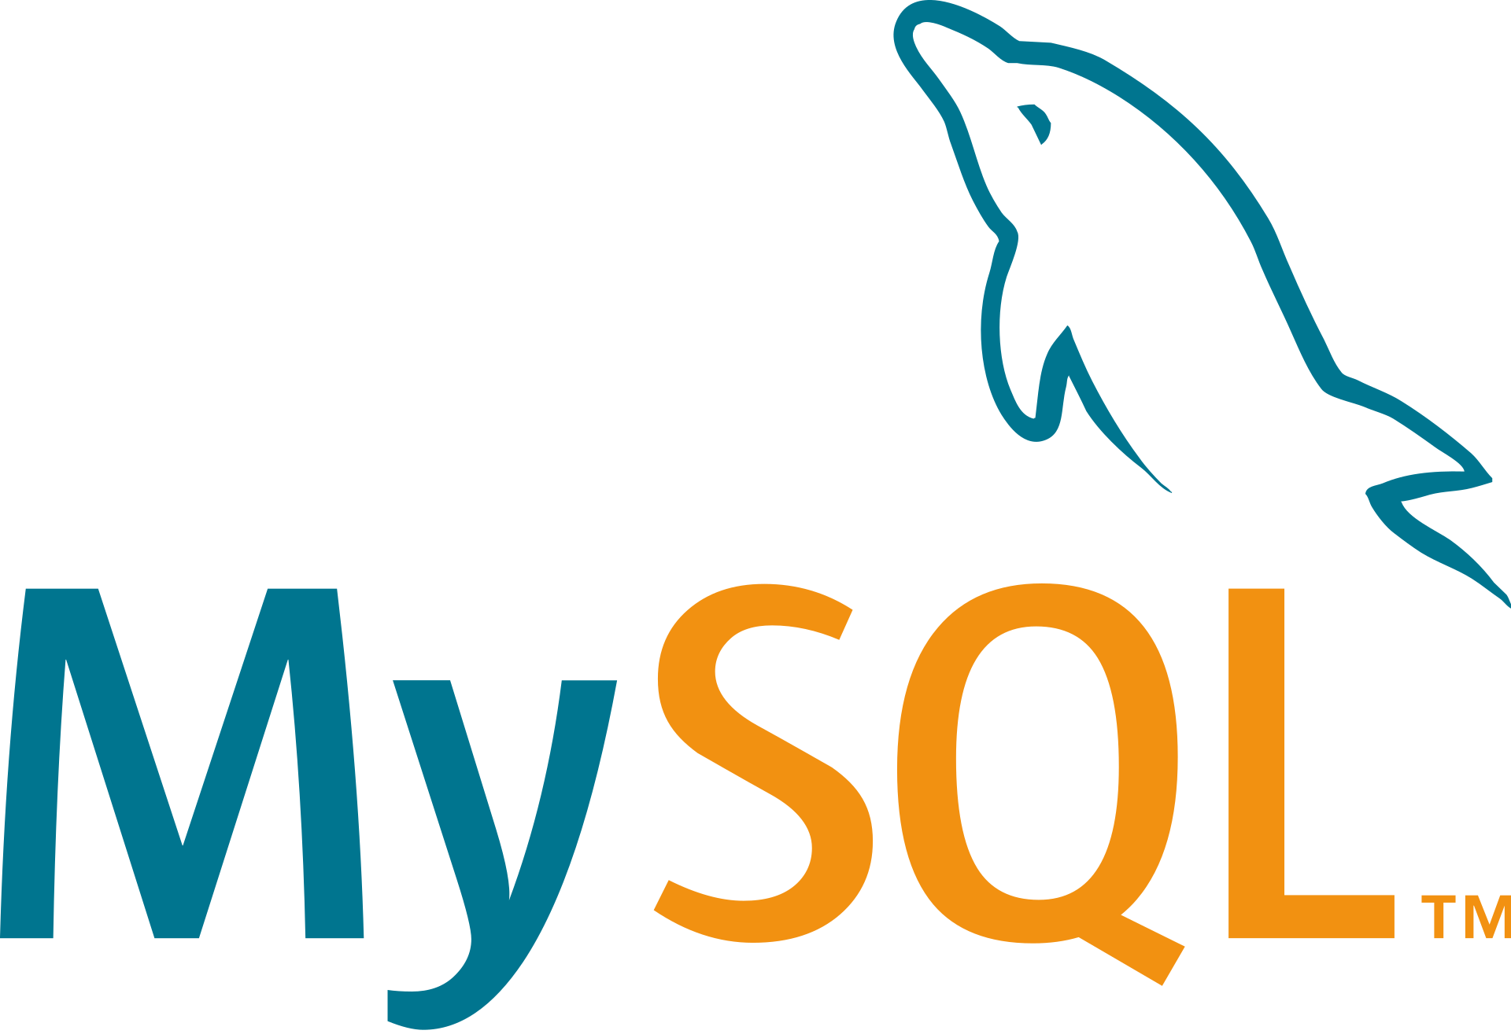
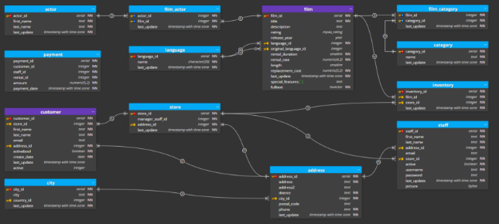
Infrastructure as Code for
$ sudo apt install mysql-server
$ sudo service mysql status
● mysql.service - MySQL Community Server
...
Active: active (running) since ...
$ sudo mysql
Welcome to the MySQL monitor.
mysql> USE mysql;
mysql> select * from global_grant;
...
Notes:
The next crucial aspect of this project is the powerful database. I chose mySQL for prototyping purposes only. In the real world, the database needs to be fast when reading and writing a large amount of live data, especially when advanced 3D scanning is involved. For this capstone project, we will focus only on the 3D movement of the robotic arm without worrying about reverse engineering from machine learning and image processing of irregular produce shapes. The main focus of this project is on storing numerous coordinates that will instruct the Raspberry Pi and Robotic Arm where and when to move. This data could be extensive considering the 3D coordinates and intensity of pressure required for slicing. Installing and running mySQL only requires a few lines of commands, along with testing the connection. The main work in the database attached to the master node will involve schema design, data mapping, and ETL using query language and entity relationship diagrams.

Slide 7

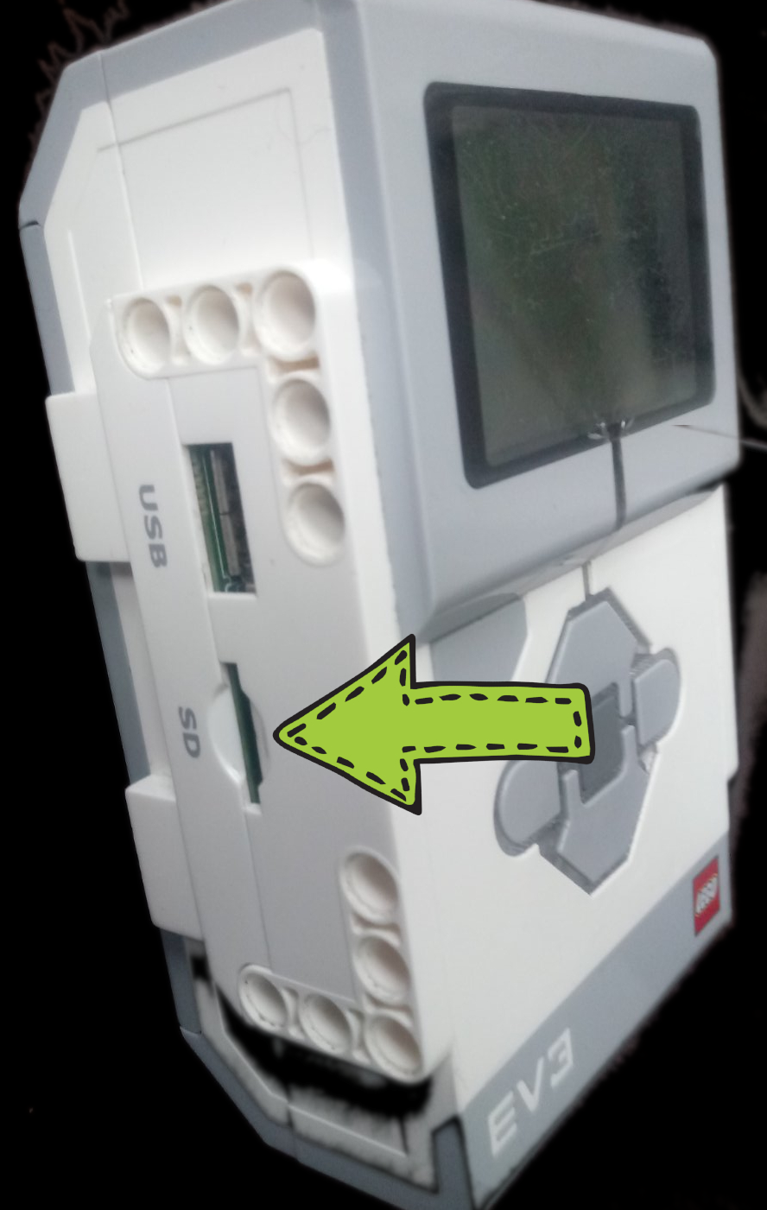
Infrastructure as Code for
Pybricks MicroPython v1.11 2020-05-06; linux version
Use Ctrl-D to exit, Ctrl-E for paste mode
>>> from pybricks.hubs import EV3Brick
>>> from pybricks.ev3devices import Motor
>>> from pybricks.parameters import Port
>>> ev3 = EV3Brick()
>>> motor_b = Motor(Port.B)
>>> motor_b.run_target(1000, 100)
Notes:
The next automation we could implement in terms of infrastructure as code is related to the robotic arm system. The EV3 brick, which connects the Raspberry Pi to the motor movement, runs on a lightweight version of Linux. By SSHing instructions and uploading new Python files to the EV3's SD card, we can convert the code into actual movement. In 2020, some official websites provided image files for this purpose. An example shown in the slide demonstrates sending interactive commands to the EV3 brick to run a motor on port B at an intensity of 1000 for 100 milliseconds.

Slide 8


Infrastructure as Code for
$ sudo snap install helm --classic
$ helm repo add prometheus-community ...
$ helm repo update
$ kubectl create namespace monitoring
$ helm install monitoring ...
$ kubectl apply -f ev3.yaml
$ kubectl port-forward ...
$ kubectl port-forward ...
Notes:
Lastly, in terms of infrastructure as code, we can also apply the same principles to the observability aspect, which is mainly managed by Prometheus and Grafana when Docker and Kubernetes are utilized. Typically, we use Helm as a package manager to deploy Prometheus and Grafana for monitoring purposes. We will dive deeper into observability towards the end of this presentation.

