Slide 1
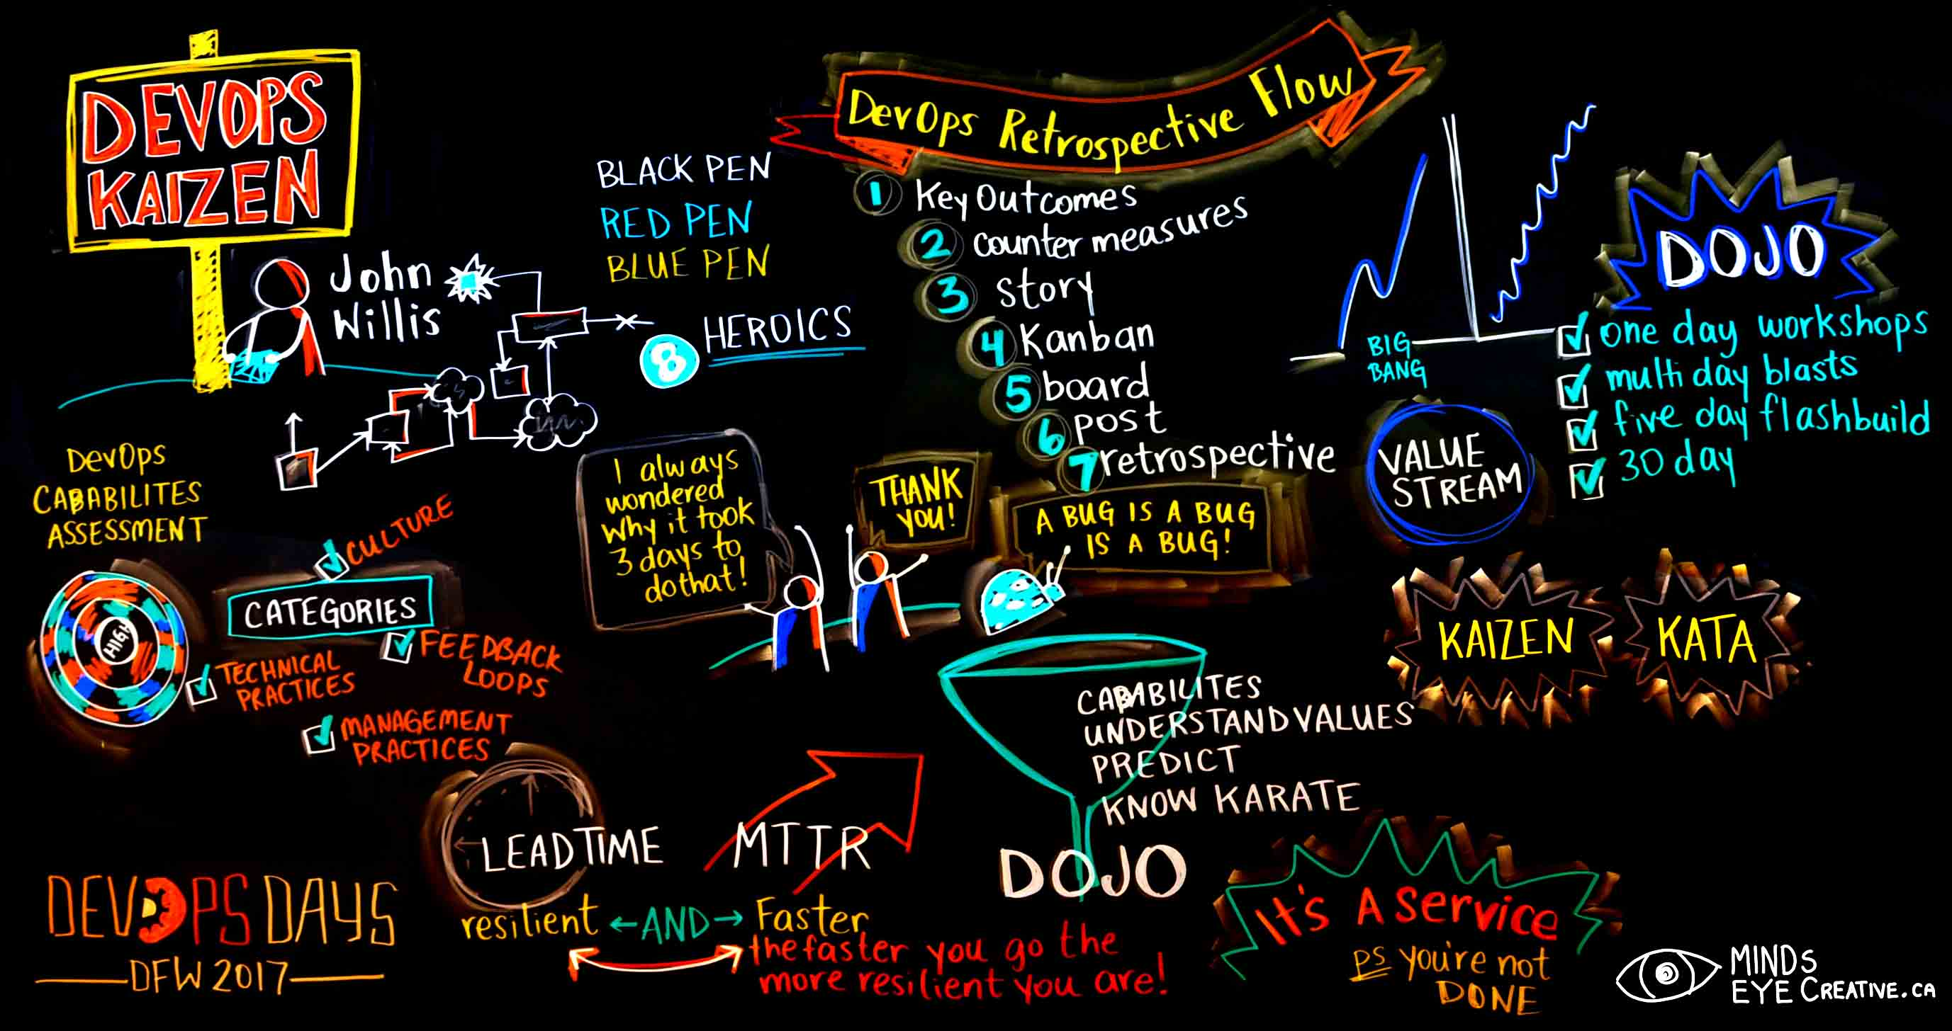
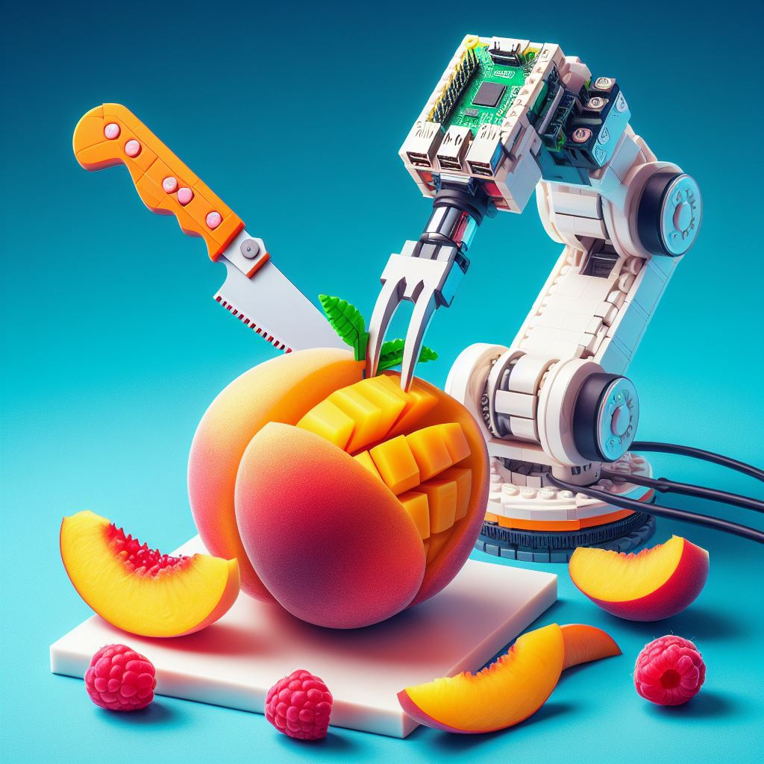
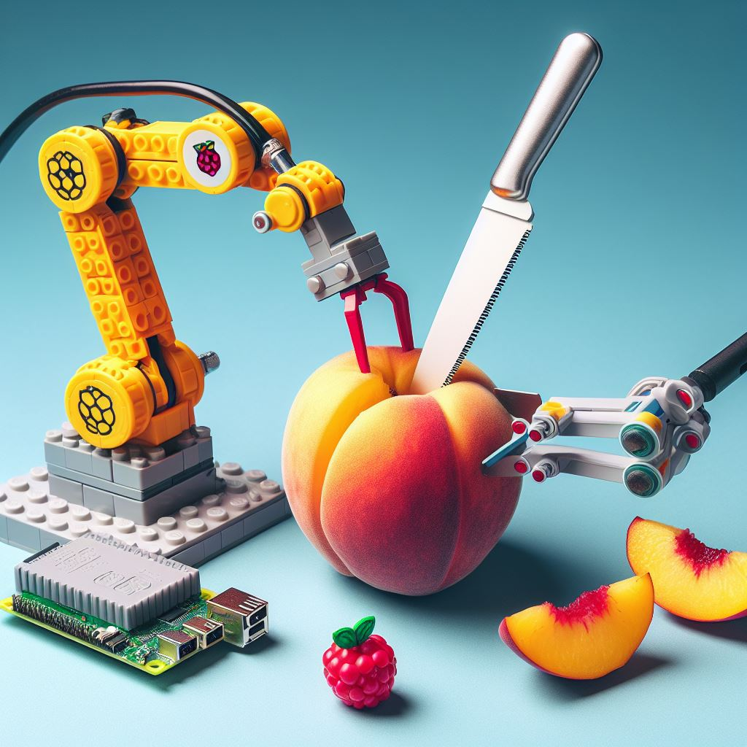
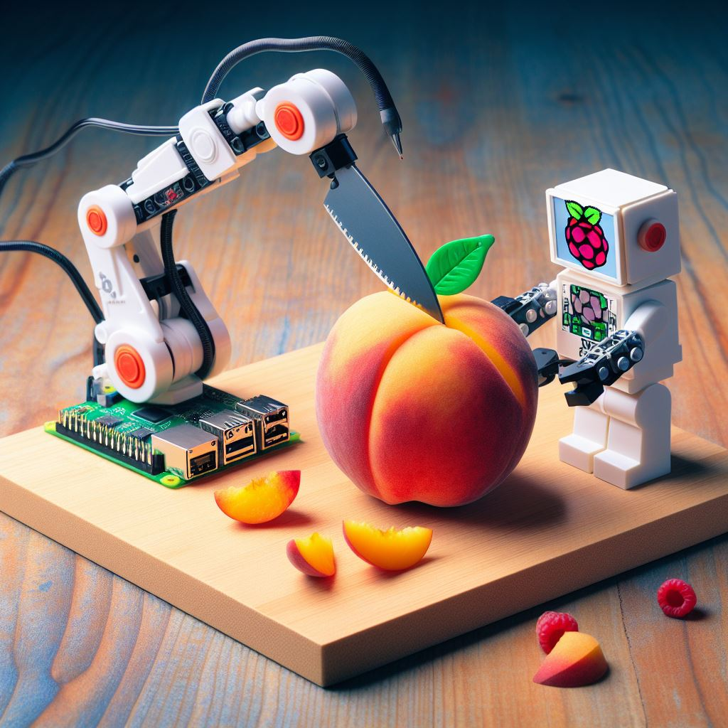
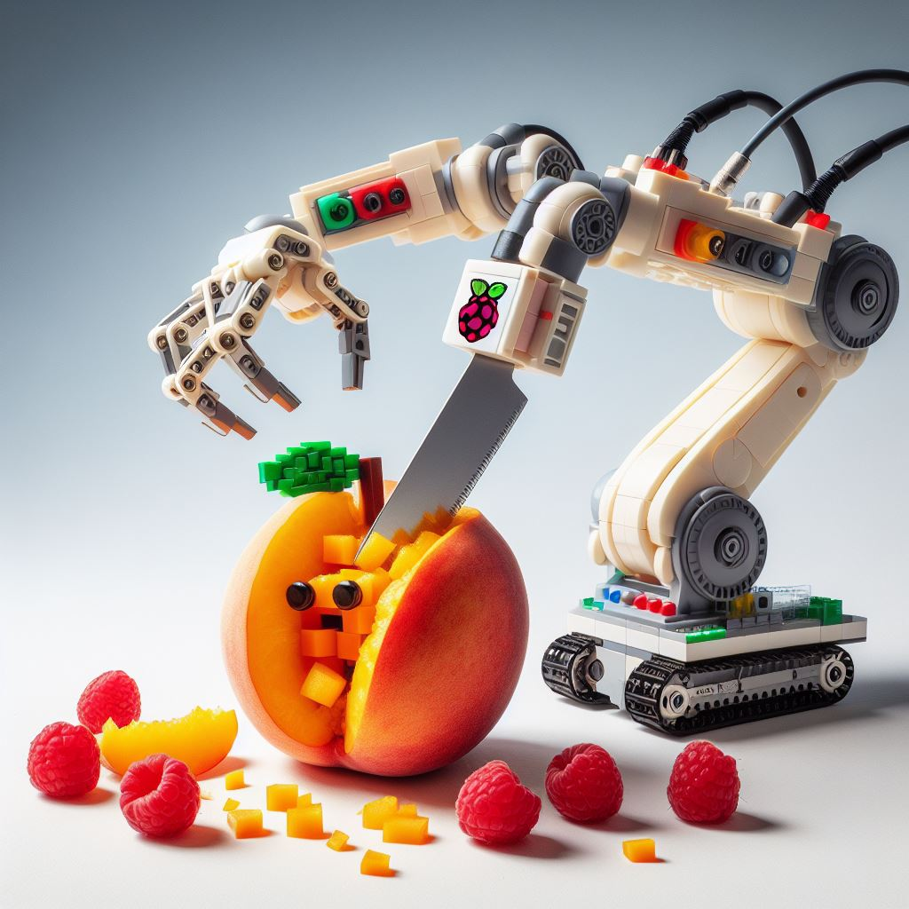
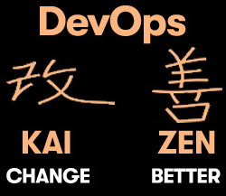
DevOps Kaizen, Container Technologies
Notes:
The next section of this presentation will cover the heart of the DevOps principles itself, Container Technology. In short, many will think DevOps is identical to Docker and Kubernetes as container and container orchestration. However, there are also a few choices from simple Docker swarm to large-scale Kubernetes clusters offered by major cloud players like AWS EKS, Google Kubernetes Engine, or Azure Kubernetes Service. As you can see in the chart, it reflects more on the business objectives and values rather than going deeper into technicality. A DevOps expert could be expected to know many things but should not be an expert in everything. There are emerging languages like Golang and Ruby, or some cloud features from AWS SNS when we apply microservices, lambda, and step functions. There are also load balancing and autoscaling, and horizontal pod autoscaling which every DevOps engineer should become familiar with. How do all of this apply to slicing a tiny peach? Well, the fun part is the materials for this experiment are abundant and relatively cheaper compared to those woods and metals every carpenter or machinist learns to do their job. Kaizen is famously known as continuous improvement, and in DevOps, it is all about it.

Slide 2
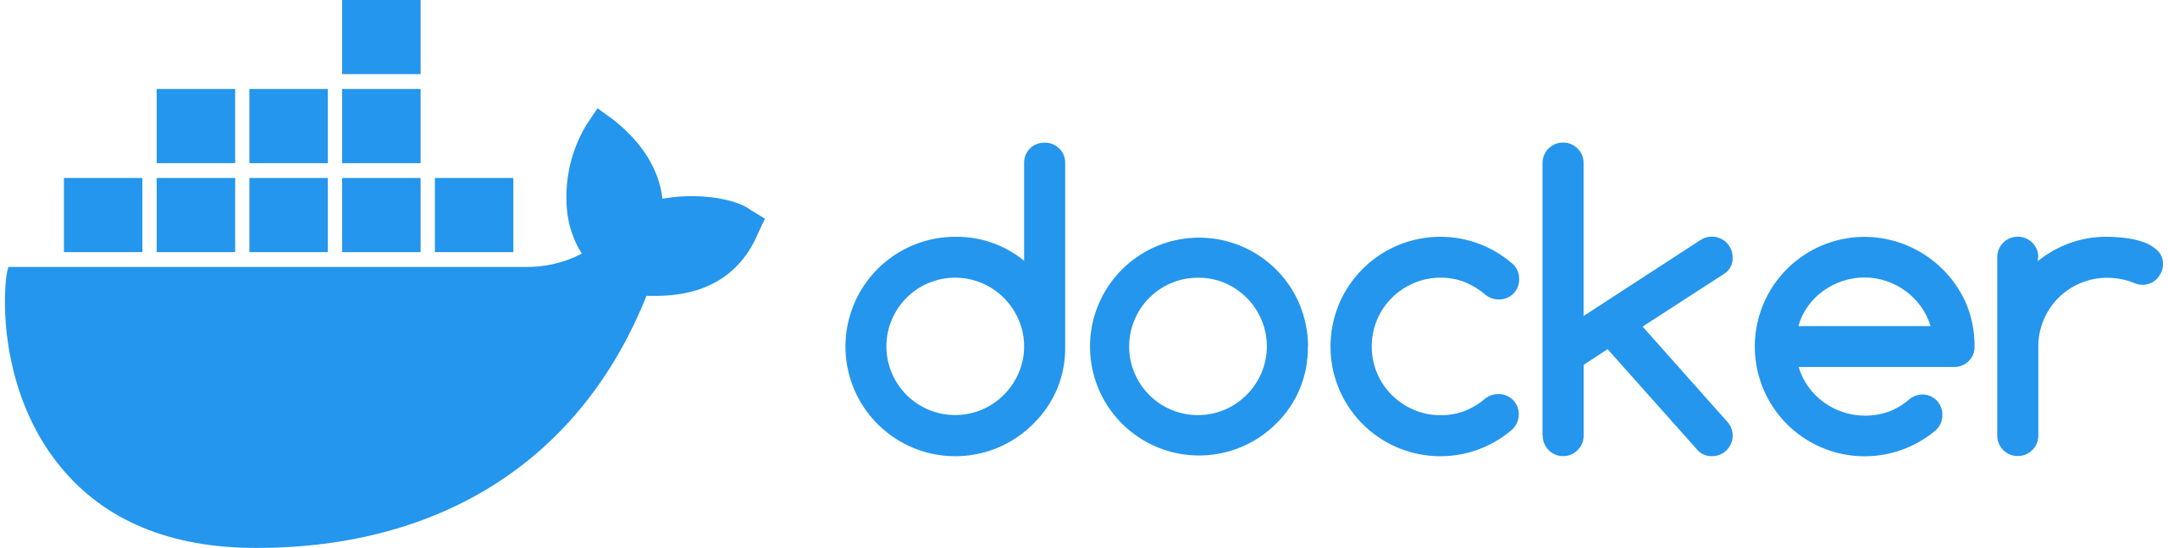
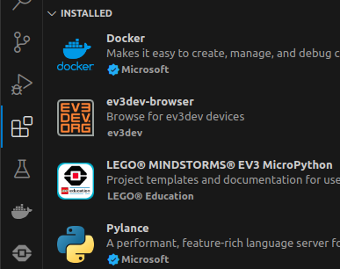
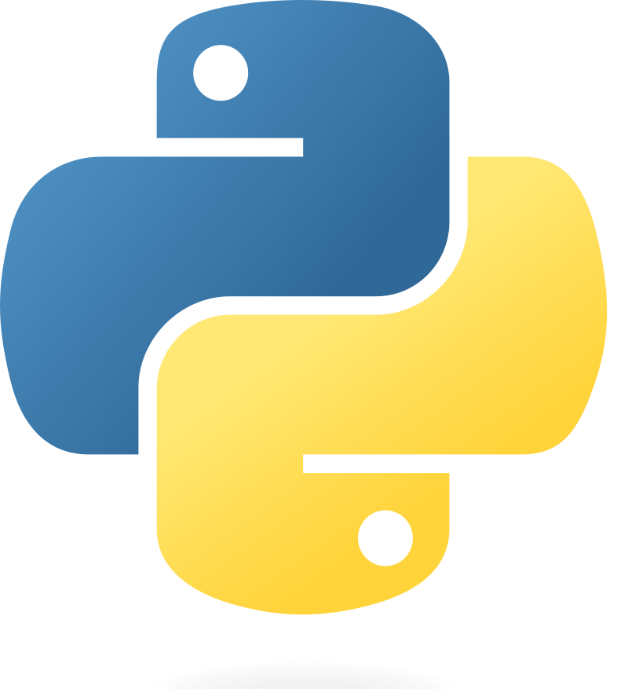

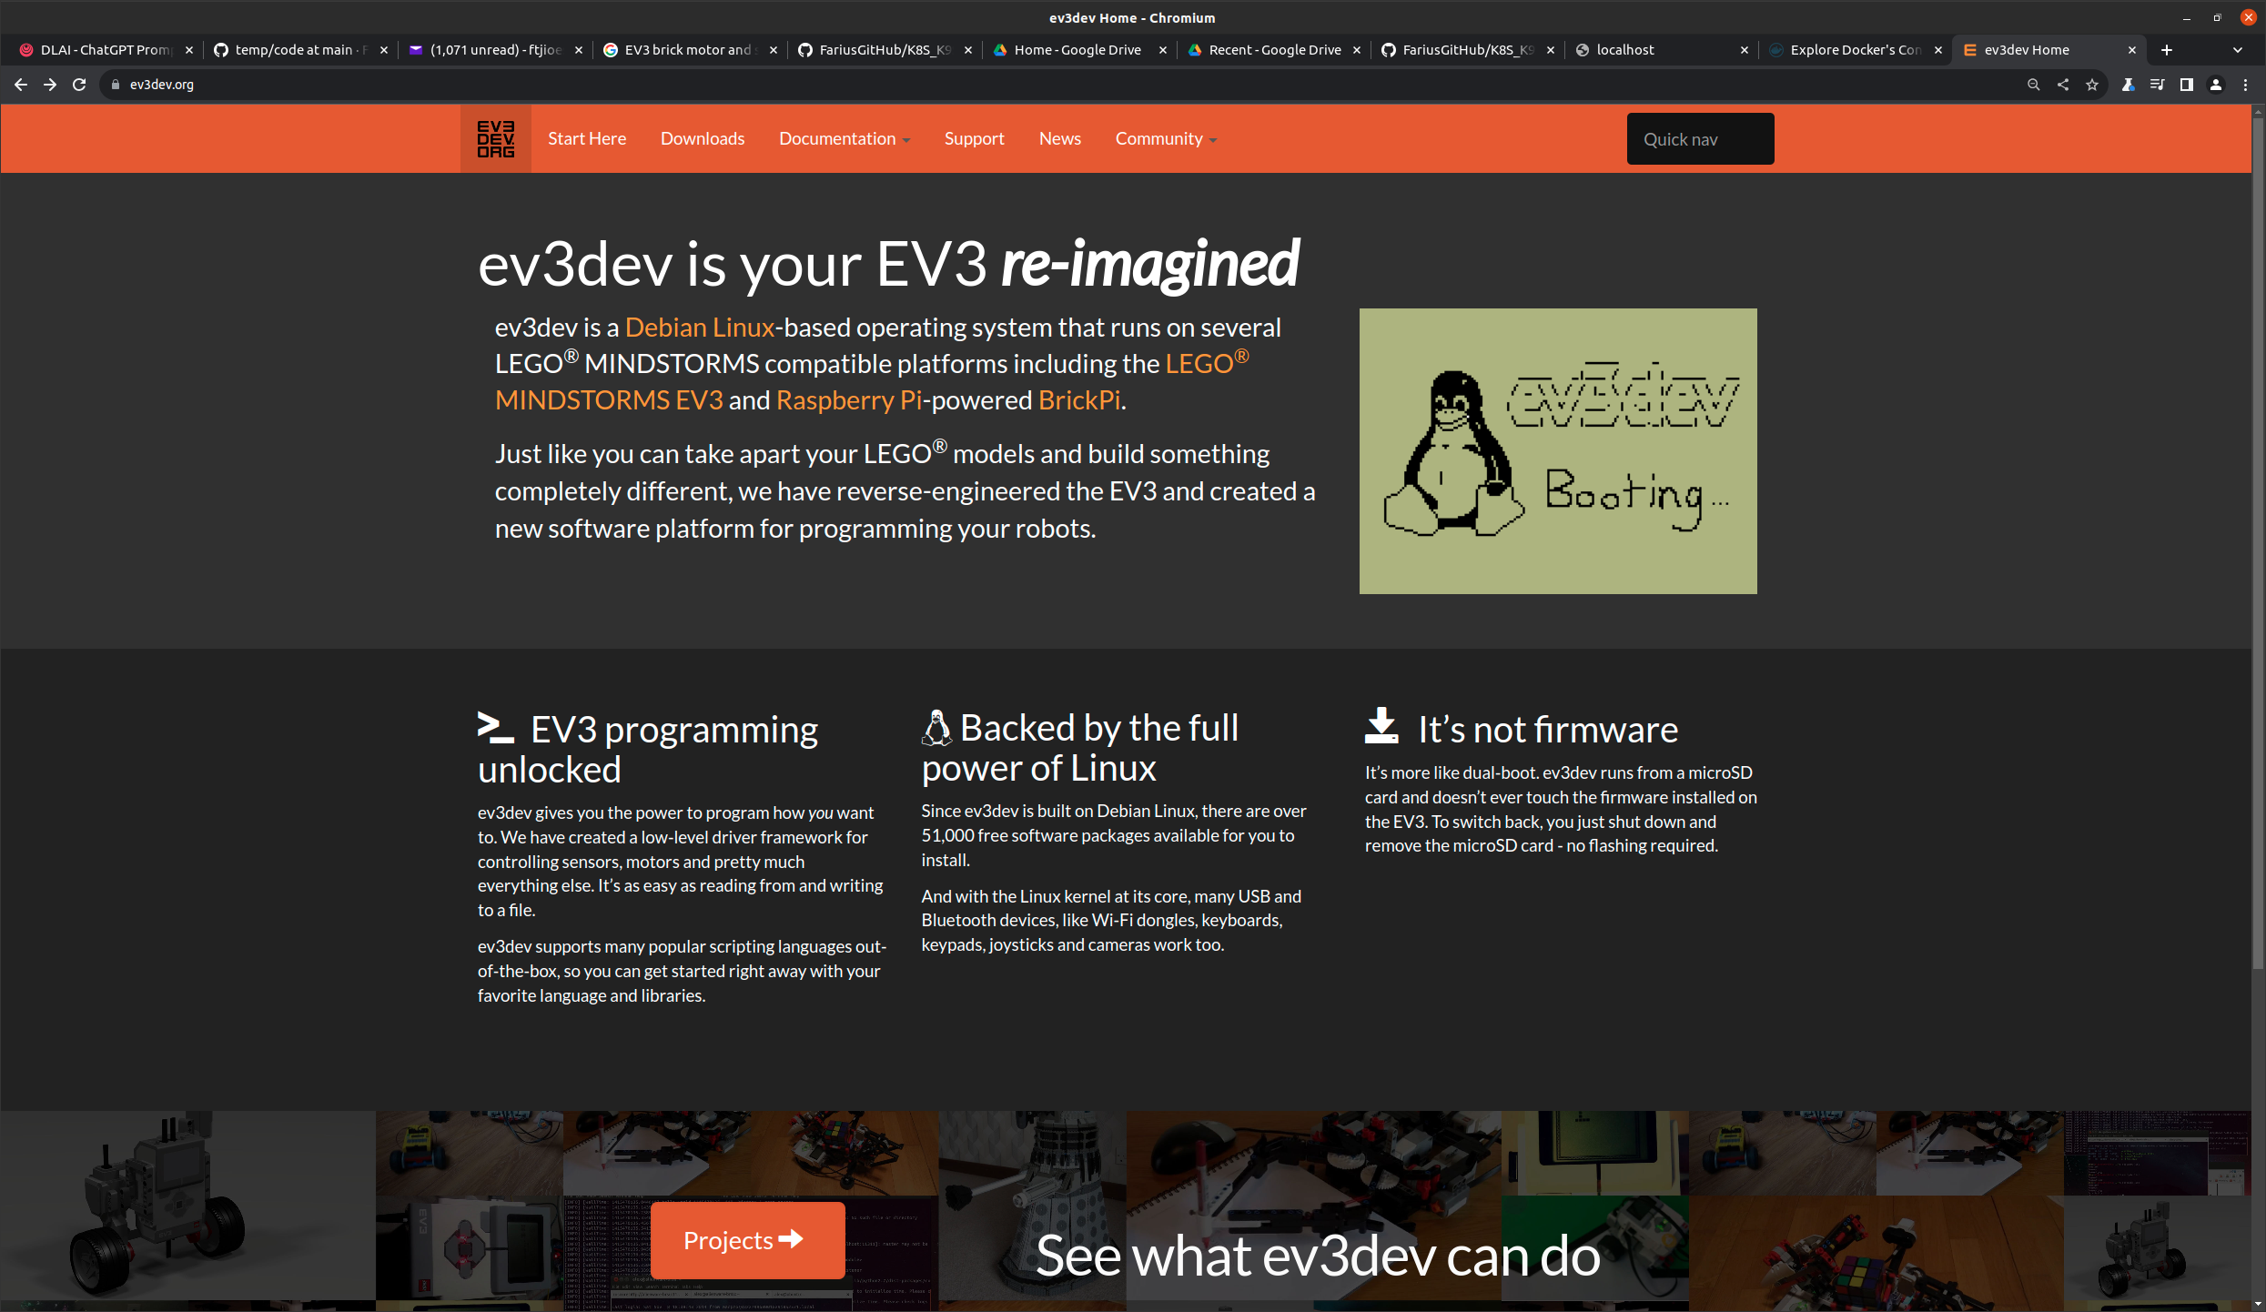

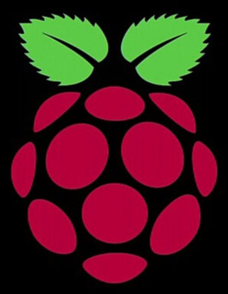
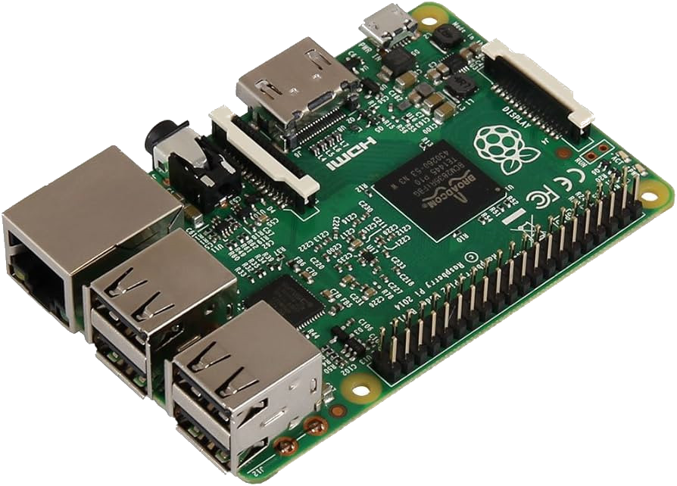
Bring Containers Altogether
Notes:
Why did I choose a Lego toy for this project and how does it work in terms of slicing peach fruit? The good news is that since EV3 was introduced in 2013, it may take seven years for this affordable platform to become as popular as Python and Raspberry Pi. Another option for running this project is utilizing an industrial-grade robotic arm, which may not be accessible for some students unless they have the opportunity to work in a robotic environment such as an automotive assembly line or agricultural machinery. In the past, something comparable to Docker and Kubernetes would be a Programmable Logic Controller (PLC) and Distributed Control System (DCS), although at that time cloud computing and single-board computers did not even exist.

Slide 3
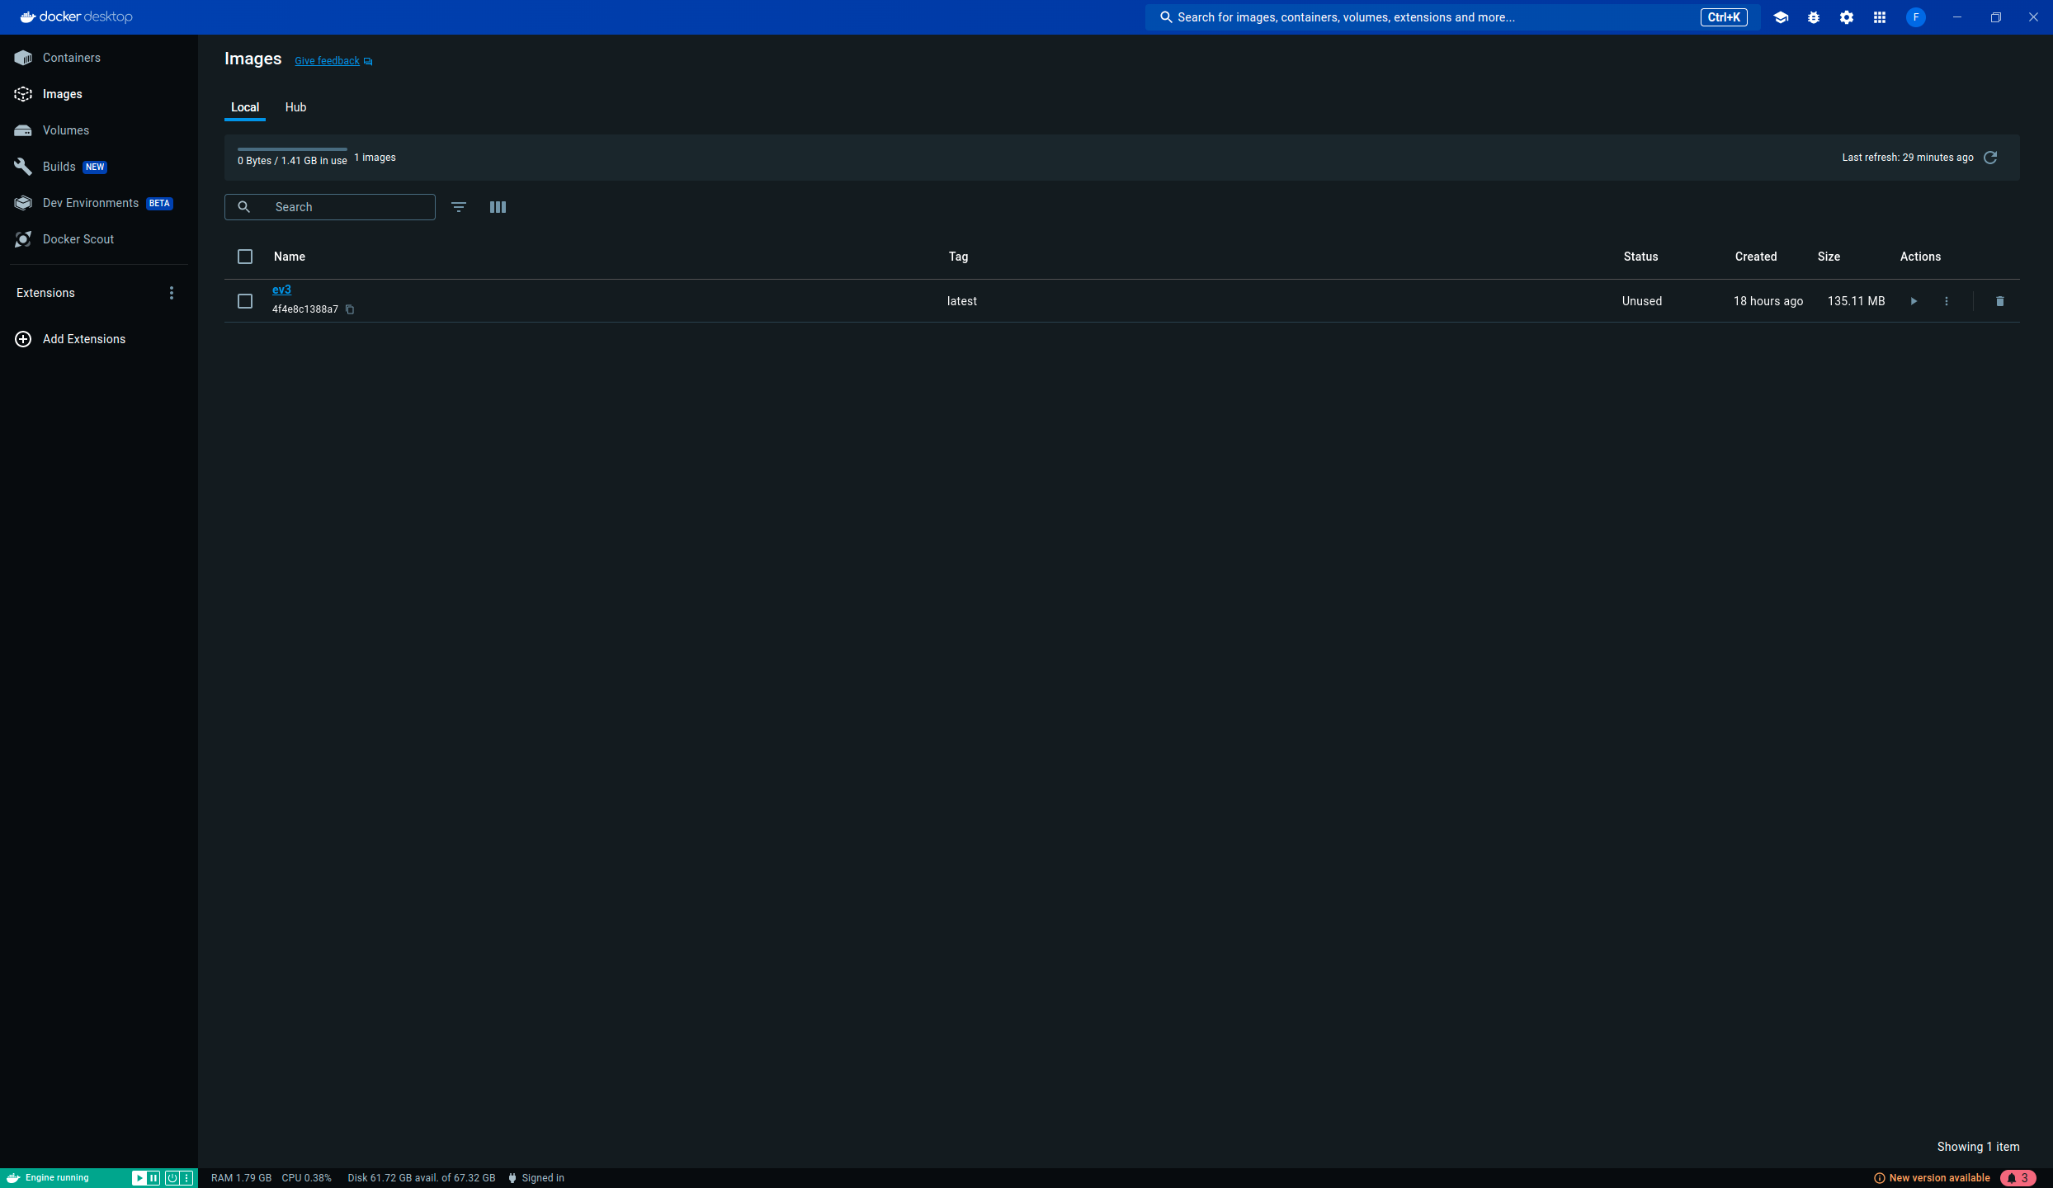
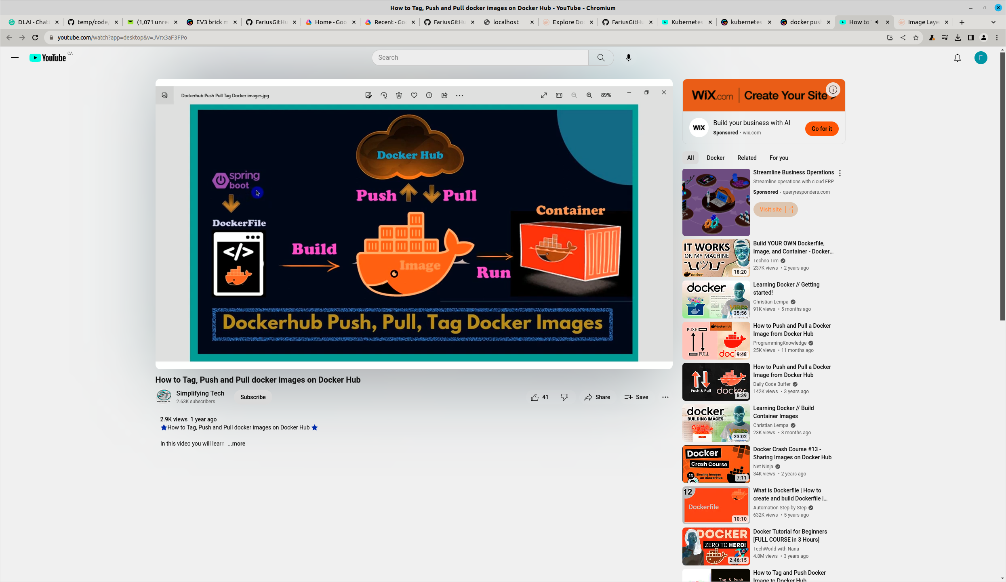
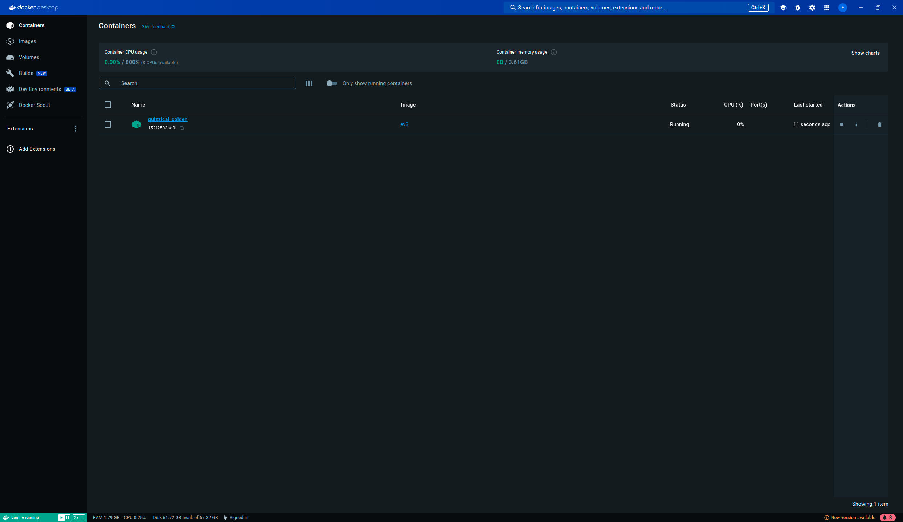
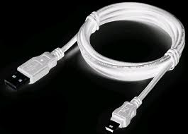
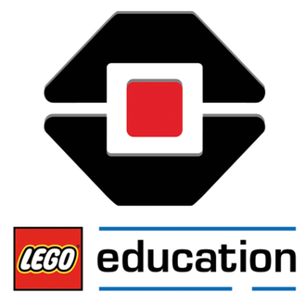
Dockerfile, Build and Run
Notes:
The basic process in Docker involves building and running from a Dockerfile, as well as pushing and pulling Docker images for sharing on Docker Hub. The Dockerfile contains a sequence of Python code stored in EV3 bricks, and a Docker container manages the selection, prioritization, and execution of these Python files. When a Docker image is run, it controls the movement of a robotic arm accordingly..
nm-connection-editor

Slide 4
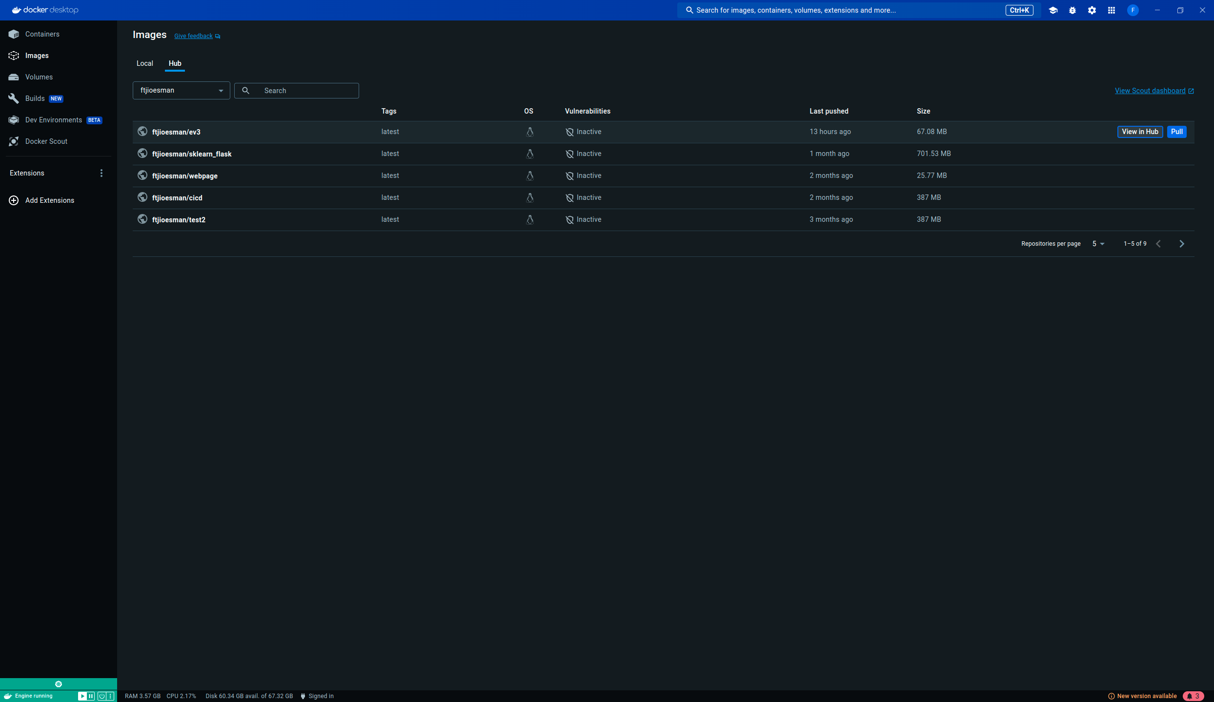
DockerHub, Push and Pull
Notes:
The push and pull process is crucial for cloud computing and sharing. Typically, we tag the image, push it to Docker Hub, and then pull it back to test on different machines.

Slide 5

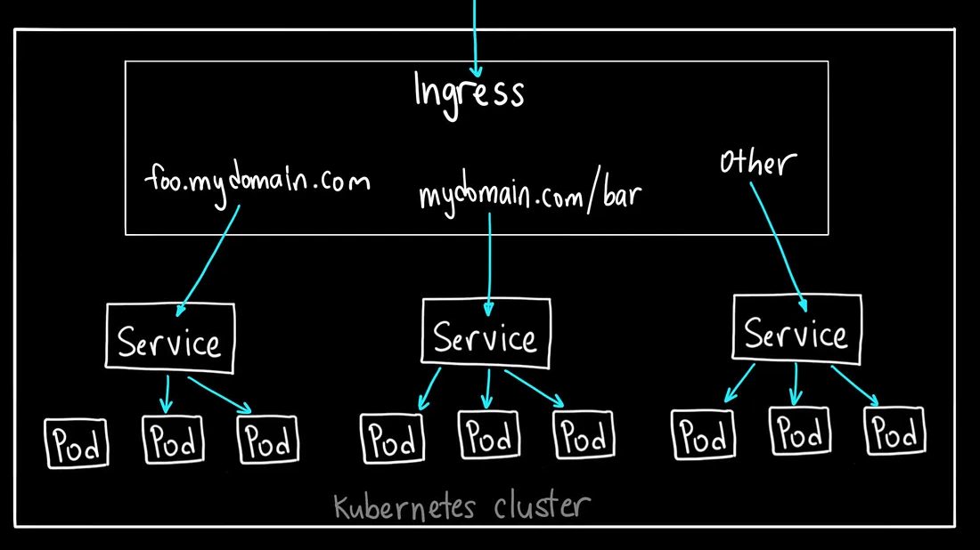

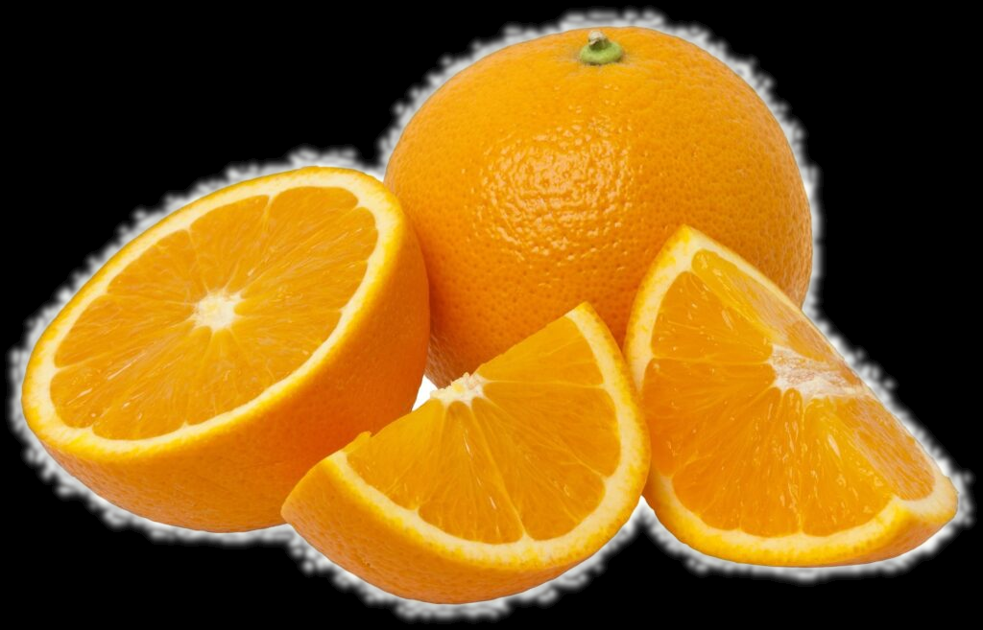
Kubernetes Cluster
Host-Based Routing
Ingress
Load Balancer
Services
Deployment
https://github.com/FariusGitHub/K8S_K9S_K3S/tree/main?tab=readme-ov-file#port-forwarding
Notes:
The last part of the container technologies discussion here will focus on orchestrating the containers themselves. Kubernetes is the most popular platform and offers tracking features such as ingress, load balancer, services, and deployment. We can switch the service based on host-based routing and typically use load balancing within a Kubernetes service to connect to deployed pods that are similar.

Slide 6
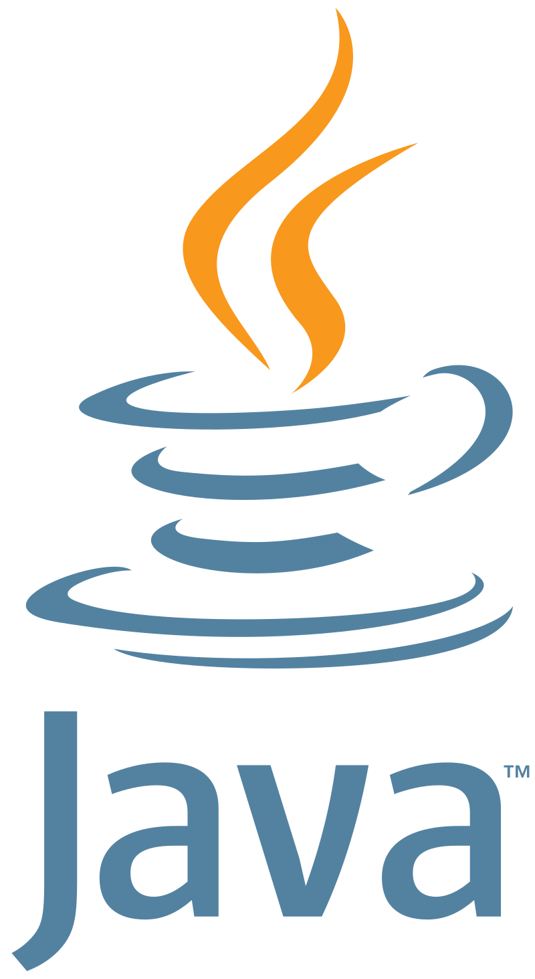
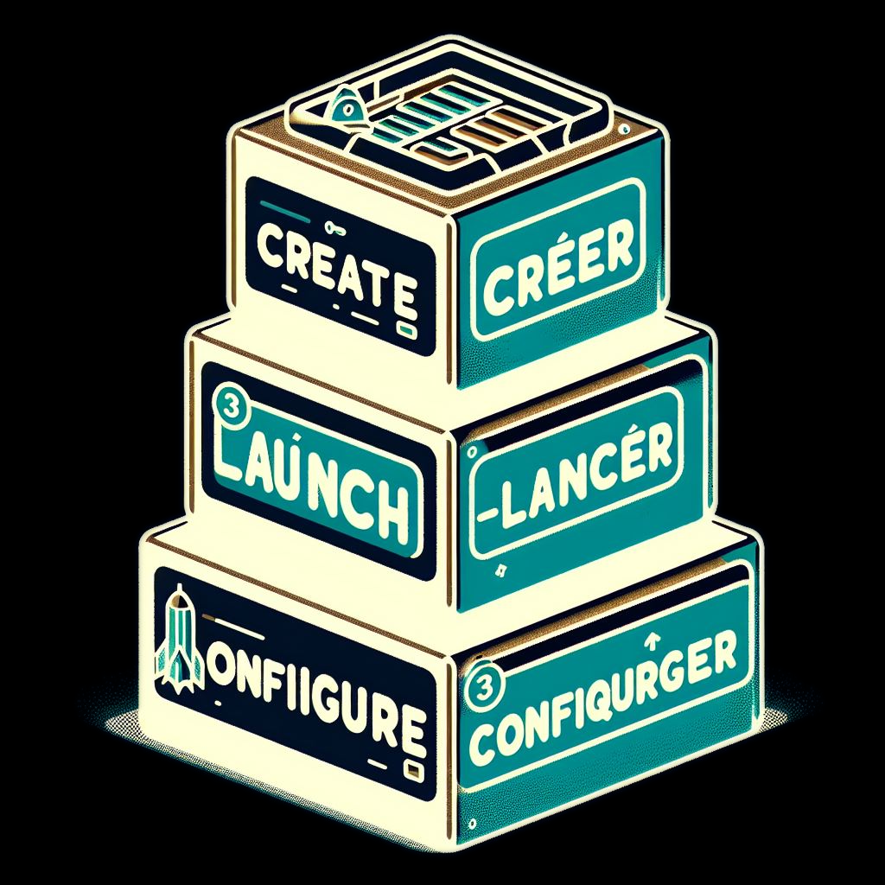





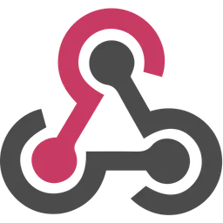
CREATE,LAUNCH,CONFIGURE, TRIGGER
Jenkins-cli.jar
{
Web UI
Notes:
The last part of this presentation focuses on CI/CD. We use Jenkins here, although GitHub Actions is also growing in popularity. In the beginning of this presentation, I introduced automation with jenkins-cli.jar. Now, we will delve deeper into the user-friendly Web UI. For configuration, we typically use Groovy syntax, as well as cron to schedule or webhooks to trigger the pipeline when there is a change.

Slide 7
Pipelines with syntax
Scripted Pipeline: Most functionality provided by the Groovy language is made available to Scripted Pipeline, which means it can be an expressive and flexible tool and it is ideal choice for power-users with complex requirements.
Example (usually within sh command)
docker run ev3
Notes:
Page 15

Slide 8
Pipelines Declarative Syntax
Declarative Pipeline: Presents a more simplified and opinionated syntax. It must be enclosed with a pipeline block and it has a strict and pre-defined structure. It is friendly for beginners.
Example
docker.image(ev3).run
Notes:
Page 16

Slide 9
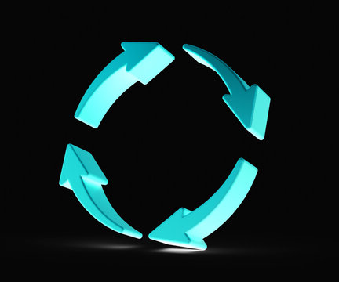
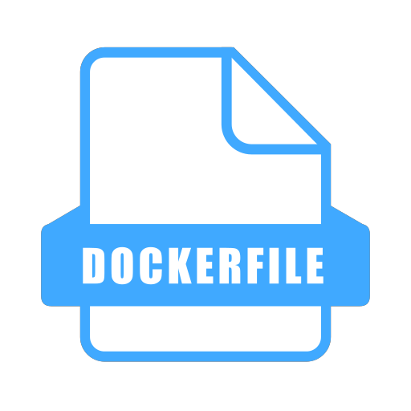

Committing code to GitHub Repo
Notes:
What is interesting in CI/CD is the continuous integration and deployment of changes into the production environment. In this case, the pipeline will typically refer to the latest Dockerfile. Whenever there is a change, it will be applied, documented in the GitHub repository using Groovy syntax, and saved as an updated Dockerfile.

Slide 10
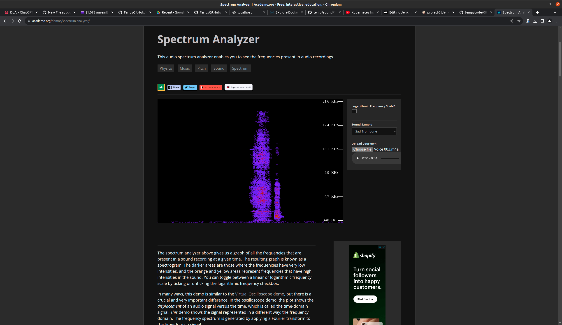


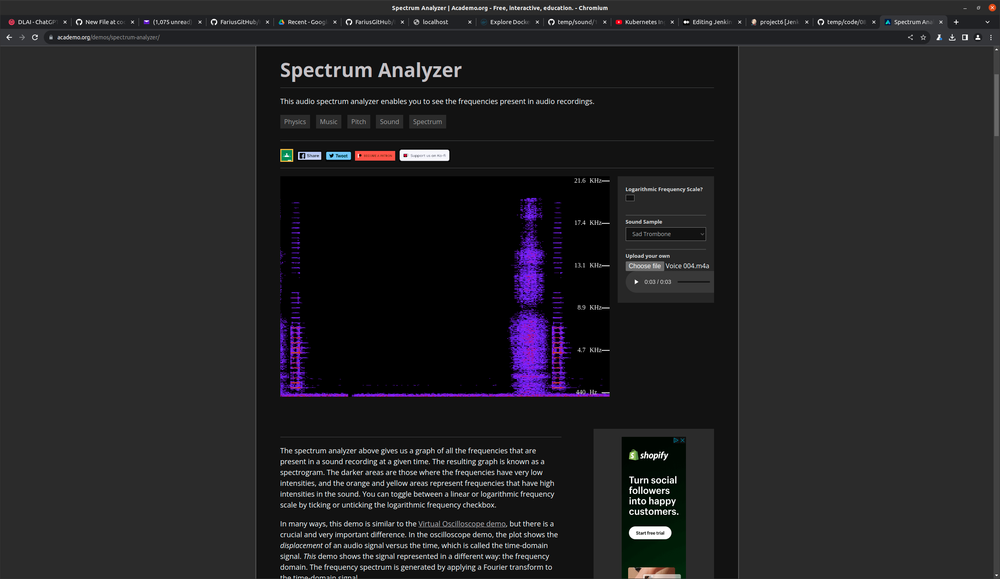
Leverage Jenkinfiles, MicroPython
20 KHz
Motor(Port.B).run_target(1000, 180)
EV3Brick().speaker.beep(100, 100)
15 KHz
10 KHz
5 KHz
Jenkinsfile at
Micropython at
ssh
20 KHz
15 KHz
10 KHz
Motor(Port.B).run_target(1000, 180)
EV3Brick().speaker.beep(500, 100)
5 KHz
Notes:
What is interesting about this project is the coexistence of distributed computing from Raspberry Pi and a robotic arm with its own system. There is a limit to what Jenkinfiles can leverage, and some improvements may need to be made outside of Jenkinfiles. In this case, a voice spectrum is used to differentiate between two scenarios by changing the beep from 100 to 500. Although changes made here do not affect the Dockerfile, they do impact the Robotic Arm PyBrick MicroPython system, not the Raspberry Pi.

Slide 11
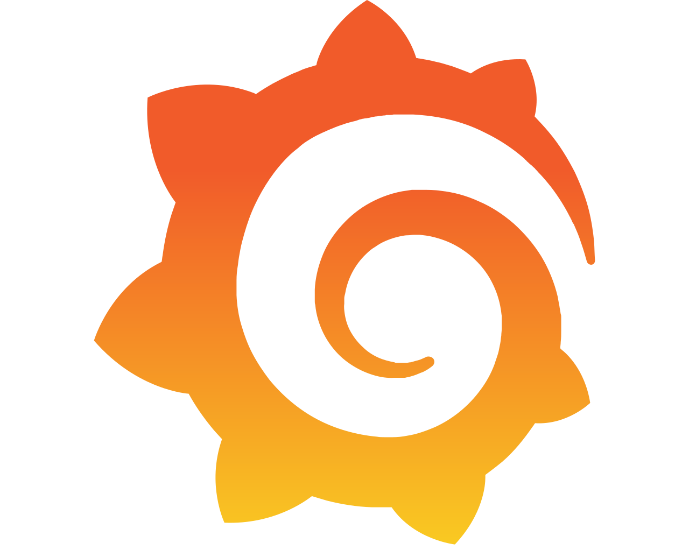

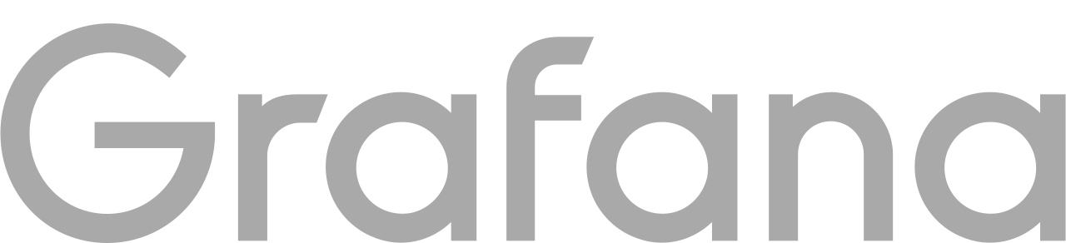

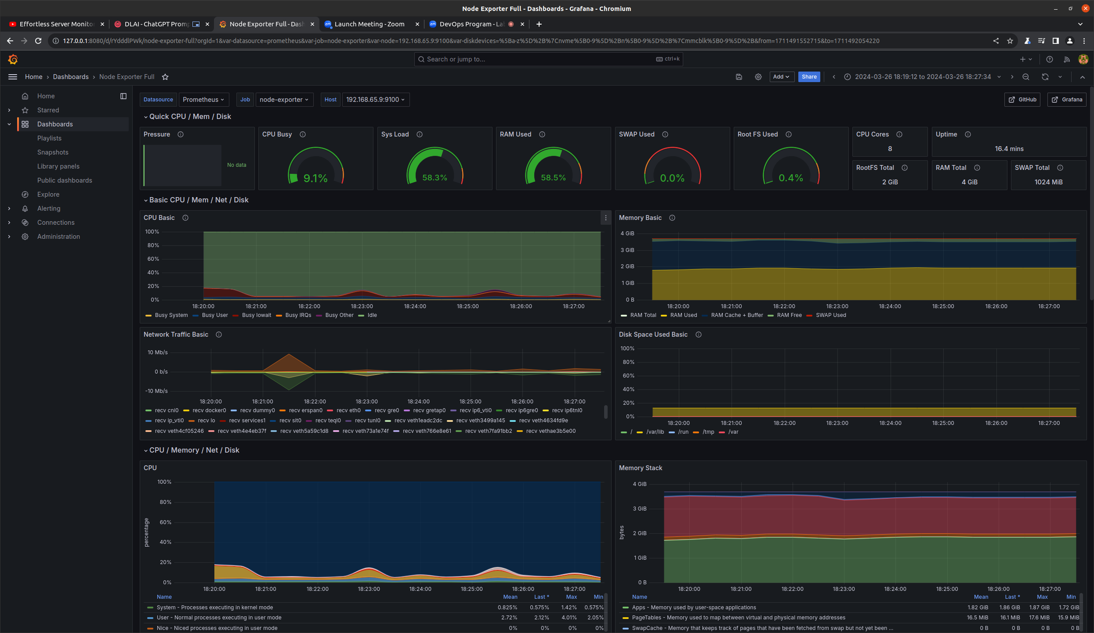
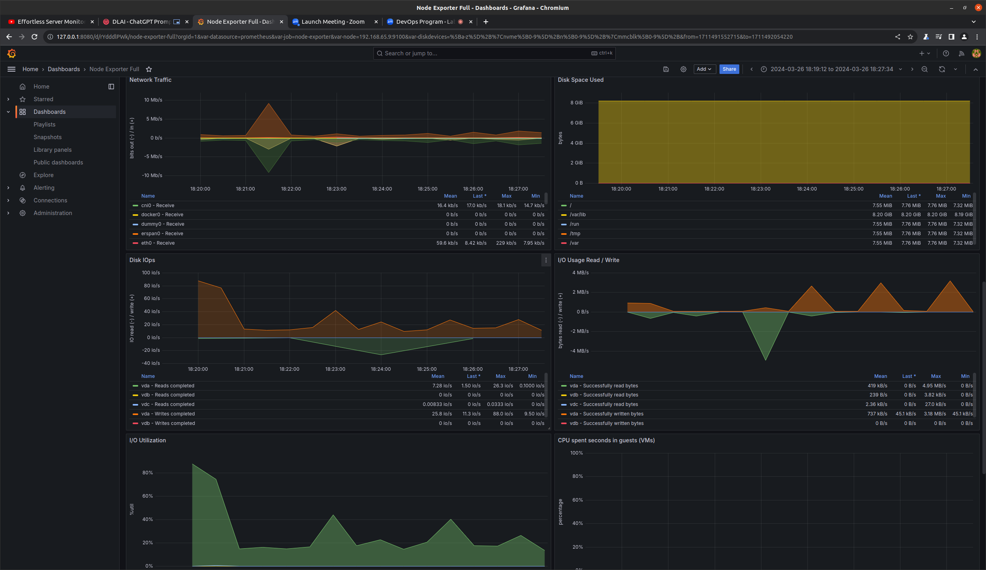
Observability
Notes:
As we covered a bit about observability in the beginning of this presentation, here is how Prometheus and Grafana work together through Helm to visualize various metrics such as CPU usage, memory allocation, networking, and more.

Slide 12

More than AWS, Kubernetes, Docker,Produce,Robotic,IoT. It’s reliability, efficiency!
Wonderful Learning with Nhat, Usman,Dawei,Juan,Rakin,Lara.
Notes:
Page 20

