Slide 1
Credit card customer churn prediction using artificial neural networks
done by :
NAME: fariya rahmath
class: III yr. b. e. cse
Register no: 813821104035
College: saranathan college of engineering

Slide 2
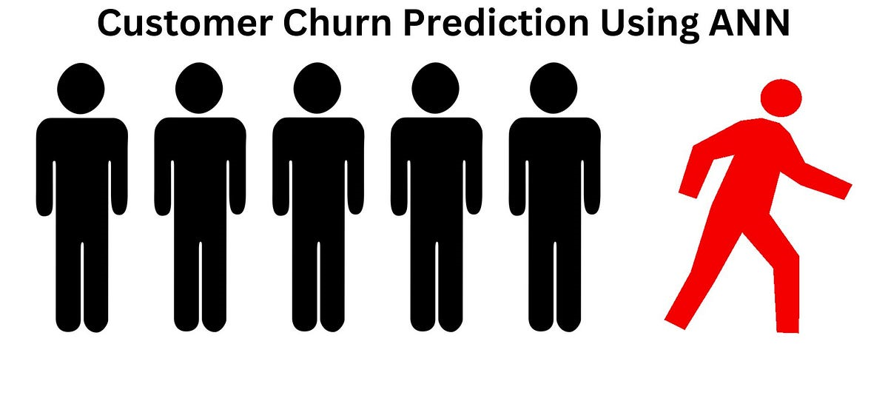
Project Title
Credit Card Customer Churn Prediction using Artificial Neural Networks (ANN)

Slide 3
Agenda
Problem Statement
Project Overview
Who are the End Users
My solution and its Value Proposition
The WOW in my solution
Modeling
Result
Conclusion

Slide 4
Problem Statement
What is the problem? - Credit card customer churn, also known as credit card attrition, is a significant concern for financial institutions. Customer churn refers to the phenomenon where credit cardholders cease their relationship with a particular bank or credit card issuer, either by closing their accounts or reducing their usage of the credit card. Churn prediction is crucial for banks and financial institutions to retain profitable customers, minimize revenue loss, and optimize customer acquisition efforts.
What is the solution? - The solution consists of a robust Credit Card Customer Churn Prediction system, which accurately identifies credit cardholders at risk of churn. By leveraging ANN, the system will help financial institutions to proactively manage credit card churn, retain valuable customers, and mitigate revenue loss. Additionally, the project will provide valuable insights into customer behavior and factors influencing churn, enabling data-driven decision-making for effective customer management.
Why should I solve it? - The main objective of solving this problem is to address immediate revenue concerns and foster long-term customer relationships, promote data-driven decision-making, and strengthen the competitive position of financial institutions in the market.

Slide 5
Project Overview
The Credit Card Customer Churn Prediction leverages Artificial Neural Networks (ANN) to accurately forecast credit card customer attrition. This project identifies customers at risk of churning by analyzing historical customer data, including demographics, transaction history, and payment behavior. Implementing targeted retention strategies based on these predictions helps financial institutions retain valuable customers, mitigate revenue loss, and gain a competitive edge. Ultimately, this project promotes data-driven decision-making, enhances customer satisfaction, and strengthens risk management practices within financial institutions.

Slide 6
Who are the End Users
Beneficiaries
The beneficiaries of a credit card customer churn prediction system using ANN are varied and include:
Marketing and Sales teams of Financial Institutions
Data Analysts and Data Scientists
Risk Management Departments
Customers, Executive Leadership and Stakeholders
Overall, the beneficiaries of the credit card customer churn prediction project include a wide range of stakeholders within financial institutions, as well as customers who benefit from enhanced services and personalized experiences.
Social Impact
The social impact of Credit Card Customer Churn Prediction project using ANN extends beyond the financial sector and influences various aspects of society:
Financial Inclusion and Digital Transformation
Consumer Protection and Economic Stability
Education and Awareness
Ethical Data Use and Social Responsibility
Overall, the credit card customer churn prediction project has a positive social impact by promoting financial inclusion, consumer protection, economic stability, education and awareness, digital transformation, ethical data use, and social responsibility within society.

Slide 7
My Solution and its Value Proposition
This project focuses on building a robust Credit Card Customer Churn Prediction system using Artificial Neural Networks (ANN). The project involves several key steps:
Data Analysis and Preprocessing
Cleansing dataset, Performing EDA on the dataset and splitting the dataset into training and testing data.
Data Visualization
Seaborn and matplotlib libraries are utilized to create visualizations for various attributes to gain insights into the data distribution and relationships between variables. The distribution of target labels (exited vs not-exited) are visualized to understand class imbalance issues.
ANN Model creation
TensorFlow and Keras are used for designing the architecture of the ANN model. Three layers, 11 neurons per layer are used. The model is compiled with appropriate loss function (binary crossentropy), optimizer (Adam), and evaluation metrics (Accuracy).
ANN Model Training and Evaluation
The ANN model is trained on the training data using the fit() method, with 100 epochs. The training process is monitored and its performance is evaluated on the testing data. The accuracy metric is calculated to assess the model's predictive power.
Loss and Accuracy Visualization
The training and validation loss over epochs is plotted to visualize the model's convergence and to identify overfitting or underfitting. The training and validation accuracy over epochs is plotted to track the model's learning progress and performance.
Model Testing and Deployment
The trained ANN Model is tested on unseen data and its generalization ability is assessed. It has predicted outcomes with an accuracy of 0.79 (~0.8).

Slide 8
The WOW in my solution
There are many "WOW" (unique) features in my project, such as:
Complex Pattern Recognition
Discerns subtle indicators of customer churn that may be difficult to detect with traditional statistical methods.
Temporal Dependencies
Considers the temporal dynamics of customer interactions and behaviors, enhancing prediction accuracy.
High Dimensionality
Incorporates a wide range of customer attributes, transaction history, and behavioral data to make accurate predictions.
Automatic Feature Learning
Automatically learns relevant features from raw data, eliminating the need for manual feature engineering, which can be particularly advantageous in customer churn prediction, where identifying informative features can be challenging due to the complexity and diversity of customer behavior.
High Scalability and Flexibility
Enables the model to handle increasing volumes of data and adapt to accommodate large datasets, complex modeling tasks and evolving business requirements over time.
Finally, the unique capabilities of ANNs, including their ability to capture complex patterns, model temporal dependencies, handle high dimensionality, perform automatic feature learning, scalability, flexibility, and integration with the deep learning ecosystem, make them a powerful and effective approach for Credit Card Customer Churn Prediction in this project.

Slide 9
Modeling
Programming Language - Python
Algorithm - Artificial Neural Networks (ANN)
Frameworks
TensorFlow - For building and deploying the ANN model
Keras - For building and training the ANN models with minimal code and complexity
NumPy - For performing advanced mathematical functions, random number generations, data manipulation and preprocessing tasks
Pandas - For performing tasks like data analysis and manipulation, reading data, handling missing values, reshaping data, data aggregation and transformation
Scikit-learn - For performing data preprocessing, feature selection and model evaluation
Matplotlib & Seaborn - For performing data visualizations
Platform - Google Colab

Slide 10
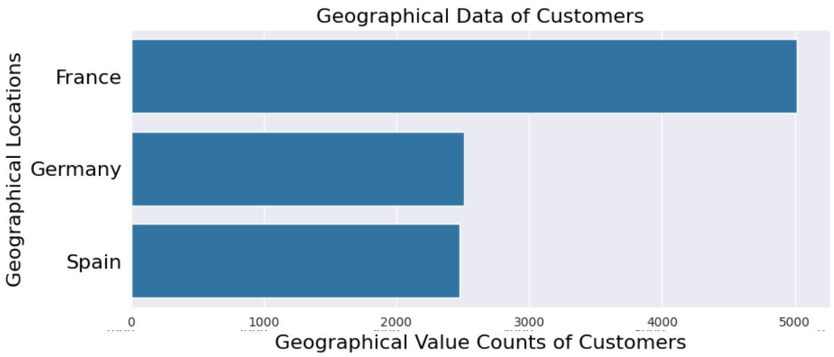
Result
This image consists of the Geographical Data of the Customers, i.e., The number of Customers from each Country.

Slide 11
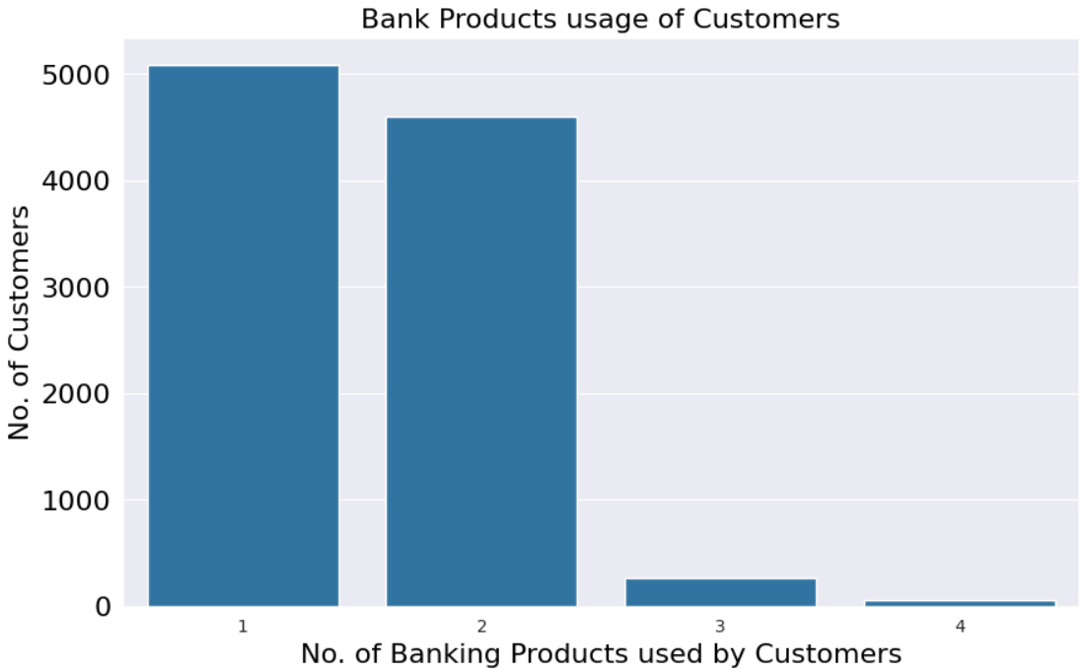
Result
This image consists of the data about the Bank Products used by the Customers.
It shows how many customers use only one product and how many customers use multiple banking products.

Slide 12
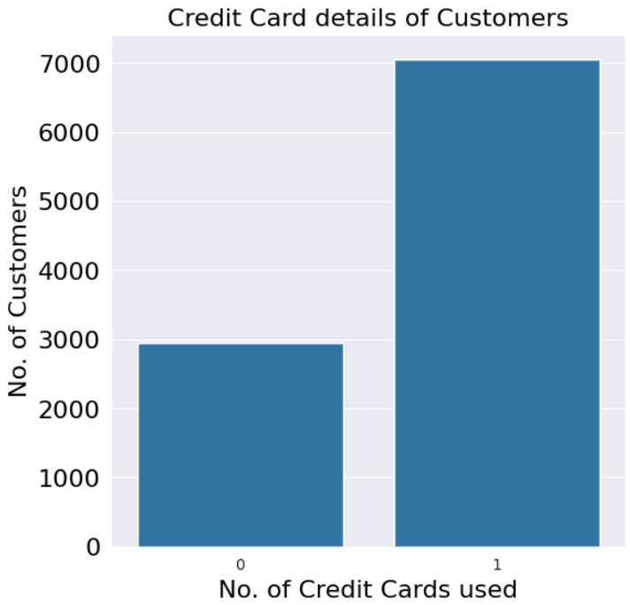
Result
This image consists of the credit card details of the customers. It tells us how many customers use and don't use a credit card.
0 represents the number of customers who don't use any credit cards.
1 represents the number of customers who use a single credit card.

Slide 13
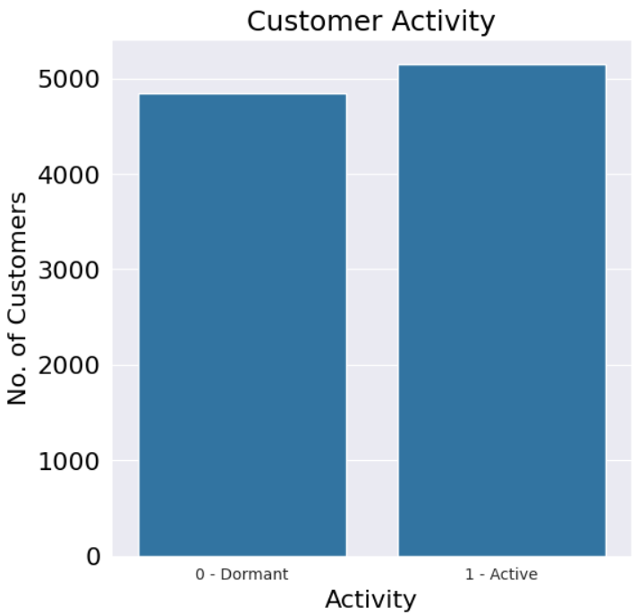
Result
This image consists of the details of customers' activity.
0 represents the number of dormant or inactive customers of the bank.
1 represents the number of active customers of the bank.

Slide 14
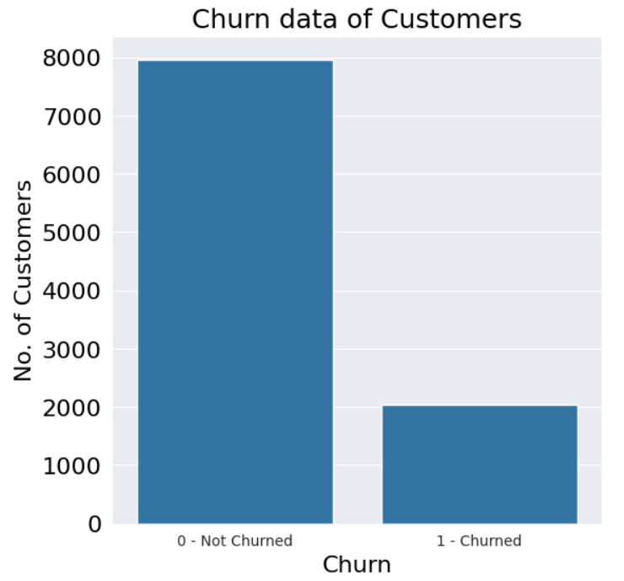
Result
This image consists of the Churn data of customers.
0 represents the number of customers / clients who have left the bank and 1 represents the number of customers retained by the bank.
This is an imbalanced dataset with a higher number of non-churned instances compared to churned instances.
This leads to biased models that perform poorly in predicting churn due to the dominance of the majority class.

Slide 15
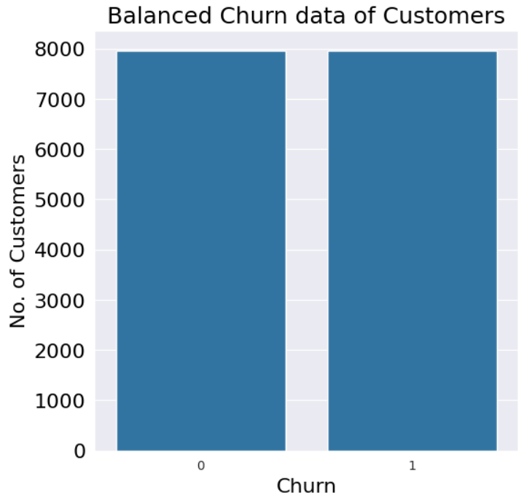
Result
This image consists of the Balanced Churn data of the customers.
0 represents the number of customers / clients who have left the bank and 1 represents the number of customers retained by the bank.
Helps address the imbalance issue and improves the performance of the models by ensuring that both classes are equally represented during training.
Prevents bias towards the majority class.

Slide 16
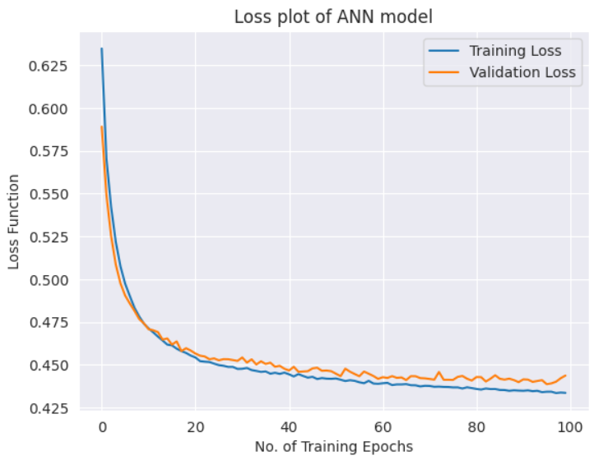
Result
This image consists of the loss plot the ANN model.
The loss plot visualizes the training progress and convergence of the model.
It helps in monitoring the performance of the model over time and diagnosing issues such as overfitting or underfitting.
As the training progresses, the loss typically decreases, indicating that the model is learning to make better predictions and fitting the training data more effectively.

Slide 17
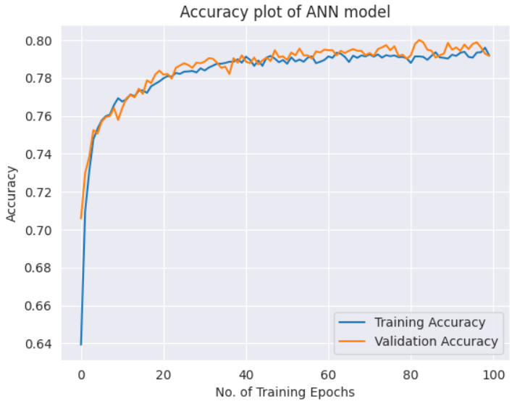
Result
This image consists of the accuracy plot the ANN model.
The accuracy plot visualizes how the model's performance improves and stabilizes over time.
The accuracy increases on both the training and validation datasets as training progresses, with convergence indicating that the model has reached an optimal state.
Monitoring both lines helps assess the model's learning progress, detect overfitting, and ensure that the model generalizes well to new data.

Slide 18
Conclusion
In conclusion, by leveraging ANN models, we have successfully identified key factors contributing to customer churn and developed predictive models capable of accurately forecasting churn probabilities. Through comprehensive data analysis, model training, and evaluation, we have gained valuable insights into customer retention strategies and highlighted the importance of proactive measures in reducing churn rates. Ultimately, the integration of ANN-based churn prediction systems offers significant potential for financial institutions to enhance customer satisfaction, optimize resource allocation, and sustain long-term profitability in an increasingly competitive market landscape.

Slide 19
THANK YOU

