Slide 1

EMG Controlled Bionic Robotic Arm using Artiﬁcial Intelligence and Machine Learning
Farhan Fuad Rupom
Shafaitul Jannat
Farjana Ferdousi Tamanna
Gazi Musa Al Johan
Dr. Md. Motaharul Islam

Slide 2
OUTLINE
Introduction
Motivation and Objectives
System Architecture
System Methodology
System Implementation
Result and Analysis
Conclusion
References

Slide 3
Introduction
Electromyography Approach
Hybrid Algorithm (SVM & KNN) Classiﬁcation
Signal Filtration along with Signal Processing and Various Feature Extractions.
Detection of Four Gestures.
Improved Outcome than Other Conventional Systems.

Slide 4

Motivation and Objectives
Motivation:
Huge Number of Amputees Causes by Road Accidents
Labor Suffering Amputees due to Construction Failure
Or Industrial Machine Accidents
Dependency on Imported Costly Prosthesis
Objectives:
Developing a Prosthetic System along with Minimum
Production Cost and Precise Data Classiﬁcation Using Unique Hybrid Algorithm Approach.

Slide 5
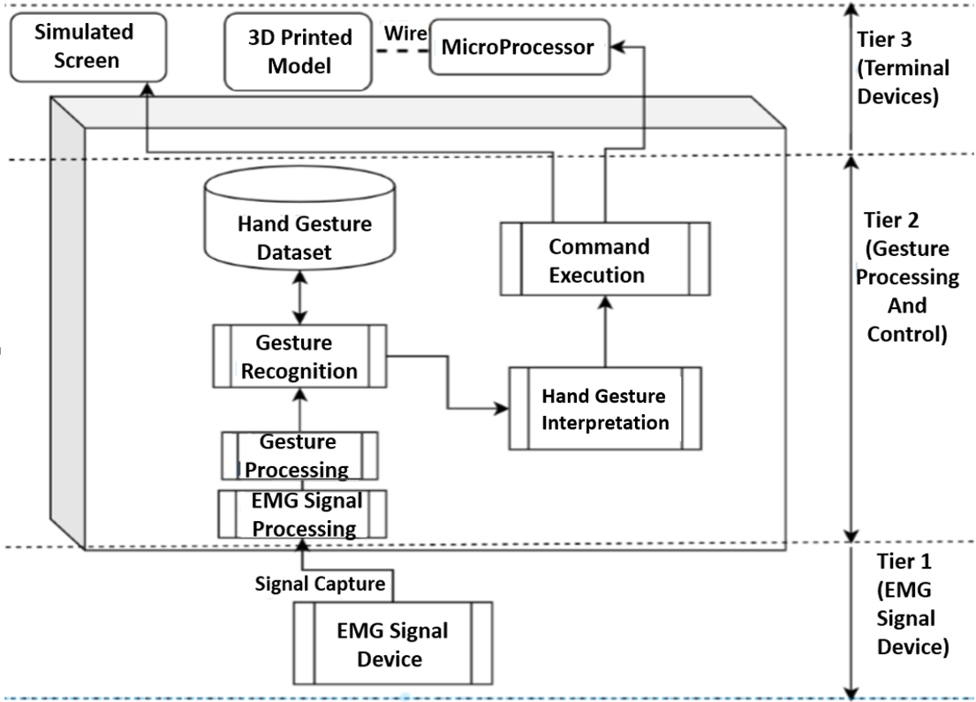
System Architecture
Three-Tiered Structure:
EMG Signal Device
Gesture Processing and Control
Terminal Devices

Slide 6
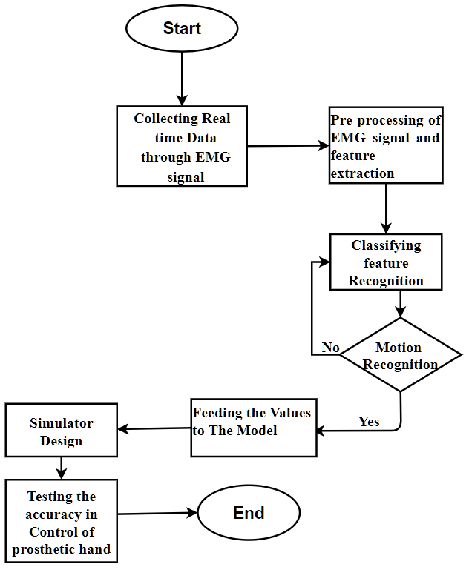
Methodologies
Workflow:
Collecting Data via EMG Signal
Pre-processing and Feature Extraction of EMG signal
Finding the Accurate Value by
Data Set Classification

Slide 7
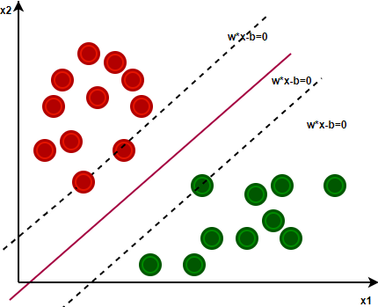
Methodologies
SVM (Binary Classifier Method):
The particular set of input vectors is called supporting vectors.
Hyper plane for distinct classification
Selects the hyper plane with maximized margin
Effective in high dimensional spaces
Non-linear data separation
Kernel trick for selecting additional feature
Works well with clear margin separation
SVM Hyper plane(Linear)

Slide 8
Methodologies
KNN (Pattern Recognition Method):
Performs Statistical Analysis
Calculates Euclidean Distance between two information
Steps of KNN:
Initialization
Calculation
Sorting the Distance and Finding out the Nearest Neighbors
Returning predicted class

Slide 9
Methodologies
Feature Extraction Methods :
Variance
Waveform Length
Integral of EMG
Zero Crossings
Slope Sign Changes

Slide 10
System Implementation
Data Acquisition:
Individual Response in Each Sensor
Response of Different Gestures Divided in 4 Classes(0-3)
Data Recording Intervals
Four Individual Movements
.csv File Buildup

Slide 11
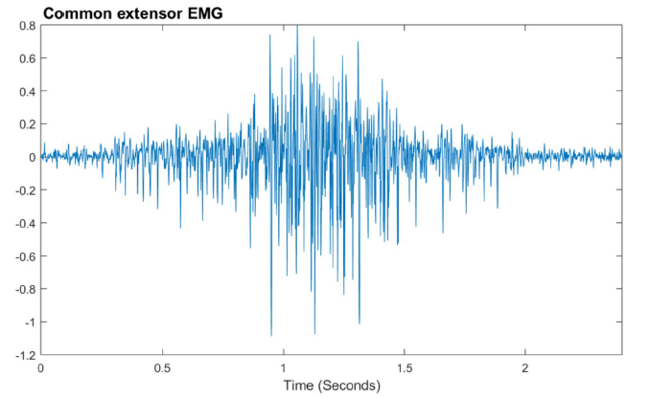

System Implementation
sEMG Signal Detection:
Observed Frequency Range of sEMG.
External Noise and Removable Signal Deduction
Signal Processing Steps:
1) Noise Refining
2) Rectification
3) Normalization

Slide 12
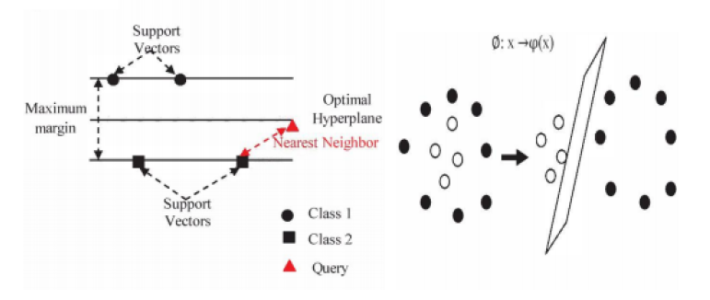

System Implementation
SVM-KNN Hybrid Approach
Many Representative Data Points
Reduces difficulty in Function Parameter Selection
Measuring margin in algorithm determination.
Better Accuracy Level than Single Algorithm.
Consists of Two Stages:
Reduced SV using SVM
Classifying Testing Sample using KNN

Slide 13
Result and Analysis
Accuracy of KNN and SVM:
Predicted Using Single Algorithms
Live Data Acquisition
Pre-processing and Feature Extraction
Pre-trained Classified Dataset
Live Data Implementation
Accuracy Result
Comparison and Acknowledgement of Implemented Algorithms

Slide 14
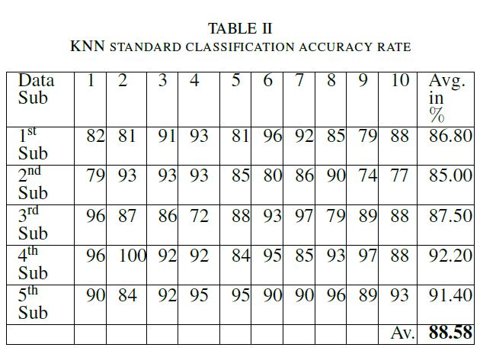
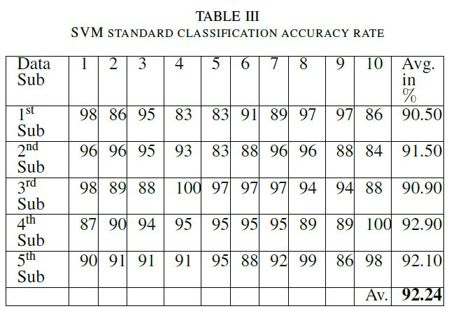
Result and Analysis
Accuracy Table of SVM and KNN:

Slide 15
Result and Analysis
Accuracy Rate of SVM-KNN hybrid:
Predicted using Hybrid Algorithm Approach
Same User Data is Applied
Live Data Implementation
Accuracy Result is 95.389%
Bar Columns Shows the Classification Rate and Average Classification Rate

Slide 16
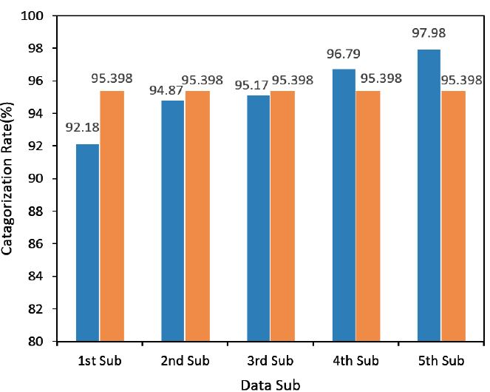
Result and Analysis
Average Categorization Rate Graph of SVM-KNN: 95.398%

Slide 17
Conclusion
Unique EMG Approach
Hybrid Algorithm
Accuracy of 95.398%
Comparative Better Outcome
Future Plan for 3D Printed Prosthetic Hand

Slide 18
THANK YOU

