Slide 1

Cryptography Projec
RC4, TEA, and RSA

Slide 2
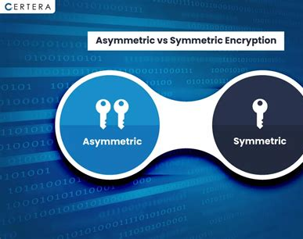
Project Overview
This project demonstrates the implementation of three encryption algorithms:
RC4 – a stream cipher
TEA – a lightweight block cipher
RSA – a public-key asymmetric cipher
All algorithms were implemented from scratch in C, without using external cryptographic libraries.
The tool supports encryption/decryption via command-line interface (CLI).

Slide 3
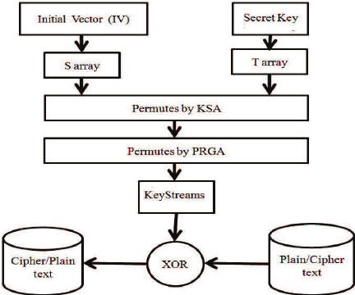
RC4 Overview
RC4 is a stream cipher designed by Ron Rivest.
It uses a key-scheduling algorithm (KSA) to initialize a permutation of all 256 bytes.
The pseudo-random generation algorithm (PRGA) creates a keystream used for XOR with the plaintext.
Symmetric: the same key is used for encryption and decryption.

Slide 4
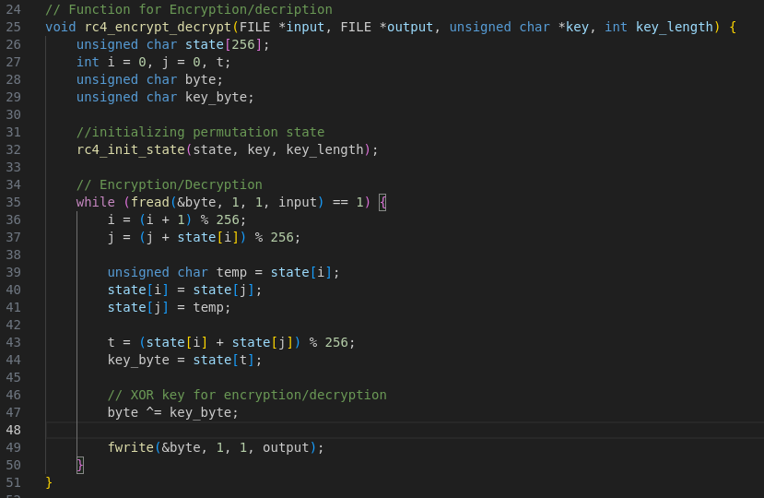
RC4 – Code Highlights
rc4_init_state() initializes the S-array with key-dependent permutations.
rc4_encrypt_decrypt():
Generates a pseudo-random byte from S.
XORs it with the plaintext byte.
Works for both encryption and decryption.
Code uses byte-wise operations and loops over the input length.

Slide 5
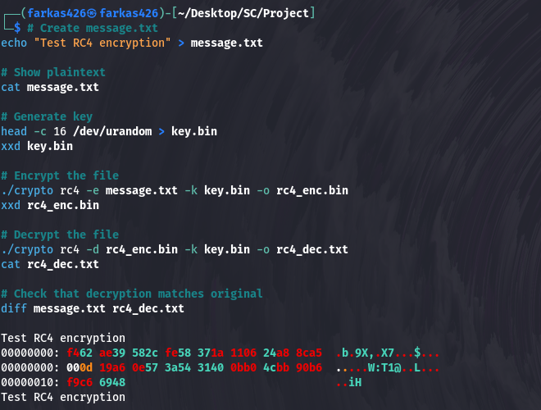
RC4 – CLI Usage Example
1. Creates a plaintext message file (`message.txt`) with the text: "Test RC4 encryption"
2. Generates a 128-bit random encryption key (`key.bin`)
3. Encrypts the plaintext using RC4 with the given key
4. Decrypts the encrypted binary using the same key
5. Confirms that the decrypted output matches the original using `diff`
The encrypted file appears unreadable (`xxd`), while the decrypted file fully restores the original message.

Slide 6
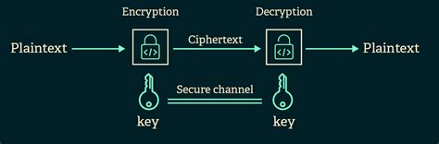
TEA – Algorithm Introduction
TEA (Tiny Encryption Algorithm) is a symmetric block cipher.
Uses a 128-bit key and 64-bit block size.
Each block is split into two 32-bit halves.
Performs 32 rounds of Feistel-based mixing using XOR, shifts, and addition.
Lightweight and fast, suitable for embedded devices.

Slide 7
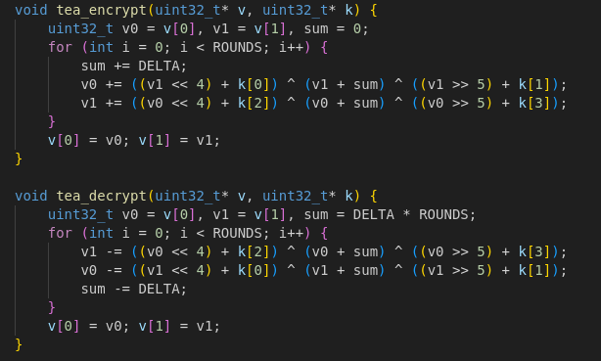
TEA – Code Highlights
tea_encrypt() and tea_decrypt() implement 32 rounds of mixing.
tea_process() reads data in 8-byte blocks:
Encrypts or decrypts each block separately.
Uses padding if necessary.
Bitwise operations ensure performance and security.

Slide 8
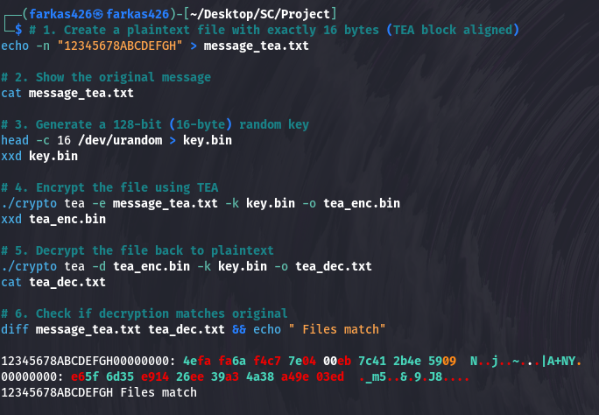
TEA – CLI Usage Example
1. Writes exactly 16 characters to a file (`message_tea.txt`) to match TEA's block size
2. Displays the original plaintext content
3. Generates a 128-bit key (`key.bin`) from random bytes
4. Encrypts the plaintext using TEA (Tiny Encryption Algorithm)
5. Decrypts the output using the same key
6. Uses `diff` to verify the decrypted file matches the original
TEA operates on 64-bit blocks and requires input sizes to be a multiple of 8 bytes.

Slide 9
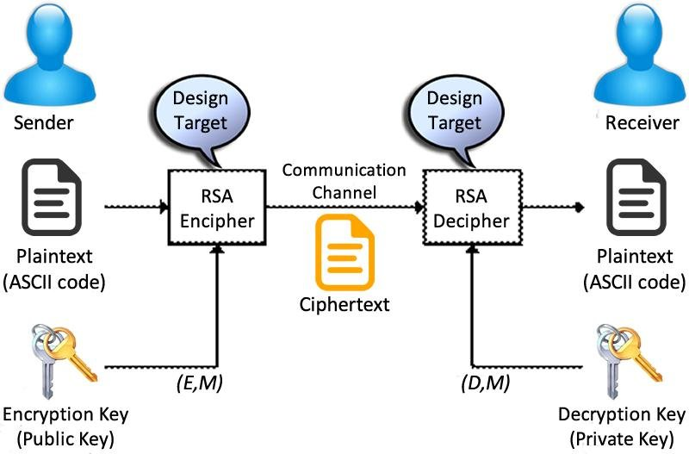
RSA – Algorithm Introduction
RSA is a public-key asymmetric encryption algorithm.
Uses two keys: public key (e, n) for encryption, private key (d, n) for decryption.
Based on difficulty of factoring large prime numbers.
Encrypts small blocks of data using modular exponentiation.

Slide 10
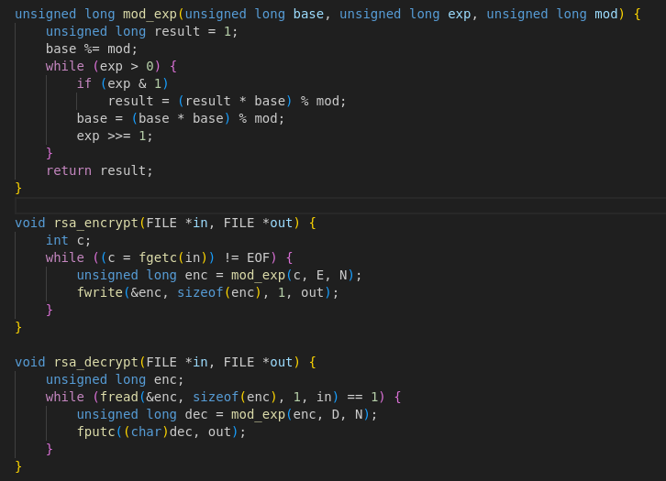
RSA – Code Highlights
mod_exp() implements modular exponentiation.
rsa_encrypt() and rsa_decrypt():
Treat each byte as an integer and apply pow(msg, e) % n.
Limited to small data (demonstration purposes).
rsa_process() wraps encryption/decryption loop.

Slide 11
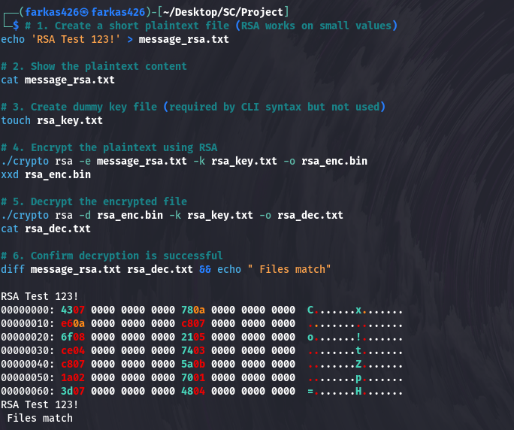
RSA – CLI Usage Example
1. Creates a simple plaintext message (`message_rsa.txt`) to encrypt
2. Displays the plaintext
3. Creates a dummy key file (not used but required syntactically)
4. Encrypts the message using RSA with a hardcoded public key (e, n)
5. Decrypts the result using the hardcoded private key (d, n)
6. Confirms the decrypted file matches the original using `diff`
This simplified RSA example encrypts and decrypts small files character-by-character.

Slide 12
Summary & Algorithm Comparison
Algorithm | Type | Key Size | Block/Stream | Use Case
RC4 | Symmetric | Any | Stream | Fast, legacy
TEA | Symmetric | 128-bit | 64-bit Block | Lightweight apps
RSA | Asymmetric | 1024+ | Integer-based | Secure key exchange

Slide 13

Thank You

