Slide 1
Establishing a Robotic Environment for Reinforcement Learning Study
Bálint Farkas, Károly Széll, Péter Galambos

Slide 2
Introduction
Reinforcement Learning in Robotics
Plug & Play robots
Research Environment needed
Flexible Hardware + Software environment
+ Hello World! Project in Embodied AI

Slide 3
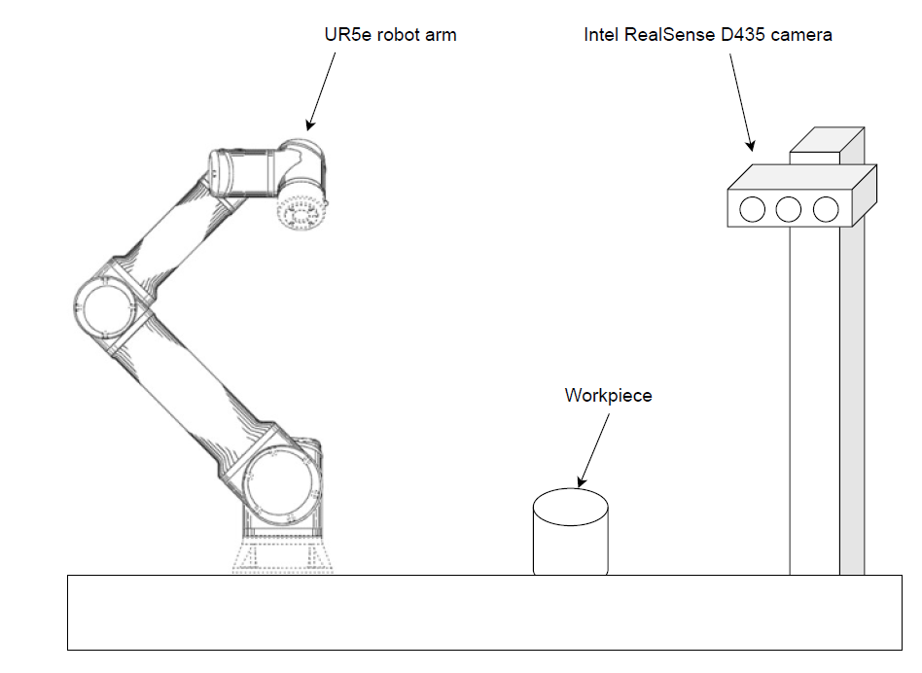
Key hardware components
UR5e
Robotiq gripper
Intel RealSense D435 camera
PC with NVIDIA GPU

Slide 4
Software Environment
Windows 11
Robotic arm
WSL2
Docker image
Camera
CUDA

Slide 5
Software Environment
Software components:
ROS2: Open-source framework
RealSense ROS2 Driver: Interface for RealSense camera
UR5e ROS2 Driver with MoveIt: Motion control for UR5e robotic arm
Isaac Manipulator: AI-driven platform for motion planning and perception
cuMotion: GPU-accelerated motion planner
FoundationPose: 6D pose estimation for object manipulation

Slide 6
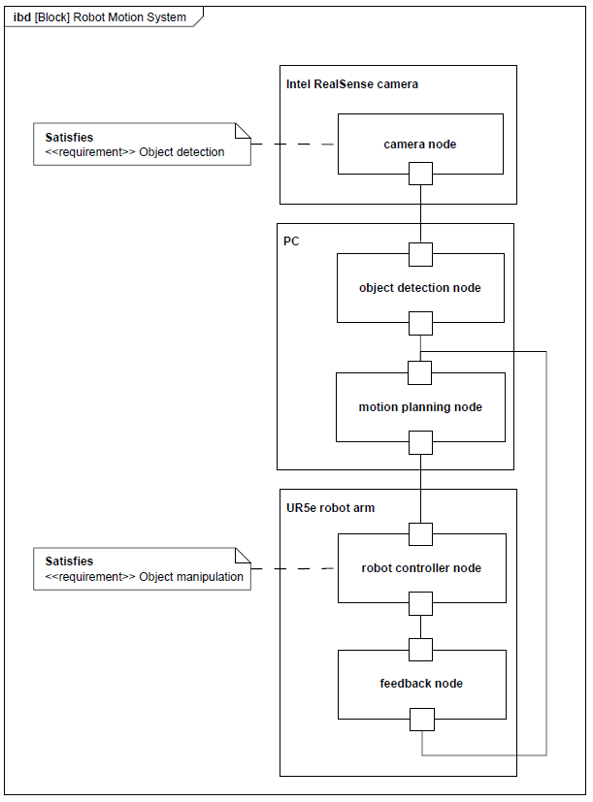
Key Software Features

Slide 7
Software Implementation Steps
Install ROS2, NVIDIA drivers, CUDA, docker, isaac tools, build image
Using the camera
Connecting the robot

Slide 8
Future Work and Research Opportunities
Reinforcement Learning – Algorithmic Improvements
Sim-to-Real Transfer – Isaac Sim
Advanced Perception and Object Recognition
Collaborative and Multi-Robot Systems
Real-Time Adaptation and Fault Tolerance

Slide 9
Conclusion
Working Hardware and Software Environment
Easier to Start Research in the University

