Slide 1
Advances in Autonomous Robotic Grasping: An Overview of Reinforcement Learning Approaches
Bálint Farkas, Károly Széll, Péter Galambos

Slide 2
Agenda
Introduction
Reinforcement Learning (RL) Overview
Key Algorithms in Robotic Grasping
Core Components of Robotic Grasping
Challenges in RL-based Grasping
Innovations and Future Directions
Conclusion

Slide 3
Introduction
Why Reinforcement Learning in Robotics?
Learning
Adaptability
Autonomous decision making
Plug and Play robots

Slide 4
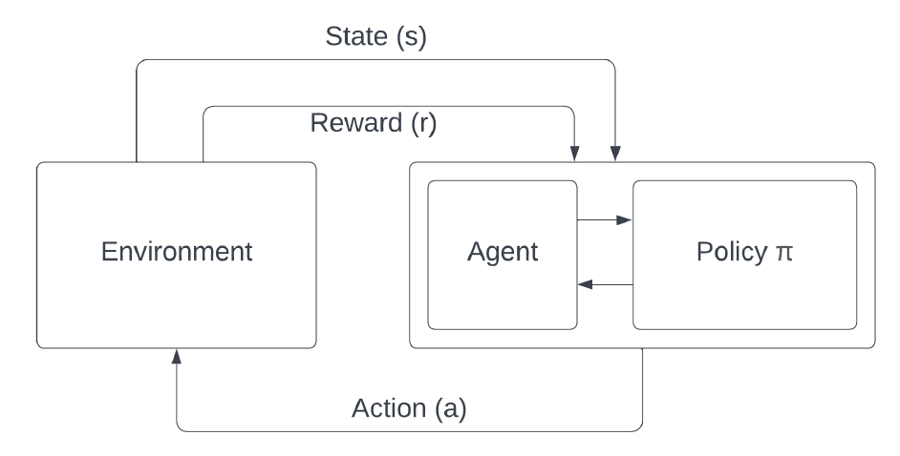
What is Reinforcement Learning? (RL)
Learning from feedback
Trial and error
exploitation
In robotics: Continous action spaces
exploration
Notes:
Exploration – trying out new actions
Exploitation – Choose best known action

Slide 5
Key Algorithms for Robotic Grasping
Q-Learning, Deep Q-Learning (DQN)
Deep Deterministic Policy Gradient (DDPG)
Soft Actor-Critic (SAC)
Advantage Actor-Critic (A2C)
Asynchronous Advantage Actor-Critic (A3C)
Proximal Policy Optimization (PPO)
Imitation Learning

Slide 6
Core Components of Robotic Grasping
Define Task
Perception
Grasp Planning
Execution

Slide 7
Decision-making/Task Defining
Large Language Models (LLM)
Searching the box
Detecting position
Moving to the box
Gripping box
Lifting box
Pick up the box from the table.
Input
Output: How to do the task

Slide 8

Perception
Visual Language Models (VLM)
Scene Description
Visual Question Answering
Object detection
Image

Slide 9
Execution
Path planning
Grasp pose estimation
Detected Object
Input
Best Grasping Strategy

Slide 10
Challenges in RL-based Grasping
Sim-to-Real transfer
Computational demands
Data requirements
Dynamic environments + object instabilities

Slide 11
Simulation vs Real World
Teaching Agent
Simulation
Deploying Agent
Real World
!
Research Directions:
Domain Randomizaton
Fine-Tuning with Real Data
Sim-to-Real Transfer Learning

Slide 12
Computational Demands
Complex Tasks
More Computational demand
Research Directions:
Faster Computational Hardwares (GPUs)
Algorithmic Improvements

Slide 13
Data Requirements
Effective Policies
Large Dataset Needed
Research Directions:
More sophisticated exploration strategies
Experience replay methods (HiER)
Synthetic data generation techniques

Slide 14
Dynamic Environment
Dynamic Environment
Real Time Adaptability
Research Directions:
Using Tactile Feedback
Real Time Hand-Eye coordination

Slide 15
Multi Agent Cooperation
More Complex Tasks
More Agent (robot) Needed
Research Directions:
Multi Agent Cooperation
Swarm Cooperation

Slide 16
Human-Robot Collaboration
Humans in Environment
Human-Robot Collaboration
Research Directions:
Learning from Human Demonstration
Safety Alongside Humans
Recognizing and Responding to non-verbal cues

Slide 17
Conclusion
RL advanced autonomous robotic systems in grasping and manipulation
RL enables robots to adapt and learn
Challenges remain: sim-to-real transfer, computational demands, dynamic environments…
Future directions include: More efficient algorithms, improving data collection, human-robot collaboration
RL holds great potential in robotics

