Slide 1

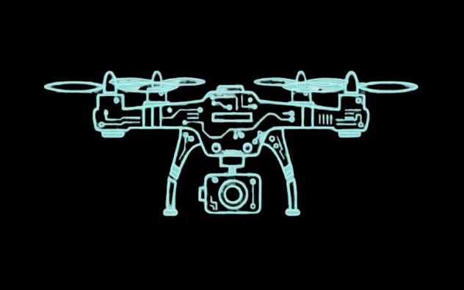
SAFEeAI
Keeping Cities Safe

Slide 2

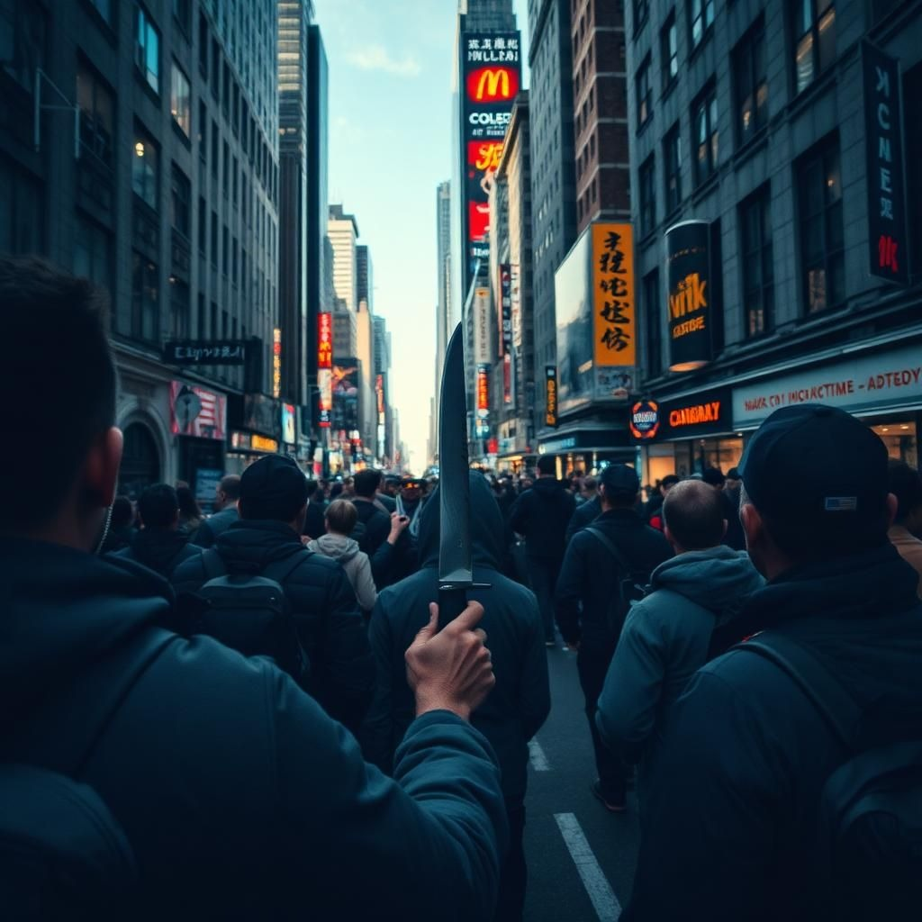
PROBLEM
25% of population reported acts of violence in urban areas

Slide 3
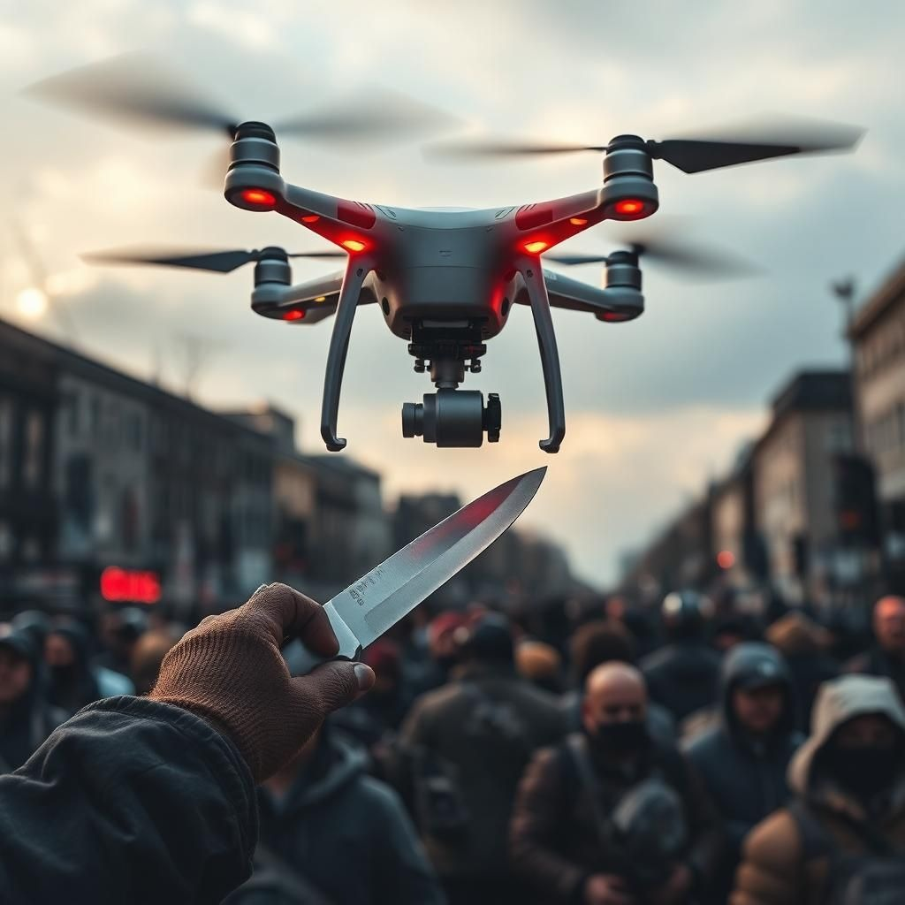
SOLUTION
Surveillance drones
Autonomous
AI integrated

Slide 4
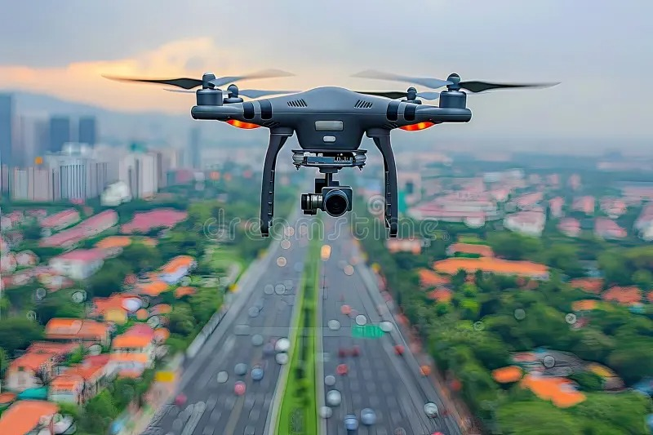
PRODUCT
Max 120 m. alt.
~ 1h. autonomy

Slide 5
PRICE BREAKDOWN
PRODUCTION | SOFTWARE | TESTING AND APPROVALS
Components Casing Manufacturing | R&D for AI Firmware Cloud | Testing CE SORA AACR ISO Cyber research audit
~€500 | ~€700 | ~€800

Slide 6
BUSINESS
01
02
03
04
MANUFACTURING
NEGOTIATIONS
Go-To
Market
SEAP
Registration
~ €2000
Government
MAI
Final Price
~ €4000
Auctions

Slide 7
GLOBAL ANALYSIS
3000+
Cities
35%
40%
20%
Chula Vista ,
California
Ahmedabad ,
India
Ensenada, Mexico
Cities with police drones

Slide 8
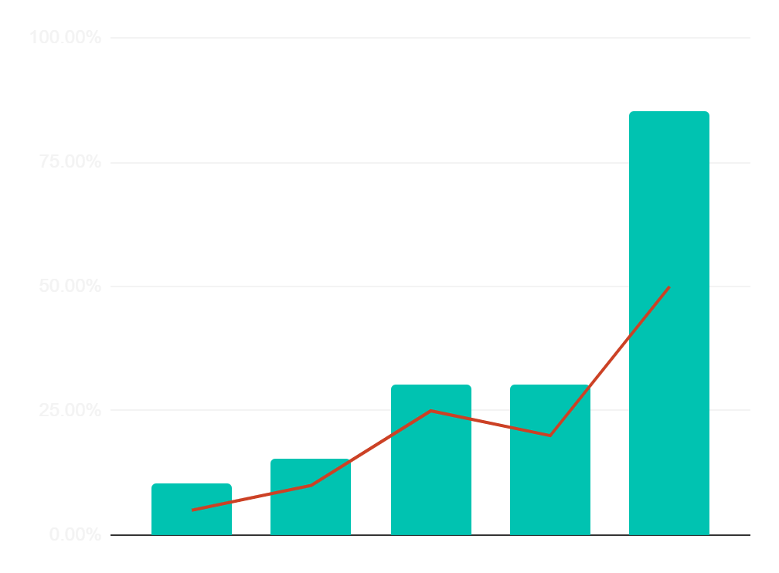
INTEREST
$2,000,000.00+
Investments in R&D
2025-2030
We aim:
EU research and innovation grants
EIC Accelerator
National grants
Smart City and Urban Security grants
2010
2015
2020
2025
2030

Slide 9
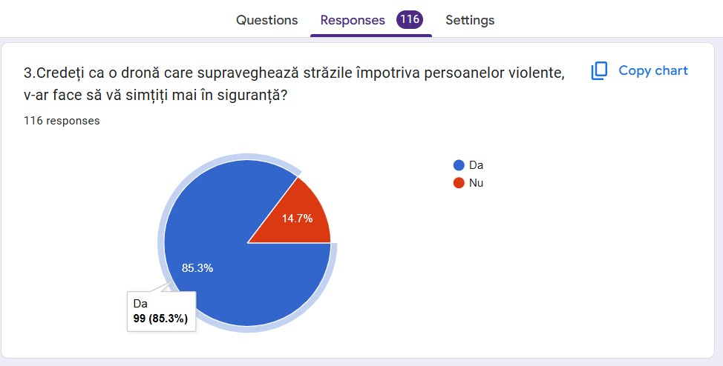
VALIDATION

Slide 10
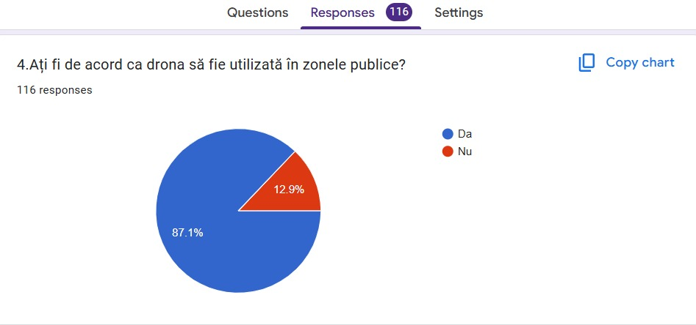
VALIDATION

Slide 11
SEGMETING THE MARKET
€2,000,000+
€30,000+
€7 mil.+
€350k+
TAM
SAM
SOM
EVG
Total global budget potential
Budget for European cities
Romanian reachable
budget segment
Realistic market
5% of the total

Slide 12
LEGAL
EU 2019/947
Art. 12-15
Art. 2(1)d)
Permits UAS operations for law enforcement purposes
surveillance without standard EASA permits but requiring national approvals.
LAWS
Art. 14(2)b)
GDPR Art. 10
UAS Registration mandatory for operators of drones posing privacy risks
Police data processing (e.g. drone footage) are lawful for crime prevention

Slide 13
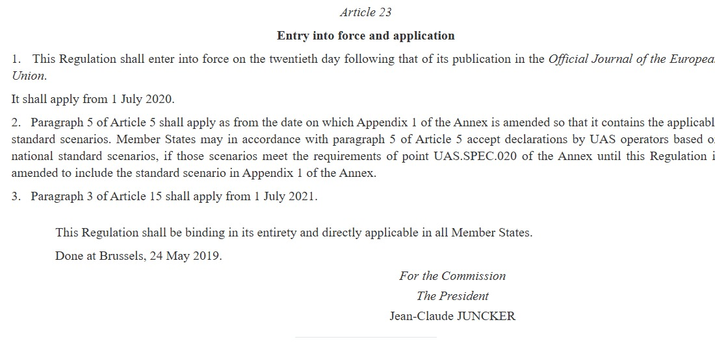
LEGAL

Slide 14
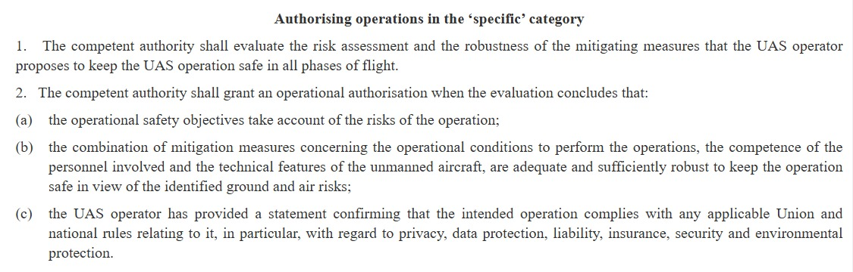
LEGAL

Slide 15
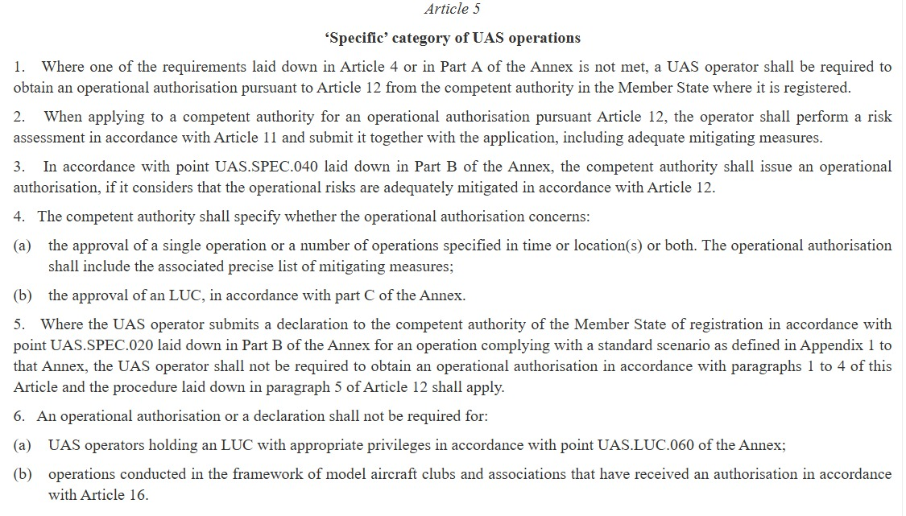
LEGAL

Slide 16
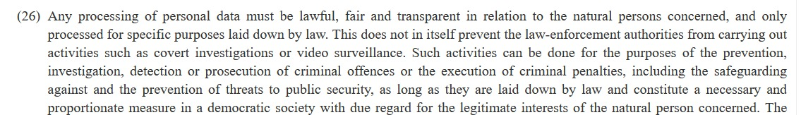
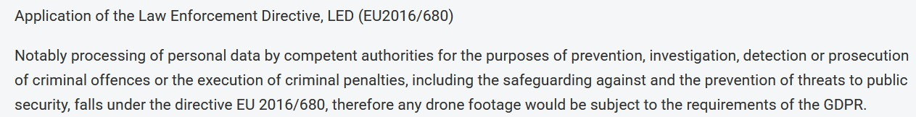
LEGAL

Slide 17
COMPETITION
DZ4H Orion
1
Topography
Atelieru de drone
2
Agriculture
BlueSpace Technology
3
Military
UAV Systems Ro
4
Partially Autonomous

Slide 18
ROADMAP
Final
Prototype
Government auction wins
Testing
and
Approval
B2G
Marketing
Strategies

Slide 19
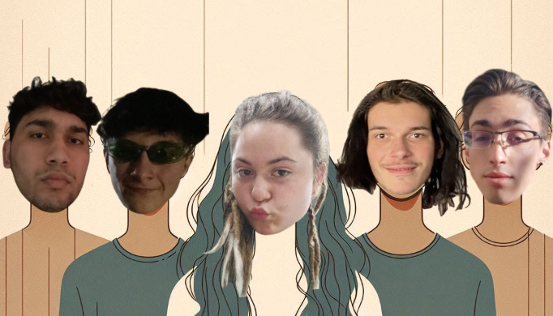
TEAM

Slide 20
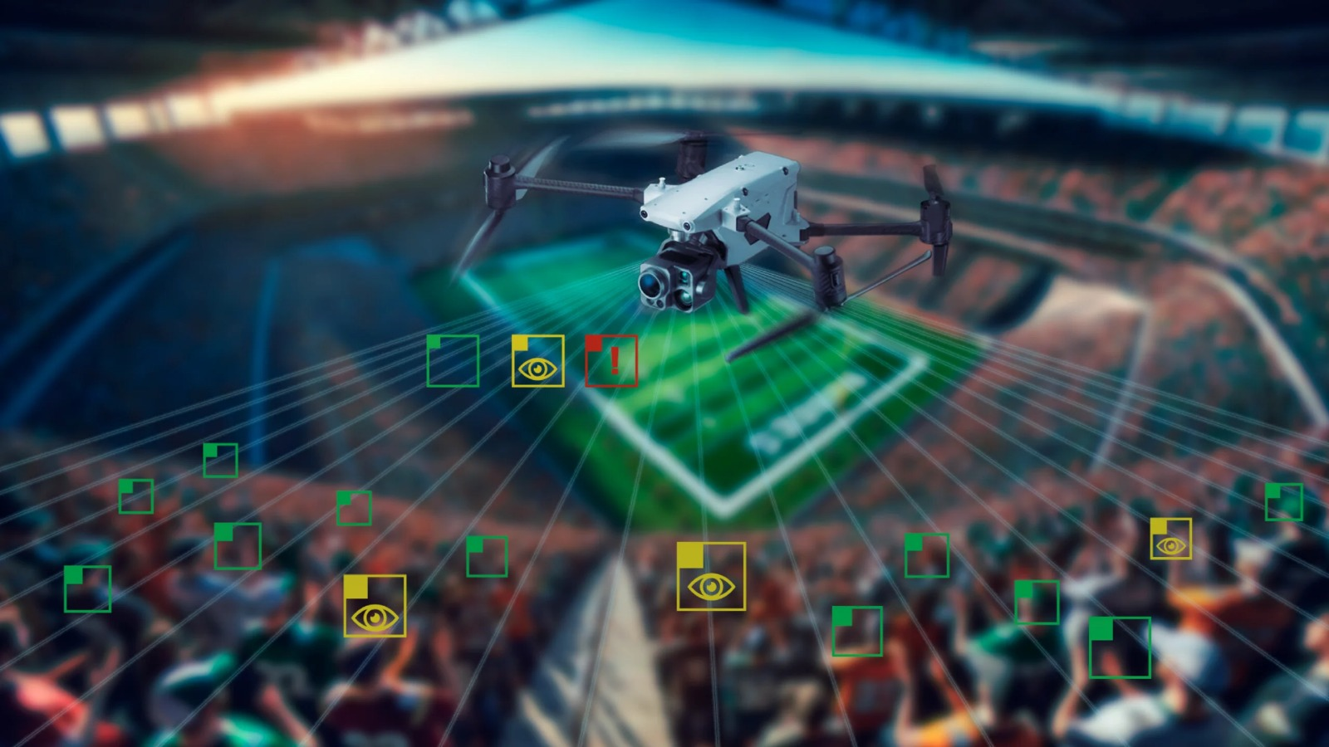
THANK YOU
SAFEeAI

