Slide 1

IS-4-23
CMD &
PYTHON
PRESENTATION
Student of Apec Higher College
ALMABEKOV FARKHAD

Slide 2
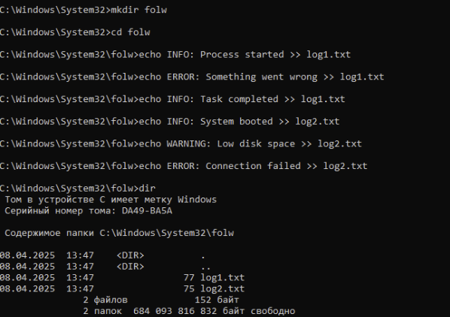
TASK 1
CREATING FOLDERS AND FILE
here is simple option to create folder and adding files there
by using cmd command
CMD

Slide 3
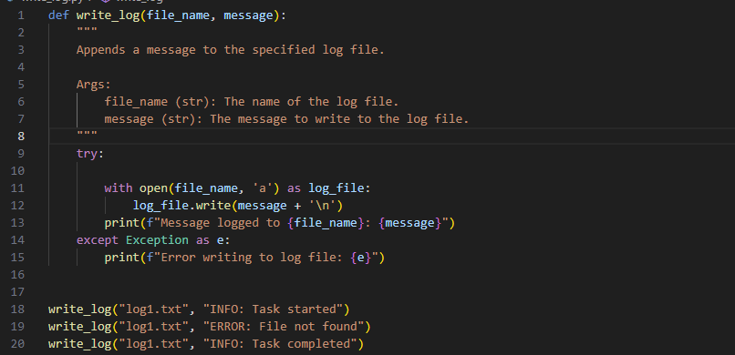
LOG MESSAGES
TASK 2
There you can show some simple function for creating message by using python
PYTHON

Slide 4
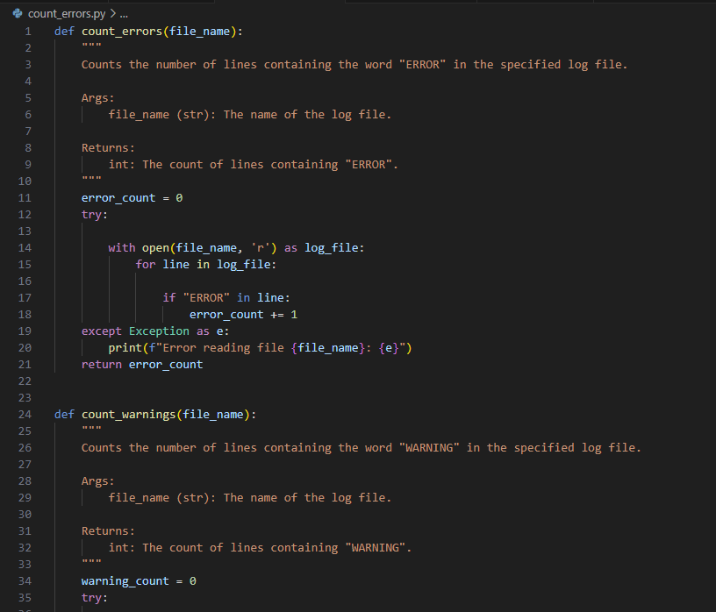
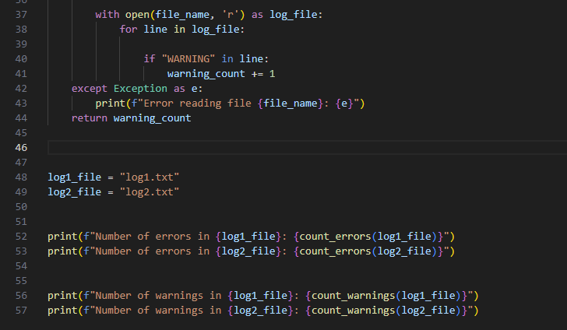
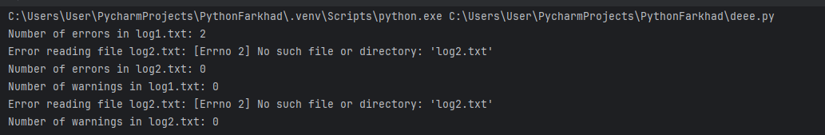
COUNT OF ERRORS
TASK 3
PYTHON

Slide 5
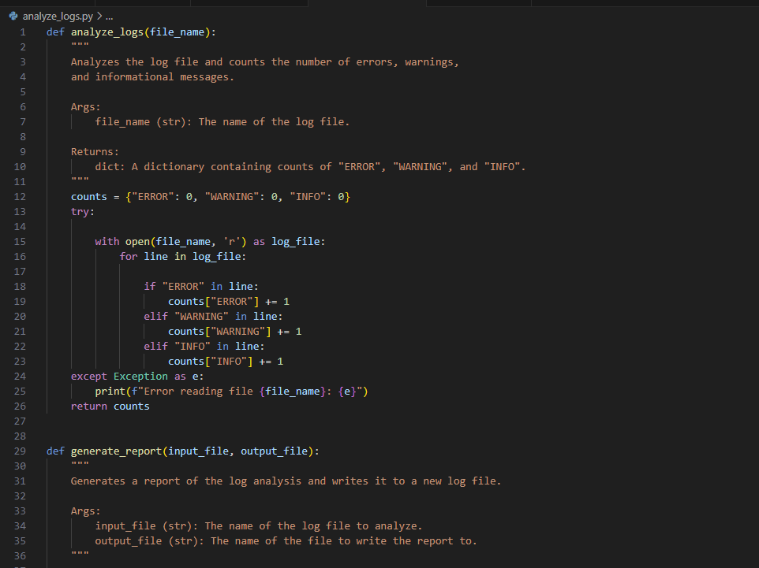
ANALYZE LOGS
TASK 4
PYTHON

Slide 6
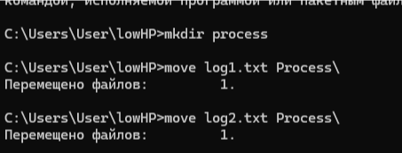
TASK 5
MOVING FILES CMD VERSION
CMD

Slide 7
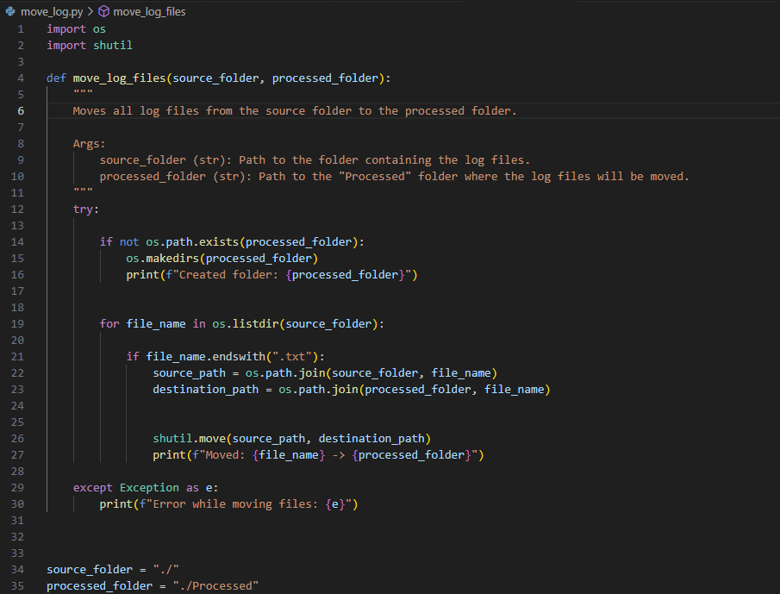

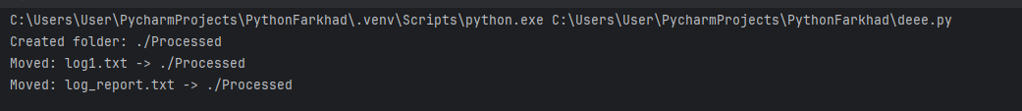
TASK 5
PYTHON
MOVING FILES PYTHON VERSION

Slide 8
FINISH
BYE
THANKS FOR ATTENTION
made by Almabekov Farkhad IS-4-23

