Slide 1

Employee Management System
A Web-Based Solution for Employee Records, Attendance, Leave, Payroll & Reporting
Presented by: Farkhunda Memon
Notes:
Welcome the audience. Introduce yourself and your roll number, and name your university. State the project title clearly: 'Employee Management System' — a web-based application built to help organizations manage their workforce data efficiently. Mention this presentation covers the problem, design, technology stack, modules, and a live/demo walkthrough, followed by Q&A.

Slide 2


GETTING STARTED
Introduction & Project Overview
What is the System?
A web-based platform that centralizes employee records, attendance, leave, departments, and payroll into one secure system — replacing scattered spreadsheets and paperwork.
Purpose of the System
One Platform,
Every HR Process
Automate day-to-day HR operations
Provide a single source of truth for employee data
Enable fast, accurate reporting for decision-making
Employees
Departments
Attendance
Leave
Why This Project?
Manual HR processes are slow and error-prone. This project was developed to demonstrate a practical, scalable ASP.NET Core solution to that real-world problem.
Payroll
Reports
Employee Management System
02
Notes:
Explain that the Employee Management System is a centralized, web-based platform. Emphasize the purpose: replacing manual/paper-based HR processes with an automated, reliable system. Briefly mention the six core areas it covers — employees, departments, attendance, leave, payroll, and reports — which will each be detailed in later slides. Close by explaining the motivation: solving a real, common organizational problem using modern web technology.

Slide 3


WHY IT MATTERS
Problem Statement & Objectives
The Problem
Project Objectives
Manual, paper-based employee records are slow to update and easy to lose
Attendance & leave tracked in disconnected spreadsheets
Payroll calculations done manually — prone to errors
No centralized reporting for management decisions
Difficult to scale as the organization grows
Build a secure, role-based web application for HR management
Digitize employee, department & attendance records
Automate leave approval workflows
Streamline payroll processing and reduce errors
Generate real-time, accurate reports for management
Employee Management System
03
Notes:
Walk through the pain points of manual HR management first — lost records, spreadsheet chaos, manual payroll errors, and lack of reporting. Then pivot to objectives: this project directly addresses each pain point with a secure, centralized, automated system. Tie each objective back to a problem to show clear cause-and-effect reasoning to examiners.

Slide 4






TECH STACK
Technologies Used
ASP.NET Core MVC
C#
MySQL (phpMyAdmin)
Backend framework & MVC architecture
Core application logic
Relational database management
Razor Views
Visual Studio
HTML/CSS with embedded C#
Integrated development environment
Employee Management System
04
Notes:
Introduce the technology stack. ASP.NET Core MVC provides the backend and application architecture, written in C#. Razor Views combine HTML/CSS with embedded C# to render dynamic pages, enhanced with JavaScript for interactivity. MySQL, managed via phpMyAdmin, stores all persistent data. Visual Studio was used as the IDE throughout development. If asked in viva, be ready to explain why MVC was chosen (separation of concerns, maintainability, testability).

Slide 5








HOW IT WORKS
System Architecture & Workflow
Login
Dashboard
Employee
Management
Attendance
Leave
Payroll
Reports
The user authenticates through a secure login, lands on a role-based dashboard, then navigates through Employee, Attendance, Leave and Payroll modules — all summarized in the Reports module for management insight.
Employee Management System
05
Notes:
Describe the end-to-end workflow: the user starts at the Login screen, is authenticated and redirected to the Dashboard, then can move into Employee Management, Attendance, Leave, and Payroll modules. All data generated across these modules feeds into the Reports section for analytics. Mention this reflects the MVC request flow: Controller receives the request, interacts with the Model/database, and renders the appropriate Razor View.

Slide 6
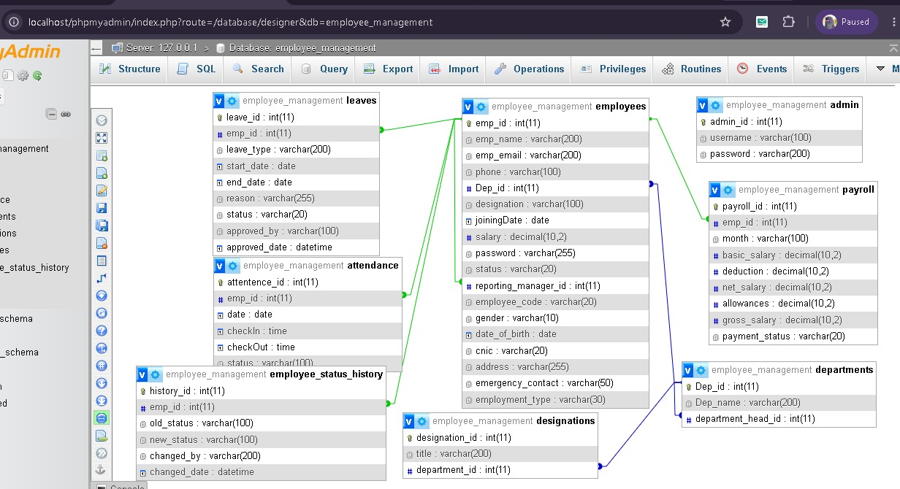
DATA LAYER
Database Design
Core Entities (ERD Overview)
Employee Management System
06
Notes:
Explain the relational database structure: the Employees table is central, linked via foreign keys to Departments, Attendance, LeaveRequests, and Payroll. Each Employee belongs to one Department, and has many Attendance records, Leave requests, and Payroll entries — a one-to-many relationship pattern. Mention MySQL was used with phpMyAdmin for schema design and management, and that primary/foreign keys enforce data integrity across modules.

Slide 7

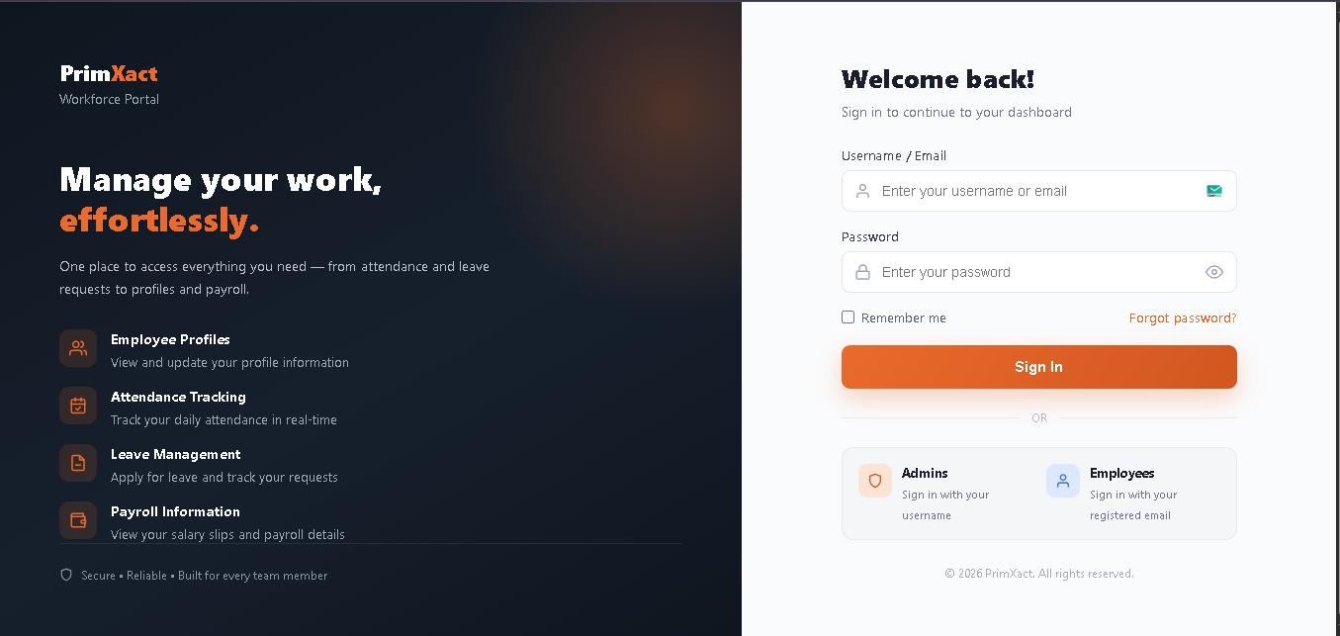
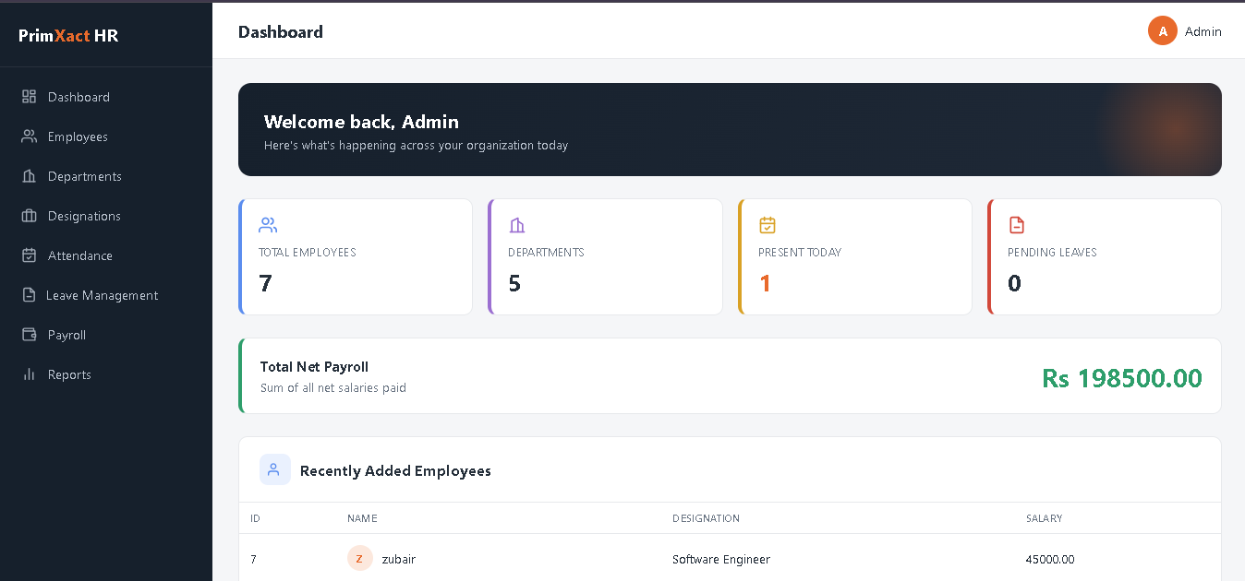
MODULE 01
Login & Dashboard Module
Features
Secure authentication with hashed credentials
Role-based access (Admin / HR / Employee)
At-a-glance summary widgets & quick stats
Quick navigation to all core modules
Benefits
Protects sensitive HR data from unauthorized access
Gives managers instant visibility into workforce status
Reduces time spent locating information
Employee Management System
07
Notes:
Demonstrate the Login page first — mention credentials are validated securely and passwords are stored hashed, not in plain text. Then move to the Dashboard, explaining the summary cards/widgets that give a quick overview (e.g., total employees, pending leave requests, department counts). If doing a live demo, log in here and show the real dashboard instead of the placeholder.

Slide 8




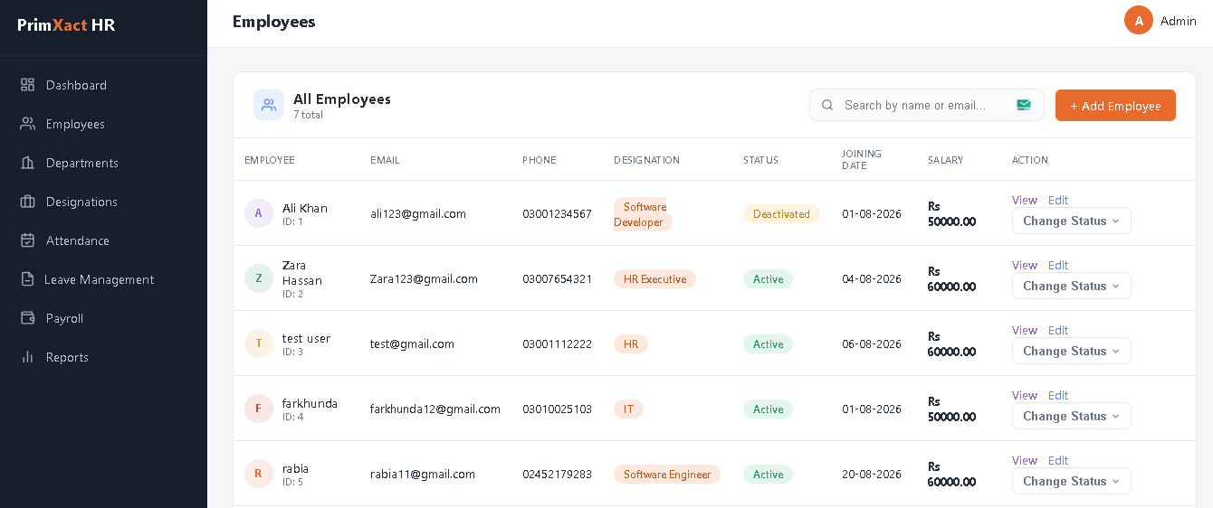
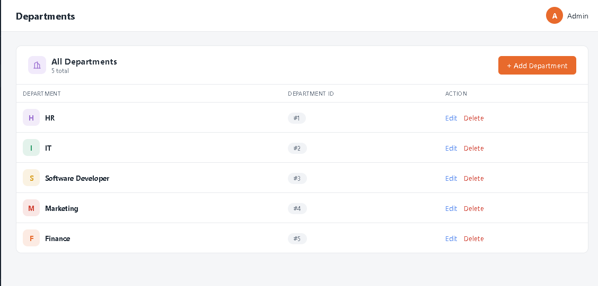
MODULE 02
Employee & Department Management
Add Employee
Edit Employee
View Employee
Terminate Employee
Manage Departments
Employee Management System
08
Notes:
Walk through the core CRUD operations for employees: Add, Edit, View, and Terminate. Emphasize validation on the Add/Edit forms (e.g., required fields, unique CNIC/email checks). Terminate is a soft action — it updates employee status rather than deleting the record, preserving historical data. Then cover Department Management: creating departments and assigning employees/managers to them. Show the corresponding screens if doing a live demo.

Slide 9
MODULE 03
Attendance, Leave & Payroll
Attendance Tracking
Leave Management
Payroll Processing
Daily check-in / check-out logging
Auto status: Present, Absent, Late
Employees submit leave requests
Admin approves / rejects with remarks
Auto salary calculation with deductions
Monthly payslip generation
Employee Management System
09
Notes:
Cover three tightly related modules. Attendance: employees are marked present/absent/late, forming the basis for payroll deductions. Leave: employees submit requests with type and dates; admins approve or reject, and approved leave automatically reflects in attendance records. Payroll: the system calculates net salary using basic pay, deductions (e.g., for absences), and generates a monthly payslip — reducing manual calculation errors.

Slide 10



MODULE 04
Reports & Analytics
Employees by Department
Attendance Summary
Leave Summary
Payroll Summary
Active Employees
Terminated Employees
Department Summary
Every report can be filtered by date range or department, giving managers instant, accurate insight without manual data compilation.
Employee Management System
10
Notes:
This module turns raw operational data into decision-ready insights. Walk through the seven report types quickly: departmental employee distribution, attendance and leave summaries, payroll totals, and active vs terminated employee counts. Mention reports can be filtered by date range or department, and are designed to be exportable for offline review by management.

Slide 11









LOOKING AHEAD
Challenges & Future Enhancements
Challenges Faced
Future Enhancements
Database Integration
Email Notifications
Mapping relational data cleanly with EF/MySQL
Form Validation
Mobile Application
Ensuring accurate, safe data entry client & server side
Biometric Attendance
Report Generation
Aggregating multi-table data into readable reports
Advanced Analytics
Employee Management System
11
Notes:
Be candid about challenges: integrating the relational database correctly (foreign keys, cascading updates), implementing robust form validation on both client and server, and aggregating data cleanly for the reports module. Then pivot positively to future scope: email notifications for leave approvals, a companion mobile app, biometric attendance hardware integration, and advanced analytics/dashboards using charts. This shows examiners you understand both the system's current limits and a realistic growth path.

Slide 12


WRAPPING UP
Conclusion
Key Achievements
Delivered a fully functional web-based HR management system
Implemented secure login and role-based access control
Automated attendance, leave, and payroll workflows
Centralized reporting for informed decision-making
Built on a scalable ASP.NET Core MVC architecture
A Practical, Scalable
HR Solution
This project demonstrates how modern web technologies can solve real organizational challenges — improving accuracy, saving time, and giving management clear visibility into their workforce.
Employee Management System
12
Notes:
Summarize the project: a complete, working Employee Management System covering the full HR lifecycle — from login to payroll to reporting. Reiterate the core benefits: reduced manual work, fewer errors, centralized data, and better decision support through reports. End with a confident statement that this project shows practical application of ASP.NET Core MVC and relational database design to a real-world business problem.

Slide 13

Thank You
Employee Management System | Farkhunda Memon
Notes:
Thank the audience and panel for their time. Invite questions. Be ready to discuss: why ASP.NET Core MVC was chosen, how data validation is enforced, how the database schema handles relationships, and any live demo requests. Keep answers concise and refer back to the relevant module slide if a deeper explanation is needed.

