Slide 1
Understanding the FarmBiddy System
A simple guide for people testing and improving Biddy

Slide 2
Why do three parts work together?
App Platform
The product people use. Accounts, data and the app.
Biddy / Agent
The brain and hands. Understands requests and uses capabilities.
Eval / Testing
Quality control. Checks that Biddy behaves as expected.

Slide 3
Why system context matters
Focus on
behaviour,
not code.
Your job is to recognise what “good” looks like.
01 MANY PATHS
Biddy receives requests in many different ways.
02 CONNECTED IMPACT
A fix in one scenario can affect another.
03 SAFE PROGRESS
Testing improves capability without breaking what works.

Slide 4
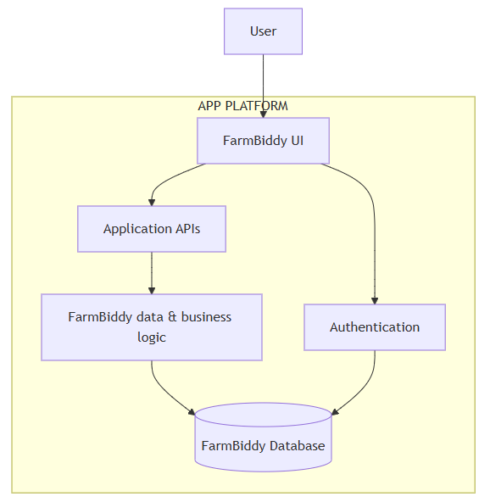

Slide 5
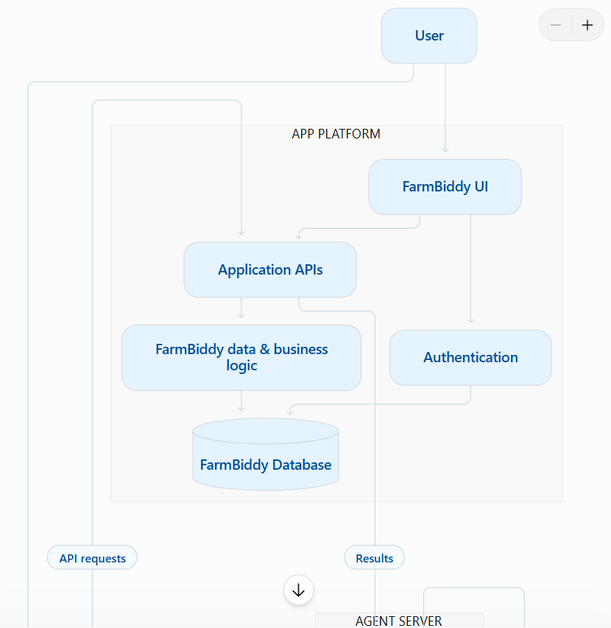

Slide 6
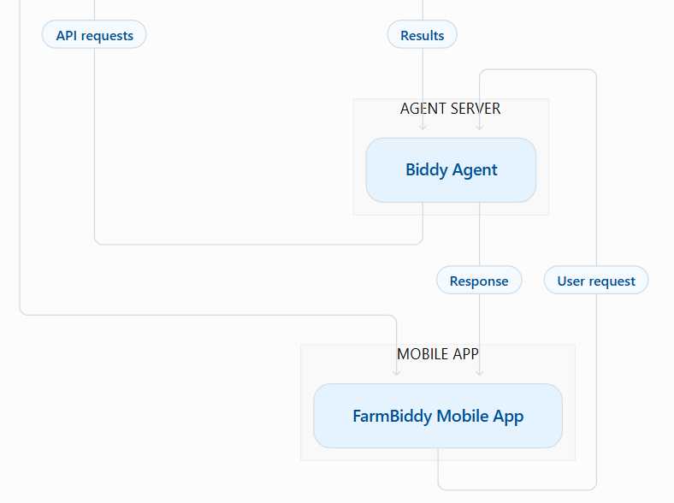

Slide 7
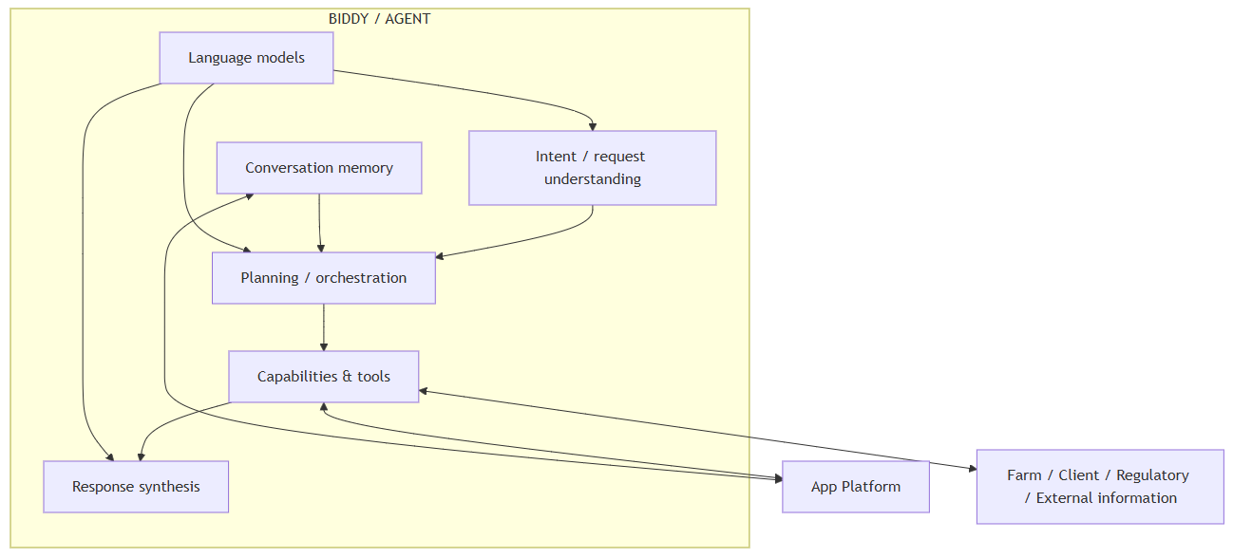

Slide 8
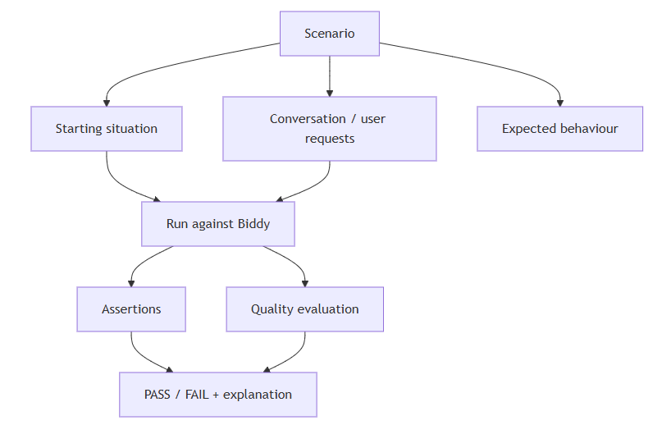

Slide 9
What happens when someone asks Biddy something?
User asks
Understand
Decide
Do the work
Answer

Slide 10
Understanding ≠ successful result
Understand
Did Biddy understand what the person meant?
Execute
Did it find the right information or perform the right action?
Answer
Was the response correct, useful and clear?

Slide 11
Conversation context matters
Earlier conversation
Remember context
Understand follow-up
Respond
Example: “Find John Murphy.” → “When was his last visit?”
Biddy needs to understand who “his” refers to.

Slide 12
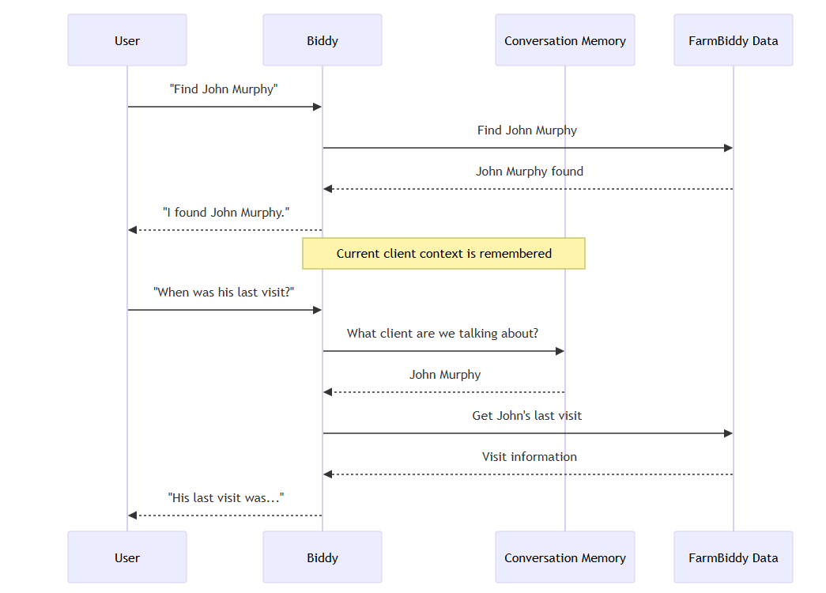

Slide 13
Why do we need an Eval system?
Build a
feedback
loop.
Automated tests, human insight and quality checks improve Biddy together.
01 AUTOMATED TESTS
Protect behaviour we already know about.
02 HUMAN TESTERS
Find what we did not think to test.
03 QUALITY CHECKS
Confirm the answer is useful — not just that the system ran.

Slide 14
Functional vs. Quality testing
Functional
“Did the system do the expected thing?” Example: Was the correct capability selected?
Quality
“Was the result actually correct and useful?” Example: Did Biddy find the right client and explain the answer properly?

Slide 15
Why human testers matter
Represent the
real
user.
Real people bring unpredictable language, shortcuts and context.
01 UNPREDICTABLE LANGUAGE
Real requests are rarely perfectly phrased.
02 NATURAL SHORTCUTS
Expect slang, incomplete requests and follow-ups.
03 CONTEXT MATTERS
The same words can mean different things.

Slide 16
Graph Execution: making Biddy more flexible
Request
Plan
Step 1
Step 2
Answer
An internal improvement to how Biddy decides what work is needed.
The plan can change depending on the request — it is not one fixed path.
For testers, the key question remains: does Biddy behave correctly?

Slide 17
More capabilities in the future
Financial modelling
Biddy gathers relevant information and uses a specialist capability to calculate or model an answer.
Agricultural data
Weather, markets, regulations and other specialist information can become capabilities.
External services
Other systems can be connected when they provide useful capabilities.
Biddy
Coordinates the work and explains the result.

Slide 18
A simple rule for the architecture
Biddy
Chooses capability
Specialist does work
Biddy explains
Biddy coordinates specialist capabilities rather than becoming a giant collection of bespoke logic.

Slide 19
What testers should focus on
Report
behaviour,
not code.
Describe what happened clearly. Diagnosis is not required.
01 SET THE BASELINE
What did you ask, and what did you expect?
02 OBSERVE THE RESULT
What did Biddy do — was it correct, complete and useful?
03 CHECK REGRESSIONS
Did anything that worked before stop working?

Slide 20
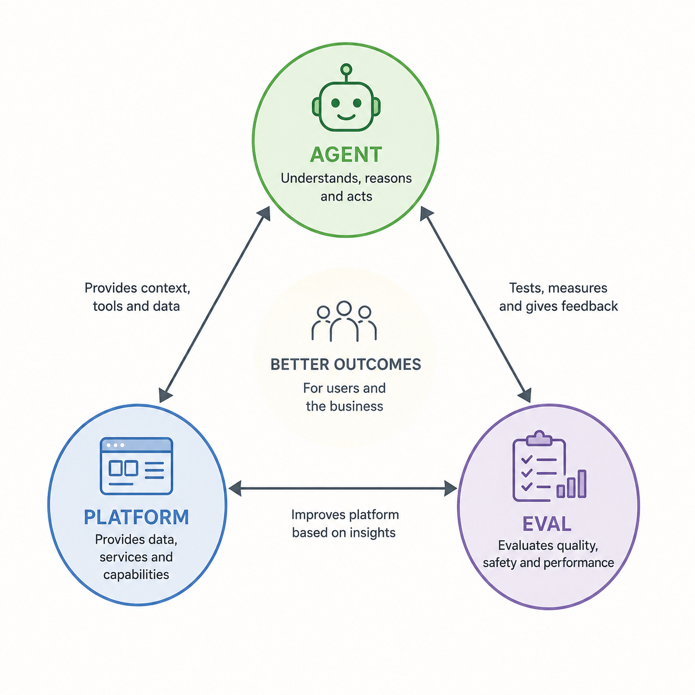

Slide 21
What to remember
Test the whole experience — not the code.
01
SEE THE WHOLE SYSTEM
App, Biddy, specialist capabilities and Eval work together.
02
TEST LIKE A REAL USER
Use natural language, ambiguity and follow-up context.
03
IMPROVE SAFELY
Judge usefulness, report behaviour and catch regressions.
The goal
More capable. More reliable. More useful. Without breaking what works.

