Slide 1
Portable Ultrasound Device for Coda-Wave Interferometry Sprint 1
Prepared by Michael Kisellus, Christopher Coppedge, Leyton Foxworthy, Matthew Baker, Kyle Fox
10OCT2023

Slide 2
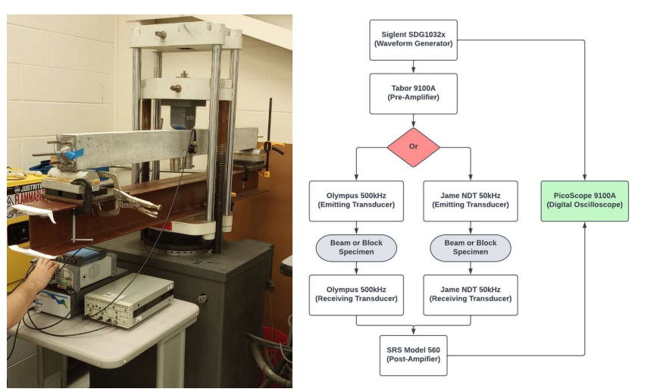
Background:
Civil engineering lab has a concrete “scanning” process that involves measuring how ultrasonic waves travel through the concrete

Slide 3
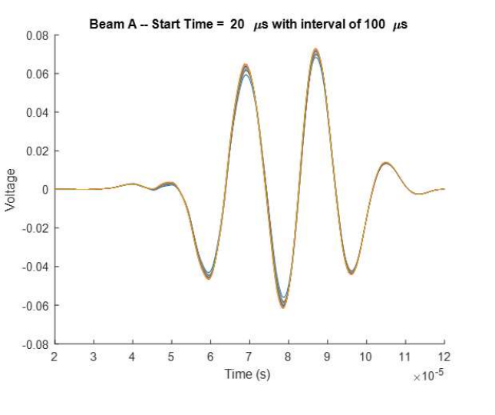
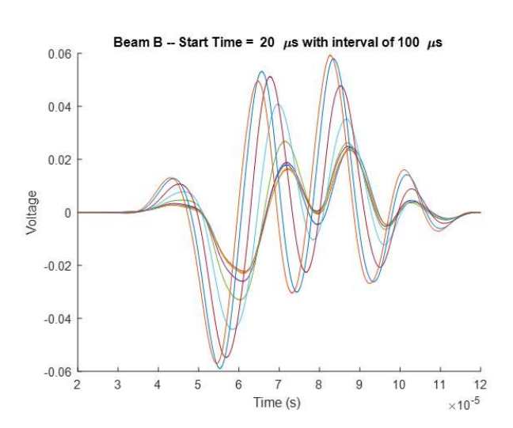
Background:
Data analysis (through MATLAB) is able to reveal imperfections in the concrete.
Scan of a proper piece of concrete
Scan of a compromised piece of concrete

Slide 4
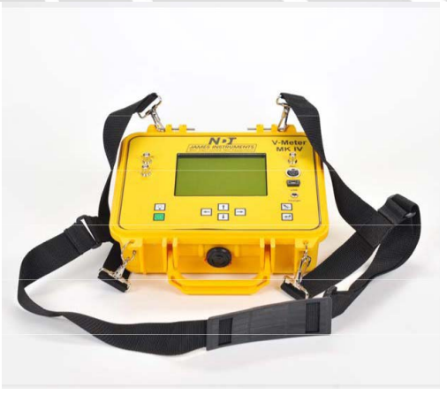
What is this projects goal?
Produce a handheld ultrasound inspection device for inspecting a bridge/structural component for faults in the field.
This handheld unit gathers and stores test data collected over time 72 hours.
Budget - $2000
Existing commercial solution:
Expensive ($5200)
Is not able to record without an operator present

Slide 5
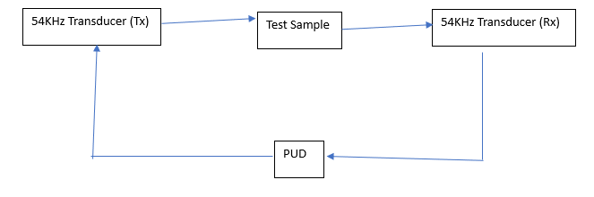
Overall system diagram

Slide 6
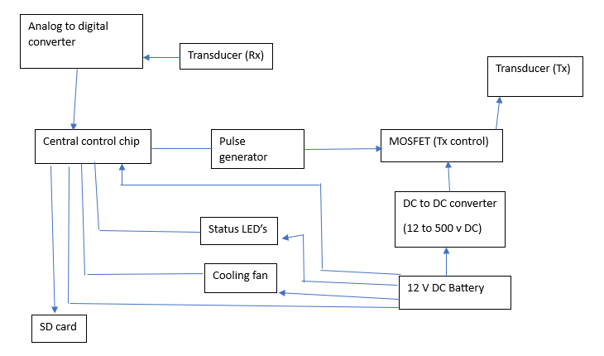
Portable Ultrasound Device (PUD) diagram

Slide 7
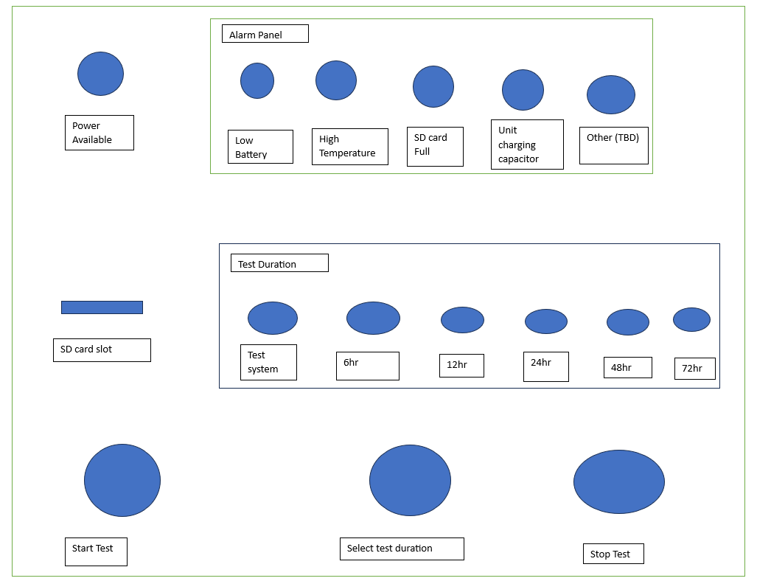
Operation panel layout

Slide 8
Sub Systems
Electrical system
Cooling system
Software
Tx and Rx system
Control system
Enclosure system

Slide 9
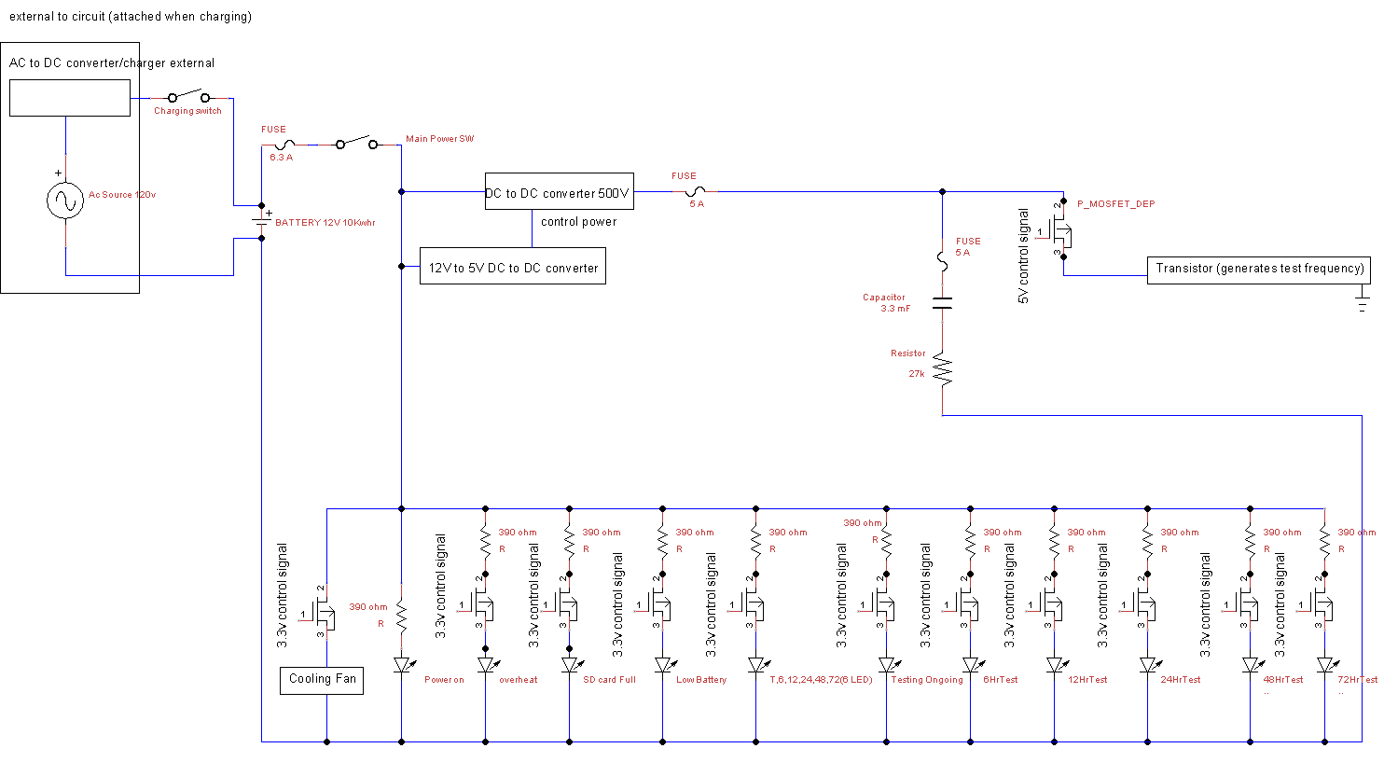

Slide 10
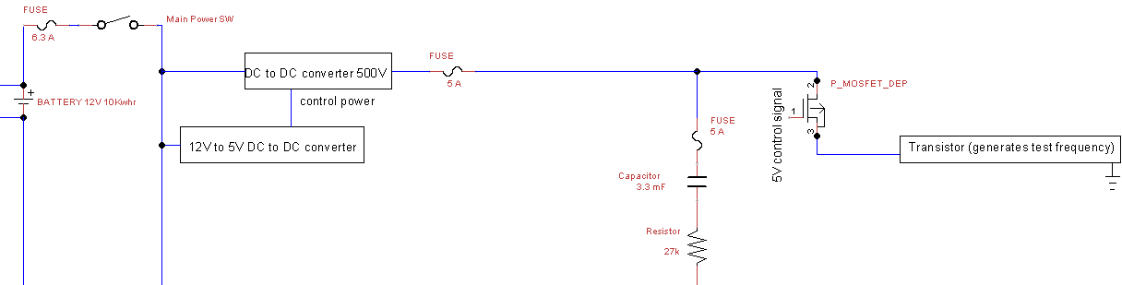
Electrical system 500V DC section

Slide 11
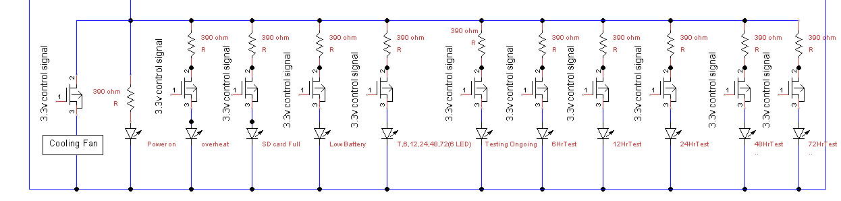
Electrical system 12 V DC load section

Slide 12
Electrical system main requirements
Operate for 48 to 72 hr without charging
Produce 500V DC
Produce 12 V DC

Slide 13
Software
Goals:
Save data coming from ADC in a usable format.
Write data to SD Card
Control LEDs and pulse generator through Raspberry Pi Pico
Other information:
Code will be written in python or C
Most likely python as it is more compatible with matlab which is what the civil engineering lab is currently using.

Slide 14
RX & TX System
TX
500V 18uS ping to the transducer
High-voltage and precise timing
RX
1V 100uS recieving ping from the opposing transducer
80 Megasamples per Second
50 recordings per ping - Approx. 400k sample points per ping

Slide 15
Control System
Microcontroller - Raspberry Pi Pico
Programming Language - Python & C++
Simple LED Display to show operations
Collected data is stored on SD card

Slide 16
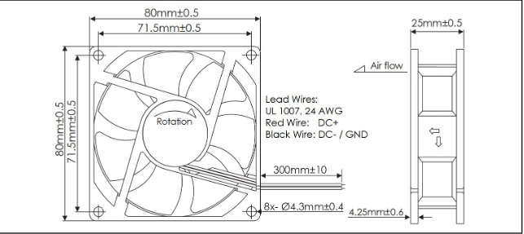
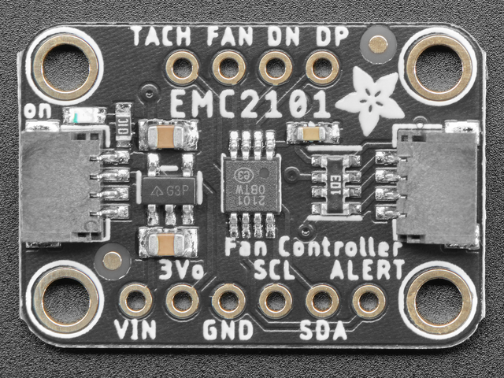
Cooling System - Components
Fan: Orion Fans OD8025-12HBIP55
IP55 Rated, 80mm fan, 40.1 CFM Airflow, 0.15” H₂O Static Pressure
Controller: EMC2101 Fan Controller & Temperature Sensor
Programmable, Arduino/Rpi Compatible

Slide 17
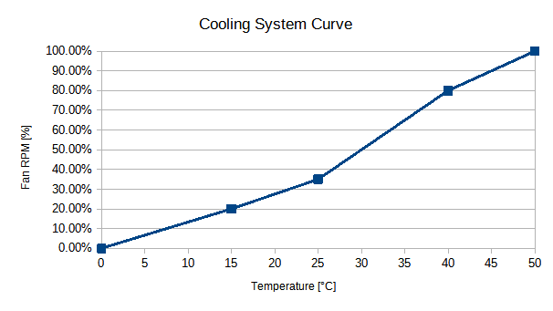
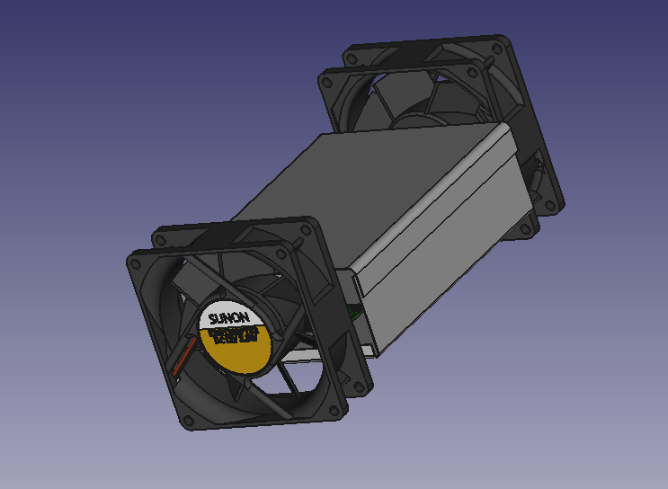
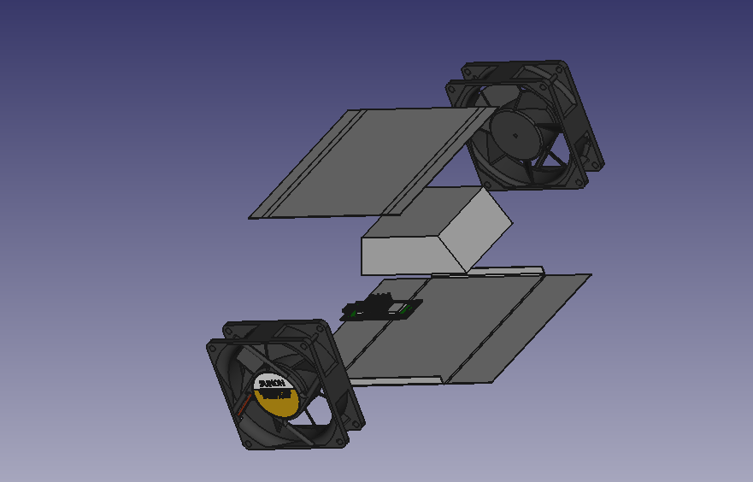
Cooling System – Parameters & Design
Fans: Intake-Exhaust
Aluminum Shroud Enclosing Components
Critical temperature for internals: 131°F (55°C)
Recommended Internals Temperature: 115°F (46.1°C)
Orthogonal View
Exploded, Unfolded View

