Slide 1
Portable Ultrasound Device for Coda-Wave Interferometry Sprint 1
Prepared by Michael Kisellus, Christopher Coppedge, Leyton Foxworthy, Matthew Baker, Kyle Fox
02OCT2023

Slide 2
What is this projects goal?
Produce a handheld ultrasound inspection device for inspecting a bridge/structural component for faults in the field.
This handheld unit gathers and stores test data collected over time 72 hours.

Slide 3
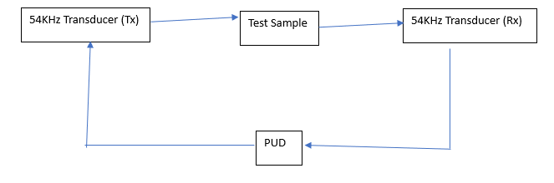
Overall system diagram

Slide 4
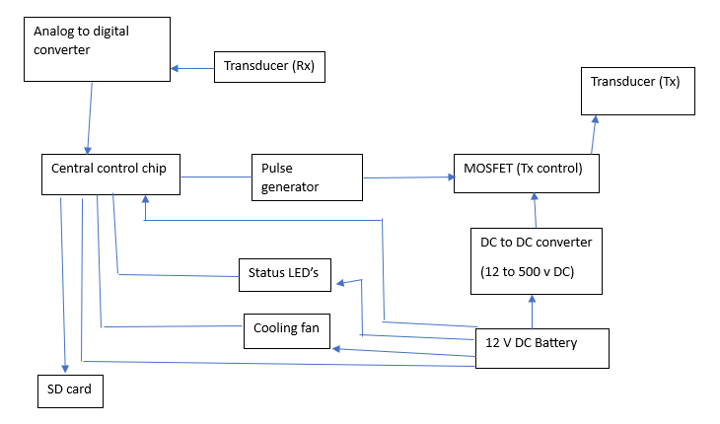
Portable Ultrasound Device (PUD) diagram

Slide 5
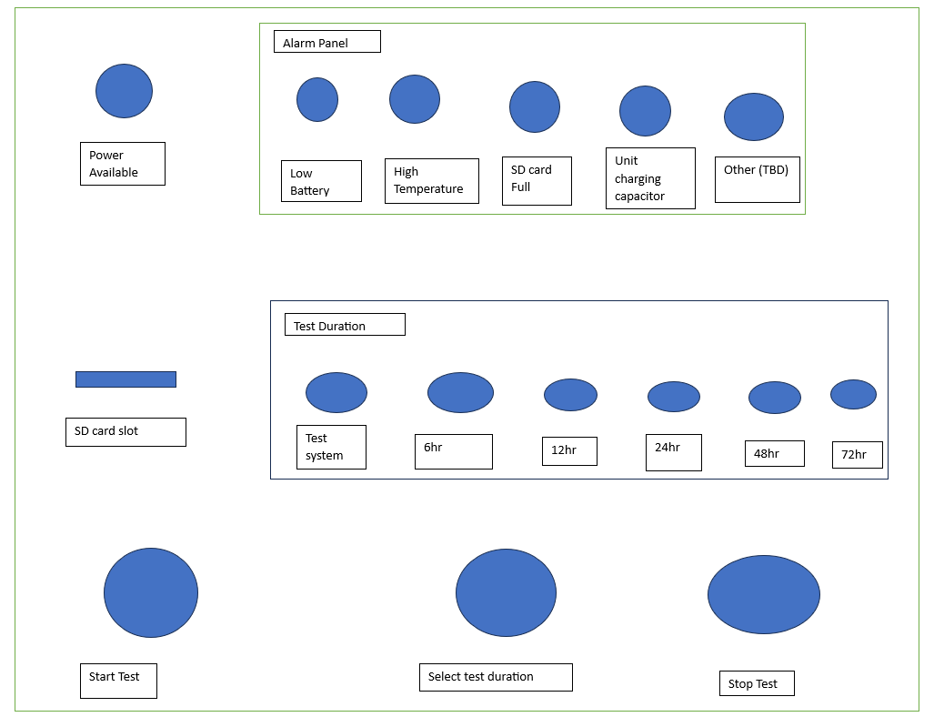
Operation panel layout

Slide 6
Sub Systems
Electrical system
Cooling system
Transmission(Tx) and Receiving(Rx) system
Control system
Enclosure system

Slide 7
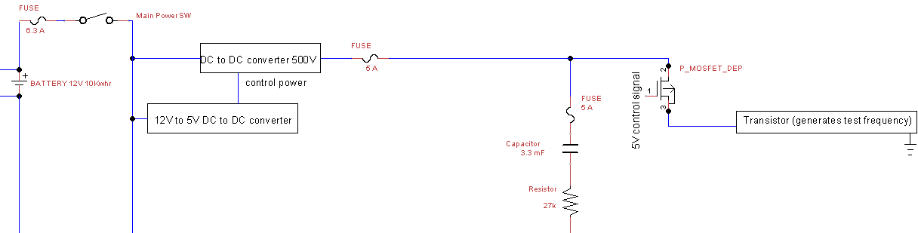
Electrical system 500V DC section

Slide 8
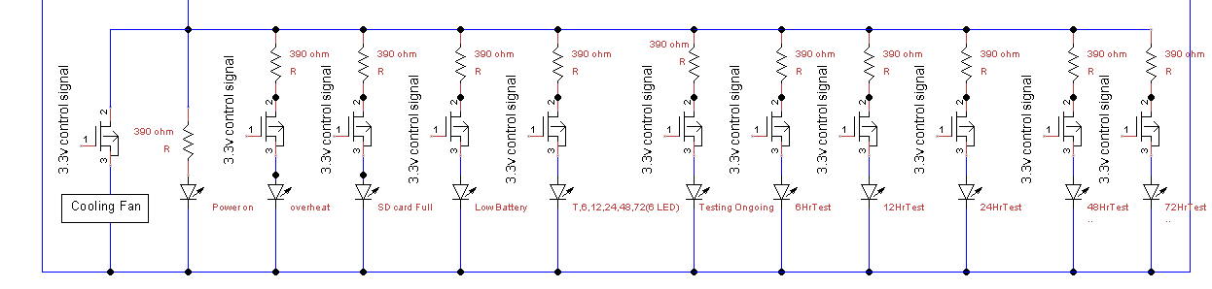
Electrical system 12 V DC load section

Slide 9
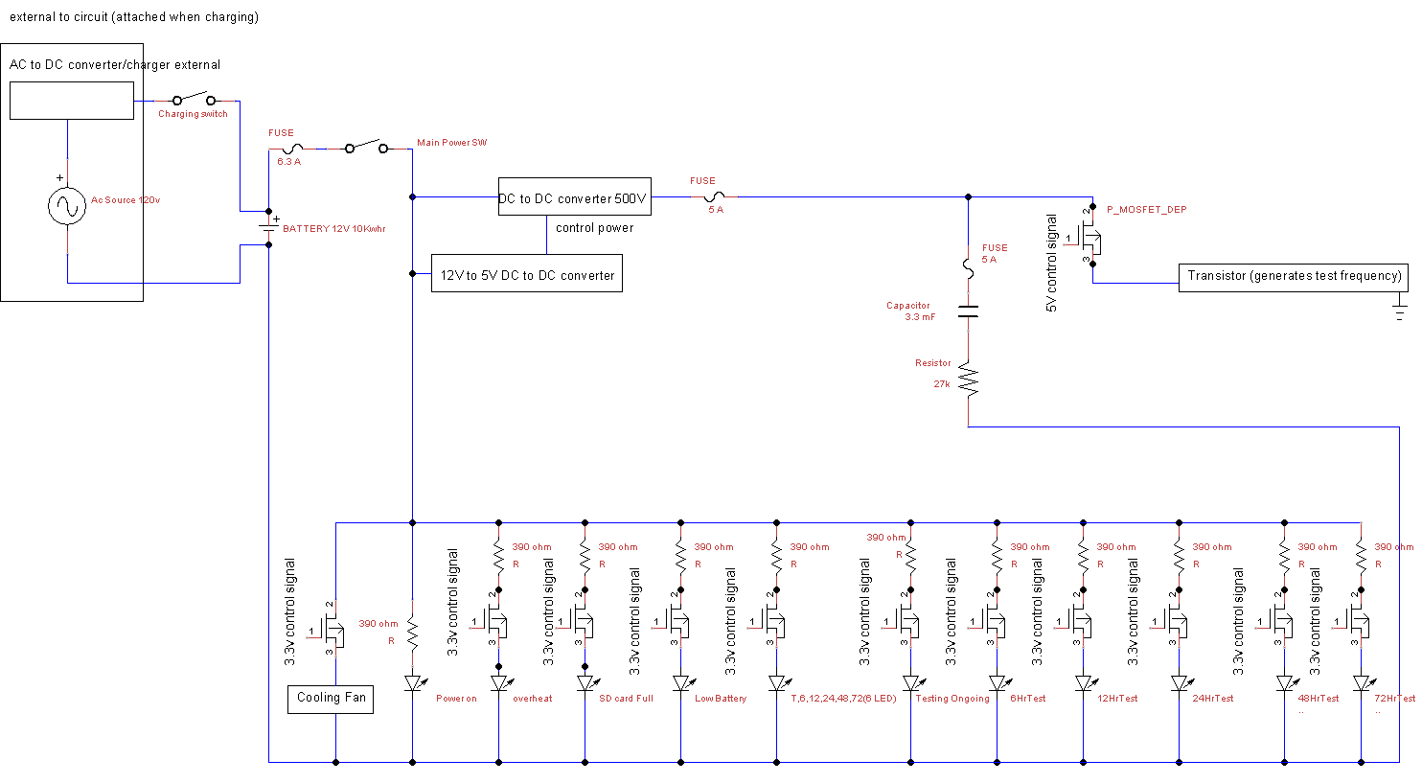

Slide 10
Electrical system main requirements
Operate for 48 to 72 hr without charging
Produce 500V DC
Produce 12 V DC

Slide 11
Next subsystem

