Slide 1
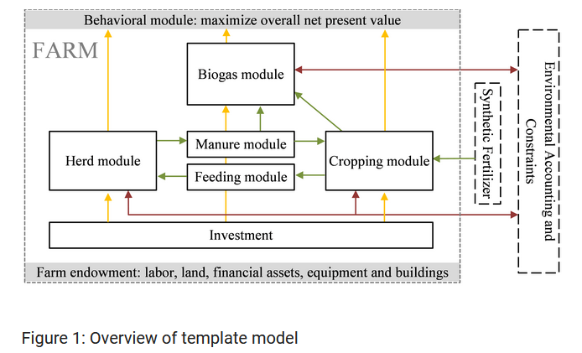
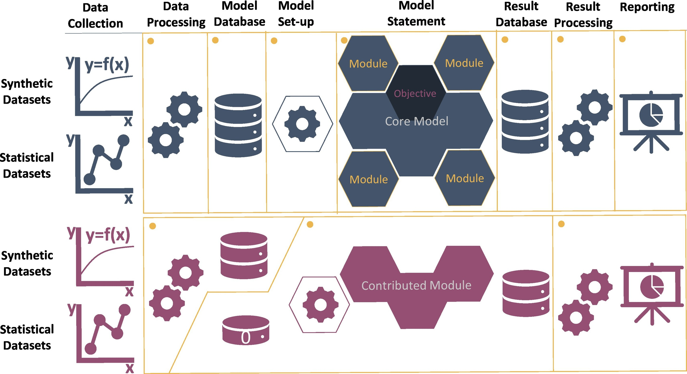
Modularity and model description in FarmDyn
Source: Britz et al. 2021
28.10.2021

Slide 2
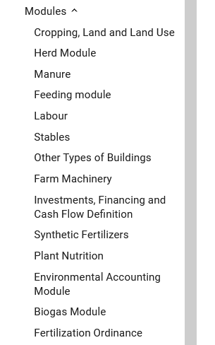
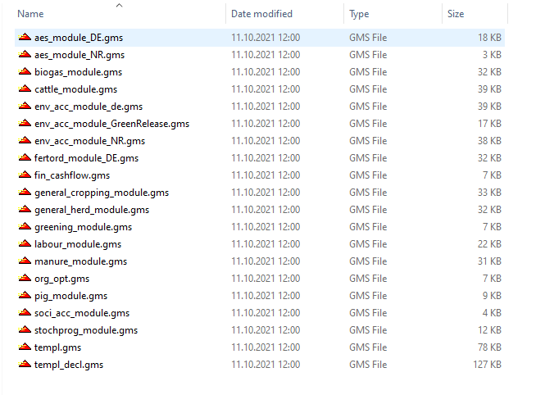
FarmDyn Documentation – Model description and Modularity
Current structure
“Module” structure
“Current structure” is rather a combination of “module” description and model description

Slide 3
Proposed Model description for webpage
Economics & Management
Animal production
Objective
Herd dynamics
Household Income & Cash Flow
Cattle
Investment & Financing
Feeding
Sexing
Labour
Cross-breeding
Building and Machine inventory
Pigs
Stables
Feeding
Machinery
Other type of buildings
Biogas
Environmental Accounting
Policy
Crop production
Fertilization Ordinance
Cropping, land and land use
Agri-environmental schemes
Plant nutrition
Manure & Synthetic Fertilizers

Slide 4
Proposed module presentation referring to Britz et al. 2021
Beginning with the general idea of modularity
Presentation and graphical illustration of the “contributed modules/ Constructs” and optional related “small modules”
Contributed module e.g. “dairy branch” which includes general_herd_module, cattle_module, manure_module and additional containing new data files e.g. feeding, stables etc.

Slide 5


Modelling Dairy branch
Core Model
Code (Optionals)
Data (\dat\....
„Templ “
„Cattle_de“
„General_Cropping_Module“
„Feeds_de“
„Labour_Module“
„Stables_de“
„Environmental Accounting“
Code (Herd - Specific)
Data (\coeffgen\....
„General_Herd_Module“
„Calves_de“
„Manure_Module“
„Cows_de“
Code (Cattle - Specific)
„Requ_de“
„Cattle_Module“

Slide 6

Raw data and data preparation
Data (\dat\....
„Cattle_de“
„Raw data“
„Dairy_data_container“
„Feeds_de“
„Stables_de“
Data (\coeffgen\....
„Calves_de“
„Cows_de“
„Data prep for code“
„Requ_de“

Slide 7
Merging together in \coeffgen\stables?
„Dairy_data_container“
„Stables_de“
Cattle
„Pig_data_container“
„Stables_de“
Pig

