Slide 1
Core model
Model Database
Model Statement
Called modules
I.
I. Templ module (farm economics)
II. General cropping module
III. Labour module
II.
III.
Dairy branch
IV.
IV. General herd module
V. Cattle module
V.

Slide 2




Data Collection
Data Processing
Model Database
Model Set-up
Model Statement
Result Database
Result Processing
Reporting
Policies
Task 3.3
y
Policies
Dairy
y=f(x)
Task 3.5
Synthetic Datasets
Objective
Objective
x
Core Model
y
Task 3.2
Statistical Datasets
Arable
Indicators
x
Task 3.4
y
y=f(x)
Arable
Synthetic Datasets
x
Dairy
y
Statistical Datasets
0
Task 3.4
x
Indicators

Slide 3
Modular structure
Grouped modules
Single modules
Economics module
Core model
Labour module
AES
Env_Acc
Core model
General cropping module
Dairy branch
General herd module
Cattle module
Dairy branch
Manure module
Env_Acc
Environmental accounting module

Slide 4
Data Collection
Data Processing
Model Database
Model Set-up
Model Statement
Result Database
Result Processing
Reporting
y
y=f(x)
Synthetic Datasets
Core model
x
y
Statistical Datasets
x
y
y=f(x)
Synthetic Datasets
Dairy branch
x
y
Statistical Datasets
0
x

Slide 5
Core model
Fattner branch
Biogas branch
Dairy branch
Sow branch
Mothercow branch
Beef branch

Slide 6
Economic
General Herd
Pig
Manure
Cattle
Biogas
Fattner
General Cropping
Labour
< >
/

Slide 7





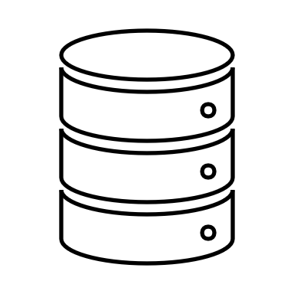
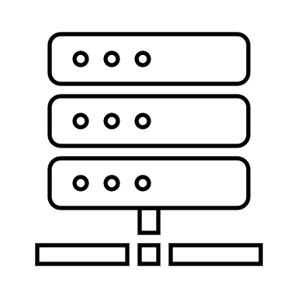
gms files
gdx files
Books
GUI configuration
GAMS / Python
Literature
GAMS / Python
FarmDyn simulation
Databases
FarmDyn database
User case dependent data processing
JSON / R / GAMS
KTBL API for German cropping

Slide 8
Pre-Simulation
Simulation
Data collection
Database FarmDyn
Data processing
Books
.gms files
.gdx files
Python / GAMS
Literature
Coefficient generator
Online databases
GUI configuration
Data processing
JSON / R / GAMS
GAMS / Python
KTBL API / R processing of FarmDyn crops
User defined FarmDyn crops
FarmDyn simulation

