Slide 1
🌿 CLAUDE BASED HACKATHON • CUTM 2026
🏆 Event Details
AI-Assisted Precision Nutrient & Water Management in Agriculture
📅 Aug 18th & 19th, 2026
🏫 Centurion University
of Technology &
Management, Odisha
🤝 Organized by:
IEEE • IIC
🎯 Theme:
Powered by Machine Learning & Gemini AI | FarmGuru Platform
Code · Innovate · Impact
⚙️ Tech Stack:
Prepared by:
React • FastAPI
◆ V. Harish (240101120077)
Gemini AI • Supabase
◆ T. Himagiri (240101120107)
scikit-learn • Python
◆ B. Hemanth (240101120091)
◆ M. Jayanth (240101120108)
FarmGuru • Smart Agriculture Platform • 2026

Slide 2
Software Requirements Specification (SRS)
FarmGuru — AI-Powered Soil & Water Management Platform
Functional Requirements
Non-Functional Requirements
✔ FR-01 Users input N, P, K & Moisture values via web form
✔ NFR-01 Response time < 3 sec for ML prediction
✔ FR-02 ML model predicts recommended crop type
✔ NFR-02 AI chat streaming response within 5 seconds
✔ FR-03 Soil health score (0–100%) computed by AI model
✔ NFR-03 System supports concurrent multi-user access
✔ FR-04 System calculates additional water requirement (mm)
✔ NFR-04 API keys secured via .env (not in codebase)
✔ FR-05 Gemini 2.5 Flash generates detailed text recommendations
System & Tech Requirements
✔ FR-06 All analyses stored in Supabase cloud database
▶ Frontend : React (Vite) + Tailwind CSS + Recharts
✔ FR-07 Dashboard shows trend graphs & average NPK charts
▶ Backend : Python FastAPI + Uvicorn server
✔ FR-08 AI chatbot answers farming queries with suggestions
▶ AI Model : Google Gemini 2.5 Flash (streaming SSE)
✔ FR-09 Light / Dark theme toggle available site-wide
▶ ML Models: scikit-learn (crop + farm analytics .pkl)
✔ FR-10 History table displays all past soil analyses
▶ Database : Supabase (PostgreSQL cloud)
▶ Hosting : Local (port 5173 / 8000), GitHub repo
FarmGuru • Smart Agriculture Platform • 2026

Slide 3
Entity-Relationship (ER) Diagram
FarmGuru — Data Model & Relationships
SOIL_ANALYSIS
USER
🔑 id (PK)
AI_RECOMMENDATION
🔑 user_id (PK)
user_id (FK)
🔑 rec_id (PK)
name
nitrogen (mg/kg)
analysis_id (FK)
email
1 : N submits
content (text)
phosphorus (mg/kg)
1 : N generates
role (farmer/admin)
potassium (mg/kg)
created_at
moisture (%)
recommended_crop
health_score
CHAT_LOG
water_needed (mm)
DASHBOARD_STATS
condition
🔑 chat_id (PK)
🔑 stat_id (PK)
1 : N chats
created_at
1 : 1 aggregates
user_id (FK)
user_id (FK)
message
total_analyses
response
avg_health
timestamp
avg_npk_n
🔑 = Primary Key | FK = Foreign Key | Supabase PostgreSQL stores all entities | Analysis is the central entity
avg_npk_p
avg_npk_k
FarmGuru • Smart Agriculture Platform • 2026

Slide 4
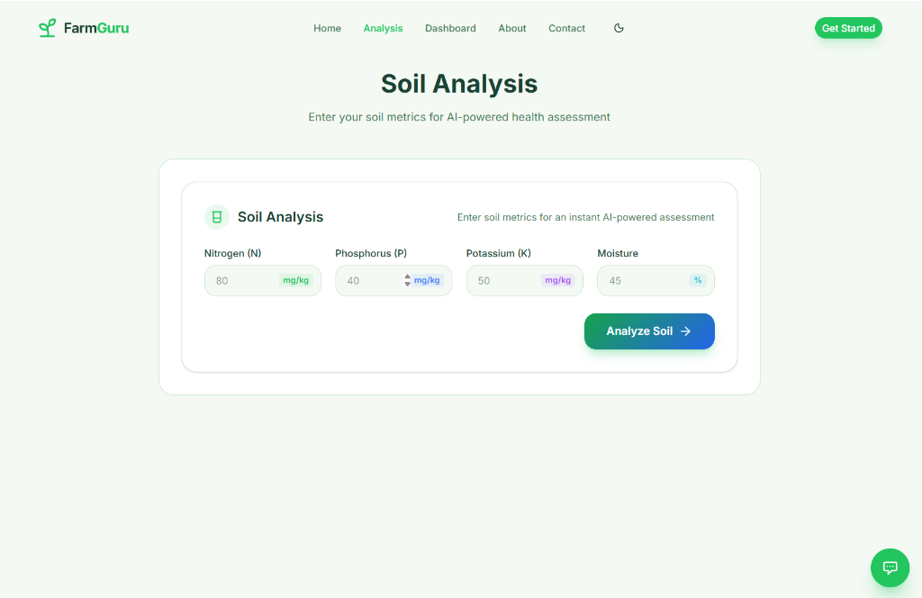
Frontend — User Interface (React + Vite + Tailwind CSS)
Live FarmGuru Web Application | Light Theme | Full Responsive Design
🌿 Analysis Form
4 inputs: N, P, K, Moisture with colored unit badges
📊 Dashboard
Live Recharts graphs from Supabase (trend + NPK avg)
🤖 AI Chatbot
Gemini streaming responses + clickable suggestion pills
🌓 Themes
Light / Dark mode with one-click toggle in navbar
FarmGuru • Smart Agriculture Platform • 2026

Slide 5
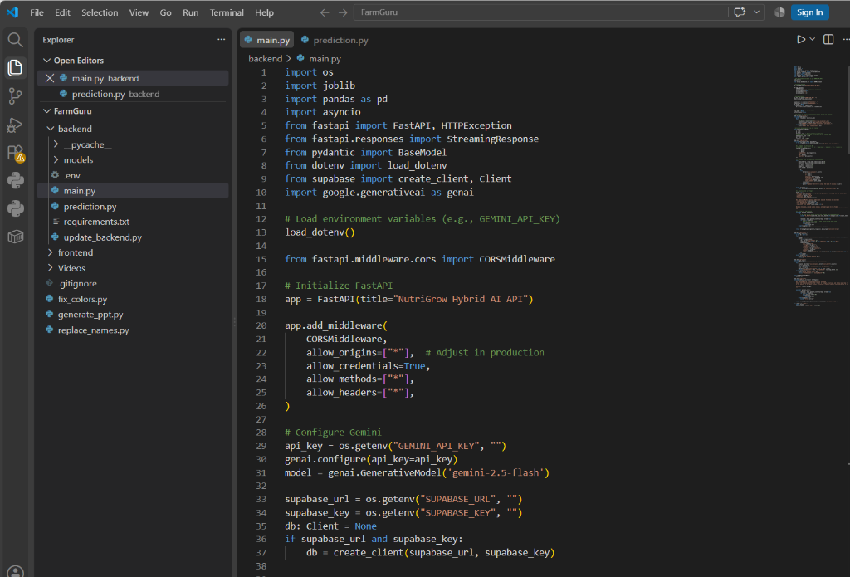
Backend — FastAPI + Python + ML Models
main.py | prediction.py | Gemini AI | Supabase Integration
⚡ FastAPI
High-performance Python web framework (Async + CORS ready)
🧠 ML Models
crop_recommender.pkl farm_analytics.pkl (scikit-learn 1.9)
✨ Gemini AI
gemini-2.5-flash SSE streaming chat & soil advice
🗄️ Supabase
PostgreSQL cloud DB Auto-logs analyses history & stats API
FarmGuru • Smart Agriculture Platform • 2026

Slide 6
🌿 FarmGuru
AI-Assisted Precision Nutrient & Water Management in Agriculture
✅ Successfully built an end-to-end AI + ML powered soil analysis platform
✅ Integrated Gemini 2.5 Flash for real-time streaming agricultural advice
✅ Supabase cloud database captures every analysis for historical tracking
✅ Farmer-friendly UI with clickable AI suggestions (accessibility first)
✅ Full Light / Dark theme with responsive design across all devices
🙏 Thank You!
We look forward to your valuable feedback.
V. Harish (077) · T. Himagiri (107) · B. Hemanth (091) · M. Jayanth (108)
FarmGuru • Smart Agriculture Platform • 2026

