Slide 1

Employee salary prediction using machine learning algorithm with streamlit webapp integration
CAPSTONE PROJECT
Presented By:
Farman Malik - Electronics&Comm.-FET Jamia Millia Islamia New Delhi

Slide 2
OUTLINE
Problem Statement
System Development Approach
Algorithm & Deployment
Result
Conclusion
Future Scope
References

Slide 3
Problem Statement
In many organizations, determining fair and accurate employee salaries is a complex task due to numerous influencing factors such as education, experience, job role, industry, and location. Manual estimation often leads to inconsistencies, biases, and inefficiencies.
The challenge is to analyze employee-related data and identify hidden patterns that can help in predicting salaries accurately for better decision-making in HR processes.

Slide 4
System Approach
Hardware Requirements
Processor: Intel Core i3 or higher (or equivalent AMD)
RAM: Minimum 8 GB (16 GB recommended for large datasets)
Programming Language: Python Version: 3.7 or above
IDE: Google Colab / Jupiter Notebook
Libraries Used:
Pandas, NumPy – Data Cleaning & Manipulation
Matplotlib, Seaborn – Data Visualization
Scikit-learn – Model Training, Evaluation
Joblib – Saving Trained Model
Streamlit – Web App Interface
Grok – Deployment Platform

Slide 5
Algorithm & Deployment
🔹 Step 1: Data Preprocessing
Loaded structured data into a DataFrame.
Performed null value imputation and cleaned outliers.
Dropped the ‘education’,’race’,etc column based on correlation and model performance validation.
Encoded categorical variables using Label Encoding and scaled using MinMaxScalar, where appropriate.
Ensured data normalization where required to stabilize model learning.

Slide 6
Algorithm & Deployment
🔹 Step 2: Model Building
Split data into training and test sets (typically 80:20).
Trained and evaluated multiple ML algorithms:
Logistic Regression
Random Forest
Linear SVM
Gradient Boosting Classifier
Final selection: Gradient Boosting Classifier due to superior performance on test accuracy and generalization.

Slide 7
Algorithm & Deployment
🔹 Step 3: Model Evaluation
Evaluated using accuracy, confusion matrix, and cross-validation scores.
Serialized final model using Joblib for easy reuse.
🔹 Step 4: Deployment Workflow
Developed a front-end using Streamlit, where users input features such as experience, company size, job title, and industry.
Integrated the .pkl model into Streamlit using Python backend logic.
Deployed the app using Grok, ensuring accessibility via browser on any device

Slide 8
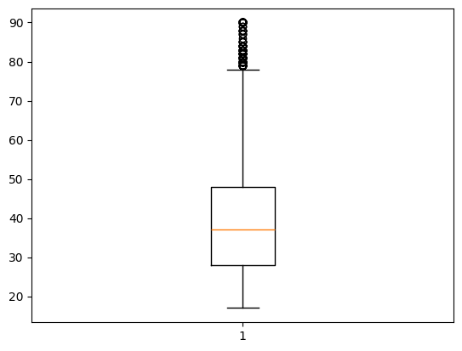
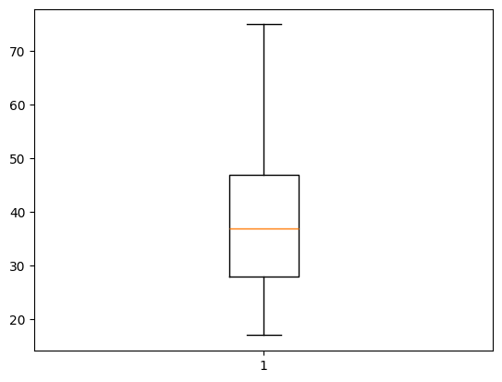
Result
Outlier Detection and Reduction
Initial Observation: During exploratory data analysis, several features such as experience, company size, and job title exhibited outliers that could skew model predictions.
Detection Methods Used:
Box Plots for visual identification
Reduction Techniques Applied:
Removed extreme data points beyond acceptable z-score thresholds
Ensured no significant data loss or class imbalance during cleaning
Impact: Enhanced data quality, reduced model variance, and improved accuracy
Outlier Detected
Outlier Reduced

Slide 9
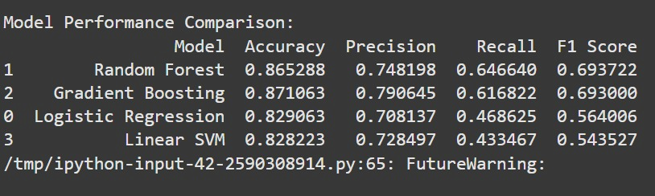
Performance Evaluation Metrics
The model was evaluated using multiple standard classification metrics:

Slide 10
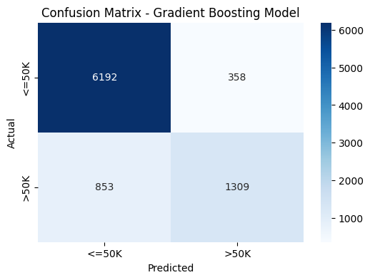
Performance Evaluation Metrics
The model was evaluated using multiple standard classification metrics:

Slide 11
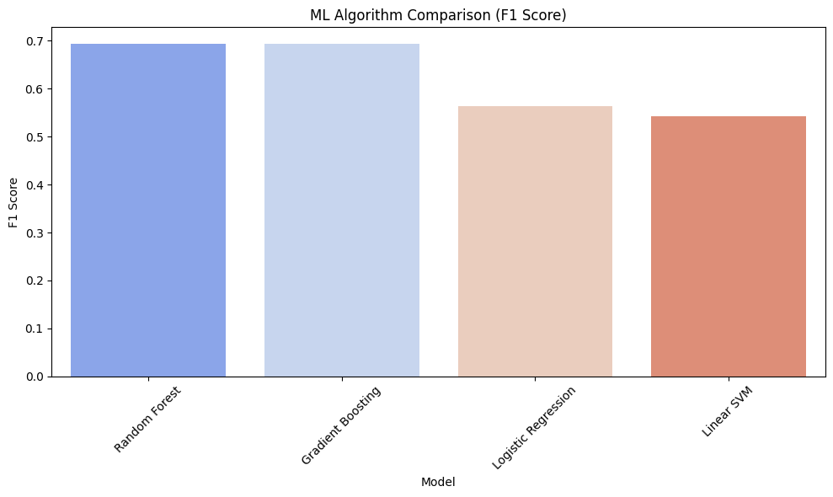
Algorithm Comparison
Multiple algorithms were trained and compared on the same preprocessed dataset:
📝 Conclusion: Gradient Boosting was selected as the final model due to optimal accuracy, acceptable training time, and better generalization on test data.

Slide 12
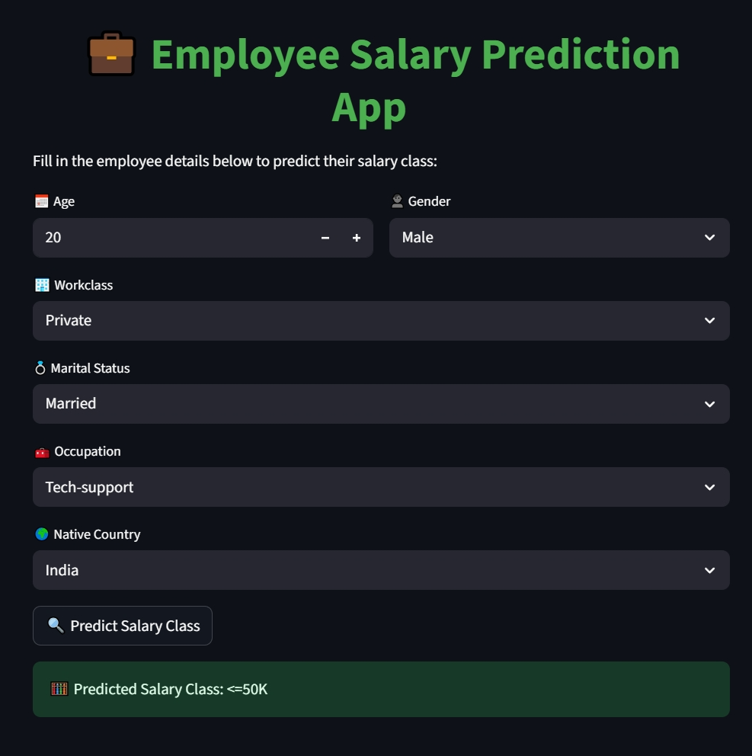
Streamlit Web App Integration of Model

Slide 13
Final Model Summary
Model Chosen: Gradient Boosting Classifier
Total Features Used: 6 (after removing low-impact features like 'education’,etc.)
Model File: gradient_boosting_salary_model.pkl (serialized with Joblib)
Test Accuracy Achieved: ~87.1%
Deployed App: Built using Streamlit, deployed on Grok

Slide 14
GitHub Repository
Repository Contents:
Employee_Streamlit_Ngrok_Final.ipynb– Model development, training, and evaluation notebook
gradient_boosting_salary_model.pkl – Trained machine learning model file
app.py – Streamlit web app script for real-time salary prediction
Deployment tools – Scripts for deploying the app using Grok
https://github.com/Farmanmalik23203/Employee-salary-predictor---Farman-Malik.git

Slide 15
Conclusion
A reliable and efficient ML-based solution was developed to predict employee salaries using a well-structured feature set and advanced classification algorithm.
The Gradient Boosting Classifier outperformed other models due to its capability to handle mixed data types and reduce bias-variance trade-offs.
The solution was successfully deployed as a web application using Streamlit and Grok, providing a user-centric platform for live predictions.
The project demonstrates a clear use-case in data-driven HR systems, helping in salary benchmarking, hiring strategies, and compensation decisions.

Slide 16
Future scope
Integrate real-time API data from HR or payroll systems to ensure continuous learning and prediction accuracy.
Include additional features such as:
Performance metrics
Certification levels
Market trends and inflation data
Expand the model to predict salary ranges across multiple industries and geographies.
Incorporate explainable AI (XAI) tools to provide transparency and fairness in salary prediction results.

Slide 17
References
Scikit-learn Documentation: https://scikit-learn.org
Streamlit Docs: https://docs.streamlit.io
Grok Deployment Docs:http://groktoolkit.readthedocs.io/
Python Official Documentation: https://python.org
Dataset Source: Edunet Foundation

Slide 18
THANK YOU

