Slide 1
CSS
CASCADE

Slide 2
A quick
background
on CSS rules

Slide 3
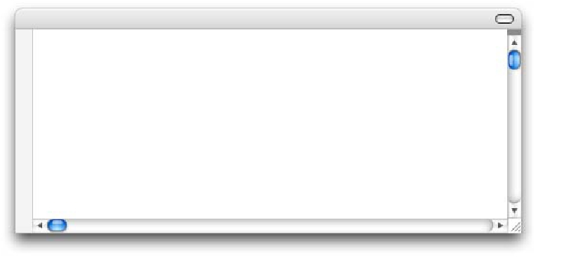
CSS rules tell browsers how to
render elements in an HTML
document.
h2
{
color: blue;
margin: 1em;
}

Slide 4
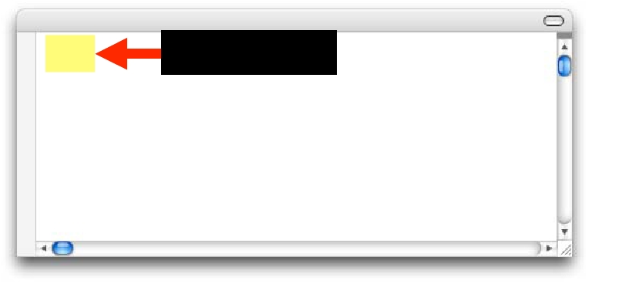
The selector "selects" the
elements in an HTML
document that are to be styled.
h2
Selector
{
color: blue;
margin: 1em;
}

Slide 5
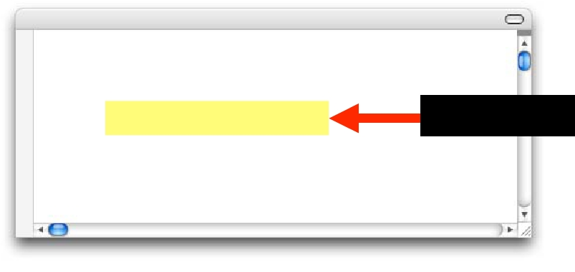
The declaration tells a
browser how to style the
element.
h2
{
color: blue;
margin: 1em;
Declaration
}

Slide 6
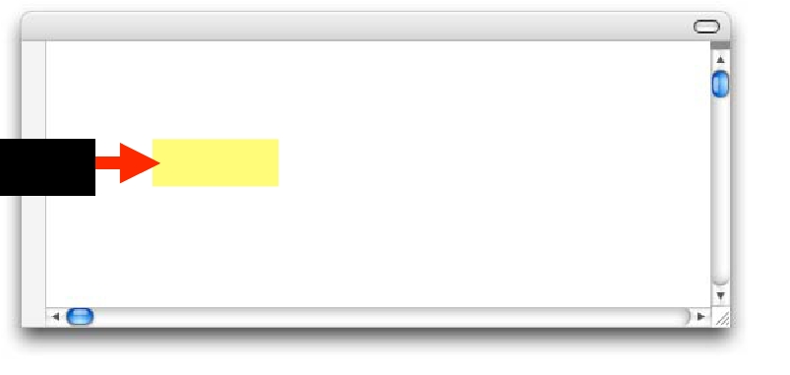
The property is the aspect of
that element that you are
choosing to style.
h2
{
Property
color: blue;
margin: 1em;
}

Slide 7
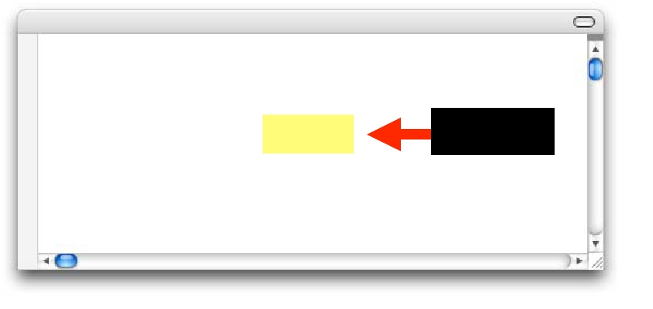
The value is the exact style
you wish to set for the
property.
h2
{
color: blue;
margin: 1em;
Value
}

Slide 8
Types of
style sheets

Slide 9
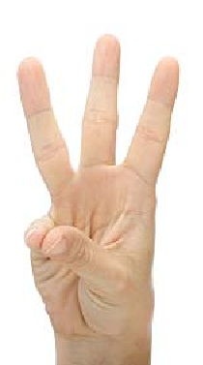
HTML documents may have
three types of style sheets
applied to them.

Slide 10
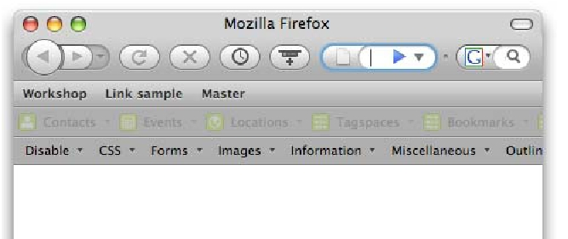
Browser style sheets
Browsers apply style sheets to
all web documents. These are
referred to as a "default"
browser style sheet.

Slide 11
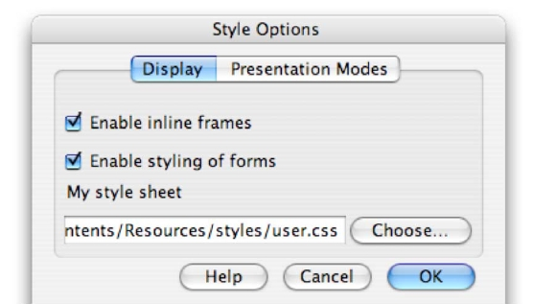
User style sheets
Most modern browsers allow
users to apply their own style
sheets within the browser.

Slide 12
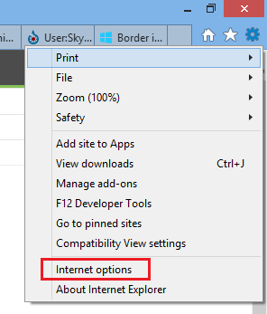
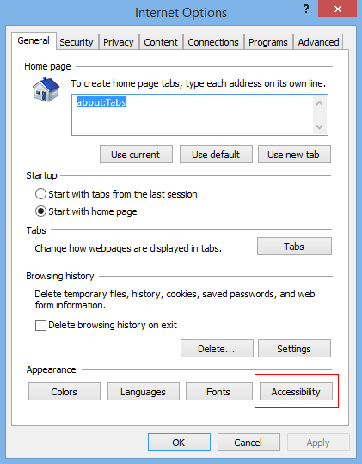
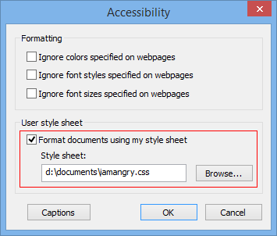
User style sheets
(IE浏览器)

Slide 13
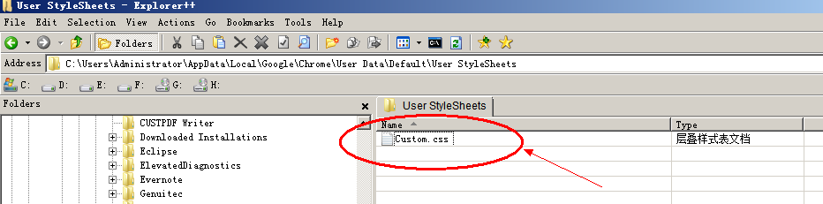
User style sheets
(chrome浏览器)
Chrome 的 User CSS 位置: C:\Users\用户名\AppData\Local\Google\Chrome\User Data\Default\User StyleSheets

Slide 14
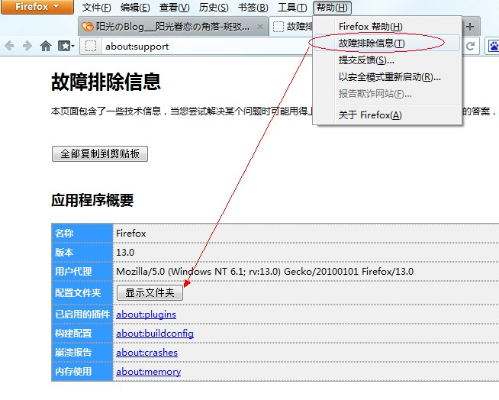
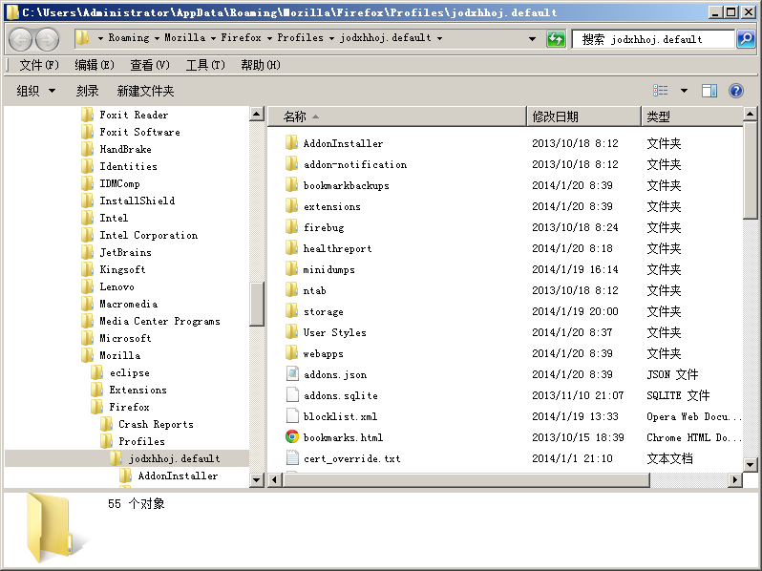
User style sheets
(firefox浏览器)

Slide 15
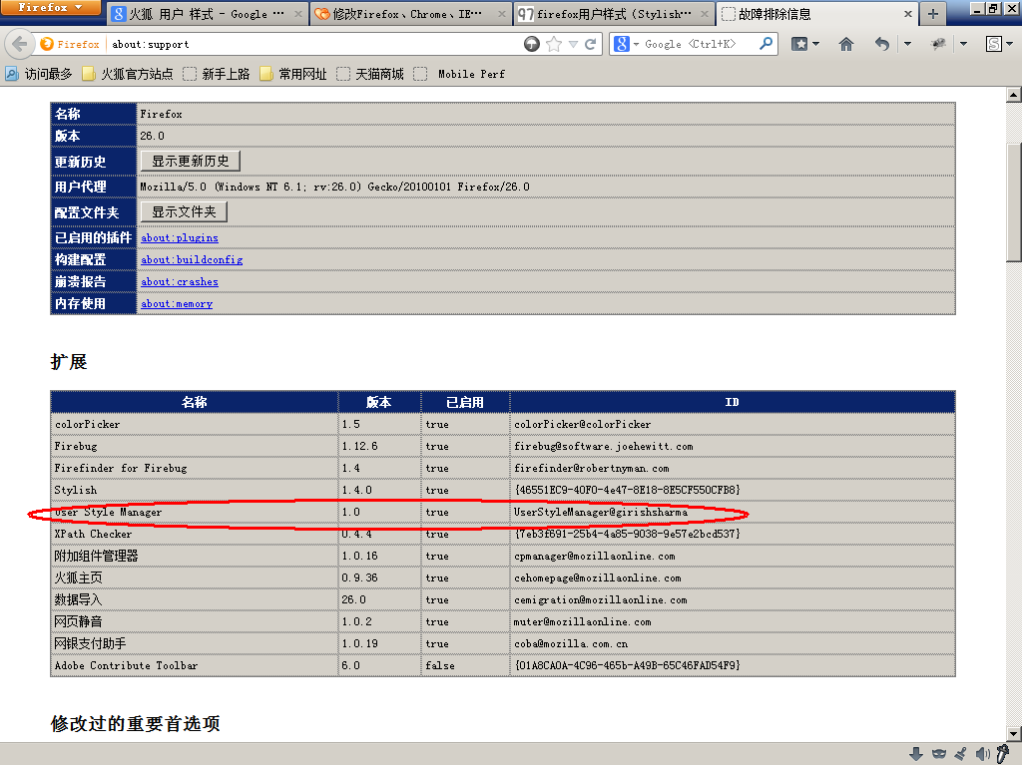
User style sheets
(firefox浏览器)

Slide 16
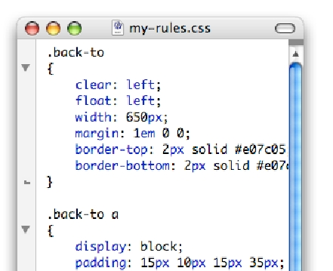
Author style sheets
Web authors can apply one or
more style sheets to an
HTML document.

Slide 17
Author styles

Slide 18
There are three methods that
authors can use to add CSS
styles to an HTML document

Slide 19
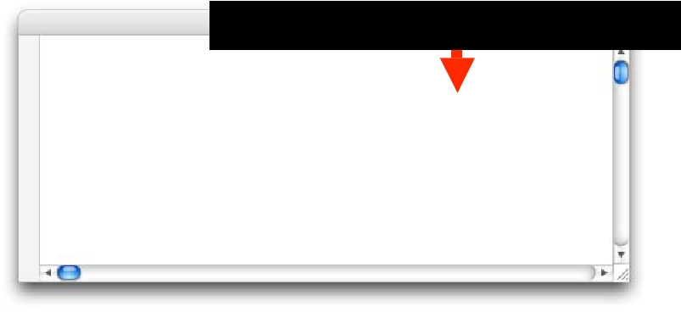
Inline styles are applied to
elements in the HTML code
using the style attribute.
Inline style using style attribute
<body>
<h2 style=“color: red;”>
Heading here
</h2>
<p>

Slide 20
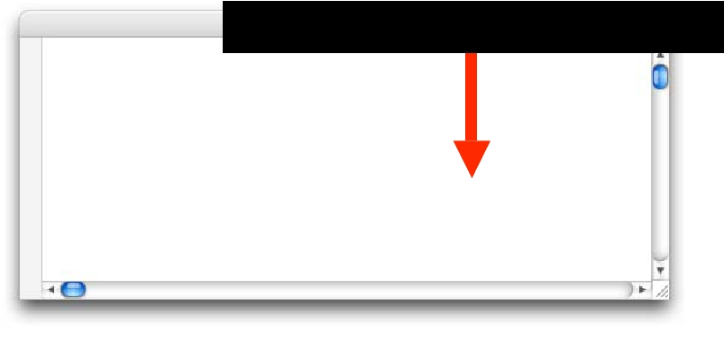
Header styles are placed in
the head of the document
using the style element
Header style inside <style> element
<head>
<title>Document title</titl
<style type="text/css" medi
h2 { color: blue; }
</style>

Slide 21
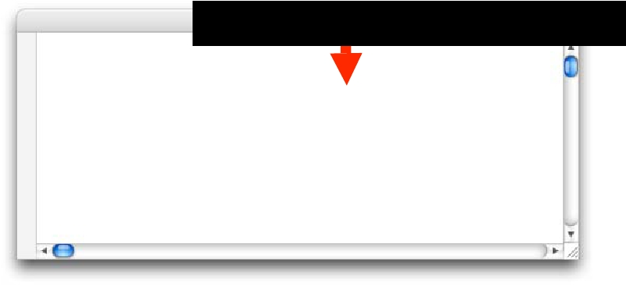
External style sheets are
applied using the link or
@import.
External style using link element
<title>Document title</titl
<link rel="stylesheet"
href=”my-styles.css”
type=”text/css"
media="screen” />

Slide 22
CSS rule
overload!

Slide 23

Browsers have to deal with
CSS rules coming from the
browser, user and author
style sheets.

Slide 24

Browsers also have to deal
with CSS rules coming from
different types of author style
sheets (external, header and
inline)

Slide 25

At some point, Browsers
have to deal with CSS rules
that conflict.

Slide 26
What does
“conflict”
mean?

Slide 27
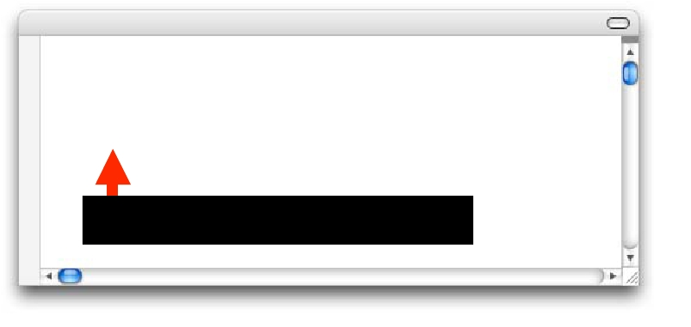
Conflict is where more than
one CSS rule refers to the
same element and property.
h2 { color: blue; }
h2 { color: red; }
Conflicting CSS rules

Slide 28
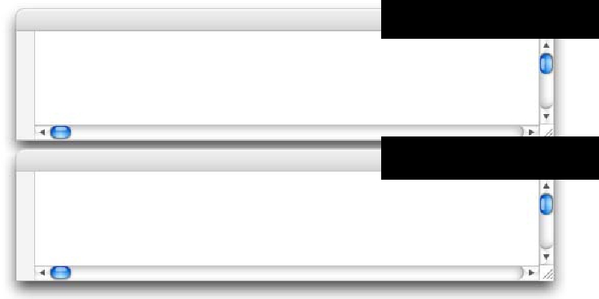
Conflict can occur between
CSS rules in different types
of style sheets.
Browser style sheet
h2 { color: blue; }
Author style sheet
h2 { color: red; }

Slide 29
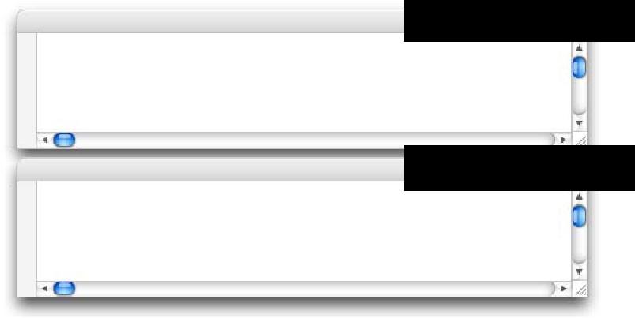
Conflict can occur between
CSS rules in within the one or
more author style sheets.
Author style sheet 1
h2 { color: blue; }
Author style sheet 2
h2 { color: red; }
h2 { color: green; }

Slide 30
So which
CSS rules
“win”?

Slide 31

There are four steps
to determine which CSS rules
will “win” (be applied to an
HTML document)

Slide 32
Step 1

Slide 33
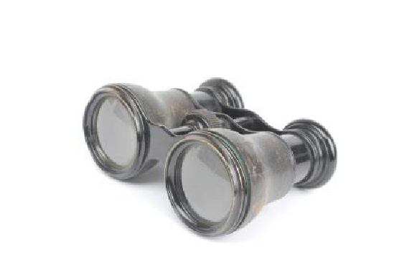
Gather all the declarations
that apply to an element and
property from browser, author
and user style sheets

Slide 34
For example, find any
declarations that matches:
element = h2
property = color

Slide 35
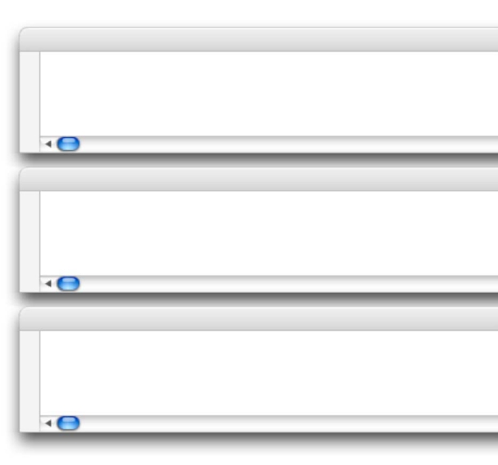
Gathered declarations
Browser style sheet
User style sheet
Author style sheets
h2 { color: black; }
h2 { color: green; }
h2 { color: blue; }
#nav h2 { color: lime; }

Slide 36

If there are declarations from
more than one of these three
sources, proceed to step 2.

Slide 37
Step 2

Slide 38

Sort the gathered declarations
according to origin (browser,
author, user style sheets) and
importance (normal or
!important).

Slide 39
What is
!important?

Slide 40
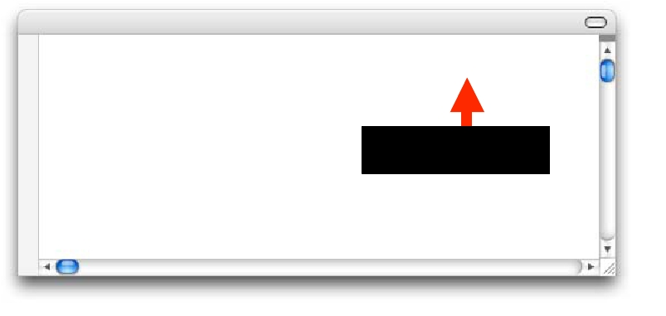
Authors can assign
“!important” to any
declaration.
h2 { color: red !important;}
!important

Slide 41

"!important" declarations
override normal declarations
(Normal declarations are
declarations that do not
contain !important).

Slide 42
So, how are
declarations
sorted?

Slide 43
From lowest to highest priority
1
2
3
4
5
browser styles
normal declarations in user style sheet
normal declarations in author style sheet
!important declarations in author style sheet
!important declarations in user style sheet

Slide 44
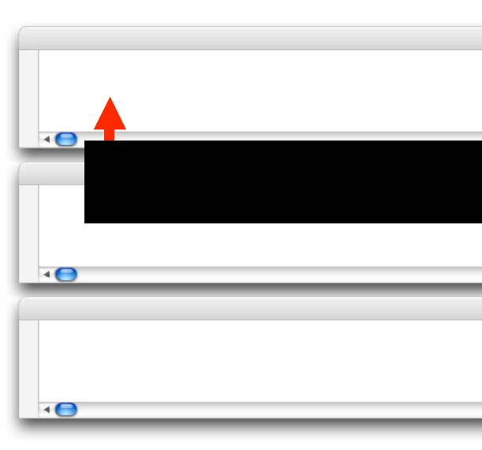
1. Browser styles
Browser style sheet
User style sheet
Author style sheets
h2 { color: black; }
If no other declarations exist,
browser declarations win

Slide 45
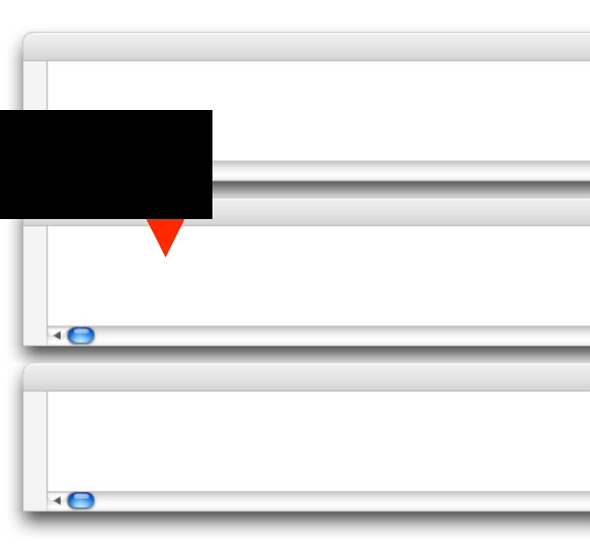
2. Normal user styles
Browser style sheet
h2 { color: black; }
Normal user declarations beat
browser declarations
User style sheet
Author style sheets
h2 { color: green; }

Slide 46
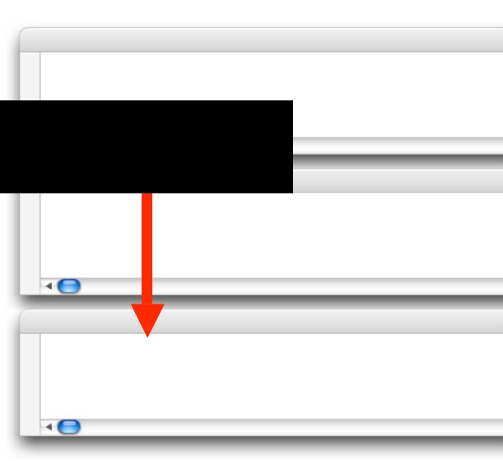
3. Normal author styles
Browser style sheet
h2 { color: black; }
Normal author declarations beat browser
declarations and normal user declarations
User style sheet
Author style sheets
h2 { color: green; }
h2 { color: blue; }

Slide 47
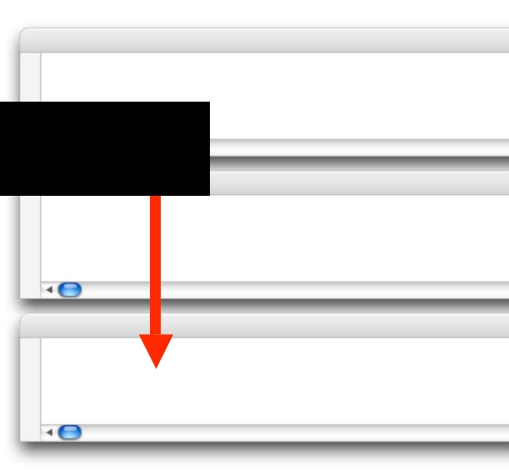
4. !important author styles
Browser style sheet
h2 { color: black; }
!important author declarations beat
all normal declarations
User style sheet
Author style sheets
h2 { color: green; }
h2 { color: blue; }
h2 { color: lime !important; }

Slide 48
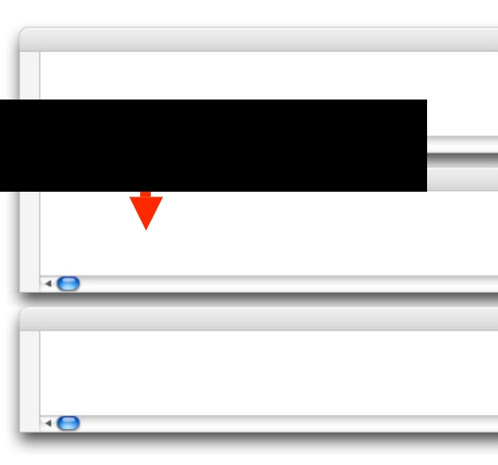
5. !important user styles
Browser style sheet
h2 { color: black; }
!important user declarations beat !important author
declarations and all normal declarations
User style sheet
Author style sheets
h2 { color: green; }
h2 { color: red !important;}
h2 { color: blue; }
h2 { color: lime !important; }

Slide 49

But what if two declarations
have the same origin
or importance?

Slide 50
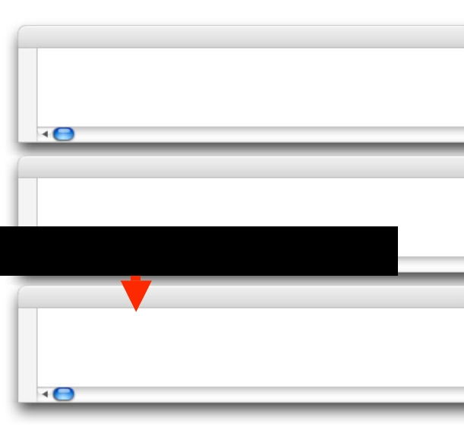
Two matching declarations
Browser style sheet
User style sheet
h2 { color: black; }
h2 { color: green; }
Two declarations with the same origin and importance
Author style sheets
h2 { color: blue; }
h2 { color: lime; }

Slide 51
If declarations have the same
origin or importance then
proceed to Step 3.

Slide 52
Step 3

Slide 53

If declarations have the same
origin or importance then the
declaration’s selectors need
to be scored, to see which
declaration will “win”.

Slide 54
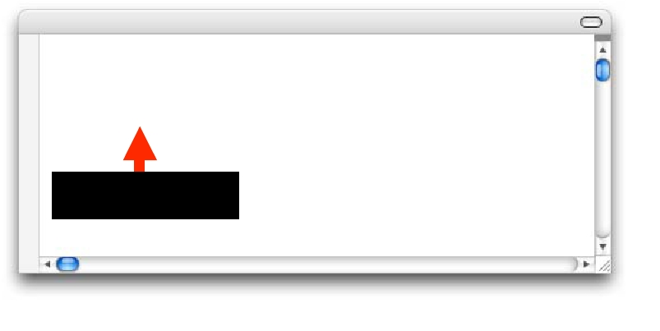
Selectors
#nav h2 { color: blue; }
h2.intro { color: red; }
Selectors

Slide 55
Four scores are concatenated
(linked together as a chain) to
create a final score.
a,b,c,d

Slide 56

This score is referred to as a
selector’s specificity.

Slide 57
So how is
specificity
calculated?

Slide 58
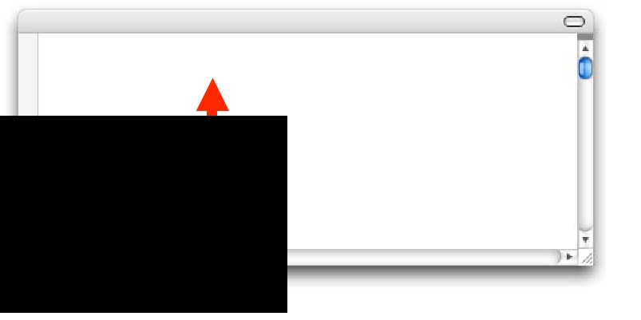
A. Is there an inline style?
<h2 style=“color: red;”>
This is a heading
a = 1 x </h2>
inline styles
b = 0 x ID<p>
c = 0 x classes Here is a paragraph of
d = 0 x element
Specificity = 1,0,0,0

Slide 59
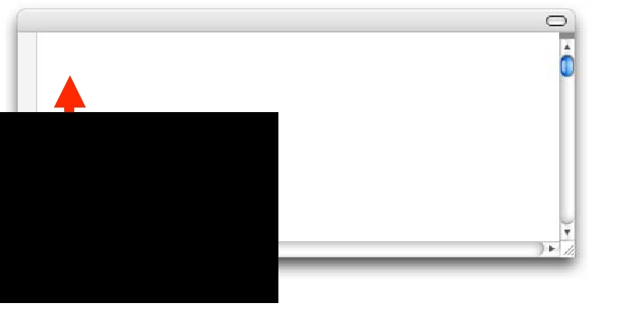
B. Count the number of IDs
in the selectors.
#nav { color: red; }
a = 0 x inline styles
b = 1 x ID
c = 0 x classes
d = 0 x element
Specificity = 0,1,0,0

Slide 60
C. Count the number of
classes, attributes and
pseudo-classes.
.main { color: red; }
a = 0 x inline styles
b = 0 x ID
c = 1 x classes
d = 0 x element
Specificity = 0,0,1,0

Slide 61
D. Count the number of
element names or pseudo-
elements.
h2 { color: red; }
a = 0 x inline styles
b = 0 x ID
c = 0 x classes
d = 1 x element
Specificity = 0,0,0,1

Slide 62
A note on
concatenation

Slide 63

“A” will always beat “B”, which
will always beat “C”, which will
always beat “D”.

Slide 64

No matter how many IDs are
used in a selector, an inline
style will always win.
(unless !important is used within the ID’s declaration)

Slide 65
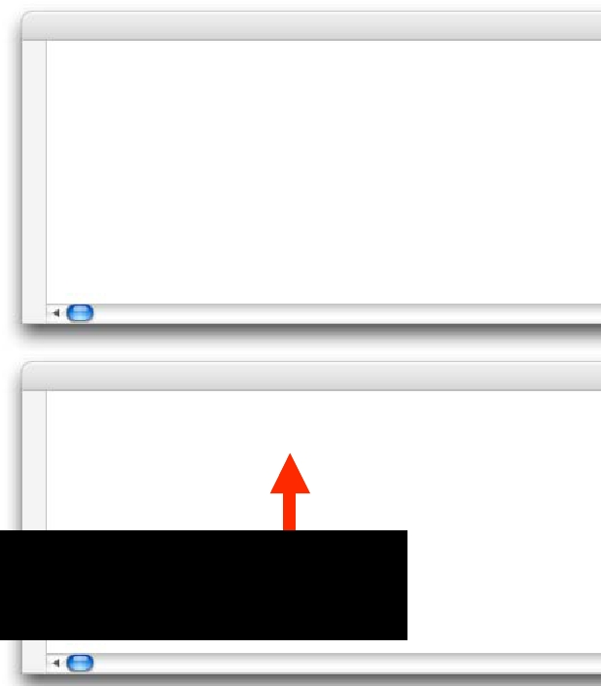
External style sheets
and header styles
(Author styles)
HTML document with
inline styles
(Author styles)
#one #two #three #four #five
#six #seven #eight #nine #ten
{ color: green; }
<h2 style=“color: purple;”>
The highlighted style wins due to specificity -
1,0,0,0 beats 0,10,0,0

Slide 66
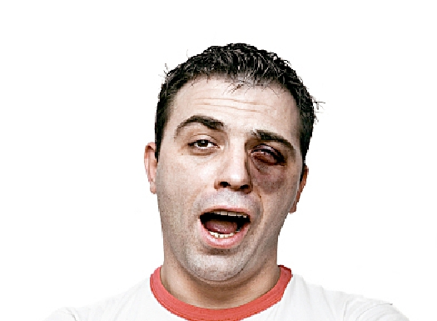
No matter how many classes
are applied to a selector, an ID
can easily win

Slide 67
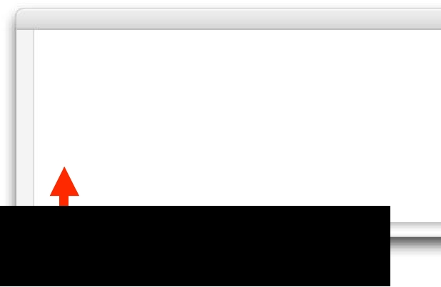
External style sheets
and header styles
(Author styles)
.one .two .three .four .five
.six .seven .eight .nine .ten
{ color: green; }
#nav { color: lime; }
The highlighted selector wins due to specificity -
0,1,0,0 beats 0,0,10,0

Slide 68

No matter how many elements
are applied to a selector, a
class can easily win.

Slide 69
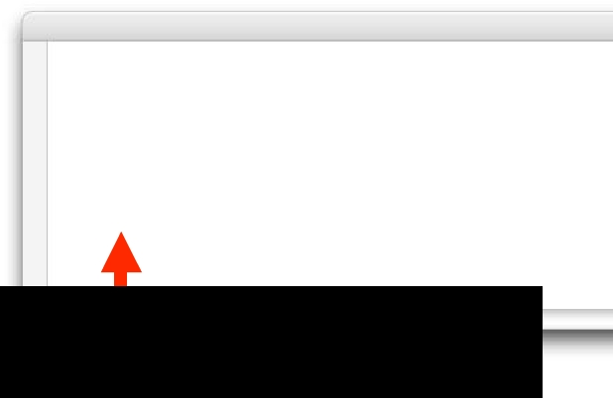
External style sheets
and header styles
(Author styles)
div div div div div form
fieldset div label span
{ color: green; }
.intro { color: lime; }
The highlighted selector wins due to specificity -
0,0,1,0 beats 0,0,0,10

Slide 70
Complex
examples of
specificity

Slide 71
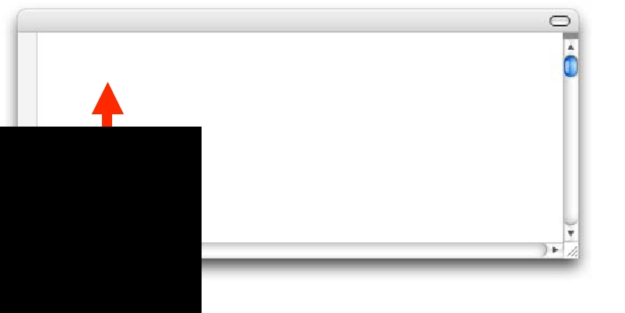
ID and element
#nav h2 { color: red; }
a = 0 x inline styles
b = 1 x ID (#nav)
c = 0 x classes
d = 1 x element (h2)
Specificity = 0,1,0,1

Slide 72
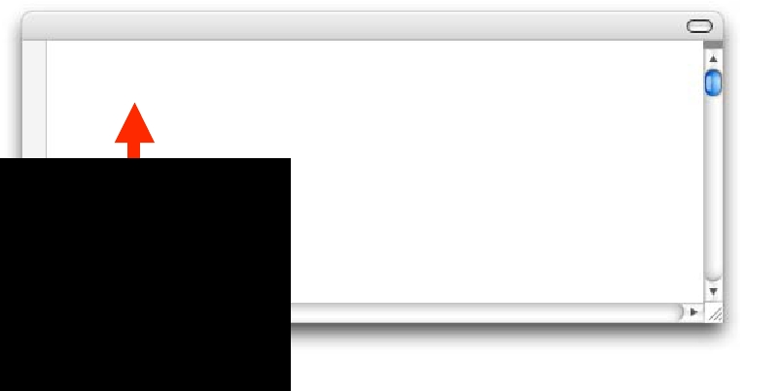
Element and class
h2.intro { color: red; }
a = 0 x inline styles
b = 0 x ID
c = 1 x classes (.intro)
d = 1 x element (h2)
Specificity = 0,0,1,1
<h2 class="intro"></h2>
<h2 class="abc intro"></h2>
<h2 class="abc intro-a"></h2>

Slide 73
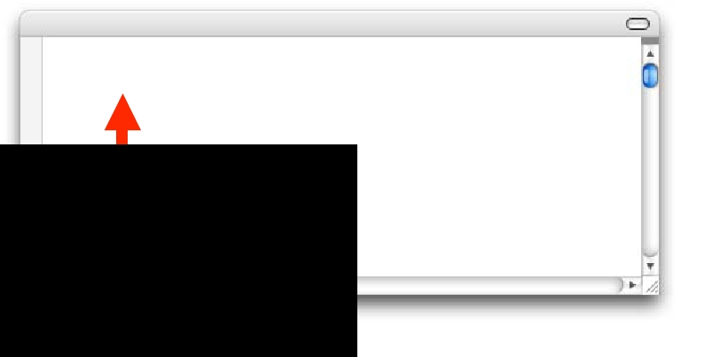
ID, elements and pseudo-class
#nav ul li a:hover { color:
a = 0 x inline styles
b = 1 x ID (#nav)
c = 1 x pseudo-class (:hover)
d = 3 x elements (ul, li, a)
Specificity = 0,1,1,3

Slide 74
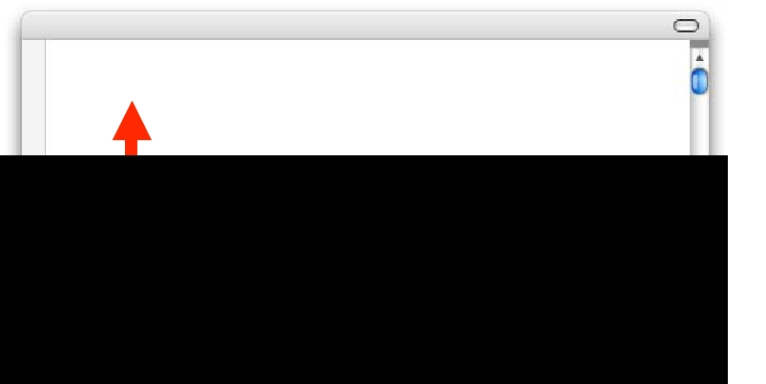
Element and pseudo-element
p::first-line { color: green
a = 0 x inline styles
b = 0 x ID
c = 0 x classes
d = 2 x element (p) and pseudo-element (::first-line)
Specificity = 0,0,0,2

Slide 75
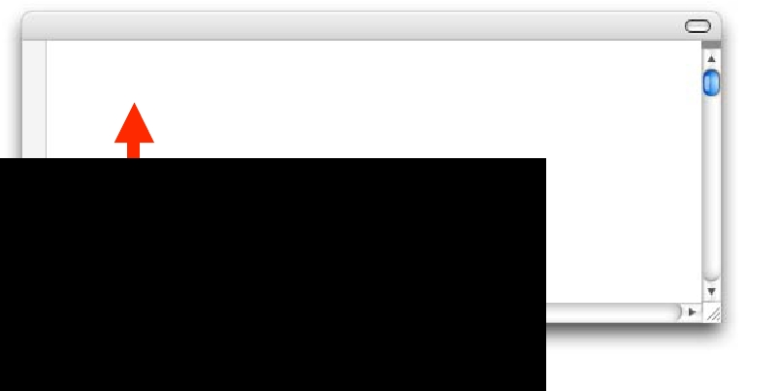
Element and attribute selector
h2[title=“intro”] { color:
a = 0 x inline styles
b = 0 x ID
c = 1 x attribute selector ([title=“intro”])
d = 1 x element (h2)
Specificity = 0,0,1,1

Slide 76
What if there
is still no
clear winner?

Slide 77
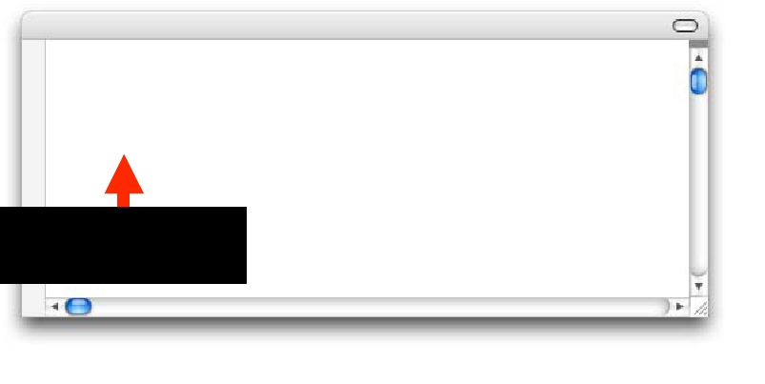
Selectors with same specificity
#nav h2 { color: red; }
#nav h2 { color: green; }
Specificity = 0,1,0,1

Slide 78

If there is still no clear winner
then proceed to Step 4.

Slide 79
Step 4

Slide 80

If two declarations have the
same importance, origin and
specificity, the latter specified
declaration wins

Slide 81
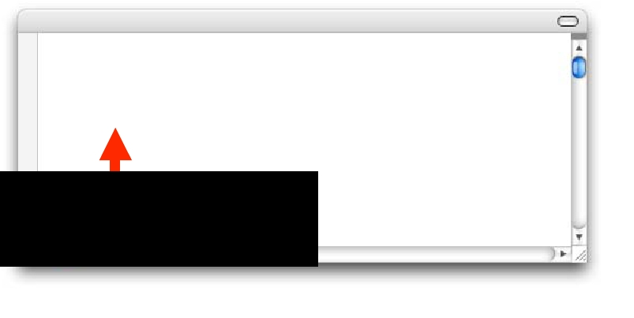
Equal-weight declarations
#nav h2 { color: green; }
#nav h2 { color: red; }
The second declaration wins
as it is written after the first.

Slide 82
And now…
a guessing
game

Slide 83
Exercise 1
browser, user, author

Slide 84
Part 1: Which one wins?

Slide 85
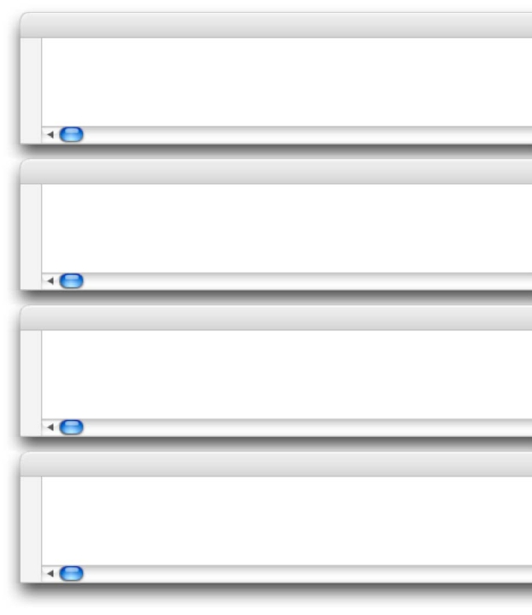
Browser style sheet
User style sheet
External style sheets
and header styles
(Author styles)
HTML document with
inline styles
(Author styles)
h2 { color: black; }
h2 { color: green; }

Slide 86
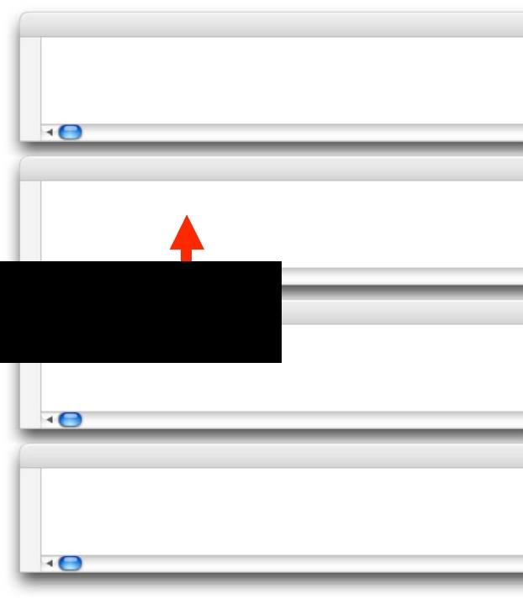
Browser style sheet
User style sheet
h2 { color: black; }
h2 { color: green; }
Normal user declarations beats browser
External style sheets
and header styles
(Author styles)
HTML document with
inline styles
(Author styles)

Slide 87
Part 2: Which one wins?

Slide 88
Browser style sheet
User style sheet
External style sheets
and header styles
(Author styles)
HTML document with
inline styles
(Author styles)
h2 { color: black; }
h2 { color: green; }
h2 { color: blue; }

Slide 89
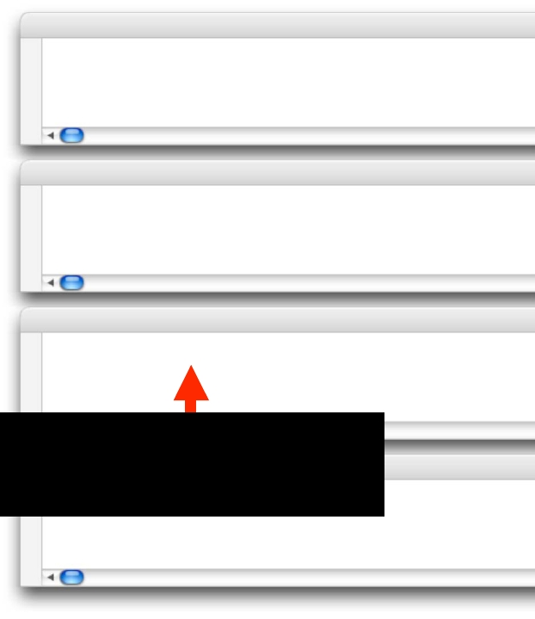
Browser style sheet
User style sheet
External style sheets
and header styles
(Author styles)
h2 { color: black; }
h2 { color: green; }
h2 { color: blue; }
Normal author declarations beat browser and
HTML
inline styles
(Author styles)

Slide 90
Part 3: Which one wins?

Slide 91
Browser style sheet
User style sheet
External style sheets
and header styles
(Author styles)
HTML document with
inline styles
(Author styles)
h2 { color: black; }
h2 { color: green; }
h2 { color: blue; }
<h2 style=“color: purple;”>

Slide 92
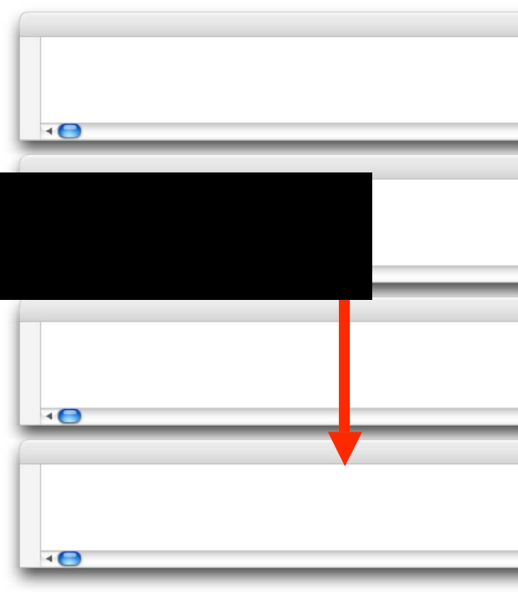
Browser style sheet
h2 { color: black; }
User style sheet
external and header declarations due to
specificity: 1,0,0,0 beats 0,0,0,1
External style sheets
and header styles
(Author styles)
HTML document with
inline styles
(Author styles)
h2 { color: blue; }
<h2 style=“color: purple;”>

Slide 93
Part 4: Which one wins?

Slide 94
Browser style sheet
User style sheet
External style sheets
and header styles
(Author styles)
HTML document with
inline styles
(Author styles)
h2 { color: black; }
h2 { color: green; }
h2 { color: blue; }
h2 { color: lime !important; }
<h2 style=“color: purple;”>

Slide 95
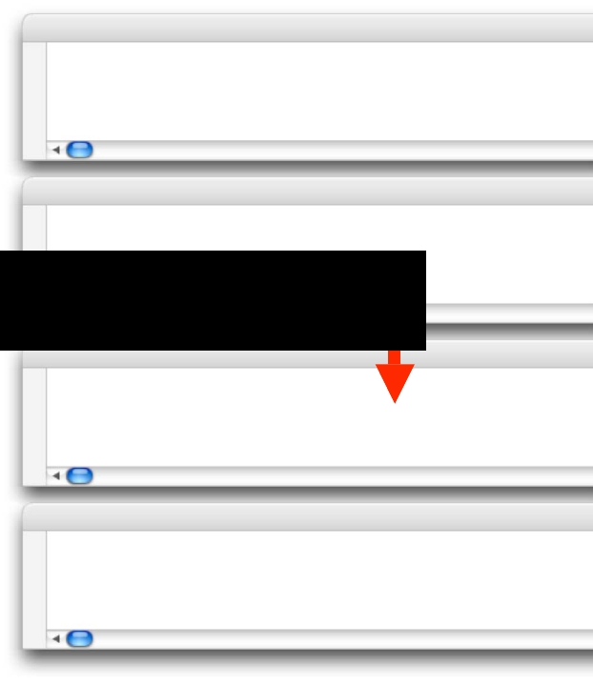
Browser style sheet
User style sheet
h2 { color: black; }
h2 { color: green; }
!important author declarations beat normal
browser, user and author declarations
External style sheets
and header styles
(Author styles)
HTML document with
inline styles
(Author styles)
h2 { color: blue; }
h2 { color: lime !important; }
<h2 style=“color: purple;”>

Slide 96
Part 5: Which one wins?

Slide 97
Browser style sheet
User style sheet
External style sheets
and header styles
(Author styles)
HTML document with
inline styles
(Author styles)
h2 { color: black; }
h2 { color: green; }
h2 { color: blue; }
h2 { color: lime !important; }
<h2 style=“color: purple
!important;”>

Slide 98

Browser style sheet
h2 { color: black; }
User style sheet
!important external author and header declarations
due to specificity: 1,0,0,0 beats 0,0,0,1
External style sheets
and header styles
(Author styles)
HTML document with
inline styles
(Author styles)
h2 { color: blue; }
h2 { color: lime !important; }
<h2 style=“color: purple
!important;”>

Slide 99
Part 6: Which one wins?

Slide 100
Browser style sheet
User style sheet
External style sheets
and header styles
(Author styles)
HTML document with
inline styles
(Author styles)
h2 { color: black; }
h2 { color: green; }
h2 { color: gray !important; }
h2 { color: blue; }
h2 { color: lime !important; }
<h2 style=“color: purple
!important;”>

Slide 101

Browser style sheet
author declarations (regardless of whether they
are external, header or inline)
User style sheet
External style sheets
and header styles
(Author styles)
HTML document with
inline styles
(Author styles)
h2 { color: green; }
h2 { color: gray !important; }
h2 { color: blue; }
h2 { color: lime !important; }
<h2 style=“color: purple
!important;”>

Slide 102
Exercise 2
author external, header
and inline CSS

Slide 103
Part 1: Which one wins?

Slide 104

External style sheets
and header styles
(Author styles)
h2.news { color: #eee; }
h2 { color: blue; }

Slide 105

The highlighted declaration wins due to
specificity - 0,0,1,1 beats 0,0,0,1
External style sheets
and header styles
(Author styles)
h2.news { color: #eee; }
h2 { color: blue; }

Slide 106
Part 2: Which one wins?

Slide 107
External style sheets
and header styles
(Author styles)
h2.news { color: #eee; }
h2 { color: blue; }
h2.news { color: green; }

Slide 108

The highlighted declaration has the same
specificity as the first declaration (0,0,1,1).
However, as it is written later, it wins!
External style sheets
and header styles
(Author styles)
h2.news { color: #eee; }
h2 { color: blue; }
h2.news { color: green; }

Slide 109
Part 3: Which one wins?

Slide 110
External style sheets
and header styles
(Author styles)
#nav h2 { color: lime; }
h2.news { color: #eee; }
h2 { color: blue; }
h2.news { color: green; }

Slide 111

The highlighted selector wins due to specificity -
0,1,0,1 beats 0,0,1,1 and 0,0,0,1
External style sheets
and header styles
(Author styles)
#nav h2 { color: lime; }
h2.news { color: #eee; }
h2 { color: blue; }
h2.news { color: green; }

Slide 112
Part 4: Which one wins?

Slide 113
External style sheets
and header styles
(Author styles)
#nav h2 { color: lime; }
h2.news { color: #eee; }
h2 { color: blue; }
h2.news { color: green; }
div#nav h2 { color: lime; }

Slide 114

The highlighted selector wins due to specificity -
0,1,0,2 beats 0,1,0,1 and 0,0,1,1 and 0,0,0,1
External style sheets
and header styles
(Author styles)
#nav h2 { color: lime; }
h2.news { color: #eee; }
h2 { color: blue; }
h2.news { color: green; }
div#nav h2 { color: lime; }

Slide 115
We’re done!

