Slide 1
Web开发中的目录概念
北京乐美无限科技有限公司

Slide 2
目录、文件夹、路径

Slide 3
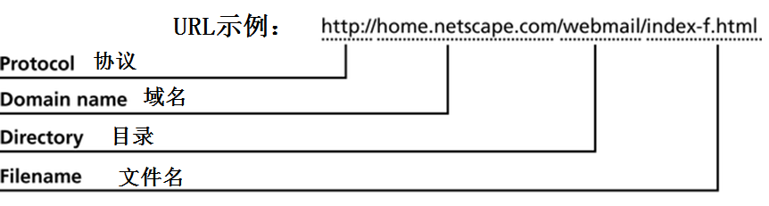
URL（ 统一资源定位器）
包含4部分:
协议（Protocol） → Hyper Text Transfer Protocol (HTTP)超文本传输协议
域名（Domain Name） → Internet Protocol (IP) 地址
Directory
Filename
指定文档的文件名称
index.(s)htm(l) 或 default.(s)htm(l) 或其他
Notes:
域名查询DOS命令：nslookup
Let’s dissect the parts of a URL (uniform resource locator). I’ll tell you how we typically refer to different parts of a URL at Google. Here’s a valid URL which has lots of components:
http://video.google.co.uk:80/videoplay?docid=-7246927612831078230&hl=en#00h02m30s
Here are some of the components of the url:
The protocol is http. Other protocols include https, ftp, etc.
The host or hostname is video.google.co.uk.
The subdomain is video.
The domain name is google.co.uk.
The top-level domain or TLD is uk. The uk domain is also referred to as a country-code top-level domain or ccTLD. For google.com, the TLD would be com.
The second-level domain (SLD) is co.uk.
The port is 80, which is the default port for web servers. Other ports are possible; a web server can listen on port 8000, for example. When the port is 80, most people leave out the port.
The path is /videoplay. Path typically refers to a file or location on the web server, e.g. /directory/file.html
This URL has parameters. The name of one parameter is docid and the value of that parameter is -7246927612831078230. URLs can have lots parameters. Parameters start with a question mark (?) and are separated with an ampersand (&).
See the “#00h02m30s”? That’s called a fragment or a named anchor. The Googlers I’ve talked to are split right down the middle on which way to refer it. Disputes on what to call it can be settled with arm wrestling, dance-offs, or drinking contests. Typically the fragment is used to refer to an internal section within a web document. In this case, the named anchor means “skip to 2 minutes and 30 seconds into the video.” I think right now Google standardizes urls by removing any fragments from the url.
What is a static url vs. a dynamic url? Technically, we consider a static url to be a document that can be returned by a webserver without the webserver doing any computation. A dynamic url is a document that requires the webserver to do some computation before returning the web document.
Some people simplify static vs. dynamic urls to an easier question: “Does the url have a question mark?” If the url has a question mark, it’s usually considered dynamic; no question mark in the url often implies a static url. That’s not a hard and fast rule though. For example, urls that look static like http://news.google.com/ may require some computation by the web server. Most people just refer to urls as static or dynamic based on whether it has a question mark though.

Slide 4
根目录、路径
文件系统中的根目录
Windows盘符下的根目录
Unix/linux文件系统的根目录
URL网址中的根目录
位于主机名/域名之后的第一个反斜杠/
网址根目录与目标文件名之间的字符串，称之为路径

Slide 5
绝对路径
从根目录（/）开始的路径，称之为“绝对路径”

Slide 6
相对路径
"/"代表Web应用的跟目录。和物理路径的相对表示。
不是以“/”开头的路径，称之为相对路径。
非”/”的字符开头，如果是一个单词，比如：”abc”, abc代表着当前目录下的一个文件或者一个子目录（文件夹）名。
“./” 代表当前目录, ./abc abc 意思相同，也就是说，可以将./省略。
“../”代表当前目录的上一级目录。

Slide 7
HTML中的相对地址
url网址中，html文件名左侧的部分，称之为“当前目录”。
以当前目录为“基准地址”，HTML文件里面所引用到的js文件、图片文件、css文件等等，所在的目录相对于“基准地址”的路径，称之为HTML相对路径。

Slide 8
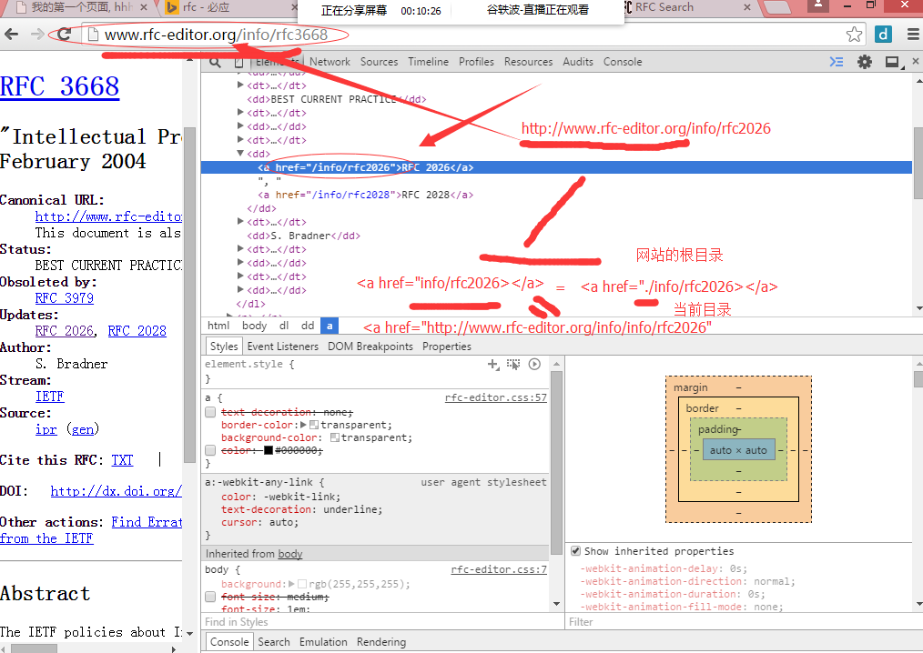
HTML中的相对地址

Slide 9
CSS文件中相对地址
CSS文件中出现的相对路径，其参考的基准地址，也就是当前工作目录，指的是CSS文件本身所在的路径，与HTML文件没有关系。

