Slide 1
Study of the correlation between five dimensions of personality
Farnaz Sharif

Slide 2
Question: how much different dimension of personality are correlated that helps to understand single or multiple personality trait in an individual.
A data frame with 2800 observations on the following 28 variables.
A1.Am indifferent to the feelings of others. (q_146)
A2.Inquire about others' well-being. (q_1162)
A3.Know how to comfort others. (q_1206)
A4.Love children. (q_1364)
A5.Make people feel at ease. (q_1419)
C1.Am exacting in my work. (q_124)
C2.Continue until everything is perfect. (q_530)
C3.Do things according to a plan. (q_619)
C4.Do things in a half-way manner. (q_626)
C5.Waste my time. (q_1949)
E1.Don't talk a lot. (q_712)
E2.Find it difficult to approach others. (q_901)
E3.Know how to captivate people. (q_1205)
E4.Make friends easily. (q_1410)
E5.Take charge. (q_1768)
N1.Get angry easily. (q_952)
N2.Get irritated easily. (q_974)
N3.Have frequent mood swings. (q_1099
N4.Often feel blue. (q_1479)
N5.Panic easily. (q_1505)
O1.Am full of ideas. (q_128)
O2.Avoid difficult reading material.(q_316)
O3.Carry the conversation to a higher level. (q_492)
O4.Spend time reflecting on things. (q_1738)
O5.Will not probe deeply into a subject. (q_1964)
genderMales = 1, Females =2
education1 = HS, 2 = finished HS, 3 = some college, 4 = college graduate 5 = graduate degree
age in years

Slide 3
Grouping data and scoring answers
The first 25 items are organized by five putative factors:
Agreeableness, Conscientiousness, Extraversion, Neuroticism, and Opennness.
The item data were collected using a 6 point response scale:
1 = Very Inaccurate
2 = Moderately Inaccurate
3 = Slightly Inaccurate
4 = Slightly Accurate
5 = Moderately Accurate
6 = Very Accurate

Slide 4
Personalities based on the scores of each categorical question.

Slide 5
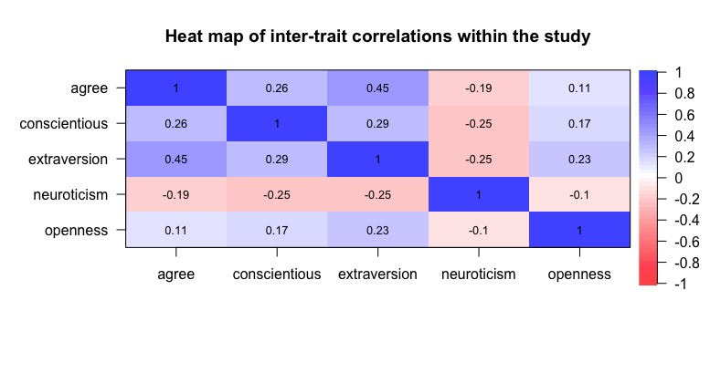
Inter-trait correlation of the five histograms

Slide 6
Age and personality

Slide 7
Gender and personality

