Slide 1
بسم الله الرحمن الرحیم
Course name: Advanced Probability and Statistic
Instructor: Dr. Mohsen Nasseri, Associate Prof., School of Civil Engineering, University of Tehran.
Students: Farnaz Sadat Shahi
Project: Sensitivity Analysis: PAWN Sensitivity Index

Slide 2

Sensitivity Analysis: PAWN Sensitivity Index
Advanced Probability and Statistic

Slide 3
Sensitivity analysis: Sensitivity analysis is the study of how the uncertainty in the output of a mathematical model or system (numerical or otherwise) can be divided and allocated to different sources of uncertainty in its inputs
Sensitivity analysis methods:
One-at-a-time (OAT)
Derivative-based local methods
Regression analysis
Variance-based methods
Variogram analysis of response surfaces (VARS)
Screening
Scatter plots

Slide 4
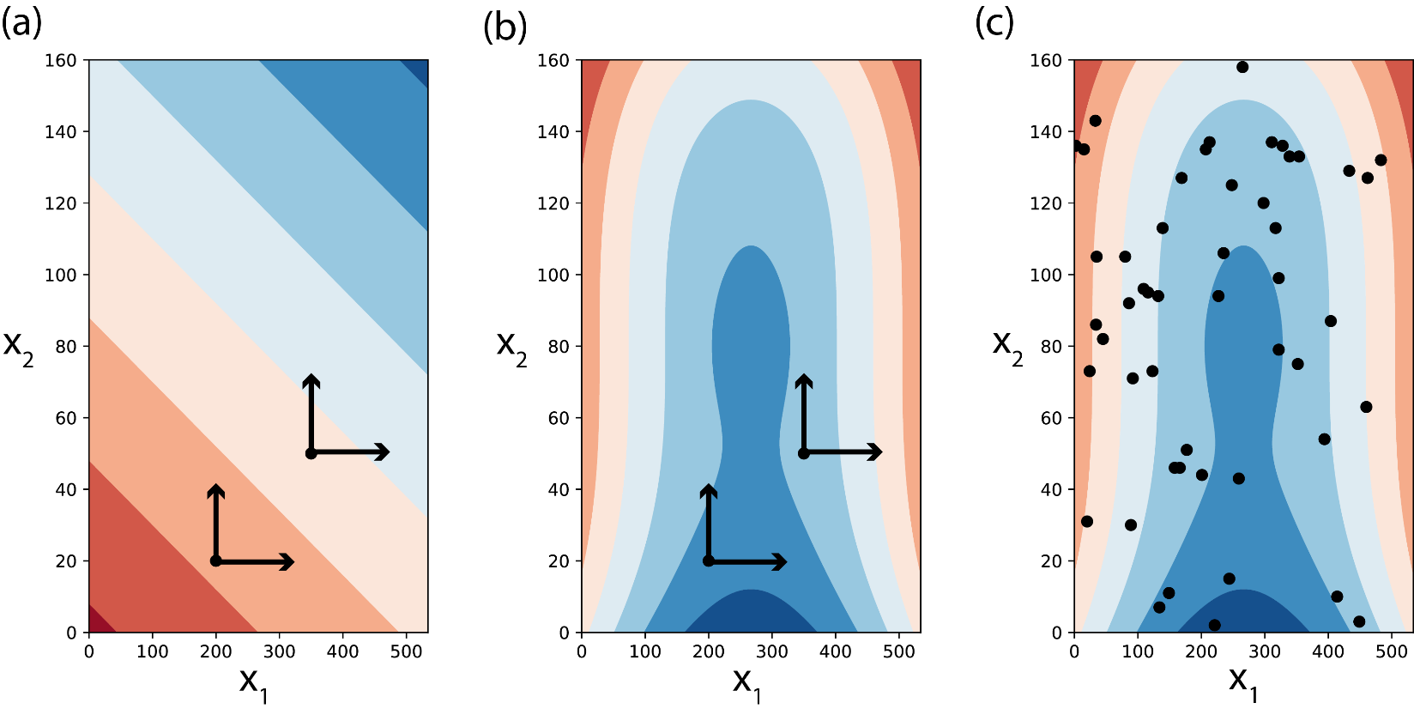
Local and global sensitivity analysis

Slide 5
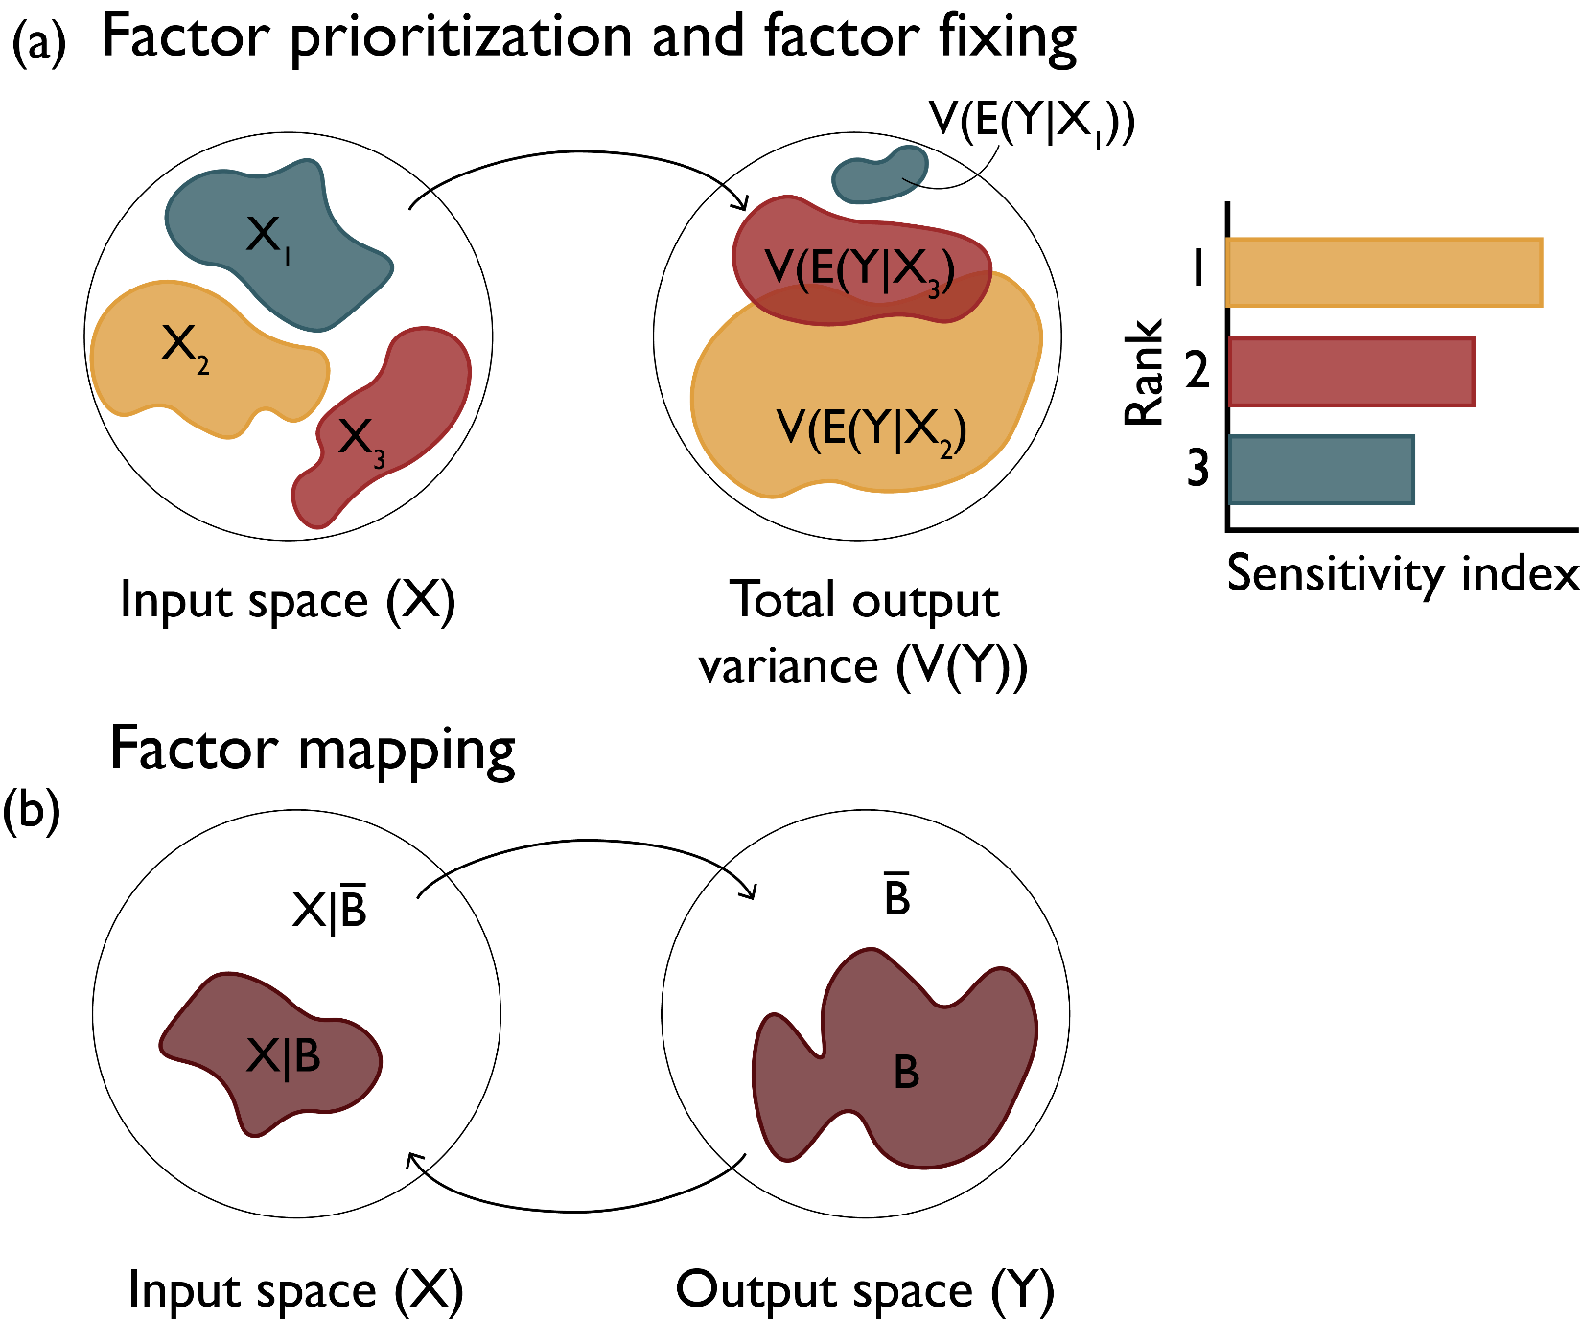
Purposes of sensitivity analysis
Factor Priorization (FP) aims at ranking the inputs xi in terms of their relative contribution to output uncertainty.
Factor Fixing (FF), or screening, aims at determining the inputs, if any, that do not give any contribution to output uncertainty.
Factor Mapping (FM) aims at determining the regions in the inputs space that produce specific output values, for instance above a prescribed threshold.

Slide 6
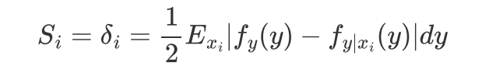

Variance-based Methods
decomposition and analysis of output variance can determine a model’s sensitivity to input parameters.
$Si^{1}=\frac{Vi}{V\left(Y\right)}$ $Vi={Var}_{xi}(E_{X\sim i}\left(Y | Xi\right))$
The X~i notation indicates the set of all variables except Xi.
Moment-Independent (Density-Based) Methods
compare the entire distribution (i.e., not just the variance) of input and output parameters.

Slide 7

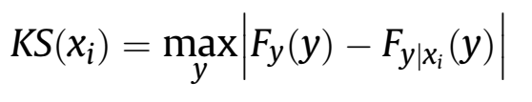
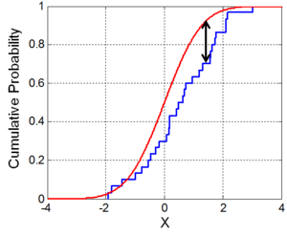

The PAWN sensitivity index:
the sensitivity to input xi is measured by the distance between the unconditional CDF of y that is obtained when all inputs vary simultaneously, and the conditional CDF that are obtained when varying all inputs but xi (i.e. xi is fixed at a nominal value xi).
In our approach, in contrast to other density-based approaches, the distributions are characterized by their CDFs rather PDFs. The reason is that they are much easier to approximate.
As a measure of distance between unconditional and conditional CDFs, it use the Kolmogorov-Smirnov statistic.
As KS depends on the value at which we fix xi, the PAWN index Ti considers a statistic (e.g. the maximum or the median) over all possible values of xi:
Obviously:
Ti varies between 0 and 1.
The lower the value of Ti, the less influential xi.
If Ti=0, then xi has no influence on y.

Slide 8
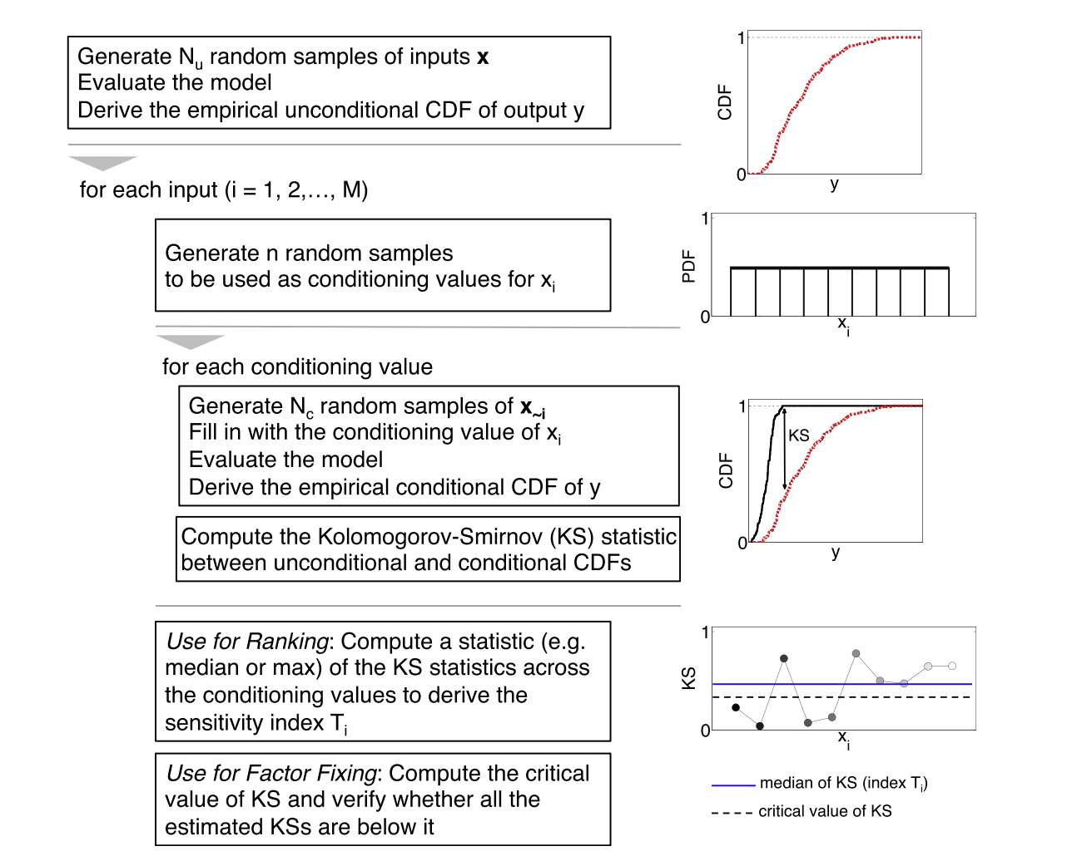
Numerical implementation of the PAWN index.

Slide 9

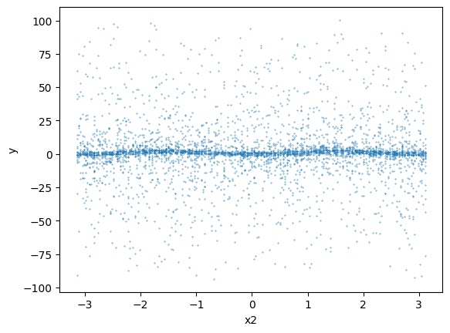
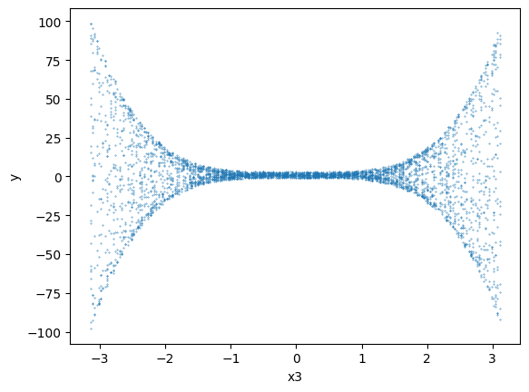
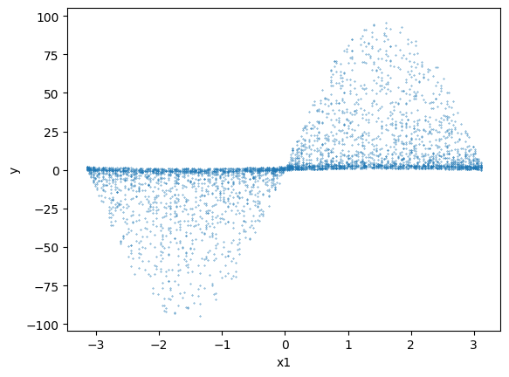
Numerical example 1
We apply PAWN to one of the most frequently used benchmark models in the Sensitivity Analysis literature, the Ishigami-Homma function:
all xi follow a uniform distribution over (-pi,+pi)and a= 2 and b= 1
x1 seems to be the most influential input;
x2 seems to be non-influential.

Slide 10
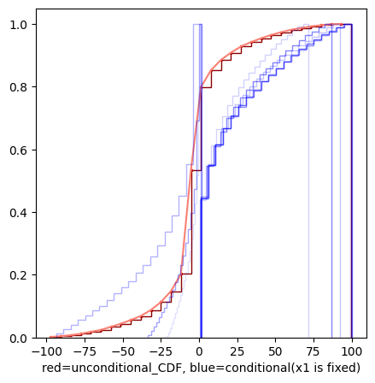
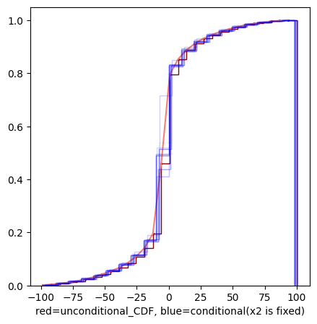
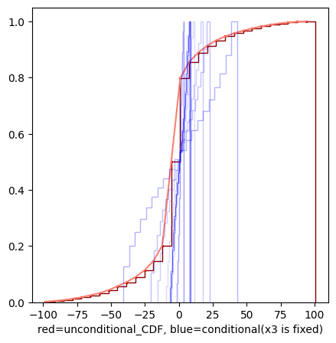
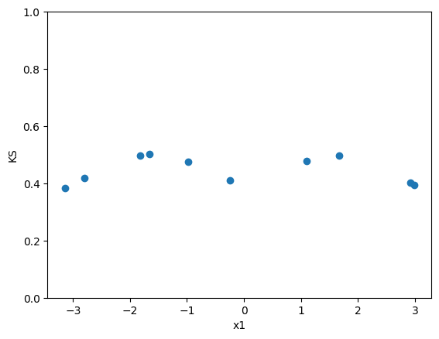
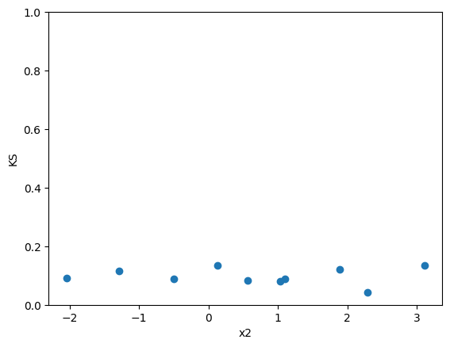
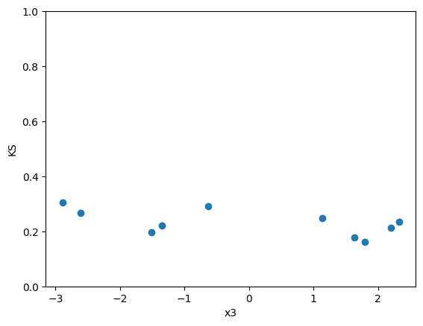
If we apply our PAWN approach we obtain the three sets of conditional CDFs.
Then By computing Kolmogorov-Smirnov statistic between unconditional and conditional CDFs we can compute PAWN sensitivity indexes:
PAWN Sensitivity indexes:
median_kstest_values1= 0.448
median_kstest_values2= 0.090
median_kstest_values3= 0.228

Slide 11


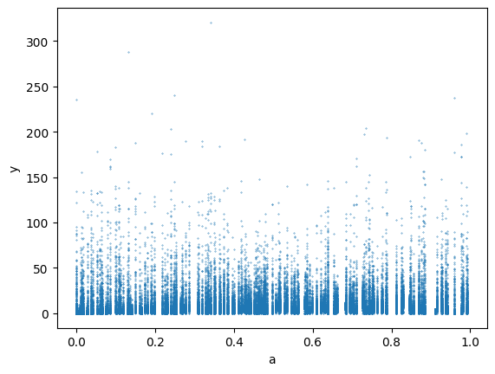
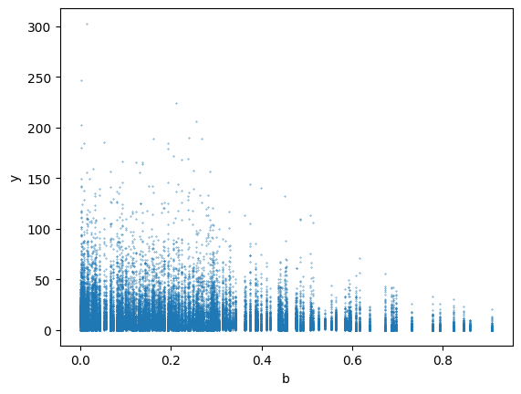
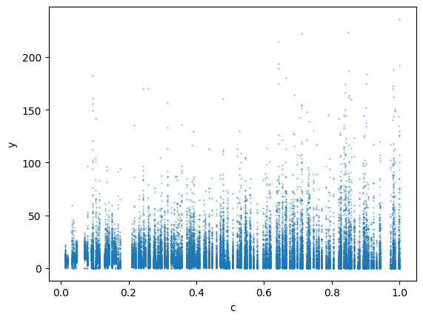
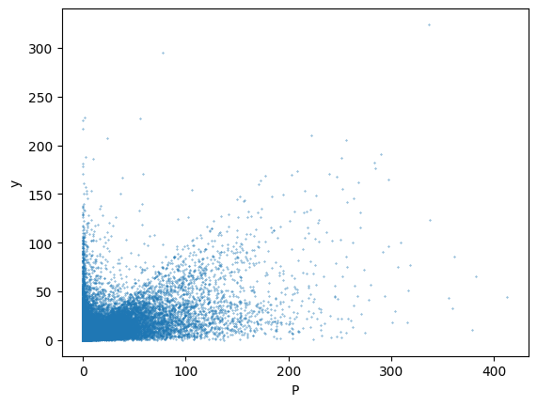
Numerical example 2:
Also we apply PAWN to the abc model for modeling relationships among precipitation, evapo-transpiration, groundwater storage, and streamflow using only three model parameters:
Since the parameters represent fractions they have upper and lower limits 0<a,b,c<1, and since infiltration and evapotranspiration combined cannot exceed total precipitation, 0<a+b<1.
A,b,c has uniform distribution. We fit different distribution on precipitation data and find that betta distribution is best fit.
b and p seem to be the most influential inputs;
a and c seem to be less influential.

Slide 12
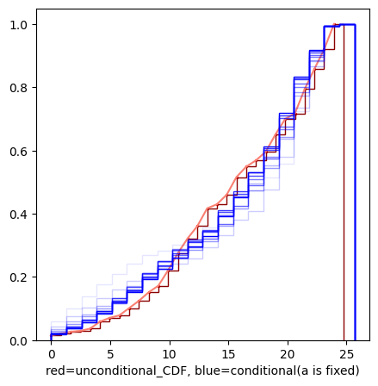
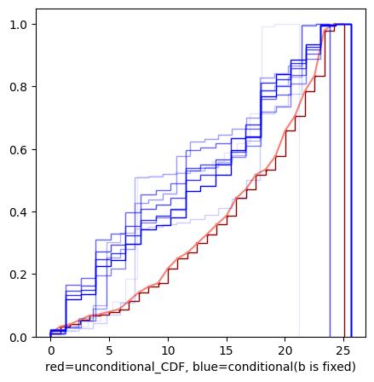
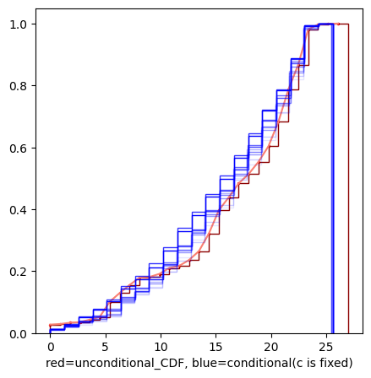
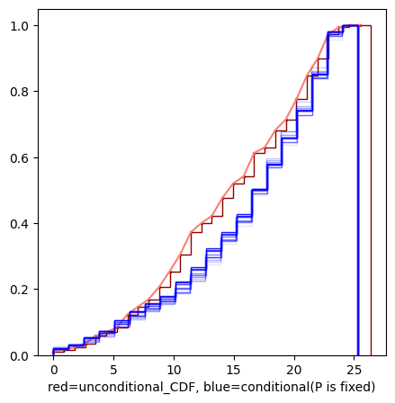
If we apply our PAWN approach, we obtain the four sets of conditional CDFs.
Visual analysis of the CDFs shows b is most influential and then P is more influential than two other inputs, as their conditional CDFs are more widespread around the unconditional one (red line), while those of a and c almost overlap with the unconditional CDF.

Slide 13
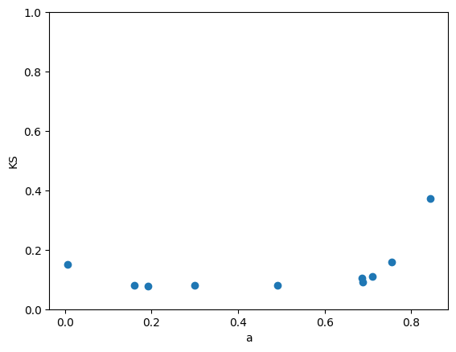
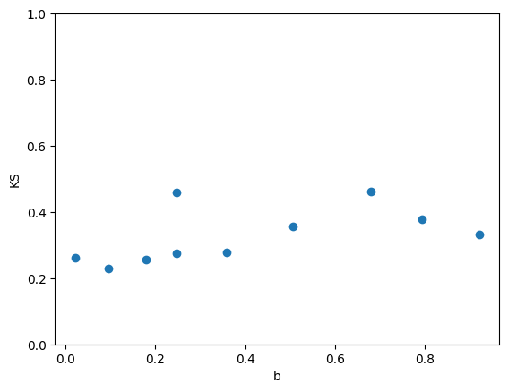
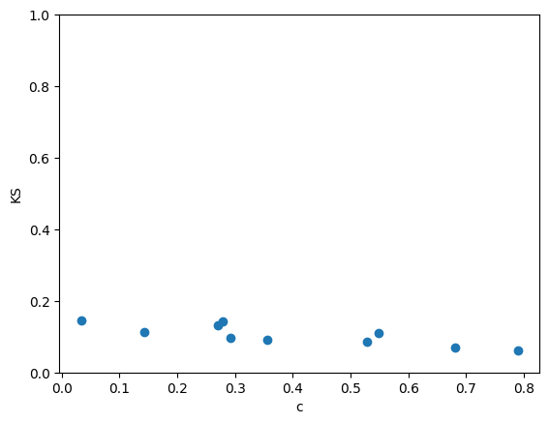
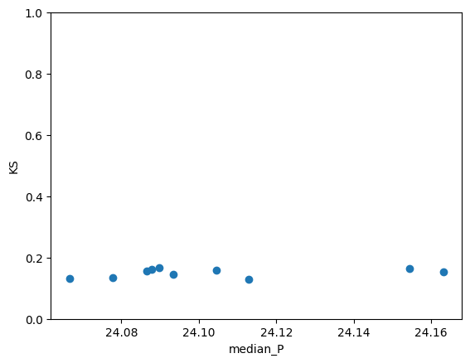
Then By computing Kolmogorov-Smirnov statistic between unconditional and conditional CDFs we can compute PAWN sensitivity indexes:
If we consider median as statistic the PAWN sensitivity indices are equal to:
PAWN Sensivity indexes
median_kstest_values_a= 0.0988191
median_kstest_values_b= 0.3040550
median_kstest_values_c= 0.1029450
median_kstest_values_P= 0.1545337

Slide 14
References:
Pianosi, F., Beven, K., Freer, J., Hall, J. W., Rougier, J., Stephenson, D. B., & Wagener, T. (2016). Sensitivity analysis of environmental models: A systematic review with practical workflow. Environmental Modelling & Software, 79, 214-232. https://doi.org/https://doi.org/10.1016/j.envsoft.2016.02.008
Pianosi, F., & Wagener, T. (2015). A simple and efficient method for global sensitivity analysis based on cumulative distribution functions. Environmental Modelling & Software, 67, 1-11. https://doi.org/https://doi.org/10.1016/j.envsoft.2015.01.004
Reed, Patrick & Hadjimichael, Antonia & Malek, Keyvan & Karimi, Tina & vernon, chris & Srikrishnan, Vivek & Gupta, Rohini & Gold, David & Lee, Ben & Keller, Klaus & thurber, travis. (2022). Addressing Uncertainty in MultiSector Dynamics Research. 10.5281/zenodo.6110623.

