Slide 1
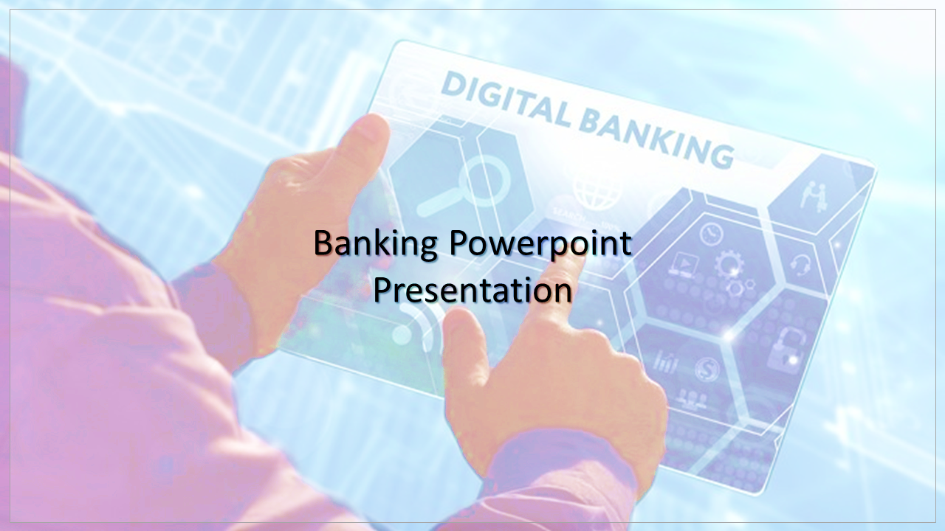
Title Layout
Subtitle
Bank of Baroda
By.
FAROOQ AHAMED S
SHASHTHIGA R

Slide 2

Problem Statement
Authentication measures of Caller ID / PIN (personal identification numbers) / Security Questions / Device Signatures are sometime inadequate and intrusive. Identify creative methods of Customer Authentication which can be used on various channels. This should be done without deteriorating the customer experience.
Objective
To Authenticate & continuously enhance Voice Signatures of Customers for interaction with the Bank via the following channels:
Contact Centre
Mobile App
Video Customer Identification Process
Voice as additional factor of authentication
Response as a Percentage of model of Voice

Slide 3
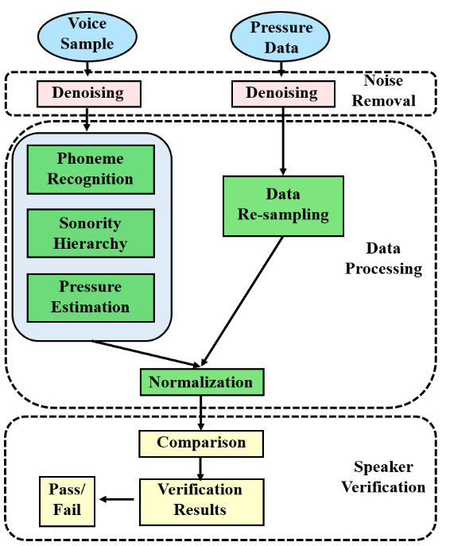
WORKING METHODOLOGY

Slide 4
CODE TOOLS USED
VISUAL STUDIO CODE
GOOGLE COLAB
EXISTING SOLUTION
Authentication measures of Caller ID / PIN (personal identification numbers) / Security Questions / Device Signatures are the existing methods used for the caller identification which is an inappropriate method to use.

Slide 5
SOLUTION
Automatic number identification (ANI):
There is a common practice of asking customer name at a first interaction but it is far more impressive to know the caller even before picking up the call. This is possible by ANI where a call comes and ANI matches the caller's number and shows the customer profile in details like their location or the name of organization from where they are making call.
Connecting to the Contact Centre
The Mobile App Is being created for the caller identification process.
The mobile app connects the user to the video call and the Video Customer Identification Process is done over to authenticate the correct user
Due to the existing of the twins face an additional voice factor is used for the authentication purpose.

Slide 6
CONCLUSION
Contact centers use authentication tools to provide frictionless, personalized customer experiences. But some authentication tools are better suited to that task than others. Exploring best practices for contact center authentication translates to positive gains in other areas. Optimizing your authentication practices can reduce average handle times, empower your customers, and improve operational efficiencies. You can leverage authentication best practices for quantifiable operational gains for your contact center. But more importantly, applying caller authentication best practices will improve your customers’ experience, increase your performance in customer experience metrics and give a boost to your brand’s power and the overall loyalty around it.

Slide 7
Thank You

