Slide 1


Performance Engineering
The Science Behind Performance Testing
By :- M Farooq Rasheed
All Rights Reserved – Do Not Distribute

Slide 2
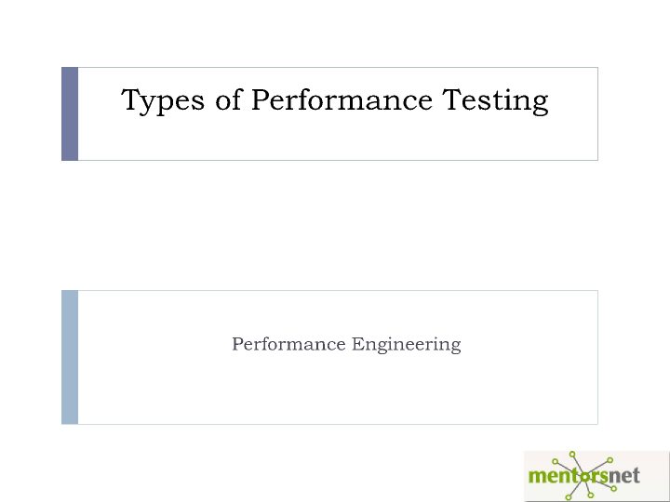
All Rights Reserved – Do Not Distribute

Slide 3
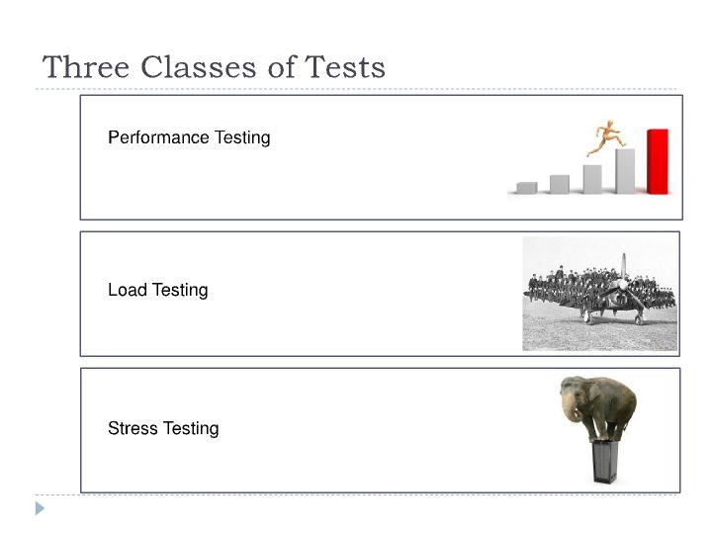
All Rights Reserved – Do Not Distribute

Slide 4
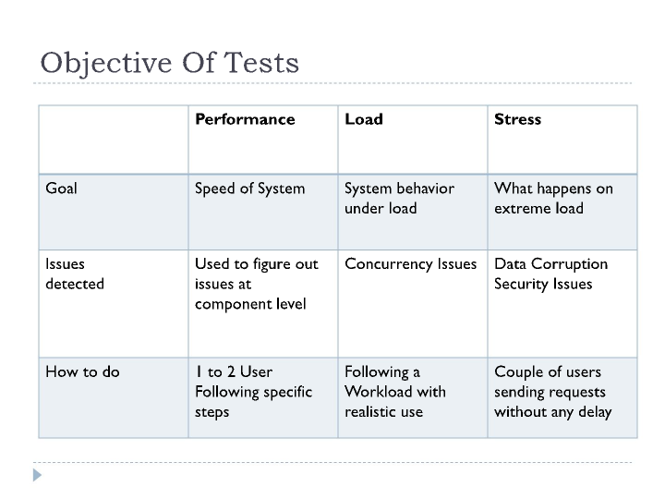
All Rights Reserved – Do Not Distribute

Slide 5
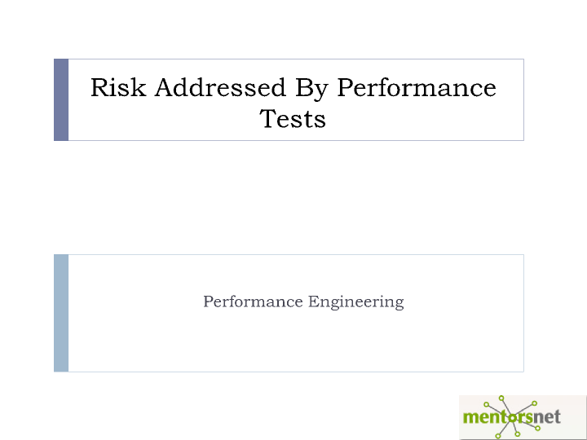
All Rights Reserved – Do Not Distribute

Slide 6
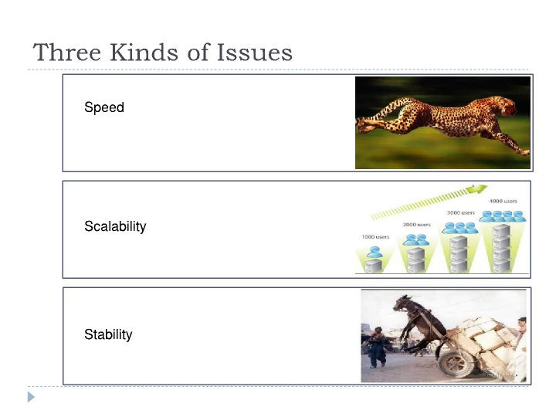
All Rights Reserved – Do Not Distribute

Slide 7

All Rights Reserved – Do Not Distribute

Slide 8
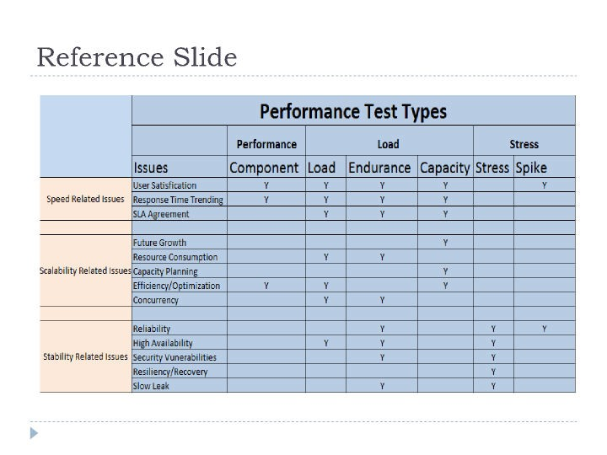
All Rights Reserved – Do Not Distribute

Slide 9
Test Methodology
Identify Test Environment
Set Performance Criteria
Design Work Flow
Test Implementation
Test Execution
Analyze Results
All Rights Reserved – Do Not Distribute

Slide 10
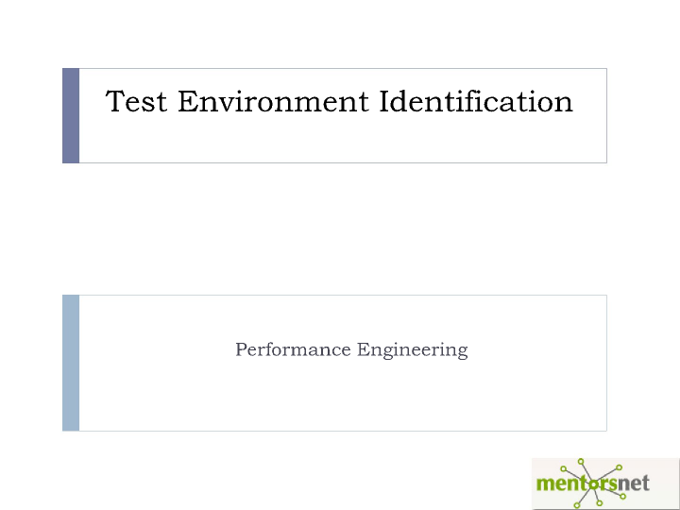
All Rights Reserved – Do Not Distribute
All Rights Reserved – Do Not Distribute

Slide 11
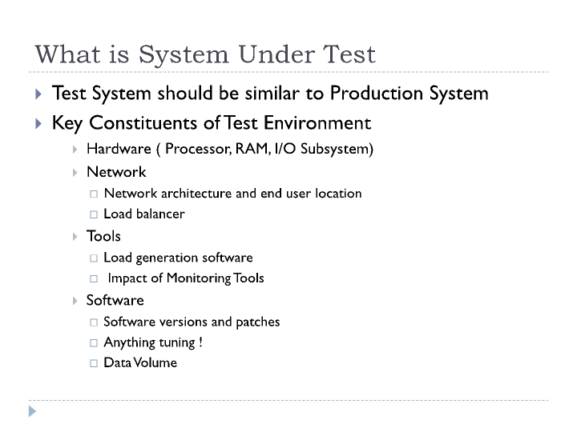
All Rights Reserved – Do Not Distribute
All Rights Reserved – Do Not Distribute

Slide 12
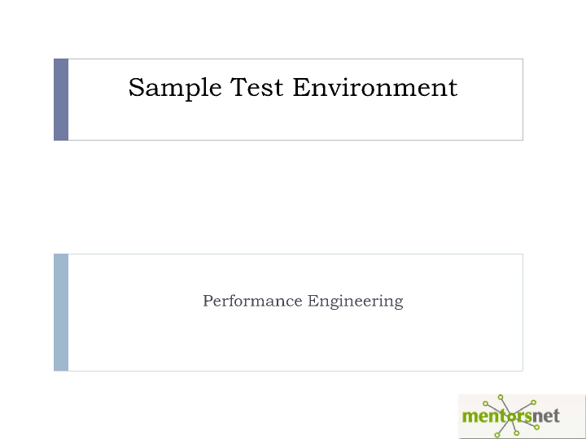
All Rights Reserved – Do Not Distribute
All Rights Reserved – Do Not Distribute

Slide 13
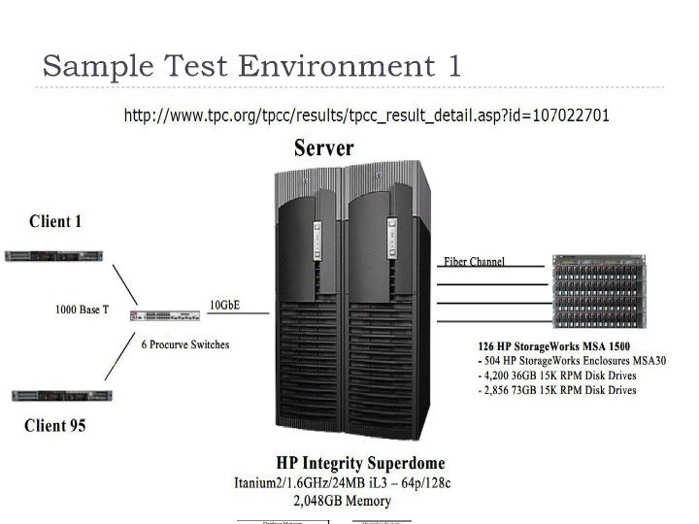
All Rights Reserved – Do Not Distribute

Slide 14
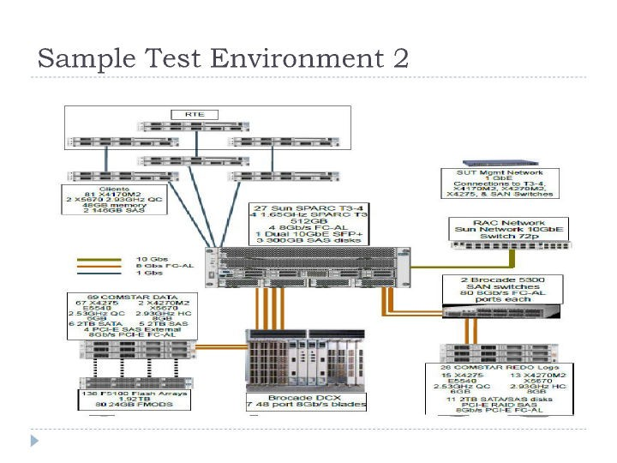
All Rights Reserved – Do Not Distribute
All Rights Reserved – Do Not Distribute

Slide 15
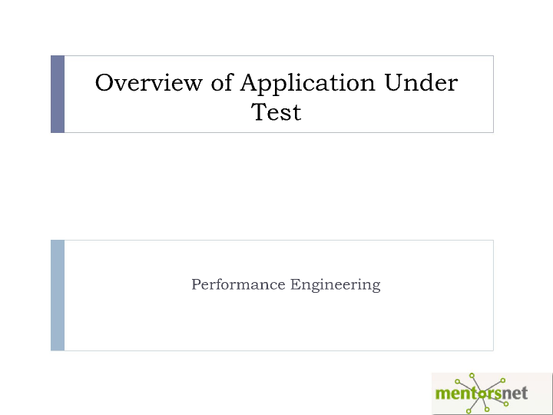
All Rights Reserved – Do Not Distribute
All Rights Reserved – Do Not Distribute

Slide 16

Care Connection Portal
Lists Articles
Lists Guides
Helpful resources for Visitors
Fill up a form to receive help
All Rights Reserved – Do Not Distribute

Slide 17
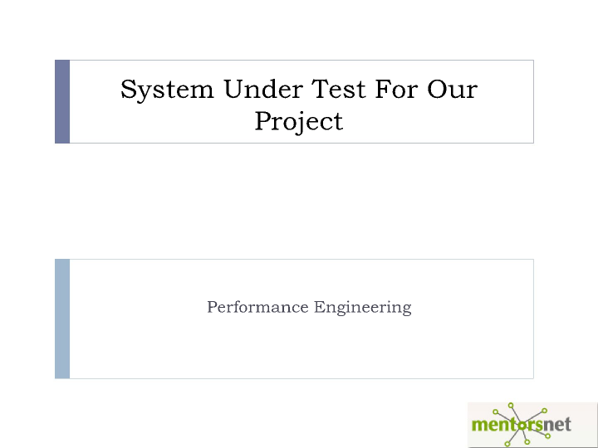
All Rights Reserved – Do Not Distribute

Slide 18
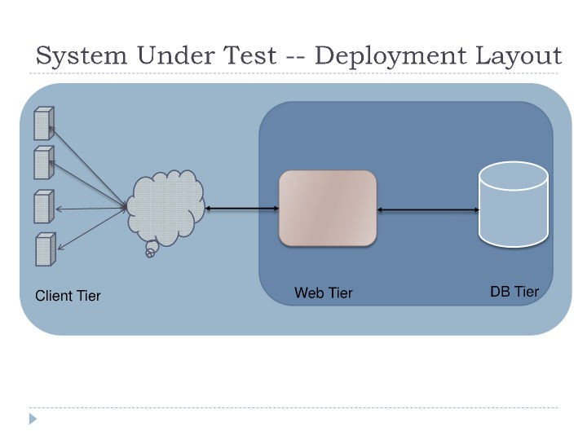
All Rights Reserved – Do Not Distribute

Slide 19
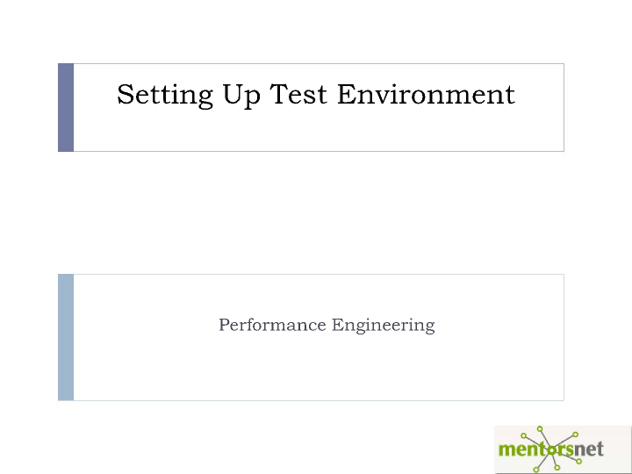
All Rights Reserved – Do Not Distribute

Slide 20
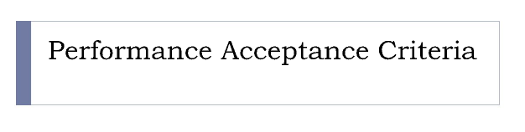
All Rights Reserved – Do Not Distribute

Slide 21
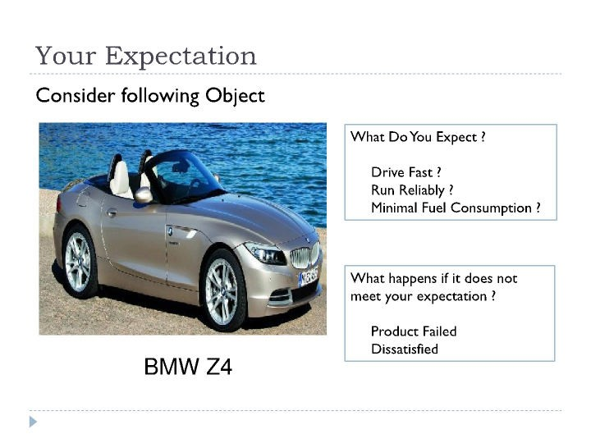
All Rights Reserved – Do Not Distribute

Slide 22
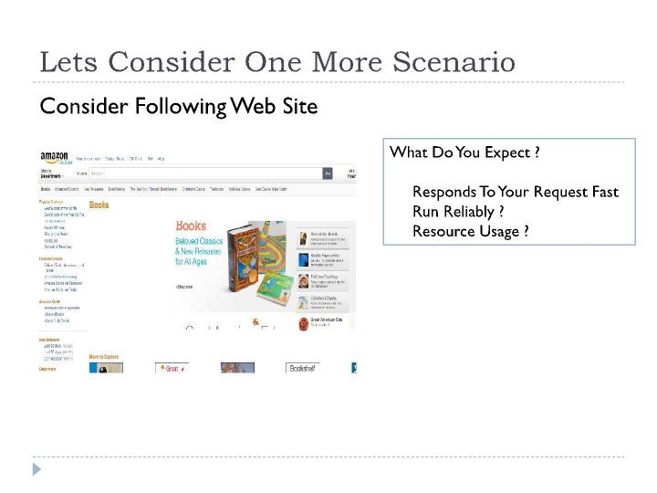
All Rights Reserved – Do Not Distribute

Slide 23
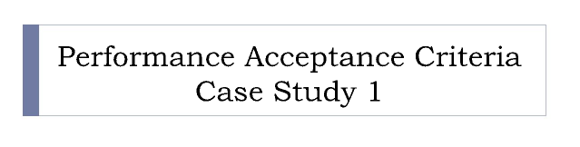
All Rights Reserved – Do Not Distribute

Slide 24
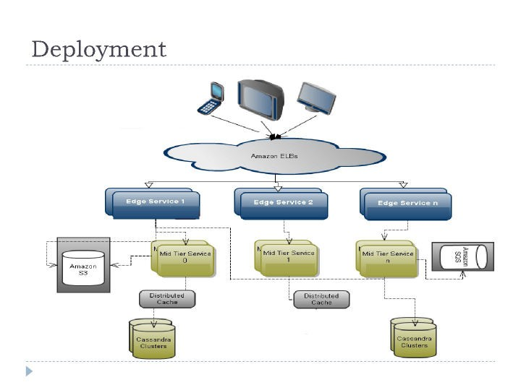
All Rights Reserved – Do Not Distribute

Slide 25
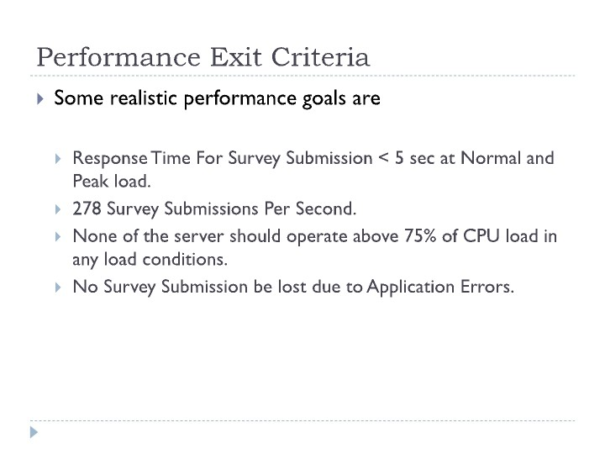
All Rights Reserved – Do Not Distribute

Slide 26

All Rights Reserved – Do Not Distribute

Slide 27
All Rights Reserved – Do Not Distribute

Slide 28
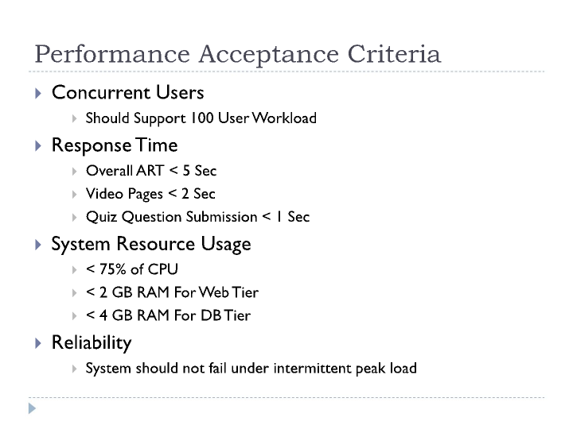
All Rights Reserved – Do Not Distribute

Slide 29
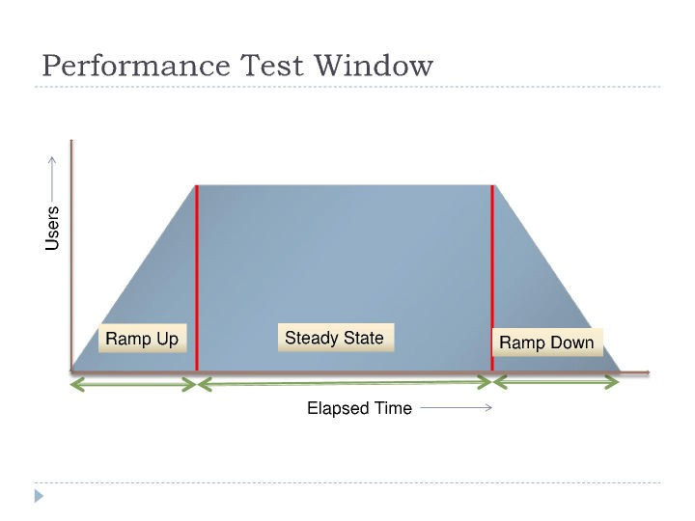
All Rights Reserved – Do Not Distribute

