Slide 1

Test Management Using Test Rail By : M Farooq Rasheed

Slide 2

Agenda
Challenges in Software Testing
Why We Choose TestRail as our TM Tool?
Introduction to TestRail

Slide 3

Testing Challenges

Slide 4
Challenges in Testing
What should I test?
Where do I test?
Difficulties with requirements.
Test Cases Coverage
Hours Tracking
Estimation
Configurations
Reports
Test cases tracking
Keeping in synch with team
Excel sheet Management
Test cases categorization

Slide 5
What is Test Management?
important part of software quality is the process of testing and validating the software
Test management is the practice of organizing and controlling the process and artifacts required for the testing effort.
The general goal of test management is to allow teams to plan, develop, execute all testing activities within the overall software development effort.

Slide 6
Why We Chose TestRail as our TM Tool?

Slide 7
TestRail Introduction
Comprehensive web-based test case management software to efficiently manage, track and organize your software testing efforts.
Get real-time insights into your testing progress.
Integrates with your issue tracker & test automation.

Slide 8
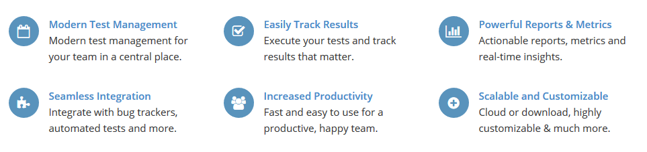
TestRail Introduction

Slide 9
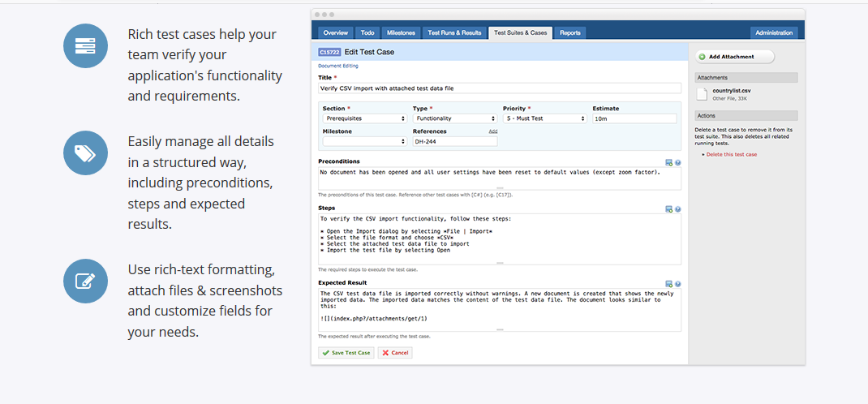
TestRail Introduction

Slide 10
Why We Choose TestRail as our TM Tool?
Two-Way JIRA Integration • API Integrations
Fast and Lean UI • Helpful Support
Short Learning Path & Easy to Use • Good Documentation
Strong Reporting • Well Ordered Test Cases

Slide 11
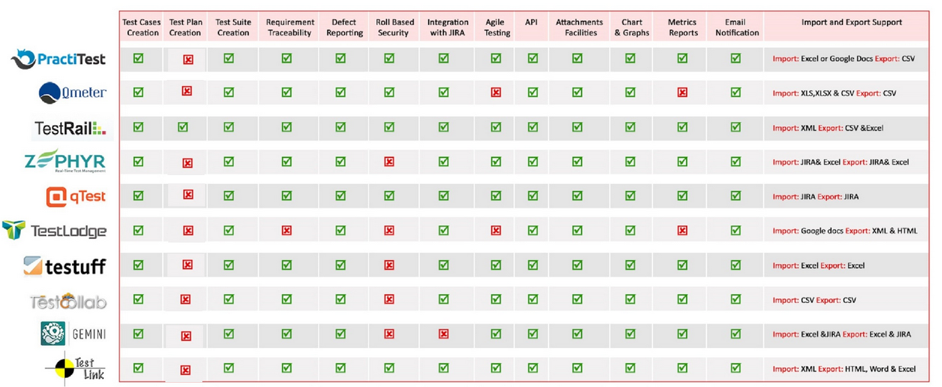
Why We Choose TestRail as our TM Tool?

Slide 12
Introduction To TestRail TestRail Screens

Slide 13
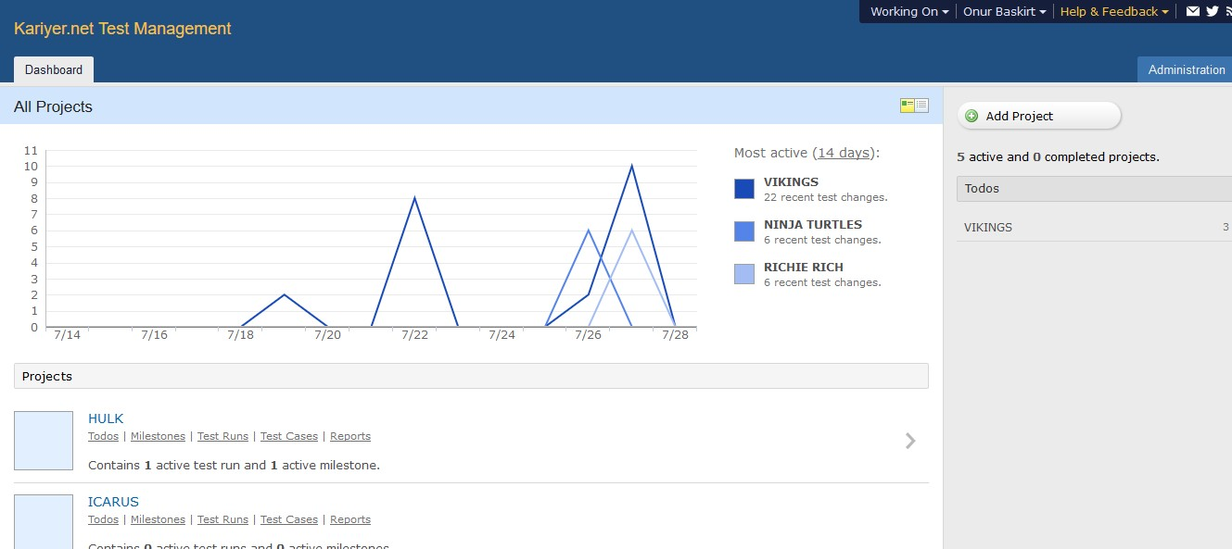
Dashboard Screen

Slide 14
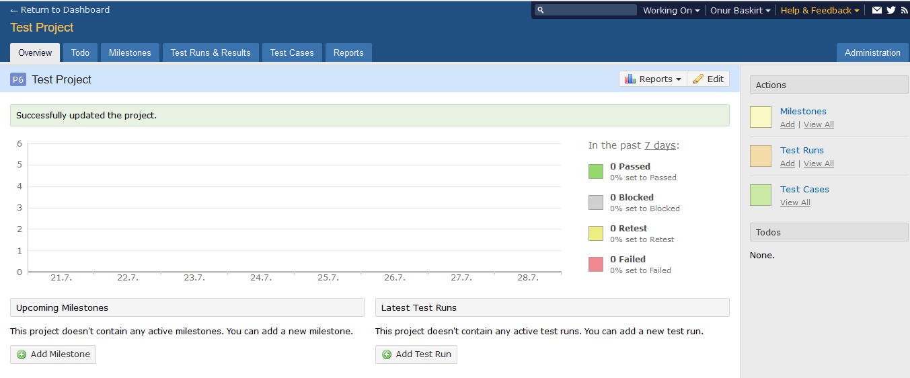
Project Screen

Slide 15
Introduction To TestRail Test Cases

Slide 16
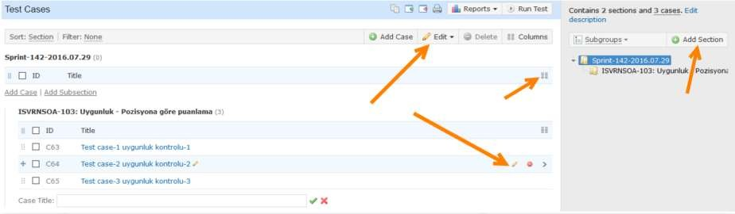
Test Cases

Slide 17
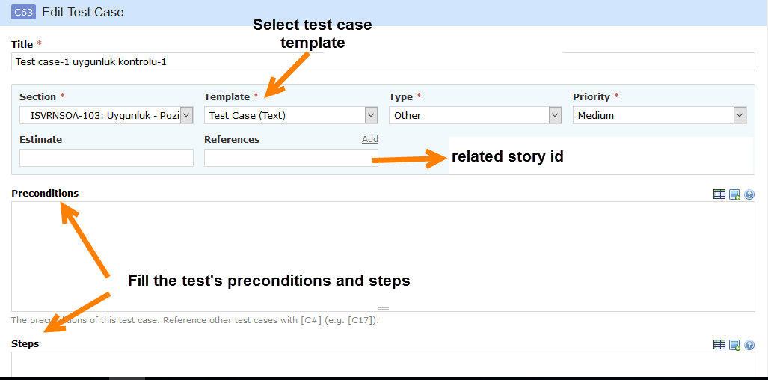
Test Case Editing

Slide 18
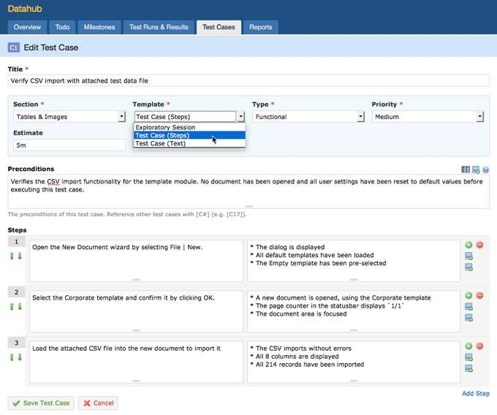
Test Case Templates

Slide 19
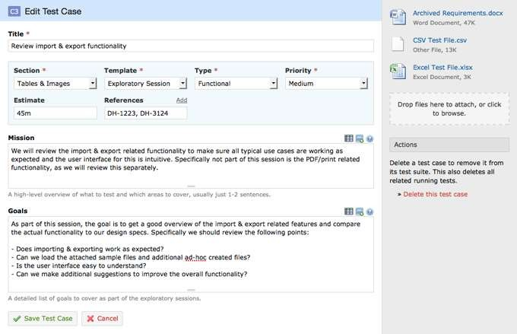
Exploratory Testing Mode

Slide 20
Introduction To TestRail Test Runs & Plans

Slide 21
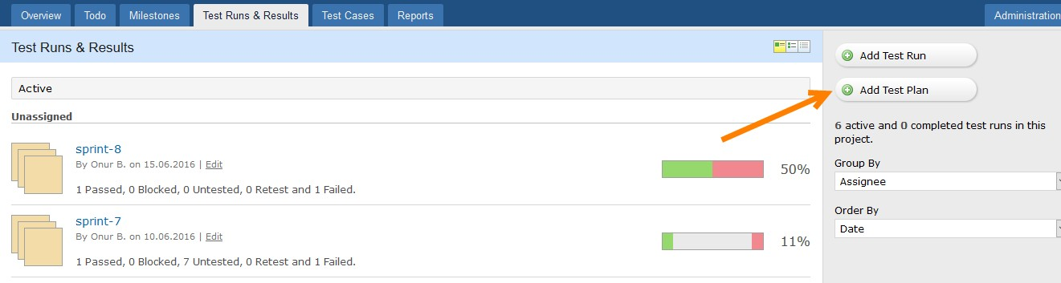
Add Test Plans – Sprints

Slide 22
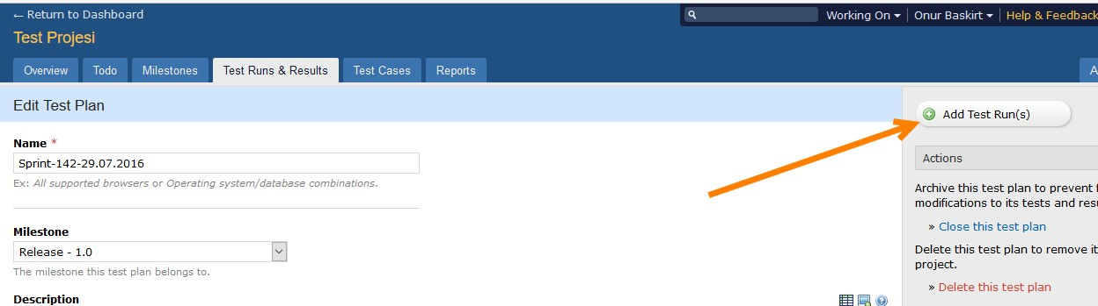
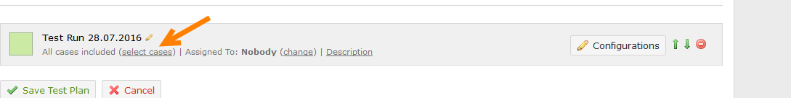
Add Test Runs

Slide 23
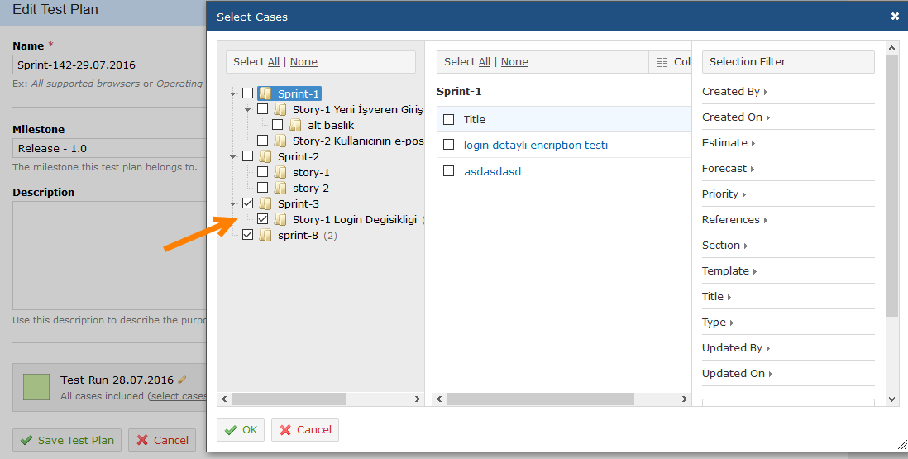
Select Test Case to Execute

Slide 24
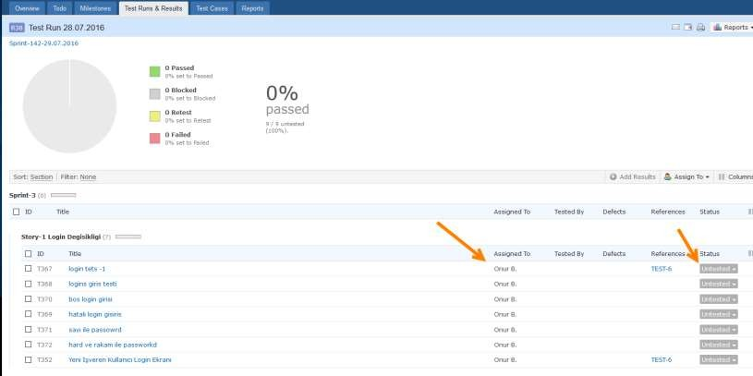
Test Run Main Screen and Test Execution

Slide 25
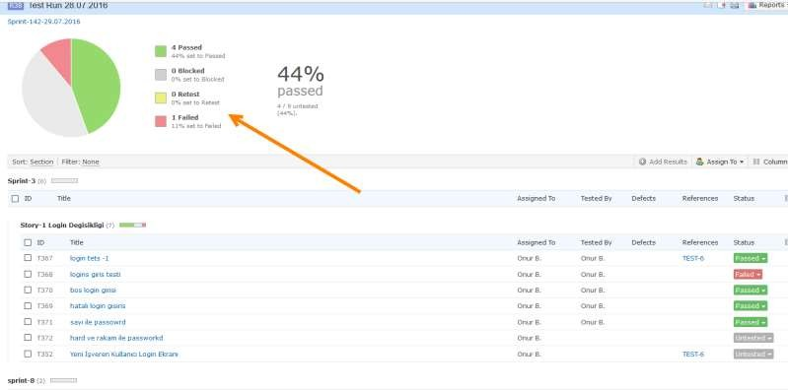
Simultaneous Test Execution Status

Slide 26
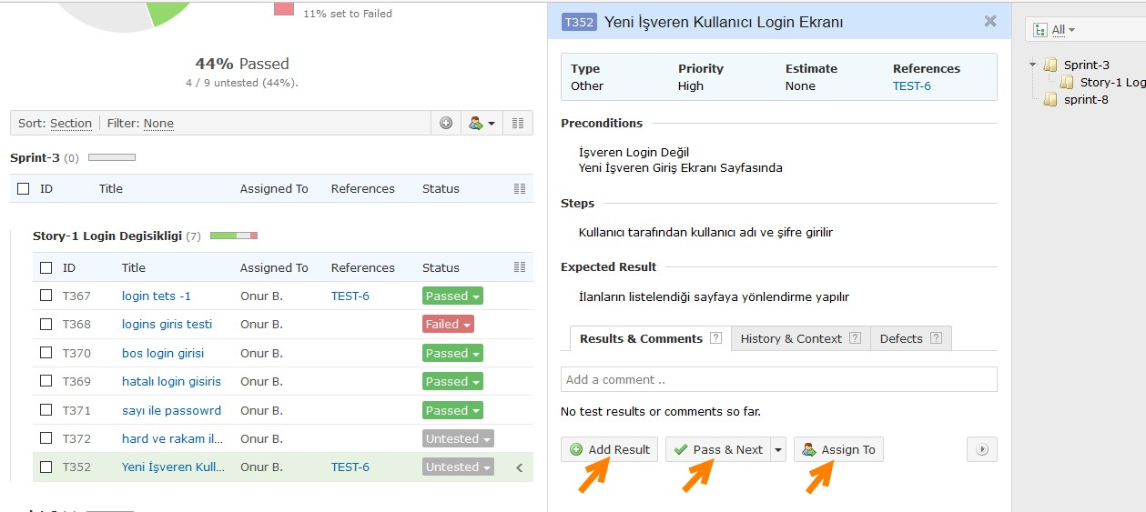
3-Column View

Slide 27
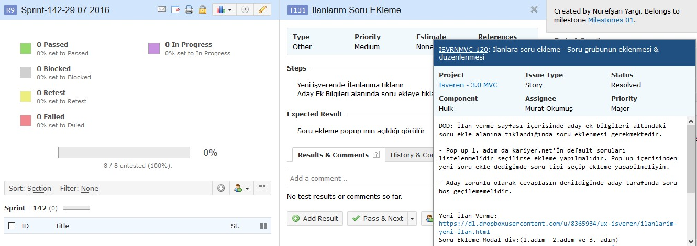
References – Stories Popup Window

Slide 28
Introduction To TestRail Reports

Slide 29
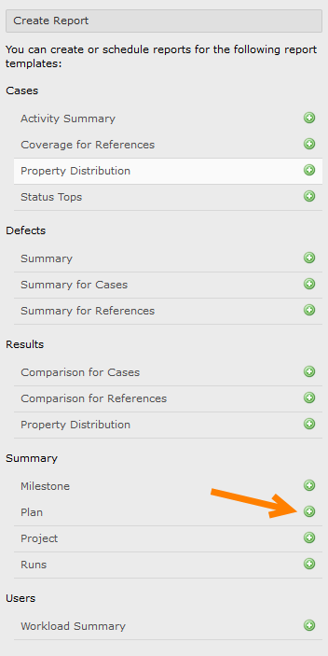
Reports

Slide 30
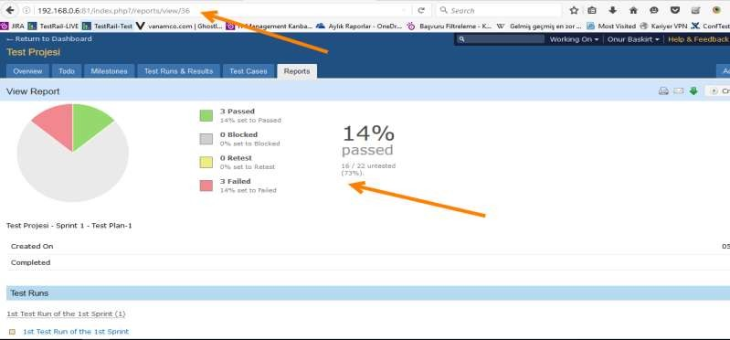
Reports

Slide 31
Introduction To TestRail JIRA Integration

Slide 32
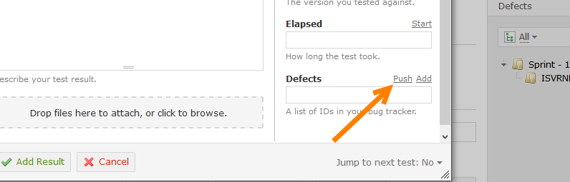
JIRA Integration
You can reach story content by writing story ids in “References” text boxes.
You can see the content preview of the defects by writing defect ids into “Defects” text boxes.
You can automatically open defects inside TestRail by clicking “push” link at defects section.

Slide 33
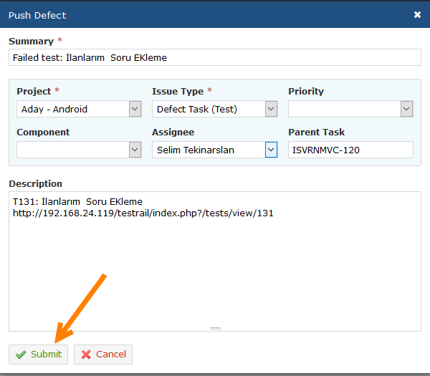
Push Defect

Slide 34
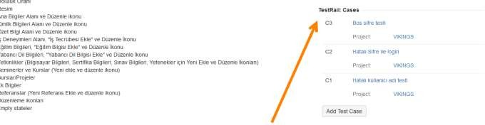
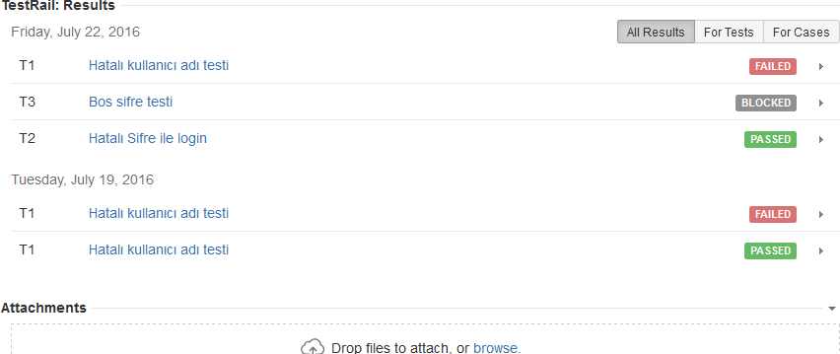
Test Cases in JIRA Story

Slide 35
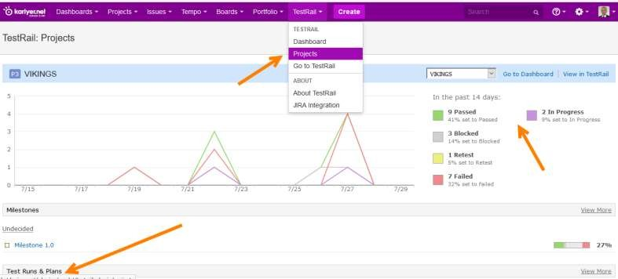
TestRail JIRA Dashboard

