Slide 1

Forecasting Electrical Power Consumption
Using Load Profiles of Households with Heat Pumps

Slide 2
Project Overview
Dataset: 33 households with heat pumps, no PV
Year: 2019
Variable: HAUSHALT_TOT
Tasks:
Data smoothing
MANOVA modeling
Clustering
Load Profiles
Kalman and Particle Filter
MSE of each model

Slide 3
Data Pre-Processing
Steps Taken for the Moving Average Method:
Averaging over minutes for every hour
Averaging over hours without NAs
k = 3
Averaging over weekdays without NAs
k = 5
where k is window size
Household (Type) | CV | Min | Max | Mean | Median
Household 3 (Original) | 0.8124 | 74.72 | 2312.67 | 232.58 | 163.99
Household 3 (Smoothed) | 0.5837 | 86.59 | 1600.67 | 231.62 | 181.02

Slide 4
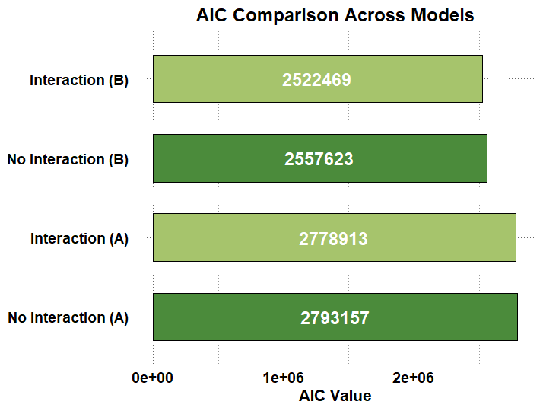
Model Comparison Using AIC
When household, week type, and season are taken into account:
Models with Interaction are best based on
lower AIC

Slide 5
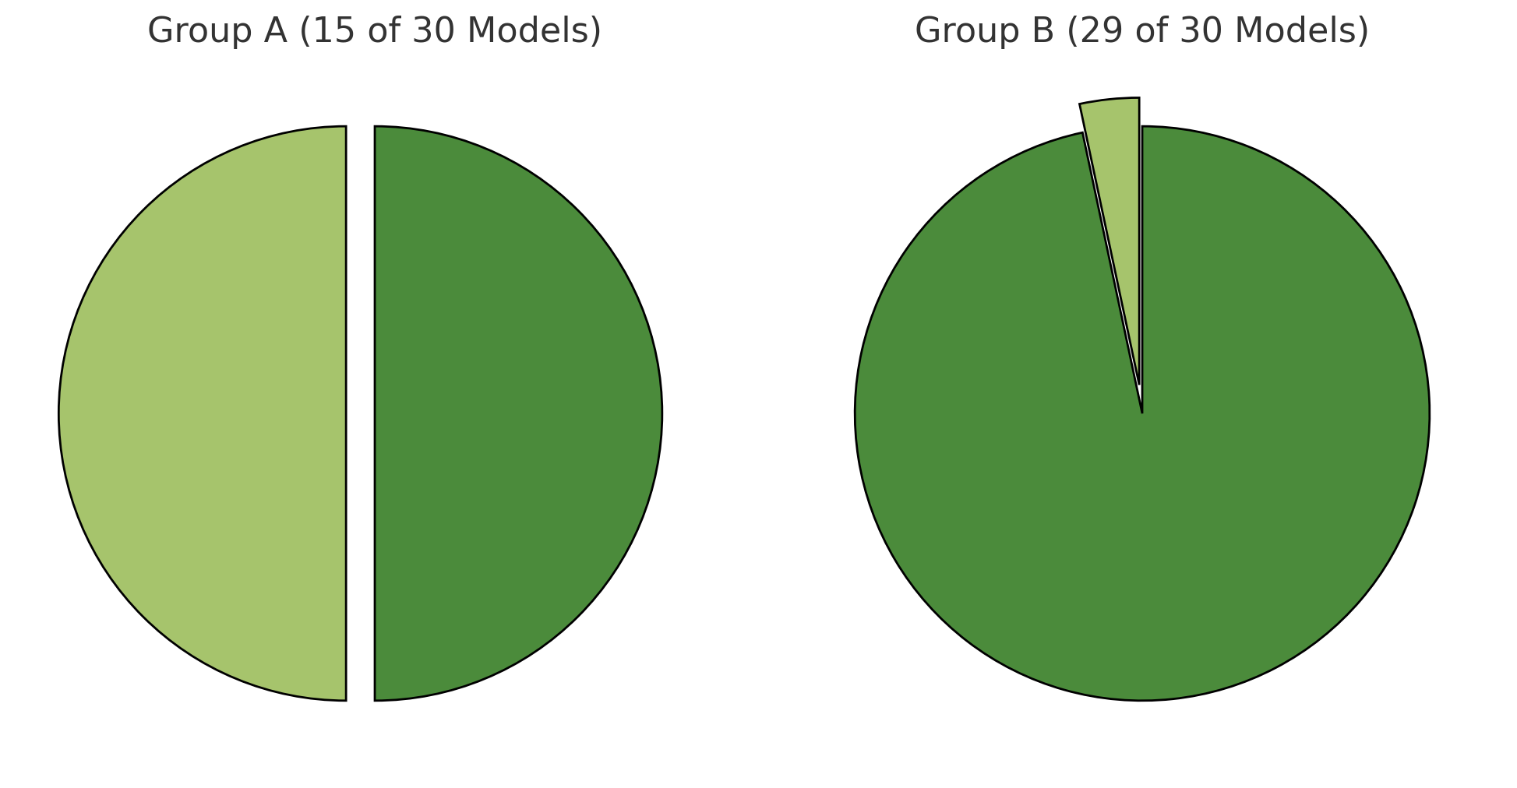
Model Choice
Model choice based on AIC when week type and season are taken into account
Method A: Smoothing over adjacent hours, models with no interaction are chosen
Method B: Smoothing over same weekday (past/future), models with interaction are chosen
Model choice based on difference in the AIC values
1 model
with
no interaction
15 models
with
interaction
15 models
with
no interaction
29 models
with
interaction
Adjacent hours (A)
Weekday (B)

Slide 6
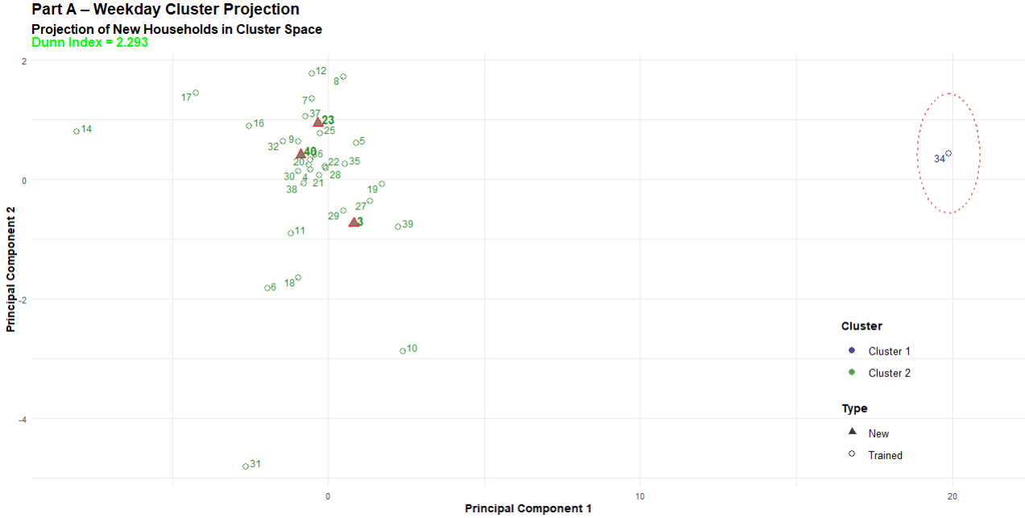
Cluster Analysis
Based on Silhouette method optimal number of clusters is chosen
Evaluation of clusters is done by Dunn index
Shows clustering of households on weekdays (smoothed A)
New households (black) closely align with trained clusters
Clear separation supports robust classification

Slide 7
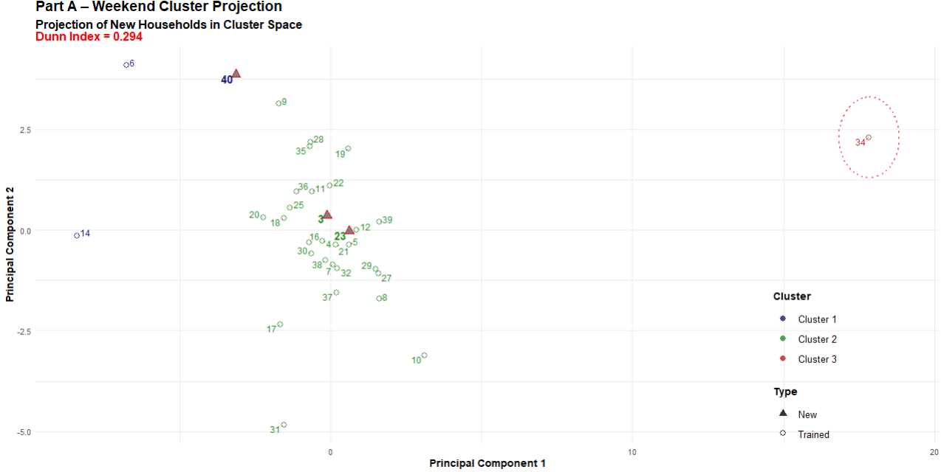
Continue...
Clustering for weekend behavior shows more spread.
Cluster 1 and cluster 2 are very close to each other.
Indicates greater behavioral variability on weekends.

Slide 8
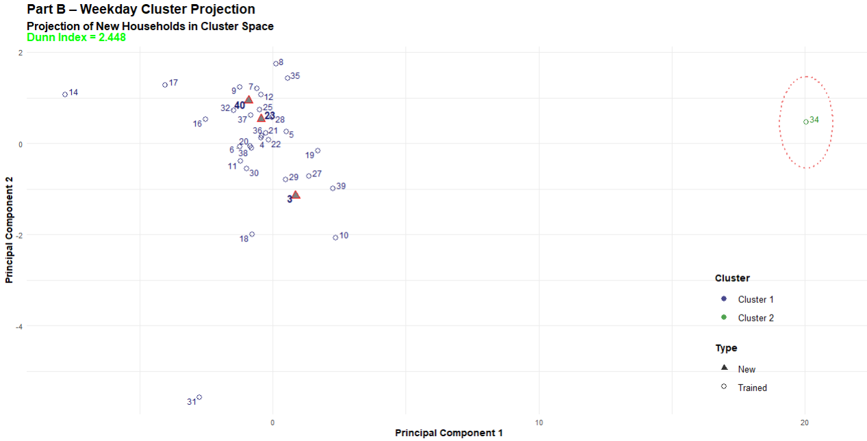
Continue…
Using weekday-smoothed values (method B).
Similar to the clustering with method A.

Slide 9
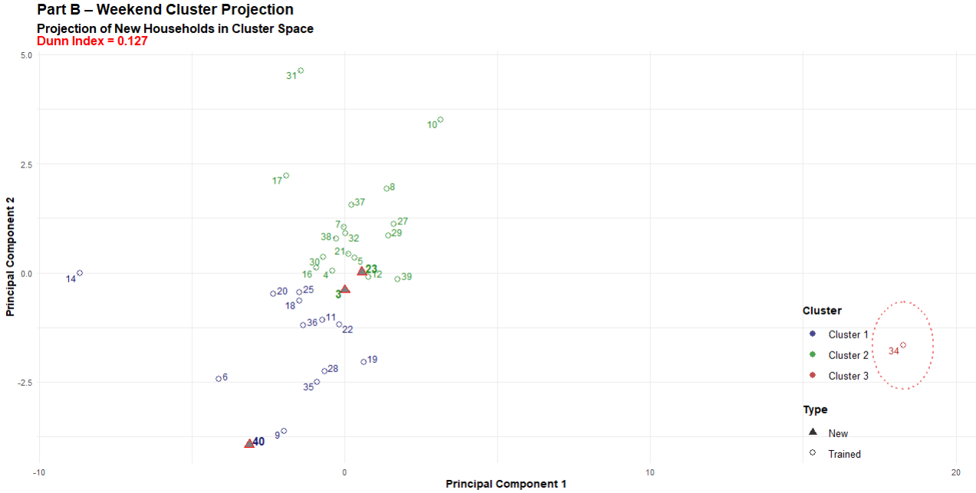
Continue...
Weekend data using method B smoothing.
Some households appear as outliers.

Slide 10
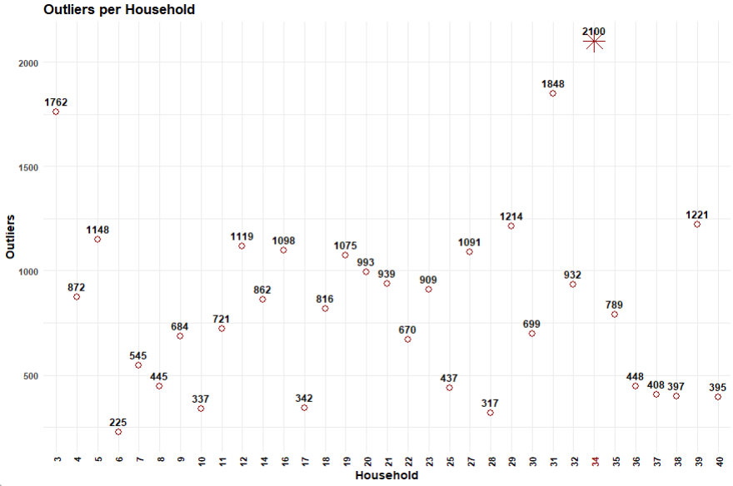
Household number 34 behaves as an outlier in all the above projections.

Slide 11
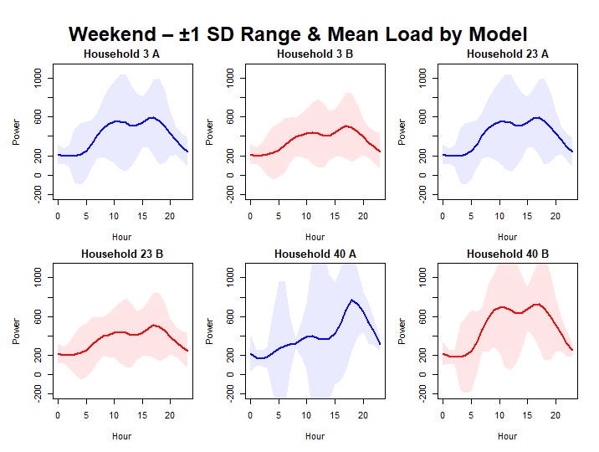
Load Profiles
Load profiles to show how power consumption varies over time⁠
Most curves show a bimodal shape
Highest consumption in late morning and evening⁠
Some intervals extend into negative range
⁠Differences between smoothed data and load profile of household 40 are exceptionally high and low

Slide 12
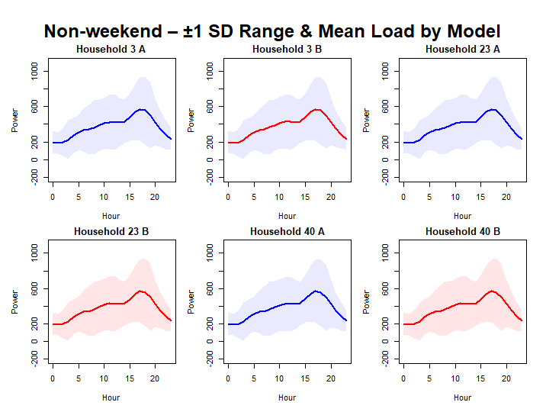
Continue…
All households in the same cluster
Consumption increases throughout the day and peaks in the evening
Intervals are the smallest at early and late hours

Slide 13
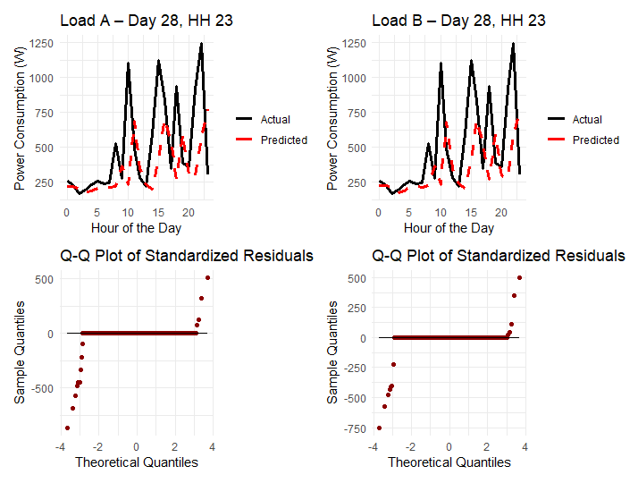
Kalman Filter
Prediction lags behind observations
1.231266e-91 / 1.228752e-91 (Shapiro)
0.9608591 / 0.9706347 (Box)

Slide 14
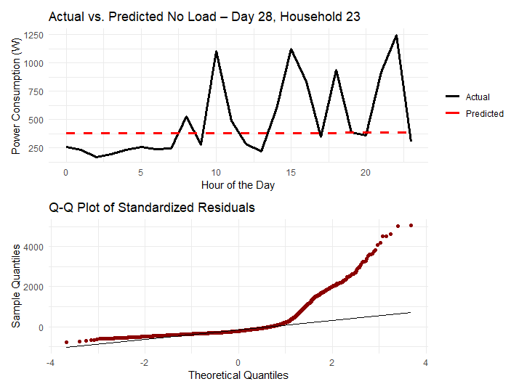
Continue…
Prediction close to 375, but there is variation
Box.test rejects independence
(p-value 0)
Shapiro.test rejects normality
(p-value 2.45*10^-70)

Slide 15
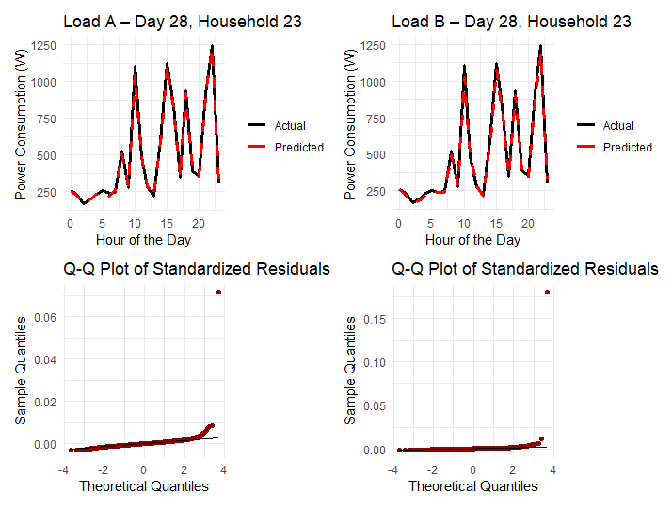
Particle Filter
Particle filter's predictions are very close to observed data
9.162591e-80 / 1.647282e-90 (Shapiro)
0.01824 / 0.8546 (Box)

Slide 16
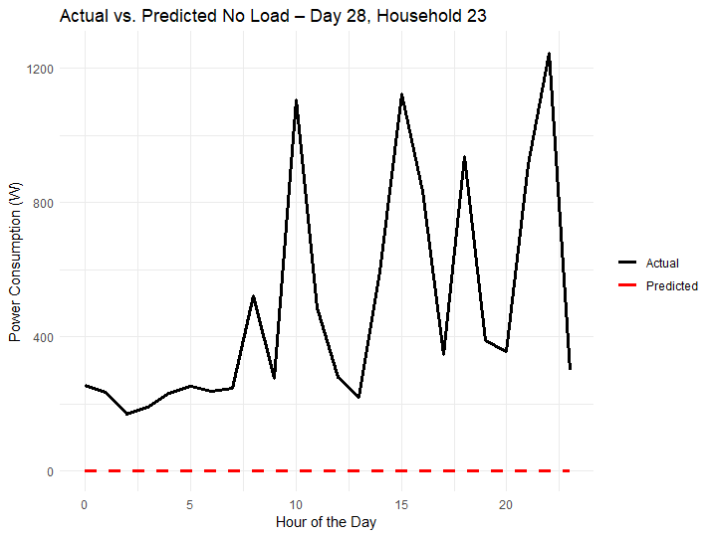
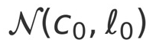
Continue…
Predictions close to zero
Parameters of starting distribution for particles – – responsible for this

Slide 17
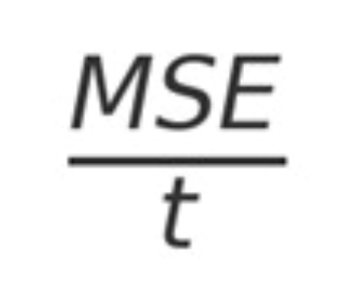
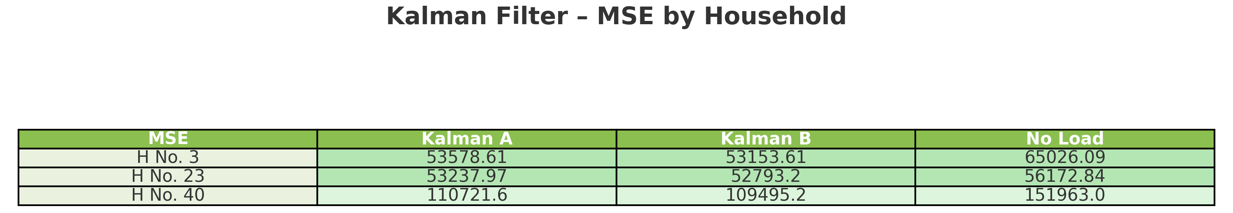
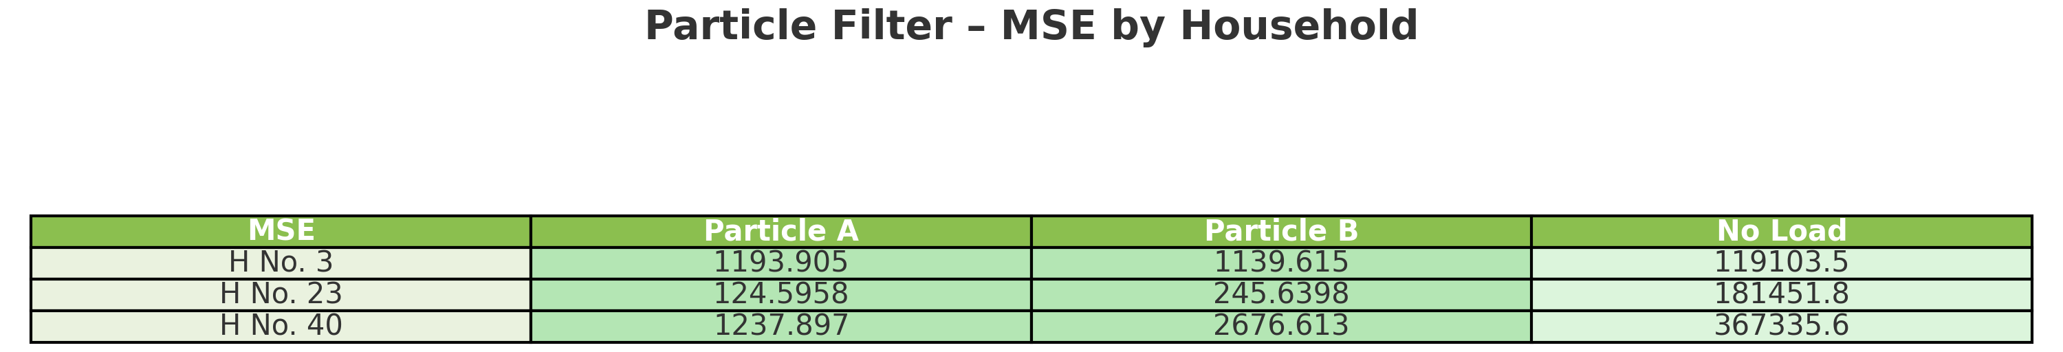
MSE
t = number of time slots
Used to compare:
MSE of particle filter generally better with load profiles
Particle filter MSE worse without load profiles
Household 23 exceptionally good
Household 40 generally bad because 109 days missing

Slide 18
Conclusion
Smoothing method B tends to produce better predictions
Household no. 34 is an outlier based on clustering analysis
MSE-wise, the Particle filter performs better than the Kalman filter with load profiles
Without load profiles, the Particle filter fails to predict – improvement possible
Parameter optimization can be improved

