Slide 1

Presentation
On
Food Waste Management
Team Name:-TECHGEEK Theme:- Zero Food Wastage
App Name:- Annadata Team Captain: Farooque
Team Member 1:- Deepak Gupta Team Member 2:- Mahin
Team Member 3:- Anil Rohilan Team Member 4:- Preeti

Slide 2
Causes Of Food Wastage
1. Lack of appropriate planning
Sometimes people buy lots of food without appropriately making plans on when and how the food will be prepared for consumption.
At times it’s out of most people’s control which leads to the expiry of the foods after which they are thrown as waste.
Also due to lack of appropriate planning, people find themselves having badly prepared food that just doesn’t taste great. It all ends up as waste.

Slide 3
2. Purchase and preparation of too much food:-
If one purchases or prepares too much food than is needed, then it’s obvious the excess food on the plate will go to waste.
In such scenarios, leftovers and partially used food account for the food that goes to waste.
Alternatively, the partially used food is at times put at the back of the fridge and is never reused.
The same applies to excess purchases that end up passing their expiration dates and therefore looks, tastes, and smells bad. At the end of it all, all the excess ends up as waste food.

Slide 4
3. Managerial, financial and technical constraints:-
This is mainly a challenge contributing to food wastage in developing countries.
The wastage takes place because of the constraints to do with a lack of proper management, inadequate finances, and technical difficulties in the lines of harvesting methods, storage, and cooling problems in adverse weather conditions, processing, packaging, infrastructure, and marketing systems.

Slide 5
4. Consumer behaviour :-
Different customers have different preferences and this highly influences consumer purchasing behavior on food items.
Particularly, the consumer behavior on focus here is the tendency of having a keen insight for good judgment which results in those who only prefer unblemished vegetables and fruits, and the restrictive must display for shelf-life dates.
Such consumer behavior more often than not contributes to the wastage of food as most of the food items may remain on the shelves till expiry.
Also, such consumer behavior tendencies may force foodservice operators in restaurants and hotels to maintain large menu options and high-end services while assuring consistency that mostly leads to food wastage.

Slide 6
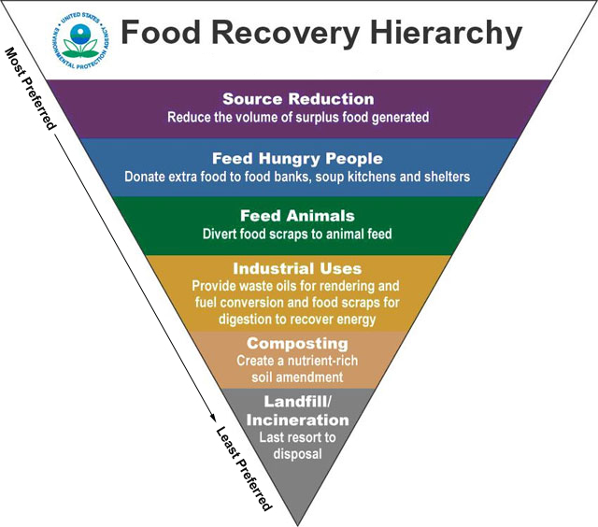
Solutions to Food Wastage
Food Recovery Hierarchy:-

Slide 7
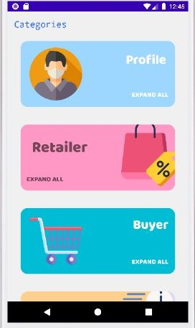
Our Provided Solution
Firstly, we have designed a user interface which contains login portal for user, buyer, retailer and delivery.

Slide 8
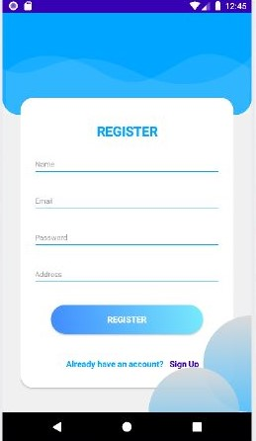
Registration Portal
Registration portal for retailer, buyer and user to register and login to their account

Slide 9
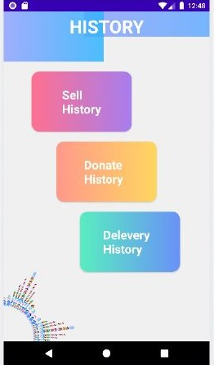
User History
All the past record of the user are stored in this section.

Slide 10
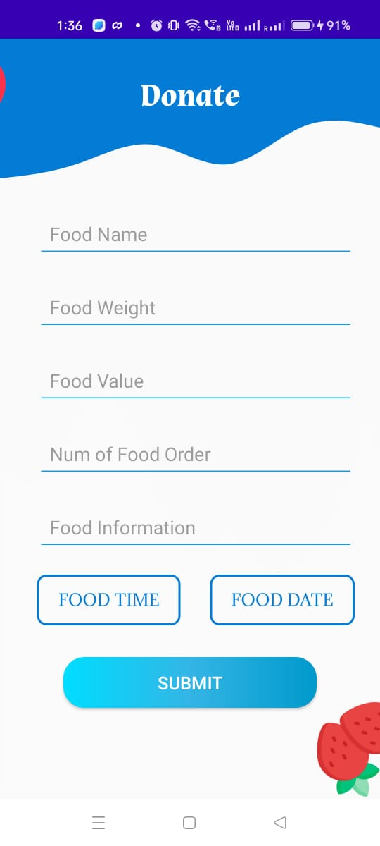
Donation Portal
Donation portal to donate to various organizations.

Slide 11

Retailer Section
Retailer section where all the records of donations and selling are kept.

Slide 12
THANK YOU

