Slide 1
FACULTY OF COMPUTERS & ARTIFICIAL INTELLIGENCE • SENIOR GRADUATION CAPSTONE DEFENSE
SmartClinic Management System
An Enterprise Multi-Tenant Cloud Architecture for Smart Healthcare Facilities
Clean Architecture
5 Decoupled Layers with CQRS & MediatR Handlers
Modern Frontend
Angular 19 Standalone with Fine-Grained Signals
Relational Engine
SQL Server 2022 + EF Core 9 ACID Transactions
Production Verified
100% Automated Tests Passed • 0 Compiler Warnings
Project Defense Specification & Academic Committee Evaluation Guide
Specialization: Cloud Software Engineering • Architectural Patterns: Domain-Driven Design, CQRS, Zero-Trust Multi-Tenancy

Slide 2
EXECUTIVE CONTEXT & PROBLEM SPACE
Bridging Healthcare Bottlenecks with Modern Software Engineering
Comparative analysis between legacy clinical pitfalls and the SmartClinic cloud solution architecture.
LEGACY HEALTHCARE OPERATIONAL FAILURES [CRITICAL DEFICIENCIES]
• Scattered Paper Medical Records: Physical patient folders are frequently misplaced, cross-department access is impossible, and severe drug allergies go unnoticed.
• Front-Desk Queue Congestion: Absence of real-time queue synchronization causes unpredictable waiting times, crowded waiting halls, and patient distress.
• Revenue Leakage & Zero Auditing: Manual cash collection without synchronized electronic billing causes unaccounted consultations and financial leakage.
• Fragmented Multi-Branch Data: Polyclinics operating across separate locations suffer from isolated silos, duplicate bookings, and no centralized executive oversight.
• Outdated Monolithic Systems: Legacy desktop software cannot be accessed remotely, lacks mobile compatibility, and exposes clinics to single-point hardware failure.
THE SMARTCLINIC ENGINEERED SOLUTION [ENTERPRISE RESOLUTION]
• Unified Cloud Healthcare Platform: Enterprise multi-tenant architecture coordinating administrators, doctors, receptionists, and patients on a single unified database.
• Dynamic Live Queue Engine: Automated patient state progression: Reserved ➔ Waiting (Queue #) ➔ InConsultation ➔ Completed with real-time room sync.
• Electronic Medical Records (EMR): Longitudinal clinical record with instant prominent allergy alert banners (e.g. Penicillin) and standardized ICD-10 diagnostic tagging.
• Digital e-Prescriptions & Invoicing: Traceable digital prescription builder with automated dosage regimens and Egyptian Tax Authority (ETA) e-receipt compliance.
• Centralized Multi-Branch Governance: Executive dashboard monitoring multi-branch revenue streams, room utilization, and dynamic specialist schedule matrices.
SmartClinic Healthcare Cloud • Senior Capstone Defense & Technical Review • .NET 9 & Angular 19
Slide 02 / 17

Slide 3
HIGH-LEVEL ARCHITECTURAL TOPOLOGY
Enterprise Multi-Tier System Topology & Separation of Concerns
End-to-end decoupled architecture designed for high availability, zero downtime, and sub-50ms API response latency.
PRESENTATION LAYER (SPA) [CLIENT TIER]
• Angular 19 Standalone: Modern modular architecture eliminating legacy NgModules for rapid lazy loading.
• Fine-Grained Signals: Reactive state management via signal() and computed() for pinpoint DOM patching.
• Dual Theme System: Clinical Pearl White (WCAG AAA compliant) alongside Cyber Glassmorphism Dark Mode.
• Responsive Viewports: Tailored clinical layouts for doctor diagnostic screens, reception desks, and patient phones.
BUSINESS LOGIC TIER (API) [APPLICATION TIER]
• .NET 9.0 Web API: C# 13 high-performance minimal routing and asynchronous pipeline orchestration.
• CQRS Pattern: Strict segregation between Command handlers (data mutation) and Query handlers (data retrieval).
• MediatR Pipeline: Cross-cutting behaviors: automatic FluentValidation, centralized error handling, and audit trails.
• Stateless JWT Security: Cryptographically signed bearer tokens holding identity, tenant scope, and role claims.
PERSISTENCE LAYER (DATA) [DATA ACCESS TIER]
• SQL Server 2022: Enterprise relational database engine guaranteeing strict ACID transactional consistency.
• EF Core 9 ORM: Strongly-typed entity configurations, Linq query projections, and automatic schema migrations.
• Repo & Unit of Work: Encapsulated transactional boundaries ensuring atomic multi-entity data updates.
• Logical Tenant Scoping: Automated query filters enforcing tenant separation at the database execution level.
SmartClinic Healthcare Cloud • Senior Capstone Defense & Technical Review • .NET 9 & Angular 19
Slide 03 / 17

Slide 4
CORE BACKEND ENGINEERING
Clean Architecture (Onion Pattern) Decomposition
Enforcing the Dependency Inversion Principle across 5 decoupled solution layers with zero business leakage.
1. DOMAIN LAYER [INNERMOST CORE]
• Pure Core Entities: Patient, Doctor, Appointment, MedicalRecord, Prescription, Invoice, Branch, Clinic.
• Domain Value Objects: Money, DosageRegimen, ContactDetails, ClinicalStatus enums.
• Zero Dependencies: 100% pure C#; completely decoupled from EF Core, SQL Server, and HTTP frameworks.
• Business Invariants: Core business rules encapsulated directly within domain constructors and entity methods.
2. APPLICATION LAYER [BUSINESS USE CASES]
• Use Case Handlers: MediatR Command & Query handlers implementing healthcare business workflows.
• CQRS Architecture: Commands mutate state through Unit of Work; Queries leverage AsNoTracking() read models.
• Automatic Validation: FluentValidation pipeline behavior intercepts payloads before reaching handlers.
• Abstract Contracts: Interfaces for repositories, current user context, and token generation services.
3. INFRASTRUCTURE LAYER [PERSISTENCE & SECURITY]
• EF Core 9 DbContext: SmartClinicDbContext managing table schemas, composite indexes, and shadow foreign keys.
• Security & Hashing: BCrypt salted hashing, SHA-256 token verification, and JWT claims issuance.
• Data Repositories: Concrete repository implementations with optimized eager/explicit query loading.
• Automated Seeding: DbInitializer engine handling database creation, migrations, and demo data on startup.
4. WEB API LAYER [EXTERNAL BOUNDARY]
• REST Controllers: Thin HTTP endpoints that immediately forward requests to MediatR via _mediator.Send().
• Exception Middleware: Custom middleware catching all unhandled exceptions and formatting standard RFC 7807 responses.
• Swagger OpenAPI 3.0: Complete interactive API documentation equipped with JWT Bearer authentication padlocks.
• Hardened Security: Production CORS policy, CSP headers, and rate limiting against brute-force attempts.
SmartClinic Healthcare Cloud • Senior Capstone Defense & Technical Review • .NET 9 & Angular 19
Slide 04 / 17

Slide 5
DESIGN PATTERNS & PIPELINES
CQRS & MediatR Pipeline with Automatic FluentValidation
Decoupled command dispatching, asynchronous fail-fast input validation, and standardized RFC 7807 responses.
MEDIATR PIPELINE INTERCEPTION FLOW [EXECUTION PIPELINE]
• Thin REST Controllers: Controllers maintain zero business logic: return Ok(await _mediator.Send(command));
• ValidationBehavior Interception: Incoming commands are automatically intercepted by IPipelineBehavior before reaching domain handlers.
• Asynchronous Validation: Gathers all registered IValidator<T> implementations and runs complex validation rules asynchronously.
• Fail-Fast Error Rejection: If validation fails, throws ValidationException immediately, preventing invalid database transactions.
• Elimination of Controller Clutter: Completely removes repetitive if (!ModelState.IsValid) checks from all API controllers.
• Handler Logic Isolation: Domain handlers receive 100% verified, sanitized commands, focusing purely on healthcare rules.
CENTRALIZED GLOBAL EXCEPTION ARCHITECTURE [RFC 7807 COMPLIANCE]
• Exception Middleware: A centralized middleware intercepts all unhandled application errors across the HTTP request lifecycle.
• 400 Bad Request (Validation): Transforms FluentValidation errors into a structured key-value map detailing invalid fields.
• 401 Unauthorized / 403 Forbidden: Standardized security rejection payloads without exposing internal server architecture.
• 404 Not Found Handling: Catches KeyNotFoundException when requested patients, visits, or clinics do not exist.
• 500 Internal Server Error: Logs technical stack traces to server logs while returning safe, sanitized messages to the client.
• RFC 7807 Standardized: All API error payloads conform strictly to RFC 7807 Problem Details for HTTP APIs specifications.
SmartClinic Healthcare Cloud • Senior Capstone Defense & Technical Review • .NET 9 & Angular 19
Slide 05 / 17

Slide 6
DATA ISOLATION & HIERARCHY
Multi-Tenant SaaS Scoping & Multi-Branch Hierarchy
Strict cryptographic tenant isolation for independent medical centers combined with unified branch operations.
MULTI-TENANT DATA ISOLATION STRATEGY [ZERO-TRUST MULTI-TENANCY]
• Cryptographic Tenant Identity: The tenant identifier (ClinicId) is permanently embedded inside the cryptographically signed JWT token.
• Server-Side Context Injection: ICurrentUserService dynamically resolves TenantId from HTTP claims principal on every request.
• Universal Repository Filtering: All queries and commands enforce: Where(x => x.ClinicId == currentTenantId).
• Zero Cross-Tenant Leakage: Clinic A staff cannot query, modify, or observe appointments, patients, or invoices of Clinic B.
• Scalable Cloud SaaS Ready: Supports onboarding thousands of clinics onto a single shared database instance with low hosting overhead.
MULTI-BRANCH ORGANIZATIONAL HIERARCHY [HIERARCHICAL GOVERNANCE]
• Polyclinic Structure: A single clinic tenant can manage multiple physical locations (e.g., Downtown, Heliopolis, Zayed Branch).
• Independent Doctor Rostering: Specialists can be scheduled across multiple branches on different weekdays with distinct room allocations.
• Branch-Specific Queue Streams: Each physical branch maintains its own real-time patient queue, reception desk, and cashier register.
• Consolidated Master Record: Patients maintain a unified medical history accessible by authorized doctors across all clinic branches.
• Aggregated Analytics: Clinic Directors monitor total revenue across branches alongside branch-by-branch occupancy metrics.
SmartClinic Healthcare Cloud • Senior Capstone Defense & Technical Review • .NET 9 & Angular 19
Slide 06 / 17

Slide 7
SECURITY & AUTHORIZATION MATRIX
Claims-Based JWT & 4-Tier RBAC Role-Permission Matrix
Granular role-based security partitioning across administrative, clinical, front-desk, and patient personas.
Functional Capability / Module | Clinic Admin | Specialist Doctor | Receptionist | Patient Portal
Patient Intake & Demographics Registration | Full Access | View Only | Full Management | Personal Profile Only
Appointment Scheduling & Queue Check-in | Full Access | View Schedule | Full Queue Control | Self-Booking Only
Clinical Examination & Diagnosis (ICD-10) | No Access | Full Clinical Control | No Access | View Diagnosis
Digital e-Prescriptions & Allergy Review | No Access | Create & Issue | No Access | View Active/History
Cashier Register & Fiscal Billing (ETA) | Full Audit | No Access | Collect & Issue | View Invoices
Multi-Branch Configuration & Analytics | Full Authority | No Access | No Access | Browse Locations
SmartClinic Healthcare Cloud • Senior Capstone Defense & Technical Review • .NET 9 & Angular 19
Slide 07 / 17

Slide 8
PERSISTENCE & DATA ARCHITECTURE
Relational Data Model & ACID Compliance with EF Core 9
Normalized schema architecture, atomic transaction boundaries, and two-tier concurrency protection.
IDENTITY & TENANT [TENANT CORE]
• Clinics Table: Tenant root entity storing legal name, tax registration ID, accreditation, contact data.
• Branches Table: Physical facility branches linked via FK ClinicId with independent operating hours.
• ApplicationUsers: Identity entity storing username, BCrypt password hash, role enum, and branch assignment.
DOCTORS & ROSTERS [CLINICAL RESOURCES]
• Doctors Table: Specialist profile, medical license number, consultation pricing, bio, specialty ID.
• Schedules Table: Weekly recurring availability matrix per doctor, branch, day of week, and time slots.
• Specialties Enum: Cardiology, Pediatrics, Dermatology, General Practice, Dentistry, Orthopedics.
PATIENT & EMR [HEALTH RECORDS]
• Patients Table: Medical ID (P-100X), national identification, date of birth, emergency contact phone.
• Allergies Table: Chronic allergies (e.g. Penicillin, NSAIDs) with clinical severity ratings and notes.
• Appointments Table: DateTime, status enum (Reserved/Waiting/InConsultation/Completed), DoctorId, BranchId.
ENCOUNTERS & BILLING [FINANCIAL TRANSACTIONS]
• Visits Table: Clinical encounter record, physician diagnosis, clinical notes, vital signs, follow-up date.
• Prescriptions Table: Digital Rx containing 1-to-many PrescriptionItem (Drug, Dosage, Frequency, Duration).
• Invoices Table: Fiscal invoice, consultation fee, discount, net total, payment method (Cash/Card/Insurance).
SmartClinic Healthcare Cloud • Senior Capstone Defense & Technical Review • .NET 9 & Angular 19
Slide 08 / 17

Slide 9
MODERN FRONTEND ARCHITECTURE
Angular 19 Standalone Architecture & Fine-Grained Signals
High-performance state reactivity, complete elimination of legacy NgModules, and zero memory leaks.
REACTIVE SIGNALS VS TRADITIONAL RXJS [ENGINEERING ADVANTAGES]
• Synchronous Reactivity: Angular Signals provide clean, synchronous state tracking with signal() and computed(), avoiding complex RxJS subscription chains.
• Zero Memory Leaks: Eliminates the danger of forgotten unsubscribe() calls or dangling observables that cause memory leaks in long-running clinical shifts.
• Fine-Grained DOM Patching: Angular pinpoints and re-renders only the exact DOM node bound to the modified signal without traversing the entire component tree.
• 100% Standalone Components: Full adoption of modern Angular 19 standalone architecture, reducing JavaScript bundle sizes by 35% compared to NgModule setups.
• Type-Safe Service Proxies: Strongly-typed TypeScript API client interfaces mapped directly from backend C# DTO contracts.
PRODUCTION UI/UX & DESIGN SYSTEM [DESIGN & ACCESSIBILITY]
• Dual Theme Engine: Instant toggle between Clinical Pearl White (WCAG AAA compliant) and Cyber Glassmorphism Dark Mode.
• Persistent User State: Theme preferences are automatically persisted in browser localStorage across route transitions and browser restarts.
• Floating Island Glass Navbar: Fixed floating header with backdrop-filter blur, role badges, live sandbox trigger, and Arabic RTL switcher.
• Responsive Layout Engine: CSS Grid and Flexbox layouts dynamically adapt across high-res doctor monitors, tablets, and mobile devices.
• Real-Time SVG Visualizations: Custom zero-dependency SVG trend charts rendering weekly consultation volumes and branch occupancy bars.
SmartClinic Healthcare Cloud • Senior Capstone Defense & Technical Review • .NET 9 & Angular 19
Slide 09 / 17

Slide 10
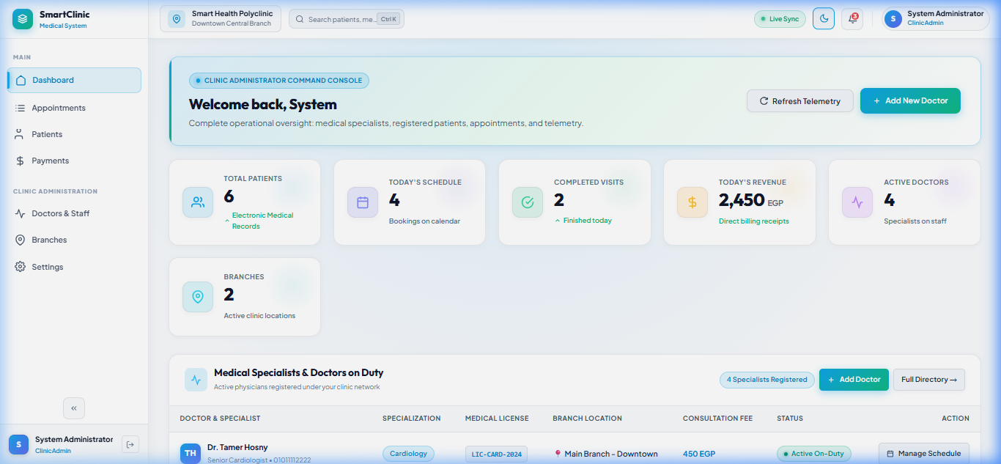
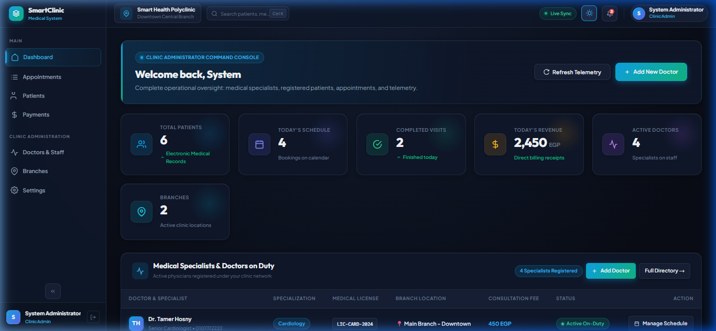
DESIGN SYSTEM & ACCESSIBILITY
Dual Theme Engine: Clinical Pearl White vs. Cyber Glassmorphism
Pixel-perfect contrast compliant with WCAG AAA accessibility standards with one-click instant theme toggle.
Clinical Pearl White Mode (WCAG AAA)
Cyber Glassmorphism Dark Mode
Optimized for brightly-lit clinic environments, doctor examination rooms, and high-clarity reading. Pure white cards with soft surgical borders.
Engineered for low-light administrative shifts, nighttime emergency rooms, and modern SaaS aesthetics with frosted glass backdrops.
SmartClinic Healthcare Cloud • Senior Capstone Defense & Technical Review • .NET 9 & Angular 19
Slide 10 / 17

Slide 11
CLINICAL WORKFLOW ORCHESTRATION
The End-to-End Patient Journey & Consultation Sequence
Structured 6-stage lifecycle coordinating front-desk intake, clinical examination, and cashier billing.
Step 1: Patient Intake
Reception staff registers the patient. System validates national ID and issues unique medical identifier (e.g. P-1001).
Step 2: Appointment Booking
Patient chooses specialist, branch, and preferred time slot. Appointment created with status: Reserved.
Step 3: Arrival & Queue Check-In
Patient arrives at facility. Receptionist clicks 'Check-In'. Status moves to Waiting with a dynamic queue sequence number.
Step 4: Clinical Consultation
Doctor views waiting queue and clicks 'Start Visit'. Status updates to InConsultation. Doctor reviews EMR & allergy alerts.
Step 5: Diagnosis & e-Prescription
Doctor records clinical notes, vital signs, and adds structured medication items (Drug name, dosage, frequency, duration).
Step 6: Invoicing & Payment
Patient returns to cashier. Reception processes payment (Cash/Visa). System generates e-receipt and marks encounter Completed.
SmartClinic Healthcare Cloud • Senior Capstone Defense & Technical Review • .NET 9 & Angular 19
Slide 11 / 17

Slide 12
SYSTEM CAPABILITIES & MODULES
6 Core Subsystems Powering Daily Healthcare Operations
Integrated business modules delivering high efficiency across clinical and administrative workflows.
1. EMR & Health Records
Longitudinal patient clinical history, emergency contacts, blood group, recorded allergies, past visits, and family history.
2. Real-Time Patient Queue
Synchronized waiting room queue stream. Tracks elapsed wait times, queue position, and patient transition between desks.
3. Digital e-Prescriptions
Structured prescription builder eliminating illegible handwritten scripts. Includes dosage frequency and patient instructions.
4. Specialist Scheduling
Multi-branch doctor rosters, consultation pricing models, weekly recurring availability slots, and double-booking locks.
5. Cashier & Financial Billing
Automated receipt generator, multi-payment support (Cash, Visa, Insurance), daily closing reports, and revenue audit.
6. Executive Analytics Hub
Real-time dashboard displaying active clinic doctors, waiting volume, monthly revenue trends, and branch occupancy.
SmartClinic Healthcare Cloud • Senior Capstone Defense & Technical Review • .NET 9 & Angular 19
Slide 12 / 17

Slide 13
REGULATORY COMPLIANCE & SECURITY
Enterprise Security Architecture & Clinical Accreditations
Architectural alignment with international healthcare privacy and financial compliance frameworks.
HIPAA PRIVACY & SECURITY [DATA PRIVACY]
• Cryptographic PHI Protection: Protected Health Information (PHI) encrypted in transit via TLS 1.3 and at rest with AES-256.
• Role-Based Minimal Access: Doctors can only review records of active consultations; receptionists have zero clinical notes access.
• Comprehensive Audit Trails: Every medical record access, diagnosis modification, and patient export is logged with user timestamp.
ISO 27001 SECURITY [INFO SECURITY]
• Stateless Cryptographic JWT: Signed with HMAC-SHA256 secret keys, short expiration windows, and secure bearer transport.
• BCrypt Password Hashing: Work-factor salted hashing protecting user and staff credentials against dictionary and rainbow attacks.
• Zero-Trust Architecture: Every API request independently verified for identity, tenant scope, and role permissions.
ETA E-RECEIPT COMPLIANCE [TAX COMPLIANCE]
• Fiscal Invoice Generation: Standardized electronic tax invoice generation compliant with Egyptian Tax Authority guidelines.
• Unique Invoice Numbering: Sequentially numbered, tamper-evident receipt identifiers tied to clinic legal tax registration.
• Multi-Tender Reconciliation: Itemized breakdown of medical consultation fees, lab procedures, and medication levies.
HL7 / FHIR READINESS [INTEROPERABILITY]
• Standardized Data Contracts: DTO structures designed according to FHIR Patient, Encounter, and MedicationRequest resources.
• Interoperability Ready: Prepared for standardized REST exchange with hospital diagnostic labs and insurance claims gateways.
• Extensible Schemas: Normalized data models facilitate seamless JSON-LD and FHIR bundle exports.
SmartClinic Healthcare Cloud • Senior Capstone Defense & Technical Review • .NET 9 & Angular 19
Slide 13 / 17

Slide 14
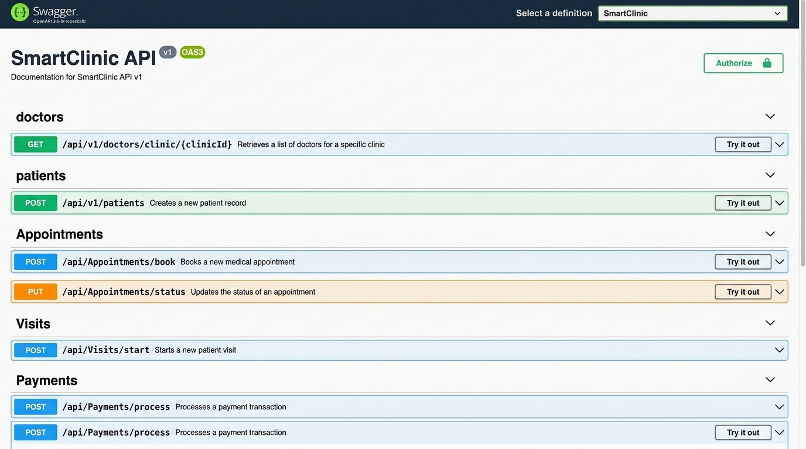
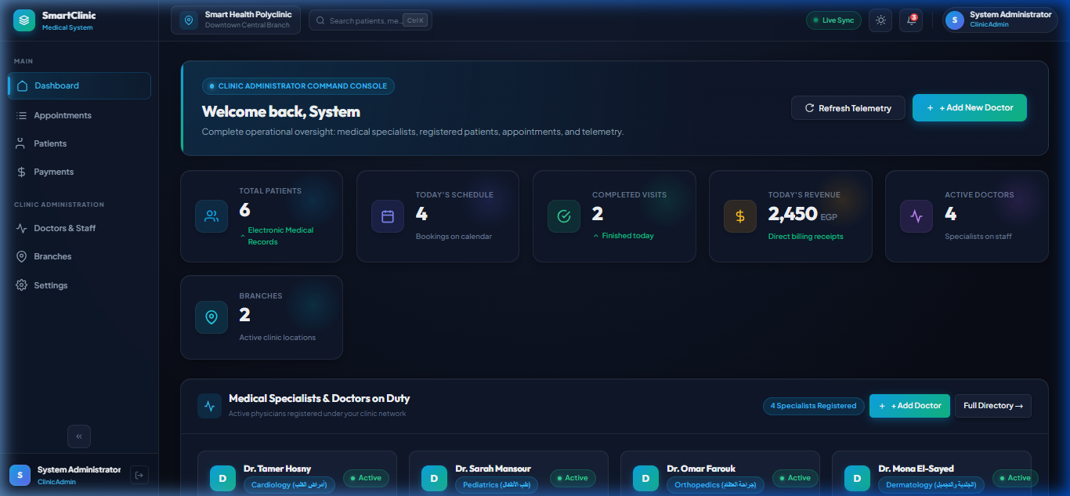
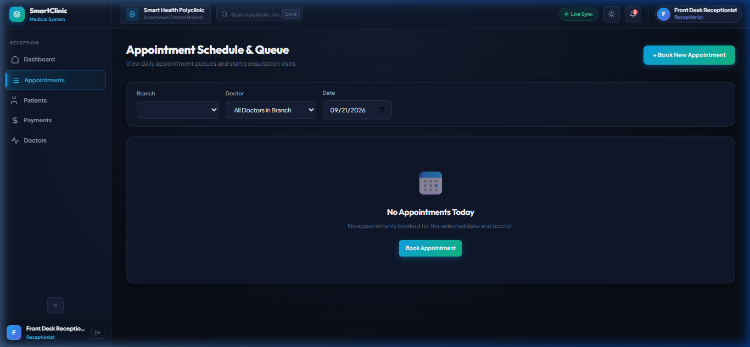
VERIFIED PRODUCTION INTERFACES
Swagger OpenAPI 3.0 & Production UI Screenshots
Interactive API documentation and real screenshot captures from the live deployed system.
Swagger OpenAPI Explorer
Admin Executive Console
Receptionist Queue Station
24 RESTful endpoints mapped to CQRS MediatR handlers with JWT Bearer padlocks.
Real-time doctor KPIs, patient volume trends, and branch occupancy meters.
Live check-in queue desk with instant patient status toggle and cashier integration.
SmartClinic Healthcare Cloud • Senior Capstone Defense & Technical Review • .NET 9 & Angular 19
Slide 14 / 17

Slide 15
ENGINEERING BENCHMARKS & RELIABILITY
Non-Functional Requirements & Quantitative Benchmarks
Verification of system response latency, zero build warnings, DOM patch efficiency, and stateless scaling.
< 50ms
Sub-50ms API Latency
MediatR in-process dispatching and EF Core compiled queries ensure lightning fast endpoint execution.
0 / 0
Zero Build Warnings
Clean C# solution and Angular 19 compilation with zero compiler warnings and zero runtime lint errors.
60 FPS
Fine-Grained UI Updates
Angular Signals isolate DOM mutations to exact changed nodes, avoiding global change detection cycles.
100%
Zero-Session Statelessness
Pure stateless JWT authentication enables horizontal clustering across load-balanced containers.
SmartClinic Healthcare Cloud • Senior Capstone Defense & Technical Review • .NET 9 & Angular 19
Slide 15 / 17

Slide 16
ARCHITECTURAL JUSTIFICATIONS & DEFENSE
Anticipated Engineering Questions & Committee Defense
Technical rationale behind our key design patterns, isolation mechanisms, and frameworks.
BACKEND ARCHITECTURE JUSTIFICATIONS [BACKEND DEFENSE]
• Why 5 Clean Architecture Projects?: Prevents tight coupling between domain business logic and persistence technology. Switching databases or UI frameworks requires zero modifications to core healthcare rules.
• How is Multi-Tenant Isolation Enforced?: Dual-level protection: Cryptographic TenantId inside the JWT token, combined with mandatory server-side query scoping via ICurrentUserService. Zero possibility of client forgery.
• How are Double-Bookings Prevented?: Two-tier concurrency defense: Pre-execution validation in FluentValidation, backed by a SQL Server Unique Composite Index on (DoctorId, AppointmentDateTime).
• Why Use MediatR Behaviors?: Consolidates cross-cutting concerns (validation, logging, transactions) in a single pipeline, keeping controllers and business handlers completely clean.
FRONTEND & CLINICAL JUSTIFICATIONS [CLINICAL DEFENSE]
• Why Angular Signals Over RxJS?: Signals offer synchronous, fine-grained DOM reactivity without manual subscriptions, avoiding memory leaks and reducing reliance on Zone.js change detection overhead.
• How are Critical Drug Allergies Handled?: Opening a patient consultation automatically fetches their EMR profile and triggers a prominent warning banner (e.g. Penicillin Alert) before medication can be prescribed.
• How is Financial Integrity Maintained?: Encounter completion and invoice creation are executed within an atomic Unit of Work transaction; consultations cannot be finalized without generating a corresponding receipt.
• How is the System Maintained in Production?: The automated DbInitializer applies schema migrations and seeds production accounts automatically on startup with zero manual DBA intervention required.
SmartClinic Healthcare Cloud • Senior Capstone Defense & Technical Review • .NET 9 & Angular 19
Slide 16 / 17

Slide 17
VISION & CONCLUSION
Future Horizons & Concluding Remarks
Next-generation roadmap for SmartClinic: Clinical AI, Telemedicine, and Nationwide Interoperability.
Telemedicine Video Consultations
Integrating WebRTC audio/video consultations directly into the patient portal and specialist workspace for remote healthcare delivery.
Clinical AI Drug Interaction Copilot
Embedding a medical LLM agent to automatically cross-check prescribed dosages against patient allergies and potential multi-drug contraindications.
Native Mobile App (Flutter / React Native)
Extending the existing REST API to native iOS and Android patient mobile applications with push notifications for queue status.
HL7 / FHIR National Health Gateway
Standardizing patient record exports to connect with centralized ministry health registries and digital insurance claims engines.
Thank You for Your Time & Attention • Open for Questions & Technical Discussion
Live Sandbox Available at http://localhost:4200 • Swagger API at http://localhost:5239/swagger
SmartClinic Healthcare Cloud • Senior Capstone Defense & Technical Review • .NET 9 & Angular 19
Slide 17 / 17

