Slide 1
"Harry Potter wand" gesture recognition system
Team Members: Zhongwang Fu Yifan Zhang
Jiagang Yu Tian Gao

Slide 2
CONTENTS
I. Data Acquisition
II. Hybrid Framework: Augmented 1D-CNN & On-Device KNN
III. Real-time On-device Gesture Recognition on Arduino
IV. Limitations and Areas for Improvement

Slide 3
I. Data Acquisition
Device: Arduino Nano 33 BLE Sense (3-axis accelerometer)
Data collection via Edge Impulse for streaming and parameter exploration
Sampling rate: 62.5 Hz, recording window: 3 seconds
→ 187 time steps × 3 axes = 561 values per sample
Three gesture classes: Flipendo, Wingardium, Others
Dataset size: 300 samples per class, 900 samples in total

Slide 4
Ⅱ Hybrid Framework: Augmented 1D-CNN & On-Device KNN
Built a lightweight end-to-end MLP for accelerometer-based gesture recognition
Network architecture: 561–32–16–3 (fully connected layers)
ReLU activations for hidden layers and Softmax output for multi-class classification
Trained fully on-device using SGD with backpropagation and L2 regularization
Improved robustness and stability compared to fixed embedding-based approaches

Slide 5
2.1 Overall System Architecture and Process Design
Feature Extraction
KNN Classifier (Explored, not used in final system)
The system adopts a standalone on-device spell recognition architecture based on IMU time-series data and an end-to-end Multi-Layer Perceptron (MLP).
After physics-based data augmentation and preprocessing, the flattened accelerometer features are directly fed into a lightweight MLP (561–32–16–3), which performs both feature learning and classification on the device.
This fully on-device training and inference pipeline improves robustness to variations in user motion while avoiding reliance on fixed embeddings or external processing.

Slide 6
2.2 Data Processing and Augmentation
Following the signal preprocessing described in the previous section, the raw acceleration data has been converted to G-units, passed through a simulated high-pass filter to remove gravity components, and aligned to a fixed length of 187 time steps.The current dataset consists of approximately 300 clean, "gravity-free" motion sequences per class (e.g., Flipendo, Wingardium Leviosa).
However, training a neural network model on such a limited dataset presents a significant risk of overfitting. In real-world deployment, the "Magic Wand" faces substantial variability in user behavior. A standard user might hold the wand with a different grip, cast spells at varying speeds, or apply different force intensities compared to the training data. To bridge the gap between the limited collected samples and complex real-world usage, a physics-based data augmentation strategy is essential.

Slide 7
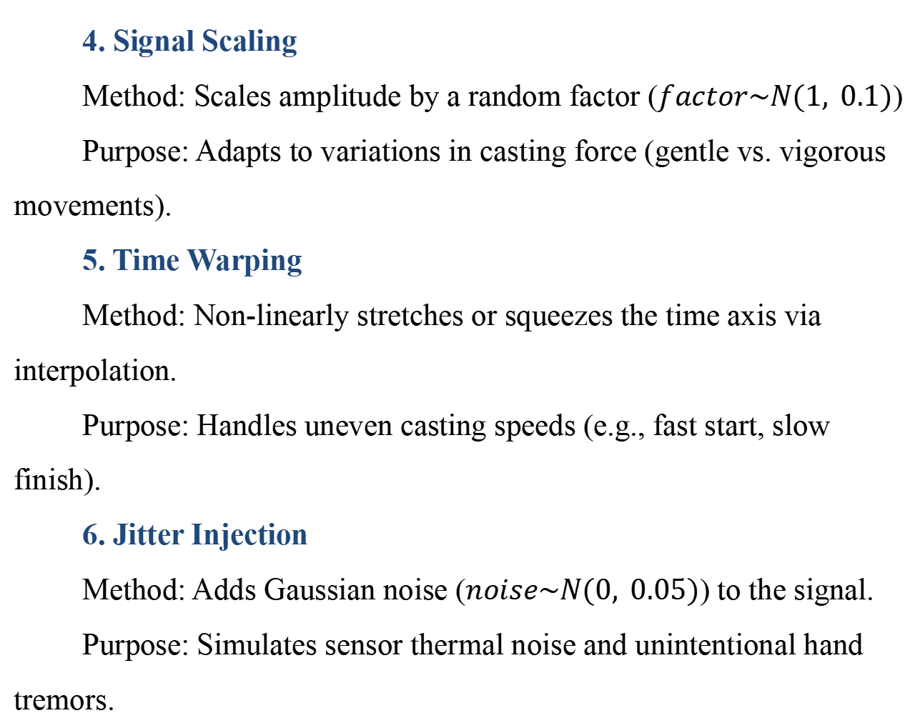
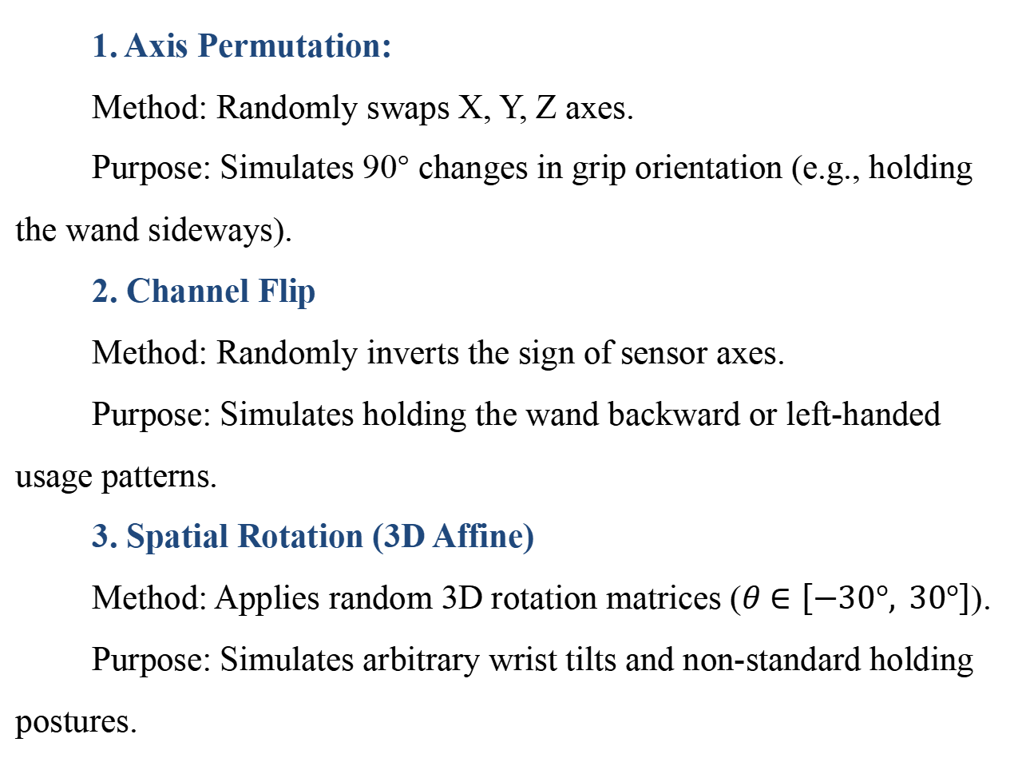
2.2.1 Physics-Based Augmentation Strategies
To simulate realistic physical variations in wand handling, the generator implements six specific stochastic transformation algorithms. Each algorithm targets a specific robustness issue observed in IMU-based gesture recognition:
4. Signal Scaling
Method: Scales amplitude by a random factor ($factor\sim N(1, 0.1)$)
Purpose: Adapts to variations in casting force (gentle vs. vigorous movements).
5. Time Warping
Method: Non-linearly stretches or squeezes the time axis via interpolation.
Purpose: Handles uneven casting speeds (e.g., fast start, slow finish).
6. Jitter Injection
Method: Adds Gaussian noise ($noise\sim N(0, 0.05)$) to the signal.
Purpose: Simulates sensor thermal noise and unintentional hand tremors.
1. Axis Permutation:
Method: Randomly swaps X, Y, Z axes.
Purpose: Simulates 90° changes in grip orientation (e.g., holding the wand sideways).
2. Channel Flip
Method: Randomly inverts the sign of sensor axes.
Purpose: Simulates holding the wand backward or left-handed usage patterns.
3. Spatial Rotation (3D Affine)
Method: Applies random 3D rotation matrices ($θ∈\left[−30°, 30°\right]$).
Purpose: Simulates arbitrary wrist tilts and non-standard holding postures.
Clarification: Although an embedding + KNN pipeline was initially explored for few-shot adaptation,the final deployed system adopts an end-to-end MLP for primary classification,while KNN is retained only as an optional on-device personalization mechanism.

Slide 8
2.3 Lightweight 1D-CNN Model Architecture
Feature Extraction
This model is designed as an efficient feature extractor for the Arduino Nano 33 BLE.
CNN Backbone: Extracts temporal motion patterns from accelerometer data using Conv1D and MaxPooling layers.
16-dim Embedding: Compresses high-dimensional features into a compact vector, creating a unique "fingerprint" for each spell.
Dual-Branch Strategy:
Training Phase: Uses a Linear Classifier (Softmax) to optimize network weights.
Deployment Phase: Discards the Softmax layer and uses the embeddings with a KNN classifier for real-time inference.

Slide 9
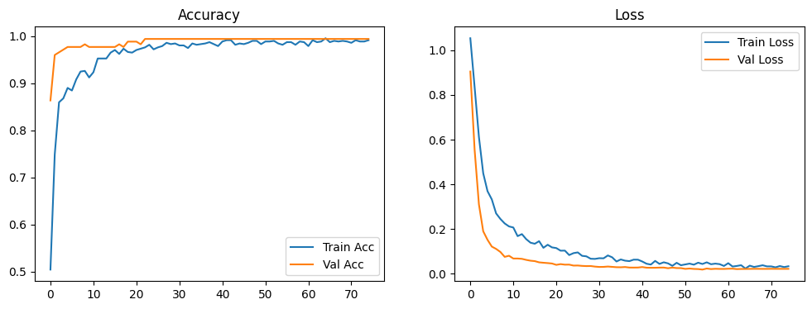
2.4 Training & Deployment
Training Strategy & Performance: The model was trained using the AdamW optimizer with dynamic learning rate adjustment (ReduceLROnPlateau) and EarlyStopping to ensure stable convergence. As shown in the graph, the validation accuracy rapidly stabilized at >99%, demonstrating that the physics-based data augmentation strategy effectively prevented overfitting and allowed the model to learn robust motion features.
Deployment: To enable few-shot learning on the microcontroller, the final Softmax classification layer was pruned to output the raw 16-dimensional embedding vector instead of class probabilities. This "Feature Extractor" was then converted to TensorFlow Lite format and exported as a C byte array (net.h), allowing the Arduino to generate spell fingerprints in real-time.

Slide 10
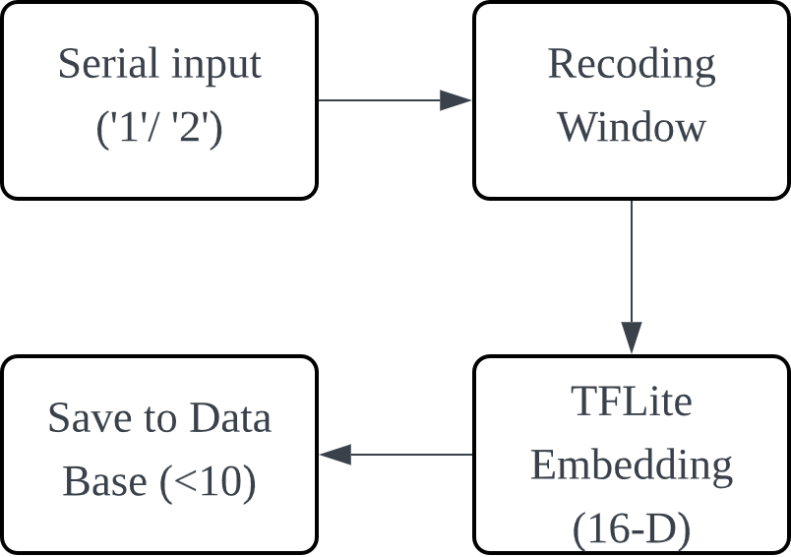
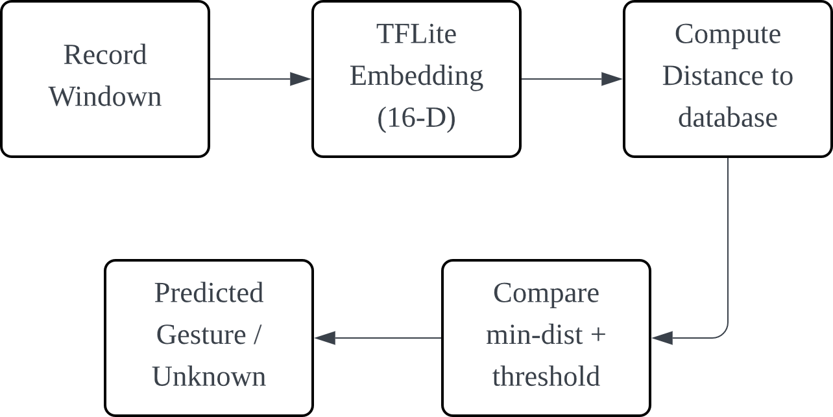
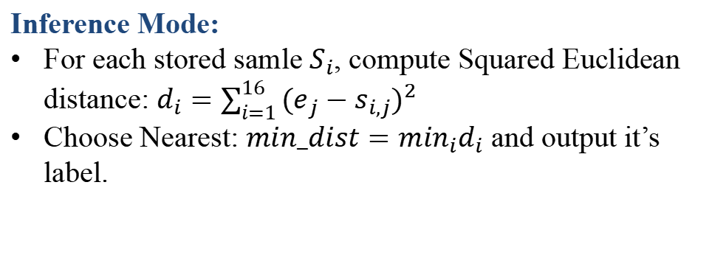
2.5 On-device KNN Decision：Learning vs Inference
Learning Mode Block Diagram
Learning Mode:
‘1’ -> label = Flipendo; ‘2’ -> label = Wingardium
Next Recording -> Get embedding[16] -> Store as new sample
Local database stores {feature[16],label)}up to 10 samples
Inference Mode:
For each stored samle $S_{i}$, compute Squared Euclidean distance: $d_{i}=\sum_{i=1}^{16}{{(e_{j}−s_{i,j})}^{2} }$
Choose Nearest: $min_dist=\min_{i}d_{i}$ and output it’s label.
Inference Mode Block Diagram
Threshold Gate (realiability):
If min_dist < TH, then accept and output the label
Else-> Unknown / Reject (Reduces false positives from random motion)

Slide 11
III Real-time On-device Gesture Recognition on Arduino
Deployed an end-to-end MLP model (561–32–16–3) on Arduino Nano 33 BLE
Triggered and recorded fixed windows (187 × 3 = 561) with gravity-free acceleration
Performed on-device inference using Softmax-based multi-class classification
Delivered real-time outputs via Serial messages and RGB LED indicators

Slide 12
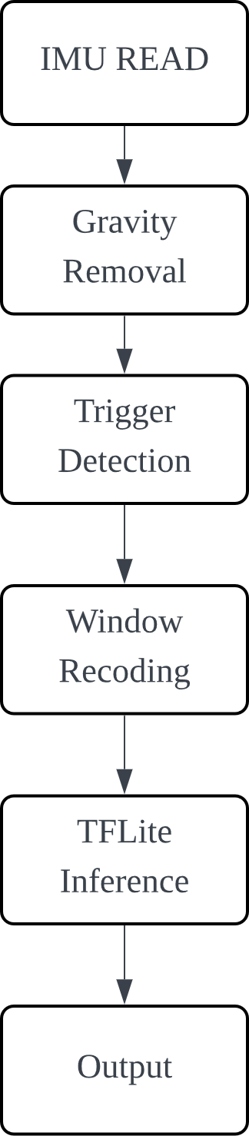
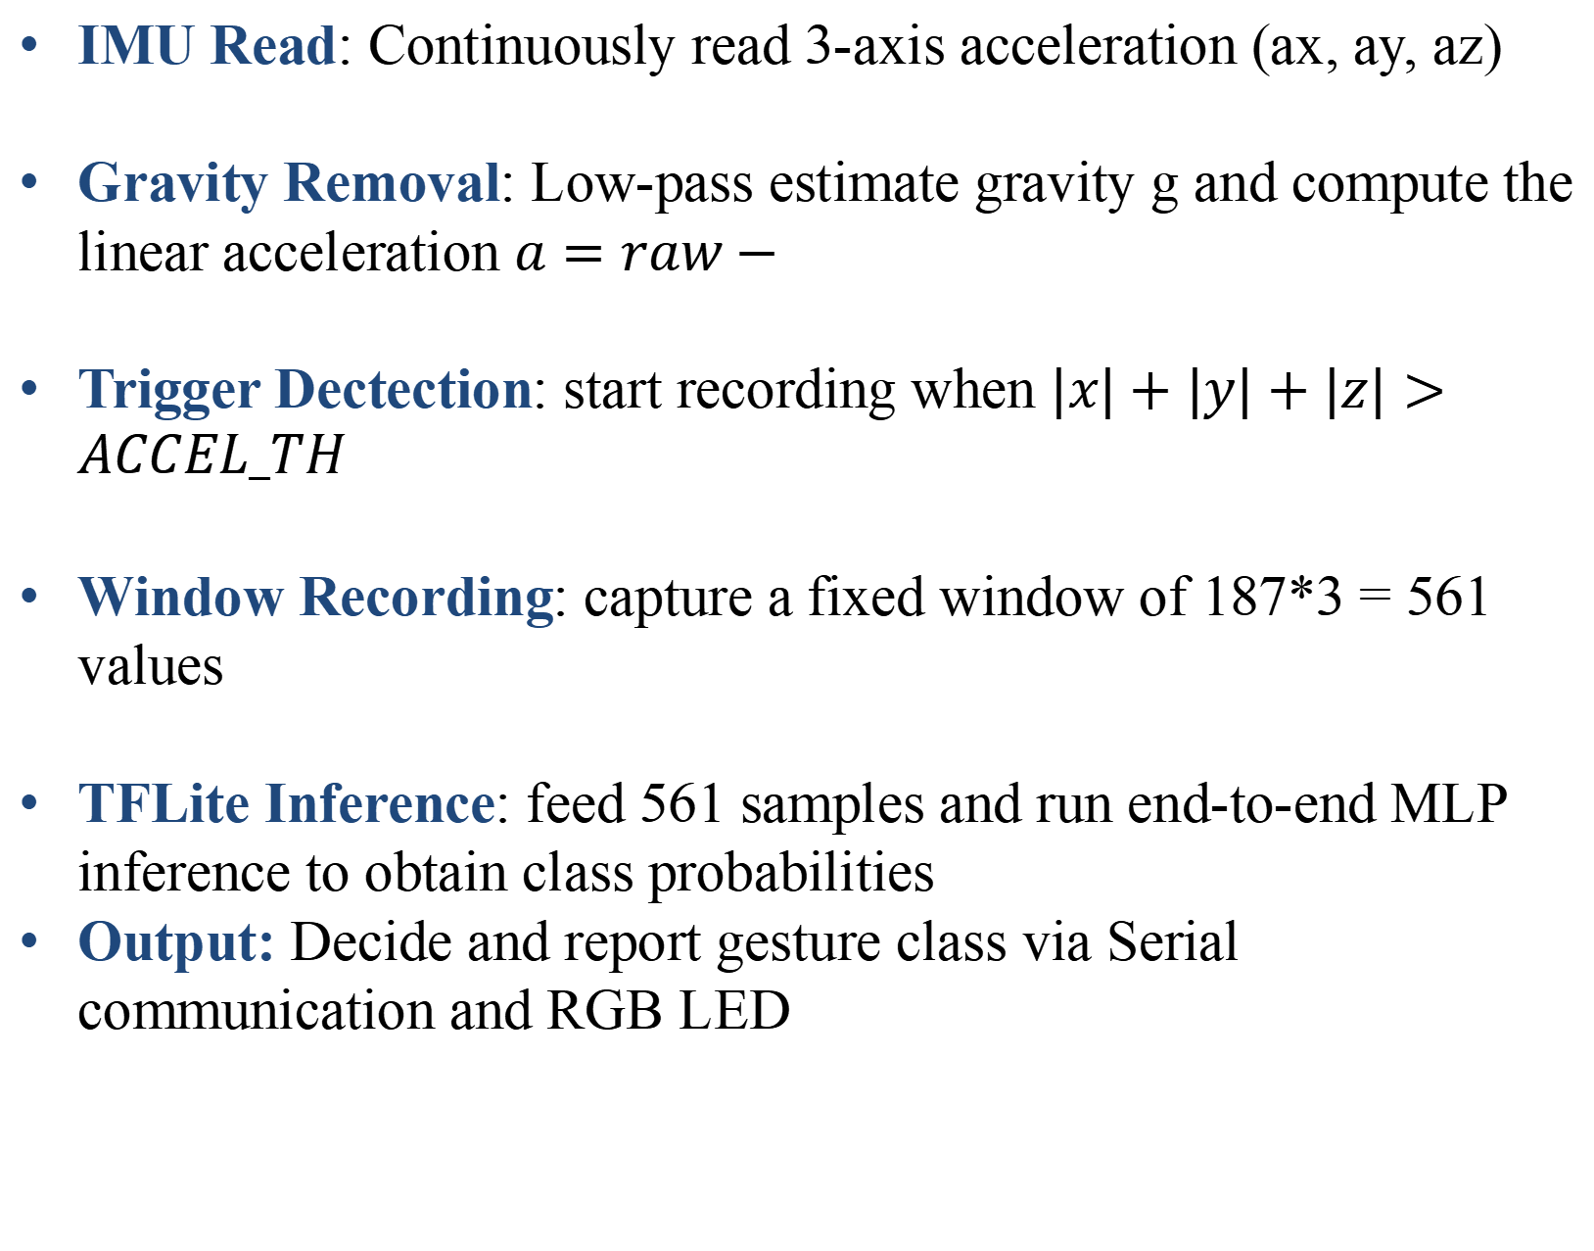
3.1 Arduino Deployment
IMU Read: Continuously read 3-axis acceleration (ax, ay, az)
Gravity Removal: Low-pass estimate gravity g and compute the linear acceleration $a=raw−$
Trigger Dectection: start recording when $|x|+|y|+|z|>ACCEL_TH$
Window Recording: capture a fixed window of 187*3 = 561 values
TFLite Inference: feed 561 samples and run end-to-end MLP inference to obtain class probabilities
Output: Decide and report gesture class via Serial communication and RGB LED

Slide 13
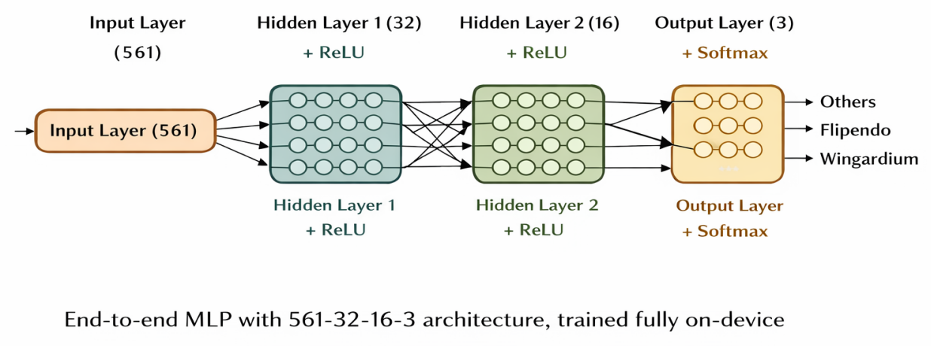
3.2 On-device Learning Architecture (End-to-End MLP)
This diagram illustrates the overall on-device learning pipeline.
In the final system, the accelerometer features are flattened and fed directly into a lightweight end-to-end MLP (561–32–16–3), which performs both feature learning and classification on the device.
Earlier CNN-based embedding and KNN designs were explored but abandoned due to stability issues, and are not used in the final implementation.

Slide 14
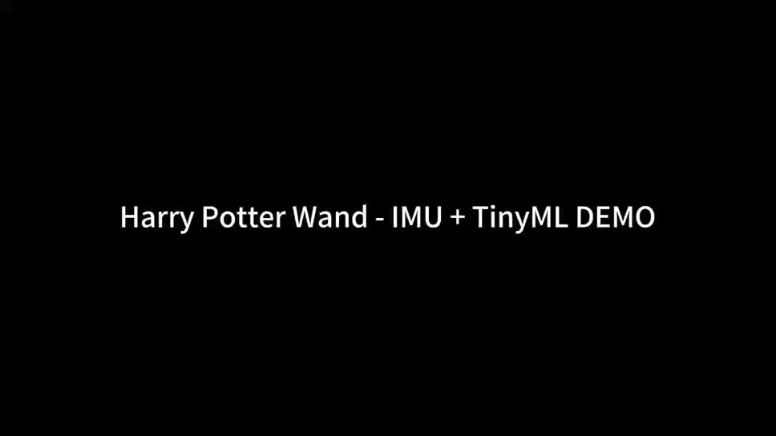
3.3 Video Demonstration

Slide 15
4.1 Limatition
Temporary Memory：
RAM-based storage
Patterns lost upon reset
Signal Windowing：
Rigid 3-second recording window.
Noise from extra silence
Decision Layer Limitation
Simple 1-NN with a single distance threshold may be sensitive to noise and motion intensity.
Easily confused by noise or intensity.

Slide 16
4.2 Solutions
Persistent Storage：
Integrate EEPROM/Flash memory
Permanent storage of user profiles.
Smart Segmentation：
Adaptive dynamic motion cropping.
Focus on core gesture features.
Robust Decision Rules：
Adaptive distance thresholding and per-user calibration.
Higher accuracy for diverse users.

Slide 17
THANK YOU

