Slide 1
Task description
Goal: Create a python code that edits the Python_test_template.pptx document according to the next slides
Before or after editing is done, a window should come up (GUI) where user can choose a folder and give a new filename, where the edited ppt will be saved (not overwriting the template).
Preferably short and most straightforward/simple methods should be used during the solution. Organize and comment your script in a way that it could be easily understood by another scripter (but long textual explanations are not required in the comments)

Slide 2
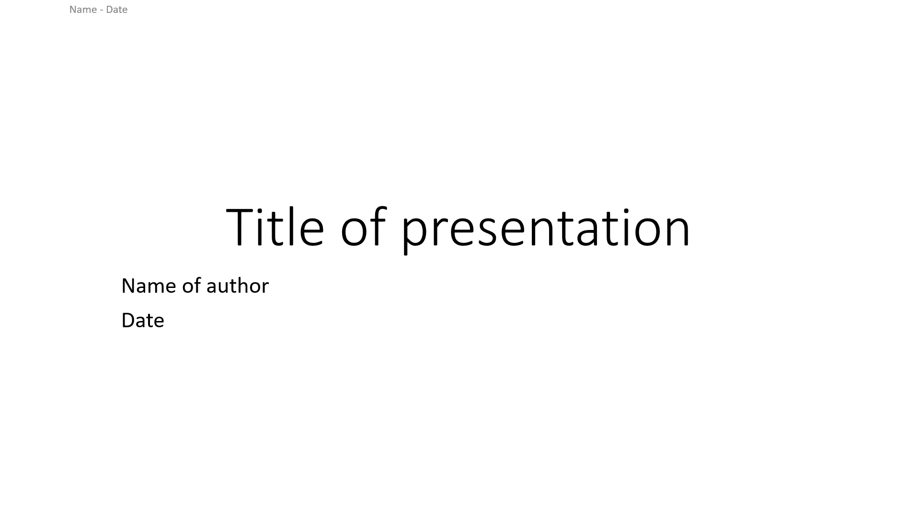
Title slide
from config file
actual date
from config file
Edit the different texts.
You can modify the content of the template ppt. E.g. you can use $ before and after a word that the script will find and replace to something else.
This is the header, so you find it on every slide

Slide 3
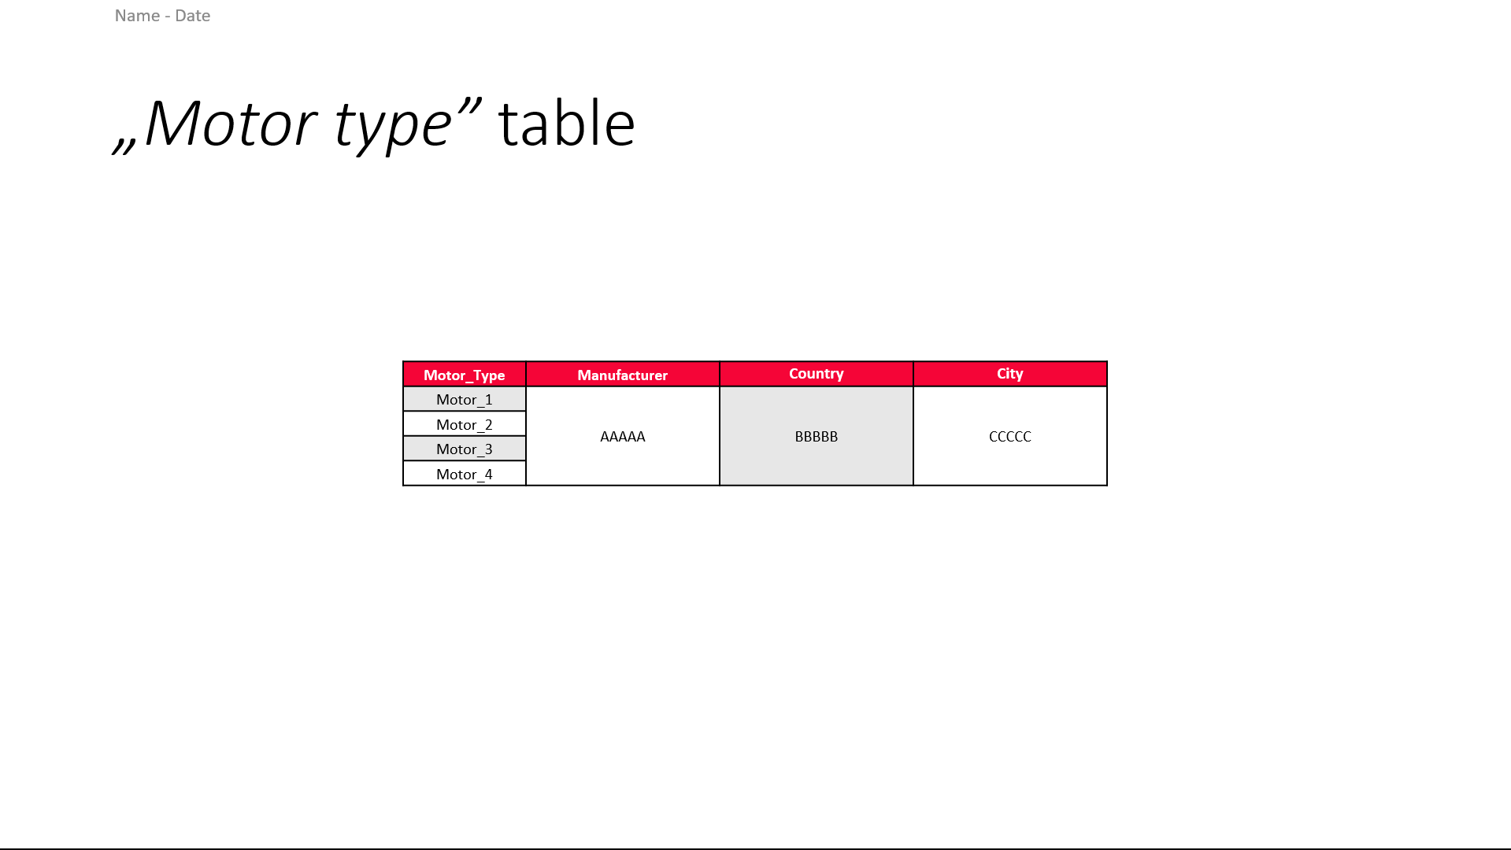
Table slide– make the table
The script should modify the table in ppt (or in excel and replace in ppt).
The motor type rows need to change dinamically depending on the number of „Motor_x” folders.
E.g. as you can see, now there are 2 folders: Motor_1 and Motor_2, the table needs to have only 2 rows.

Slide 4

Table slide– fill with data
Give values from data file in the motor folder (merge the cells for County and City – they are the same - and individual cells for Manufacturer)
Replace the „Motor_1” text with the exact motor type which comes from the .png or .jpeg picture’s name.
The motor type is always defined in the 3rd place in the name. So between the 2nd and 3rd „_”keys (Audi-v10)

Slide 5
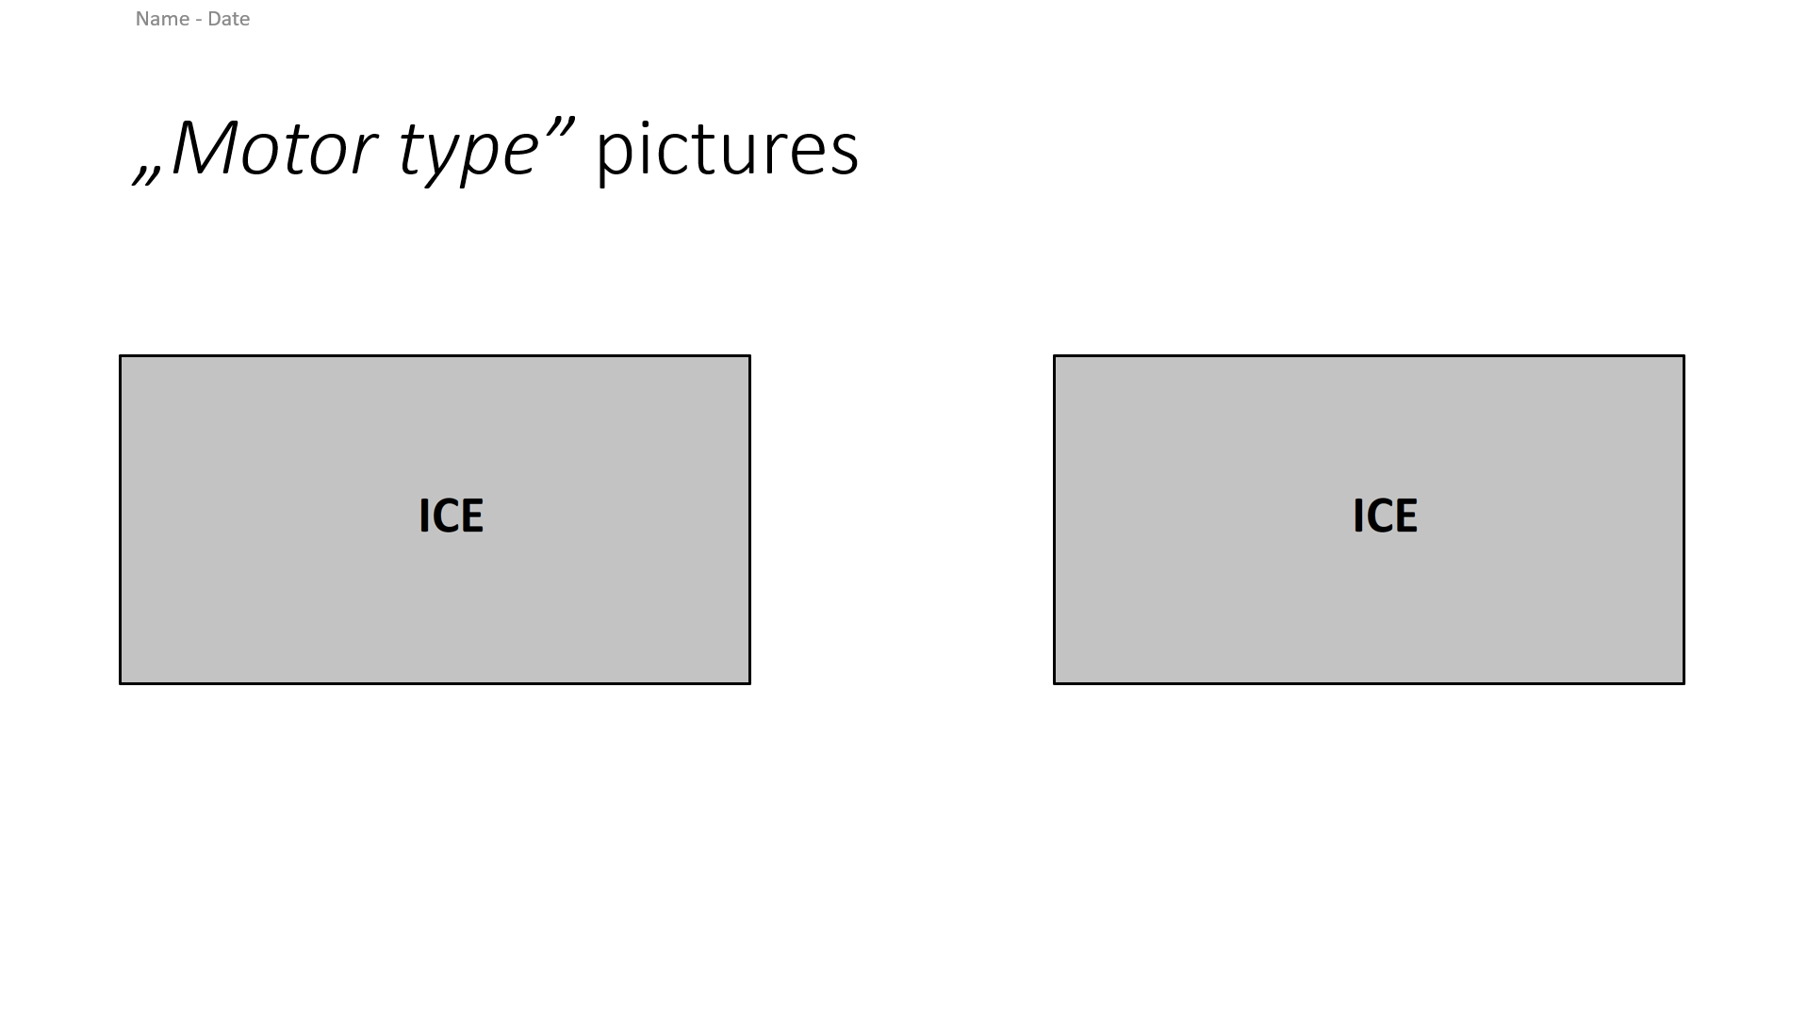
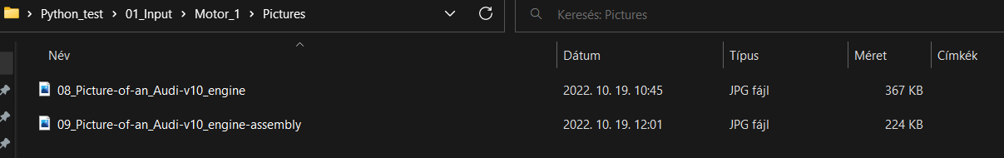
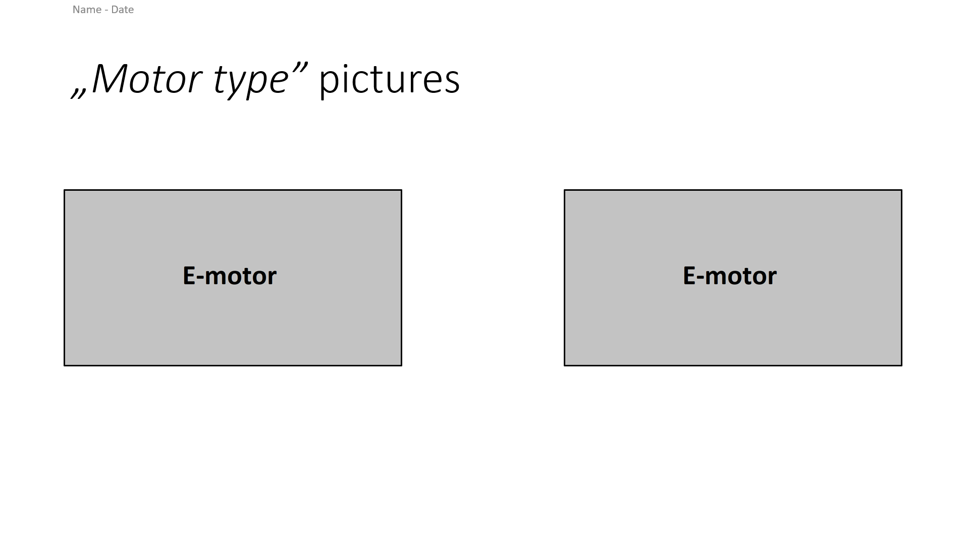
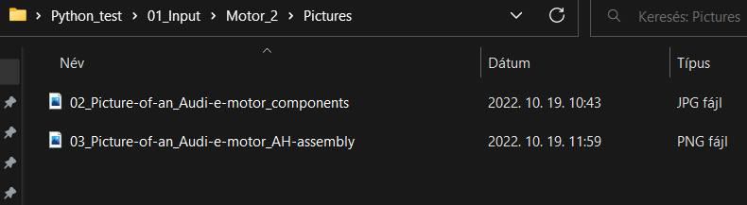
Picture slide
Insert (replace) the pictures and rewrite the „Motor type” to the exact type (Audi-v10 or Audi e-motor)

Slide 6
Python modul recommendation
Python-pptx: LINK
Xlsxwriter: LINK
Datetime: LINK

