Slide 1
Python test
Worker Wanda -09/11/2022 11:15:46
Name of author: Worker Wanda
Date : 09/11/2022 11:15:46

Slide 2
Motor Types table
Worker Wanda -09/11/2022 11:15:46
Motor Types | Manufacturer | Country | city
Motor_1 | Audi Hungaria Zrt. | Hungary | Gyor
Motor_2

Slide 3
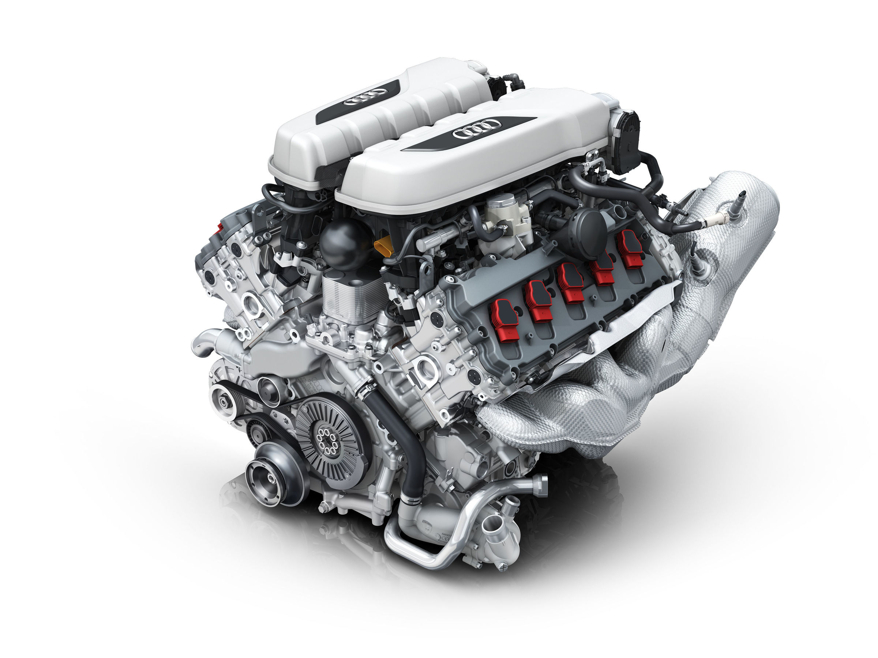
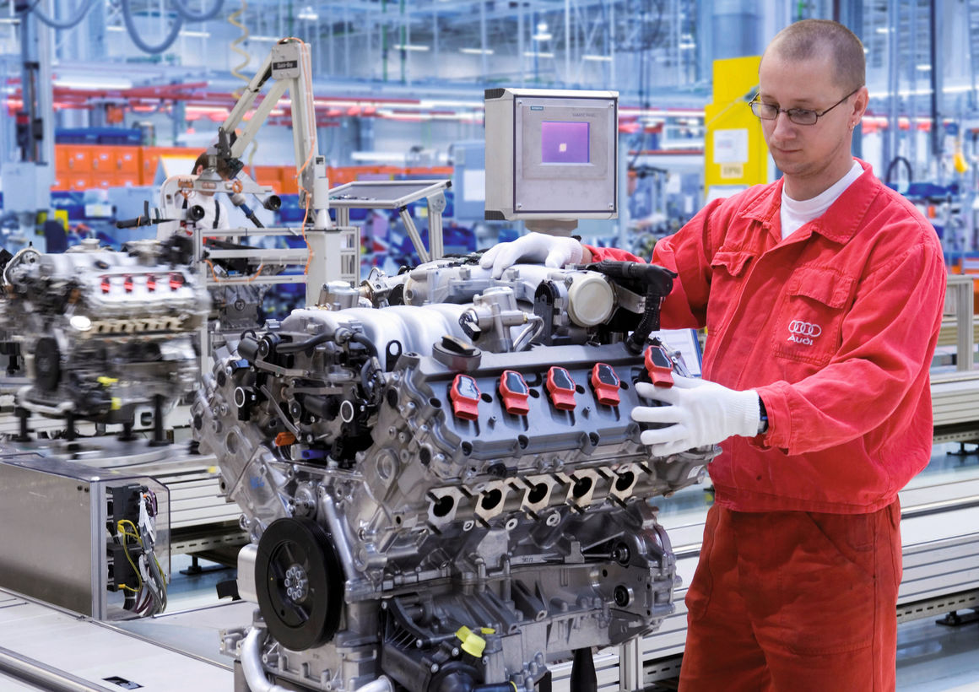
Audi-v10
Worker Wanda -09/11/2022 11:15:46

Slide 4
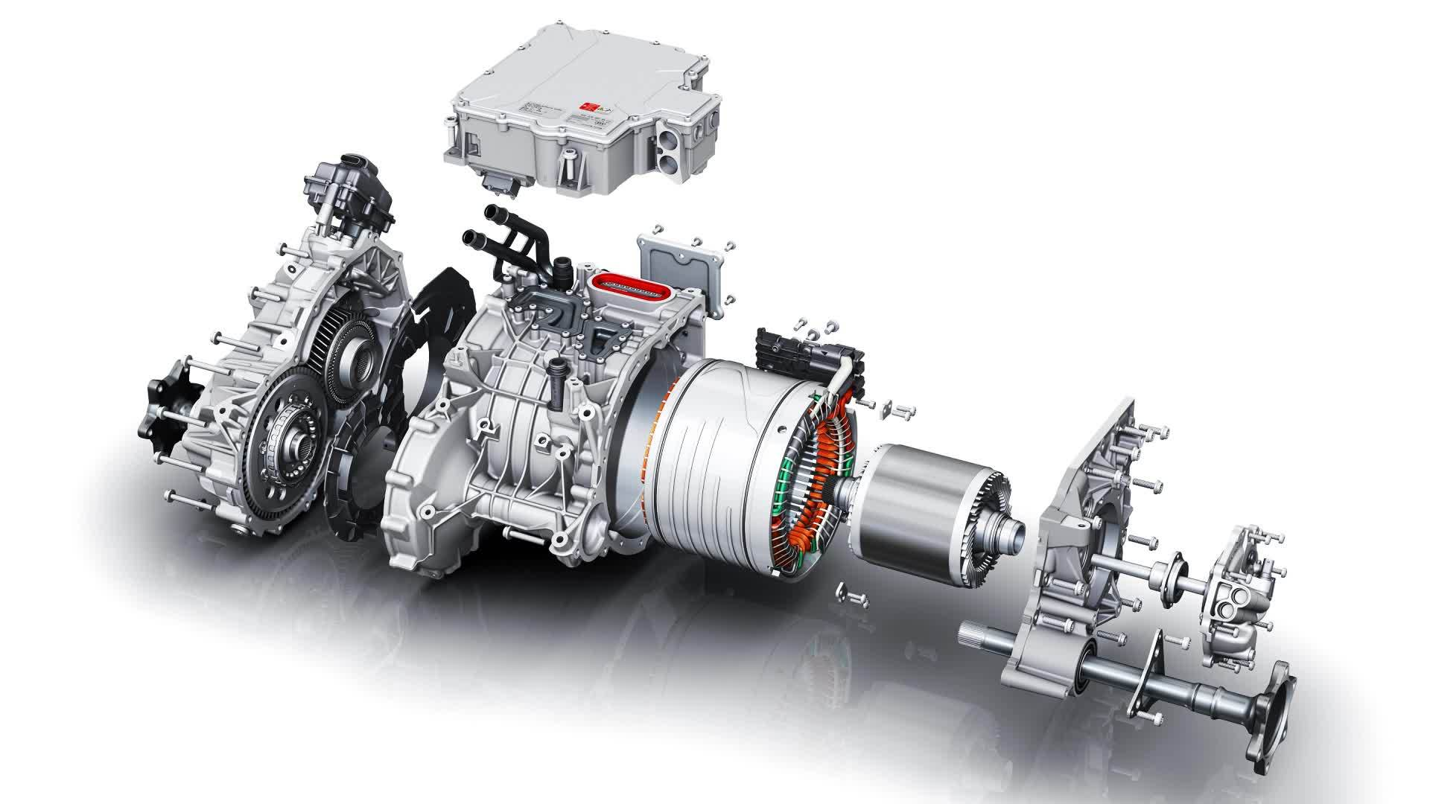
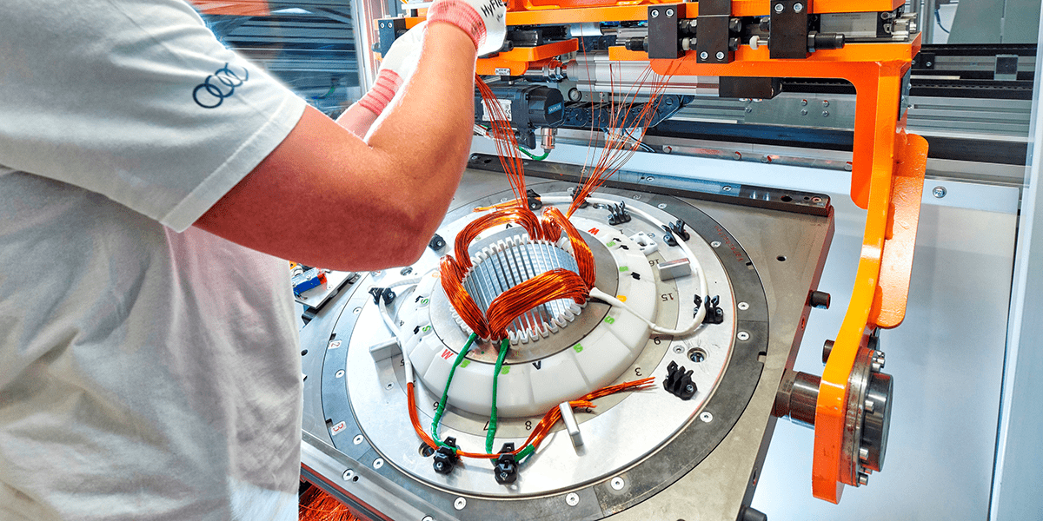
Audi-e-motor
Worker Wanda -09/11/2022 11:15:46

