Slide 1
Linux Development Courses
Programming language: Python
Session VII
Siarhei Boika
LLPD EPAM

Slide 2
Содержание
Python VII
Отладка
Profiling

Slide 3
Отладка
Python VII
Python VII

Slide 4
Технологии отладки
Python VII
Отладчики
pdb set_trace()
python –m pdb
Журналирование
print
syslog
file output
IDE
XXX-pdb

Slide 5
Журналирование
Python VII
How to log?
logging
syslog
custom loggers

Slide 6
logging
Python VII
#debug.py
import logging
logging.basicConfig(level=logging.DEBUG)
logging.debug('This is a debug message.')
$python debug.py
$python debug.py 2>/dev/null
Notes:
DEBUG:root:This is a debug message.

Slide 7
syslog
Python VII
#debug.py
from syslog import syslog
syslog('This is a debug message.')
$python debug.py
$cat /var/log/messages | tail

Slide 8
Python debugger
Python VII
#debug.py
a = "aaa"
b = "bbb"
c = "ccc"
final = a + b + c
print final

Slide 9
python –m pdb debug.py
Python VII
(Pdb)
n
p a,b,c
q
c
help

Slide 10
pdb.set_trace()
Python VII
#debug.py
import pdb
a = "aaa"
pdb.set_trace()
b = "bbb"
c = "ccc"
final = a + b + c
print final

Slide 11
Post mortem анализ
Python VII
#debug.py
a = "aaa"
b = "bbb"
final = a + b + c
print final
$python -i debug.py
>>>import pdb; pdb.pm()

Slide 12
Запуск в интерпретаторе
Python VII
>>> import pdb
>>> import yourModule
>>> pdb.run('yourModule.test()')
>>> import pdb
>>> import yourModule
>>> yourModule.test()
[crash traceback appears here]
>>> pdb.pm()
(pdb)

Slide 13
profiling
Python VII
Python VII

Slide 14
cProfile (profile)
Python VII
import cProfile
import re
cProfile.run('re.compile("foo|bar")')

Slide 15
Анализ результатов
Python VII
194 function calls (189 primitive calls) in 0.001 seconds
Ordered by: standard name
ncalls tottime percall cumtime percall filename:lineno(function)
1 0.000 0.000 0.001 0.001 <string>:1(<module>)
1 0.000 0.000 0.001 0.001 re.py:188(compile)
1 0.000 0.000 0.001 0.001 re.py:226(_compile)
1 0.000 0.000 0.000 0.000 sre_compile.py:179(_compile_charset)
1 0.000 0.000 0.000 0.000 sre_compile.py:208(_optimize_charset)
……….

Slide 16
Профилирование скрипта
Python VII
python -m cProfile [-o output_file] [-s sort_order] myscript.py

Slide 17
Профилирование функций
Python VII
#начало функции
import cProfile; prof = cProfile.Profile(); prof.enable()
……..
#завершение функции (return)
prof.disable(); prof.dump_stats('/tmp/results.profile')

Slide 18
Иные средства анализа
Python VII
RunSnakeRun
https://pypi.python.org/pypi/RunSnakeRun
http://www.vrplumber.com/programming/runsnakerun/

Slide 19
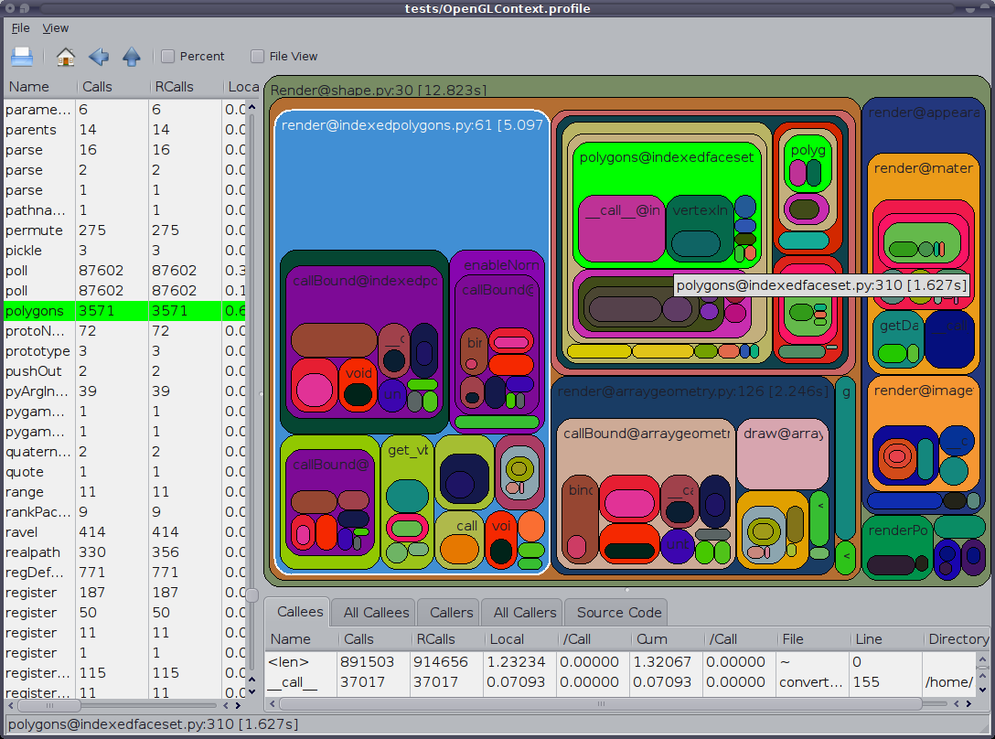
RunSnakeRun
Python VII

Slide 20
RunSnakeRun
Python VII
import reactor
import cProfile
command = """reactor.run()"""
cProfile.runctx( command, globals(), locals(), filename=“result_file.profile" )
python runsnake.py result_file.profile

Slide 21

See you!

