Slide 1
10 Hook Frameworks
That Stop the Scroll.
BEN MEER X HUBSPOT
Capture your audience’s attention. Swipe to learn every framework.

Slide 2

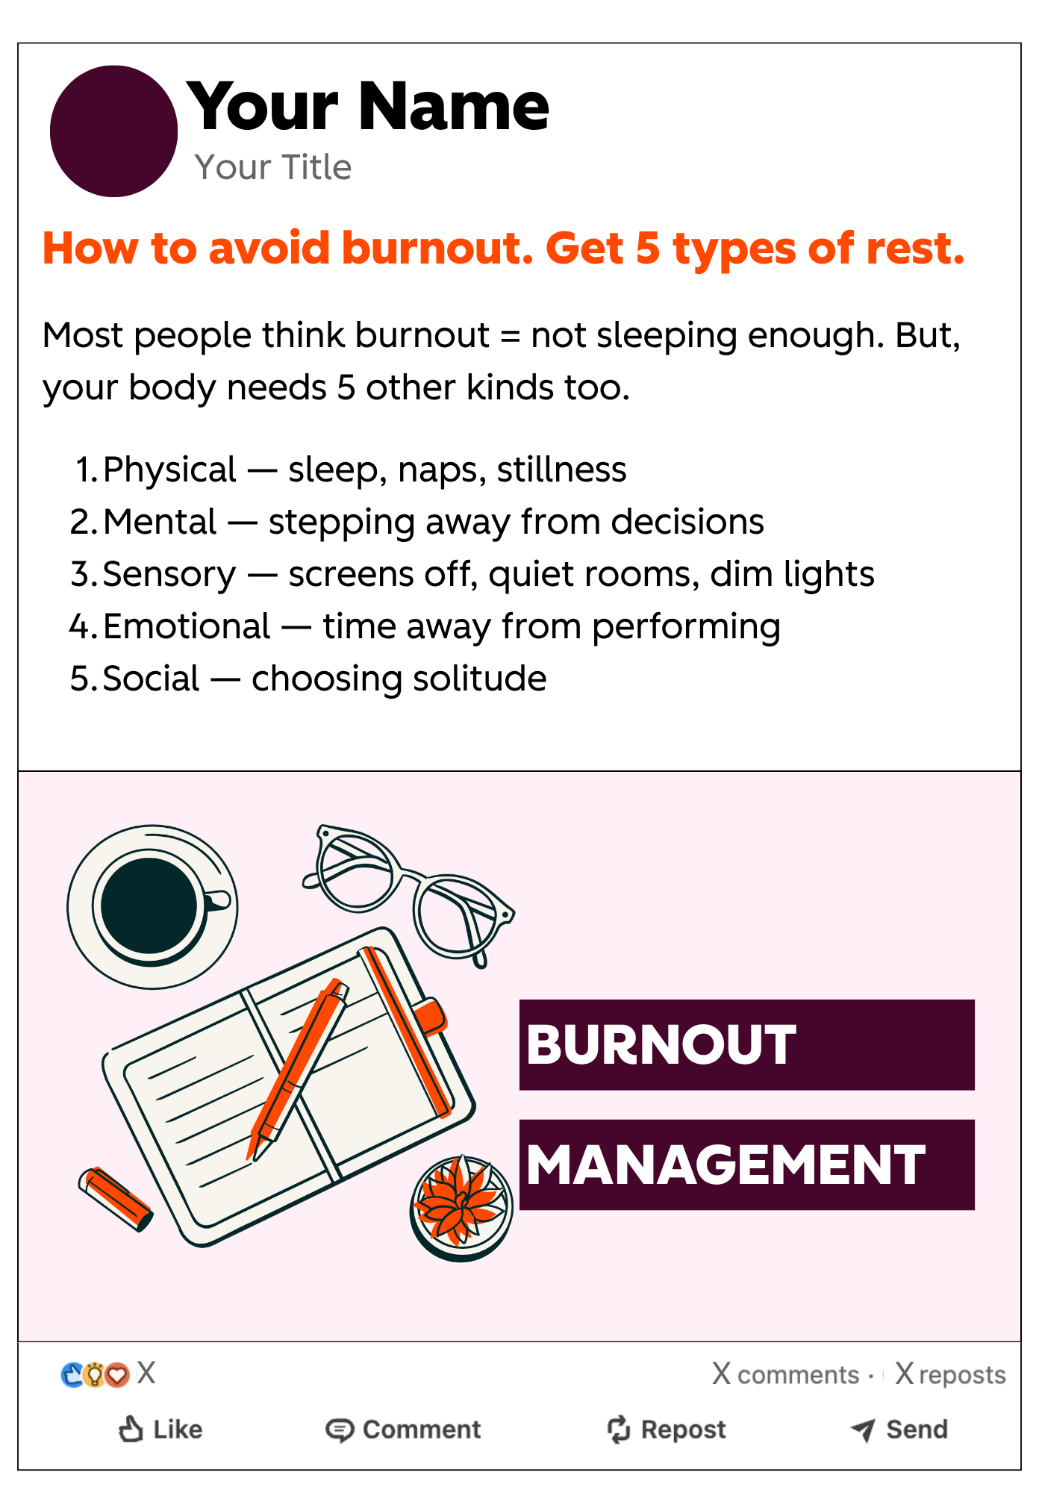
HubSpot
Hook #1 of 10
How to [X]. [Action] [Y]...
Why It Works: Combines a pain point with an immediate promise of relief. The colon signals a list is coming — which keeps people reading.

Slide 3
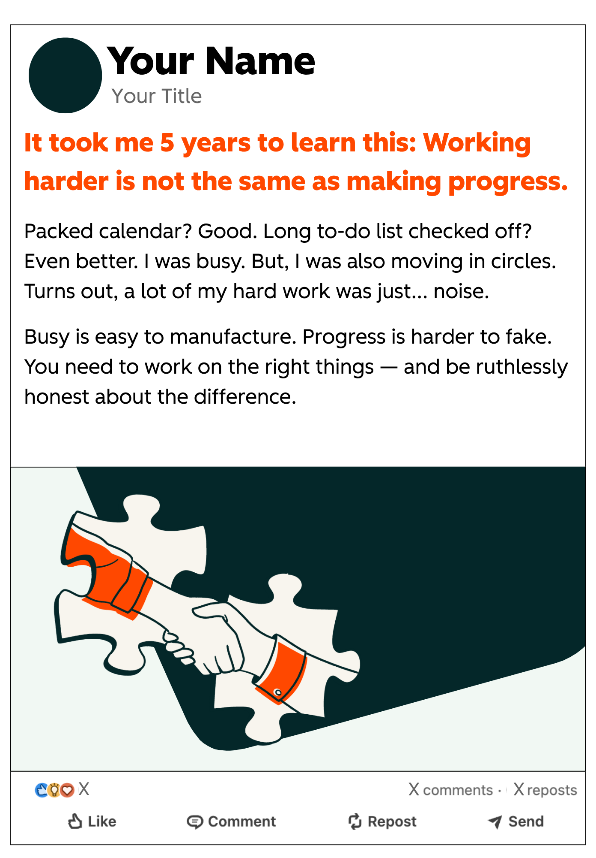
HubSpot
Hook #2 of 10
It took me [X years] to learn this: [truth]...
Why It Works: Time investment signals hard-won wisdom. Readers feel they're getting a shortcut to years of experience.

Slide 4
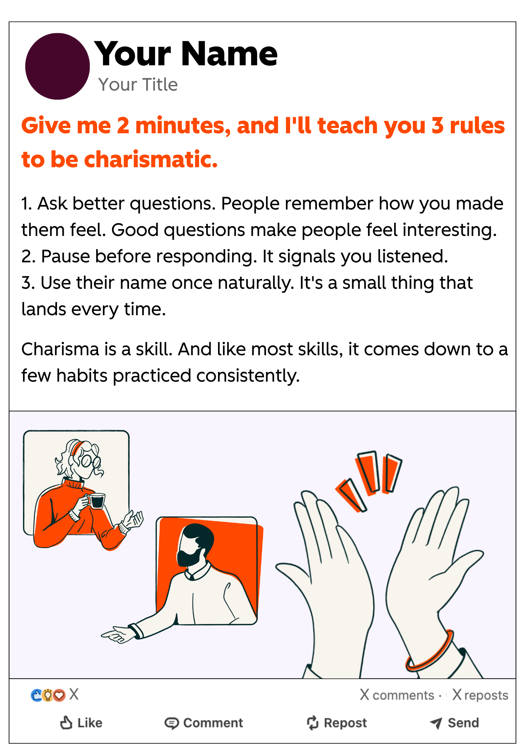
HubSpot
Hook #3 of 10
Give me [X minutes], and I'll teach you [skill]...
Why It Works: Explicit time commitment lowers the barrier. The reader already knows the ROI before they start.

Slide 5
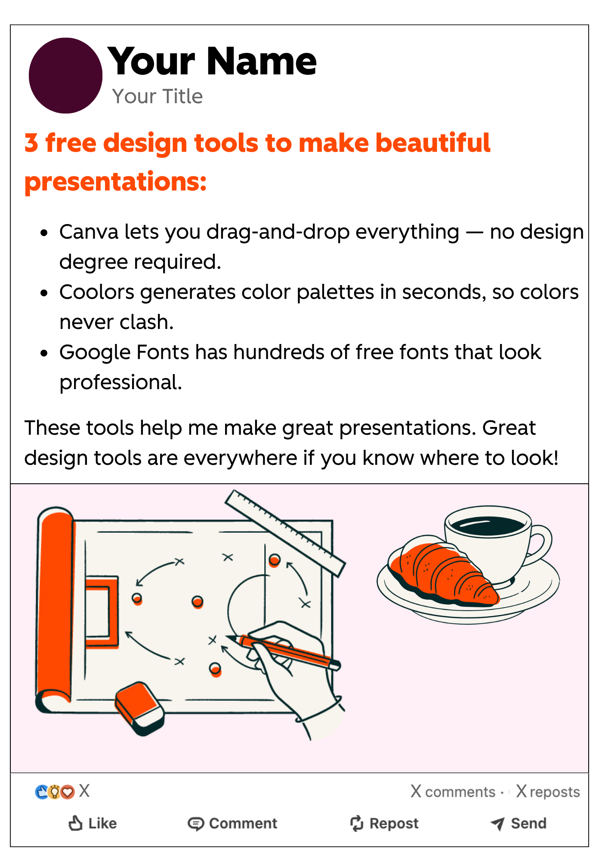
HubSpot
Hook #4 of 10
[Number] free [item] to [benefit]...
Why It Works: Free + a specific number + a desirable outcome is a formula LinkedIn's algorithm loves. Easy save, easy share.

Slide 6
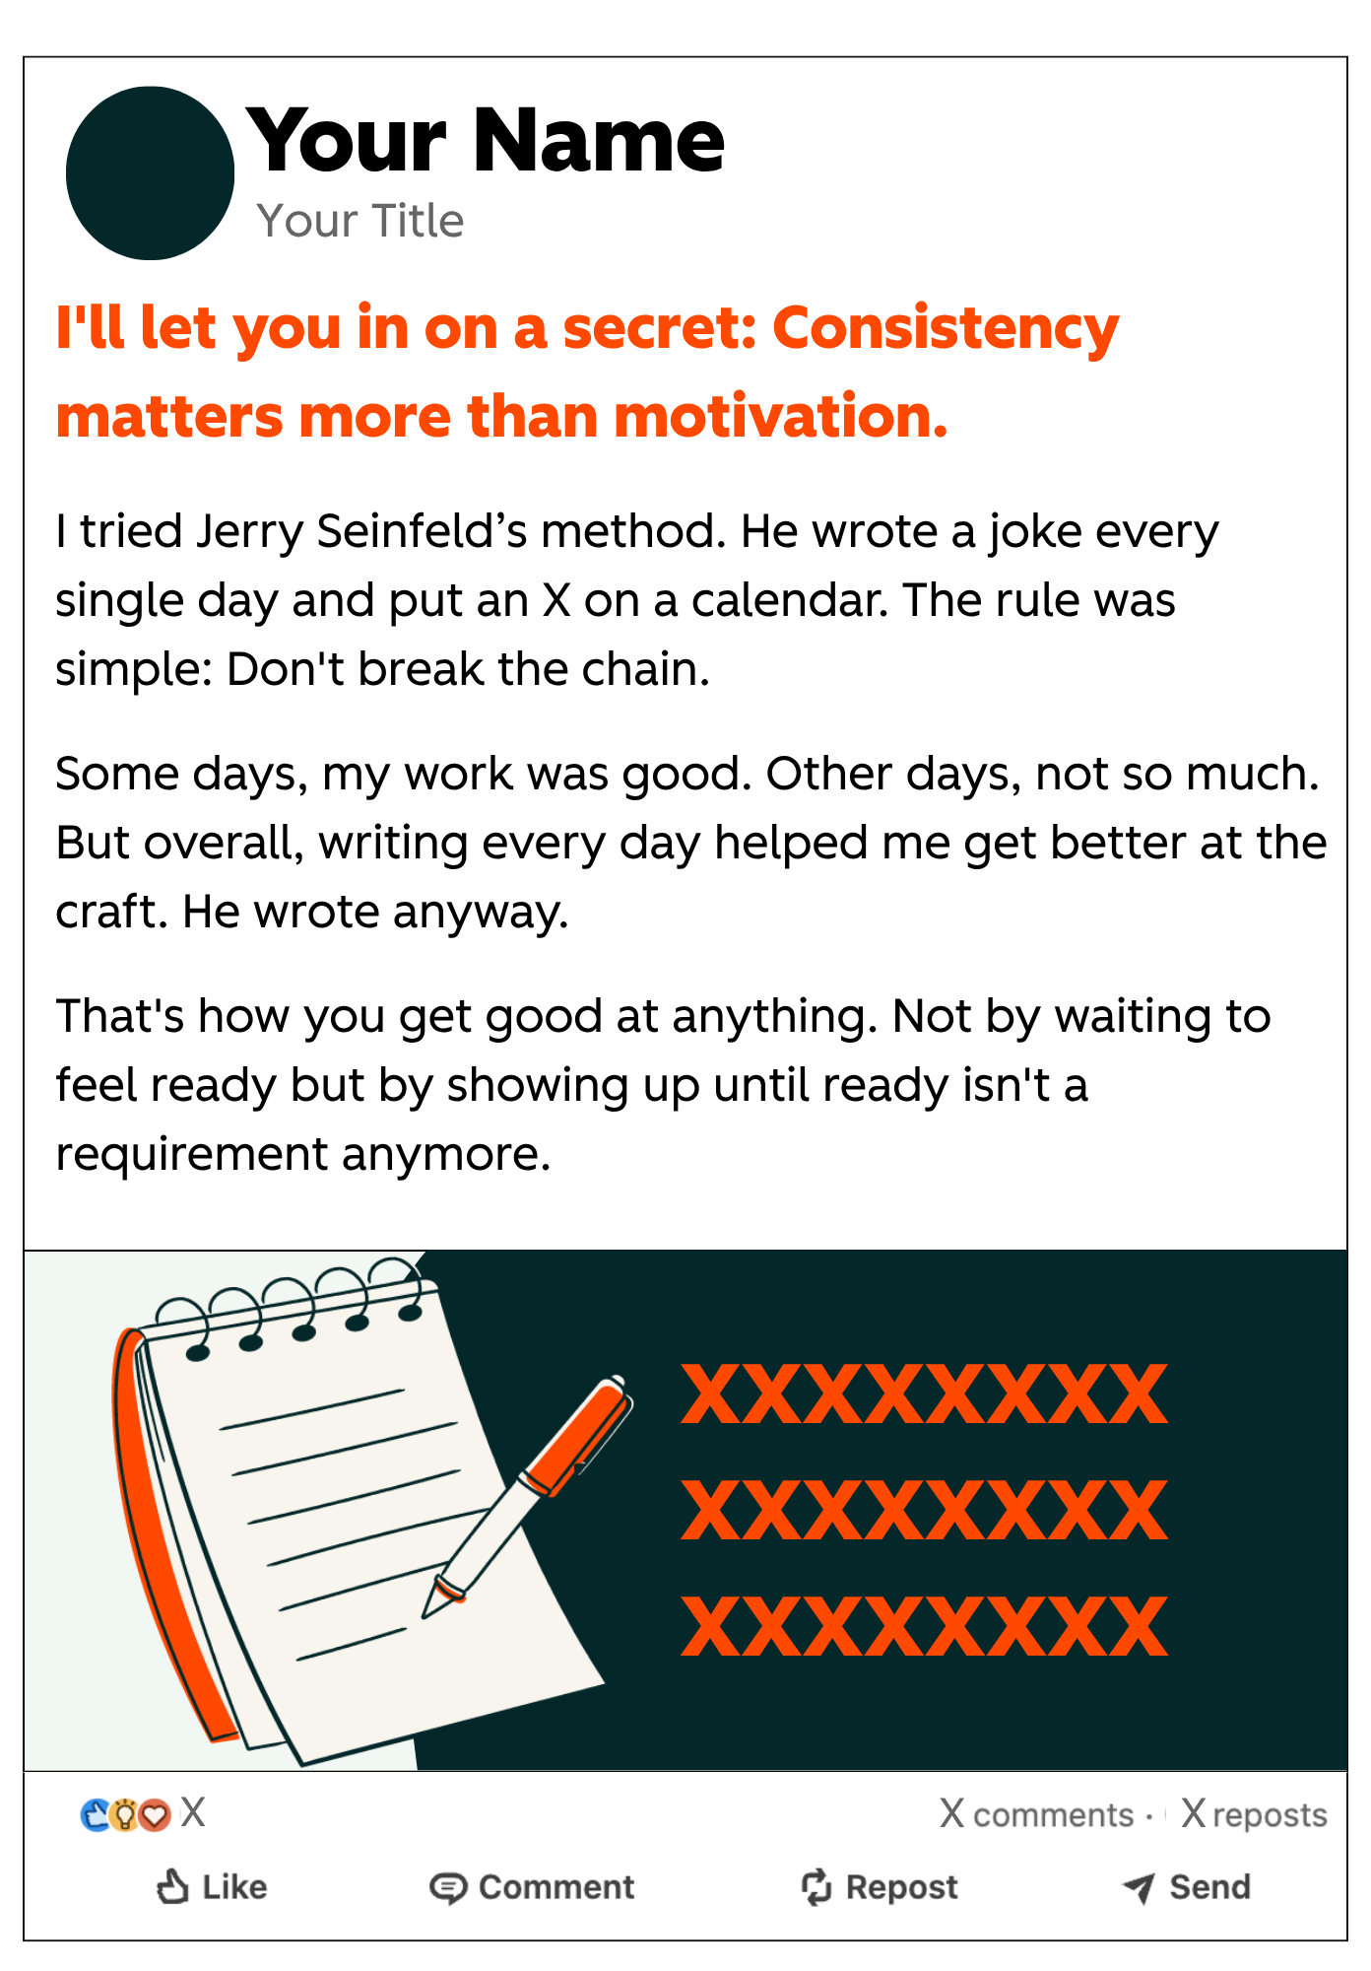
HubSpot
Hook #5 of 10
I'll let you in on a secret: [counterintuitive truth].
Why It Works: Contrarian takes break expectations — which creates attention. When the insight is true, not just edgy, engagement follows.

Slide 7
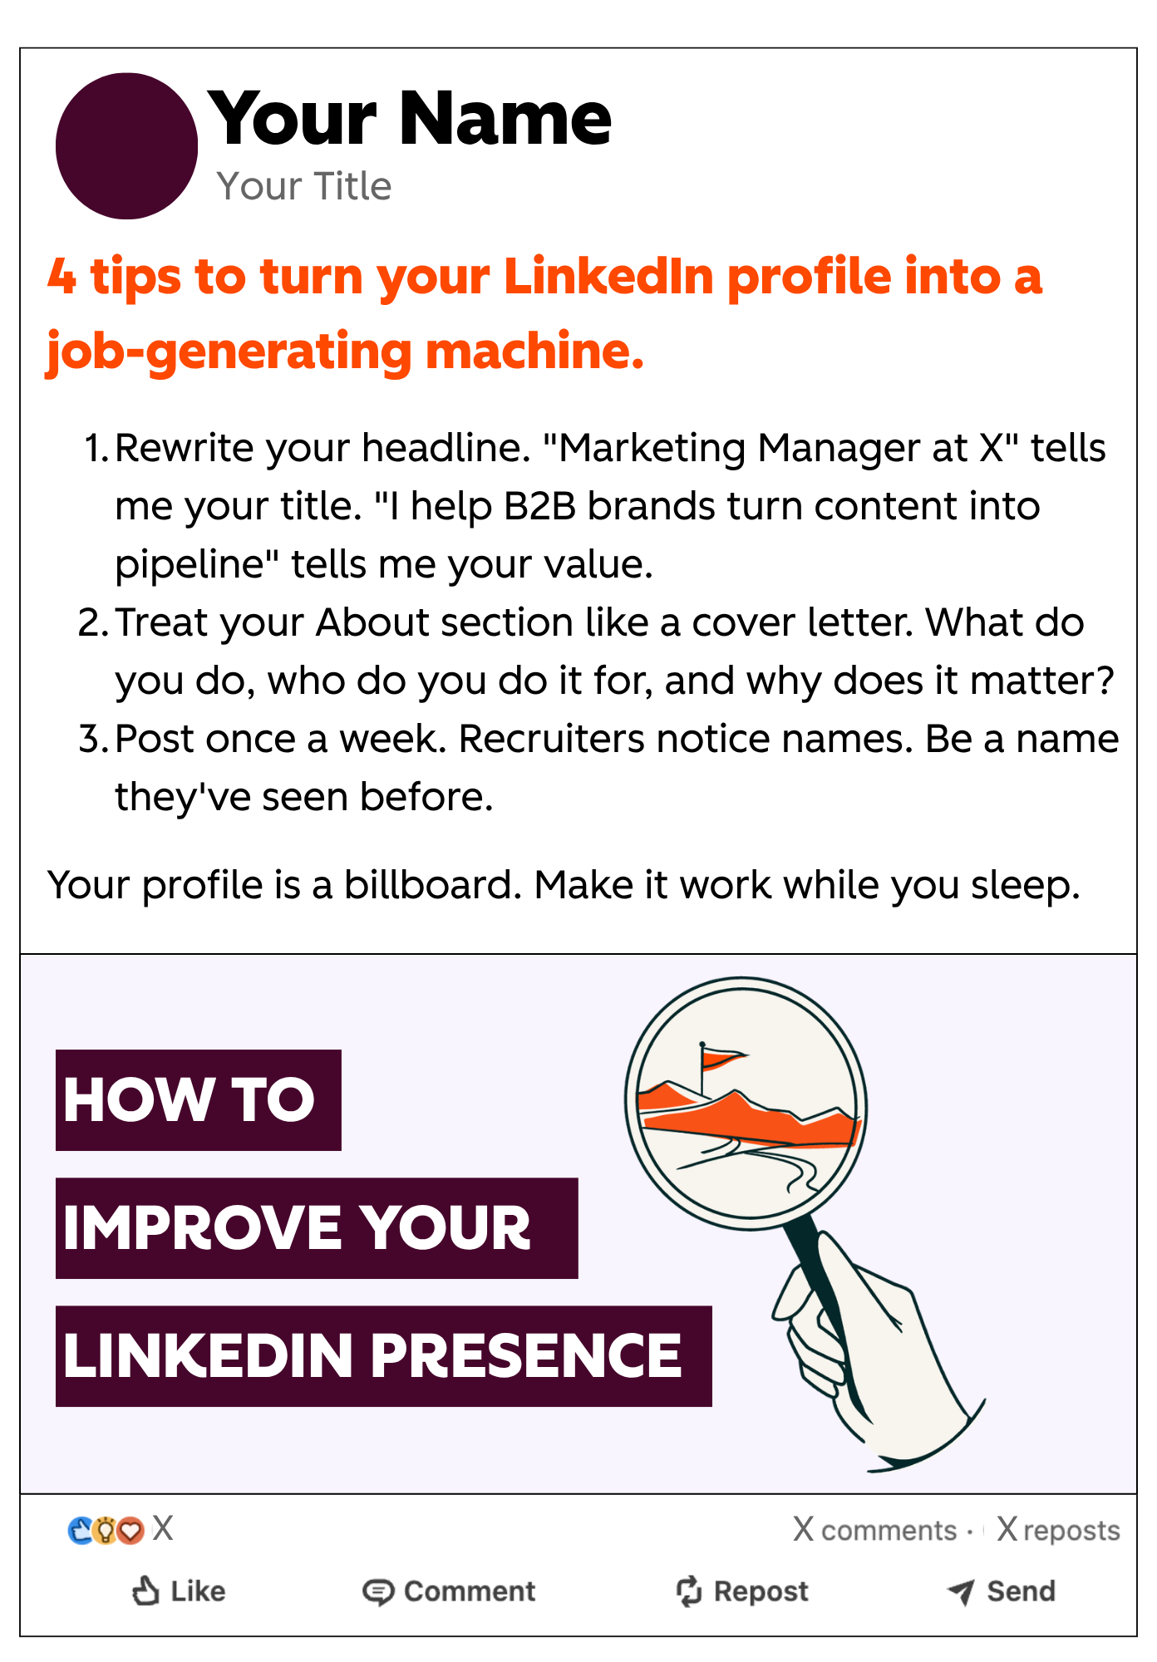
HubSpot
Hook #6 of 10
[Number] ways to [result] in [timeframe]...
Why It Works: Specific number + clear result + defined timeframe = highest-clarity value promise. Readers know exactly what they're getting.

Slide 8
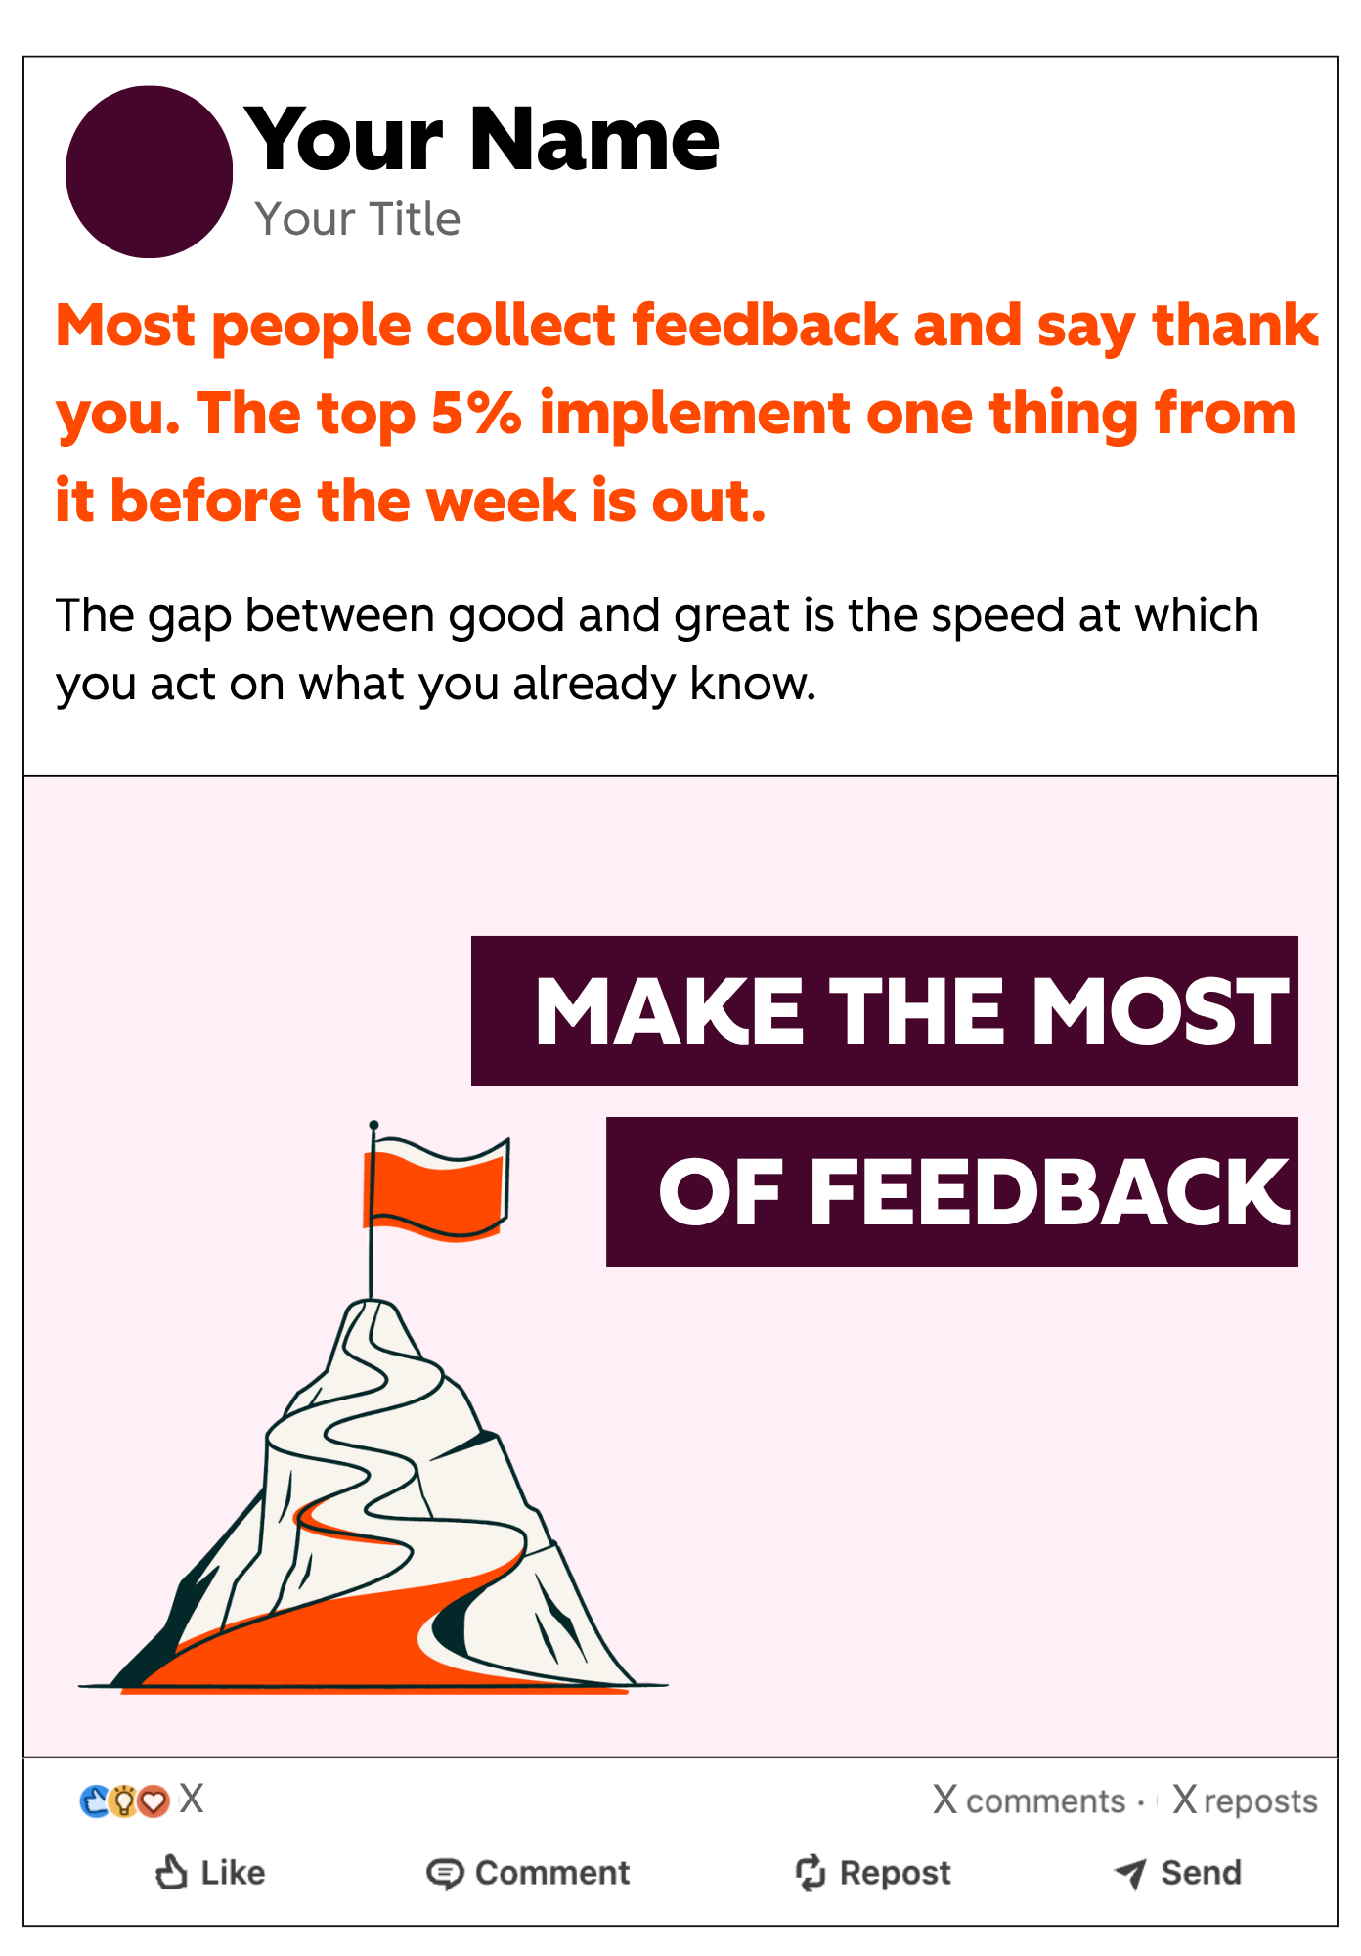
HubSpot
Hook #7 of 10
Most people [common behavior]. The top [X]% [contrasting behavior]...
Why It Works: Identity contrast creates instant tension. Readers self-sort, and most want to be in the elite group. So, they keep reading to see how.

Slide 9
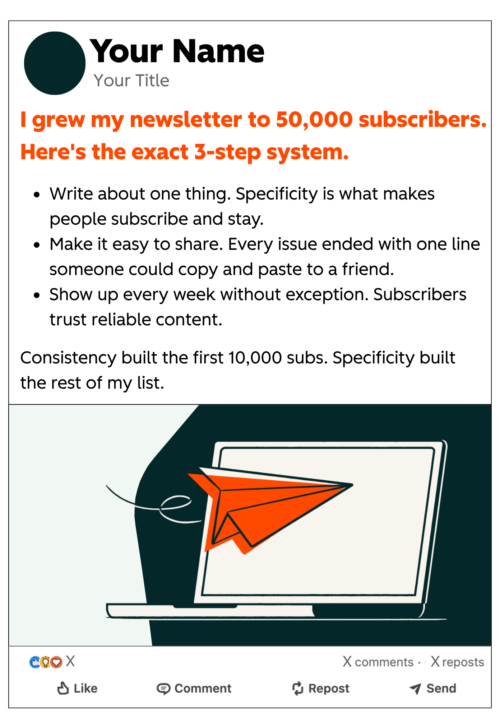
HubSpot
Hook #8 of 10
[Impressive result]. Here's the exact [X]-step system…
Why It Works: Leading with proof before the pitch is the most credible structure on LinkedIn. The word "exact" signals specificity, not fluff.

Slide 10
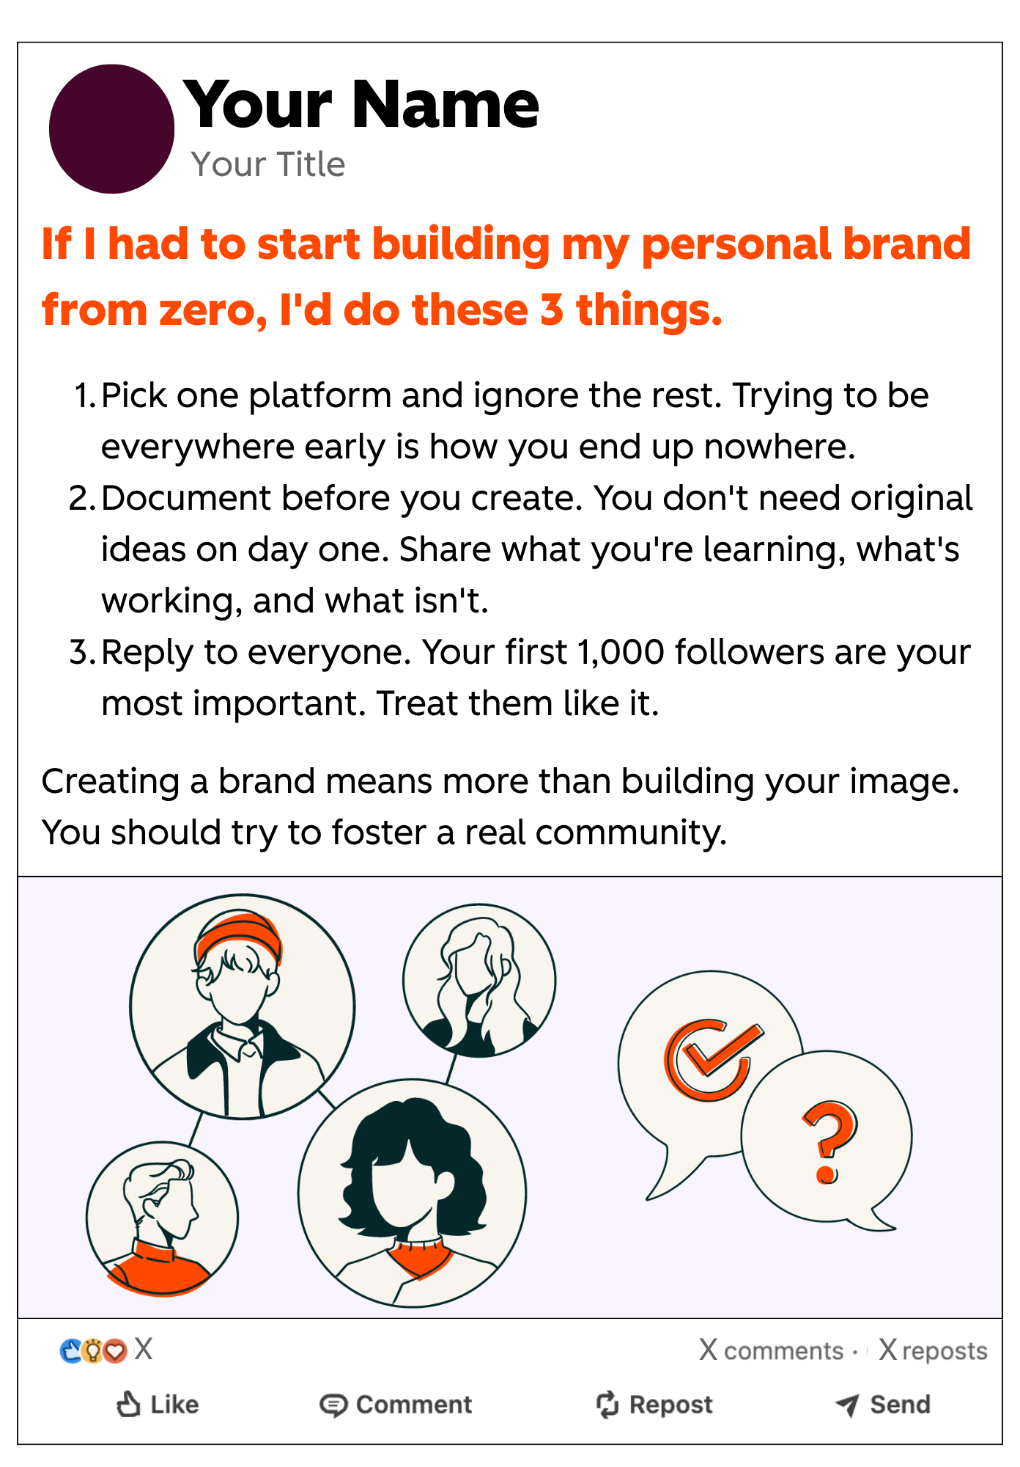
HubSpot
Hook #9 of 10
If I had to start [goal] from zero, I'd do these [X] things…
Why It Works: The "from scratch" framing removes assumed advantages. Advice feels accessible to anyone. It's aspirational and practical at the same time.

Slide 11
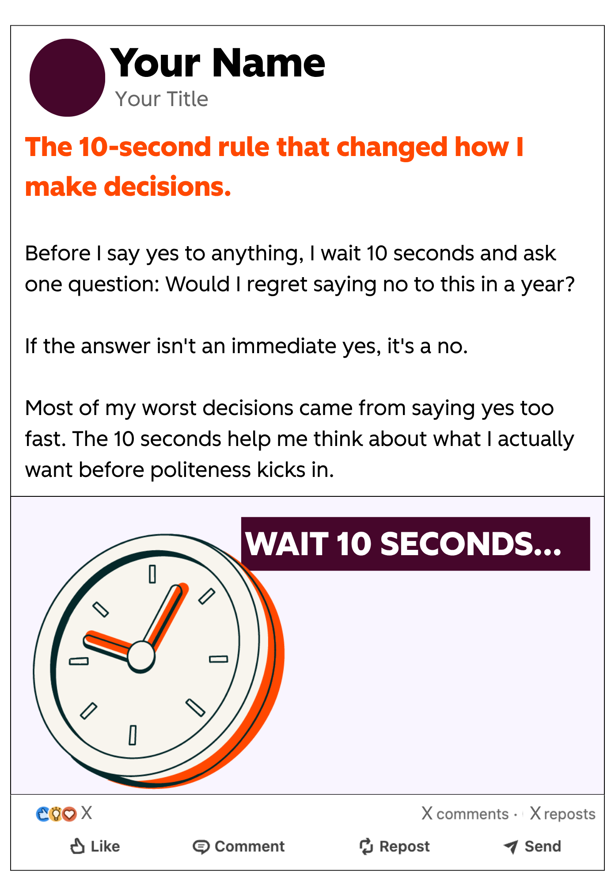
HubSpot
Hook #10 of 10
The [X]-second rule that changed how I [area of life]...
Why It Works: A specific, tiny time commitment makes the tip feel instantly actionable. Readers trust concise, testable frameworks over vague advice.

Slide 12
HubSpot
Hooks That Stop the Scroll
THE RULE
— BEN MEER
Is this surprising or actionable?
“
The best LinkedIn content always falls into one of those two categories. Ask yourself this before you hit publish — every single time.

Slide 13
WANT THE FULL SYSTEM?
Ben Meer's 7-Part LinkedIn Growth System
From 1K → 840K followers in under 3 years. Get the complete playbook — free via HubSpot.

