Slide 1

Personal Specialization Project
Cybersecurity EHV-02
Written by Farros Ramzy

Slide 2
The Influence of Virtual Private Network (VPN)

Slide 3
Contents of Project
Goal of Project
Research Question
DOT Framework
Results of Research
Conclusions
Recommendation

Slide 4

The Goal of The Project
To find the influence of the VPN as one of many network security tools for the network user.
To know better about the VPN by its pros and cons.

Slide 5
Research Question
Why is VPN very important nowadays?
What exactly is a VPN?
What makes VPN app very popular?
How to use a VPN?
What might be the disadvantages of using a VPN?

Slide 6
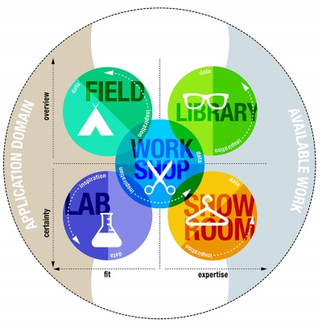
How to Find The Answers?

Slide 7
DOT Frameworks
Field
Problem Analysis
Library
Literature Study
Available Product Analysis
Lab
Security Test

Slide 8
Results of Research

Slide 9
Findings
What is a VPN?
What Protocols That They Use?
A software tool to disguise an internet users’ identity to protect it from any risk of data leaks.
PPTP (Point-to-Point Tunneling Protocol)
OpenVPN
SSTP (Secure Socket Tunneling Protocol)
L2TP (Layer 2 Tunneling Protocol)
IKEv2 (Internet Key Exchange version 2)

Slide 10
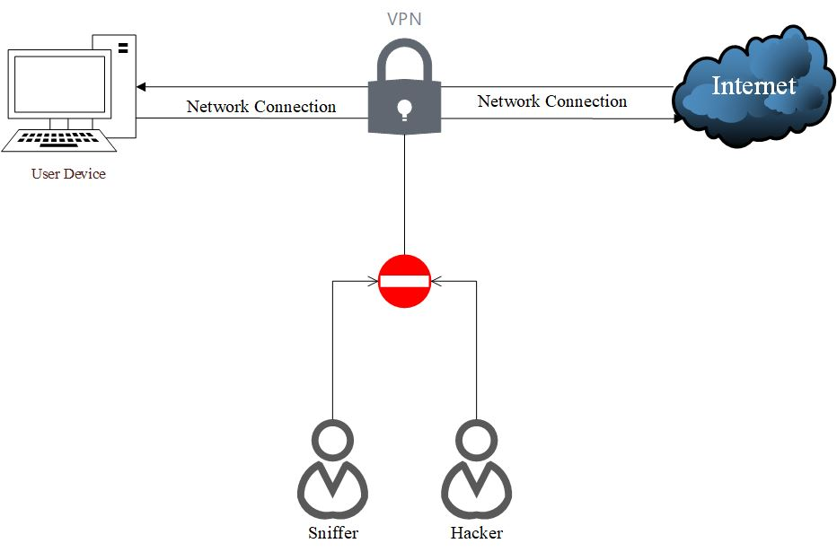
How is it Work?

Slide 11
Advantages & Disadvantages
Pros:
Increased Security
Disguise the Network Traffic
Free from some internet geo-restrictions
Flexible
Hides and removes activity data
Cons:
Mostly costs money
Sometimes, the product is fake
Reduced network speed
Potential legal issues
Compatibility issues
Their trust policies

Slide 12
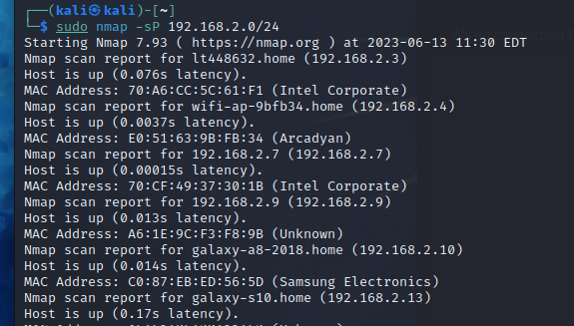
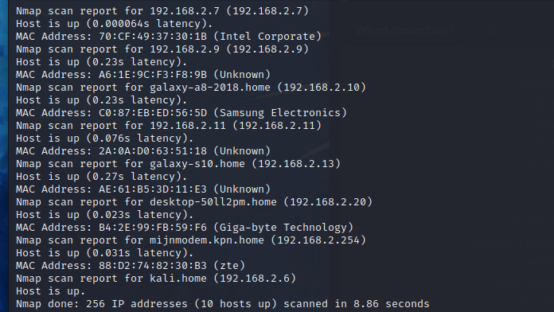
Experiment
Without VPN
With VPN

Slide 13
Conclusions
VPN is important because of the increasing privacy issue, but not mandatory.
There are some benefits of using the VPN for Privacy Security, but sometimes, it costs too much.
VPN may hide user’s identity, but it doesn’t fully protect the user’s network.

Slide 14
Recommendations
Always keep Firewalls on while using a VPN.
It is important to be aware of the VPN policies before using the product.
It is better to subscribe to the cheapest but legit VPN service rather than using a free VPN, but a fake one.

