Slide 1
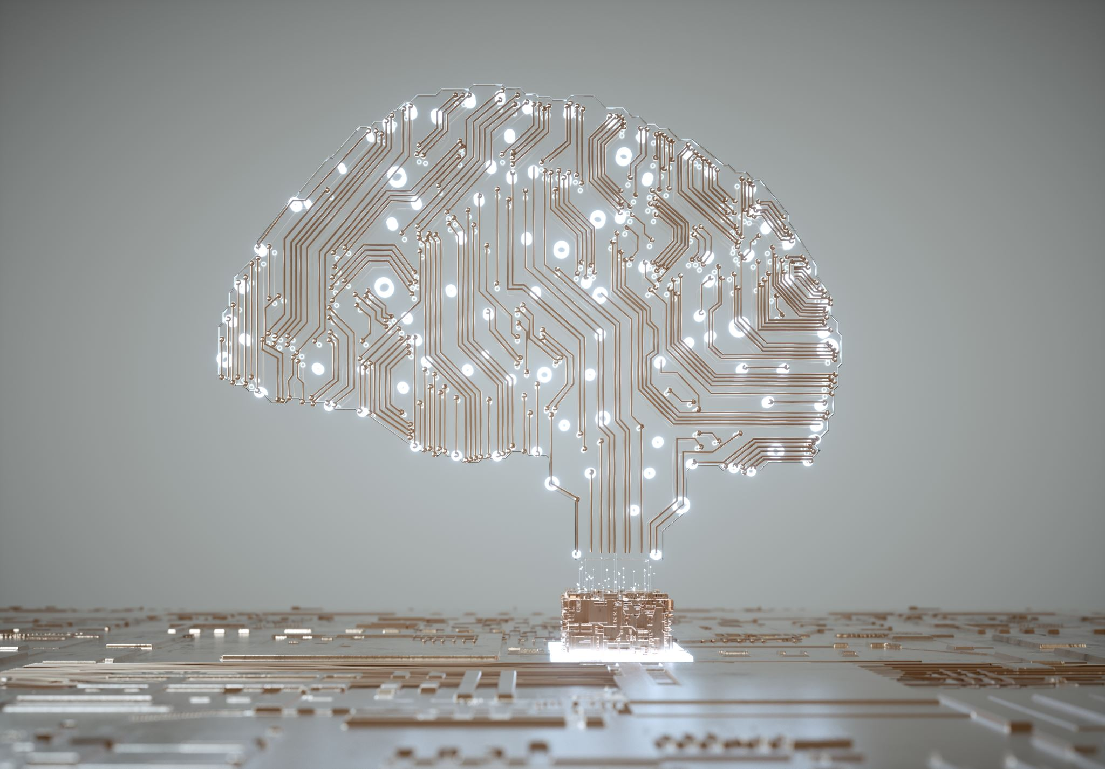
Artificial Intelligence Lecture 1

Slide 2
Artificial Intelligence
Welcome to Artificial Intelligence
Lecturer: Prof. Hilal Tayara
hilaltayara@jbnu.ac.kr
Office: Global Frontier College, 333
Office hours: Thursday 9.00 AM - 10.00 AM
Lectures:
Wednesday: 15:00-16:00, classroom #504
Friday: 14:00-16:00, classroom #504
All lectures’ materials are uploaded to LMS: https://ieilms.jbnu.ac.kr/

Slide 3
Class objectives
Network Control System Lab (NSCL) Artificial Intelligence
Understanding AI & ML algorithms.
Using AI & ML algorithms for solving challenging problems.

Slide 4
AI Syllabus
Network Control System Lab (NSCL) Artificial Intelligence
Introduction to AI and machine learning.
Regression.
Classification.
Clustering.
Deep Learning.
Convolutional Neural Network.
Recurrent Neural Network.
Applications of Deep learning.

Slide 5
Background?
Network Control System Lab (NSCL) Artificial Intelligence
Programming: Python
Machine Learning libraries
Sklearn
Keras
Tensorflow
…

Slide 6


Anaconda
Network Control System Lab (NSCL) Artificial Intelligence
https://colab.research.google.com/
https://anaconda.org/

Slide 7
Grading
Tentative and subject to change
Midterm 25%
Final 35%
Assignments, projects 30%
Attendance 10%

Slide 8
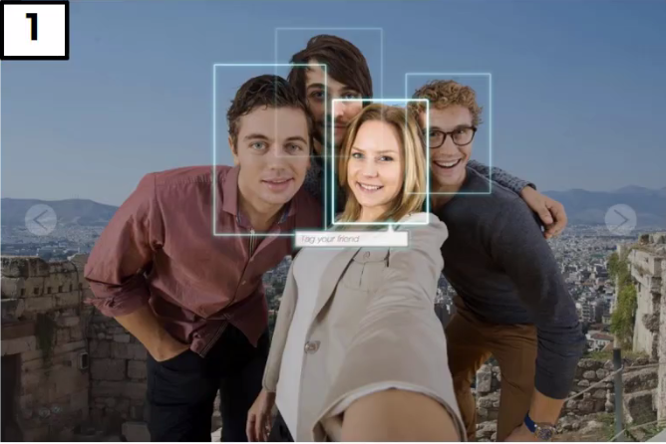
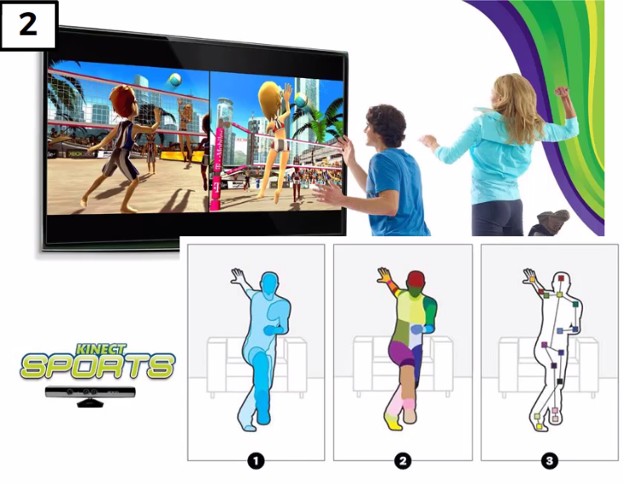
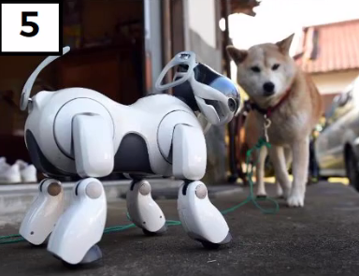

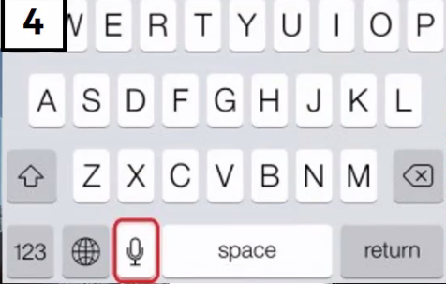
Applications of AI
Network Control System Lab (NSCL) Artificial Intelligence

Slide 9


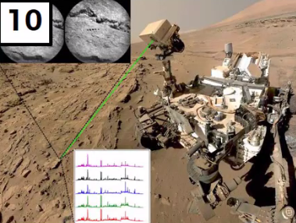
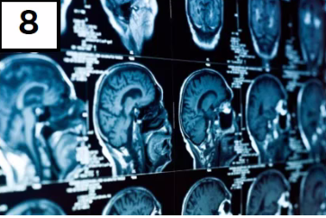

Network Control System Lab (NSCL) Artificial Intelligence

Slide 10
Why AI?!
Network Control System Lab (NSCL) Artificial Intelligence
UP until 2005 humans had created 130 Exabyte of data.
2010 → 1200 Exabyte.
2015 → 7900 Exabyte.
2020 → 40900 Exabyte.
1 Exabyte = 10¹⁸ Byte

Slide 11
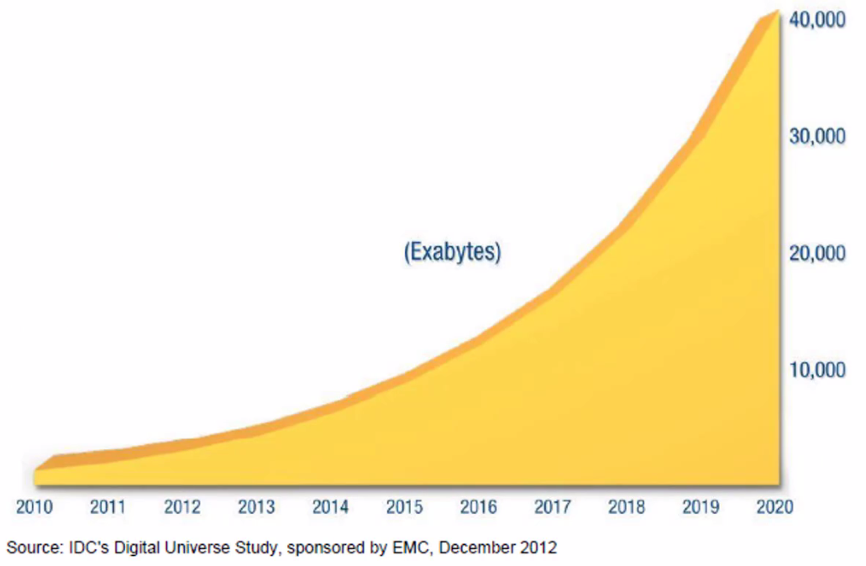
Why Machine Learning?!
Network Control System Lab (NSCL) Artificial Intelligence

Slide 12
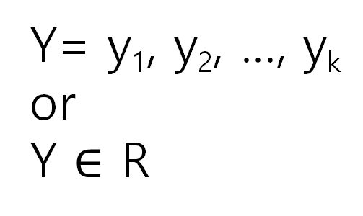
The essence of machine learning
Network Control System Lab (NSCL) Artificial Intelligence
A pattern exists.
We cannot pin it down mathematically.
We have data on it.
AI
X
Y
Y= y₁, y₂, …, y_{k}
or
Y $∈$ R
X = x₁, x₂, …, x_{n}

Slide 13
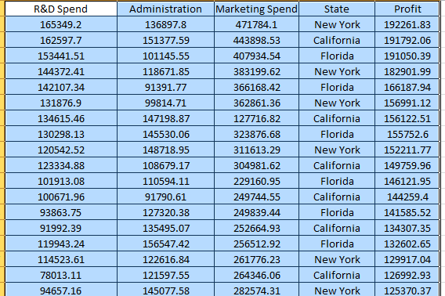
The essence of machine learning
Network Control System Lab (NSCL) Artificial Intelligence
Regression
AI
X
Y
X = {x₁= R&D Spend, x₂= Administration,
x₃= Marketing spend, x4=State}
Y = Profit

Slide 14
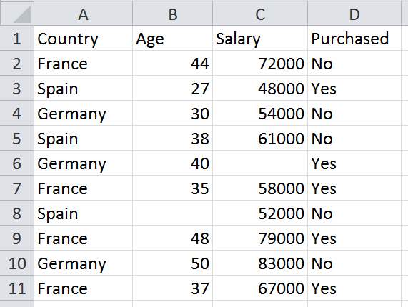
The essence of machine learning
Network Control System Lab (NSCL) Artificial Intelligence
Classification
AI
X
Y
X = {x₁= Country, x₂= Age, x₃= Salary}
Y = {Yes, No}

Slide 15
The essence of machine learning
Network Control System Lab (NSCL) Artificial Intelligence
i.i.d. Independent and identically distributed
Population
Random Sample
Unknown Relationship
☺
☺
☺
☺
☺
☺
☺

Slide 16
Component of learning
Network Control System Lab (NSCL) Artificial Intelligence
Input: x
Output: y
Target fonction f: X → Y
Data: (x₁, y₁),(x₂, y₂), · · · ,(x_{N}, y_{N}).
Hypothesis: h : X → Y

Slide 17
Component of learning
Network Control System Lab (NSCL) Artificial Intelligence
UNKNOWN TARGET FUNCTION
f: X→ Y
TRAINING EXAMPLES
(x1,y1), …, (XN,YN)
LEARNING ALGORITHM
A
Final Hypothesis
g≈f
HYPOTHESIS SET
H

Slide 18
Component of learning
Network Control System Lab (NSCL) Artificial Intelligence
UNKNOWN TARGET FUNCTION
f: X→ Y
TRAINING EXAMPLES
(x1,y1), …, (XN,YN)
LEARNING ALGORITHM
A
Final Hypothesis
h≈f
The 2 solution components of the learning problem:
The Hypothesis Set
H = {h} h∈ H
The Learning Algorithm
HYPOTHESIS SET
H

Slide 19
Algorithms Grouped by Learning Style
Network Control System Lab (NSCL) Artificial Intelligence
Supervised Learning
Example problems are classification and regression.
Example algorithms include Logistic Regression and the Back Propagation Neural Network.
Unsupervised Learning
Example problems are clustering, dimensionality reduction and association rule learning.
Example algorithms include k-Means.
Semi-Supervised Learning
Example problems are classification and regression.
Example algorithms are extensions to other flexible methods that make assumptions about how to model the unlabeled data.

Slide 20
Artificial Intelligence
Network Control System Lab (NSCL) Artificial Intelligence
Introduction
Data preprocessing
Regression

Slide 21
DATA Pre-processing
Network Control System Lab (NSCL) Artificial Intelligence
It is crucial step for building machine learning system.

Slide 22
DATA Pre-processing
Network Control System Lab (NSCL) Artificial Intelligence

Slide 23
DATA Pre-processing
Network Control System Lab (NSCL) Artificial Intelligence
Variables
Independent variables
Country
Age
Salary
Dependent variables
Purchased

Slide 24
DATA Pre-processing
Network Control System Lab (NSCL) Artificial Intelligence
Variables
Independent variables
Country
Age
Salary
Dependent variables
Purchased
Missing Data
Imputation
Mean
Median
Most frequent

Slide 25
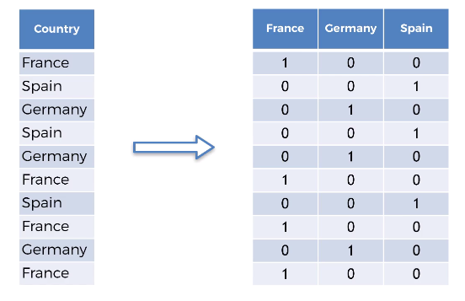
DATA Pre-processing
Network Control System Lab (NSCL) Artificial Intelligence
Variables
Independent variables
Country
Age
Salary
Dependent variables
Purchased
Dummy variables
France → 0
Spain → 1
Germany → 2
Missing Data
Imputation
Mean
Median
Most frequent
Variables
Categorical
Country
Purchased
Numerical
Age
Salary

Slide 26
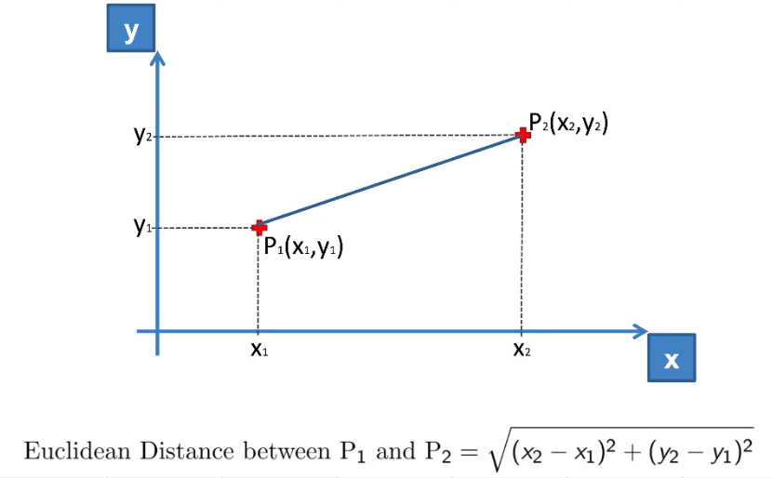
DATA Pre-processing
Network Control System Lab (NSCL) Artificial Intelligence
Features Scaling
Considering Age and Salary only for example
(83000-48000)^2= 2304000000
(50-27)^2 = 529

Slide 27
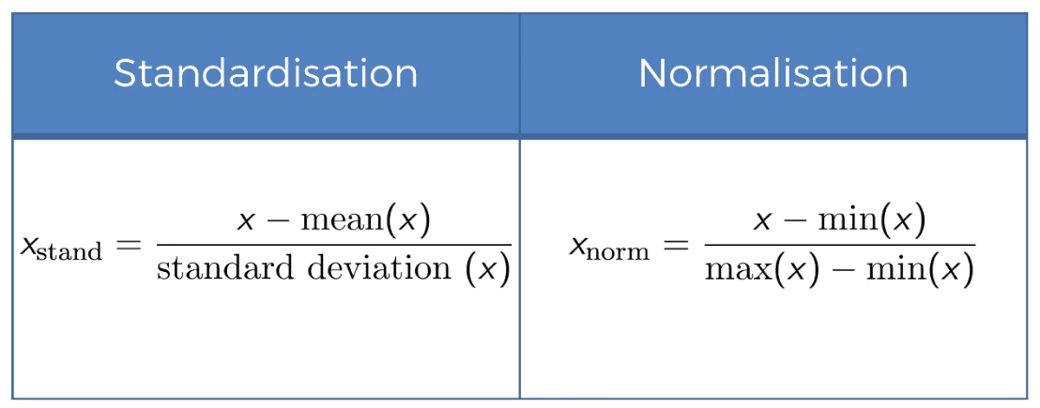
DATA Pre-processing
Network Control System Lab (NSCL) Artificial Intelligence

Slide 28
DATA Pre-processing
EXAMPLE

