Slide 1

Artificial Intelligence Lecture 2

Slide 2
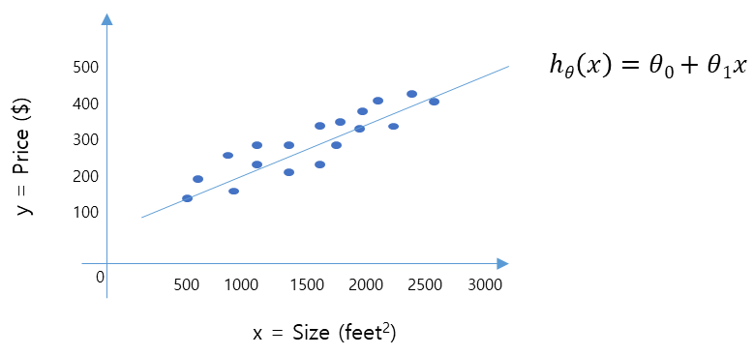
Linear regression
How to represent h in housing price problem?
Linear regression with one variable.
Univariate linear regression.

Slide 3

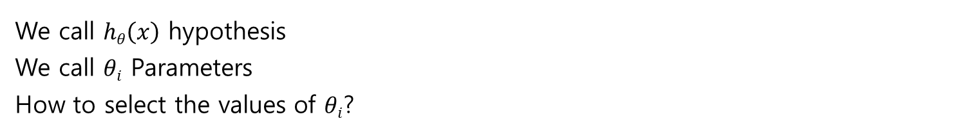
Linear regression
$$hθ\left(x\right)=θ0+θ1x$$
500
400
300
200
100
y = Price ($)
0
500 1000 1500 2000 2500 3000
x = Size (feet²)
We call $hθ\left(x\right)$ hypothesis
We call $θi$ Parameters
How to select the values of $θi$?

Slide 4
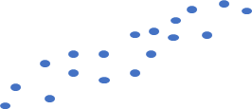




Linear regression
$$hθ\left(x\right)=θ0+θ1x$$
5
4
3
2
1
5
4
3
2
1
5
4
3
2
1
0
1 2 3 4 5 6
0
1 2 3 4 5 6
0
1 2 3 4 5 6
$θ0$=1.5
$θ1$=0
$θ0$=0
$θ1$=0.5
$θ0$=1
$θ1$=0.5

Slide 5
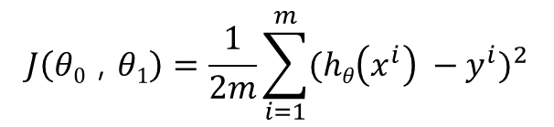


Linear regression
$$hθ\left(x\right)=θ0+θ1x$$
500
400
300
200
100
$$J\left(θ0\text{ , }θ1\right)=\frac{1}{2m}\sum_{i=1}^{m}{{(hθ\left(x^{i}\right) −y^{i})}^{2}}$$
y = Price ($)
0
500 1000 1500 2000 2500 3000
x = Size (feet²)
We need to choose $θ0$ , $θ1$ so that $hθ\left(x\right)$ is close to y
for our training examples (x,y)

Slide 6
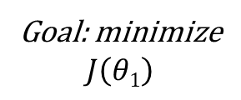
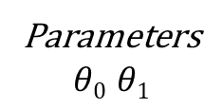
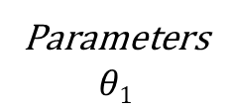
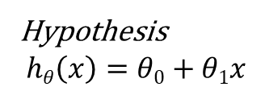
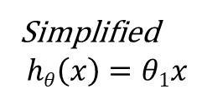
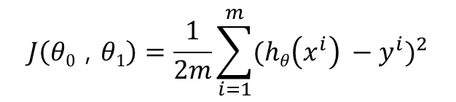
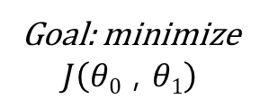
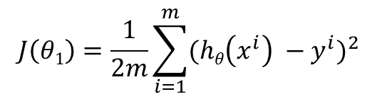
Cost function
Hypothesis
$$hθ\left(x\right)=θ0+θ1x$$
Simplified
$$hθ\left(x\right)=θ1x$$
Parameters
$$θ0 θ1$$
Parameters
$$θ1$$
Cost function
Cost function
$$J\left(θ0\text{ , }θ1\right)=\frac{1}{2m}\sum_{i=1}^{m}{{(hθ\left(x^{i}\right) −y^{i})}^{2}}$$
$$J\left(θ1\right)=\frac{1}{2m}\sum_{i=1}^{m}{{(hθ\left(x^{i}\right) −y^{i})}^{2}}$$
Goal: minimize
$$J\left(θ0\text{ , }θ1\right)$$
Goal: minimize
$$J\left(θ1\right)$$

Slide 7
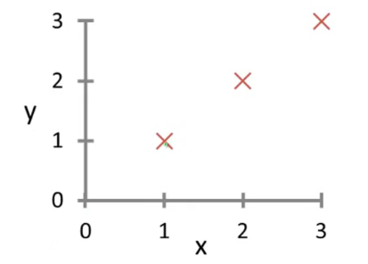
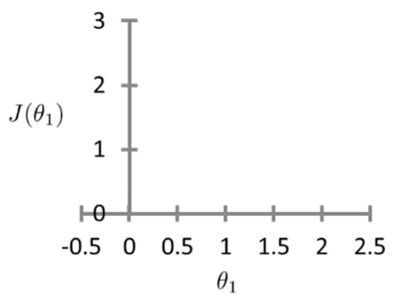
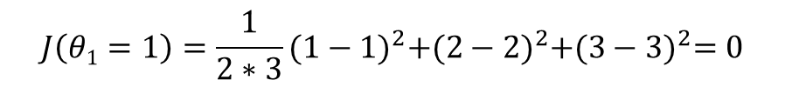


Cost function
$$θ1=1$$
$$hθ\left(x\right)=1x$$
$$J\left(θ1=1\right)=\frac{1}{2∗3}{(1−1)}^{2}+{(2−2)}^{2}+{(3−3)}^{2}=0$$

Slide 8


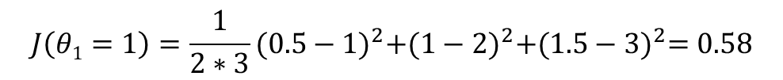


Cost function
$$hθ\left(x\right)$$
$$J\left(θ1\right)$$
$$θ1=0.5$$
$$hθ\left(x\right)=0.5x$$
$$J\left(θ1=1\right)=\frac{1}{2∗3}{(0.5−1)}^{2}+{(1−2)}^{2}+{(1.5−3)}^{2}=0.58$$

Slide 9
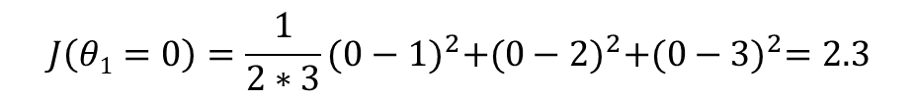


Cost function
$$hθ\left(x\right)$$
$$J\left(θ1\right)$$
$$θ1=0$$
$$hθ\left(x\right)=0x$$
$$J\left(θ1=0\right)=\frac{1}{2∗3}{(0−1)}^{2}+{(0−2)}^{2}+{(0−3)}^{2}=2.3$$

Slide 10



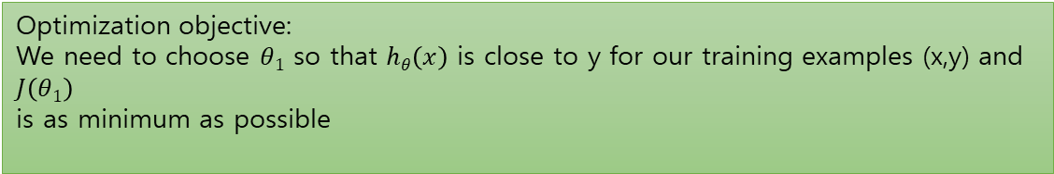
Cost function
$$hθ\left(x\right)$$
$$J\left(θ1\right)$$
$$θ1=1$$
$$θ1=0.5$$
$$θ1=0$$
Optimization objective:
We need to choose $θ1$ so that $hθ\left(x\right)$ is close to y for our training examples (x,y) and $J\left(θ1\right)$
is as minimum as possible

Slide 11


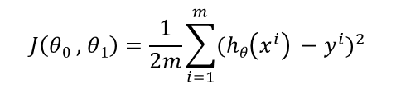

Cost function
Hypothesis
$$hθ\left(x\right)=θ0+θ1x$$
Parameters
$$θ0 θ1$$
Cost function
$$J\left(θ0\text{ , }θ1\right)=\frac{1}{2m}\sum_{i=1}^{m}{{(hθ\left(x^{i}\right) −y^{i})}^{2}}$$
Goal: minimize
$$J\left(θ0\text{ , }θ1\right)$$

Slide 12
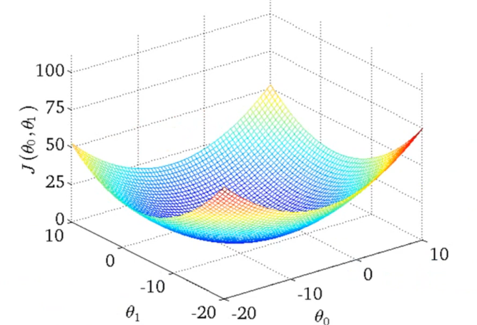
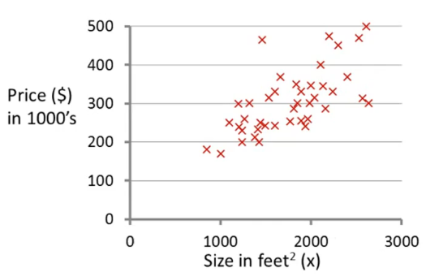

Cost function
$$hθ\left(x\right)=50+0.06x$$

Slide 13
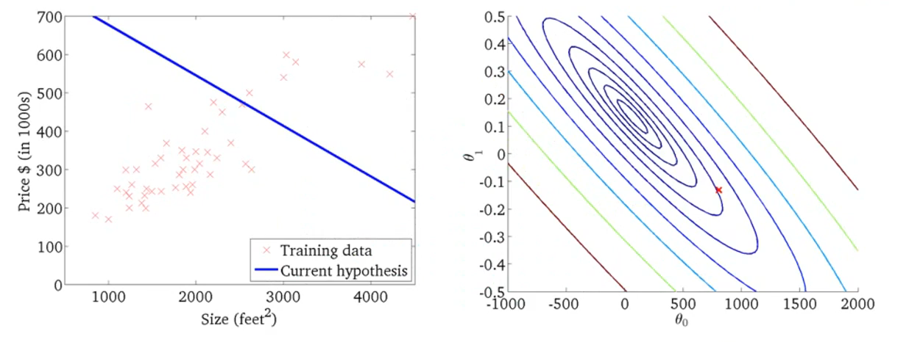



Cost function
$$J\left(θ0\text{ , }θ1\right)$$
$$θ1$$
$$θ0$$

Slide 14
Convex function: Bowl shape function, it is a function that doesn’t have
any local optima except the global optima. Therefor, Linear Regression function
will always converge to a global optima.

Slide 15
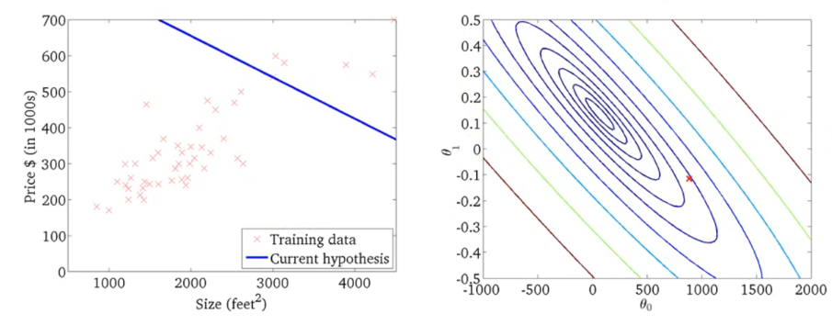


for fixed $θ0$, $θ1$ , this is a function of x
function for the parameters for fixed $θ0$, $θ1$

Slide 16
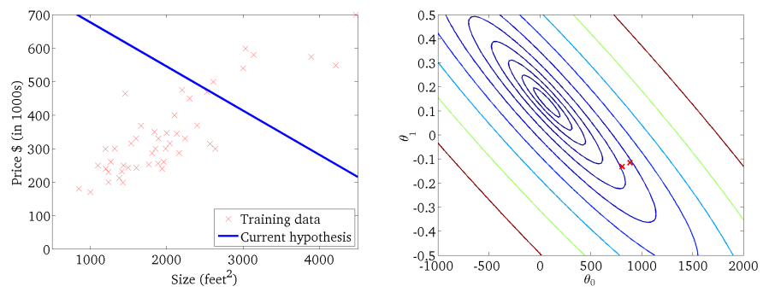


for fixed $θ0$, $θ1$ , this is a function of x
function for the parameters for fixed $θ0$, $θ1$

Slide 17
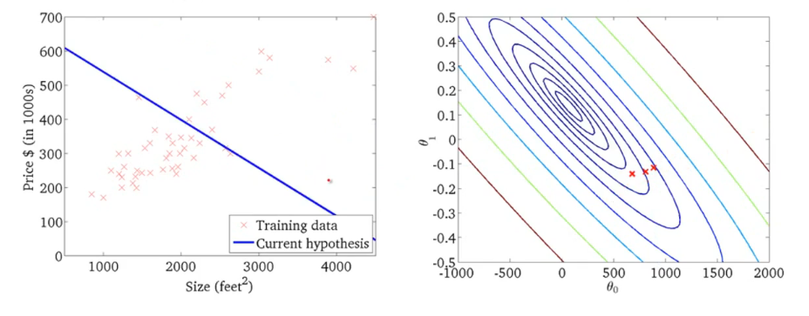
for fixed $θ0$, $θ1$ , this is a function of x
function for the parameters for fixed $θ0$, $θ1$

Slide 18
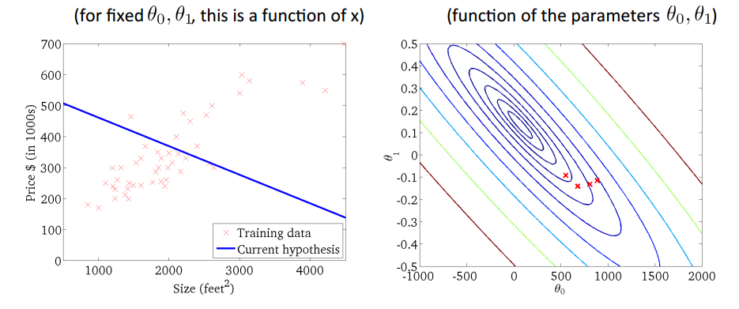

Slide 19
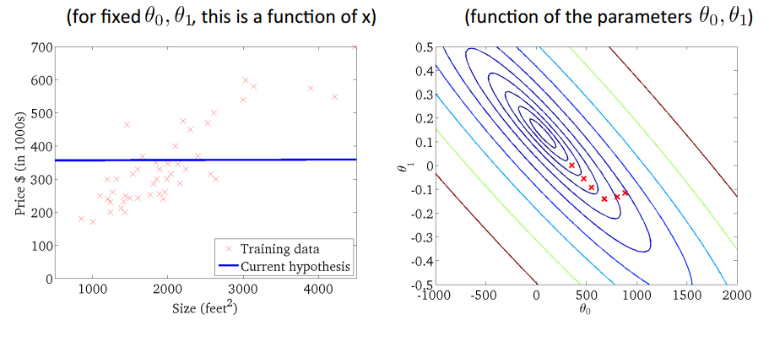

Slide 20
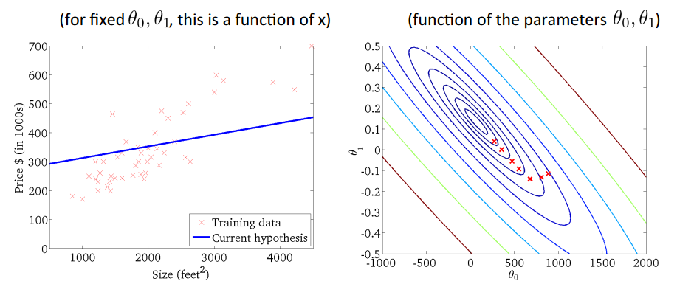

Slide 21
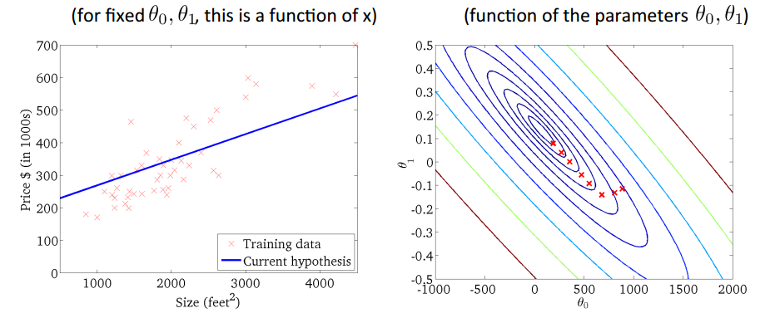

Slide 22
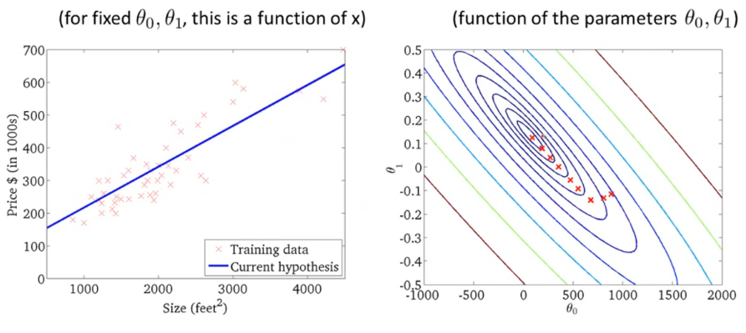

Slide 23
Gradient Descent
Gradient descent is a more general algorithm and is used not only in linear regression. It's actually used all over the place in machine learning. And later in the class, we'll use gradient descent to minimize other functions as well, not just the cost function J for the linear regression.
We'll talk about gradient descent for minimizing some arbitrary function J and then, we'll take this algorithm and apply it specifically to the cost function J that we have defined for linear regression.

Slide 24
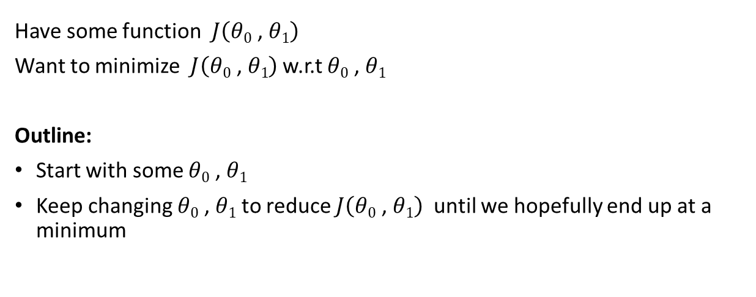
Problem setup
Have some function $J\left(θ0\text{ , }θ1\right)$
Want to minimize $J\left(θ0\text{ , }θ1\right)$ w.r.t $θ0\text{ , }θ1$
Outline:
Start with some $θ0\text{ , }θ1$
Keep changing $θ0\text{ , }θ1$ to reduce $J\left(θ0\text{ , }θ1\right)$ until we hopefully end up at a minimum

Slide 25
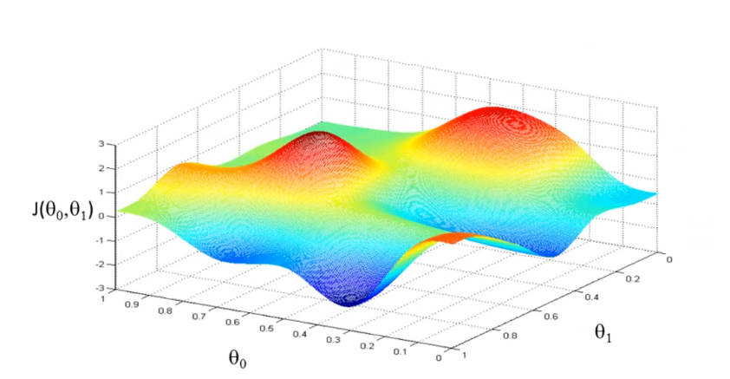

Slide 26
Gradient descent algorithm

Slide 27
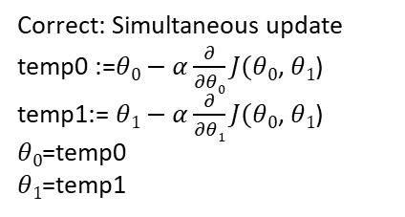
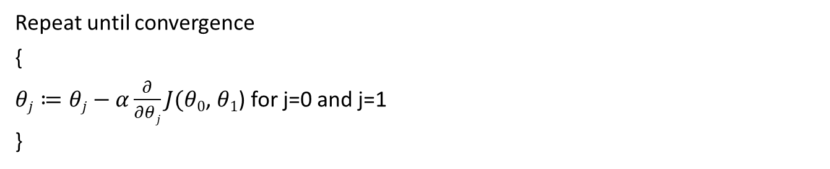
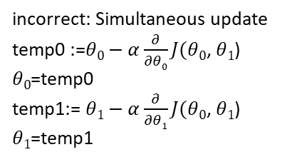
Gradient descent algorithm
Repeat until convergence
{
$θj≔θj−α\frac{∂}{∂θj}J(θ0$, $θ1$) for j=0 and j=1
}
Correct: Simultaneous update
temp0 :=$θ0−α\frac{∂}{∂θ0}J(θ0$, $θ1$)
temp1:= $θ1−α\frac{∂}{∂θ1}J(θ0$, $θ1$)
$θ0$=temp0
$θ1$=temp1
incorrect: Simultaneous update
temp0 :=$θ0−α\frac{∂}{∂θ0}J(θ0$, $θ1$)
$θ0$=temp0
temp1:= $θ1−α\frac{∂}{∂θ1}J(θ0$, $θ1$)
$θ1$=temp1

Slide 28






Understand Gradient Descent
$θ1≔θ1−α\frac{d}{dθ1}J(θ1$)
$J(θ1$); $θ1∈R$
$$α>0$$
$J(θ1$)
$$θ1≔θ1−α(positive number)$$
$$θ1$$

Slide 29




Understand Gradient Descent
$θ1≔θ1−α\frac{d}{dθ1}J(θ1$)
$J(θ1$)
$J(θ1$); $θ1∈R$
$$α>0$$
$$θ1≔θ1−α(negative number)$$
$$θ1$$

Slide 30






Understand Gradient Descent
$J(θ1$)
$θ1≔θ1−α\frac{d}{dθ1}J(θ1$)
If $α$is too small, gradient descent can be slow.
$$θ1$$
$J(θ1$)
If $α$is too large, gradient descent can overshoot
the minimum. It may fail to converge, or diverge
$$θ1$$

Slide 31
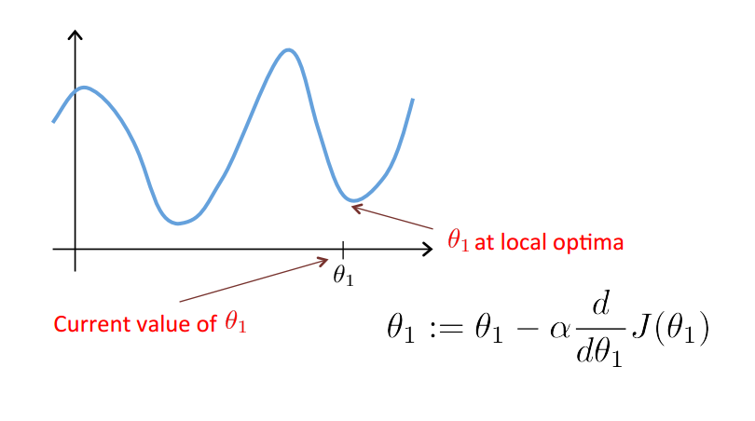
Understand Gradient Descent

Slide 32

Understand Gradient Descent
Gradient descent can converge to a local minimum, even with the learning rate α fixed.
As we approach a local minimum, gradient descent will automatically take smaller steps. So, no need to decrease α over time.
$θ1≔θ1−α\frac{d}{dθ1}J(θ1$)

Slide 33

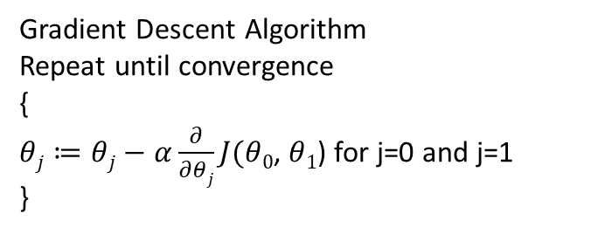
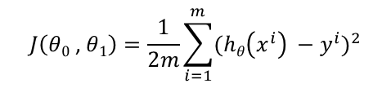
Gradient Descent For Linear Regression
Gradient Descent Algorithm
Repeat until convergence
{
$θj≔θj−α\frac{∂}{∂θj}J(θ0$, $θ1$) for j=0 and j=1
}
Linear Regression Model
$$hθ\left(x\right)=θ0+θ1x$$
$$J\left(θ0\text{ , }θ1\right)=\frac{1}{2m}\sum_{i=1}^{m}{{(hθ\left(x^{i}\right) −y^{i})}^{2}}$$
Apply Gradient Descent to minimize loss function $J\left(θ0\text{ , }θ1\right)$

Slide 34
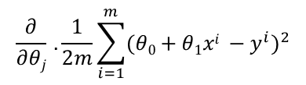

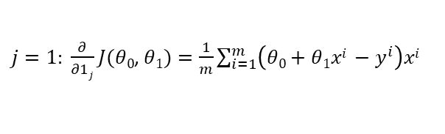
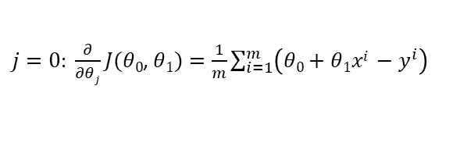
Gradient Descent For Linear Regression
$\frac{∂}{∂θj}J(θ0$, $θ1$) →
$$\frac{∂}{∂θj} .\frac{1}{2m}\sum_{i=1}^{m}{{(θ0+θ1xi −y^{i})}^{2}}$$
$j=0: \frac{∂}{∂θj}J(θ0$, $θ1)=\frac{1}{m}\sum_{i=1}^{m}{{\left(θ0+θ1xi −y^{i}\right)}^{}}$
$j=1: \frac{∂}{∂1j}J(θ0$, $θ1)=\frac{1}{m}\sum_{i=1}^{m}{{\left(θ0+θ1xi −y^{i}\right)xi}^{}}$

Slide 35

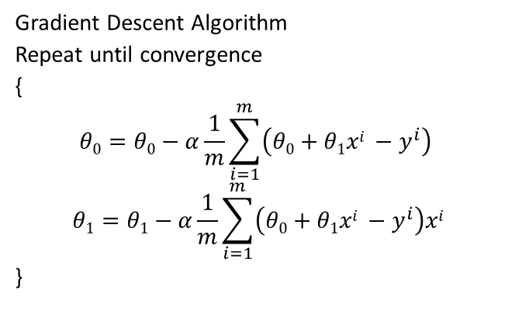
Gradient Descent For Linear Regression
Gradient Descent Algorithm
Repeat until convergence
{
$$θ0=θ0−α\frac{1}{m}\sum_{i=1}^{m}{{\left(θ0+θ1xi −y^{i}\right)}^{}}$$
$$θ1=θ1−α\frac{1}{m}\sum_{i=1}^{m}{{\left(θ0+θ1xi −y^{i}\right)xi}^{}}$$
}
Update $θ0$, $θ1$ and simultaneously

Slide 36
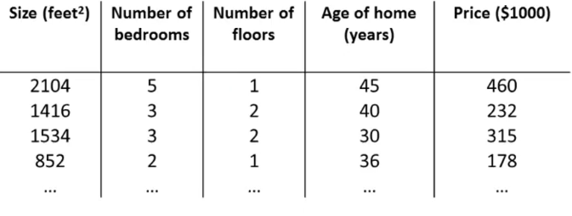


Multiple features linear regression
$hθ\left(x\right)=θ0+θ1x1$+$θ2x2$+$θ3x3\text{+}θ4x4$
$hθ\left(x\right)=θ0x0+θ1x1$+$θ2x2$+$θ3x3\text{+}θ4x4$

Slide 37

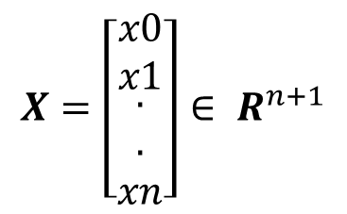

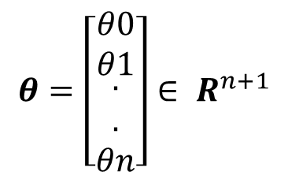
Multiple features linear regression
$hθ\left(x\right)=θ0x0+θ1x1$+$θ2x2$+$θ3x3\text{+}θ4x4$
$$X=\left[\begin{matrix}x0 \\ x1 \\ \begin{aligned}. \\ . \\ xn\end{aligned}\end{matrix}\right]∈ R^{n+1}$$
$$θ=\left[\begin{matrix}θ0 \\ θ1 \\ \begin{aligned}. \\ . \\ θn\end{aligned}\end{matrix}\right]∈ R^{n+1}$$
$hθ\left(x\right)$= $θ$^{T}X
Multivariate linear regression

Slide 38

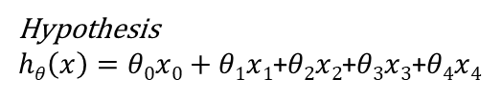
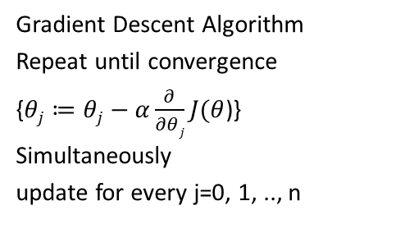
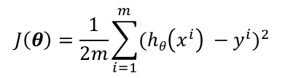
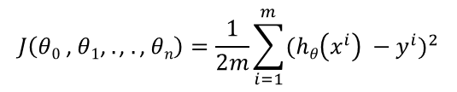
Gradient Descent for Multiple Linear Regression
Hypothesis
$hθ\left(x\right)=θ0x0+θ1x1$+$θ2x2$+$θ3x3\text{+}θ4x4$
Gradient Descent Algorithm
Repeat until convergence
{$θj≔θj−α\frac{∂}{∂θj}J(θ$)}
Simultaneously
update for every j=0, 1, .., n
Parameters:
$$θ0,θ1,θ2,θ3,θ4$$
Cost function:
$$J\left(θ0\text{ , }θ1\text{, }.\text{, }.\text{, }θn\right)=\frac{1}{2m}\sum_{i=1}^{m}{{(hθ\left(x^{i}\right) −y^{i})}^{2}}$$
$$J\left(θ\right)=\frac{1}{2m}\sum_{i=1}^{m}{{(hθ\left(x^{i}\right) −y^{i})}^{2}}$$

Slide 39

Gradient Descent for Multiple Linear Regression
n=1: Simple linear regression
{
$$θ0=θ0−α\frac{1}{m}\sum_{i=1}^{m}{{\left(θ0+θ1xi −y^{i}\right)}^{}}$$
$$θ1=θ1−α\frac{1}{m}\sum_{i=1}^{m}{{\left(θ0+θ1xi −y^{i}\right)xi}^{}}$$
}
Simultaneously
update for every j=0, 1, .., n

Slide 40

Gradient Descent for Multiple Linear Regression
N>=1: Simple linear regression
{
$$θj=θj−α\frac{1}{m}\sum_{i=1}^{m}{{\left(hθ\left({xj}^{i}\right) −y^{i}\right)xji}^{}}$$
}
Simultaneously
update for every j=0, 1, .., n

Slide 41

Learning rate
Debugging: How to make sure gradient descent is working correctly.
How to Choose learning rate α.
$$\min{}J\left(θ\right)$$
$$θ$$
Iterations?
Depends on the problem.
Iteration
0 100 200 300 400

Slide 42



Learning rate
$$J\left(θ\right)$$
$$J\left(θ\right)$$
Iterations
Iterations
Gradient descent is not working
Use smaller learning rate α
For sufficiently small α, $J\left(θ\right)$ should decrease on every iteration. But if is too small, gradient descent can be slow to converge.

Slide 43

Learning rate
Match each plot with the reasonable learning rate.
α = 1, α=0.1, α=0.01
C A B

Slide 44

Learning rate
If α is too small: slow convergence.
If α is too large: $J\left(θ\right)$ may not decrease on every iteration may not converge.
To choose α, try
…, 0.001, 0.003, 0.01, 0.03, 0.1, 0.3, 1, …

