Slide 1

Artificial Intelligence Lecture 3

Slide 2
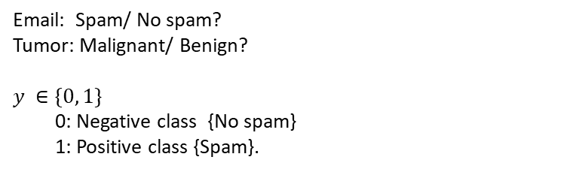
Classification
Email: Spam/ No spam?
Tumor: Malignant/ Benign?
$y ∈\{0, 1\}$
0: Negative class {No spam}
1: Positive class {Spam}.

Slide 3
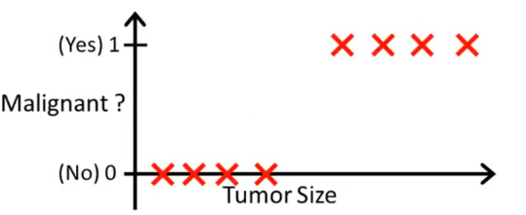

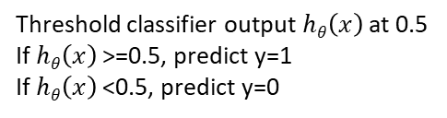
Classification
$$hθ\left(x\right)=θ0+θ1x$$
Threshold classifier output $hθ\left(x\right)$ at 0.5
If $hθ\left(x\right)$ >=0.5, predict y=1
If $hθ\left(x\right)$ <0.5, predict y=0
It seems to be working well here but let's extend the horizontal axis

Slide 4

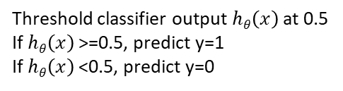
Classification
$$hθ\left(x\right)=θ0+θ1x$$
It seems to be working well here but let’s extend the horizontal axis
Threshold classifier output $hθ\left(x\right)$ at 0.5
If $hθ\left(x\right)$ >=0.5, predict y=1
If $hθ\left(x\right)$ <0.5, predict y=0

Slide 5


Classification
Develop an algorithm
“Logistic Regression”
The output is always between zero and one
$$hθ\left(x\right)=θ0+θ1x$$
$$hθ\left(x\right)>1 or hθ\left(x\right)<0 ????$$
We cannot use linear regression for classification problems

Slide 6
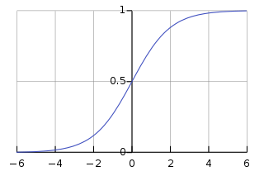




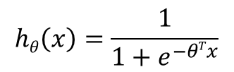


Logistic regression
Logistic Regression Model:
Want
$$g\left(z\right)$$
$$0≤hθ\left(x\right)≤1$$
$$hθ\left(x\right)=g(θTx)$$
$$hθ\left(x\right)=\frac{1}{1+e^{−θTx}}$$
$$z$$
$$g\left(z\right)=\frac{1}{1+e^{−z}}$$
$$parameters θ$$
g is sigmoid function or called logistic function

Slide 7
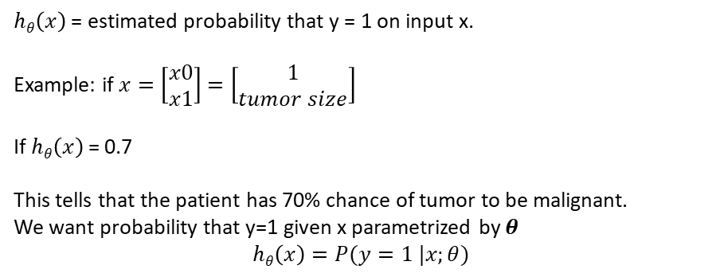
Interpretation of Hypothesis output
$hθ\left(x\right)$ = estimated probability that y = 1 on input x.
Example: if $x=\left[\begin{matrix}x0 \\ x1\end{matrix}\right]=\left[\begin{matrix}1 \\ tumor size\end{matrix}\right]$
If $hθ\left(x\right)$ = 0.7
This tells that the patient has 70% chance of tumor to be malignant.
We want probability that y=1 given x parametrized by $θ$
$hθ\left(x\right)=P(y=1 |x;θ)$

Slide 8




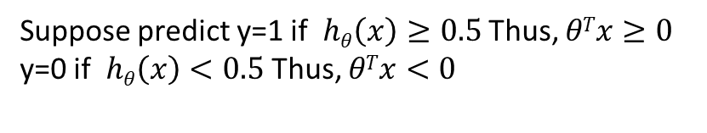
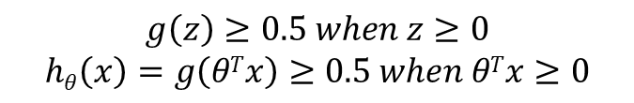
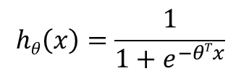
$$g\left(z\right)$$
$$hθ\left(x\right)=g(θTx)$$
$$hθ\left(x\right)=\frac{1}{1+e^{−θTx}}$$
$$g\left(z\right)=\frac{1}{1+e^{−z}}$$
$$z$$
$$g\left(z\right)≥0.5 when z≥0$$
$$hθ\left(x\right)=g\left(θTx\right)≥0.5 when θTx≥0$$
Suppose predict y=1 if $hθ\left(x\right)≥0.5$ Thus, $θTx≥0$
y=0 if $hθ\left(x\right)<0.5$ Thus, $θTx<0$

Slide 9
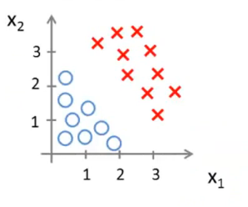

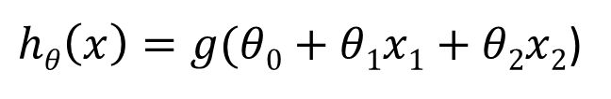


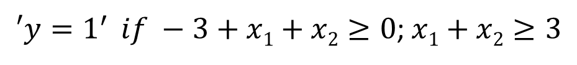
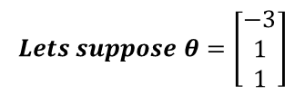
$hθ\left(x\right)=g(θ0+θ1x1+θ2x2$)
We will talk about finding the parameters later
Now we want to understand how it works.
$$Lets suppose θ=\left[\begin{aligned}−3 \\ 1 \\ 1\end{aligned}\right]$$
$$x1+x2>3$$
$$x1+x2<3$$
Decision boundary
$$x1+x2=3$$
$′y=1^{′ } if −3+x1+x2≥0$; $x1+x2≥3$

Slide 10
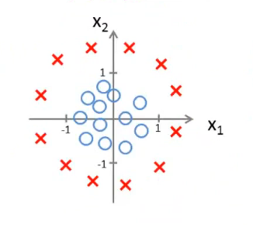
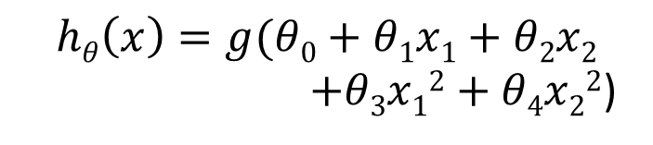
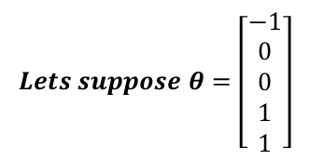
$$hθ\left(x\right)=g(θ0+θ1x1+θ2x2$$
$+θ3x12+θ4x22$)
$$Lets suppose θ=\left[\begin{aligned}−1 \\ 0 \\ 0 \\ 1 \\ 1\end{aligned}\right]$$
Decision boundary
$′y=1^{′ } if −1+θ3x12+θ4x22≥0$;$θ3x12+θ4x22≥1$
Decision boundary is defined by the parameters not by the data

Slide 11
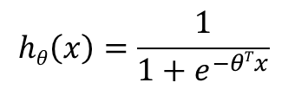
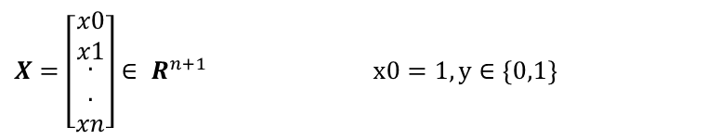

Training set: {(x₁,y₁), (x₂,y₂), …, (x_{m},y_{m})}
$X=\left[\begin{matrix}x0 \\ x1 \\ \begin{aligned}. \\ . \\ xn\end{aligned}\end{matrix}\right]∈ R^{n+1 }$ $x0=1, y∈\{0,1\}$
$$hθ\left(x\right)=\frac{1}{1+e^{−θTx}}$$
How to choose parameters $θ$

Slide 12


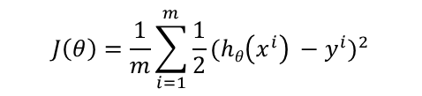



$$J\left(θ\right)=\frac{1}{m}\sum_{i=1}^{m}{\frac{1}{2}{(hθ\left(x^{i}\right) −y^{i})}^{2}}$$
Suppose $cost(hθ\left(x^{i}\right) ,y^{i}) =\frac{1}{2}{(hθ\left(x^{i}\right) −y^{i})}^{2}$ but this is a non convex function and we cannot minimize
$$non−convex$$
$$convex$$
$$J\left(θ\right)$$
$$J\left(θ\right)$$

Slide 13

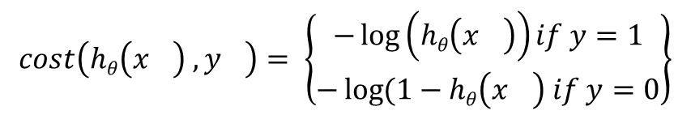
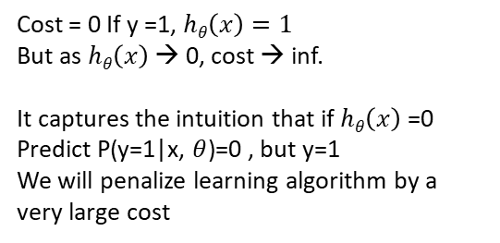
$$cost\left(hθ\left(x^{}\right) ,y^{}\right)= \left\{\begin{aligned}−\log\left(hθ\left(x^{}\right)\right)if y=1 \\ −\log{(1−hθ\left(x^{}\right) if y=0}\end{aligned}\right\}$$
If y =1
Cost = 0 If y =1, $hθ\left(x\right)=1$
But as $hθ\left(x\right)$ → 0, cost → inf.
It captures the intuition that if $hθ\left(x\right)$ =0
Predict P(y=1|x, $θ$)=0 , but y=1
We will penalize learning algorithm by a very large cost
|
$$hθ\left(x^{}\right)$$
1
0

Slide 14

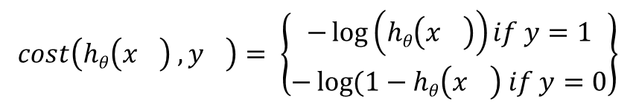
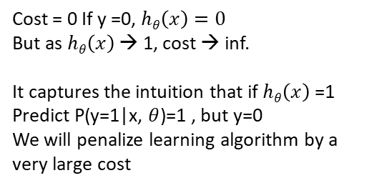
$$cost\left(hθ\left(x^{}\right) ,y^{}\right)= \left\{\begin{aligned}−\log\left(hθ\left(x^{}\right)\right)if y=1 \\ −\log{(1−hθ\left(x^{}\right) if y=0}\end{aligned}\right\}$$
If y =0
Cost = 0 If y =0, $hθ\left(x\right)=0$
But as $hθ\left(x\right)$ → 1, cost → inf.
It captures the intuition that if $hθ\left(x\right)$ =1
Predict P(y=1|x, $θ$)=1 , but y=0
We will penalize learning algorithm by a very large cost
|
$$hθ\left(x^{}\right)$$
1
0

Slide 15
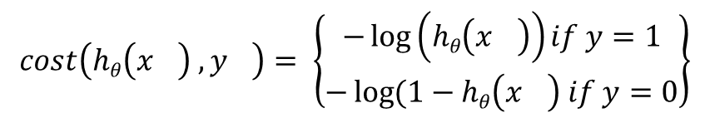


$$cost\left(hθ\left(x^{}\right) ,y^{}\right)= \left\{\begin{aligned}−\log\left(hθ\left(x^{}\right)\right)if y=1 \\ −\log{(1−hθ\left(x^{}\right) if y=0}\end{aligned}\right\}$$
If $hθ\left(x\right)=y$ then cost ($hθ\left(x\right)$ , y)=0 (for y=0 and y=1)
True
If $y=0$then cost($hθ\left(x\right)$ , y)→ inf as $hθ\left(x\right)$ →1
True
If $y=0$then cost ($hθ\left(x\right)$ , y)→ inf as $hθ\left(x\right)$ →0
False
Regardless whenever $y=0 or y=1 , if hθ\left(x\right)$=0.5 then cost ($hθ\left(x\right)$ , y)>0.
True

Slide 16
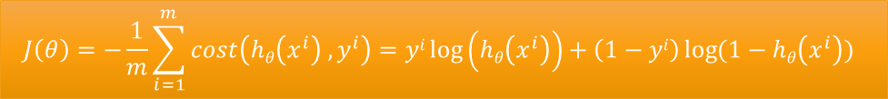
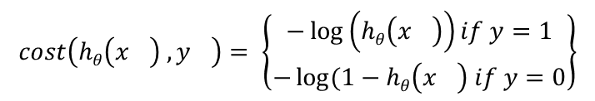
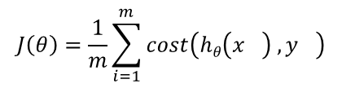


$$J\left(θ\right)=\frac{1}{m}\sum_{i=1}^{m}{cost\left(hθ\left(x^{}\right) ,y^{}\right)}$$
$$cost\left(hθ\left(x^{}\right) ,y^{}\right)= \left\{\begin{aligned}−\log\left(hθ\left(x^{}\right)\right)if y=1 \\ −\log{(1−hθ\left(x^{}\right) if y=0}\end{aligned}\right\}$$
$y ∈\{0, 1\}$
$$cost\left(hθ\left(x^{}\right) ,y^{}\right)=−y\log\left(hθ\left(x^{}\right)\right) −\left(1−y\right)\log{(1−hθ\left(x^{}\right)}$$
If y=1 →
$$cost\left(hθ\left(x^{}\right) ,y^{}\right)=−y\log\left(hθ\left(x^{}\right)\right)$$
If y=0 →
$$cost\left(hθ\left(x^{}\right) ,y^{}\right)=−\left(1−y\right)\log{(1−hθ\left(x^{}\right)}$$
$$J\left(θ\right)=−\frac{1}{m}\sum_{i=1}^{m}{cost\left(hθ\left(x^{i}\right) ,y^{i}\right)=yi\log\left(hθ\left(x^{i}\right)\right)+\left(1−yi\right)\log{(1−hθ\left(x^{i}\right))} }$$

Slide 17

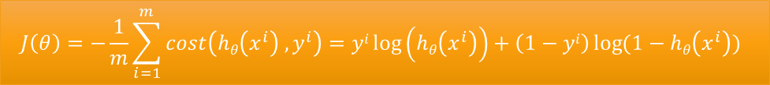


$$J\left(θ\right)=−\frac{1}{m}\sum_{i=1}^{m}{cost\left(hθ\left(x^{i}\right) ,y^{i}\right)=yi\log\left(hθ\left(x^{i}\right)\right)+\left(1−yi\right)\log{(1−hθ\left(x^{i}\right))} }$$
To fit parameters $θ$: $min J\left(θ\right)$ w.r.t. $θ$
$$hθ\left(x\right)=\frac{1}{1+e^{−θTx}}$$
To make prediction for new x:
How to $min J\left(θ\right)$ w.r.t. $θ$
→
Gradient Descent

Slide 18
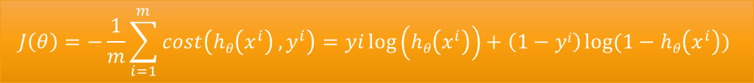
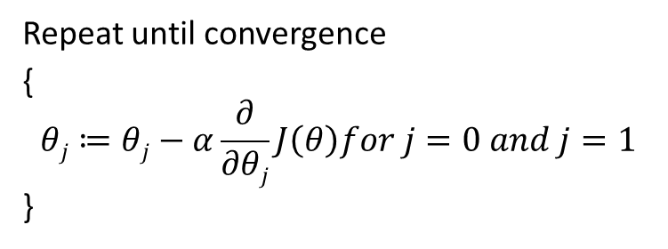
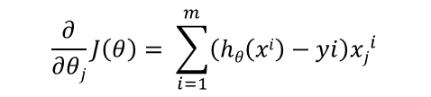
$$J\left(θ\right)=−\frac{1}{m}\sum_{i=1}^{m}{cost\left(hθ\left(x^{i}\right) ,y^{i}\right)=yi\log\left(hθ\left(x^{i}\right)\right)+\left(1−yi\right)\log{(1−hθ\left(x^{i}\right)}) }$$
Repeat until convergence
{
$$θj≔θj−α\frac{∂}{∂θj}J\left(θ\right)for j=0 and j=1$$
}
$$\frac{∂}{∂θj}J\left(θ\right)= \sum_{i=1}^{m}{\left(hθ\left(xi\right)−yi\right){xj}_{}^{i}}$$

Slide 19
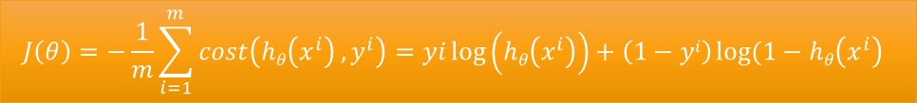
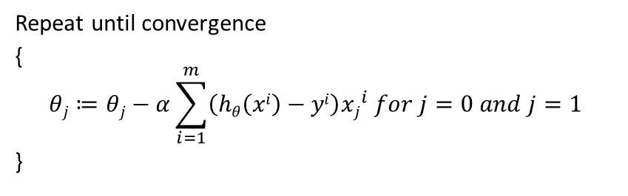
$$J\left(θ\right)=−\frac{1}{m}\sum_{i=1}^{m}{cost\left(hθ\left(x^{i}\right) ,y^{i}\right)=yi\log\left(hθ\left(x^{i}\right)\right)+\left(1−yi\right)\log{(1−hθ\left(x^{i}\right)} }$$
Repeat until convergence
{
$$θj≔θj−α\sum_{i=1}^{m}{\left(hθ\left(xi\right)−yi\right){xj}_{}^{i}}for j=0 and j=1$$
}

Slide 20
Multiclass Classification One-vs-all
Email tagging: Work, Friend, Family, Hobby
Medical diagnosis: Not ill, Cold, Flu
Weather: Sunny, Cloudy, Rain, Snow.

Slide 21
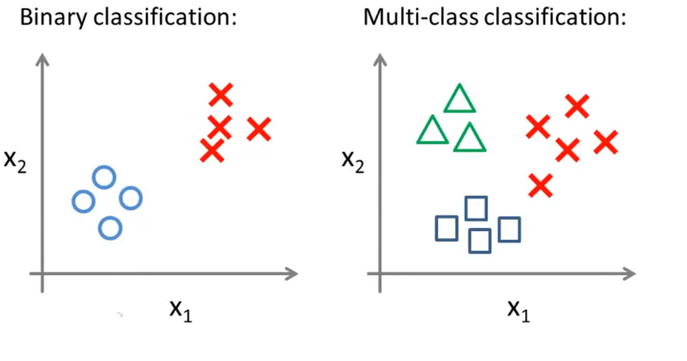
Multiclass Classification One-vs-all

Slide 22
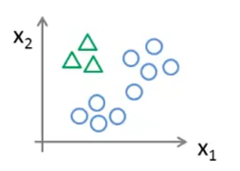
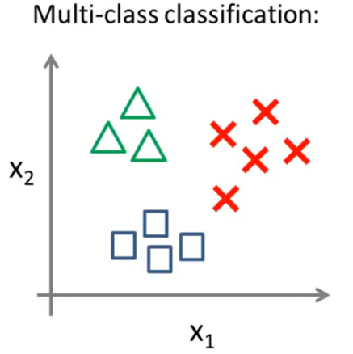
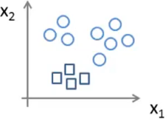
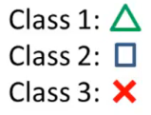
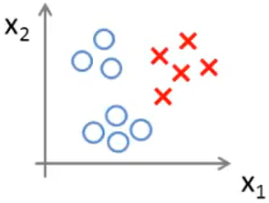




Multiclass Classification One-vs-all
$$hθ1\left(x\right)$$
$$hθ2\left(x\right)$$
$$hθ3\left(x\right)$$
Final prediction is: $\max{hθi\left(x\right)}$

