Slide 1

Artificial Intelligence Lecture 4

Slide 2
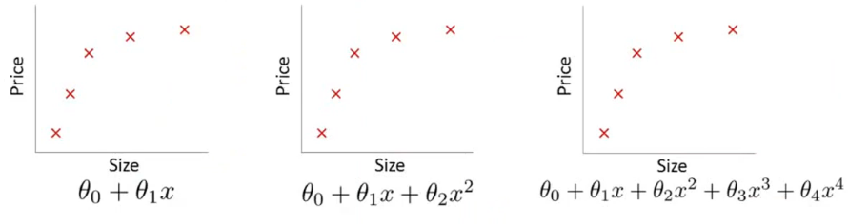
Overfitting
Under fitting
High bias
Overfitting
High variance
Overfitting
When we have too many features and the learned hypothesis may fit the
training set very well, but fails to generalize to new examples (predict prices on new examples)

Slide 3
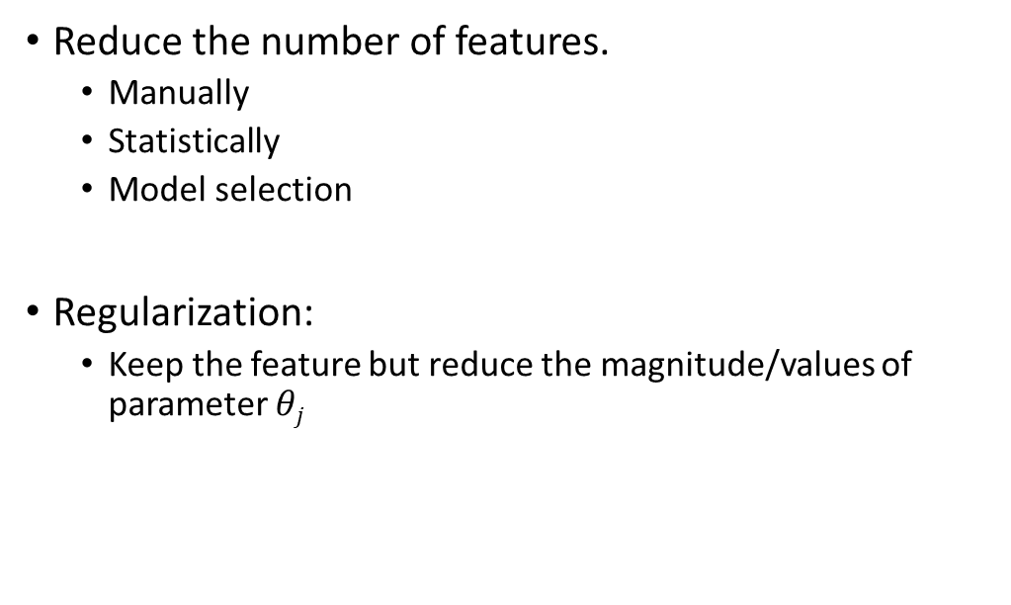
Addressing overfitting
Reduce the number of features.
Manually
Statistically
Model selection
Regularization:
Keep the feature but reduce the magnitude/values of parameter $θj$

Slide 4
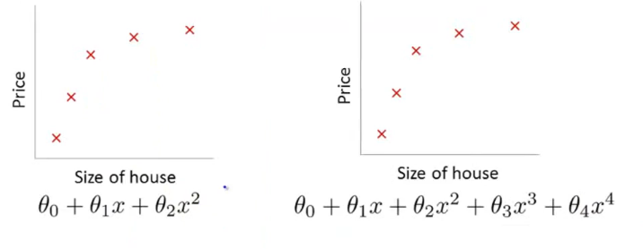


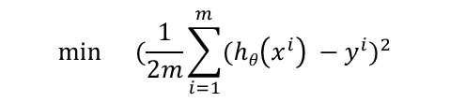
Regularization – Cost function
Intuition
Suppose we penalize and make $θj$ and $θj$ really small
$$\min{}(\frac{1}{2m}\sum_{i=1}^{m}{{(hθ\left(x^{i}\right) −y^{i})}^{2}}$$
$$+ 1000θ3 +1000θ4)$$
$θ3≈0$ and $θ4≈0$

Slide 5

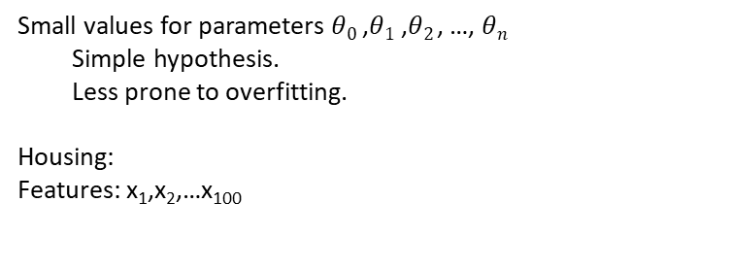
Regularization – Cost function
Small values for parameters $θ0$ ,$θ1$ ,$θ2$, …, $θn$
Simple hypothesis.
Less prone to overfitting.
Housing:
Features: x₁,x₂,…x₁₀₀
$$J\left(θ\right)=\frac{1}{2m}(\sum_{i=1}^{m}{{\left(hθ\left(x^{i}\right) −y^{i}\right)}^{2}+\text{λ}\sum_{i=1}^{n}{{θ2}_{i}^{}}})$$

Slide 6
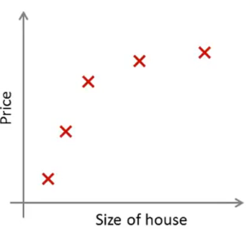
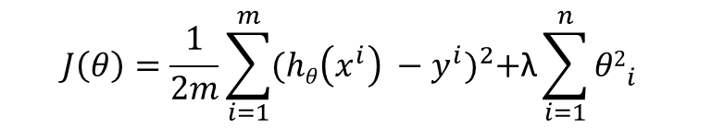
Regularization: Regression
$$J\left(θ\right)=\frac{1}{2m}\sum_{i=1}^{m}{{(hθ\left(x^{i}\right) −y^{i})}^{2}+\text{λ}\sum_{i=1}^{n}{{θ2}_{i}^{}}}$$
Data fitting
Make the parameters small

Slide 7

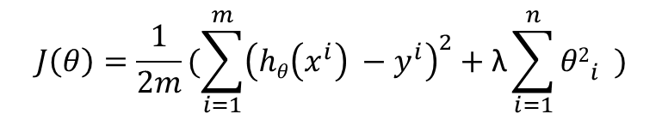


Regularization: Regression
$$J\left(θ\right)=\frac{1}{2m}(\sum_{i=1}^{m}{{\left(hθ\left(x^{i}\right) −y^{i}\right)}^{2}+\text{λ}\sum_{i=1}^{n}{{θ2}_{i}^{}}})$$
What if we set λ to an extremely high value (λ= 10¹⁰ )
$h\left(θ\right)= θ0$ +$θ1$x +$θ2$x² + $θ3$x³+ $θ4$x⁴
$θ1≈0$,$θ2 ≈0$, $θ3≈0$, $θ4≈0$
$h\left(θ\right)= θ0$
under fitting

Slide 8

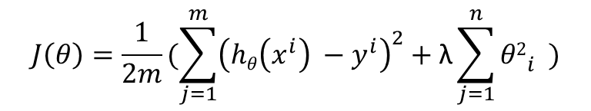
Regularization: Regression
$$J\left(θ\right)=\frac{1}{2m}(\sum_{j=1}^{m}{{\left(hθ\left(x^{i}\right) −y^{i}\right)}^{2}+\text{λ}\sum_{j=1}^{n}{{θ2}_{i}^{}}})$$
$$\min{J\left(θ\right) }$$

Slide 9
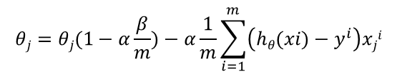
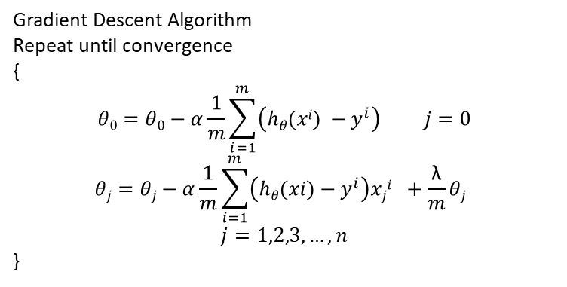

Regularized Linear Regression
Gradient Descent Algorithm
Repeat until convergence
{
$$θ0=θ0−α\frac{1}{m}\sum_{i=1}^{m}{{\left(hθ(xi) −y^{i}\right)}^{} j=0}$$
$$θj=θj−α\frac{1}{m}\sum_{i=1}^{m}{{\left(hθ(xi)−y^{i}\right)xji}^{}+\frac{\text{λ}}{m}θj}$$
$$j=1,2,3, …, n$$
}
$$θj=θj(1−α\frac{β}{m})−α\frac{1}{m}\sum_{i=1}^{m}{{\left(hθ(xi)−y^{i}\right)xji}^{}}$$
$(1−α\frac{\text{λ}}{m})$ <1

Slide 10
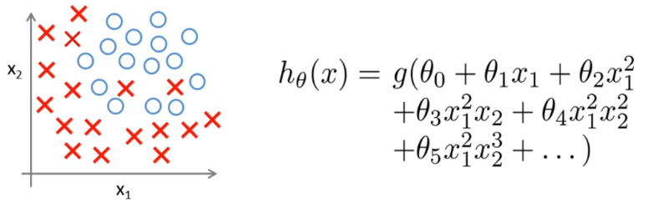
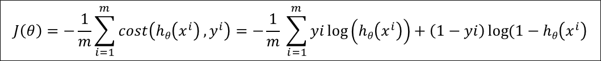
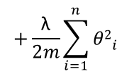
Regularized Logistic Regression
$$J\left(θ\right)=−\frac{1}{m}\sum_{i=1}^{m}{cost\left(hθ\left(x^{i}\right) ,y^{i}\right)=−\frac{1}{m} \sum_{i=1}^{m}{yi\log\left(hθ\left(x^{i}\right)\right)+\left(1−yi\right)\log{(1−hθ\left(x^{i}\right)}}}$$
$$+\frac{\text{λ}}{2m}\sum_{i=1}^{n}{{θ2}_{i}^{}}$$

Slide 11
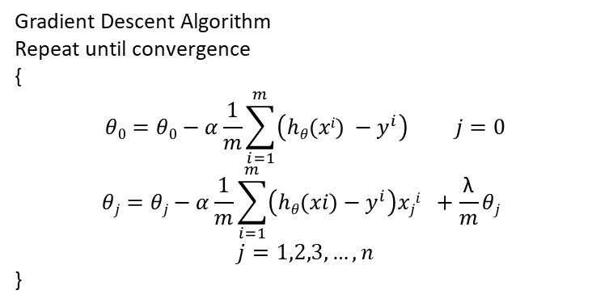
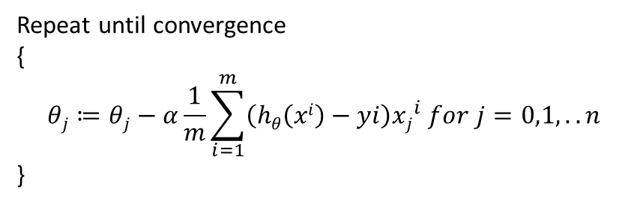
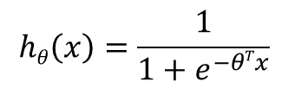
Regularized Logistic Regression
Repeat until convergence
{
$$θj≔θj−α\frac{1}{m}\sum_{i=1}^{m}{\left(hθ\left(xi\right)−yi\right){xj}_{}^{i}}for j=0,1, ..n$$
}
Gradient Descent Algorithm
Repeat until convergence
{
$$θ0=θ0−α\frac{1}{m}\sum_{i=1}^{m}{{\left(hθ(xi) −y^{i}\right)}^{} j=0}$$
$$θj=θj−α\frac{1}{m}\sum_{i=1}^{m}{{\left(hθ(xi)−y^{i}\right)xji}^{}+\frac{\text{λ}}{m}θj}$$
$$j=1,2,3, …, n$$
}
$$hθ\left(x\right)=\frac{1}{1+e^{−θTx}}$$

