Slide 1

Artificial Intelligence Lecture 6
Notes:
These slides are credited to Andrew Ng

Slide 2
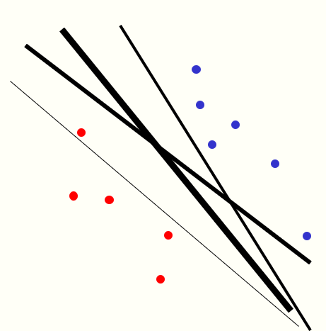
Support Vector Machine (SVM)

Slide 3
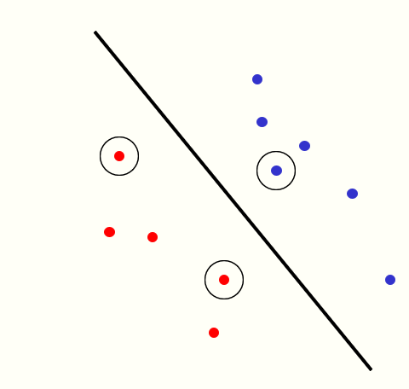
Support Vector Machine (SVM)
The line that maximizes the minimum margin is a good bet.
This maximum-margin separator is determined by a subset of the datapoints.
Datapoints in this subset are called “support vectors”.
It will be useful computationally if only a small fraction of the datapoints are support vectors, because we use the support vectors to decide which side of the separator a test case is on.
The support vectors are indicated by the circles around them.

Slide 4
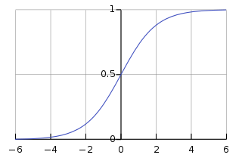




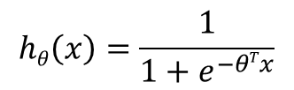




Logistic regression: review
Logistic Regression Model:
Want
$$g\left(z\right)$$
$$0≤hθ\left(x\right)≤1$$
$$hθ\left(x\right)=g(θTx)$$
$$hθ\left(x\right)=\frac{1}{1+e^{−θTx}}$$
$$z$$
$$g\left(z\right)=\frac{1}{1+e^{−z}}$$
$$parameters θ$$
If y = 1, we want $hθ\left(x\right)$ = 1 so $θTx$>>0
If y = 0, we want $hθ\left(x\right)$ = 0 so $θTx$<<0

Slide 5
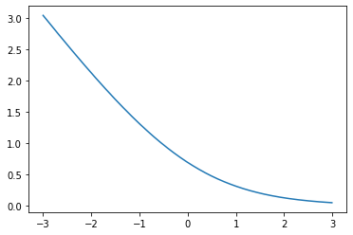
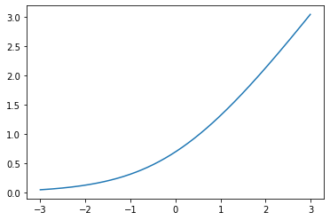



Modifying logistic regression model
$$cost\left(hθ\left(x^{}\right) ,y^{}\right)=−y\log\left(hθ\left(x^{}\right)\right) −\left(1−y\right)\log{(1−hθ\left(x^{})\right)}$$
$$cost\left(hθ\left(x^{}\right) ,y^{}\right)=−y\log\left(\frac{1}{1+e^{−θTx}}\right) −\left(1−y\right)\log{(1−\frac{1}{1+e^{−θTx}})}$$
$$−\log\left(\frac{1}{1+e^{−θTx}}\right)$$
$$\log{(1−\frac{1}{1+e^{−θTx}})}$$
cost₁(z)
cost₀(z)
z

Slide 6
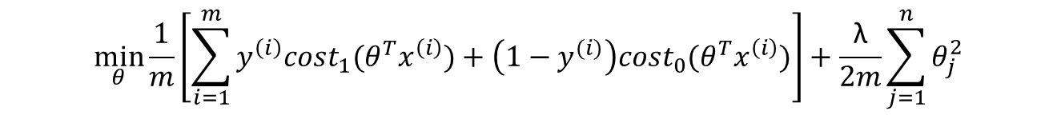
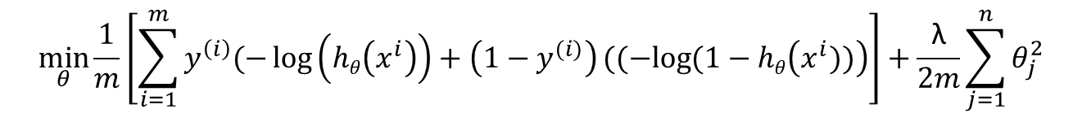
Modifying logistic regression model
logistic regression
$$\min_{θ}{\frac{1}{m}}\left[\sum_{i=1}^{m}{y^{\left(i\right)}(−\log\left(hθ\left(x^{i}\right)\right)+\left(1−y^{(i)}\right)((−log{(1−hθ\left(x^{i}))\right)}}\right]+\frac{\text{λ}}{2m}\sum_{j=1}^{n}{θ_{j}^{2}}$$
SVM
$$\min_{θ}{\frac{1}{m}}\left[\sum_{i=1}^{m}{y^{\left(i\right)}{cost}_{1}(θ^{T}x^{\left(i\right)})+\left(1−y^{(i)}\right){cost}_{0}(θ^{T}x^{\left(i\right)})}\right]+\frac{\text{λ}}{2m}\sum_{j=1}^{n}{θ_{j}^{2}}$$
We can remove m because it is the same for optimizing without m

Slide 7
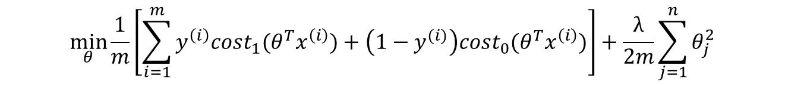
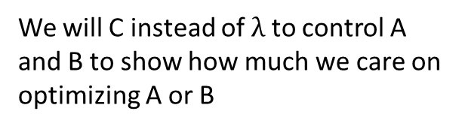
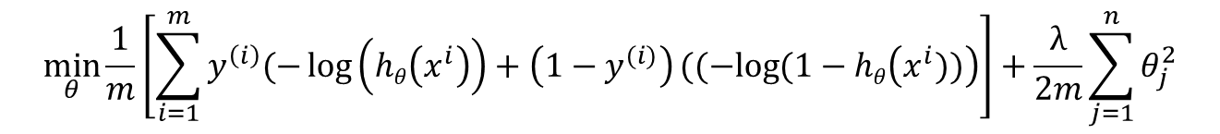

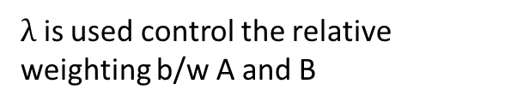

Modifying logistic regression model
logistic regression
$$\min_{θ}{\frac{1}{m}}\left[\sum_{i=1}^{m}{y^{\left(i\right)}(−\log\left(hθ\left(x^{i}\right)\right)+\left(1−y^{(i)}\right)((−log{(1−hθ\left(x^{i}))\right)}}\right]+\frac{λ}{2m}\sum_{j=1}^{n}{θ_{j}^{2}}$$
SVM
$$\min_{θ}{\frac{1}{m}}\left[\sum_{i=1}^{m}{y^{\left(i\right)}{cost}_{1}(θ^{T}x^{\left(i\right)})+\left(1−y^{(i)}\right){cost}_{0}(θ^{T}x^{\left(i\right)})}\right]+\frac{λ}{2m}\sum_{j=1}^{n}{θ_{j}^{2}}$$
$λ$ is used control the relative weighting b/w A and B
A+ $\text{λ}$ B
We will C instead of $λ$ to control A and B to show how much we care on optimizing A or B
CA+ B

Slide 8


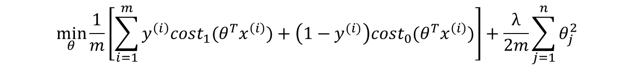
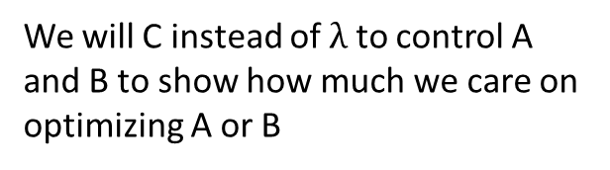

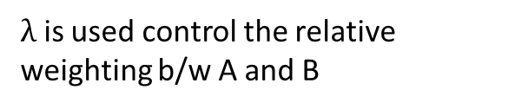
SVM
$$\min_{θ}{\frac{1}{m}}\left[\sum_{i=1}^{m}{y^{\left(i\right)}{cost}_{1}(θ^{T}x^{\left(i\right)})+\left(1−y^{(i)}\right){cost}_{0}(θ^{T}x^{\left(i\right)})}\right]+\frac{λ}{2m}\sum_{j=1}^{n}{θ_{j}^{2}}$$
$λ$ is used control the relative weighting b/w A and B
A+ $\text{λ}$ B
We will C instead of $λ$ to control A and B to show how much we care on optimizing A or B
CA+ B
$$\min_{θ}{C}\left[\sum_{i=1}^{m}{y^{\left(i\right)}{cost}_{1}(θ^{T}x^{\left(i\right)})+\left(1−y^{(i)}\right){cost}_{0}(θ^{T}x^{\left(i\right)})}\right]+\frac{1}{2}\sum_{j=1}^{n}{θ_{j}^{2}}$$

Slide 9

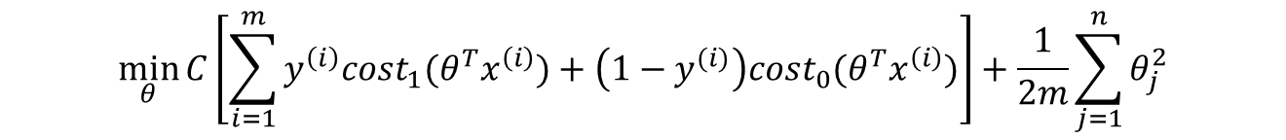


SVM
$$\min_{θ}{C}\left[\sum_{i=1}^{m}{y^{\left(i\right)}{cost}_{1}(θ^{T}x^{\left(i\right)})+\left(1−y^{(i)}\right){cost}_{0}(θ^{T}x^{\left(i\right)})}\right]+\frac{1}{2m}\sum_{j=1}^{n}{θ_{j}^{2}}$$
SVM doesn’t output the probability. It just make the prediction of y=1 or y=0 directly
1
$$θ^{T}x^{\left(i\right)}≥0$$
$$hθ\left(x\right)$$
0
$$θ^{T}x^{\left(i\right)}≤0$$

Slide 10
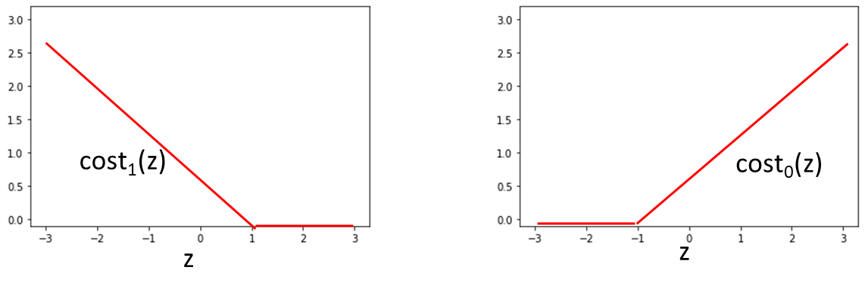
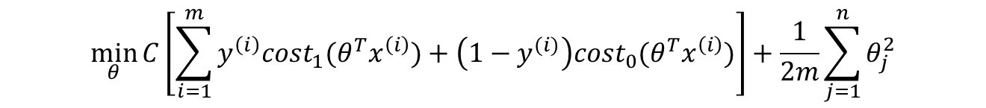
Large Margin Intuition
$$\min_{θ}{C}\left[\sum_{i=1}^{m}{y^{\left(i\right)}{cost}_{1}(θ^{T}x^{\left(i\right)})+\left(1−y^{(i)}\right){cost}_{0}(θ^{T}x^{\left(i\right)})}\right]+\frac{1}{2m}\sum_{j=1}^{n}{θ_{j}^{2}}$$
If y = 1. we want $θ^{T}x^{}≥1 not just≥0$
If y = 0. we want $θ^{T}x^{}≤−1 not just<0$

Slide 11
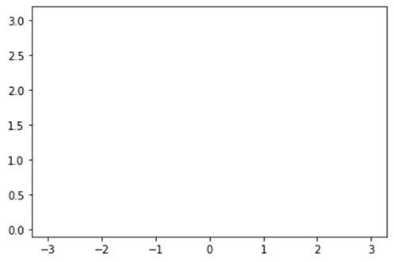


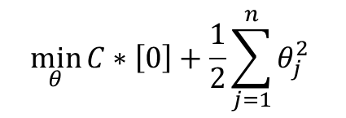


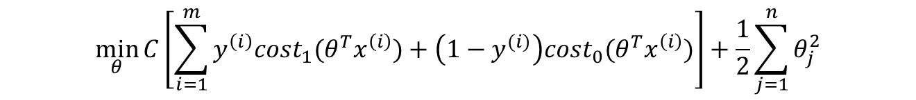

Large Margin Intuition
$$\min_{θ}{C}\left[\sum_{i=1}^{m}{y^{\left(i\right)}{cost}_{1}(θ^{T}x^{\left(i\right)})+\left(1−y^{(i)}\right){cost}_{0}(θ^{T}x^{\left(i\right)})}\right]+\frac{1}{2}\sum_{j=1}^{n}{θ_{j}^{2}}$$
If C is very large, when minimizing the objective function, we try to make the first term (A) = 0. How can we do that?
cost₁(z)
cost₀(z)
z
z
$$θ^{T}x^{}≥1$$
$$θ^{T}x^{}≤−1$$
$$\min_{θ}{C}∗\left[0\right]+\frac{1}{2}\sum_{j=1}^{n}{θ_{j}^{2} }$$
s.t.
$$θ^{T}x^{}≥1$$
If y =1
$$θ^{T}x^{}≤−1$$
If y =-1

Slide 12
SVM decision boundary: Linearly separable case
x2
x1

Slide 13
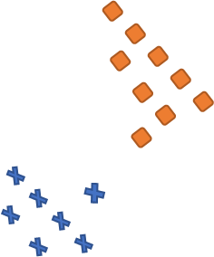
SVM decision boundary: outlies presense
x2
x1

Slide 14
Large Margin Intuition
$$\min_{θ}{C}\left[\sum_{i=1}^{m}{y^{\left(i\right)}{cost}_{1}(θ^{T}x^{\left(i\right)})+\left(1−y^{(i)}\right){cost}_{0}(θ^{T}x^{\left(i\right)})}\right]+\frac{1}{2}\sum_{j=1}^{n}{θ_{j}^{2}}$$
If C is very large, when minimizing the objective function, we try to make the first term (A) = 0. How can we do that?
margin

Slide 15











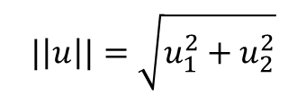



Mathematics Behind Large Margin Classification
$$u= \left[\begin{aligned}u_{1} \\ u_{2}\end{aligned}\right]$$
$$v= \left[\begin{aligned}v_{1} \\ v_{2}\end{aligned}\right]$$
Vector inner product
$$v$$
$$|\left|u\right||=\sqrt{u_{1}^{2}+u_{2}^{2}}$$
$$v_{2}$$
$$u$$
$$u_{2}$$
$u^{T}v=u_{1}$ $v_{1}$+ $u_{2} v_{2}$
$$P$$
P is the projection of the vector v on the vector u
$$v_{1}$$
$$u_{1}$$
$$u^{T}v=P.\left|\left|u\right|\right|$$
$$u$$
$$v$$
$$P<0$$
$$P$$

Slide 16




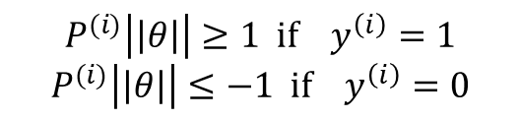
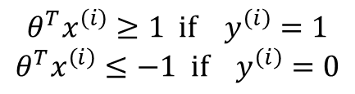



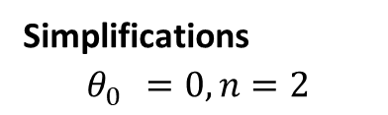


SVM Decision Boundary
$\min_{θ} \frac{1}{2}\sum_{j=1}^{n}{θ_{j}^{2}=\frac{1}{2}\left(θ_{1}^{2}+θ_{2}^{2}\right)=\frac{1}{2}{\left({(\sqrt{θ_{1}^{2}+θ_{2}^{2})}}^{}\right)}^{2};{||θ||=\sqrt{θ_{1}^{2}+θ_{2}^{2})}}_{}^{}}$
$$\min_{θ} \frac{1}{2}\sum_{j=1}^{n}{θ_{j}^{2}}$$
s.t.
$$θ^{T}x^{\left(i\right)}≥1 if y^{\left(i\right)}=1$$
$$θ^{T}x^{\left(i\right)}≤−1 if y^{\left(i\right)}=0$$
$θ^{T}x^{\left(i\right)}=P\left|\left|θ\right|\right|=θ_{1}x_{1}^{(i)}$+ $θ_{2}x_{2}^{(i)}$
Simplifications
$$θ_{0}^{}=0, n=2$$
s.t.
$$P^{(i)}\left|\left|θ\right|\right|≥1 if y^{\left(i\right)}=1$$
$$P^{(i)}\left|\left|θ\right|\right|≤−1 if y^{\left(i\right)}=0$$
$$x^{\left(i\right)}$$
$P^{\left(i\right)}$ is the projection of $x^{\left(i\right)}$ on the vector $θ$
$$x_{2}^{(i)}$$
$$θ_{2}$$
$$P^{(i)}$$
$$x_{1}^{(i)}$$
$$θ_{1}$$

Slide 17









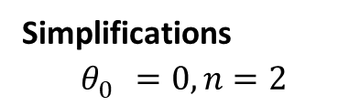

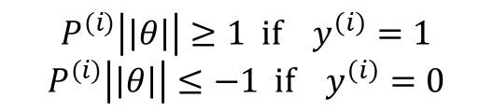


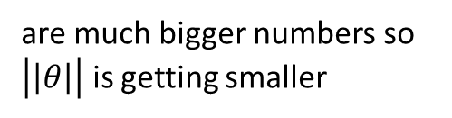


SVM Decision Boundary
$$\min_{θ} \frac{1}{2}\sum_{j=1}^{n}{θ_{j}^{2}}$$
s.t.
$$P^{(i)}\left|\left|θ\right|\right|≥1 if y^{\left(i\right)}=1$$
$$P^{(i)}\left|\left|θ\right|\right|≤−1 if y^{\left(i\right)}=0$$
Simplifications
$$θ_{0}^{}=0, n=2$$
Decision Boundary
$$θ$$
$$P^{\left(1\right)}$$
$$x^{\left(2\right)}$$
$$x^{\left(1\right)}$$
$$x^{\left(2\right)}$$
$$P^{\left(2\right)}$$
$$x^{\left(1\right)}$$
$$P^{\left(2\right)}$$
$$P^{\left(1\right)}$$
$$P^{\left(1\right)}$$
$$P^{\left(2\right)}$$
are small numbers so $\left|\left|θ\right|\right|$ is large
$$P^{\left(1\right)}$$
$$P^{\left(2\right)}$$
are much bigger numbers so $\left|\left|θ\right|\right|$ is getting smaller

Slide 18

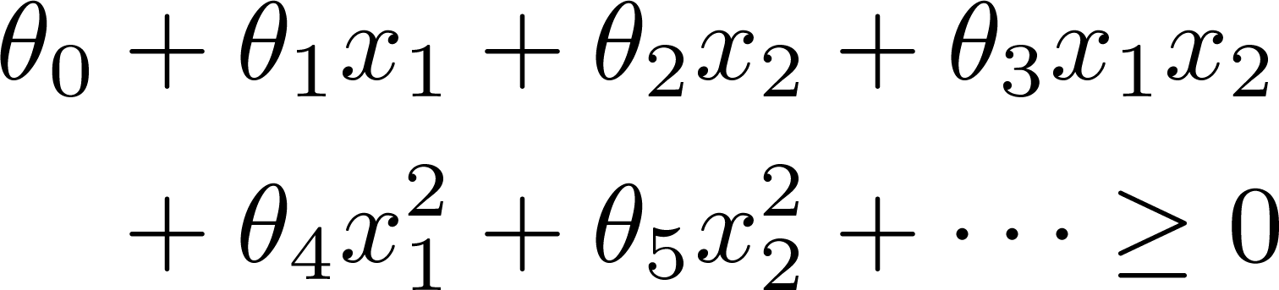

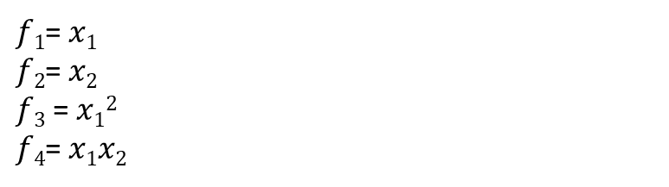
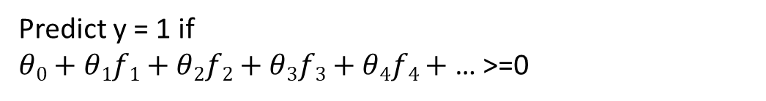

Non-linear Decision Boundary
x₂
x₁
Predict y = 1 if
$θ0+θ1f1+θ2f2+θ3f3+θ4f4+$ … >=0
$f1$= $x1$
$f2$= $x2$
$f3$ = $x12$
$f4$= $x1x2$
Is there a different / better choice of the features ?

Slide 19
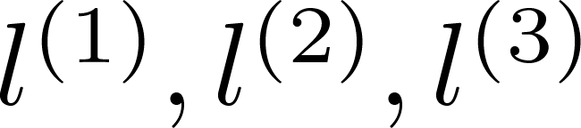
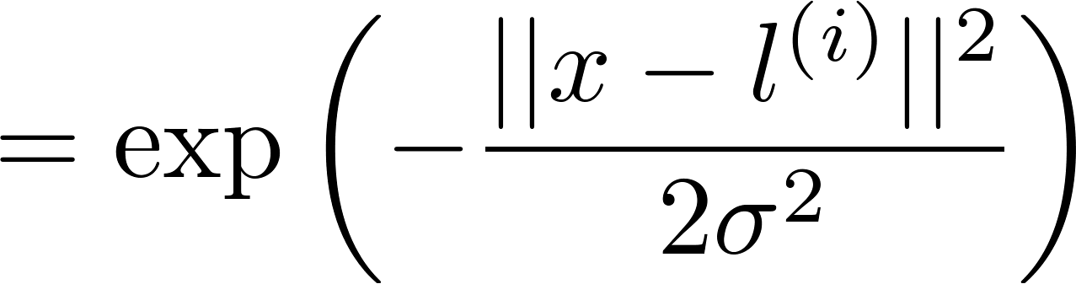
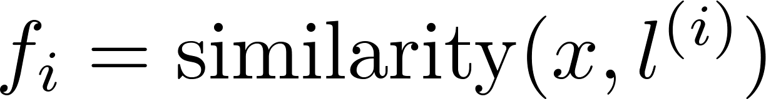



Kernel
Given , compute new feature depending
on proximity to landmarks
$$l^{\left(1\right)}$$
x₂
$$l^{\left(2\right)}$$
$$l^{\left(3\right)}$$
x₁
Notes:
Kernel
Gaussian Kernal

Slide 20




$$if x≈l^{\left(1\right)}$$
=0 Then similarity =1
$if x$ is far from $l^{\left(1\right)}$
is large number Then similarity $≈$0

Slide 21
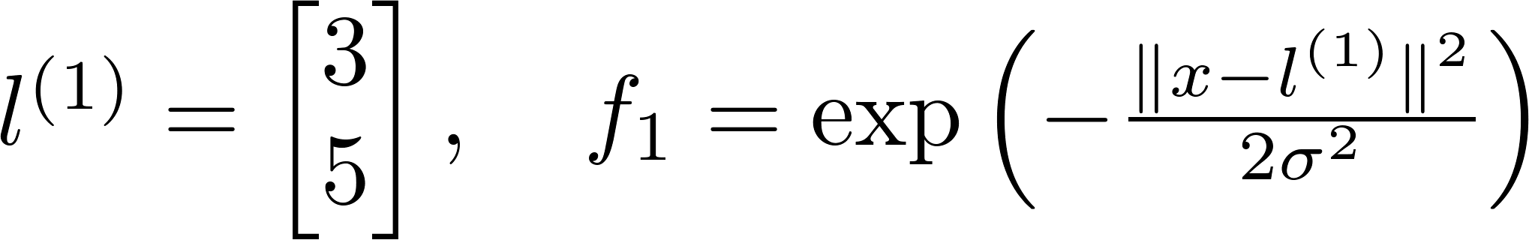
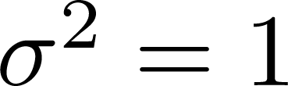
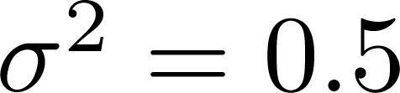

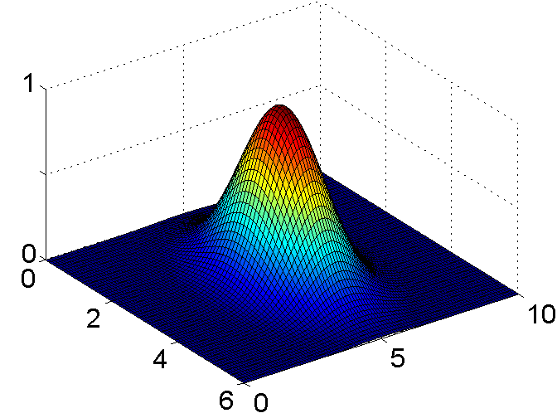
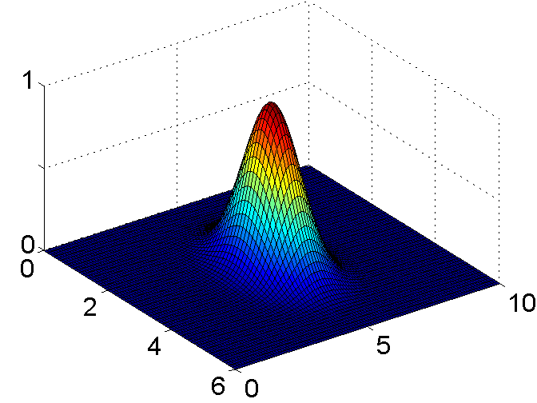
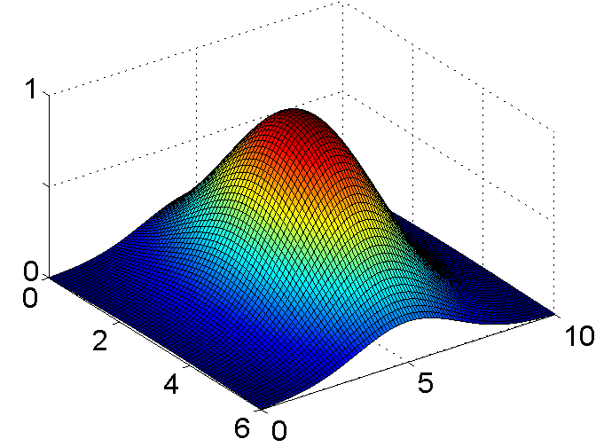
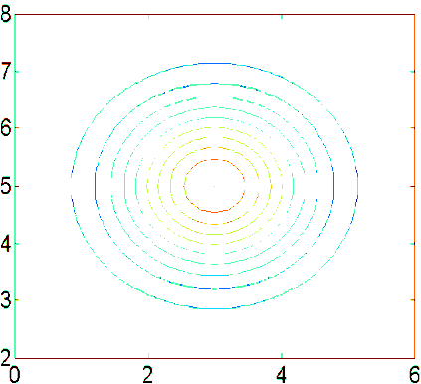
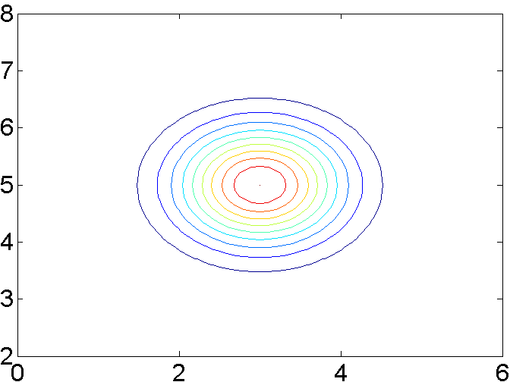
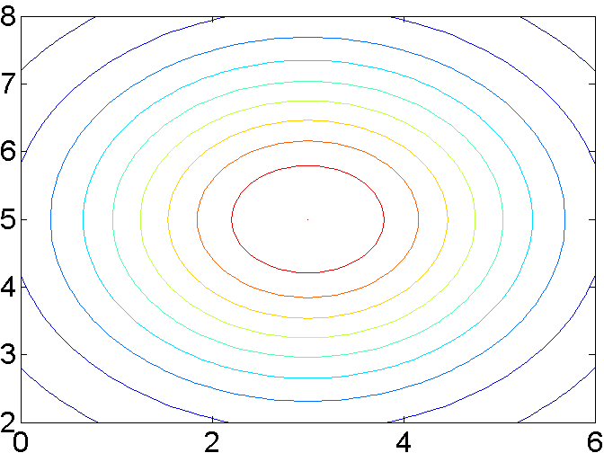



Example:
$$f$$
$$x_{2}$$
$$x_{1}$$

Slide 22





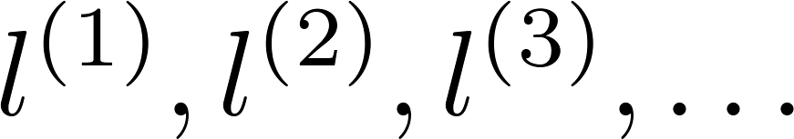
Choosing the landmarks
Given :
x₂
x₁
Predict if
Where to get ?

Slide 23
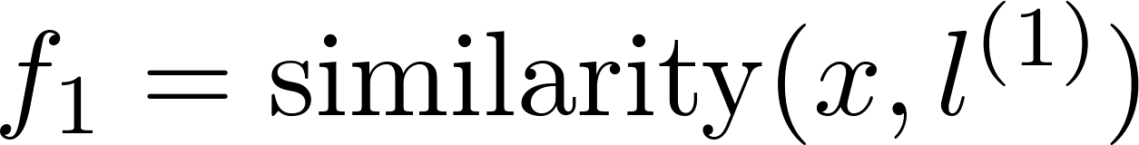
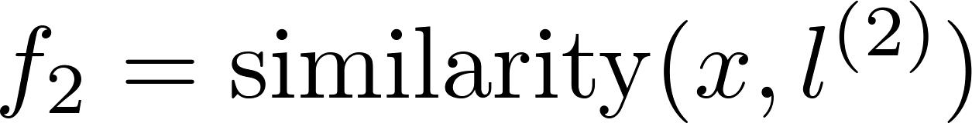
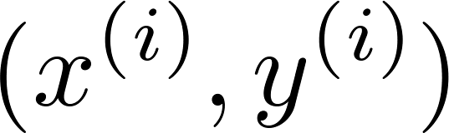
SVM with Kernels
Given
choose
Given example :
For training example :

Slide 24



SVM with Kernels
Hypothesis: Given , compute features
Predict “y=1” if
Training:
m

Slide 25



SVM parameters:
C ( ). Large C: Lower bias, high variance.
Small C: Higher bias, low variance.
Large : Features vary more smoothly.
Higher bias, lower variance.
Small : Features vary less smoothly.
Lower bias, higher variance.

Slide 26





Use SVM software package (e.g. liblinear, libsvm, …) to solve for parameters .
Need to specify:
Choice of parameter C.
Choice of kernel (similarity function):
E.g. No kernel (“linear kernel”)
Predict “y = 1” if
Gaussian kernel:
, where .
Need to choose .

Slide 27


Other choices of kernel
Note: Not all similarity functions make valid kernels.
(Need to satisfy technical condition called “Mercer’s Theorem” to make sure SVM packages’ optimizations run correctly, and do not diverge).
Many off-the-shelf kernels available:
Polynomial kernel:
More esoteric: String kernel, chi-square kernel, histogram intersection kernel, …
$$K<x,l> =(x^{T}l+c)$$

Slide 28






Multi-class classification
Many SVM packages already have built-in multi-class classification functionality.
Otherwise, use one-vs.-all method. (Train SVMs, one to distinguish
from the rest, for ), get
Pick class with largest

Slide 29





Logistic regression vs. SVMs
number of features ( ), number of training examples
If is large (relative to ):
Use logistic regression, or SVM without a kernel (“linear kernel”)
If is small, is intermediate:
Use SVM with Gaussian kernel
If is small, is large:
Create/add more features, then use logistic regression or SVM without a kernel
Neural network likely to work well for most of these settings, but may be slower to train.

