Slide 1

Artificial Intelligence Lecture 7

Slide 2
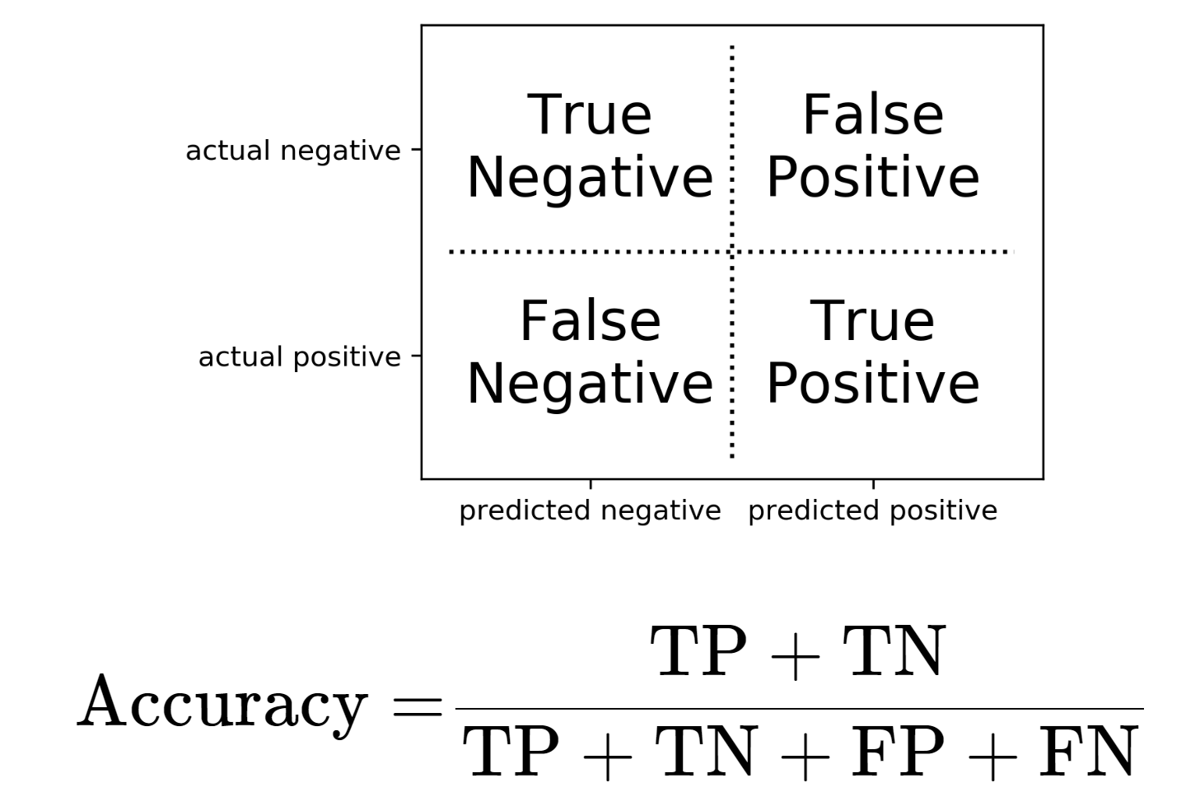
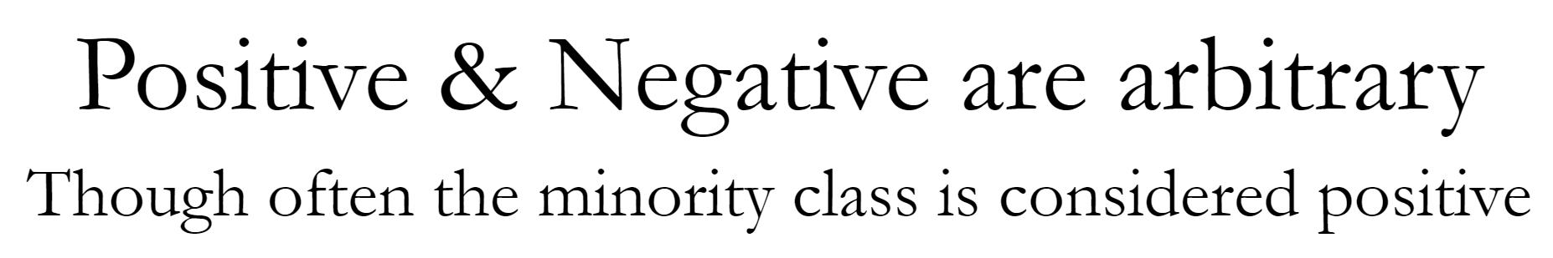
Classification

Slide 3
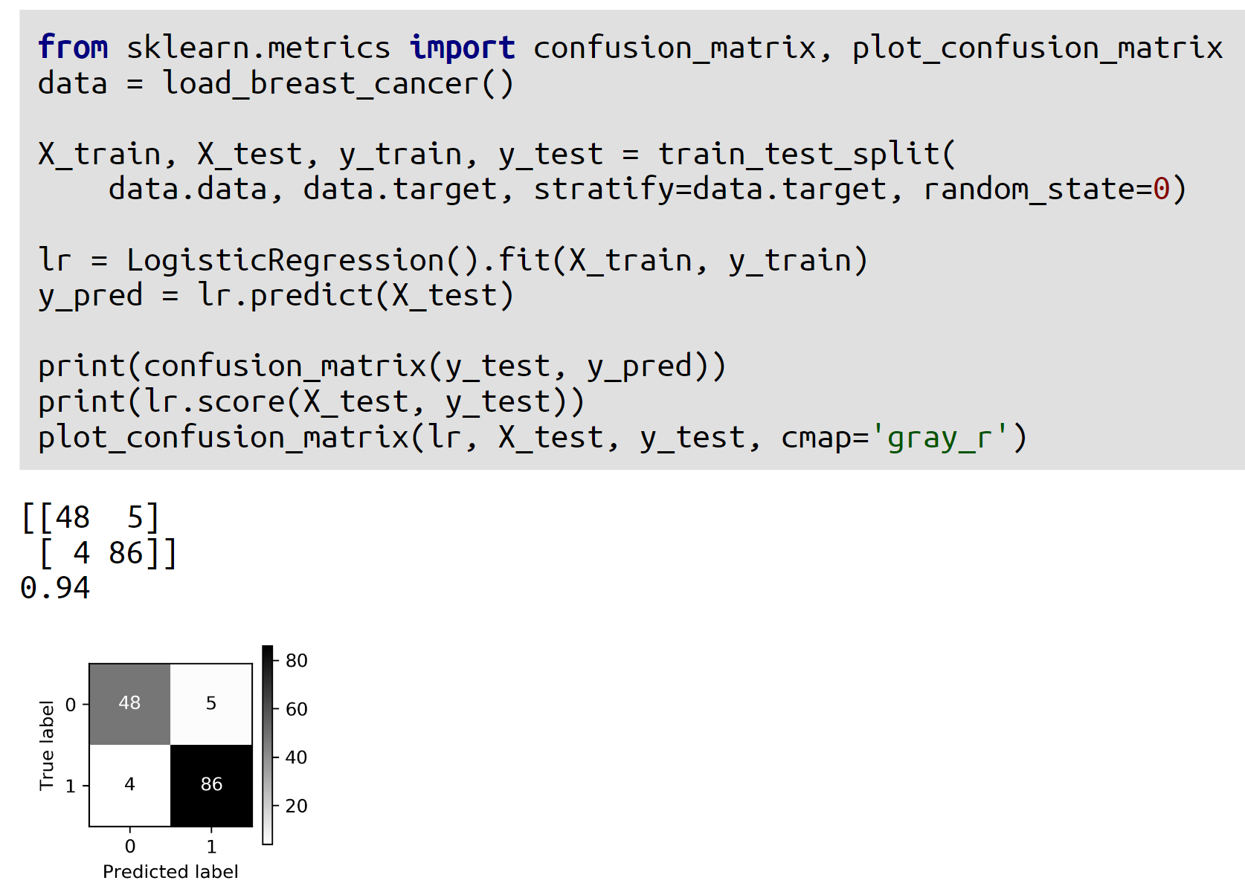
Example 1

Slide 4
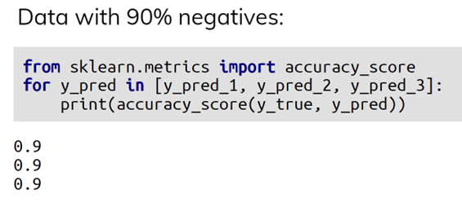
Example 2

Slide 5
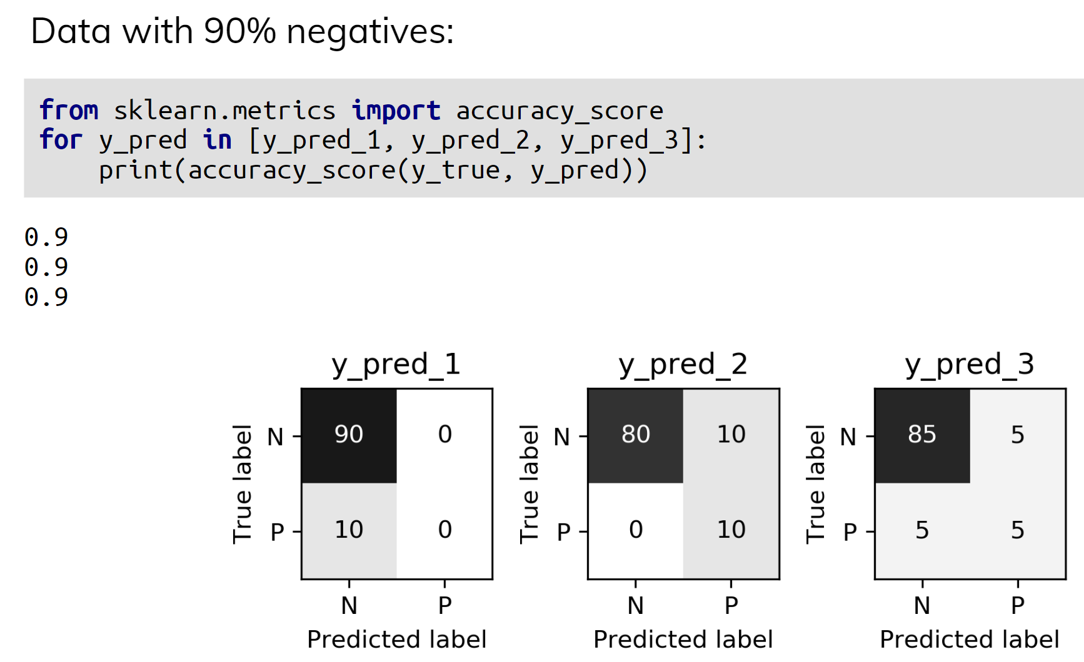
Example 2

Slide 6
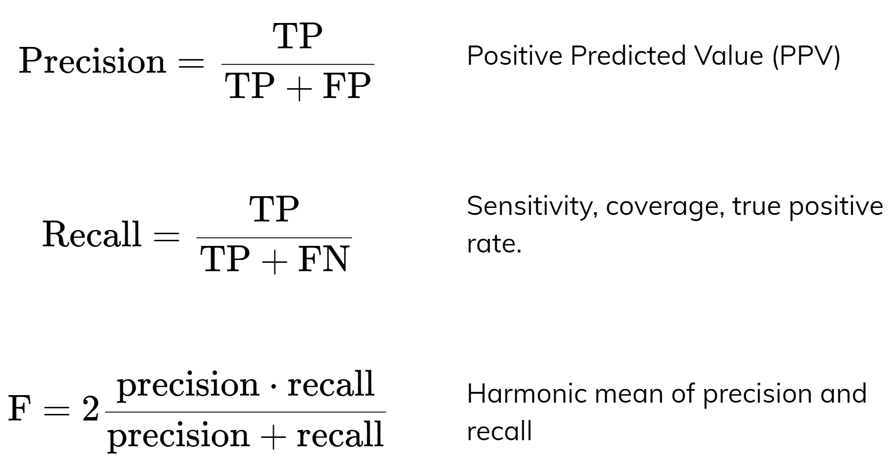
Precision, Recall, f-score

Slide 7
Precision, Recall
Precision is a measure of the accuracy of positive predictions. In other words, precision represents the proportion of positive predictions that are correct.
Recall, on the other hand, is a measure of the completeness of positive predictions. In other words, recall represents the proportion of actual positive instances that are correctly identified by the model.
The main difference between precision and recall is that precision focuses on the proportion of positive predictions that are correct, while recall focuses on the proportion of actual positive instances that are correctly identified by the model.
In other words, precision measures the model's ability to avoid false positives, while recall measures the model's ability to detect all positive instances.
In general, there is often a trade-off between precision and recall, meaning that improving one metric may result in a decrease in the other. Therefore, the choice of which metric to prioritize depends on the specific problem and application domain.

Slide 8
f-score
F score is a commonly used metric in machine learning for evaluating the performance of classification models. It is a single number that combines precision and recall into one measure of performance.
The F score is calculated as the harmonic mean of precision and recall.
The F1 score ranges from 0 to 1, where a score of 1 indicates perfect precision and recall, and a score of 0 indicates poor performance.
The F1 score is particularly useful when the classes are imbalanced, meaning that one class has significantly fewer examples than the other. In such cases, accuracy can be a misleading metric, as the model may simply predict the majority class for every example and achieve a high accuracy but perform poorly in terms of correctly identifying the minority class. The F1 score takes into account both precision and recall, which are important for evaluating the model's performance on imbalanced data.

Slide 9
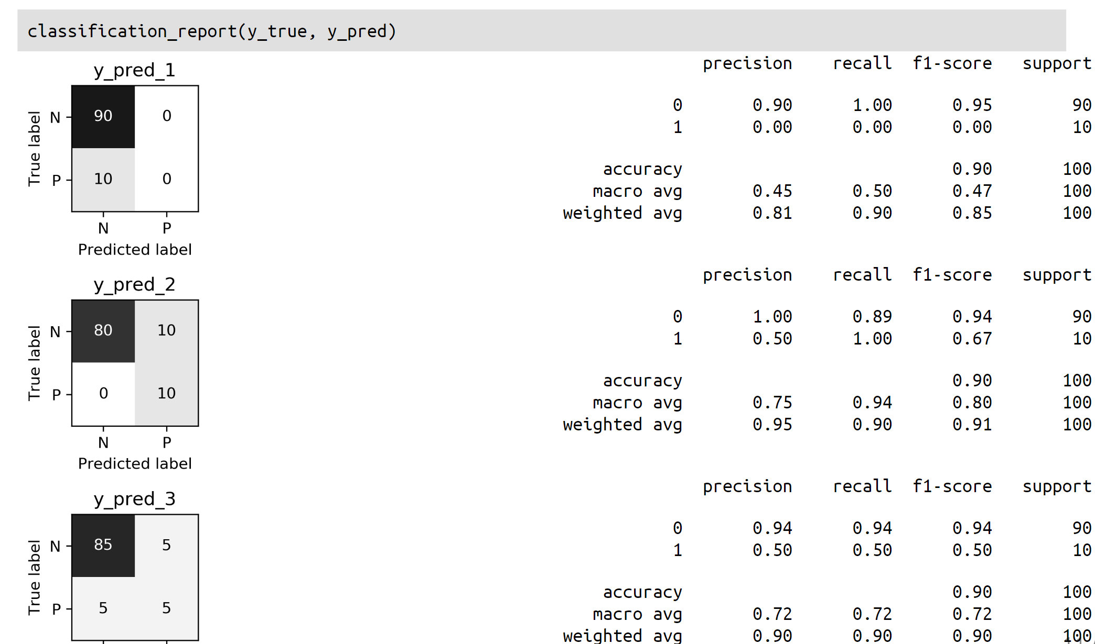

Slide 10
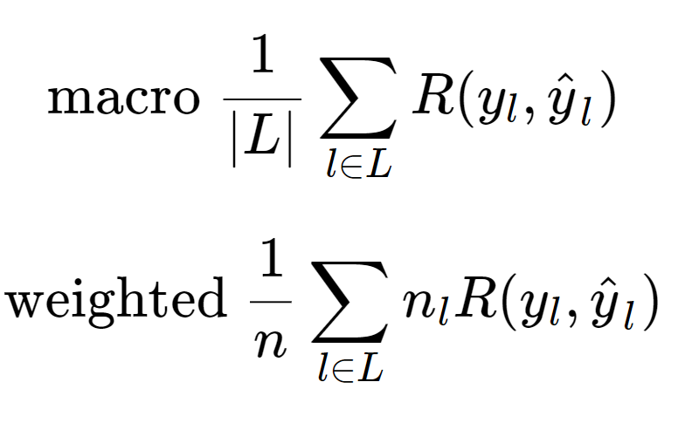
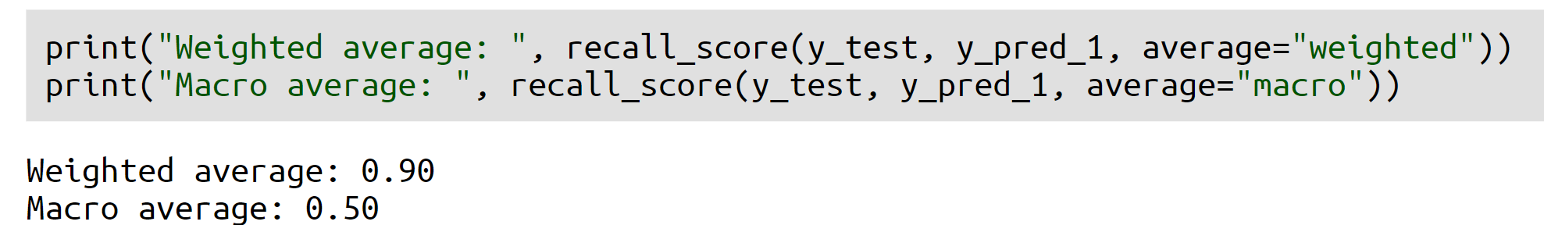
Averaging strategies
When the "average" parameter is set to "macro", the recall score is calculated as the average of the recall scores for each individual class, without considering the class imbalance. In other words, each class is given equal weight in the calculation, regardless of the number of instances of that class in the dataset. This approach is useful when each class is considered equally important, and the goal is to evaluate the model's performance on each class separately.
When the "average" parameter is set to "weighted", the recall score is calculated as the weighted average of the recall scores for each individual class, taking into account the class imbalance. In other words, each class is given a weight proportional to the number of instances of that class in the dataset, and the recall score for each class is multiplied by that weight before being averaged. This approach is useful when the dataset is imbalanced, and some classes have significantly more instances than others.

Slide 11
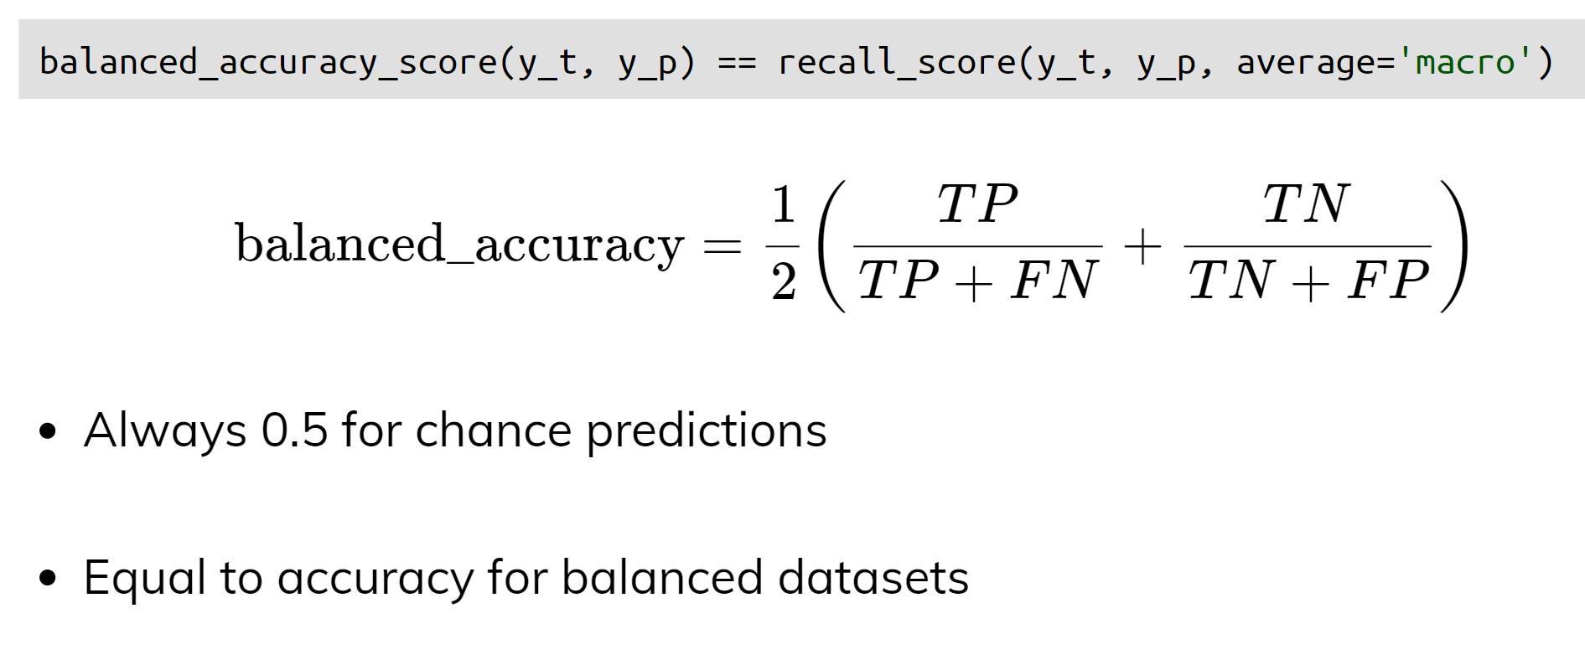
Balanced Accuracy

Slide 12
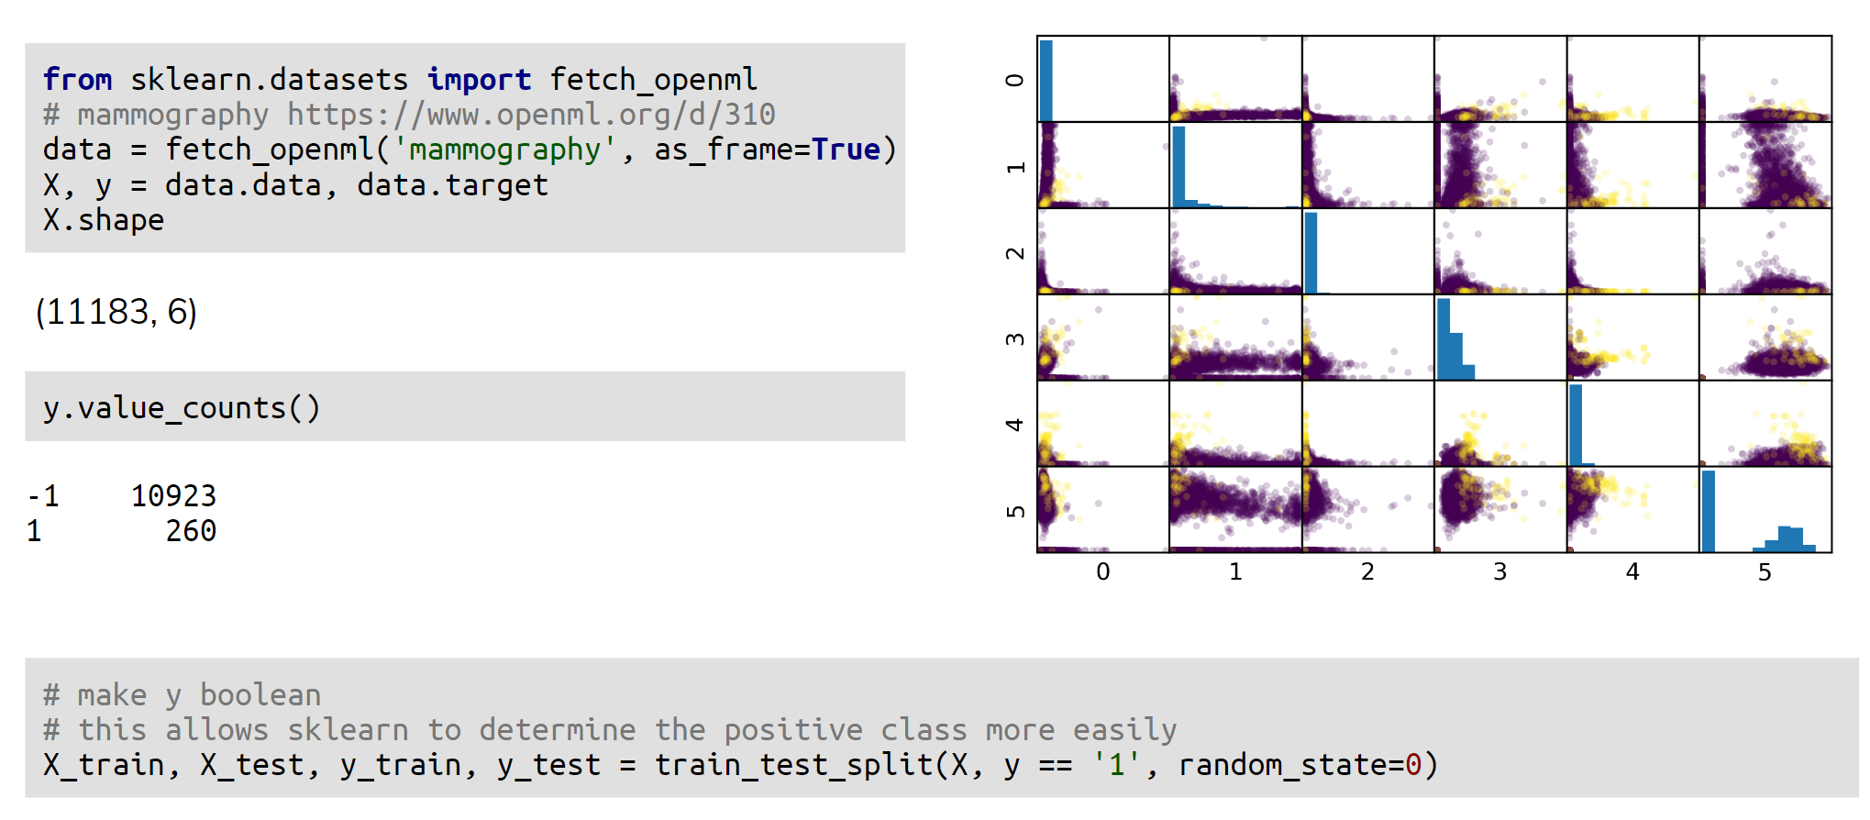
Mammography Data

Slide 13
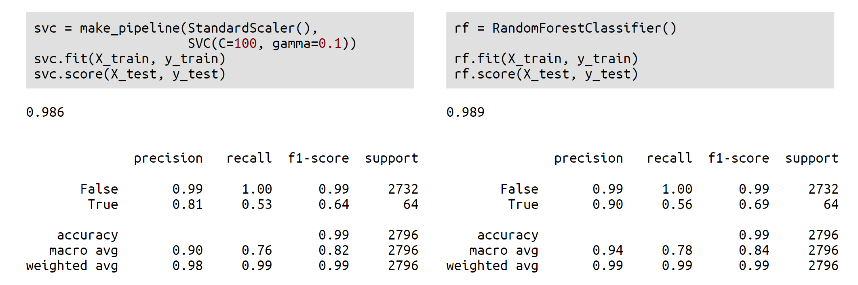
Mammography Data

Slide 14
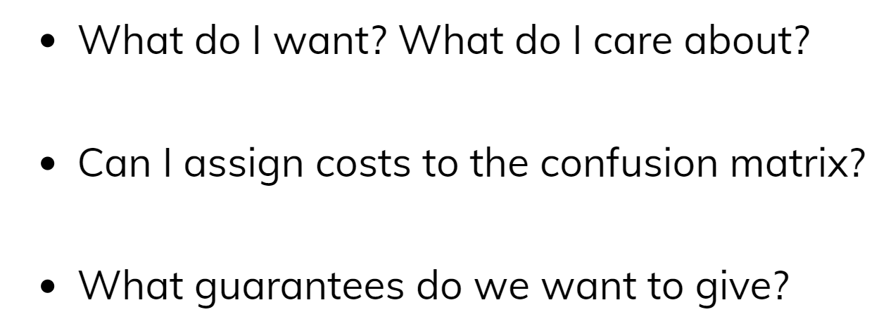
Goal setting!

Slide 15
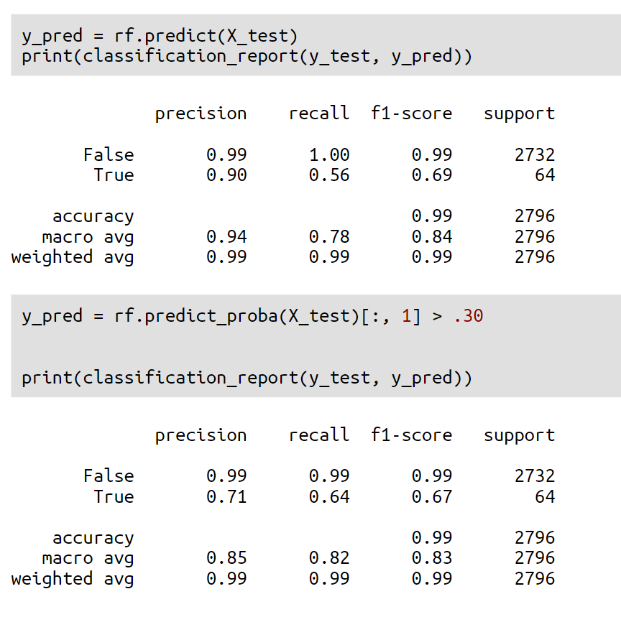
Changing Thresholds
For example, try to improve the recall of class True

Slide 16
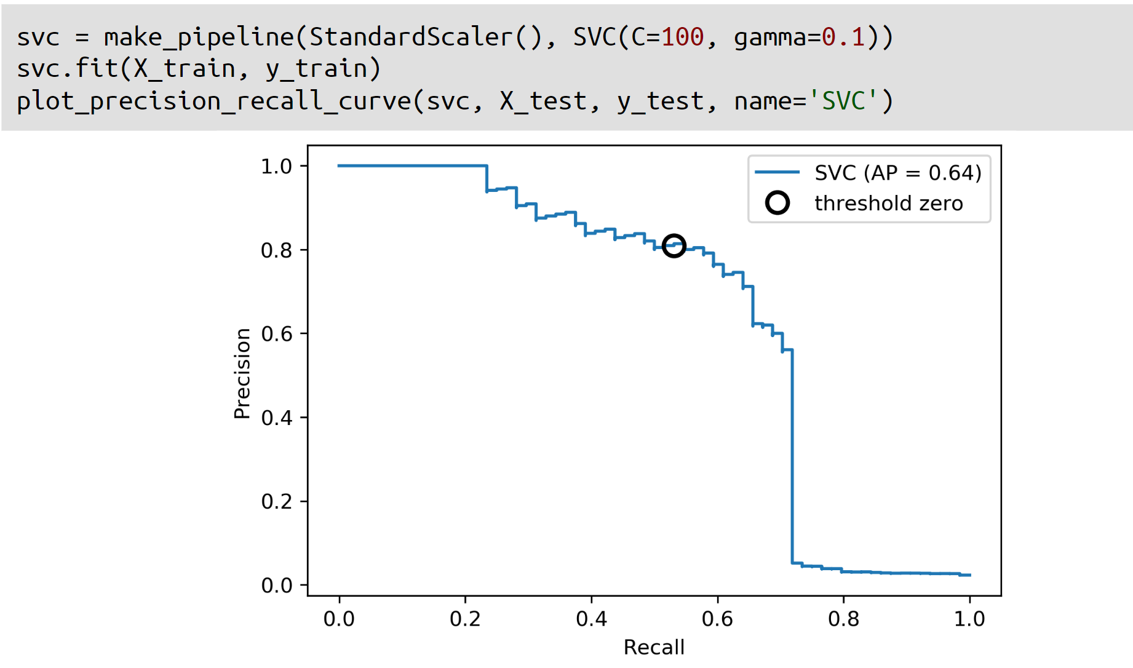
Precision-Recall curve
The PR curve is a useful tool for evaluating the trade-off between precision and recall at different classification thresholds, and is often used when the positive class is rare or when the cost of false positives and false negatives are asymmetric.

Slide 17
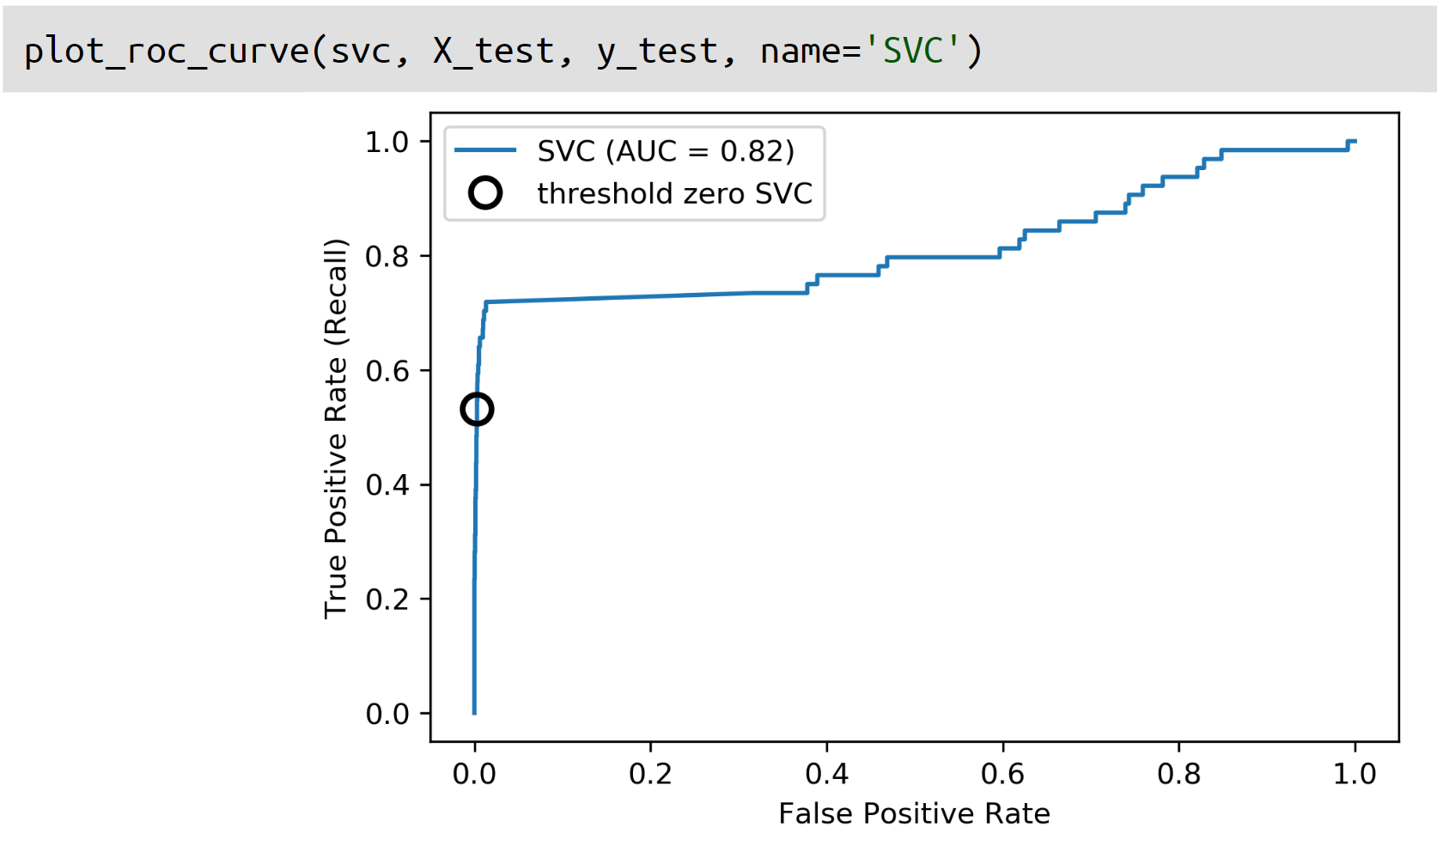
ROC Curve (Receiver Operating Characteristic)
The ROC curve is a useful tool for evaluating the trade-off between TPR and FPR at different classification thresholds, and is often used when the two classes are relatively balanced.

Slide 18
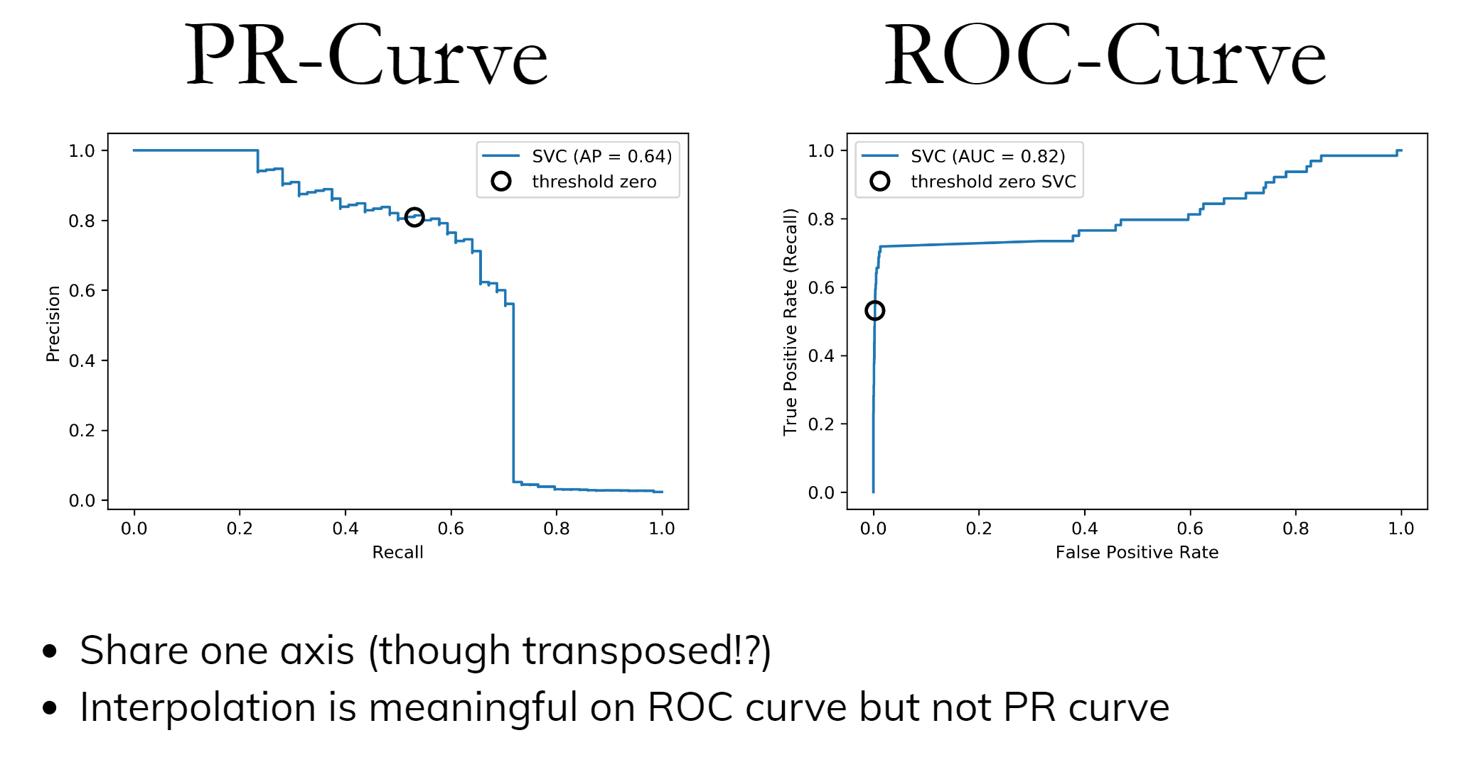

Slide 19
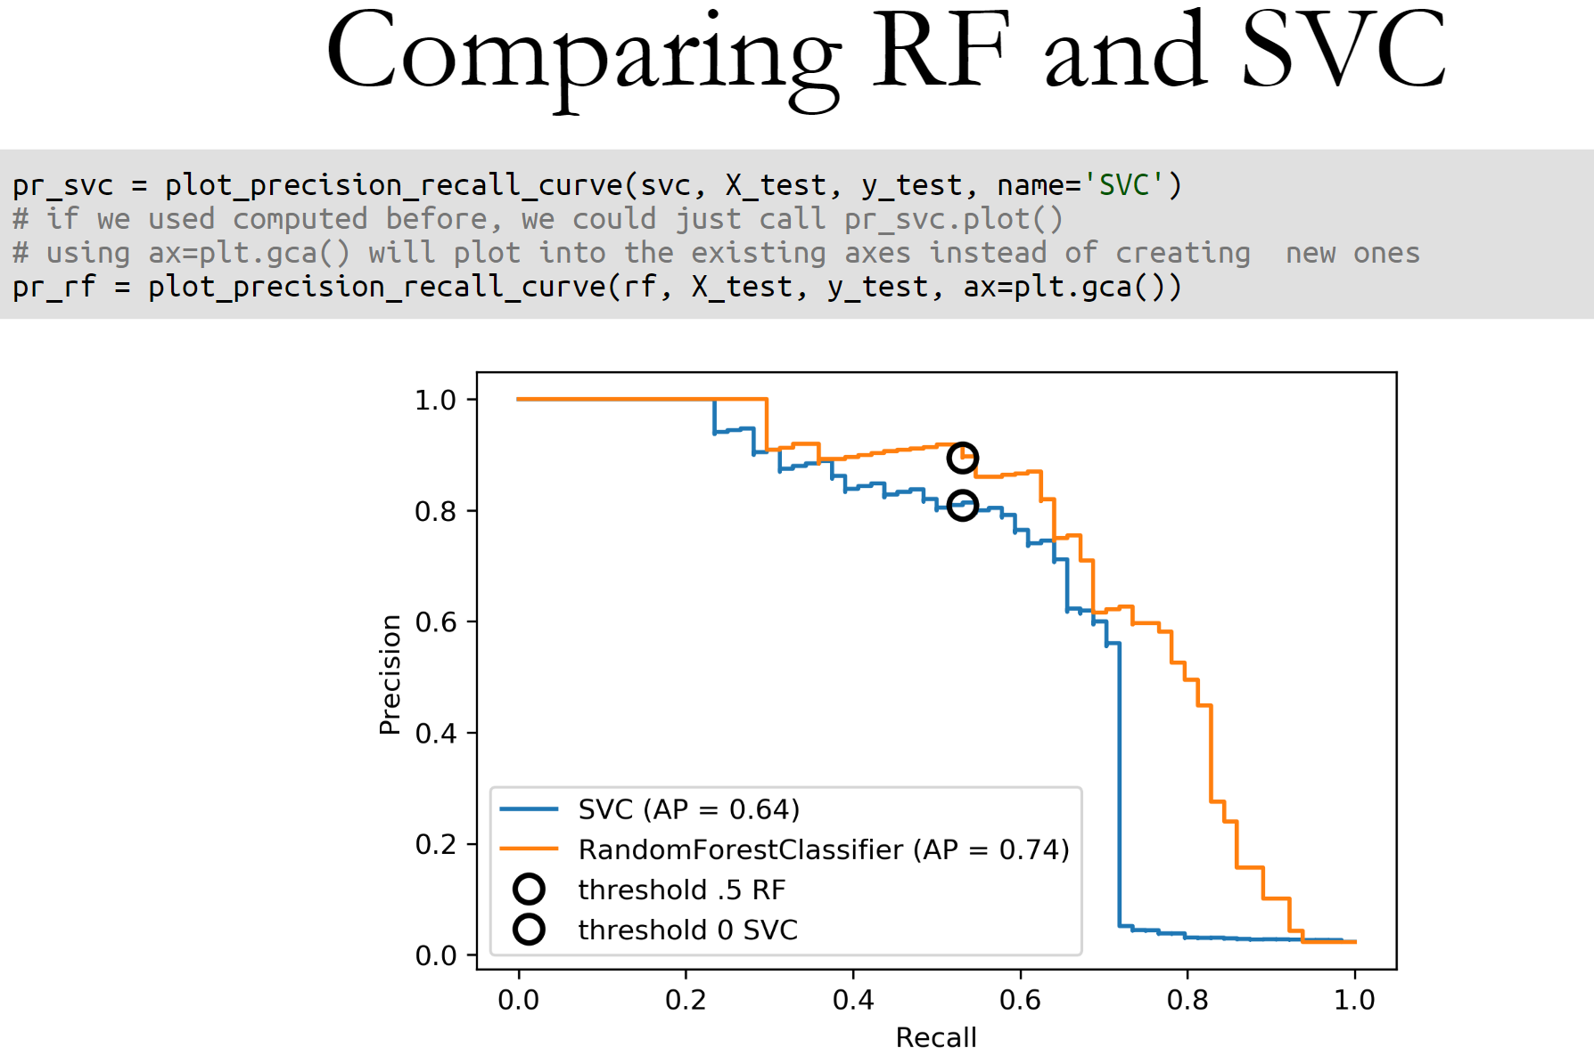

Slide 20
Further reading on evaluation curves
The Relationship Between Precision-Recall and ROC Curves
Precision-Recall-Gain Curves: PR Analysis Done Right

Slide 21
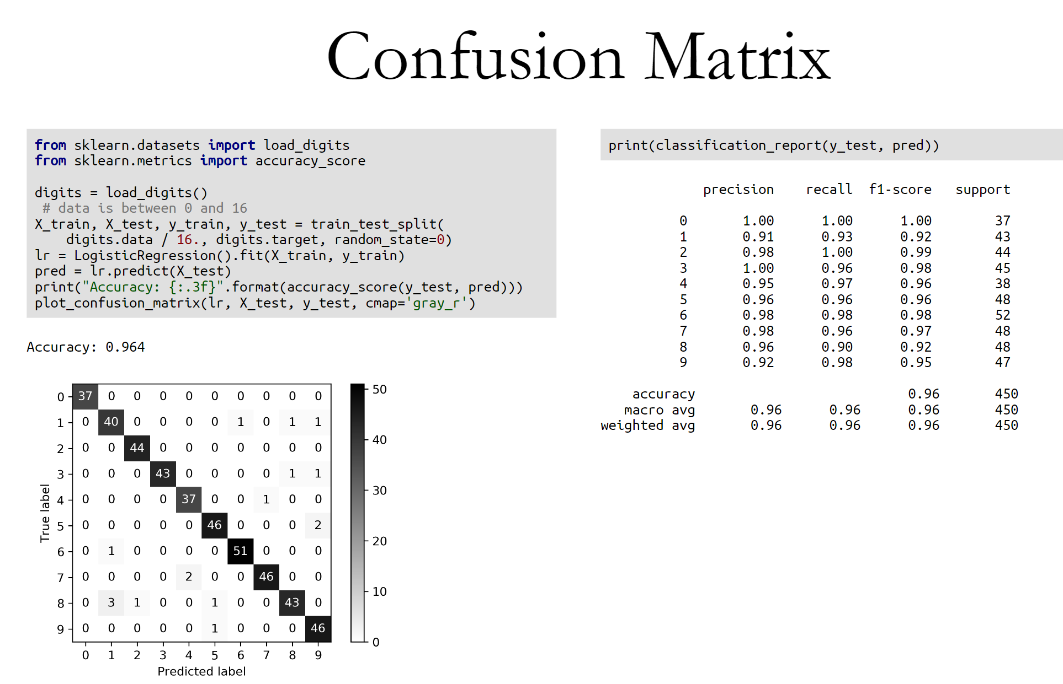

Slide 22
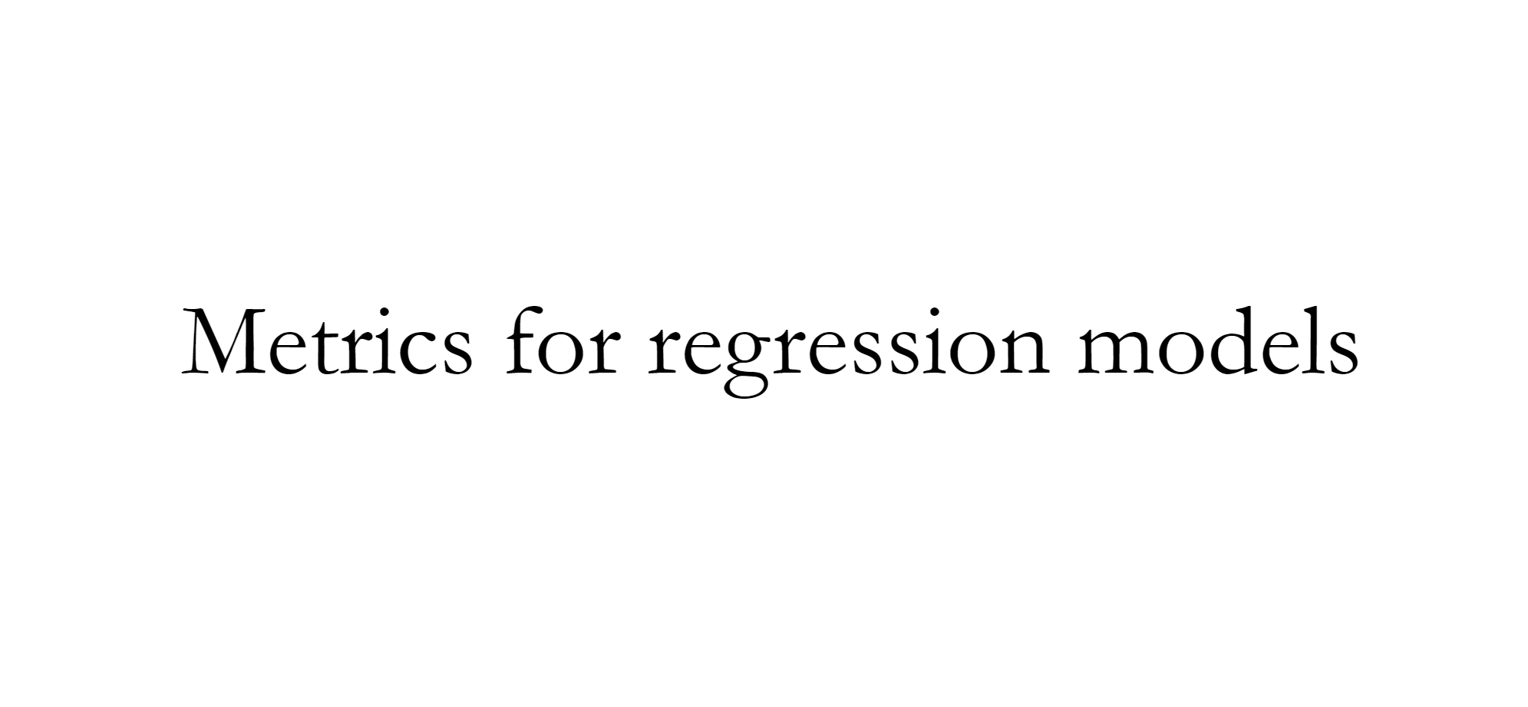

Slide 23
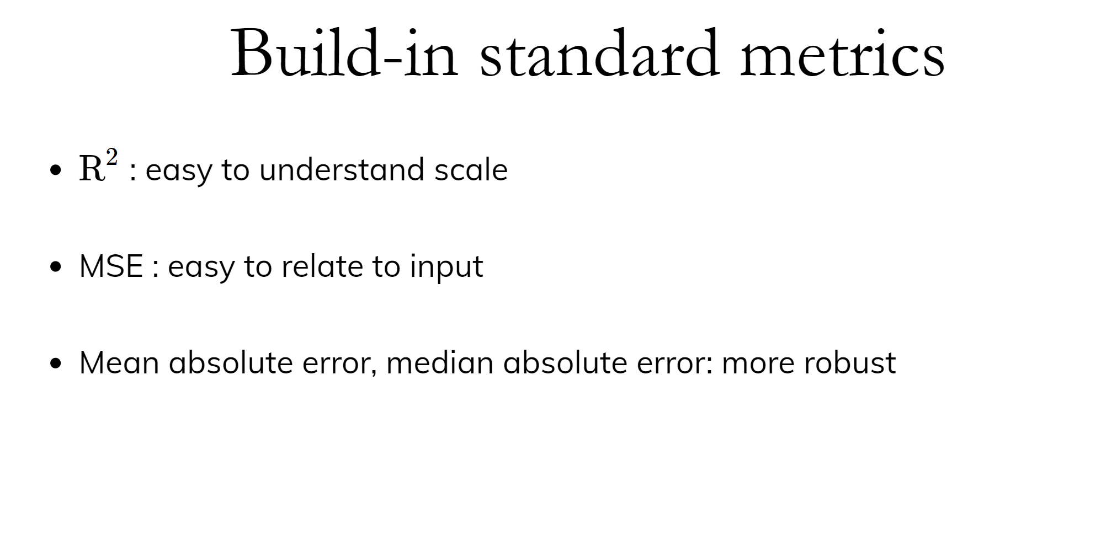

Slide 24
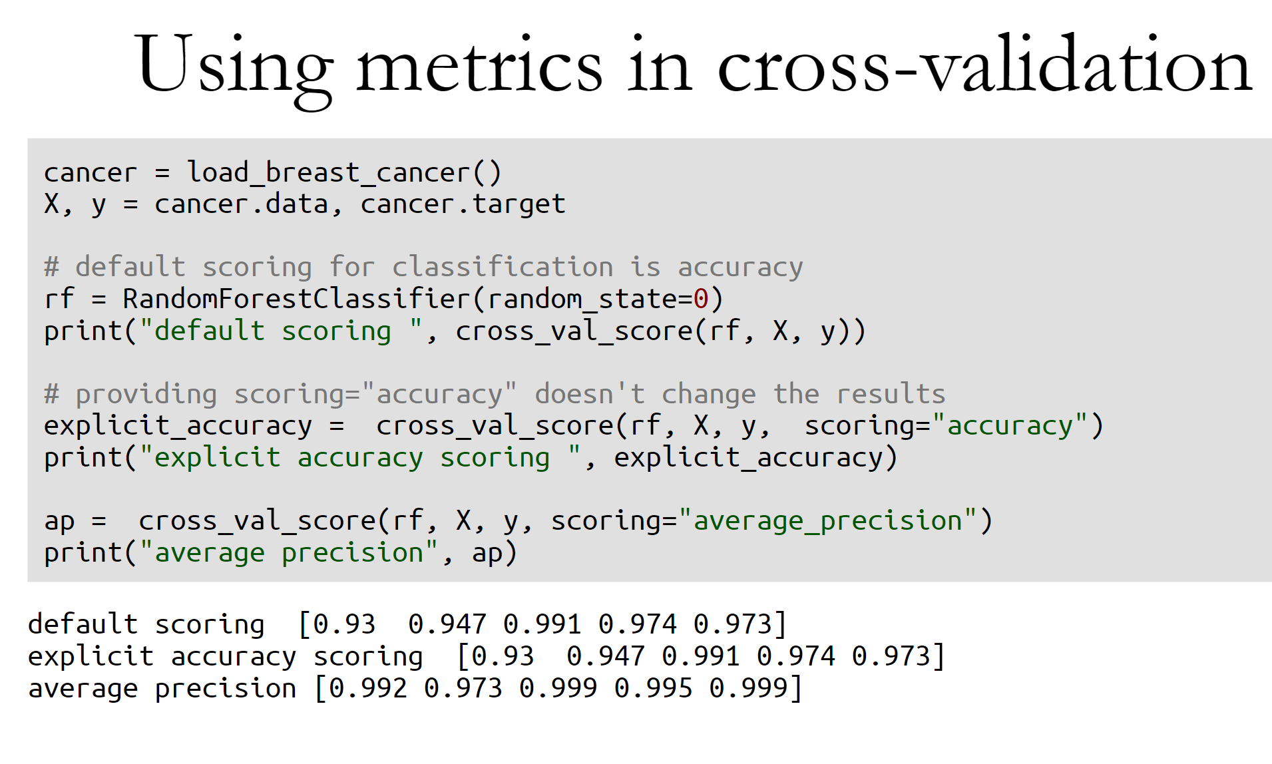

Slide 25
