Slide 1
Artificial Intelligence Lecture 13

Slide 2
Recurrent Neural Network
https://stanford.edu/~shervine/teaching/cs-230/cheatsheet-recurrent-neural-networks

Slide 3
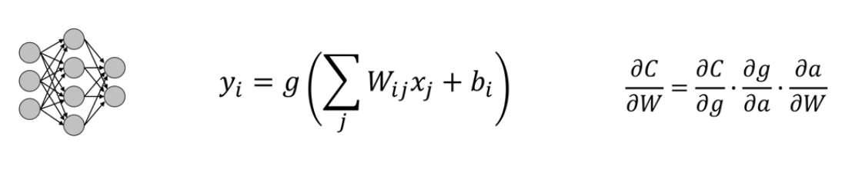
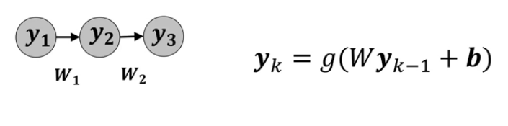
Feed Forward NN

Slide 4
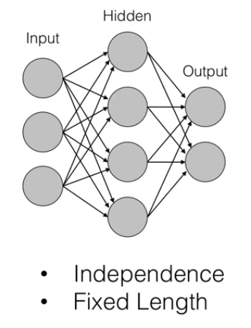
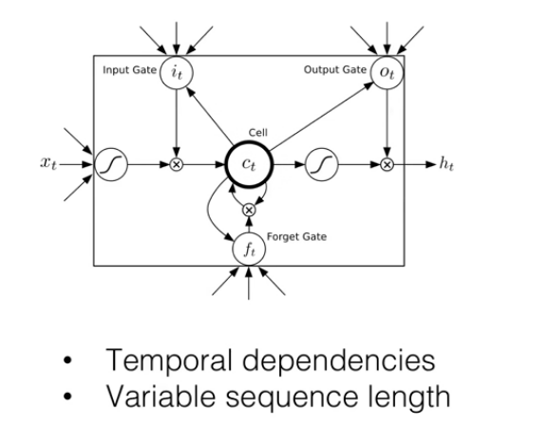
Why RNN?

Slide 5





Recurrent Neuron

Slide 6
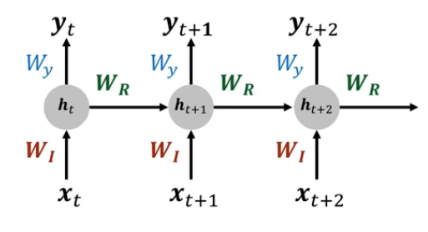
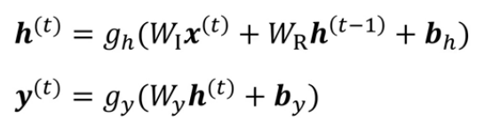
Unrolling a recurrent network into a feed forward net

Slide 7
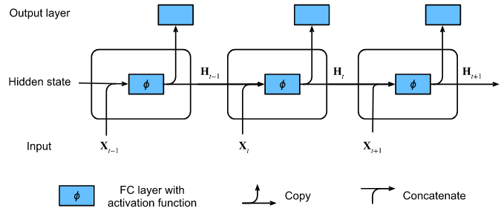


RNN
https://d2l.ai/chapter_recurrent-neural-networks/rnn.html

Slide 8
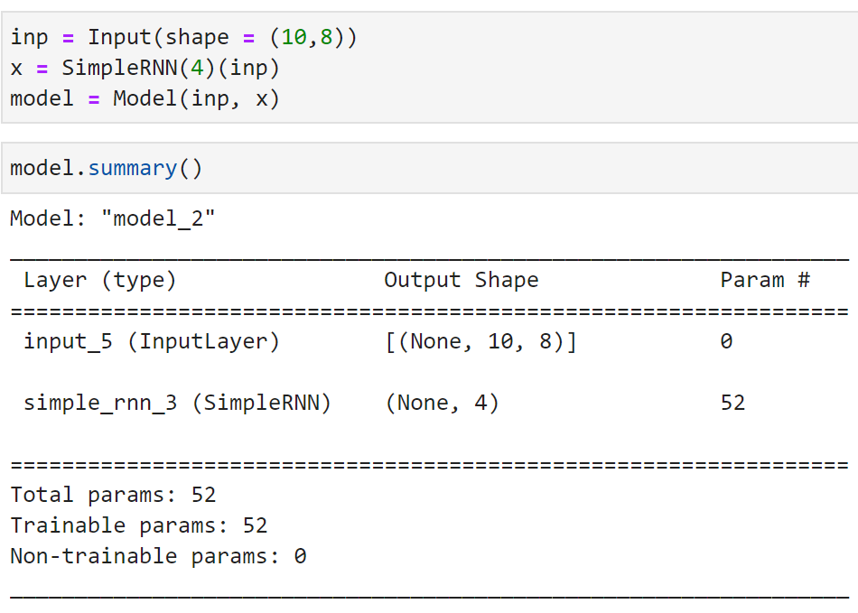
Keras Simple RNN

Slide 9
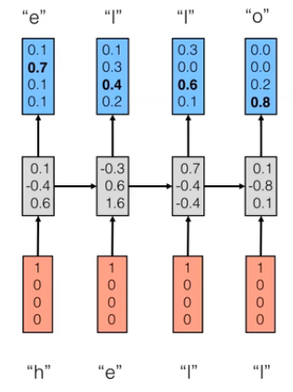
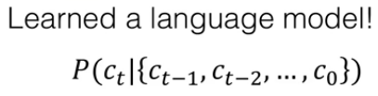
RNN: what is it good for?

Slide 10
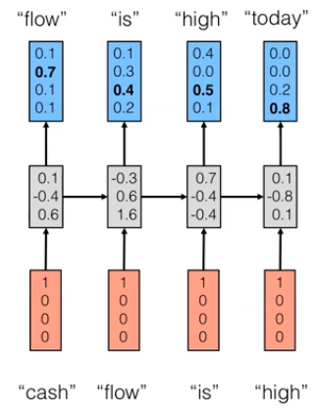
RNN: what is it good for?

Slide 11
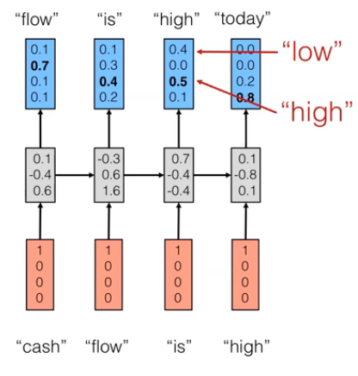
RNN: what is it good for?

Slide 12
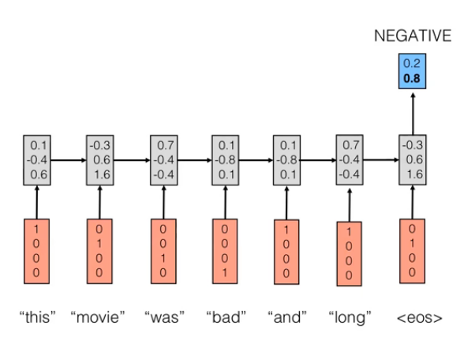
Sentiment analysis

Slide 13
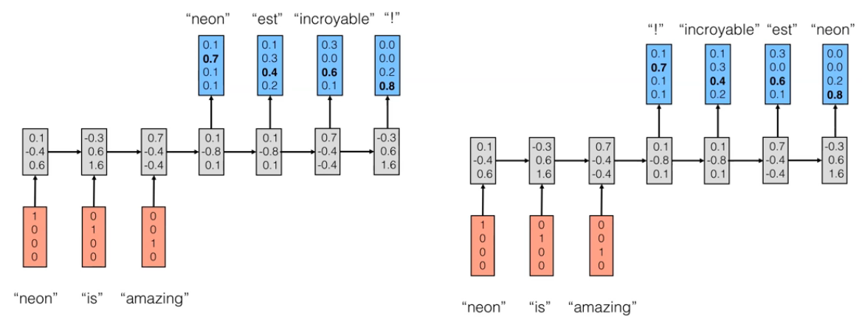
Translation

Slide 14
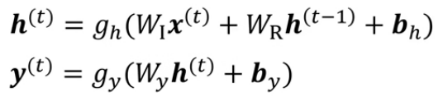
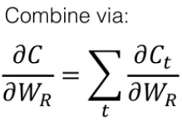

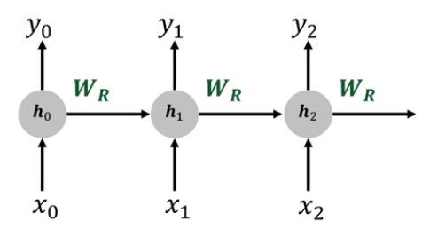
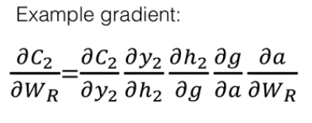
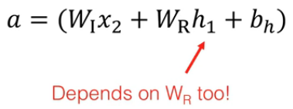
Training an RNN
WI
WI
WI
Notes:
Multiple cost
Shared w

Slide 15
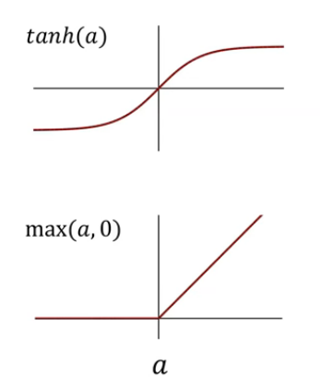
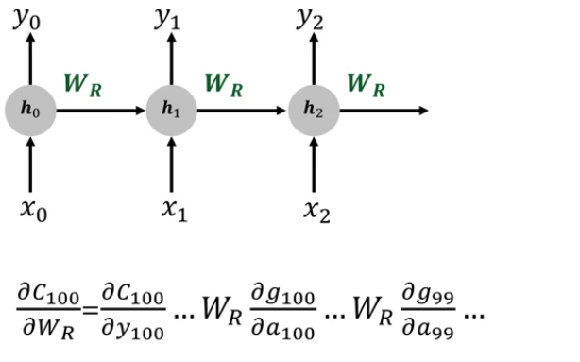

Vanishing / exploding gradient
Notes:
Wr<0 → 0
Wr>0 → inf

Slide 16
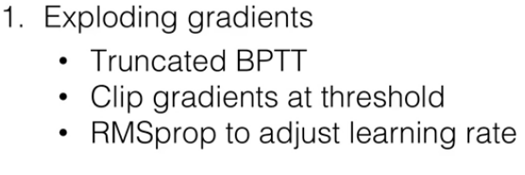
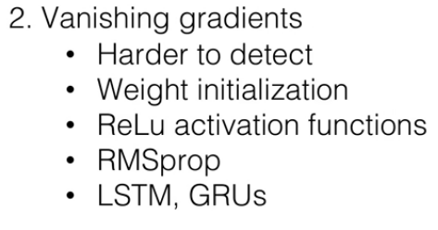
Vanishing / exploding gradient
Notes:
Truncated: Instead of taking all time steps we take few only. The disadv. Is loosing information.
ReLU deriv is one when input is zero. So no small deriv. outputs

Slide 17
Long Short-Term Memory networks (LSTM)
They are capable of learning long-term dependencies.
LSTMs are explicitly designed to avoid the long-term dependency problem.
Remembering information for long periods of time is practically their default behavior, not something they struggle to learn.

Slide 18
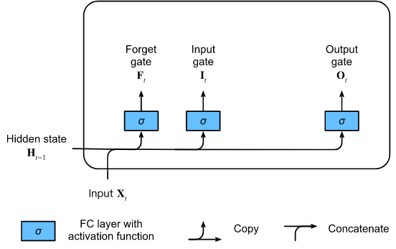
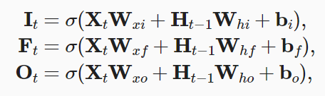
Forget Gate
https://d2l.ai/chapter_recurrent-modern/lstm.html

Slide 19
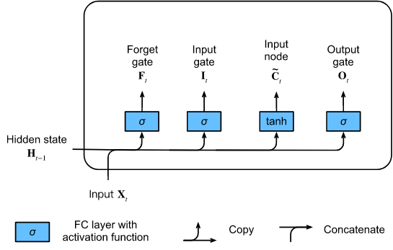

Input Node

Slide 20
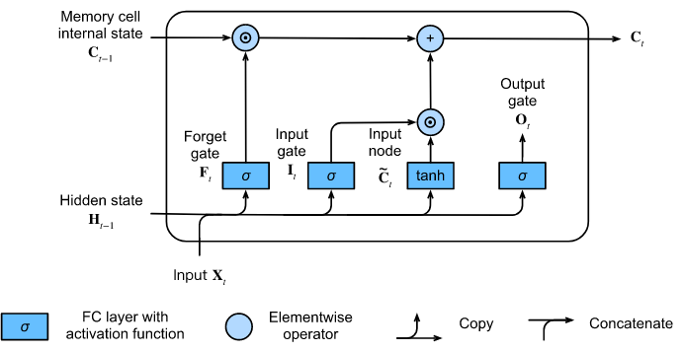

Memory Cell Internal State

Slide 21
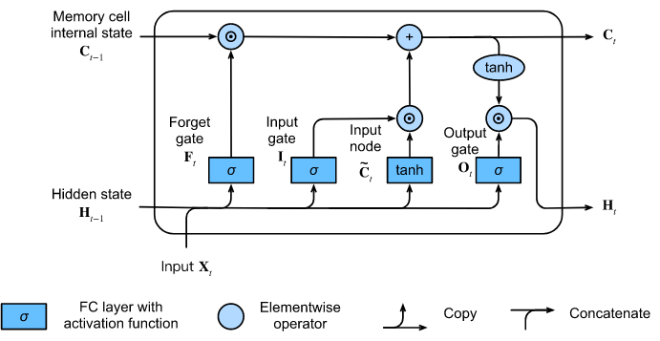

Hidden State

Slide 22
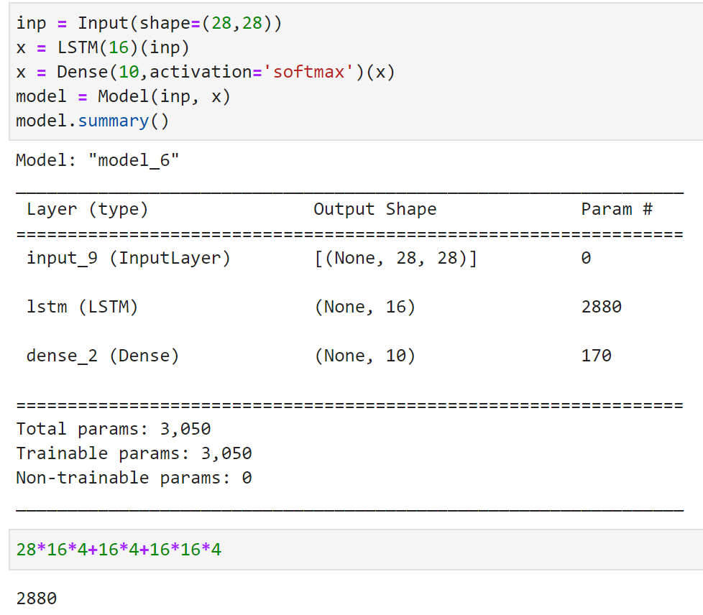
Keras LSTM

Slide 23
Gated Recurrent Units (GRU)
As RNNs and particularly the LSTM architecture rapidly gained popularity during the 2010s, a number of papers began to experiment with simplified architectures in hopes of retaining the key idea of incorporating an internal state and multiplicative gating mechanisms but with the aim of speeding up computation.
The gated recurrent unit (GRU) (Cho et al., 2014) offered a streamlined version of the LSTM memory cell that often achieves comparable performance but with the advantage of being faster to compute (Chung et al., 2014).

Slide 24
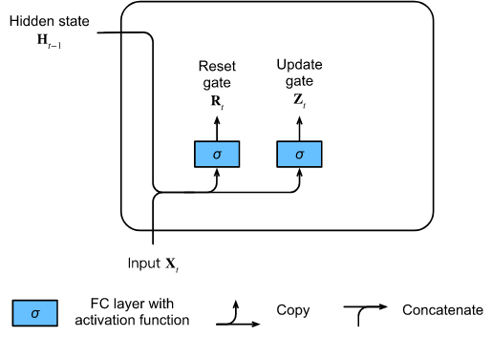

Reset Gate and Update Gate
Here, the LSTM’s three gates are replaced by two: the reset gate and the update gate. As with LSTMs, these gates are given sigmoid activations, forcing their values to lie in the interval. Intuitively, the reset gate controls how much of the previous state we might still want to remember. Likewise, an update gate would allow us to control how much of the new state is just a copy of the old state.
https://d2l.ai/chapter_recurrent-modern/gru.html

Slide 25
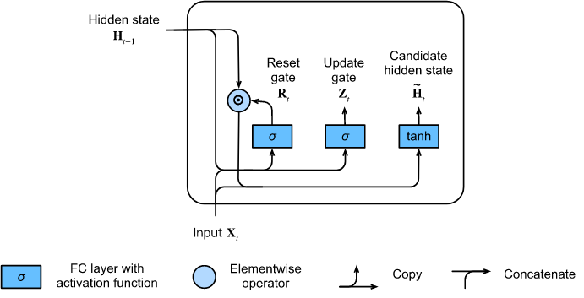
Candidate Hidden State

Slide 26
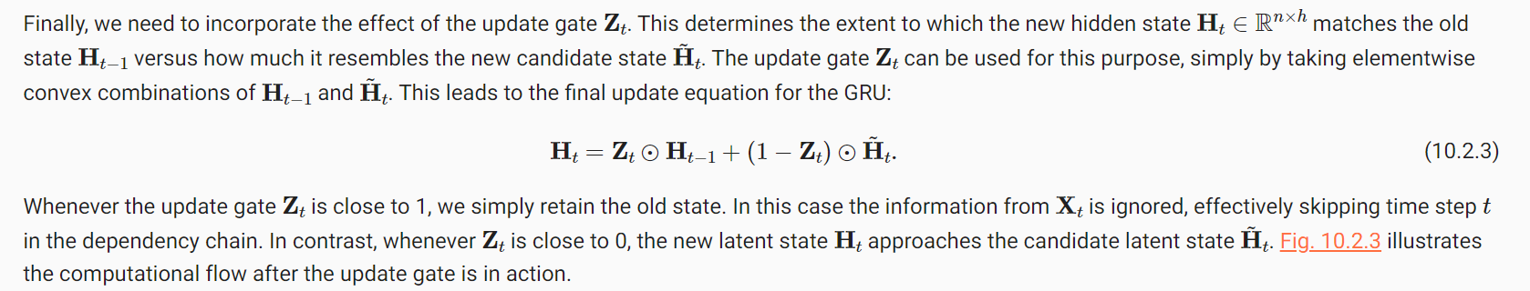
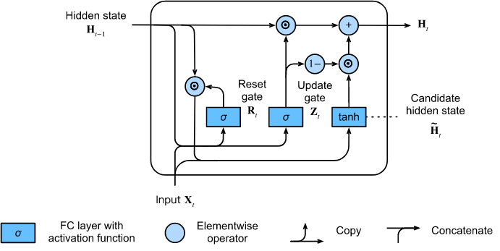

Hidden State

Slide 27
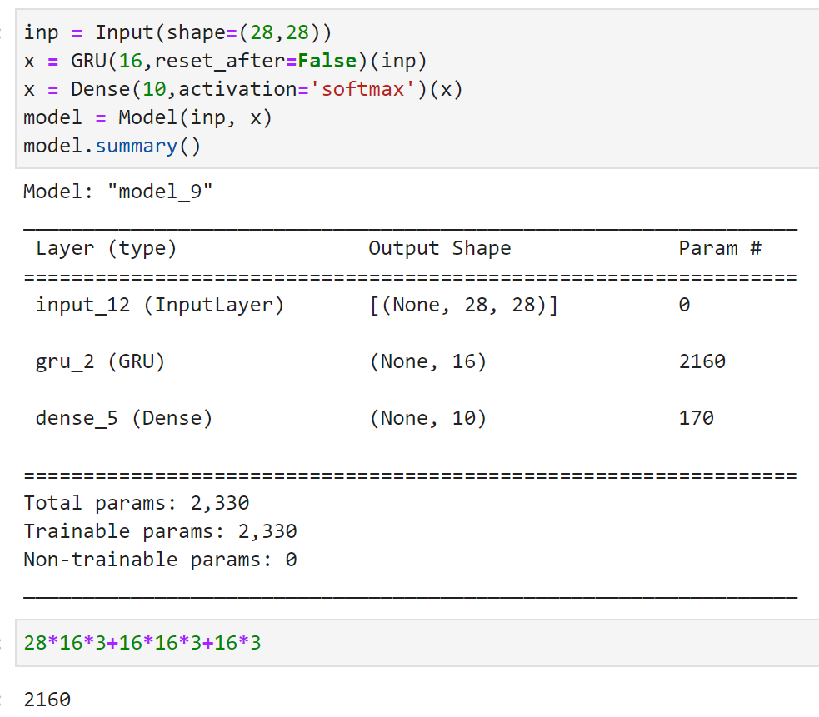
Keras GRU

Slide 28
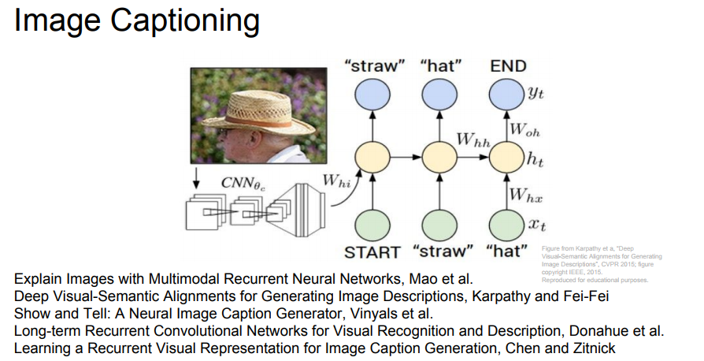
CNN-RNN Example

Slide 29
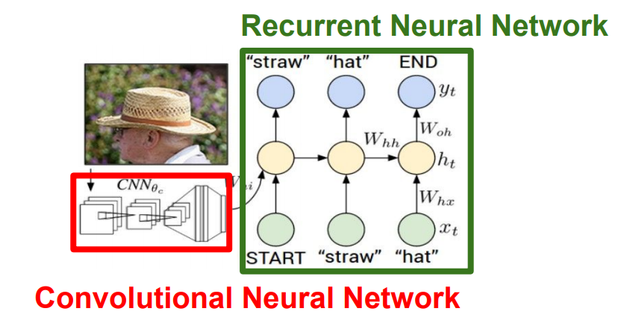
CNN-RNN Example

Slide 30
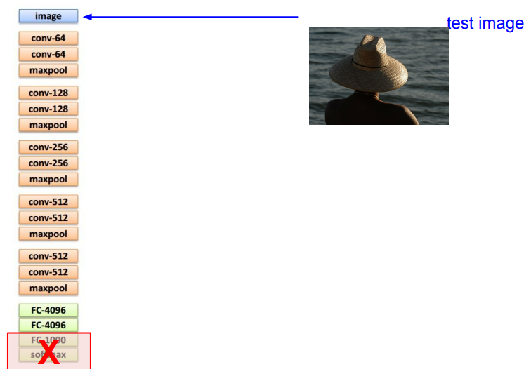
CNN-RNN Example

Slide 31
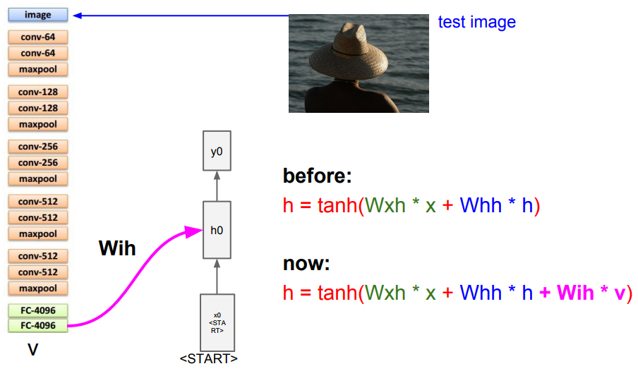
CNN-RNN Example

Slide 32
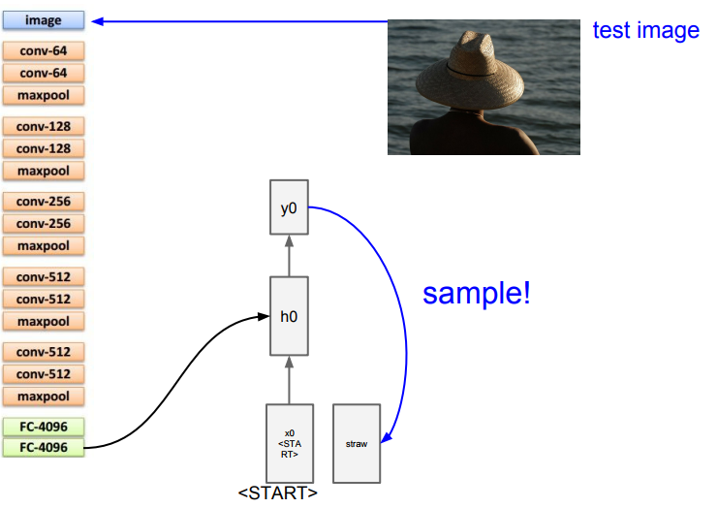
CNN-RNN Example

Slide 33
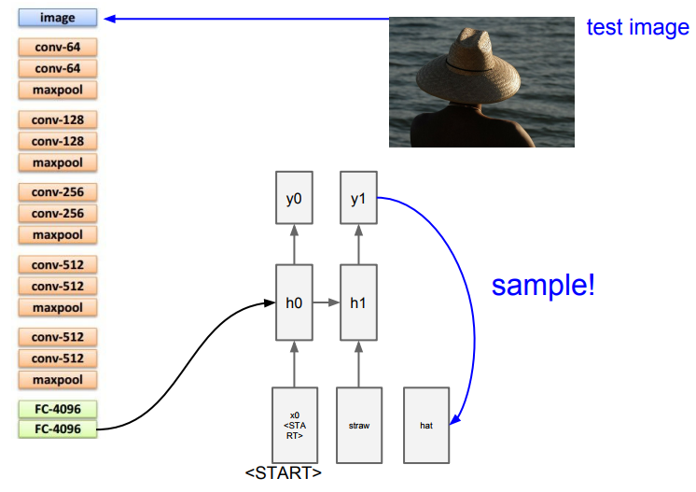
CNN-RNN Example

Slide 34
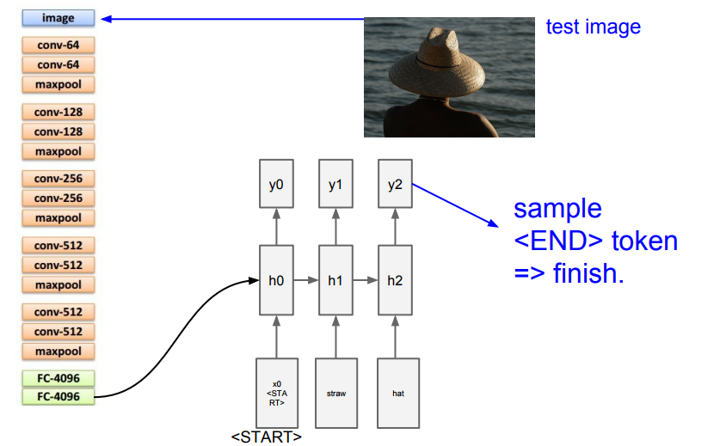
CNN-RNN Example

Slide 35
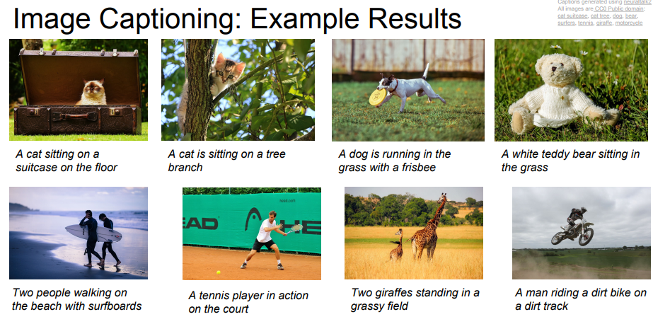
CNN-RNN Example

Slide 36
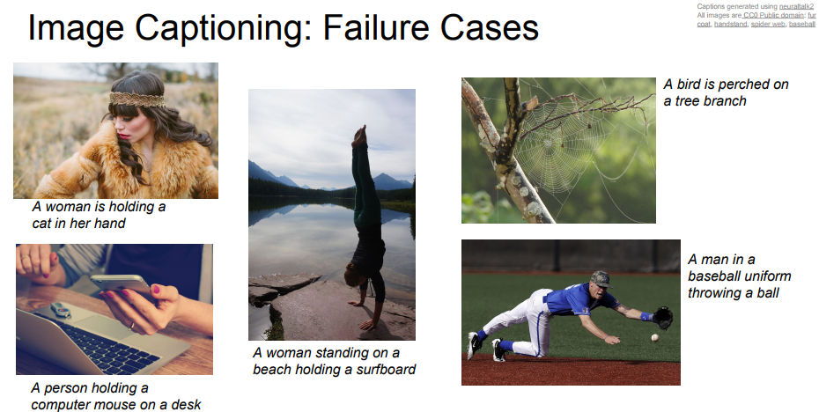
CNN-RNN Example

