Slide 1
Algorithms
Lecture 9

Slide 2
Merge sort
Merge sort
Bottom-up merge sort
Quicksort

Slide 3
Two classic sorting algorithms
Critical components in the world’s computational infrastructure.
Full scientific understanding of their properties has enabled us to develop them into practical system sorts.
Quicksort honored as one of top 10 algorithms of 20th century in science and engineering.
Mergesort
Java sort for objects.
Perl, C++ stable sort, Python stable sort, Firefox JavaScript, ...
Quicksort
Java sort for primitive types.
C qsort, Unix, Visual C++, Python, Matlab, Chrome JavaScript, ...

Slide 4
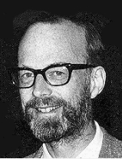
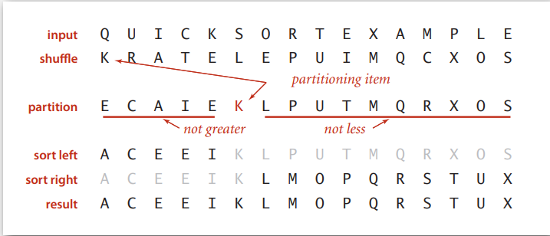
QUICKSORT
Basic plan.
Shuffle the array.
Partition so that, for some j
– entry a[j] is in place
– no larger entry to the left of j
– no smaller entry to the right of j
Sort each piece recursively.
Sir Charles Antony Richard Hoare 1980 Turing Award

Slide 5
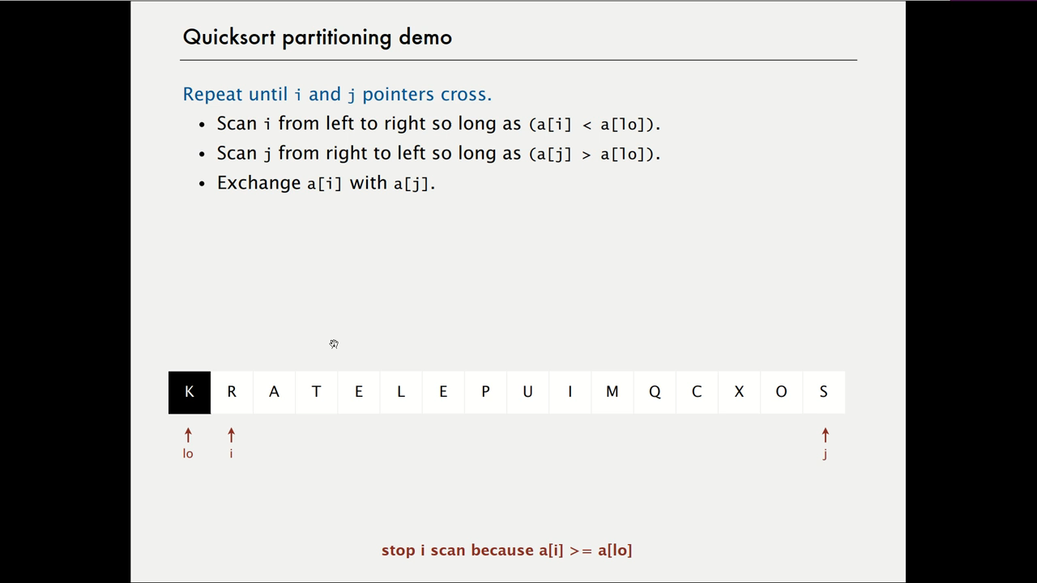
Quicksort partitioning demo
Repeat until i and j pointers cross.
Scan i from left to right so long as (a[i] < a[lo]).
Scan j from right to left so long as (a[j] > a[lo]).
Exchange a[i] with a[j].

Slide 6
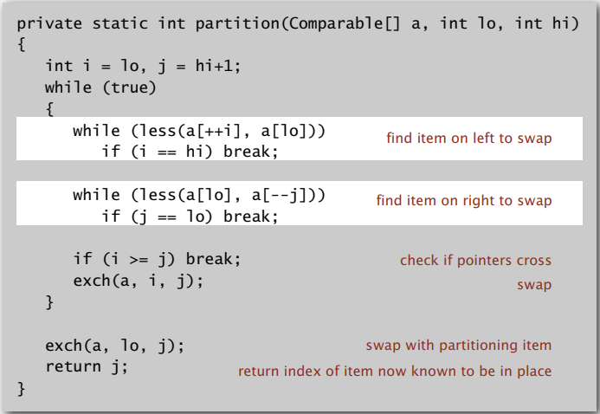
Quicksort: Java code for partitioning

Slide 7
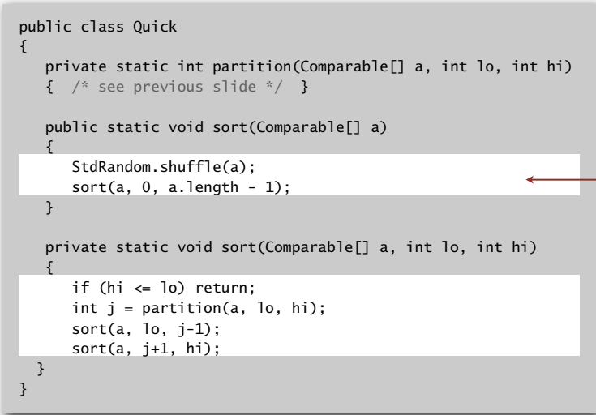
Quicksort: Java implementation
shuffle needed for performance guarantee

Slide 8
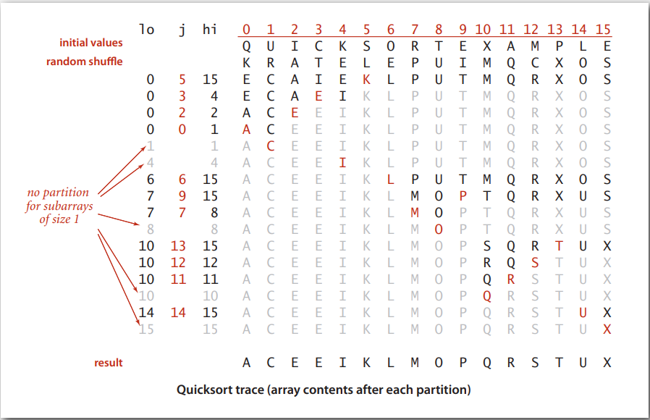
Quicksort trace

Slide 9
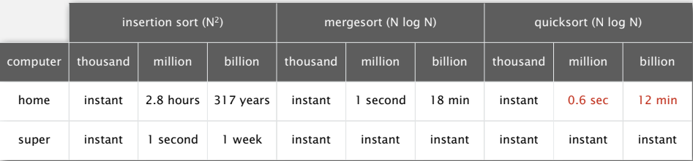
Quicksort: empirical analysis
Running time estimates:
Home PC executes 10⁸ compares/second.
Supercomputer executes 10¹² compares/second.
Lesson 1. Good algorithms are better than supercomputers. Lesson 2. Great algorithms are better than good ones.

Slide 10
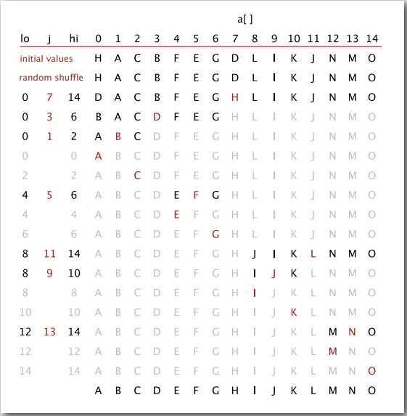
Quicksort: best-case analysis
Best case. Number of compares is ~ N lg N.

Slide 11
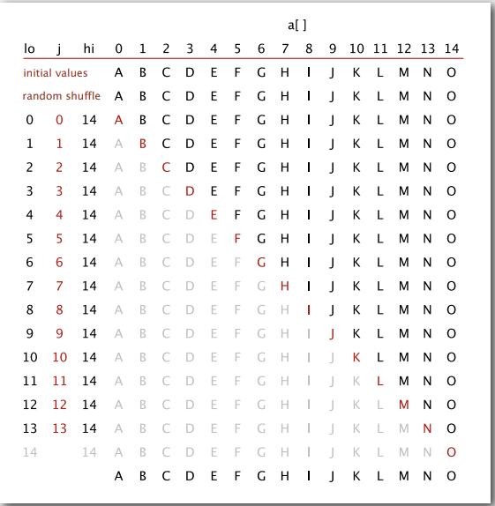
Quicksort: worst-case analysis
Worst case. Number of compares is ~ ½ N ² .

Slide 12
Quicksort: average-case analysis
Proposition. The average number of compares CN to quicksort an array of N distinct keys is ~ 2N lnN (and the number of exchanges is ~ ⅓ N ln N).

Slide 13
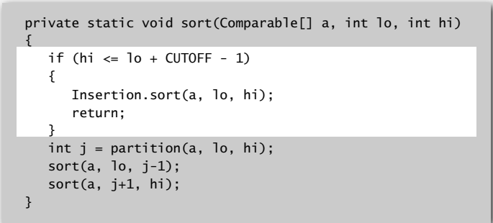
Quicksort: practical improvements
Insertion sort small subarrays.
Even quicksort has too much overhead for tiny subarrays.
Cutoff to insertion sort for ≈ 10 items.
Note: could delay insertion sort until one pass at end.

Slide 14
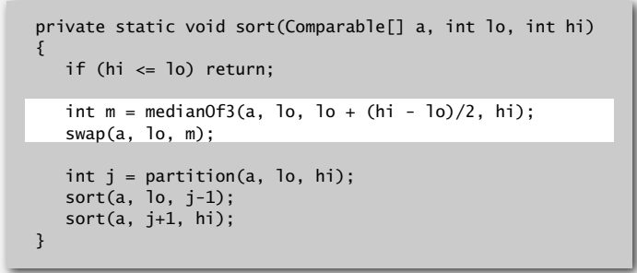
Quicksort: practical improvements
Median of sample.
Best choice of pivot item = median.
Estimate true median by taking median of sample.
Median-of-3 (random) items.
~ 12/7 N ln N compares (slightly fewer) ~ 12/35 N ln N exchanges (slightly more)

Slide 15
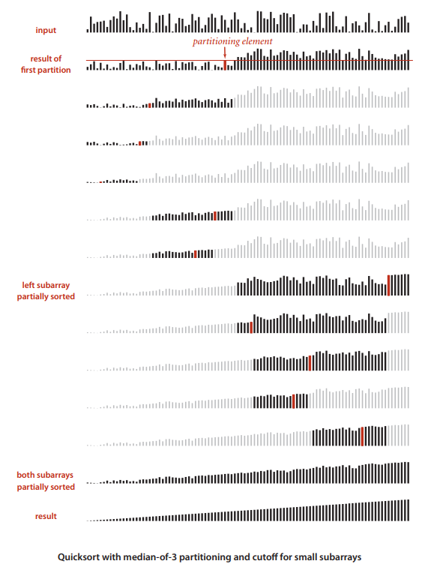
Quicksort with median-of-3 and cutoff to insertion sort: visualization

Slide 16
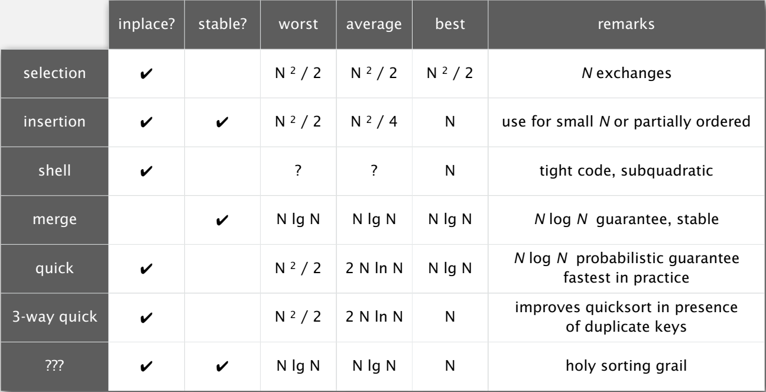
Sorting summary

