Slide 1
GENERATIVE ADVERSARIAL NETWORKS
Artificial Intelligence Lecture 15

Slide 2
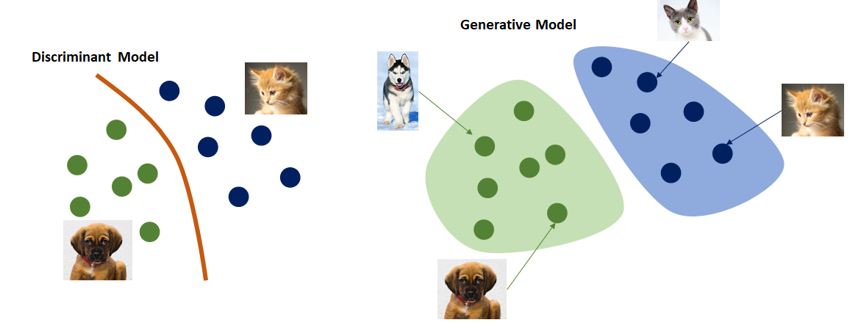
Generative V/S Discriminative

Slide 3
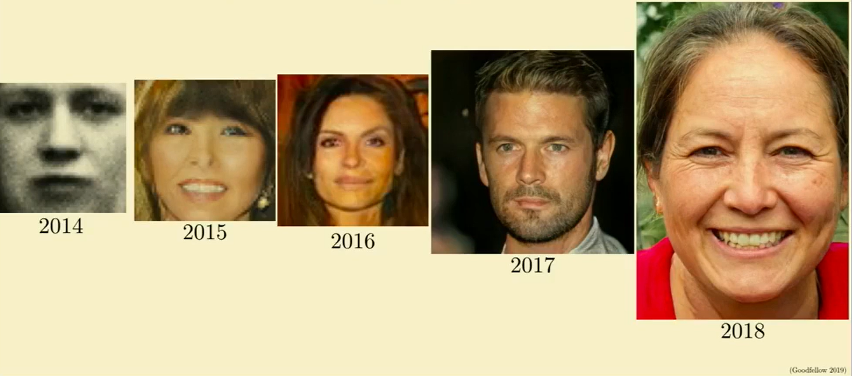
4.5 years progress on faces
4.5 years progress on faces

Slide 4
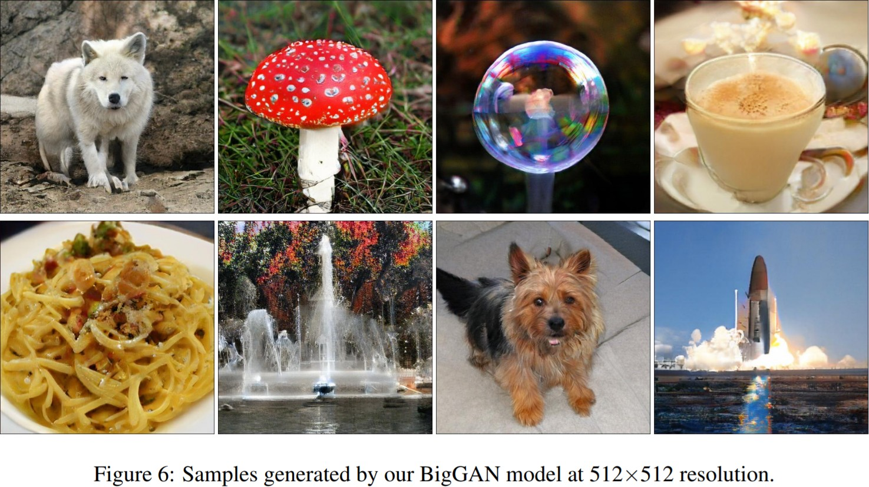
Large Scale GAN Training for High Fidelity Natural Image Synthesis (2019)

Slide 5
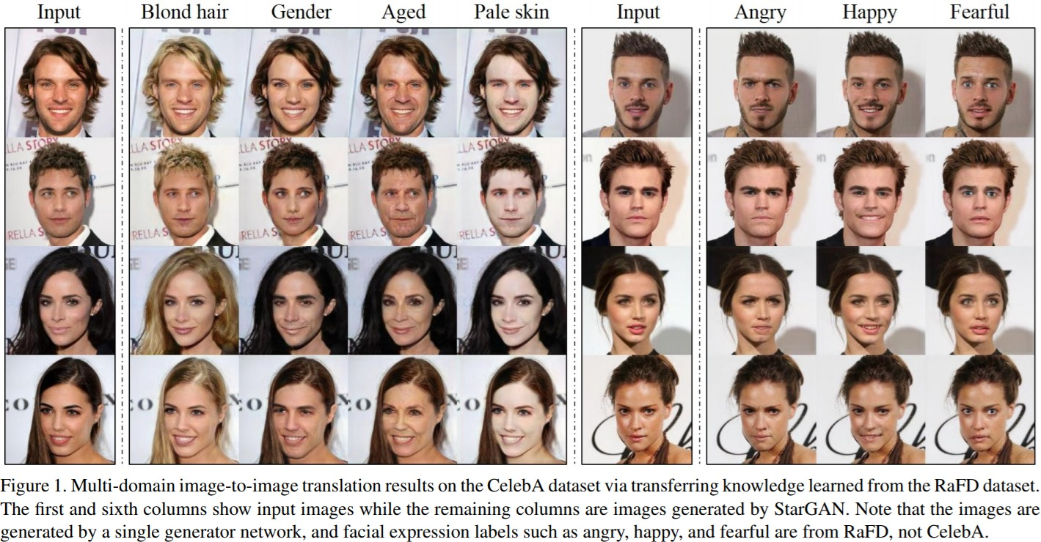
StarGAN (2018)

Slide 6
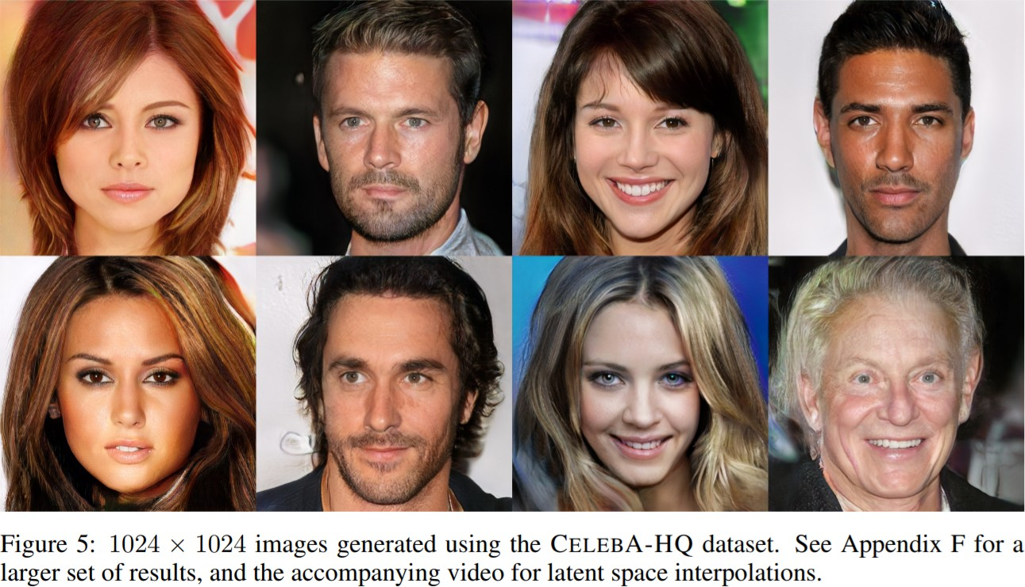
Progressive Growing of GANs (2018)
https://www.youtube.com/watch?v=XOxxPcy5Gr4

Slide 7
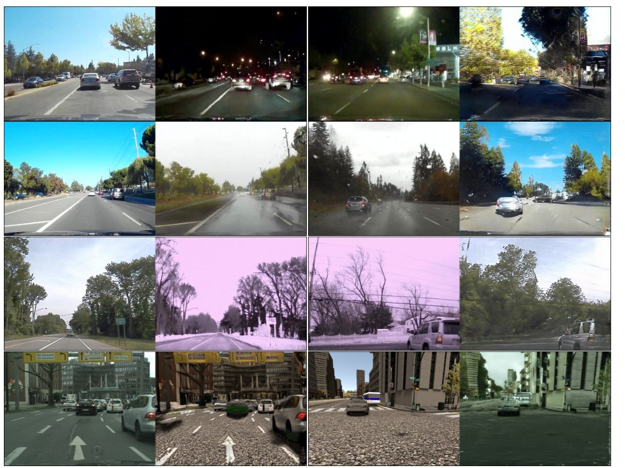
Unsupervised Image to Image Translation (2018)
https://www.youtube.com/watch?v=9VC0c3pndbI

Slide 8
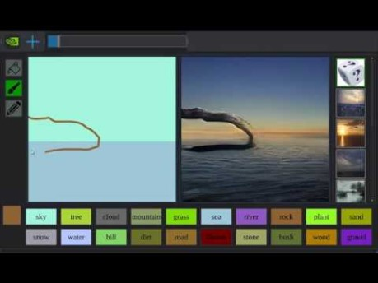

Slide 9
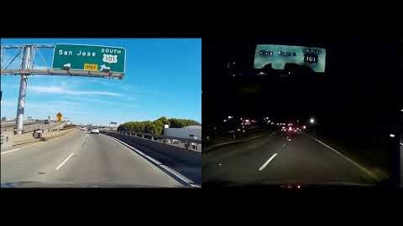

Slide 10
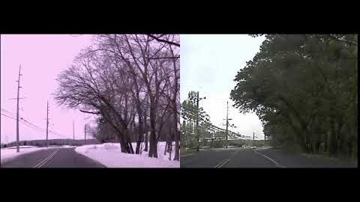

Slide 11
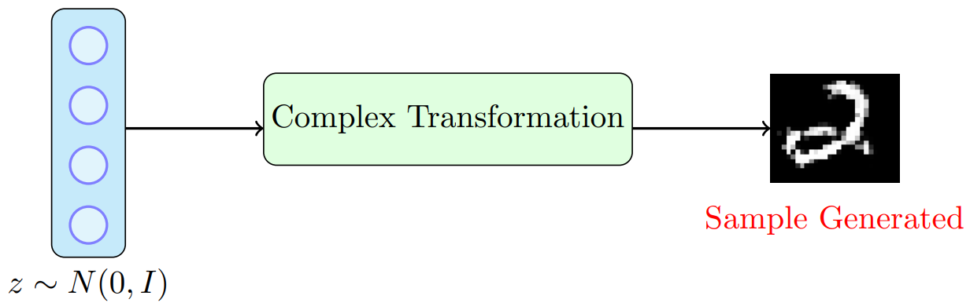
The intuition
GANs’ the idea is to sample from a simple tractable distribution (say, z ∼ N(0, I)) and then learn a complex transformation from this to the training distribution
In other words, we will take a z ∼ N(0, I), learn to make a series of complex transformations on it so that the output looks as if it came from our training distribution

Slide 12
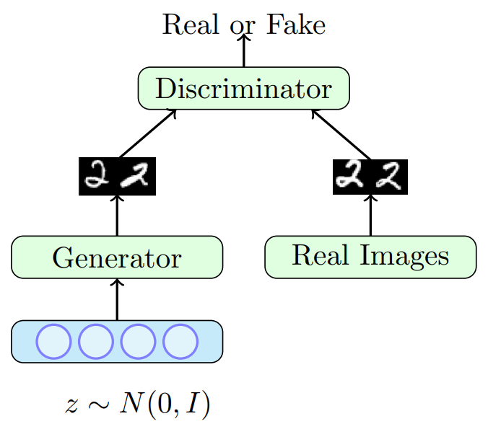
The intuition
What can we use for such a complex transformation?
A Neural Network
How do you train such a neural network?
Using a two player game
There are two players in the game: a generator and a discriminator
The job of the generator is to produce images which look so natural that the discriminator thinks that the images came from the real data distribution
The job of the discriminator is to get better and better at distinguishing between true images and generated (fake) images

Slide 13
The intuition
Let G_{φ} be the generator and D_{θ} be the discriminator (φ and θ are the parameters of G and D, respectively)
We have a neural network based generator which takes as input a noise vector z ∼ N(0, I) and produces G_{φ}(z) = X
We have a neural network based discriminator which could take as input a real X or a generated X = G_{φ}(z) and classify the input as real/fake

Slide 14
The intuition
What should be the objective function of the overall network?
Let’s look at the objective function of the generator first
Given an image generated by the generator as G_{φ}(z) the discriminator assigns a score D_{θ}(G_{φ}(z)) to it
This score will be between 0 and 1 and will tell us the probability of the image being real or fake
For a given z, the generator would want to maximize log D_{θ}(G_{φ}(z)) (log likelihood) or minimize log(1 − D_{θ}(G_{φ}(z)))

Slide 15
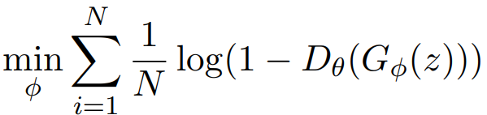
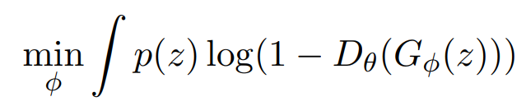

The intuition
This is just for a single z and the generator would like to do this for all possible values of z,
For example, if z was discrete and drawn from a uniform distribution (i.e., p(z) = 1/N ∀z) then the generator’s objective function would be
However, in our case, z is continuous and not uniform (z ∼ N(0, I)) so the equivalent objective function would be

Slide 16
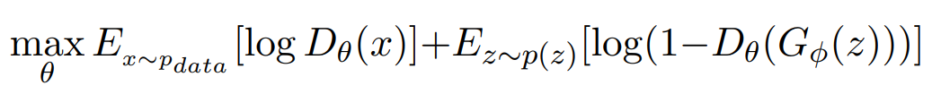
The intuition
Now let’s look at the discriminator
The task of the discriminator is to assign a high score to real images and a low score to fake images
And it should do this for all possible real images and all possible fake images
In other words, it should try to maximize the following objective function

Slide 17
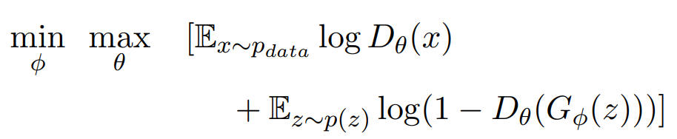
The intuition
If we put the objectives of the generator and discriminator together we get a minimax game
The first term in the objective is only w.r.t. the parameters of the discriminator (θ)
The second term in the objective is w.r.t. the parameters of the generator (φ) as well as the discriminator (θ)
The discriminator wants to maximize the second term whereas the generator wants to minimize it (hence it is a two-player game)

Slide 18

The intuition
So the overall training proceeds by alternating between these two step
Step 1: Gradient Ascent on Discriminator
Step 2: Gradient Descent on Generator
In practice, the above generator objective does not work well and we use a slightly modified objective. Let us see why

Slide 19
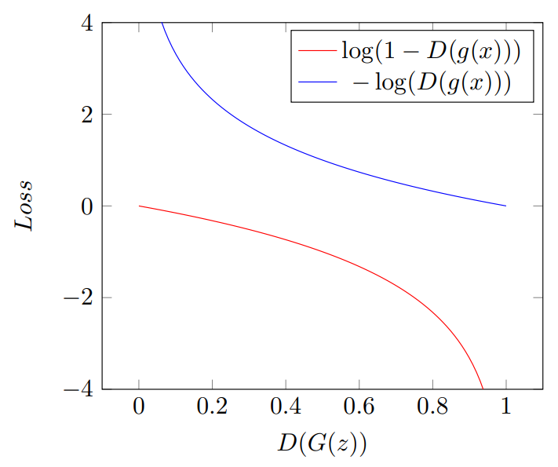
The intuition
When the sample is likely fake, we want to give a feedback to the generator (using gradients)
However, in this region where D(G(z)) is close to 0, the curve of the loss function is very flat and the gradient would be close to 0
Trick: Instead of minimizing the likelihood of the discriminator being correct, maximize the likelihood of the discriminator being wrong
In effect, the objective remains the same but the gradient signal becomes better

Slide 20
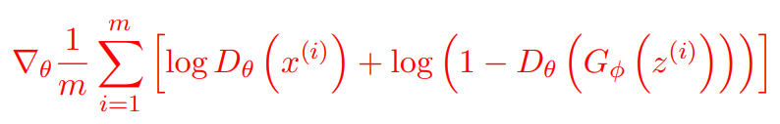
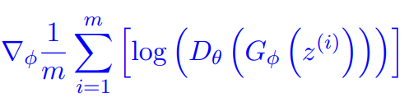
Training GAN
procedure GAN Training
for number of training iterations do
for k steps do
Sample minibatch of m noise samples {z⁽¹⁾ , .., z ^{(m)}} from noise prior p_{g}(z)
Sample minibatch of m examples {x ⁽¹⁾ , .., x ^{(m)}} from data generating distribution p_{data}(x)
Update the discriminator by ascending its stochastic gradient:
end for
Sample minibatch of m noise samples {z⁽¹⁾ , .., z^{(m)}} from noise prior pg(z)
Update the generator by ascending its stochastic gradient
end for
end procedure

Slide 21
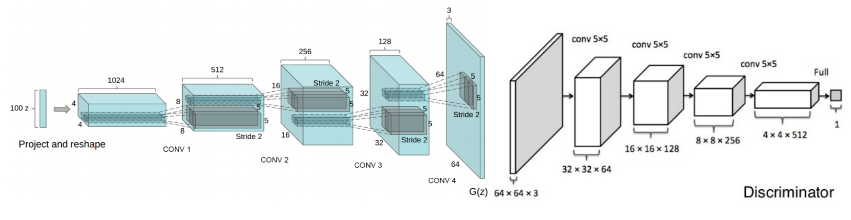
Generative Adversarial Networks Architecture
We will now look at one of the popular neural networks used for the generator and discriminator (Deep Convolutional GANs)
For discriminator, any CNN based classifier with 1 class (real) at the output can be used (e.g. VGG, ResNet, etc.)
Figure: Generator (Redford et al 2015) (left) and discriminator (Yeh et al 2016) (right) used in DCGAN

Slide 22
Generative Adversarial Networks Architecture
Architecture guidelines for stable Deep Convolutional GANs
Replace any pooling layers with strided convolutions (discriminator) and fractional-strided convolutions (generator).
Use batchnorm in both the generator and the discriminator.
Remove fully connected hidden layers for deeper architectures.
Use ReLU or LeakyReLU activation in generator for all layers except for the output, which uses tanh/sigmoid.
Use LeakyReLU activation in the discriminator for all layers

Slide 23
Wasserstein GAN (WGAN) with Gradient Penalty (GP)
Advantages of WGAN:
Better training stability.
Loss has meaning so it helps in termination criteria
Disadvantages of WGAN
Longer to train.
Reading:
https://arxiv.org/abs/1701.07875
https://www.alexirpan.com/2017/02/22/wasserstein-gan.html

Slide 24
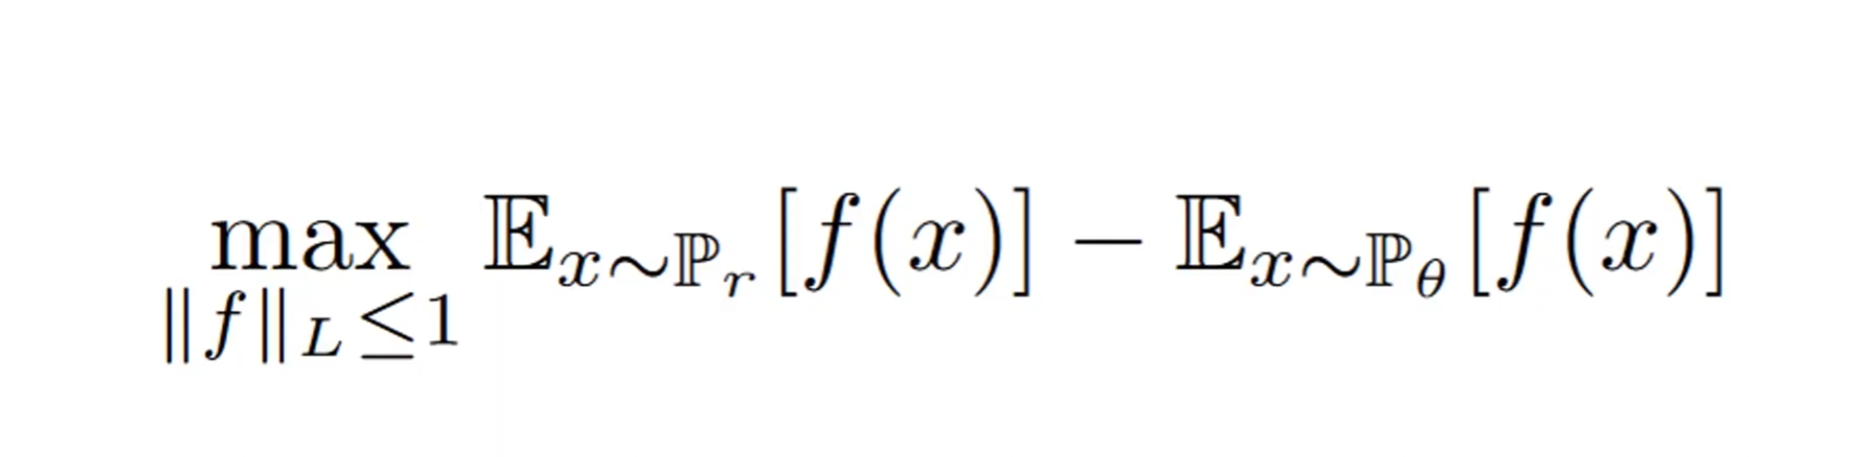
WGAN
Real images
Generator
Constrained on discriminator
Discriminator wants to separate these as much as possible (maximize)
Generator wants to put these close to each other as much as possible (minimize)

Slide 25
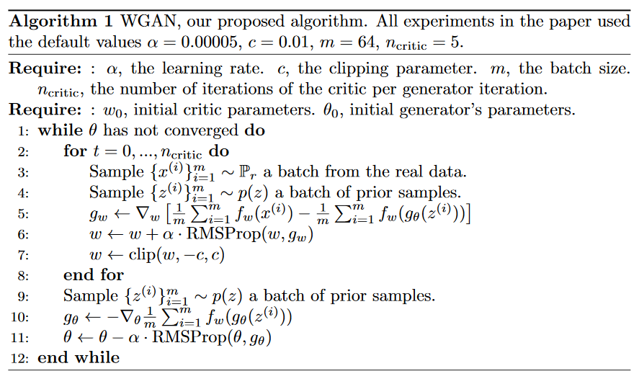
The full algorithm

