Slide 1
Algorithms
Lecture 1
Global Frontier College

Slide 2
Algorithms
Welcome to Algorithms
Lecturer: Hilal Tayara
hilaltayara@jbnu.ac.kr
Office: Global Frontier College, 333
Office hours: Monday 9.00 AM - 10.00 AM
Lectures:
Mon: 10:00-12:00
Wed: 10:00-11:00
Due to Covid-19, we will have non-face-to-face classes
All lectures’ materials are uploaded to new LMS: https://ieilms.jbnu.ac.kr/
You must watch the uploaded videos within a week of upload, so it can be counted attendance.

Slide 3
Course contents
Algorithms: sequence of instructions for solving a problem.
data structures: methods to organize data in a computer.
Topics to be covered in this class:
Data types: (stack, queue, union–find, priority queue)
Sorting: (quicksort, mergesort, heapsort, radix sorts)
Searching: (BST, red–black BST, hash table, kd-tree)
Graphs: (BFS, DFS, Prim, Kruskal, Dijkstra, maxflow)
Strings: (tries, KMP, regexp, suffix arrays, data compression)
Dynamic programming

Slide 4
Grading
Tentative and subject to change
Midterm 25%
Final 35%
Assignments, projects 30%
Attendance 10%

Slide 5
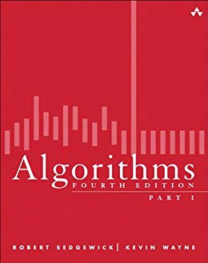
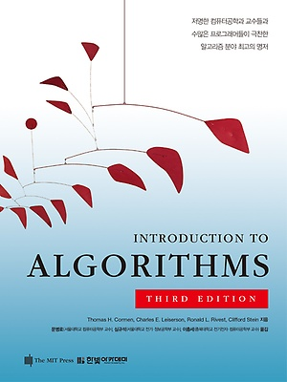
Books
Robert Sedgewick and Kevin Wayne
Thomas H. Cormen, Charles E. Leiserson, Ronald L. Rivest, and Clifford Stein.

Slide 6
Java
https://algs4.cs.princeton.edu/home/
C++
https://github.com/KanRobert/algorithmcpp
Python
https://github.com/shellfly/algs4-py

Slide 7
Algorithms
Sequence of instructions for solving a problem.
A process or set of rules to be followed in calculations or other problem-solving operations, especially by a computer.
The word algorithm itself is derived from the 9th-century Persian mathematician Muḥammad ibn Mūsā al-Khwārizmī.
Al-Khwārizmī's contributions to mathematics, geography, astronomy, and cartography established the basis for innovation in algebra and trigonometry.

Slide 8
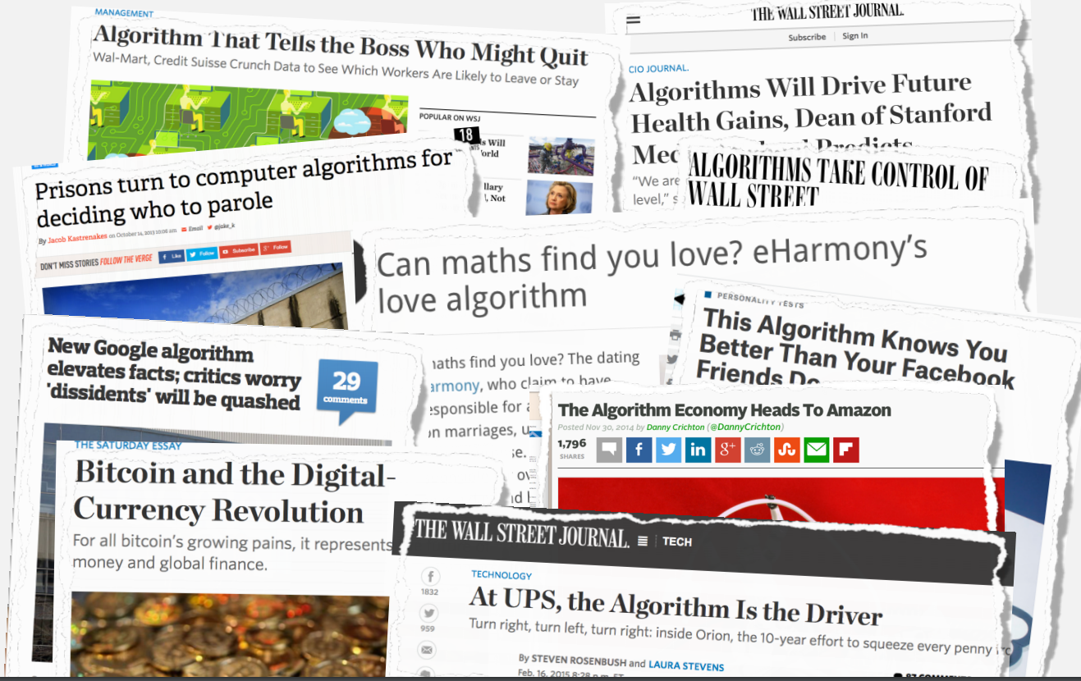
Why to study algorithms and data structures?
Their impact is broad and far-reaching.
Credit: https://www.cs.princeton.edu/courses/archive/spring20/cos226/

Slide 9

Why to study algorithms and data structures?
They may unlock the secrets of life and of the universe.
Parallel N-body simulation using 32 GPUs
https://www.youtube.com/watch?v=ua7YlN4eL_w

Slide 10
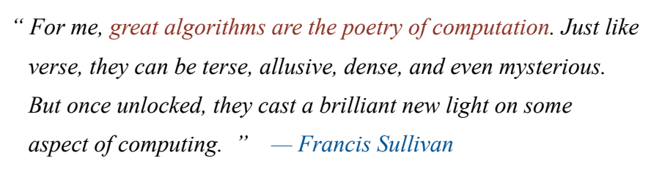
Why to study algorithms and data structures?

Slide 11
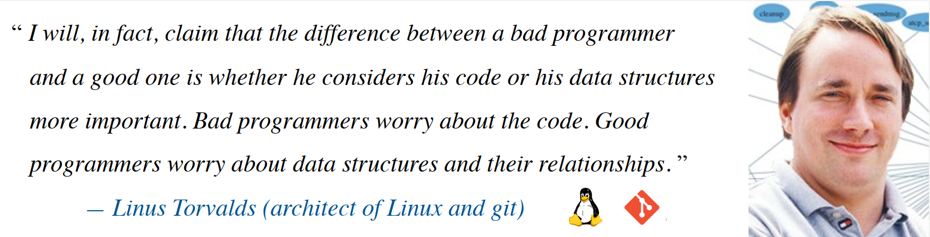
Why to study algorithms and data structures?

Slide 12

Why to study algorithms and data structures?

Slide 13
Why to study algorithms and data structures?
Algorithms help us to understand scalability.
Performance often draws the line between what is feasible and what is impossible.
Algorithmic mathematics provides a language for talking about program behavior.
The lessons of program performance generalize to other computing resources.
Speed is fun!

Slide 14
Steps to developing a usable algorithm.
Model the problem.
Find an algorithm to solve it.
Fast enough? Fits in memory?
If not, figure out why.
Find a way to address the problem.
Iterate until satisfied.

Slide 15
Steps to developing a usable algorithm.
Model the problem
Design the algorithm
Try again
Analyze and understand why it is not efficient
efficient
No
yes
Solve the problem

Slide 16
Thank you

