Slide 1
Introduction to Bioinformatics
Lecture 2

Slide 2
Sequence Analysis

Slide 3
Genomes change over time
begin
C | G | T | A | C | C | G | A | A | T
mutation
C | G | T | A | G | C | G | A | A | T
deletion
C | X | T | A | C | C | G | A | X | T
Insert
A | C | T | A | C | C | G | A | T
End
A | C | T | A | C | C | G | A | T

Slide 4
Genomes change over time
begin
C | G | T | A | C | C | G | A | A | T
mutation
?
End
A | C | T | A | C | C | G | A | T

Slide 5
Pairwise sequence alignment
Sequences can differ in three ways
Substitutions ACGA → AGGA
Insertions ACGA → ACCGA
Deletions ACGA → AGA
Insertion or deletion result in gap
Substitution results in mismatch
Notes:
By applying all above ways to any sequence the matching and mismatching can be increased or
decreased between to different comparing sequencing.
Both local and Global ways of alignments give us different results.
But among above Substitution increases mismatch of sequence.

Slide 6
Dot Plots
dot plot is a graphical method for comparing two biological sequences and identifying regions of close similarity after sequence alignment.
Global similarity between the two sequences.
helps us to visualize the alignments of sequences
sequence repeats appear as diagonal stacks in plot

Slide 7
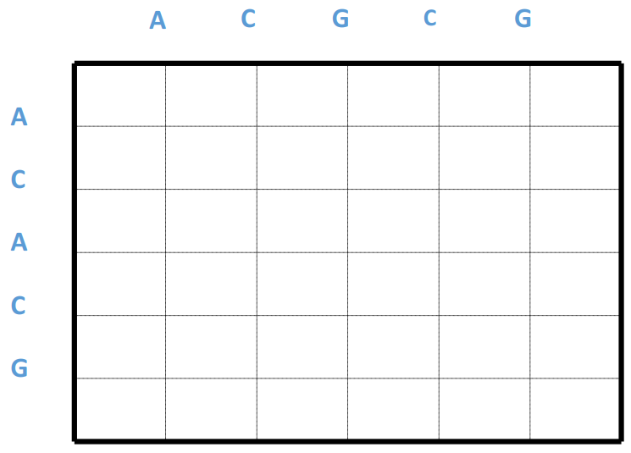
Dot Plots
Dots on diagonal repeats the alignments and separate one give difference to the sequence.

Slide 8
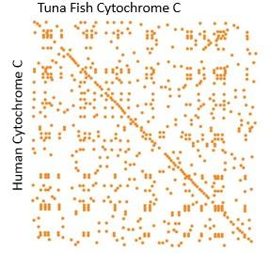
Dot Plots

Slide 9
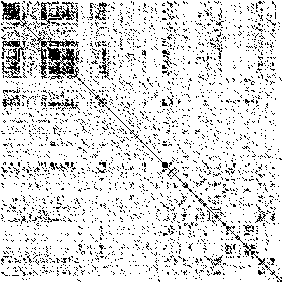
Dot Plots
A DNA dot plot of a human zinc finger transcription factor (GenBank ID NM_002383), showing regional self-similarity.
We can reduce the noise by selecting the diagonals that are more than a threshold.

Slide 10
Identity vs Similarity
Identity: means the counting number of nucleotides or amino acids which exactly match when two biological sequences are matched.
S1: ACCUGAC
S2: ACCUG
len(S1) = 7, len(S2)=5
Identity= No. of Matches / smaller length × 100 = 5/5 × 100=100%
Similarity: means the comparison between two different sequences calculated by alignment approach.
How to go from S1 to S2?

Slide 11
Sequence Alignment
Procedure of comparing two (pairwise) or more (multiple) sequences by searching for a series of individual characters that are in the same order in the sequences
GCTAGTCAGATCTGACGCTA
| |||| ||||| ||| TGGTCACATCTGCCGC

Slide 12
Sequence Alignment
Procedure of comparing two (pairwise) or more (multiple) sequences by searching for a series of individual characters that are in the same order in the sequences
VLSPADKTNVKAAWGKVGAHAGYEG
||| | | | || | || VLSEGDWQLVLHVWAKVEADVAGEG

Slide 13
Homology
In biology, homology is similarity due to shared ancestry between a pair of structures or genes in different scientifically classified group or entity (taxa).
Orthologs
Divergence follows speciation
Similarity can be used to construct phylogeny between species
Paralogs
Divergence follows duplication
Notes:
"By definition, orthologs are genes that are related by vertical descent from a common ancestor and encode proteins with the same function in different species. By contrast, paralogs are homologous genes that have evolved by duplication and code for protein with similar, but not identical functions

Slide 14
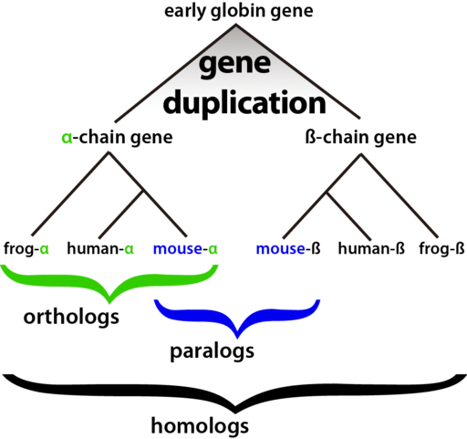
Orthologs and paralogs

Slide 15
Sources of variation
Nucleotide substitution
Replication error
Chemical reaction
Insertions or deletions (indels)
Unequal crossing over
Replication slippage
Duplication
a single gene (complete gene duplication)
part of a gene (internal or partial gene duplication)
Domain duplication
Exon shuffling
part of a chromosome (partial polysomy)
an entire chromosome (aneuploidy or polysomy)
the whole genome (polyploidy)

Slide 16
Common assumptions
All nucleotide sites change independently
The substitution rate is constant over time and in different lineages
The base composition is at equilibrium
The conditional probabilities of nucleotide substitutions are the same for all sites, and do not change over time
Most of these are not true in many cases…

Slide 17
A simple alignment
Let us try to align two short nucleotide sequences:
– AATCTATA and AAGATA
Without considering any gaps (insertions/deletions) there are 3 possible ways to align these sequences
AATCTATA AAGATA
AATCTATA AAGATA
AATCTATA AAGATA
Which one is better?

Slide 18
What is a good alignment?
AGGCTAGTT, AGCGAAGTTT
AGGCTAGTT- 6 matches, 3 mismatches, 1 gap
AGCGAAGTTT
AGGCTA-GTT- 7 matches, 1 mismatch, 3 gaps
AG-CGAAGTTT
AGGC-TA-GTT-
7 matches, 0 mismatches, 5 gaps
AG-CG-AAGTTT

Slide 19
Scoring the alignments
We need to have a scoring mechanism to evaluate alignments
match score
mismatch score
We can have the total score as:
n
∑match or mismatch score at position i
i=1
For the simple example, assume a match score
of 1 and a mismatch score of 0:
AATCTATA AAGATA
4
AATCTATA AAGATA
1
AATCTATA AAGATA
3

Slide 20
Good alignments require gaps
Maximal consecutive run of spaces in alignment
Matching mRNA (cDNA) to DNA
Shortening of DNA/protein sequences
Slippage during replication
Unequal crossing-over during meiosis
– …
We need to have a scoring function that considers gaps also

Slide 21
Simple alignment with gaps
Considering gapped alignments vastly increases the number of possible alignments:
AATCTATA AATCTATA AATCTATA
AAG-AT-A
1
AA-G-ATA
3
AA--GATA
3
If gap penalty is -1 what will be the new scores?

Slide 22
Scoring Function
Sequence edits:
AGGCCTC
Alternative definition:
minimal edit distance
Mutations
Insertions
Deletions
AGGACTC AGGGCCTC AGG . CTC
“Given two strings x, y, find minimum # of edits (insertions, deletions, mutations) to transform one string to the other
Scoring Function:
Match: +m Mismatch: -s Gap: -d
Score F = (# matches) × m - (# mismatches) × s – (#gaps) × d

Slide 23
More complicated gap penalties
Nature favors small number of long gaps compared to large number of short gaps.
How do we adjust our scoring scheme to account for this fact above?
By having different gap opening and gap extension penalties.
Choices of gap penalties
Linear
Affine
Gap open penalty
Gap extension penalty
Arbitrary

Slide 24
Score matrix
Instead of having a single match/mismatch score for every pair of nucleotides or amino acids, consider chemical, physical, evolutionary relationships:
E.g.
alanine vs. valine or alanine vs. lysine? Alanine and valine are both small and hydrophobic, but lysine is large and charged.
which substitutions occur more in nature?
Assign scores to each pair of symbol
Higher score means more similarity

Slide 25
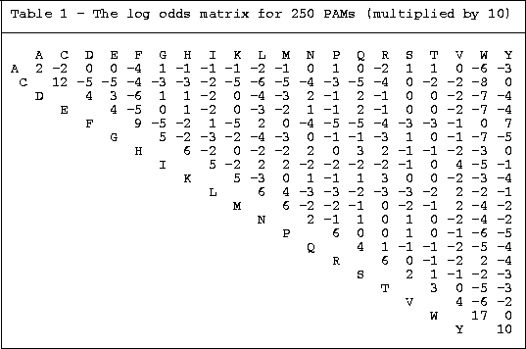

Slide 26
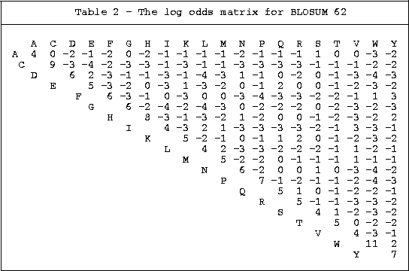

Slide 27
Major Differences between PAM and BLOSUM
PAM
BLOSUM
Built from global alignments
Built from local alignments
Built from small amout of Data
Built from vast amout of Data
Counting is based on minimum replacement or maximum parsimony
Counting based on groups of related sequences counted as one
Perform better for finding global
alignments and remote homologs
Better for finding local
alignments
Higher PAM series means more
divergence
Lower BLOSUM series means
more divergence

