Slide 1
Introduction to Bioinformatics
Lecture 3

Slide 2
Sequence Alignment
Procedure of comparing two (pairwise) or more (multiple) sequences by searching for a series of individual characters that are in the same order in the sequences
GCTAGTCAGATCTGACGCTA
| |||| ||||| ||| TGGTCACATCTGCCGC

Slide 3
Sequence Alignment
Procedure of comparing two (pairwise) or more (multiple) sequences by searching for a series of individual characters that are in the same order in the sequences
VLSPADKTNVKAAWGKVGAHAGYEG
||| | | | || | || VLSEGDWQLVLHVWAKVEADVAGEG

Slide 4
Homology
In biology, homology is similarity due to shared ancestry between a pair of structures or genes in different scientifically classified group or entity (taxa).
Orthologs
Divergence follows speciation
Similarity can be used to construct phylogeny between species
Paralogs
Divergence follows duplication

Slide 5
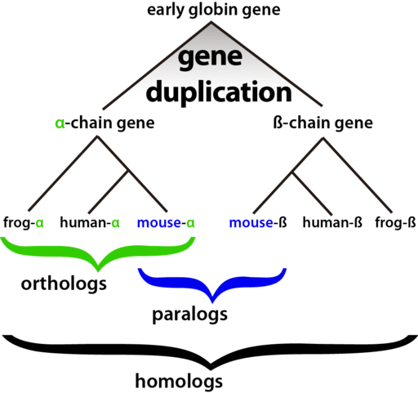
Orthologs and paralogs

Slide 6
Sources of variation
Nucleotide substitution
Replication error
Chemical reaction
Insertions or deletions (indels)
Unequal crossing over
Replication slippage
Duplication
a single gene (complete gene duplication)
part of a gene (internal or partial gene duplication)
Domain duplication
Exon shuffling
part of a chromosome (partial polysomy)
an entire chromosome (aneuploidy or polysomy)
the whole genome (polyploidy)

Slide 7
Common assumptions
All nucleotide sites change independently
The substitution rate is constant over time and in different lineages
The base composition is at equilibrium
The conditional probabilities of nucleotide substitutions are the same for all sites, and do not change over time
Most of these are not true in many cases…

Slide 8
A simple alignment
Let us try to align two short nucleotide sequences:
– AATCTATA and AAGATA
Without considering any gaps (insertions/deletions) there are 3 possible ways to align these sequences
AATCTATA AAGATA
AATCTATA AAGATA
AATCTATA AAGATA
Which one is better?

Slide 9
What is a good alignment?
AGGCTAGTT, AGCGAAGTTT
AGGCTAGTT- 6 matches, 3 mismatches, 1 gap
AGCGAAGTTT
AGGCTA-GTT- 7 matches, 1 mismatch, 3 gaps
AG-CGAAGTTT
AGGC-TA-GTT-
7 matches, 0 mismatches, 5 gaps
AG-CG-AAGTTT

Slide 10
Scoring the alignments
We need to have a scoring mechanism to evaluate alignments
match score
mismatch score
We can have the total score as:
∑match or mismatch score at position i
i=1
For the simple example, assume a match score
of 1 and a mismatch score of 0:
n
AATCTATA AAGATA
4
AATCTATA AAGATA
1
AATCTATA AAGATA
3

Slide 11
Good alignments require gaps
Maximal consecutive run of spaces in alignment
Matching mRNA (cDNA) to DNA
Shortening of DNA/protein sequences
Slippage during replication
Unequal crossing-over during meiosis
– …
We need to have a scoring function that considers gaps also

Slide 12
Simple alignment with gaps
Considering gapped alignments vastly increases the number of possible alignments:
AATCTATA AATCTATA AATCTATA
AAG-AT-A
1
AA-G-ATA
3
AA--GATA
3
If gap penalty is -1 what will be the new scores?

Slide 13
Scoring Function
Sequence edits:
AGGCCTC
Alternative definition:
minimal edit distance
Mutations
Insertions
Deletions
AGGACTC AGGGCCTC AGG . CTC
“Given two strings x, y, find minimum # of edits (insertions, deletions, mutations) to transform one string to the other
Scoring Function:
Match: +m Mismatch: -s Gap: -d
Score F = (# matches) × m - (# mismatches) × s – (#gaps) × d

Slide 14
More complicated gap penalties
Nature favors small number of long gaps compared to large number of short gaps.
How do we adjust our scoring scheme to account for this fact above?
By having different gap opening and gap extension penalties.
Choices of gap penalties
Linear
Affine
Gap open penalty
Gap extension penalty
Arbitrary

Slide 15
Score matrix
Instead of having a single match/mismatch score for every pair of nucleotides or amino acids, consider chemical, physical, evolutionary relationships:
E.g.
alanine vs. valine or alanine vs. lysine? Alanine and valine are both small and hydrophobic, but lysine is large and charged.
which substitutions occur more in nature?
Assign scores to each pair of symbol
Higher score means more similarity

Slide 16
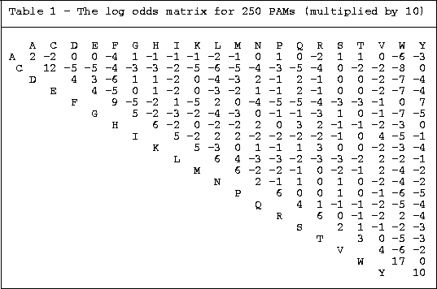

Slide 17
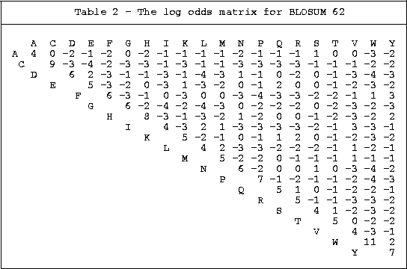

Slide 18
Major Differences between PAM and BLOSUM
PAM
BLOSUM
Built from global alignments
Built from local alignments
Built from small amout of Data
Built from vast amout of Data
Counting is based on minimum replacement or maximum parsimony
Counting based on groups of related sequences counted as one
Perform better for finding global
alignments and remote homologs
Better for finding local
alignments
Higher PAM series means more
divergence
Lower BLOSUM series means
more divergence

Slide 19
Typical score matrix
DNA
Match = +1
Mismatch = -3
Gap penalty = -5
Gap extension penalty = -2
Protein sequences
Blossum62 matrix
Gap open penalty = -11
Gap extension = -1

Slide 20
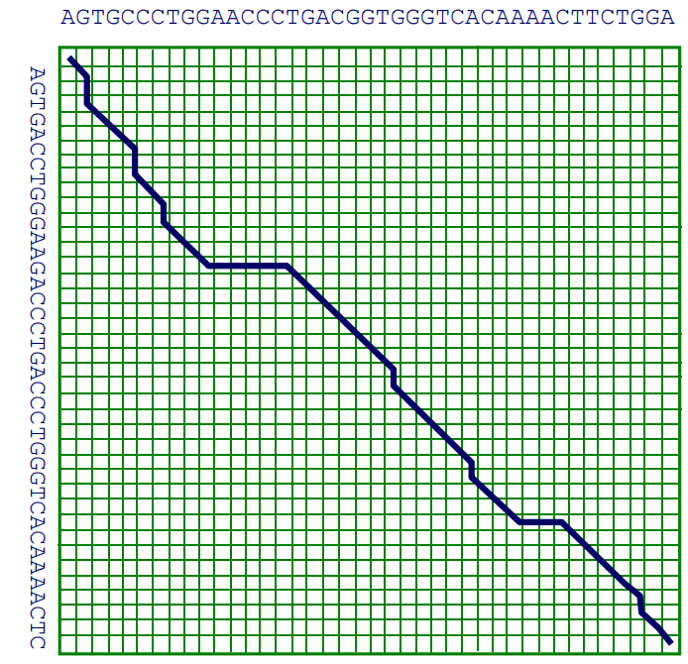
How do we compute the best alignment?

Slide 21
Alignment is additive
Observation: The score of aligning
x₁……x_{M}
y₁…… y_{N}
is additive Say that
x₁…x_{i} x_{i+1}…x_{M} aligns to aligns y₁…y_{j} y_{j+1}…y_{N}
The two scores add up:
F(x[1:M], y[1:N]) = F(x[1:i], y[1:j]) + F(x[i+1:M], y[j+1:N])

Slide 22
Types of alignment Types of alignment
Global (Needleman & Wunsch)
Strings of similar size
Genes with a similar structure
Larger regions with a preserved order (syntenic regions)
Local (Smith & Waterman)
Finding similar regions among
Dissimilar regions
Sequences of different lengths

Slide 23
Dynamic programming
Instead of evaluating every possible alignment, we can create a table of partial scores by breaking the alignment problem into subproblems.
Consider two sequences CACGA and CGA
we have three possibilities for the first position of the alignment
First position | Score | Remaining seqs.
C C | +1 | ACGA GA
- C | -1 | CACGA GA
C - | -1 | ACGA CGA

Slide 24
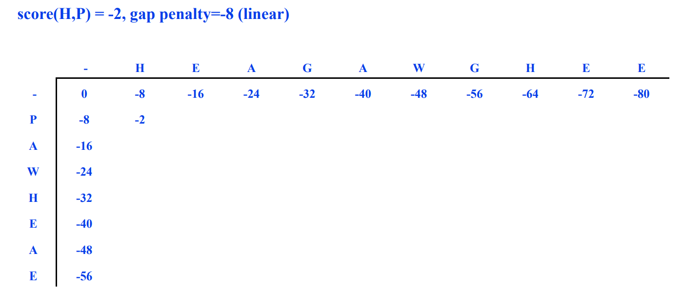
Example

Slide 25
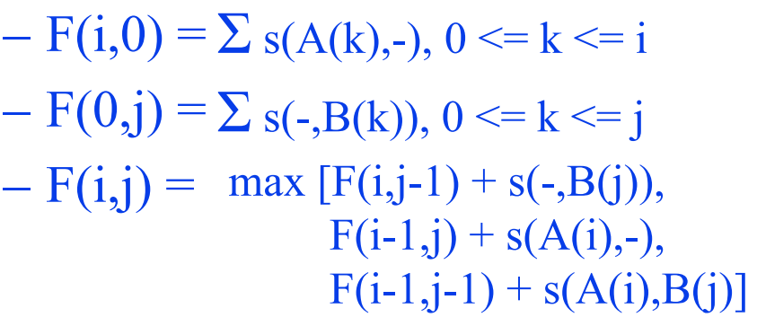
The DP recurrence relation
s(a,b) = score of aligning a and b
F(i,j) = optimal similarity of A(1:i) and B(1:j)
Recurrence relation
Assume linear gap penalty

Slide 26
Align ATCG with TCG
 | - | T | C | G
-
A
T
C
G
Match = +1
Mismatch = -1
Gap = -2
Steps:
1- Scoring matrix
2- Trace back
Find highest value in the scoring matrix
Trace back
3- Alignment
ATCG
-TCG

Slide 27
Align ATCG with TCG
 | - | T | C | G
- | 0 | -2 | -4 | -6
A | -2 | -1 | -3 | -5
T | -4 | -1 | -2 | -4
C | -6 | -3 | 0 | -2
G | -8 | -5 | -2 | +1
Match = +1
Mismatch = -1
Gap = -2
Steps:
1- Scoring matrix
2- Trace back
Find highest value in the scoring matrix
Trace back
3- Alignment
ATCG
-TCG

Slide 28
Align GATC with GAGC
 | - | G | A | G | C
-
G
A
T
C
Match = +1
Mismatch = -1
Gap = -2
Steps:
1- Scoring matrix
2- Trace back
Find highest value in the scoring matrix
Trace back
3- Alignment
GATC
GAGC

Slide 29
Align GATC with GAGC
 | - | G | A | G | C
- | 0 | -2 | -4 | -6 | -8
G | -2 | 1 | -1 | -3 | -5
A | -4 | -1 | 2 | 0 | -2
T | -6 | -3 | 0 | 1 | -1
C | -8 | -5 | -2 | -1 | 2
Match = +1
Mismatch = -1
Gap = -2
Steps:
1- Scoring matrix
2- Trace back
Find highest value in the scoring matrix
Trace back
3- Alignment
GATC
GAGC

Slide 30
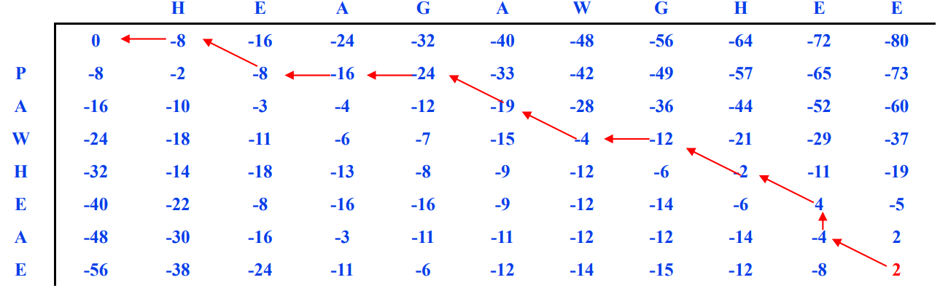
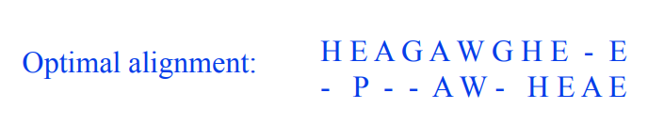
Example

