Slide 1
Introduction to Bioinformatics
Lecture 4

Slide 2
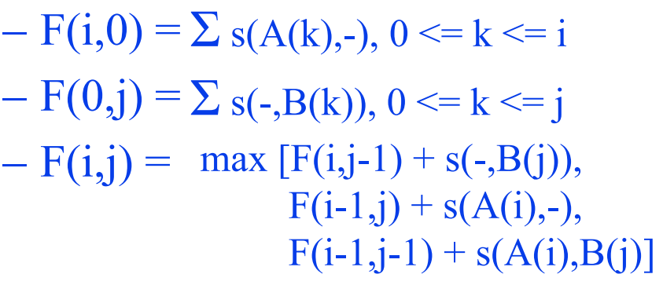
The DP recurrence relation
s(a,b) = score of aligning a and b
F(i,j) = optimal similarity of A(1:i) and B(1:j)
Recurrence relation
Assume linear gap penalty

Slide 3
Align AACGATA with AATA
 | - | A | A | T | A
-
A
A
C
G
A
T
A
Match = +1
Mismatch = -1
Gap = -2
Steps:
1- Scoring matrix
2- Trace back
Find highest value in the scoring matrix
Trace back
3- Alignment

Slide 4
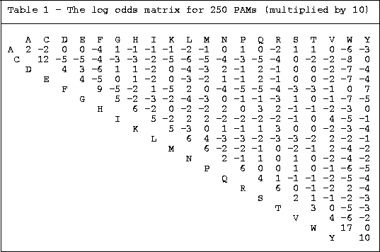
 | - | A | K | S | L
-
A
D
H
L
L
Align ADHLL with AKSL
Steps:
1- Scoring matrix
2- Trace back
Find highest value in the scoring matrix
Trace back
3- Alignment
Match = +1
Mismatch = -1
Gap = -2

Slide 5
Local sequence alignment
Suppose we have a long DNA sequence (e.g., 4000 bp) and we want to compare it with the complete genome in the yeast (12.5Mbp).
What if only a portion of our query, say 200 bp length, has strong similarity to a gene in yeast.

Slide 6
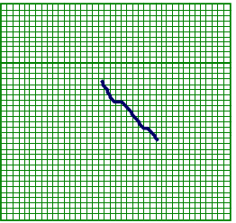

The local alignment problem
Given two strings x = x₁……x_{M},
y = y₁……y_{N}
Find substrings x’, y’ whose similarity (optimal global alignment value) is maximum

Slide 7
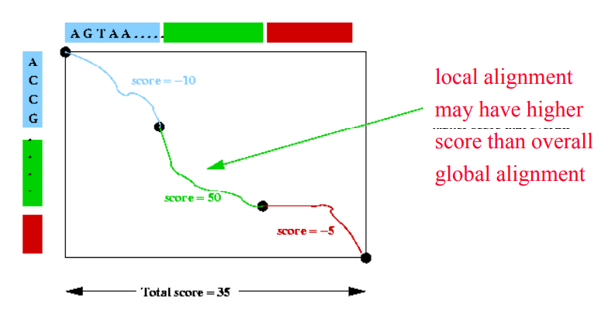
Local alignment

Slide 8
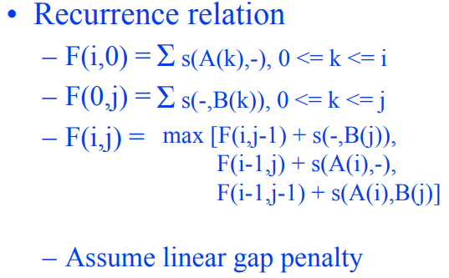
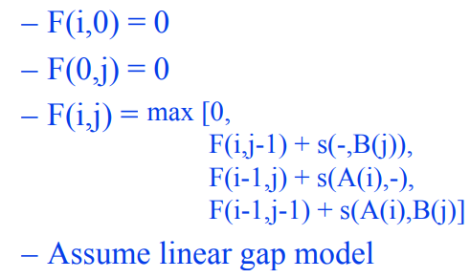
Local sequence alignment (Smith -Waterman)
F(i j) = optimal local similarity among suffixes of A(1:i) and B(1:j)
Needleman&Wunsch
Smith -Waterman

Slide 9

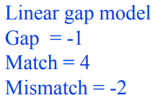
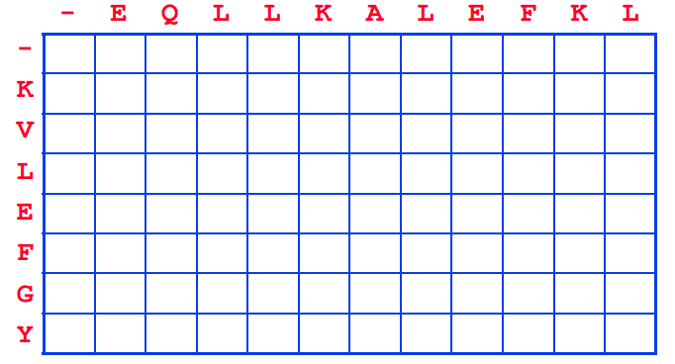
Example

Slide 10
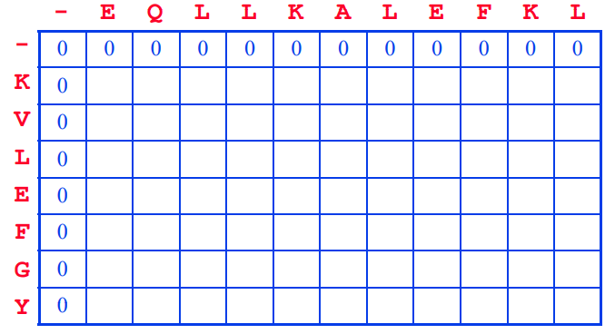
Example

Slide 11
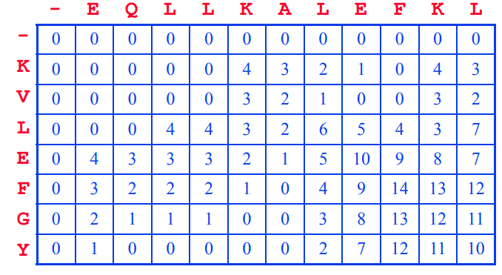
Example

Slide 12
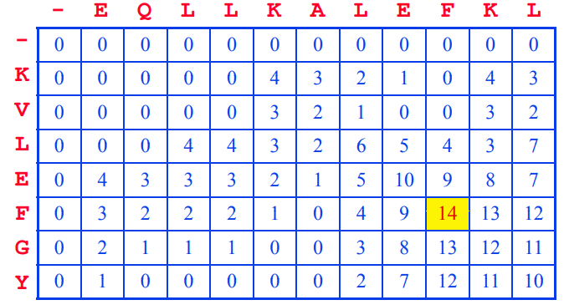
Example

Slide 13
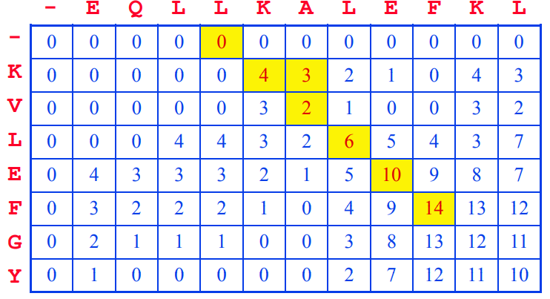
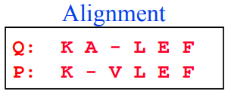
Example

Slide 14
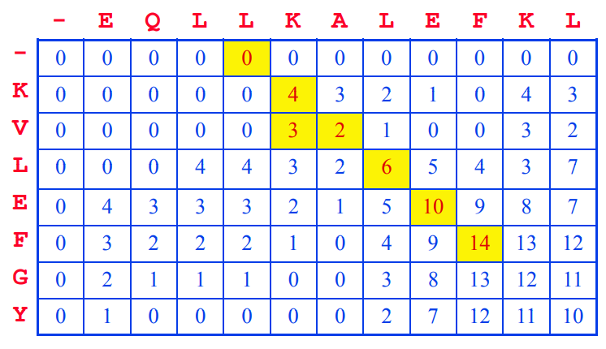
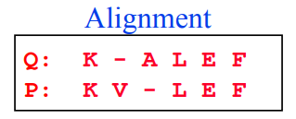
Example

Slide 15
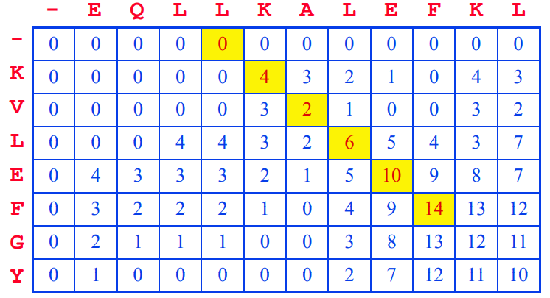
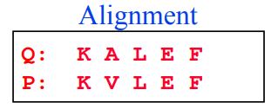
Example

Slide 16
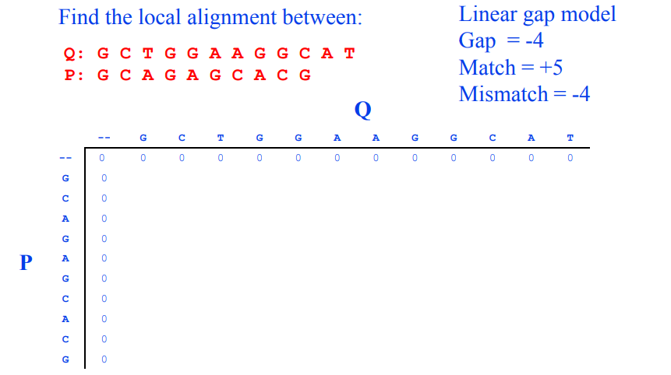
Another Example

Slide 17
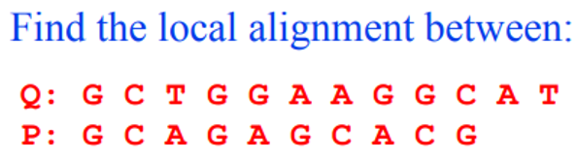
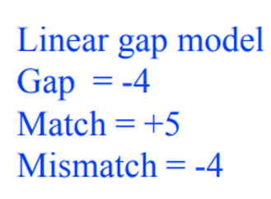
 | - | G | C | T | G | G | A | A | G | G | C | A | T
- | 0 | 0 | 0 | 0 | 0 | 0 | 0 | 0 | 0 | 0 | 0 | 0 | 0
G | 0
C | 0
A | 0
G | 0
A | 0
G | 0
C | 0
A | 0
C | 0
G | 0
Smith -Waterman

Slide 18
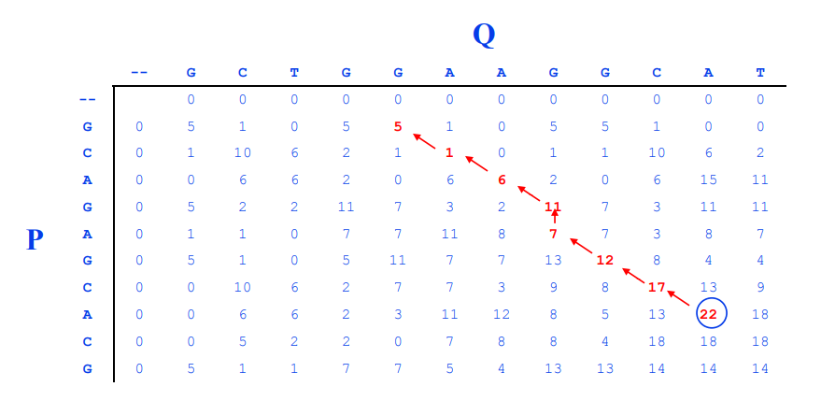

Another Example

Slide 19
ACCGAGA
AGAT
 | - | A | C | C | G | A | G | T
- | 0 | 0 | 0 | 0 | 0 | 0 | 0 | 0
A | 0
G | 0
A | 0
T | 0
Match=+1
Mismatch=-1
Gap=-2

