Slide 1
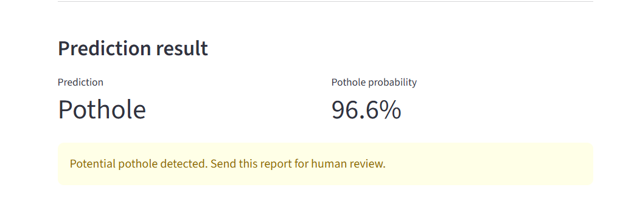
CAPSTONE DEFENSE
GOV-01
Road Damage
Classifier
A reproducible computer-vision pipeline for preliminary Normal vs Pothole triage—with human review retained.
PUBLIC DEMO
ff2050-gov01-road-damage.streamlit.app
FARRUX OLIMOV · AI/ML CAPSTONE
Notes:
Open with the public-service use case. State immediately that this is a binary triage assistant, not an autonomous road-safety system.
[Sources]
- D:/GitHub/gov-01-road-damage-classifier-capstone/PROJECT_BRIEF.md
- D:/GitHub/gov-01-road-damage-classifier-capstone/README.md
- D:/GitHub/gov-01-road-damage-classifier-capstone/presentation/fallback_evidence/local_streamlit_prediction.png
[/Sources]

Slide 2
PROBLEM AND STAKEHOLDER
A triage assistant—not a safety decision
Municipal staff may receive many road photographs from inspectors and citizens. The model provides one consistent first signal to support review.
WHAT IT DOES
Classifies one image as Normal or Pothole
Returns a pothole probability for human review
INTENDED FLOW
1
Upload
Predict
WHAT IT MUST NOT DECIDE
→
2
One road image
Normal or Pothole
No danger, size, depth, severity, or road-safety decision
No repair cost, repair priority, or automatic report closure
02
Notes:
Explain the operational value in plain language, then define the boundary before discussing performance. A human reviews every result.
[Sources]
- D:/GitHub/gov-01-road-damage-classifier-capstone/PROJECT_BRIEF.md
- D:/GitHub/gov-01-road-damage-classifier-capstone/docs/RESPONSIBLE_AI_AND_LIMITATIONS.md
[/Sources]

Slide 3
DATA GATE
Leakage had to be removed before modeling
The supplied test folder duplicated training and validation images. Using it would make model performance look better than it really was.
1,401
1,228
0
images audited
all opened successfully
unique labeled images
after exact-hash deduplication
exact-hash overlap
in the rebuilt split
TRAIN
VALIDATION
PROTECTED TEST
860 images · 236 Normal · 624 Pothole
185 images · 51 Normal · 134 Pothole
183 images · 50 Normal · 133 Pothole
Fixed stratified split · seed 42 · raw supplied test excluded
03
Notes:
This is the most important data decision: the original test was not independent. The project rebuilt a duplicate-free stratified split and protected the new test until the candidate was locked.
[Sources]
- D:/GitHub/gov-01-road-damage-classifier-capstone/docs/data_audit.md
- D:/GitHub/gov-01-road-damage-classifier-capstone/docs/split_summary.csv
- D:/GitHub/gov-01-road-damage-classifier-capstone/docs/clean_image_manifest.csv
[/Sources]

Slide 4
PREPROCESSING AND DELIVERY
The inference path is fixed end to end
01
02
03
04
05
Road image
→
RGB resize
→
Preprocess
→
Predict
→
Human review
PNG or JPEG
224 × 224 pixels
MobileNetV2 input
Probability + label
Original image + context
LEAKAGE CONTROL
Random flip, rotation, and zoom are applied only to training images. Validation, protected test, and live inference receive no random augmentation.
04
Notes:
Walk from left to right. Emphasize that the same deterministic preprocessing is used for validation, protected test, saved-model reload, and the app.
[Sources]
- D:/GitHub/gov-01-road-damage-classifier-capstone/docs/preprocessing_manifest.json
- D:/GitHub/gov-01-road-damage-classifier-capstone/src/inference.py
- D:/GitHub/gov-01-road-damage-classifier-capstone/app.py
[/Sources]

Slide 5
CONTROLLED EXPERIMENTS
Model comparison beat the majority baseline
Validation Macro F1 was the primary selection metric because the dataset is imbalanced and both classes matter.
Naive majority
0.420
reference floor
Compact CNN
0.674
learned visual patterns
Class-weighted CNN
0.775
better class balance
Frozen MobileNetV2 V4
0.933
selected candidate
Excluded: MobileNetV2 V3 — validation images were randomly augmented, so its result was invalid for selection.
05
Notes:
Explain the experiment ladder, not every training detail. Each step had a clear hypothesis. V3 is shown only as a rejected experiment, never as evidence for model selection.
[Sources]
- D:/GitHub/gov-01-road-damage-classifier-capstone/reports/experiment_record.csv
- D:/GitHub/gov-01-road-damage-classifier-capstone/reports/model_gate.md
[/Sources]

Slide 6
QUALITY CONTROL
A validation error was caught and corrected
The strongest lesson was not a metric—it was protecting the evaluation boundary.
V3 REVIEW
BOUNDARY FIX
VALIDATION LEADER
Detected
Corrected
Locked
Random augmentation reached validation and inference.
Augmentation moved to the training loader only.
V4 selected before protected-test access.
Locked configuration: MobileNetV2 V4 · 224×224 RGB · class weights · threshold 0.50 · no post-test tuning
06
Notes:
Own the invalid V3 result. Finding and rejecting it strengthened the project. V4 corrected the preprocessing boundary and was locked before the protected test.
[Sources]
- D:/GitHub/gov-01-road-damage-classifier-capstone/reports/experiment_record.csv
- D:/GitHub/gov-01-road-damage-classifier-capstone/reports/model_gate.md
- D:/GitHub/gov-01-road-damage-classifier-capstone/notebooks/GOV_01_mobilenetv2_transfer_v4.ipynb
[/Sources]

Slide 7
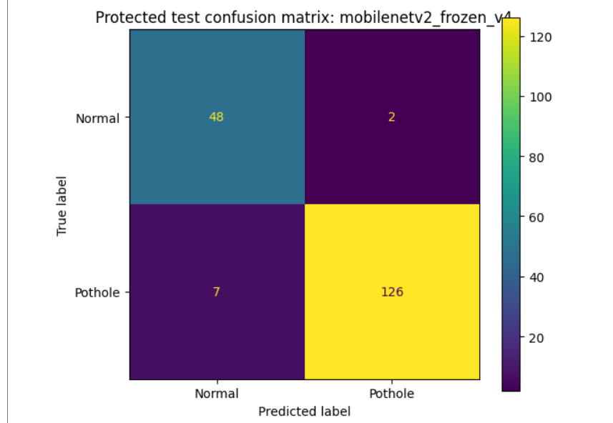
PROTECTED-TEST EVIDENCE
The locked model held on unseen images
0.940
0.951
Macro F1
primary metric
Accuracy
on 183 images
ERROR ACCOUNTING
48 Normal images correctly identified
126 potholes correctly identified
2 false pothole alerts
7 missed potholes — the higher-risk error
Candidate locked before test access · no tuning afterward
07
Notes:
State the protected-test rule before the numbers. Then interpret the confusion matrix: nine total errors, with missed potholes treated as the higher-risk case.
[Sources]
- D:/GitHub/gov-01-road-damage-classifier-capstone/reports/model_gate.md
- D:/GitHub/gov-01-road-damage-classifier-capstone/reports/error_analysis/ERROR_ANALYSIS.md
- D:/GitHub/gov-01-road-damage-classifier-capstone/reports/mobilenetv2_frozen_v4_protected_test_confusion_matrix.png
[/Sources]

Slide 8
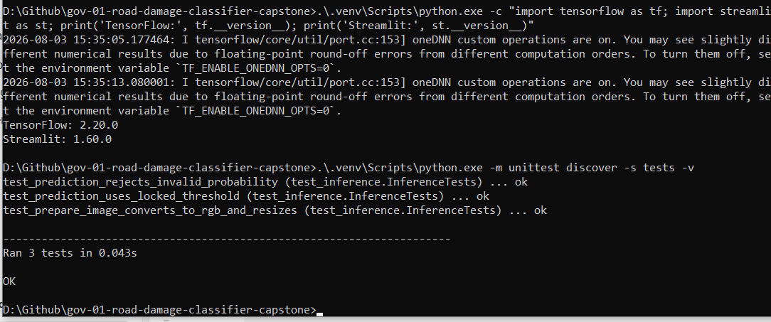
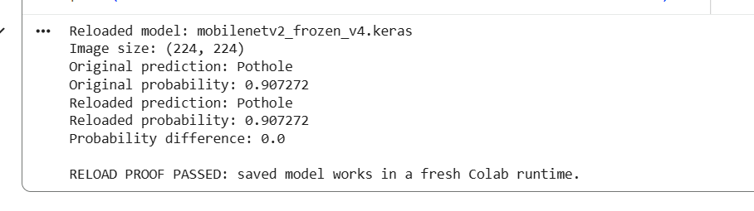
REPRODUCIBILITY AND VERIFICATION
The saved model works outside training
The final artifact was tested in a fresh runtime and through the local inference path before deployment.
FRESH-RUNTIME RELOAD
LOCAL AUTOMATED CHECKS
Same label, same probability, difference 0.0
Image preparation, threshold logic, invalid probability
The app loads the saved Keras artifact; it does not retrain or modify the model.
08
Notes:
Use these screenshots as operational proof: the model reloads independently of training, the deterministic inference unit tests pass, and the deployed app only performs inference.
[Sources]
- D:/GitHub/gov-01-road-damage-classifier-capstone/artifacts/reload_proof.md
- D:/GitHub/gov-01-road-damage-classifier-capstone/tests/test_inference.py
- D:/GitHub/gov-01-road-damage-classifier-capstone/docs/REPRODUCTION_TEST.md
- D:/GitHub/gov-01-road-damage-classifier-capstone/reports/mobilenetv2_frozen_v4_reload_proof.png
- D:/GitHub/gov-01-road-damage-classifier-capstone/presentation/fallback_evidence/local_inference_tests_passed.png
[/Sources]

Slide 9
DEPLOYMENT AND RESPONSIBLE AI
The demo keeps a human in the loop
PUBLIC ROUTE
Streamlit demo ff2050-gov01-road-damage.streamlit.app
REQUIRED HUMAN OVERSIGHT
Review the original image and report context
Escalate unclear, dark, distant, or unusual scenes
Never auto-close a report from a Normal result
Dataset: low-resolution images from one source · external municipal validation remains future work
09
Notes:
Demo the upload and prediction flow if the public app is available. Read the human-review message aloud, then state the limits on image resolution, domain coverage, and external validation.
[Sources]
- D:/GitHub/gov-01-road-damage-classifier-capstone/app.py
- D:/GitHub/gov-01-road-damage-classifier-capstone/docs/RESPONSIBLE_AI_AND_LIMITATIONS.md
- D:/GitHub/gov-01-road-damage-classifier-capstone/data/README.md
- D:/GitHub/gov-01-road-damage-classifier-capstone/presentation/fallback_evidence/local_streamlit_prediction.png
- https://ff2050-gov01-road-damage.streamlit.app/
[/Sources]

Slide 10
CONCLUSION
The evidence chain
is complete
01
Evidence first
Every key claim maps to repository evidence.
02
Honest evaluation
GOV-01 demonstrates an end-to-end AI/ML workflow: data audit, leakage control, controlled experiments, protected evaluation, reload proof, and a public demo.
The protected test was used once after candidate lock.
03
Responsible use
The output supports review; it does not replace judgment.
Live demo ff2050-gov01-road-damage.streamlit.app
Repository github.com/Farrux-dot/gov-01-road-damage-classifier-capstone
QUESTIONS
Notes:
Resolve the opening: the project delivers a reproducible triage signal with documented limits. Invite questions about data leakage, model selection, protected testing, deployment, or responsible use.
[Sources]
- D:/GitHub/gov-01-road-damage-classifier-capstone/RUBRIC_EVIDENCE_MATRIX.md
- D:/GitHub/gov-01-road-damage-classifier-capstone/PROJECT_STATUS.md
- https://ff2050-gov01-road-damage.streamlit.app/
- https://github.com/Farrux-dot/gov-01-road-damage-classifier-capstone
[/Sources]

