Slide 1
AI/ML CAPSTONE DEFENSE
GOV-01 Road Damage
Classifier
V1
FINAL
A reproducible Normal-or-Pothole classifier
for municipal human-review triage
Final model: mobilenetv2_frozen_v4
Module 8 • Farrux
Notes:
[Sources]
PROJECT_BRIEF.md; README.md

Slide 2
SCOPE AND INTENDED USE
One clear task: support human review of a road photo
IN SCOPE
NOT IN SCOPE
Normal or Pothole
A probability score
A first signal for a human reviewer
No severity or physical size
No danger, safety, or repair decision
No repair priority or cost
The classifier is educational triage support—not an automated municipal decision-maker.
02
Notes:
[Sources]
PROJECT_BRIEF.md; docs/RESPONSIBLE_AI_AND_LIMITATIONS.md

Slide 3
DATA QUALITY AND LEAKAGE CONTROL
Cleaning the dataset was necessary before model training
1,228
140
70 / 15 / 15
unique labelled images
in the clean V1 split
duplicate groups found
and removed
train / validation /
protected test split
Important finding: the supplied test folder contained duplicates, so it was excluded. The rebuilt clean split has no exact-hash overlap across train, validation, and test.
03
Notes:
[Sources]
docs/data_audit.md; docs/split_summary.csv; docs/clean_image_manifest.csv

Slide 4
CONTROLLED INFERENCE PIPELINE
One image follows the same preprocessing path every time
Road image
RGB resize
224 × 224
MobileNetV2
preprocessing
V1 model
Probability +
human review
Training-time augmentation was used only on training images. Validation and protected test images were not randomly altered.
04
Notes:
[Sources]
docs/preprocessing_manifest.json; src/inference.py; reports/model_gate.md

Slide 5
MODEL SELECTION USED VALIDATION EVIDENCE
Corrected frozen MobileNetV2 V4 was the clear V1 candidate
SELECTED
V4 validation Macro F1: 0.933126
Historical V3 was not used for selection because random augmentation affected validation images. The corrected V4 run replaced it.
05
Notes:
[Sources]
reports/experiment_record.csv; reports/model_gate.md

Slide 6
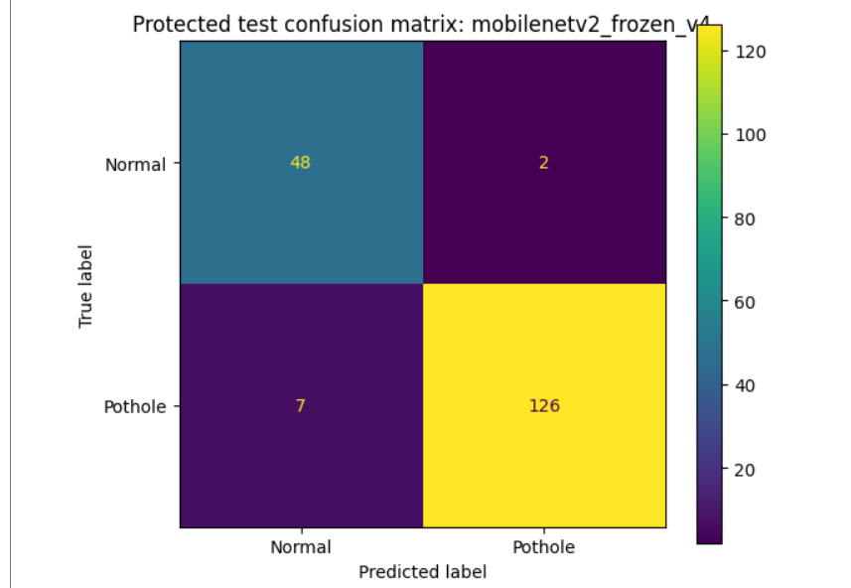
FINAL EVALUATION WAS DONE ONCE ON PROTECTED TEST DATA
V1 generalizes well on this project’s clean held-out split
0.939901
Protected-test Macro F1
95.1%
Accuracy on 183 protected images
7 missed potholes • 2 false alerts
Human review remains required.
06
Notes:
[Sources]
reports/model_gate.md; reports/error_analysis/ERROR_ANALYSIS.md; reports/mobilenetv2_frozen_v4_protected_test_confusion_matrix.png

Slide 7
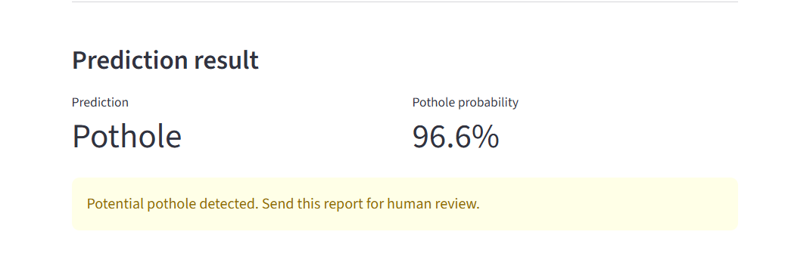
THE DEMO LOADS THE FINAL SAVED MODEL—IT DOES NOT TRAIN
A local Streamlit route makes one new-image prediction
Saved Keras model
loaded locally
Inference tests
passed before the demo
The private .keras file is intentionally not stored on GitHub.
07
Notes:
[Sources]
app.py; src/inference.py; docs/REPRODUCTION_TEST.md; presentation/fallback_evidence/

Slide 8
CONCLUSION
V1 is a strong, reproducible
educational triage model—
with clear limits.
What is final
What comes next
• V1 MobilenetV2 V4 on main
• Protected test recorded once
• Local reproducible demo route
• External, diverse road evaluation
• Review false classifications
• Do not tune after protected test
Questions
Notes:
[Sources]
RUBRIC_EVIDENCE_MATRIX.md; docs/RESPONSIBLE_AI_AND_LIMITATIONS.md

